Slide 1
Species360 History
By Nate Flesness 1st Executive Director (served 30 years)
1st Director of Science (served 7 years)

Slide 2
The Origin Story
Not very useful blood and serum data,
a tale of a tail,
that wagged the dog

Slide 3
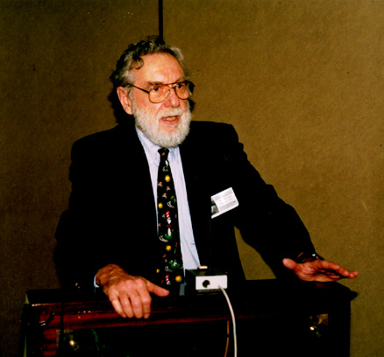
Prologue
A polymath professor of Biochemistry and Wildlife, who worked fulltime at the VA hospital Research Center, studied comparative biochemistry and endocrinology, and psychology …and cancer..and…more in the 1960’s and 1970’s.
Dr. Ulysses S. Seal needed exotic species for comparison studies, so he built a network of zoo contacts (and had visiting tigers and bears and dingos in a Quonset hut at the VA research building in Mpls).
Dr. Ulysses S. Seal Species360 and CBSG Founder

Slide 4
1st Phys Reference database – SEAMAK ZOOGAD, early 1970s
Seal and his grad student Dale Makey built the first database of blood and serum norms for a number of wildlife species.
PROBLEM: As they tried to re-sample the same animals over following years, to get older ages, hibernation season, pregnancy, and other variables, they discovered the zoos generally could NOT identify that same animal
At the time they generally did NOT have specimens marked nor was it common to record specimen-level records.
Vets commonly had case numbers, and every animal treated received a new case number – not linked to any previous “case” (Gee, I wonder if the animal that died was the one we didn’t vaccinate??, etc).

Slide 5
A modest solution –
So to solve the unforeseen specimen identification problem, Seal and Makey proposed an animal records and collection inventory computer system, to be called International Species Inventory System (ISIS.org)
That marked-animal specimen records would exist to support the veterinary and biochemical data going forward, and generate a pooled animal inventory.
They presented their proposals at the 1973 AAZV and AAZPA (now AZA) conferences, and received endorsements and commitments to help. The timing was good (new U.S. Federal and emerging international regulations on obtaining animals, created pressure for inventory data). Seal was also on the Board that was building the then-new MN State Zoo.
…this inventory system became the tail that wagged the dog.

Slide 6
The institutional transaction, acquisitions and dispositions, P&O
ISIS was initially intended to do animal inventory for institutions – hence the initial “Inventory” name. Dale Makey led the systems analysis, and designed the single institution basic animal transaction records- birth and death, acquisition and disposition, inspired by earlier word-processing systems developed at Denver and Oklahoma City Zoos.
We tracked both physical animals and ownership from the beginning, because institutions need to know what they own. After a couple of unsuccessful ZIMS detours (more later), these single-institution transactions remain roughly the single-institution transactions that underlie the working ZIMS today.

Slide 7
ISIS’ initial office, staffing, funding
1974 – operations started from the MN State Zoo design office while the zoo was under construction. The zoo hired a registrar but had no animals yet – so was “volunteered” for ISIS work. She managed the 2nd person under Seal’s volunteer leadership (the other staffer, Kim Hastings, keypunched paper data forms).
AAZV donated and found foundations to contribute more
AAZPA donated
Seal raised the majority of funds from US Dept of Interior, other sources too, and “borrowed” staff and computer time from MN Zoo and US Veterans Administration.

Slide 8
Free in 1970s
Invitations to join ISIS were sent out worldwide to WAZA (then called IUDZG) and AZA (then AAZPA) zoos to about 150 zoos
Other Associations did not yet exist
110 zoos said they would join.
55 did!
Fortunately, London, Jersey and Copenhagen joined in the early years, making the “International” ambition real.

Slide 9
Brilliant underlying design, awful user reality
Terrible paper data forms (>1 million would be filled in)
Long numeric codes for taxon (1405009003002001) and institution (310505032) which users had to look up and enter onto the paper forms. Thick manuals were published by ISIS full of these codes, which users had to exhaustively look up.
Mainframe generated zoo inventory and transaction reports on fanfold green and white paper. Pooled inventory on microfiche – often “used” by zoos using their vet’s microscope since most didn’t buy a microfiche reader.

Slide 10
ISIS Paper Data Form 1974-1985+
ZIMS includes over 1,000,000 in or out transactions and identifiers, captured from these paper forms

Slide 11
Free membership ended by 1976
Fees became $1 per mammal on year end inventory, $100 minimum
This worked to get more dots on the map
If there were nearby dots, the next zoo might consider joining
Terrible negative incentive for data
Then we added birds to the mammal inventory. They were “little”, so $.35 each was as high as the community would go

Slide 12
1979 – bankruptcy threatened, narrowly avoided
Seal had volunteered as ISIS’ leader for 5 years, and was ready to move on. ISIS was in continued financial trouble, and was not making payroll. The ISIS office manager, who had a mortgage, needed a job with reliable paychecks, so she left.
The MN Zoo director offered Nate a job as director. Nate was then Seal’s grad student, had been volunteering in various ways (genetic advice, 1 volunteered grant proposal, etc). He didn’t have a mortgage at the time and was accustomed to “intermittent income”….
Seal started CBSG as his new hobby and let ISIS and Nate go forward on their own
By great good fortune, the $25,000 IMLS grant Nate had written months earlier for ISIS as a volunteer, with no prior successful grant-writing experience, was awarded and landed unexpectedly on Nate’s desk
After Nate joined ISIS as staff, it literally saved the day!

Slide 13
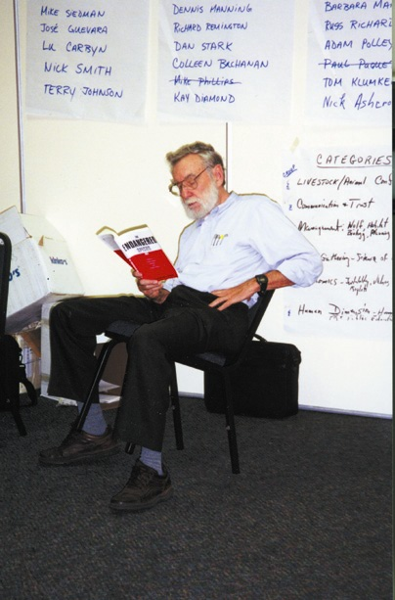
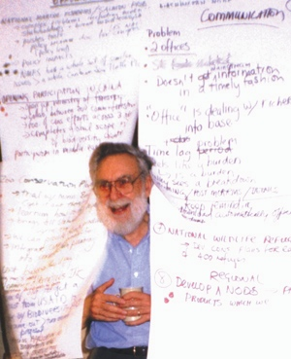
Ulie
Founded ISIS
Founded CBSG
100% volunteer – never drew a salary
Long term vision – driven by best science

Slide 14
After 10 years of paper forms 1974-1984 (thank heavens) PC’s came along
WCS, US National Zoo, and Brookfield were investing in expensive custom mainframe institutional computer systems in the 1980s. They were hundreds of thousands of dollars invested in each case, and the efforts were struggling.
A casual discussion at a 1984 CBSG workshop on St. Catherine’s island, led to each offering ISIS $10,000 as a small side bet, for PC software development by ISIS (a new role).
We generated a $25,000 IMLS grant too, and with a $55,000 total budget hired biologist/programmer (Paul Scobie) for one year.

Slide 15
Digital Records Evolved – 1985 ARKS
ARKS 1 was delivered on schedule in 1985, 12 months after we started, thanks to Paul and a straightforward design based on our internal experience. It ran on the then-new PCs, did 5 things (the already-standard zoo 6 column annual inventory report, 2 new reports we invented – taxon and specimen, some data validation, and an export data file- to be sent on floppy disk by snail mail to ISIS). It used ISIS transactions as a data model.
It worked.
ARKS spoke English and latin taxonomy, and mnemonics for institutions, instead of long numeric codes. We preloaded each zoo’s ARKS with the data we had from paper data forms – (getting revenge for what they had sent us). We had promised IMLS that 25 zoos would eventually computerize with ARKS. 55 did the first year. The expensive mainframe software development projects at the big institutions were quietly abandoned thereafter (San Diego’s remained for ~30 more years)

Slide 16
SPARKS and MedARKS followed in the late 1980s
Several IMLS grants in series, powered by our ARKS 1 success, developed the early versions of SPARKS (Paul Scobie) and MedARKS (Andrew and Cyd Teare) and later versions of ARKS.
Dr. Andrew Teare had developed a pre-SPARKS studbook program (“Omaha”), and had great vision for veterinary data systems, so he joined our team on and off, part-time and full-time, depending on grant revenues and zoo vet jobs..

Slide 17
1980s Challenges …everyone wanted their own regional system
Several regions acted to have regional animal inventory systems
So, Governance became an issue
Australasia built one (AZDANZ)
UK built one
The Dutch zoos built one
North America wanted to make ISIS their own regional system
But many species have pedigrees stretching back around the world – we needed a global system.
Since 1974 we had been a self-funding part of the MN State Zoo
An “ISIS Policy Advisory Group” was set up, including an Australian, a European and a couple of American directors
It acted like a constitutional convention

Slide 18
A larger vision was emerging
We had an “I” in front of our name and we hoped to make it really mean something…

Slide 19
ISIS incorporated as International Species Information System, in 1989, as a IRS 501c3 non-profit.
The legal framework was created by Fredrickson and Byron, LLC, content driven by the Policy Advisory Group.
The MN Zoo officially gave us all the physical and intellectual property we had acquired while part of them.
The whole ISIS staff, all 5 of us, quit their State civil service jobs and went to work for the little non-profit the next day, in the same zoo-hospital basement office (where CBSG now is).
The former informal Policy Advisory Group became our first Board of Trustees.

Slide 20
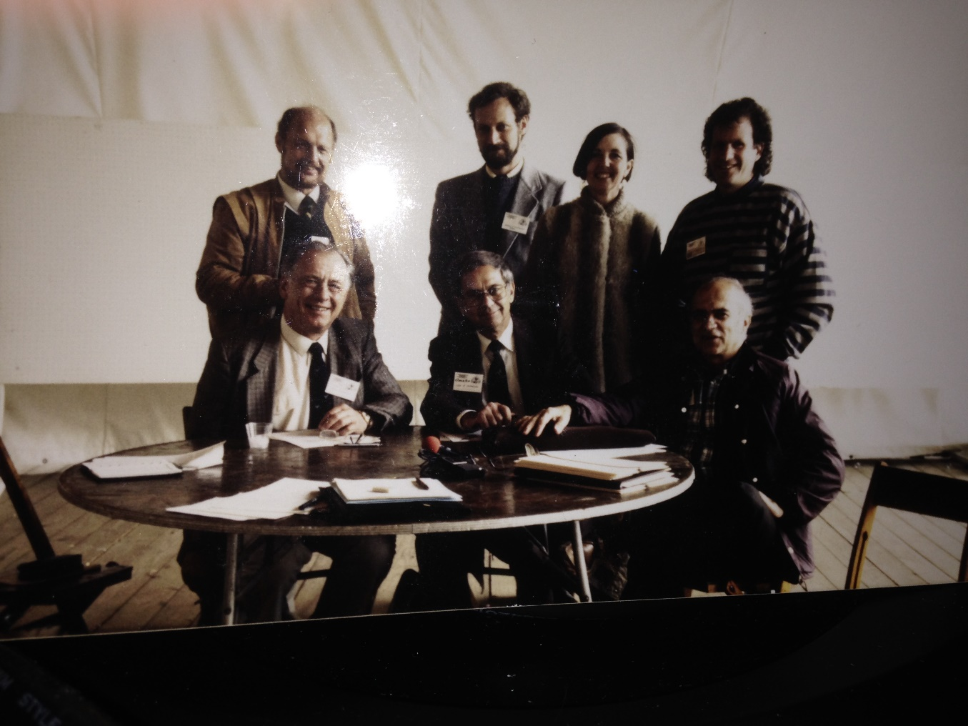
1989 – 1st Board of Trustees sign incorporation documents
Left-Right rear row:
Dr. Gunther Nogge, Cologne
Nate Flesness, ISIS
Karen Sausman, Living Desert
John DeJose, Perth
Left-Right front row:
John Knowles, Marwell
Dr. Lee Simmons, Omaha
Dr. George Rabb, Brookfield

Slide 21
1990s challenges
Windows arrived in 1993 and it was soon clear we needed to redevelop ARKS, SPARKS and MedARKS for Windows.
It was not so clear to our Board that our members should pay for this- they had not paid for most of the earlier software. However, the many grants that had funded the DOS versions were not renewable – because we had succeeded, had many users, who the grant agencies thought should pay for software upgrades.
We succeeded with ARKS4 for Windows, and client-server interaction with ISIS’central database, but otherwise became stuck in DOS as the IT world moved rapidly.

Slide 22
1990s Opportunities – WAZA HDQRS ‘93-’99
WAZA (then IUDZG) didn’t have a permanent office or staff. They needed one. ISIS was asked to be their office, and Nate their employee #1, “Executive Secretary”, in 1993.
We wrote a newsletter for them, organized their annual conferences, and Nate took the minutes at their Council meetings, in spite of his poor typing. They paid for the staff time (4 hours/week) and travel.
This really helped our international zoo contacts – and membership growth.
After 6 years of this, we helped them run a fund-raising campaign to set up their own office in Switzerland, and passed the baton.

Slide 23
1998-2000 New ISIS Vision needed
Rumors of potential Y2K problems, and biggest-institutions’ needs for more functionality than ARKS and MedARKS, led AZA to quietly start investing in its own system development
Y2K problems did not happen to us (we had always been smart and used 4-digit years), but ISIS needed a new long-term plan…

Slide 24
A New Vision - ZIMS
An ISIS Futures Search, facilitated by CBSG, was conducted in 2000, with 25 stakeholders from around the world.
Jonathan Wilcken, Bob Lacy, Jon Ballou, Bengt Holst, and then-senior AZA staff were included.

Slide 25
A Bold Vision emerged for ISIS’ Future:
“One, global, accurate, comprehensive, web-enabled, real-time animal and collection information system.”
Many program and administrative suggestions were included – Technology committee, science committee, combined user committees (IADISC).
Complex politics ensued, but after two ad-hoc international meetings convened by Bob Lacy at Dr. Rabb’s request, all parties finally agreed that ISIS would build ZIMS, the conditions being:
User-driven design
A new committee of big zoo CTO’s would drive the project
ISIS staff would lead fund-raising but have very limited input role otherwise

Slide 26
ZIMS 1st try …
CTOs helped us find and hire a project manager (Hassan Syed) for the recommended HUGE outsourced project
An elaborate 8-month vendor selection process ensued driven by the CTOs.
Flesness was tasked by the Board to raise $10 million, and they helped.
A 25,000 person software integration company was selected and hired on a fixed price $3 million contract.
Many user-design-input meetings were held engaging zoo folks, mostly registrars, worldwide.
The users put their focus on data entry – so this was the first time we had a design for input instead of output, and at their request they dealt directly with the vendor, not ISIS staff in between.
This effort took a few years, made a lot of noise, and FAILED.
A Microsoft Canada SQL expert (Nury Sword) was brought in to evaluate – he gave it bad grades – it was modeled on a bank-style fund transfer transaction.

Slide 27
Much unpleasantness followed…
6 months of late-evening-time meetings with corporate lawyers yelling back and forth …
ISIS got our $3 million back and $1.3 million in penalties.
We agreed NOT to name the vendor publicly.
We lost some of our invested costs, but kept the user-design-input.
We lost a lot of credibility in our community….
On the upside, managerial control of the project returned to ISIS..

Slide 28
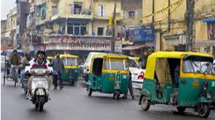
ZIMS 2nd try…
We regrouped and tried a small outsourcing company with ISIS staff (rather than users) directing their activity, but using the user-design input from try 1 and some of the proposed architecture.
The company was in India, so it was an adventure.
Having reached the 30 year mark as executive director, not enjoying the big-system outsourcing, bank loans, vendor contracts, software failures (we’d never failed before), yelling corporate lawyers, and seeing the need for different leadership skills, Nate stepped aside to become Director of Science in 2009.
Roger Stonecipher was hired as the new CEO.
He inspired the Board to substantially raised fees – stabilizing operations financially. Losing 100 small members.
He launched ZIMS second try on deadline. It struggled, did some data damage, and died.
He then made a stunningly good call – he backed Nury Sword’s unexpected proposal (with demo) to build a third try for us, using slightly improved animal transaction record designs based on those that had worked for ISIS all these years, SQL and Javascript.
That worked, that’s ZIMS Husbandry, and that saved the day!
Thank you Nury and SwordIT!

Slide 29
Relevant Death Information …for the first two ZIMS systems
They used a two-party “Transfer” record, unlike our earlier systems, which used single institution in and out records.
ZooA animal transferred to ZooB (both parties agree on the transfer record)
Its like selling a car.
It should solve the fragmented animal data problem.
It sounds good, right?
This two-party record was designed to solve the fragmented animal history problem.
But…for a record agreed to by two parties, who has later edit rights?
How to load a database of two-party records, with one-party records containing disagreements?
Guess where the extra acq and disp problem came from??

Slide 30
Two parties controlling one record …unsolved dilemmas for us:
In ZIMs design we saw the potholes ahead re: partial animal ownership (i.e. warthogs). If two institutions each have partial ownership, who gets to edit the record as to what % they own?
So we avoided doing this one – its just tough cookies for those owning part of a warthog…..
Zoo A owns the Hakuna part,
Zoo B owns the Matata part….

Slide 31
The ZIMS Dream ~75% fulfilled with the launch of studbook
In the original ZIMS Vision (ISIS Futures 2000) studbooks were imagined as fully integrated into institutional records, so there would be just one best-data-available species’ dataset.
A VERY compelling vision, but…..
17 years later, we still don’t quite know how to do this – the studbook keeper’s edits to a shared animal record would change the zoo’s inventory… not acceptable…
This is another two-parties-own-one-record problem.
So maybe some complicated future scheme, where we highlight data differences and gradually resolve many, then maintain multiple data versions only for the unresolved intentional differences on a limited number of animals?????
This will be one of Your Challenges for the long term future…

Slide 32
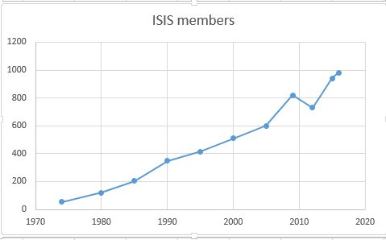
What a long strange trip it’s been, but look where we are now
By the Numbers:
> 1,000 Aquariums, Zoos and conservation members
> 90 Countries
~ 7 Million animal records
> 21,000 species tracked
> 167 Million husbandry records
> 74 Million medical records
43 Years of International Data Sharing
New Name, Same Mission:

Slide 33
That’s the past Its been a great adventure in good company but one more slide…

Slide 34
It is a sunrise. There is a very bright future ahead.
ZIMS is working! We have nearly 1,000 data-contributing members!
Studbooks are launching!
The enormous and unique wildlife data we have assembled is just beginning to unfurl.
Thanks to your leadership, our new Science Director, Dalia and her team are already making waves.
We are ready to sail for the next 40 years. Thanks to you, the adventure continues… Bon Voyage Nate!!

