Slide 1

ZIMS and Species360 Highlights from
January 2021 Tips and Tricks

Slide 2

It was a wild and crazy year….
But Species360 and ZIMS kept getting better and better !
We made improvements and
additions to all our modules
by fixing Bugs and incorporating
many requested Enhancements in:
Husbandry
Medical
Studbook
And our Research Team was
very busy!

Slide 3
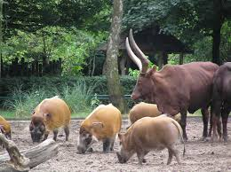
Husbandry – Auto Update Animal Lists
You can select to have your Animal Lists
automatically remove animals from them that are dispositioned or die. This option is available only as an Institution Preference under Application Preferences > Animal Lists. This option will only remove animals going forward, so it is recommended to remove any dispositioned/dead animals from your
Lists prior to selecting this Preference.

Slide 4
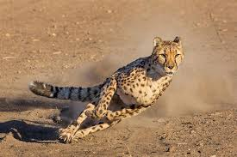
Husbandry – Edit Provisional Data Before Approval
Provisional Data can now be approved
in cheetah-like speed! If you want to make an edit in Provisional Data, you can now do so right from the Approve screen. There is no longer the need to Approve and then open the record to edit or Reject and send back to the author for correction. You may still wish to Reject major incorrect entries when training your staff for proper ZIMS entries. But minor errors won’t slow you down.

Slide 5
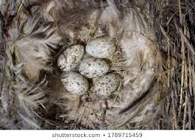
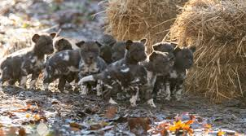
Husbandry – Clutch/Litter ID Transfer to Split Records
The Clutch/Litter ID now automatically transfers into the record for any
groups/individuals that are split from the original group of eggs or group
of animals. No need to remember to add it after the split transaction!

Slide 6

Husbandry – Accreditation Visibility
In the Regional Association Institution page, a column has been added to the Association Members grid to indicate if the Institution is currently accredited with them. This is a resource for Expedia to know which institutions are accredited to help those using Expedia to make well-informed travel destination decisions.

Slide 7
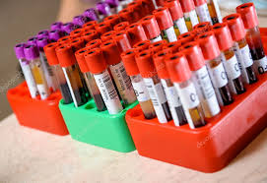
Medical - Biobank
This project was developed so that EAZA
institutions can share samples with the
EAZA Biobank and the Biobank can record storage information on them. If a sample is recorded in ZIMS, EAZA institutions can share that single sample. If the sample is not recorded in ZIMS, the Biobank has the ability to create the sample on your behalf if you are on the Authorizing Institution list. It is hoped this project is just the first step in allowing sample sharing with Biobanks throughout the world.

Slide 8
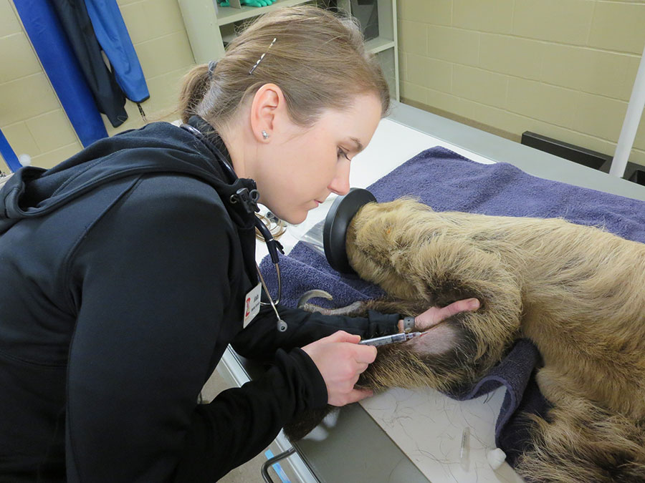
Medical – Test Results Upload
The Test Results Upload functionality
helps save you time and reduces data
entry errors by allowing you to upload
Tests Results directly from the lab into
the ZIMS Test Results module. It is a three
step process:
Import tests for processing
Link the imported tests to a ZIMS sample
Upload the results into the ZIMS Tests
and Results module
At this time only Test results from IDEXX Labs
VetConnectPlus site, Gribbles Veterinary
Australia and New Zealand can be uploaded.
More labs are planned for inclusion in the
future with Antech (coming soon!)

Slide 9
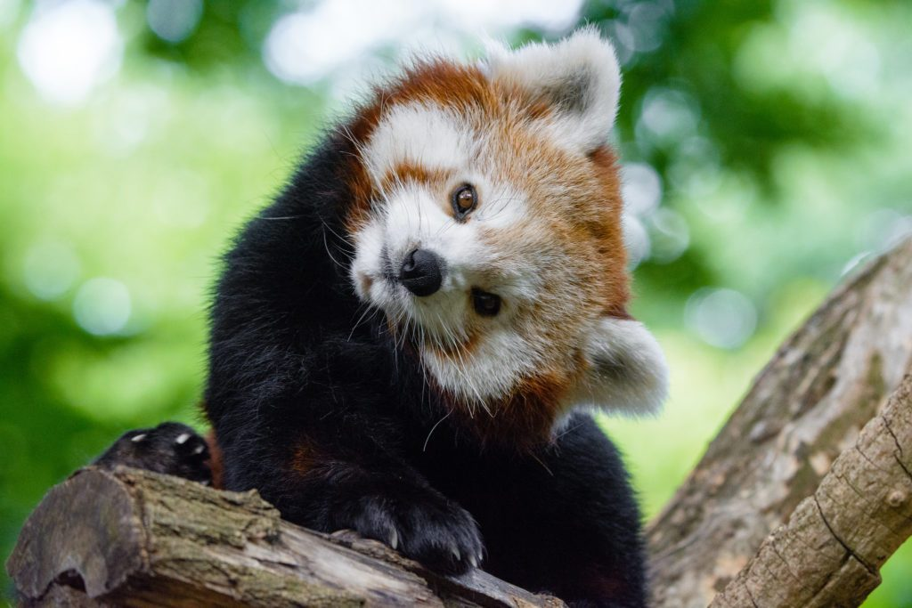
Studbooks – Global Studbook Search Tool
There are now over 1,060 studbooks
being managed in ZIMS worldwide!
This new global tool allows you to
search for the studbooks currently
managed in ZIMS by various filters.
This tool replaces the Studbook
Keeper List and Studbook Chart tools.
One filter very useful to institutions
is the ability to find a list of all the
species you hold that have studbooks
associated with them and limit the
search to your Regional Association.

Slide 10
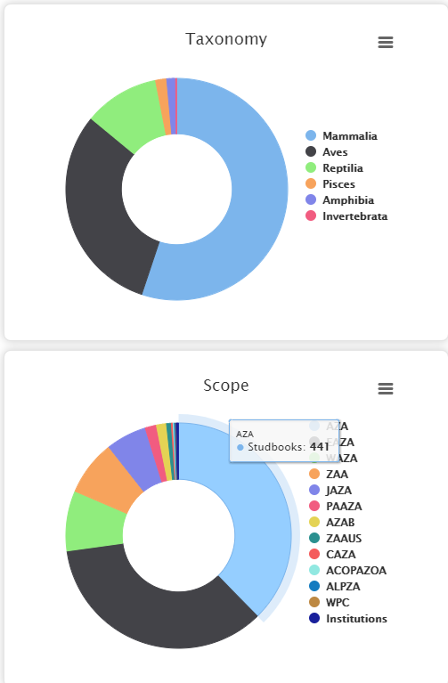
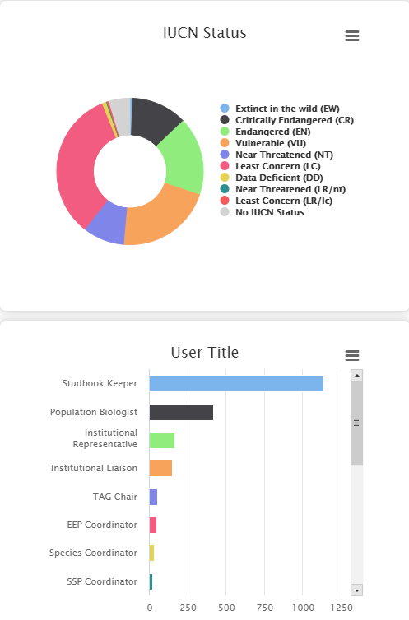
Studbooks – Global Studbooks Search Tool
There are also graphs by Taxonomy, Scope, IUCN
Status and User Title available in this tool.

Slide 11
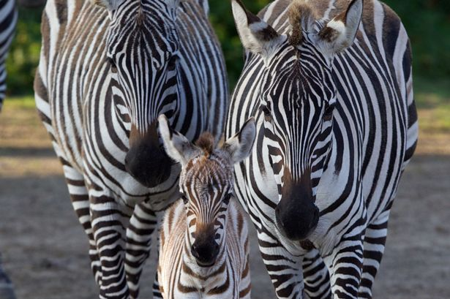
Studbooks – Census Report & Graph
The Census Report, Census Detail and
Census Graph have been combined into
one tool for ease of use! This new tool
contains all the raw data calculations as
well as visual graphs and it is easy to go
back and forth between the graph and
the raw data.

Slide 12
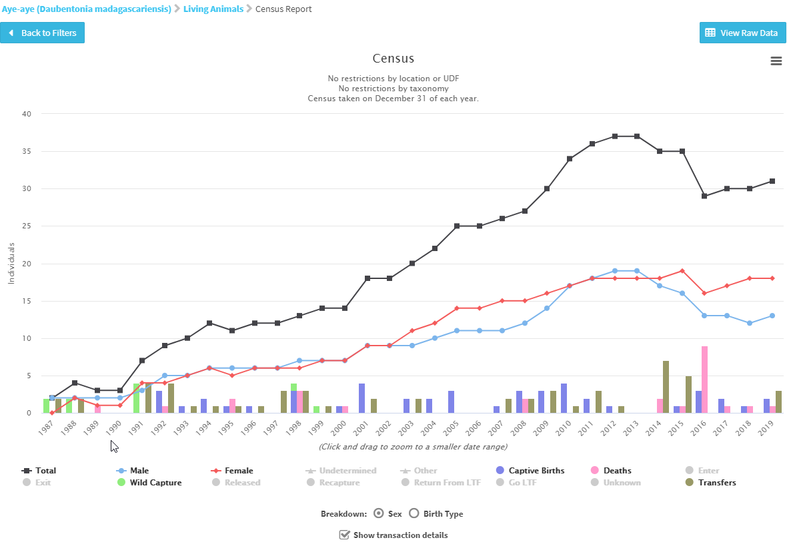
Studbooks – Census Report & Graph
The graph can be broken down by Sex or Birth Type.
You can also opt to view the Transaction Event details.

Slide 13
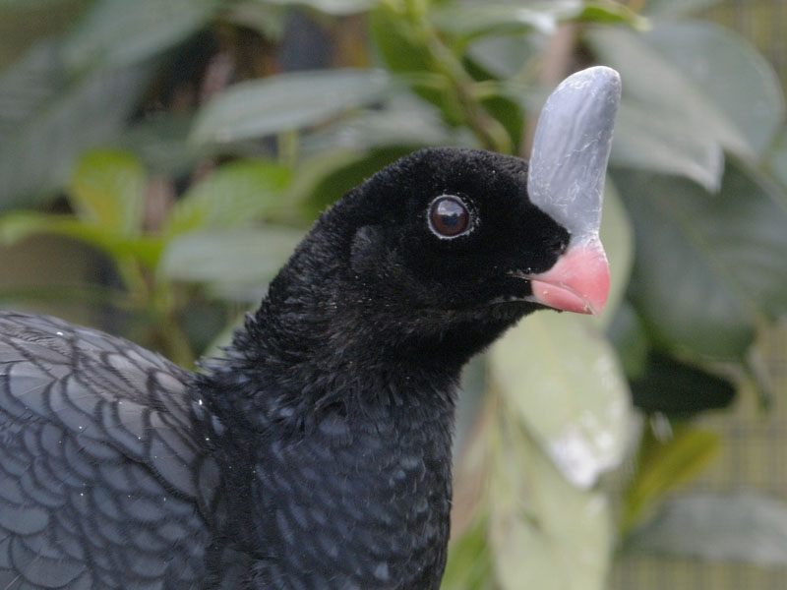
Studbooks – Studbook ID Auto Display in Husbandry
All Husbandry animals that are linked to an
animal in a Studbook will now automatically
display the Studbook ID in the Husbandry
Identifier grid as a global identifier with the
Regional Association or Institution that
manages the studbook displayed in the
Reported By column. You cannot delete this
from the grid. This was a highly requested
Enhancement by both Studbook and
Husbandry users as it will improve efficiency
and save time for both Registrars and
Studbook Keepers.

Slide 14
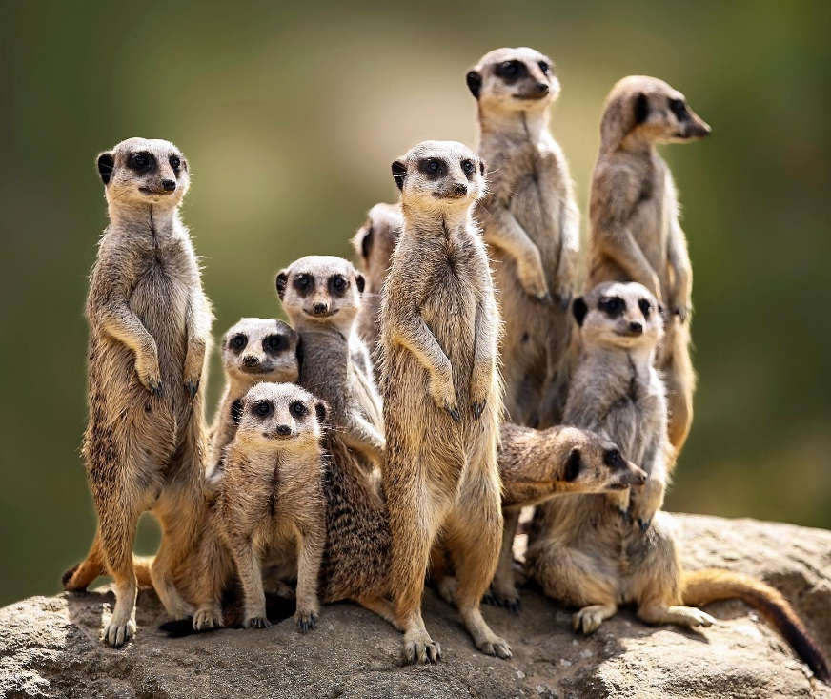
Studbooks – Batch Add
Studbook Keepers can now choose to “batch add” up to 50 animals to the studbook at one time from any draft animal screen. You have the option to define the Local ID and Sex and all
other records from the draft animal will
automatically populate. This was the highest voted for studbook related Enhancement request at the time of the development of this feature.

Slide 15
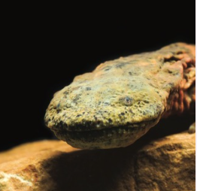
Studbooks – Institution Studbooks
The functionality is now developed that
allows our member institutions to migrate
or create studbooks for species they
manage. Multiple facilities can be included
in these institutional studbooks that are not
managed by a Regional Association but
rather by the Institutions themselves.

Slide 16
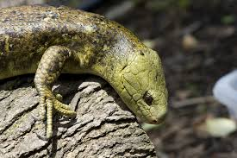
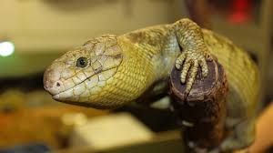
Studbooks – Compare Tool Improvements
You can now use the Animal Comparison
Tool to compare Husbandry animals with
Studbook animals to make it more useful
when comparing animals to determine
links or duplicates. Studbook animals are
light blue and Husbandry animals are dark
blue to make it easy to determine if you are
viewing a Studbook or a Husbandry record.

Slide 17
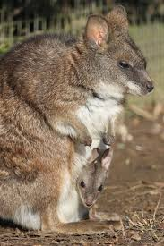
Studbooks – Add Note to Data Quality Error
Data Quality Errors are very helpful to
assist with cleaning up your studbook.
However, there may be times when ZIMS
thinks it is an error and it is not due to the
biology of the species. For example, species
with delayed implantation or embryonic
diapause will often generate “errors” that
the sire was not alive at the time of
contraception. You now have the option
to add a Note to active or dismissed Data
Quality Errors. This allows you to record why
the error was dismissed or document
investigation on an active error.

Slide 18
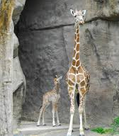
Studbooks – And More!
Improvements to PMx Export
  Taxonomy filter
  Include in situ animals
  Can continue working or close down while run
Linking criteria is displayed
Overlay Export
Archive/Unarchive Studbooks
Notification for previously linked animals
In situ animals display in lists
Export to XML format
GAN link to Husbandry
Filter Animal List by multiple statuses
Non-ZIMS parents removed from Pending Updates
And even more………..

Slide 19
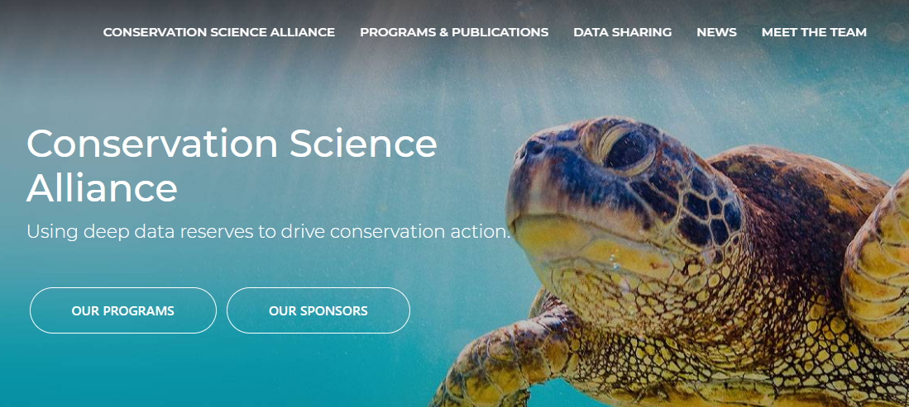
Research
Our Research Team was very busy in 2020!
  Published 5 peer-reviewed papers with 3 still under review
  Developed Analytics
    on survival on 2000 species
    measure increase in species survival in Zoos and Aquariums
    on 2 fish taxa
  Reviewed 15 research requests
  Launched the Species Knowledge Index for Songbirds and Sharks for CITES
  Presented at 7 conferences/workshops
  Supervised 4 students who graduated with CSA projects (Master and PhD)
  Developed/continued strategic relationships with
    Global Initiative to End Wildlife Crime
    Earth Biogenome Project (EBGP)
    AZA Aquarium Collections Sustainability Committee
    IUCN Asian Species Actions Partnership Specialist Group (ASAP)
    IUCN CPSG Decision Analysis Specialist Group
    WAZA Aquarium Committee
    Alliance of Zero Extinction (AZE)
  Submitted 3 grants

Slide 20
ZIMS Data Used for Conservation Efforts
EAZA Songbirds TAG and Species360 used ZIMS data to pinpoint species at risk
Researchers at the Clinic for Zoo Animals at the University of Zurich used ZIMS data to study reproduction in primates for a publication in Biological Reviews
The Red Siskin Conservation Center is using ZIMS data to help manage one of the most endangered bird species in the world
The Borneo Orangutan Survival Foundation uses ZIMS to manage the orangutans in their two sanctuary sites
The Aquarium L’Oceanographic uses ZIMS data to measure its role in sustaining 28 coral species assessed as vulnerable to climate change

Slide 21



Welcome Back!!!
We want to end on a very happy
note! We are extremely pleased
that three of our former members
rejoined Species360 in 2020!
The Nashville Zoo and Memphis
Zoo migrated their data and went
live last year. The return of these
two institutions added ~1.5
million records to the ZIMS database!
The Houston Zoo is completing
migration and will go live in January
2021.
It is so good to have you back!

Slide 22
ZIMS and Species360 Highlights from 2020
Any Questions?

