Slide 1
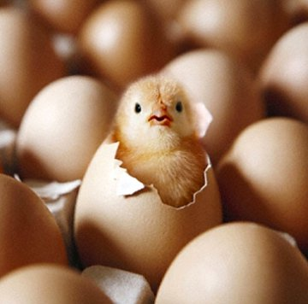
Managing Eggs in ZIMS
September 2020 TNT
Notes:
Welcome to the September Tips and Tricks session on managing eggs in ZIMS.

Slide 2
Welcome Deanna!
Notes:
I am very pleased to have Deanna Snell, Registrar at Calgary Zoo and an instructor at AZA’s Institutional Records Keeping course, on the TNT with us. Deanna has been using ZIMS for many years to help manage their eggs for several endangered and threatened species. She can speak from experience! Later in the presentation she will be discussing how she uses ZIMS for their eggs. She will be happy to answer any of your egg related questions. Thank you for joining us!

Slide 3
Egg Entities
Egg
Single identifiable egg
Can be part of a clutch or a number of eggs
Group of Eggs
Multiple eggs, usually a clutch, that can be counted
Multiple eggs you want to manage as one entity
Egg Mass
Too numerous to count
Held together by a gelatinous substance or laid in a substrate

Slide 4
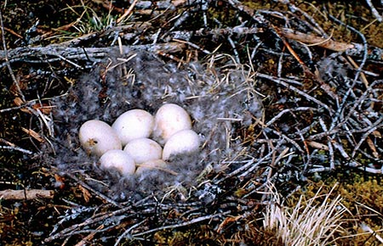
Modes of Accession
Egg and Group of Eggs
From Another Institution
Collected From Wild
Rescued
Appeared
From Lay
Splits
Egg Mass
From Another Institution
Collected From Wild
From Lay
Splits
NOTE: With accessioned wild collected eggs,
ZIMS does not record the hatch as a “Wild”
animal since it was a captive hatch. Be
aware that this can cause some challenges
with studbooks and founders and
interpretation of the Population Overview
Report regarding “Wild” origins.
Notes:
DEANNA: Read/discuss the NOTE in the box

Slide 5
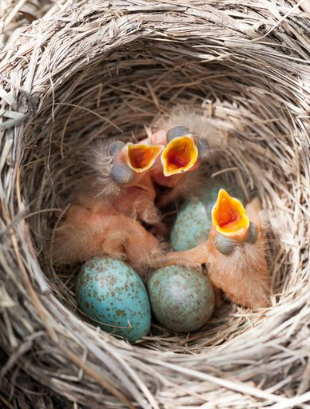
Modes of Disposition
Death (prior to Hatch Event)
Identify Early, Mid or Late Term
Entity remains Egg or Group of Eggs/Egg Mass
Disposal
Egg is Infertile
You do not want a fertile egg to hatch
Entity remains Egg or Groups of Eggs/Egg Mass
Hatch
Success!
Entity becomes Individual or Group of Animals
Disposition
Missing
Release to Wild
To Another Institution
Merges

Slide 6
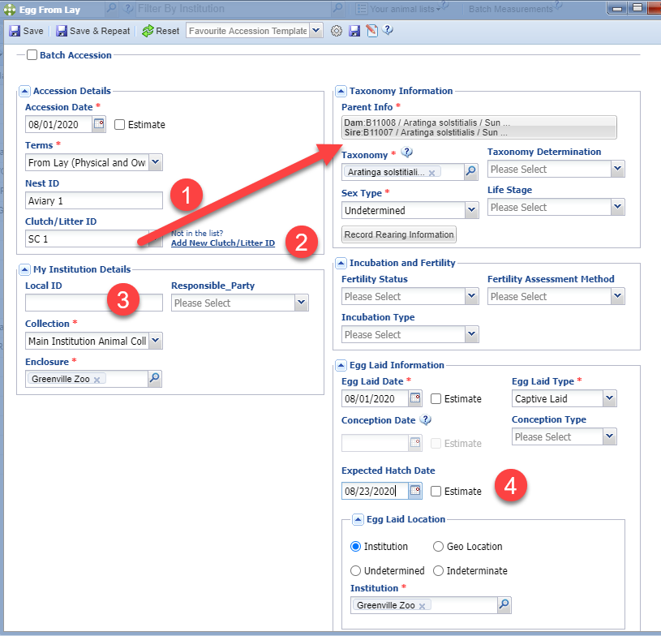
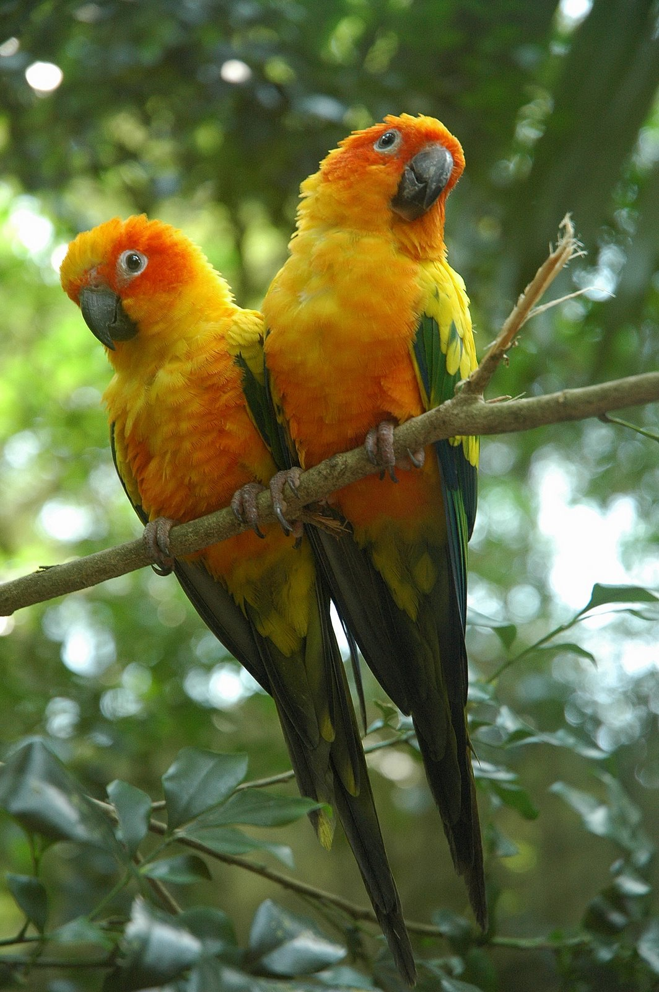
Recording a Single Egg
Notes:
For this session we are going to record an egg from Lay. There are some fields I want to cover. #1, the Nest ID is a free text field and is not captured as a locally created dropdown list. You may want to keep a list of all the Nests location you have identified.
#2 If you have created a Clutch it will display in the local dropdown list. If you have not created the Clutch you can create one here. More on Clutches later. If you select a Clutch and have identified the parents both the Parents and the Taxonomy will prefill. If you have selected Wild/Unk/Ind for both Parents the Taxonomy will not prefill.
#3You are not required to record a Local ID for an Egg. Should it hatch then you will have to assign one. CAUTION! If you have auto-increment Local ID it WILL prefill so your will need to delete it if you do NOT want a Local ID for the egg.
DEANNA: It is best not to record a local ID which will be discussed more when talking about Egg ID’s.
#4 If you know the expected hatch date you can record it here and also create a calendar task for the dam to watch for eggs.

Slide 7
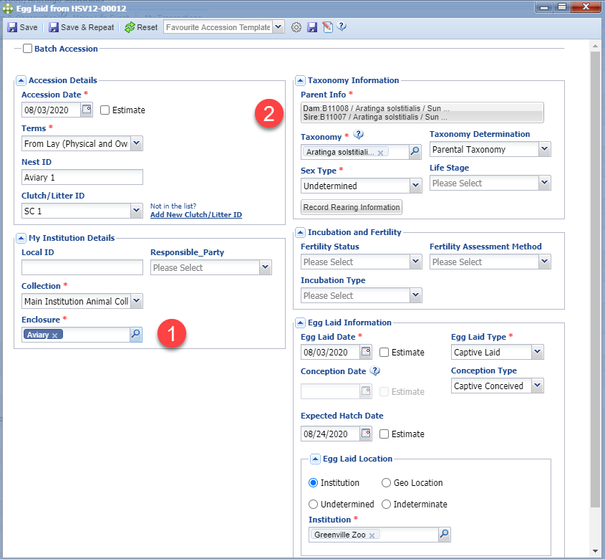
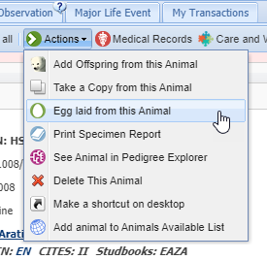
From the Dam Record
Notes:
You also have the option to record an Egg From Lay from within the female’s record. This can save data entry time because #1, the enclosure the dam occupies will prefill.
#2 the dam information will also prefill and you only need to record the Sire. If you select a Clutch the parents info will also prefill as shown previously for an Accession from the Start menu. If you do NOT want to assign a Local ID, if using auto-increment remember to delete it.

Slide 8
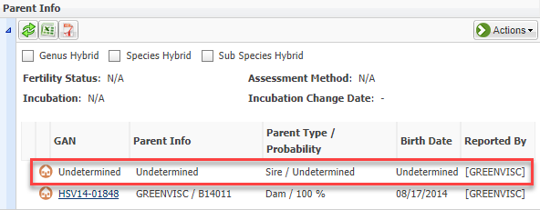
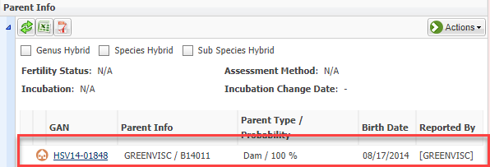
Infertile/No Sire Eggs
1.Record Sire as Undetermined
2.Save
3.Select Actions > Edit Parents
4.Remove the Undetermined
Sire (single left click!)
5.Save
Notes:
DEANNA: There may be times when you want to record eggs that are laid but do not have a Sire or are assumed to be Infertile. ZIMS requires a Sire to be entered in order to save but there is a workaround! First record the Sire as Undetermined and Save. Then select Edit Parents under the Actions menu. Remove the Undetermined Sire and save. ZIMS will now accept the single Parent record. Note that it will only accept this for an egg record.

Slide 9
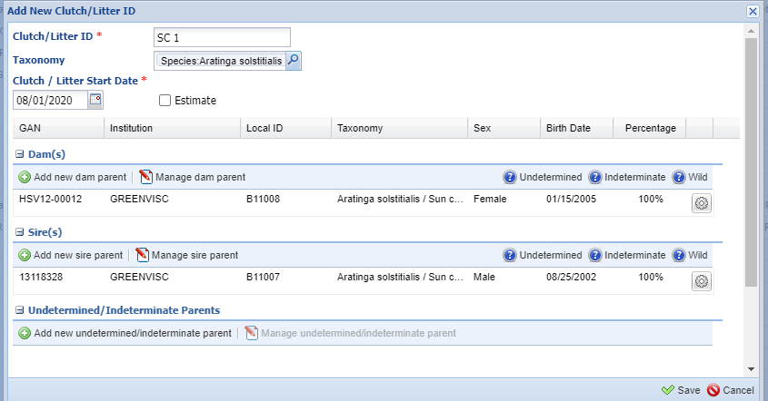
Recording a Clutch
Notes:
When you are recording a new clutch you will need to name it. Suggest developing a naming convention. Record the date of the first egg lay. Then record the Parents. As mentioned, if they are identified they and the taxonomy will prefill once the Clutch is selected.
DEANNA: At the Calgary Zoo, we do have a protocol for assigning clutch ID’s as we deal with both wild-collected and captive-laid eggs for our sage grouse so we can easily tell which egg came from the wild and which came from our collection.
The list can become very long over time.

Slide 10
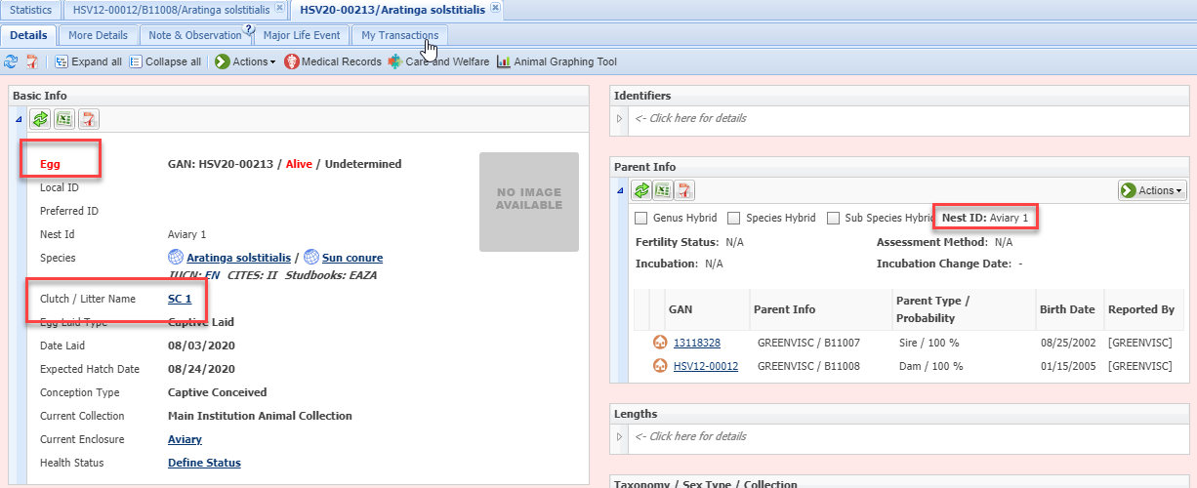
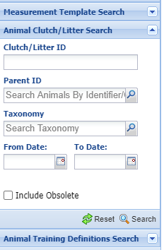
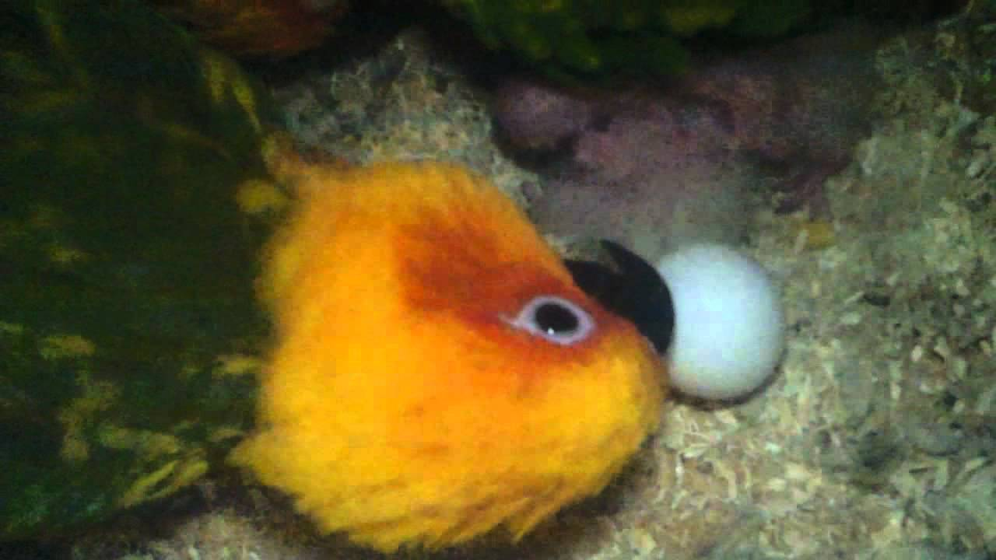
Clutch/Nest ID Display
Notes:
Once you save, note that the entity is an Egg. The Clutch is displayed in the Basic Info grid. If you need to correct it you will need to open the From Lay My Transaction screen. You can search for Clutches using the Clutch/Litter search box. The Nest ID displays in the Parent grid and you can edit, or add it, it from the Actions menu there.
DEANNA: It does not autofill when using the Animal/Clutch Litter Search.
This has been submitted as a low priority Bug.

Slide 11
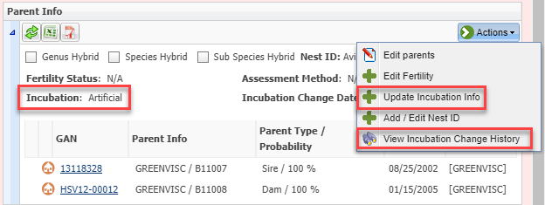
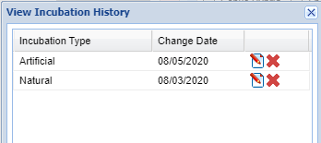
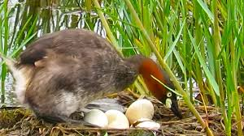
Incubation
Notes:
Incubation also displays in the Parents grid and can be added or updated from the Actions menu there. You can also select to view the Incubation history from the Actions menu.

Slide 12
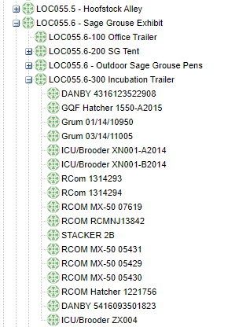
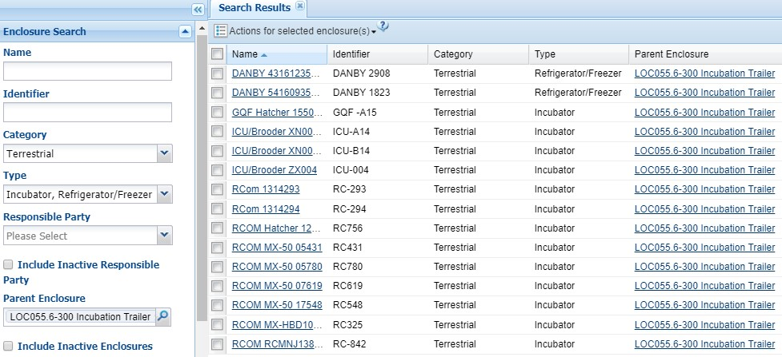
Incubator Organization
Notes:
DEANNA: At the Calgary Zoo, all our incubators are recorded as enclosures. As an egg moves from the nest, we add an enclosure move. This way we can accurately trace the eggs’ move history. This information can prove beneficial to trace the history of the egg/chick if there are abnormalities and if it could be related to a specific incubator.
Because we have incubators located in different areas of the zoo, we set them up so they are a sub-enclosure of the building they are located; for example, our sage grouse incubators are located in our sage grouse incubation trailer. Because we have so many eggs being laid in a season, it is easy to pull a report of where eggs are located weekly by enclosure/incubator to send to our sage grouse keepers to ensure what we have in ZIMS is what is happening the field. I use the Advanced Animal Search for this report and download it as an Excel spreadsheet for sorting, etc.

Slide 13
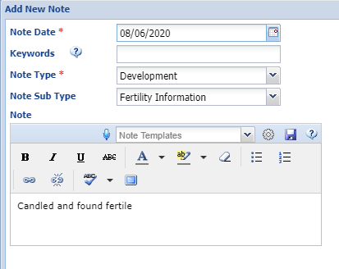
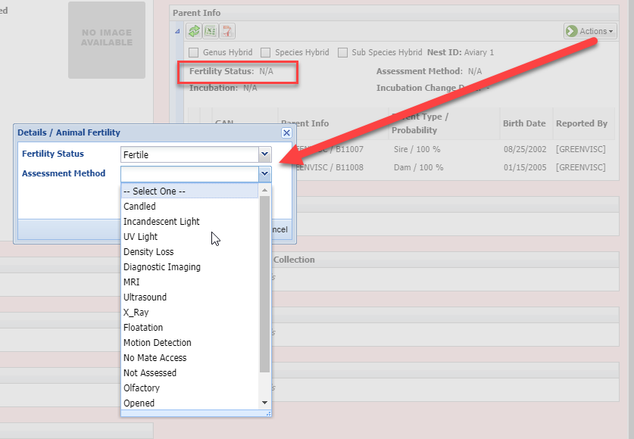
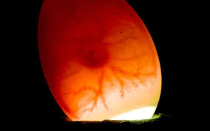
Fertility
Suggest Features:
I want #19110!
Notes:
The egg Fertility status also displays in the Parents gird. since you probably didn’t record this when you recorded the Egg Laid, you can update it using the Actions button. The Assessment Method is a single select dropdown list to select from. There is no Date associated with the Fertility so you may want to record a note to capture that information. Use Note Type = Development and Sub-type = Fertility Information.
DEANNA: CANNOT pull reports based on fertility in ZIMS and it isn’t a column option in the Advanced Animal Search. Please go to Suggest Features and search #19110 and click “I want” to move it up the priority ladder.

Slide 14
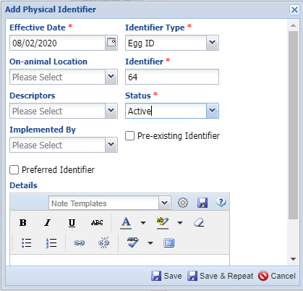
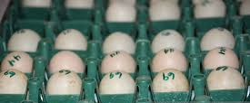
Egg ID
Notes:
Especially if you have not assigned a Local ID, to help you identify the eggs you can assign them an Egg ID number. This is a physical identifier because in most cases, the number is written directly on the egg. If you are incubating the eggs you could also use the Clutch ID as the egg ID or even the Local ID.
DEANNA: It is very useful to create a protocol or spreadsheet for assigning unique egg numbers as these number can be duplicated which can cause confusion when pulling reports with repeated egg numbers. At the Calgary Zoo we manage a lot of eggs so we will assign a block of egg numbers to a section. If more egg numbers are needed, we will assign another block in order to avoid repeating of egg numbers.
Calgary Zoo clicks preferred ID so the egg number appears on your animal search lists to reduce number of columns when we pull our section reports.
As well, this is one quick way to ascertain if an egg hatched or not—if there is no Local ID, then the egg never hatched.

Slide 15
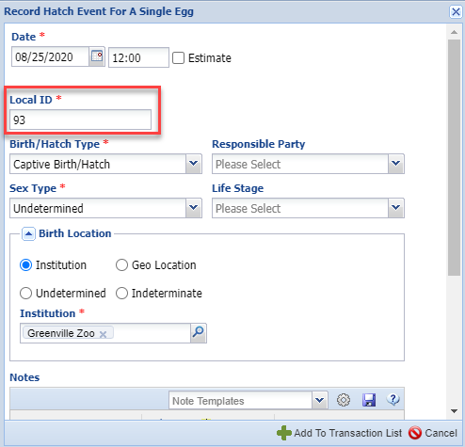
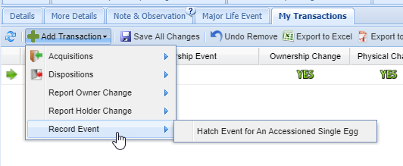
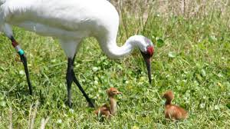
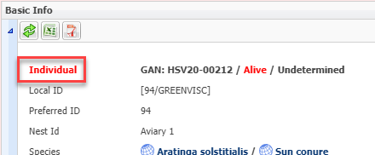
Recording a Hatch
I want #9467!
Notes:
One of our eggs has hatched! When an egg hatches you record an Event and not a Transaction. Go to My Transactions > Record Event > Record Event for an Accessioned Single Egg. Because we did not assign a Local ID to the egg you must do so now. NOTE: Auto-increment Local ID will NOT prefill in this screen. Once you complete the screen and Save, the entity is now an Individual and no longer an Egg. A Hatch Event will display in the My Transactions stream.
DEANNA: Similar to births, ZIMS does not record hatch events in the parents note. As well, you cannot batch enter eggs into hatches; eg: if you have multiple eggs hatch out from different clutches on the same day, you cannot batch enter the hatch. For example, with our sage grouse, we accession over 300 eggs in a season with over 200 hatches all in an approximate 60-day window. We must go into each egg and record the hatch event. Remember that Rearing is very important! Sage grouse we do Hand and Parent; Whooping crane we do Foster and Parent. This has also been submitted as an enhancement – vote for 9467!

Slide 16
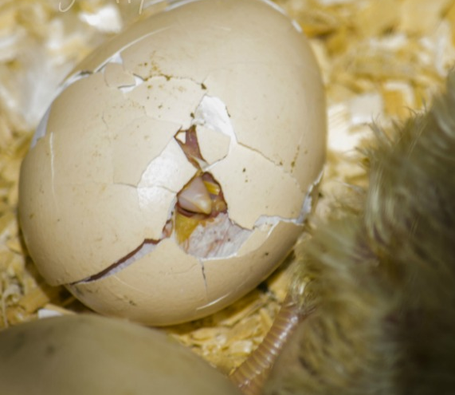
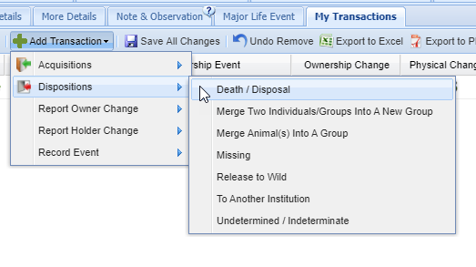
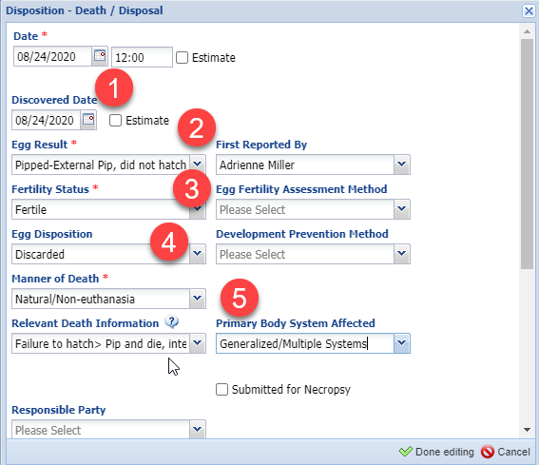
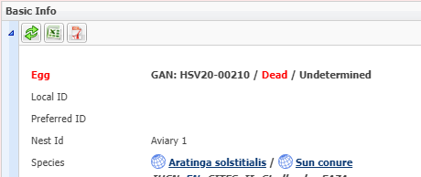
Recording a Death
Notes:
Unfortunately, one of the chicks started hatching but didn’t survive. To record the death select My Transactions > Add Transaction > Disposition > Death/Disposal. #1 there are 2 dates that can be recorded, the actual death date and the discovered date. #2 the egg results is what happened to the embryo. Here it pipped externally but then died. #3 the fertility status prefilled because that selection indicated a fertile egg. #4 egg disposition is what happened to the egg after the result was determined. #5 the Manner of Death, Relevant Death Info and Primary Body System Affected can be edited by the Veterinarian if a Necropsy is performed. Notice we did NOT have to record a Local ID. Once you save the entity will remain an Egg, but the status will be Dead. An Egg Disposal or Death will display in the My Transaction stream. If the chick actually gets out of the shell and breaths air, a hatch should be recorded and then a death.

Slide 17
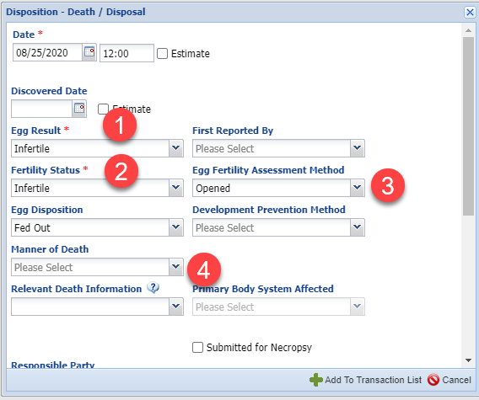
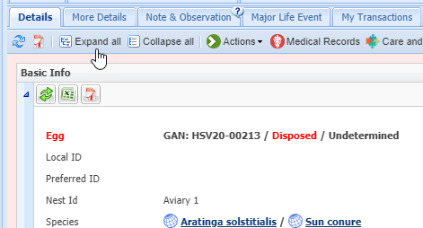
Recording a Disposal
Notes:
Our last egg was found to be infertile. For this you will also go to Death/Disposal in My Transactions. #1 The Egg Result is Infertile. #2 the fertility status does not prefill for this option. #3 the infertility was found because we opened the egg. #4 you will not be entering any information regarding a death. The entity remains an egg and the status is discarded. The My Transaction stream will display as Egg Disposal or Death.

Slide 18
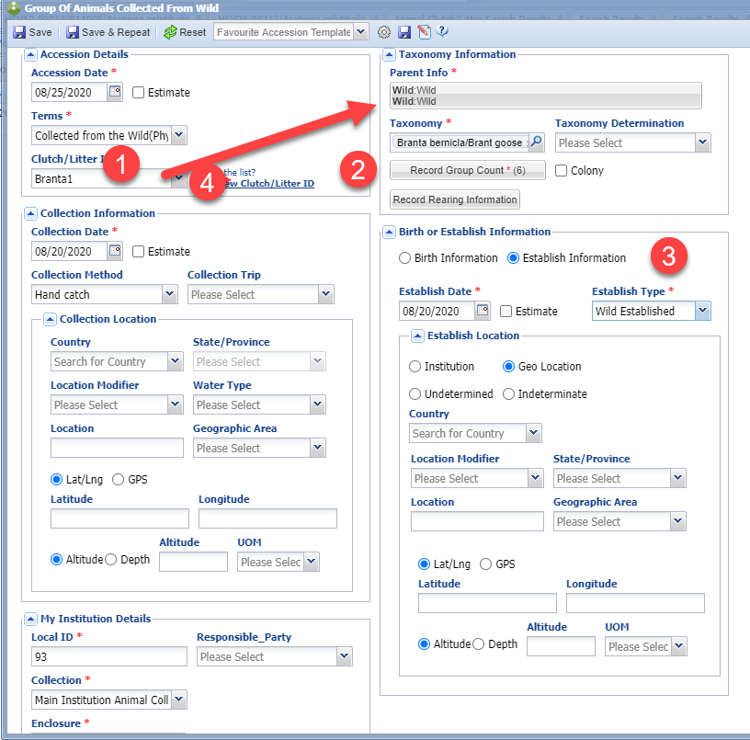
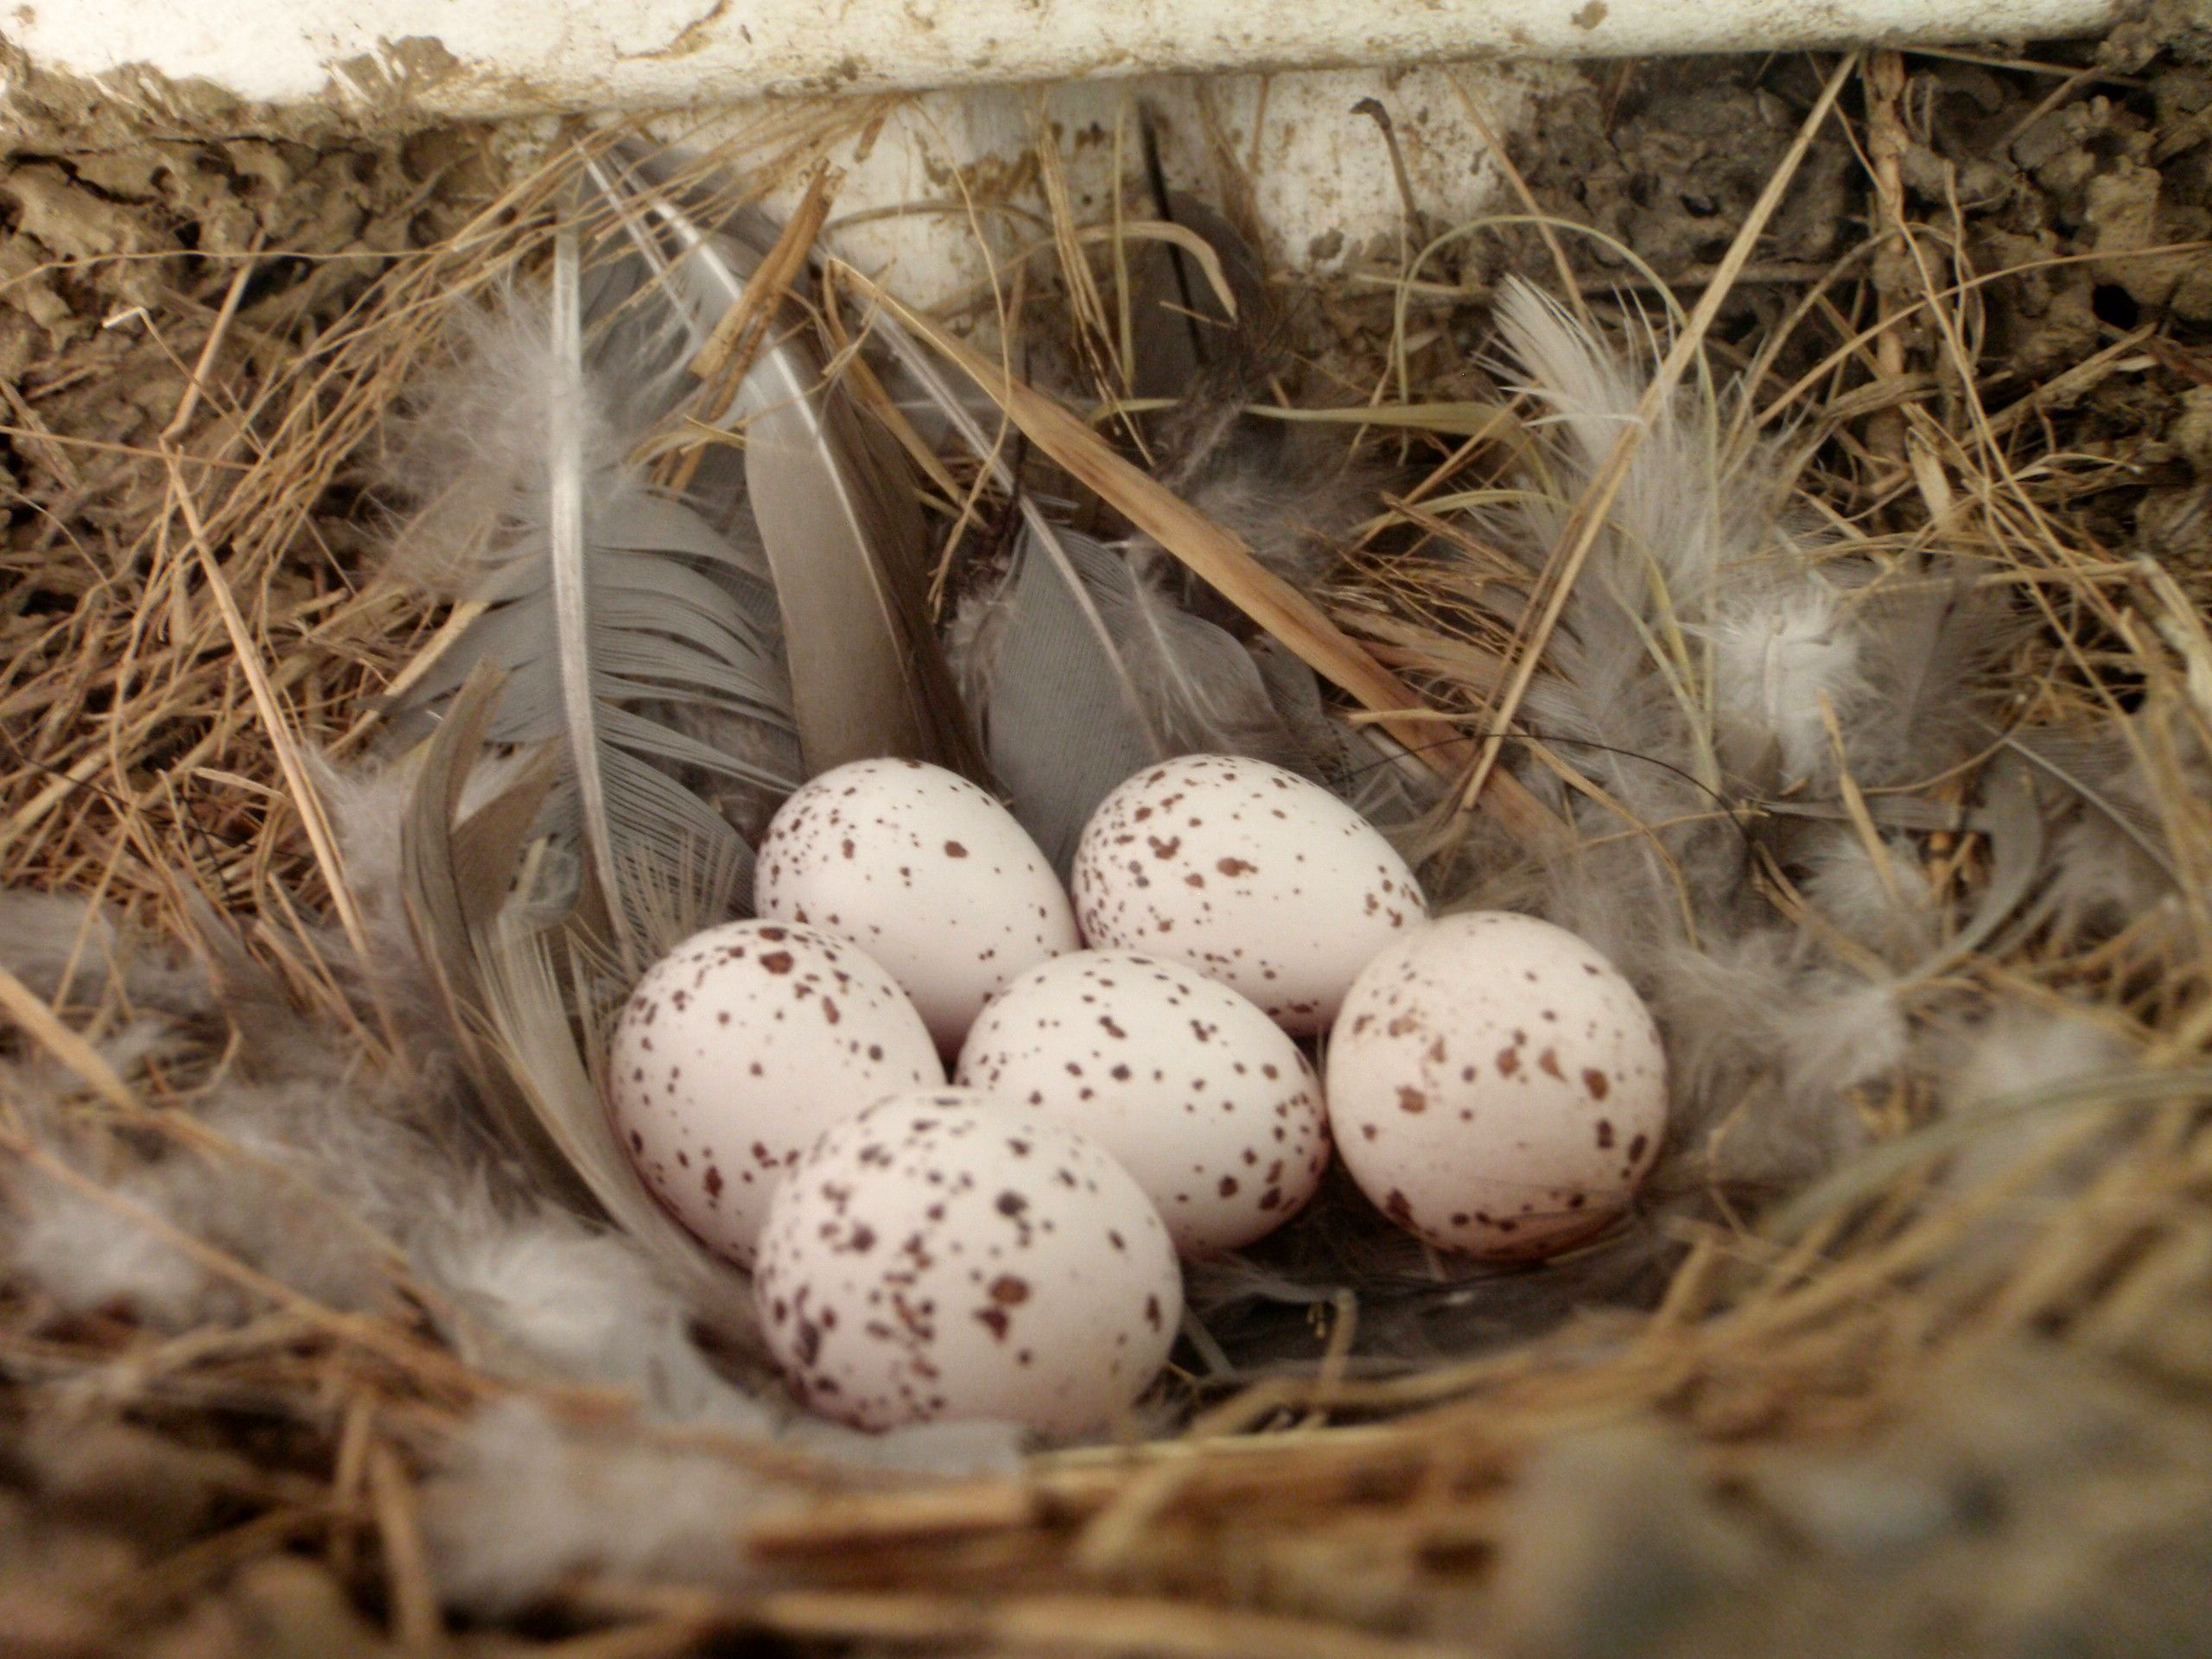
Group of Eggs
Notes:
Recording Groups of Eggs is very similar to recording Groups of Animals. In our previous example we recorded the Clutch as single eggs but you may wish to record a Clutch as a Group of Eggs if you cannot identify each egg.
Here we are recording a group of eggs collected from the wild. When we recorded the Clutch ID the Parents prefilled but because they were listed as Wild the Taxonomy did not and we had to enter that. If the group of eggs is split and hatched, the Clutch ID will go into the new record. The Record Group Count does not become active until the Taxonomy is recorded. And as for Groups of Animals you also have the ability to select Established information.
DEANNA: Calgary Zoo does not use this function although we do use Egg Mass for our leopard frogs.

Slide 19
Group of Eggs - Splits & Merges
Group of Eggs function as Group of Animals
Partial Transactions
Group of Eggs or Individual Egg(s) can be Split from origin Group
Group of Eggs or Individual Egg(s) can be Merged into a new Group or an existing Group
Death or Disposal
If last Disposition is not a Full Disposition (even if it brings the count down to 0.0.0) the Group of Eggs must be Closed Out

Slide 20
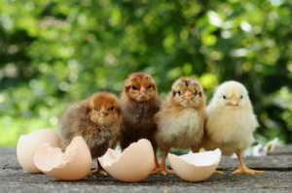
Hatching a Group of Eggs
Not all groups have to be handled the same way
You may only want to record hatched eggs and don’t care about capturing information on deaths or infertile eggs
In addition to hatches, you want to record information on eggs from the clutch that did not hatch
You want to associate an actual hatch date with an egg

Slide 21
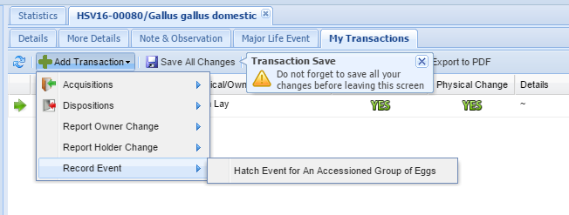
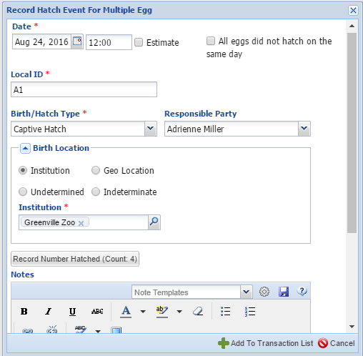
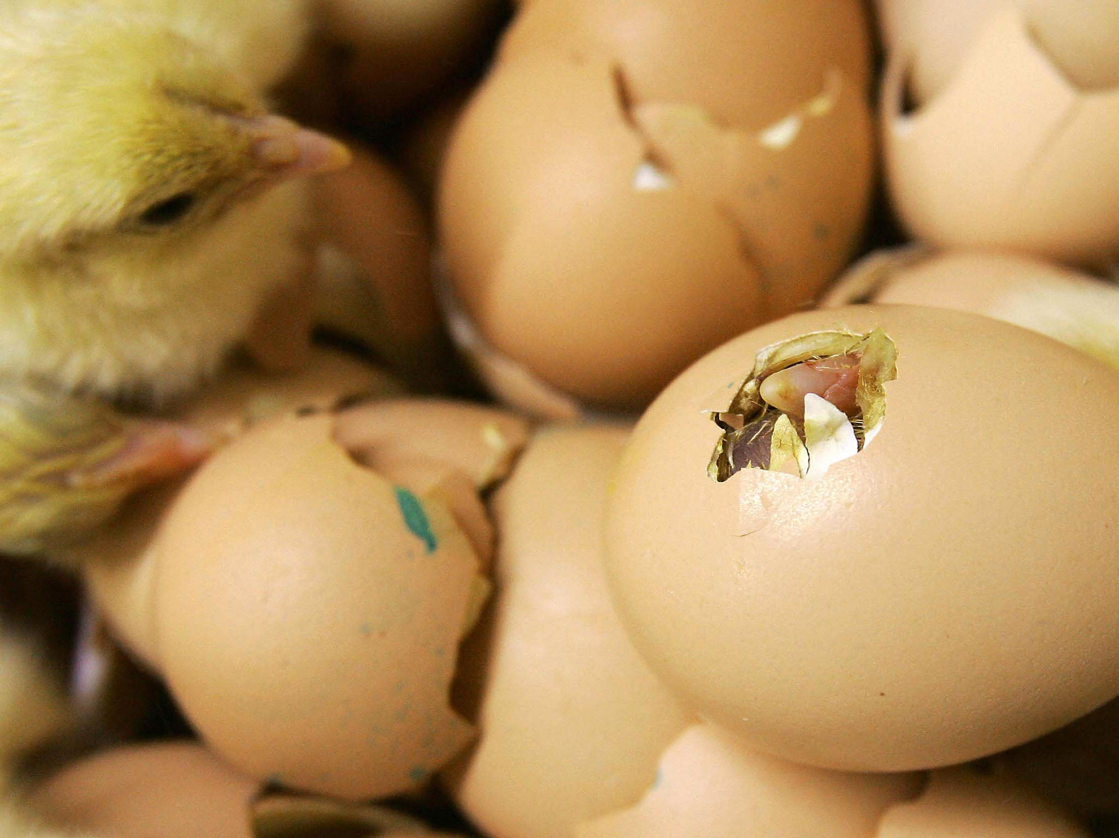
Scenario A: The eggs hatch on the same day. You do not want to record information on any that died in shell or were infertile.
Notes:
This is the easiest scenario. From the record for the group of eggs
select My Transactions > Record Event > Hatch Event for an Accessioned Group of Eggs.
Complete the screen. Do NOT check “All eggs did not hatch on the same day”. If you did not provide a Local ID for the Group of
Eggs you will need to do so now. If you did it will prefill. Record the number that hatched. The number may or may not be the
same as the number of eggs that were in the clutch.

Slide 22
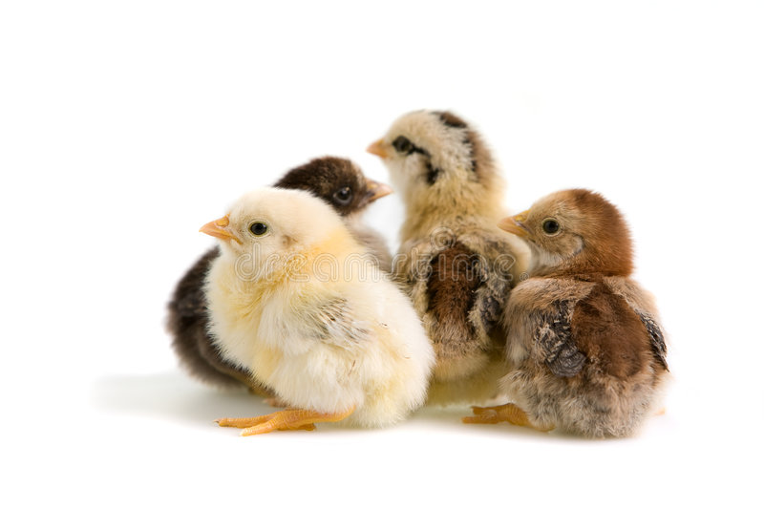
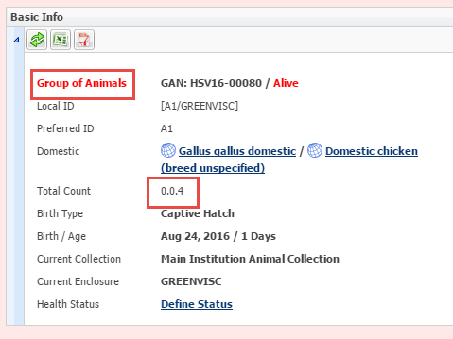
Scenario A continued
Notes:
When you Save the transaction the record will now be for a Group of Animals with the count you recorded as Hatching. You will not be able to record any deaths against any embryos that died
in shell or any infertile eggs after the Hatch Event is recorded.

Slide 23
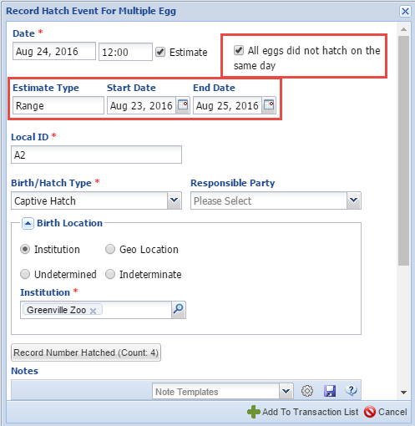
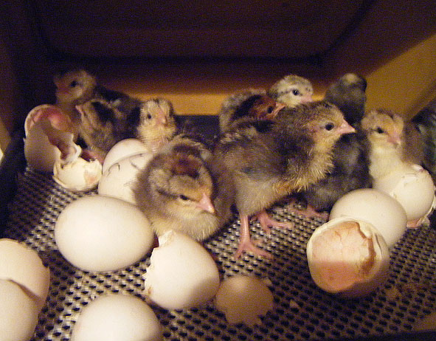
Scenario B: The eggs hatched on different days but you don’t want to associate a specific hatch date with a specific animal. You do not want to record any information on any that died in shell or were infertile.
Notes:
For this scenario you will also select to Record Hatch Event for an Accessioned Group of Eggs. This time you will check the “All eggs did not hatch on the same day” checkbox. This will bring up the Range Estimate box. Enter the date the first one hatched and the date the last one hatched. Record the number hatched.

Slide 24
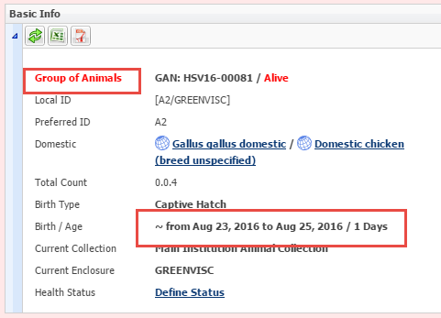
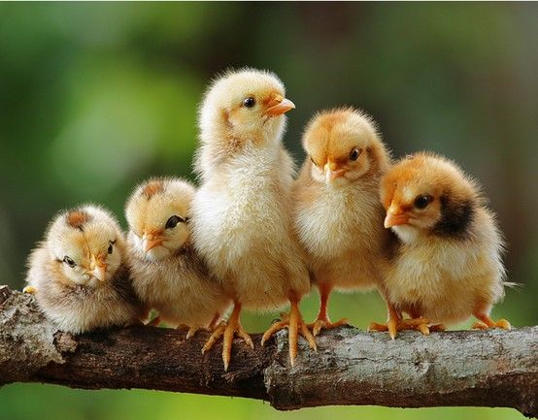
Scenario B continued
Notes:
When you Save you will have a Group of Animals with an
estimated Hatch Date Range. If you later split out Individuals
they will have this estimated Hatch Date associated with them. You cannot enter any information on death in shell or infertile once the Hatch Event is recorded.

Slide 25
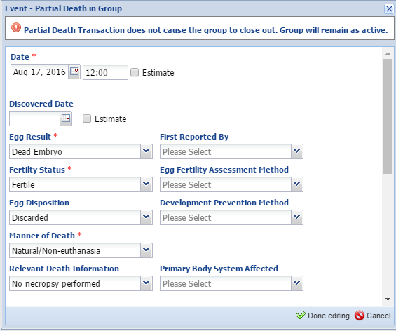
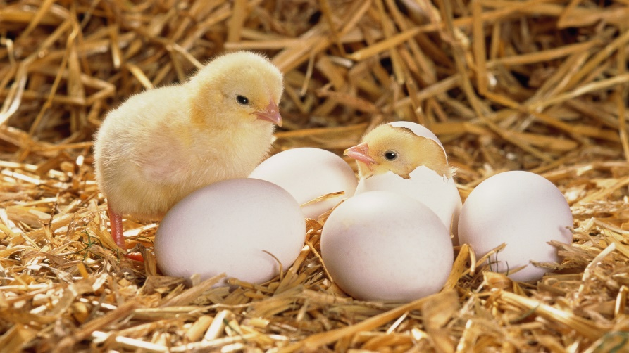
Scenario C: For either of the two previous scenarios you DO want to capture any infertile or dead in shell eggs.
Notes:
Any dead in shell or infertile eggs will need to be recorded PRIOR to recording the Hatch Event. Go to My Transactions > Dispositions > Partial Disposition > Death/Disposal. Here we recorded a dead
embryo in one of the eggs.

Slide 26
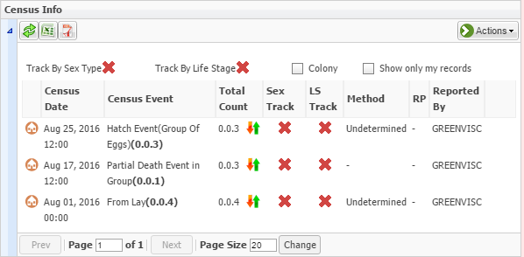
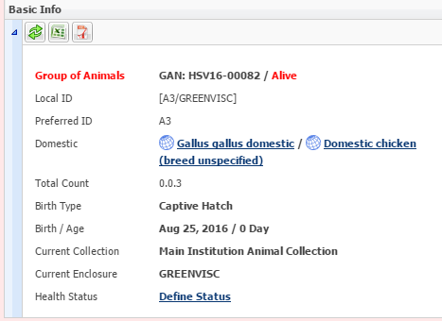
Scenario C continued
Notes:
My Transactions will display the dead in shell. We can then record a Hatch Event for the remaining 3 eggs. Remember the death needs to be recorded BEFORE the Hatch Event. If the eggs hatched over a period of time remember to check the box for All eggs Did not Hatch on the Same Day.

Slide 27
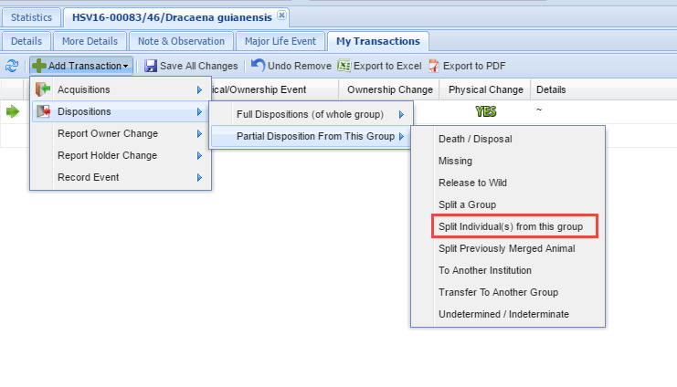
Scenario D: You want to record hatches as they happen and dead in shell or infertile as they are found, even after the clutch is done hatching
Notes:
This is the most timing consuming method but it provides you with the most details on your group as it allows for specific hatching dates for individuals and the ability to capture dead in shells or infertile eggs found after the rest of the clutch hatched.
One egg was found missing on 3 August, you record that
Transaction. Two of the eggs hatched on 22 August. You split
these two eggs out of the group by selecting a Partial Disposition
of Split Individual(s) from this Group.

Slide 28
Scenario D continued
Notes:
Complete the fields. Because two hatched you can select a Batch split. This Institution has selected to auto-generate Local IDs so
ZIMS asks how many you would like generated. If not
auto-generating you would fill them in manually. The Birth/Hatch Date should be left empty.

Slide 29
Scenario D continued
Notes:
When you Save the two splits will display. Select one of the hyperlinks, go to My Transactions and record a Hatch Event for an Accessioned Egg. You may need to change the time for this Hatch Event as ZIMS will note that you already have a transaction on this day and time.

Slide 30
Scenario D continued
Notes:
As the eggs hatch, continue to split them out and record a Hatch Event. If any dead in shell are found record them as a Partial Group Death. If you want to collect Individual information on why that particular egg resulted in a dead in shell you should split out that egg and record a death.
Continue to record splits as the eggs hatch, or deaths/infertile eggs as they are found. If the final transaction is a Full Transaction the group will automatically be Closed Out. If it is a Partial Transaction you will need to Close Out the group so that it will not continue to appear in reports. Close Out is found under Full Disposition options.

Slide 31
Egg Mass
Notes:
Egg Masses function basically as Groups of Eggs. The only real difference is that their numbers usually need to be estimated as there are too many to correctly count. Egg masses are typically held together by a gelatinous substance such as frog eggs or they are laid in substrates such as beetle eggs. Your options for recording hatches are the same as given for Groups of Eggs.

Slide 32
Eggs in Reports
Eggs can display in:
Activity
Daily
Enclosure
Transaction (check box!)
Specimen
Taxon (check box!)
Peak Holding (check box!)
Note Retrieval
Wild Collection
Eggs don’t display in:
Enclosure Occupants Summary
Inventory (both Summary or Detail)
Loan
Notes:
Read Slide
DEANNA: The report I use most frequently for our collection advanced animal search or the transaction report as both provide the most useful information I find. I will show some of the reports at the end of the presentation.

Slide 33
More on the Calgary Zoo & Eggs!
Notes:
Now you get to hear more from the source from someone who has years of experience managing eggs.

Slide 34
Egg/Chick Search
Notes:
DEANNA: When searching for eggs (unhatched AND hatched), the best way to do it is to go:
Advanced Animal Search>Local>All Animals>Taxonomy (Grus americana)>Animal Type (individual AND egg—if you don’t click both then you will only get the hatched chicks OR eggs)>Acquisition Date Range (eg: April 1, 2020, to today’s date to get all eggs and chicks that hatched out). You do not want to choose birth date range as that will only search for chicks that hatch. Acquisition grabs both egg lay and hatches.

Slide 35
Reports—Woot Woot
Advanced Animal Search
Notes:
DEANNA:
Great thing about this report:
1. Shows the number of eggs laid (bottom right-hand corner)
2. Shows which egg hatched
3. Show where I have missed fields; for example: didn’t click preferred identifier for EGG IN4-2-20 and for EGG R1-1-20.
Looking at EGG R1-1-20, this is an egg laid by an unpaired female who is sharing a fenceline with a male.
I use the advanced animal search for most of my egg reports.

Slide 36
Reports—Woot Woot
Transaction Reports
Notes:
DEANNA: At Calgary Zoo, I use advanced transaction filter a lot in the transaction report for preparing egg reports.
For our whooping crane program, we ship fertile eggs to the US so it’s a quick way to see which eggs were shipped out. Nothing related to reports--the other benefit of adding eggs to ZIMS is if the receiving institution is a ZIMS member, they just accept our egg into ZIMS and all the accession information is transferred; we also give them access to both the husbandry/medical records. We can also see what happened to our egg once it’s left our institution—did it hatch? Was the chick released? Etc.
For our sage grouse eggs and because we have so many eggs, we can pull a transaction report for eggs that were hatched in a specific enclosure; eg: hatched out by the hens in that enclosure.
In the example above, I wanted to know which eggs successfully hatched in a specific enclosure and their status; therefore, I chose the enclosure code, clicked births and deaths, and then sorted by GAN.

Slide 37
Managing Eggs in ZIMS
Any Questions?

