Slide 1
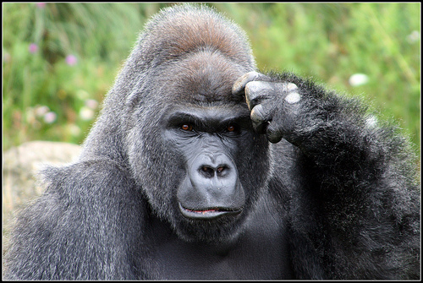
Estimating Dates
August 2020 Tips and Tricks
Notes:
Welcome to August 2020 TNT on Estimating Dates in ZIMS. Recording dates doesn't always involve entering clear-cut information. Sometimes dates are vague and things can get a little fuzzy and confusing if they aren't known. Hopefully we can help take the confusion out of estimating dates. I can present some rules or hints to follow, but you still may end up with a different date estimation then someone else, and it could possibly be just as right. The main thing is to document how you came up with the estimated date. I think it was algebra in high school that the teacher didn’t care so much that you got the answer but that you documented how you got there. Remember those Notes!

Slide 2
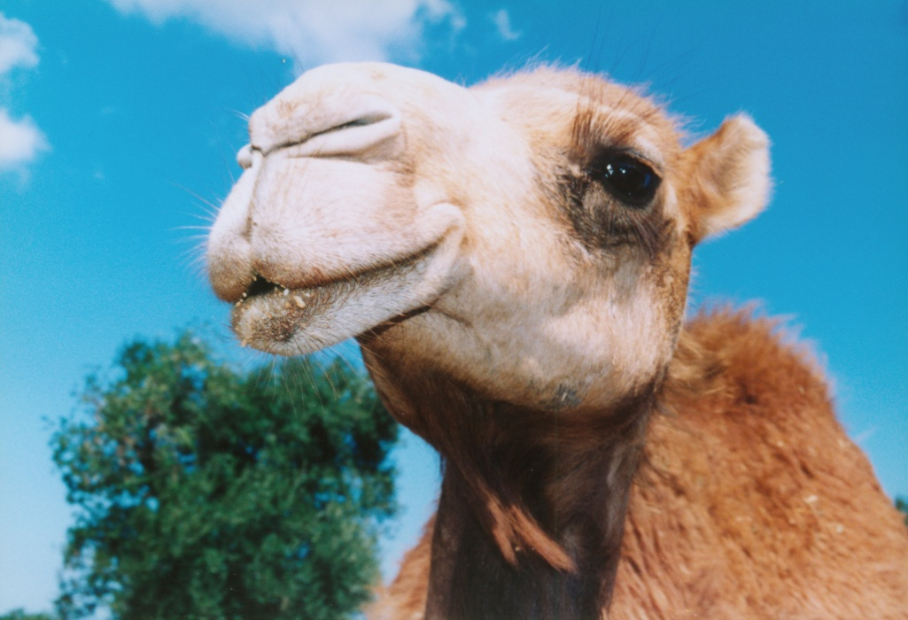
KNOWN: I know this camel arrived 10 October 1970
ESTIMATED: I know this camel arrived sometime in October 1970
UNDETERMINED: I have no clue when this camel
arrived but I might be able to find out.
INDETERMINATE: I have no clue when this camel
arrived and I will never be able to find out.
Notes:
There are various states of “Known-ness” for a date
> Known is the best case you know when something happened, and this makes everyone happy. You know this camel arrived on 10 October 1970
> Estimated is the next best you know something about it, but it still leaves a question. You know the camel arrived sometime in October of 1970.
> Undetermined: You don’t know when the camel arrived but you might be able to find out
> Indeterminate: You don’t know when the camel arrived and you will never know.

Slide 3
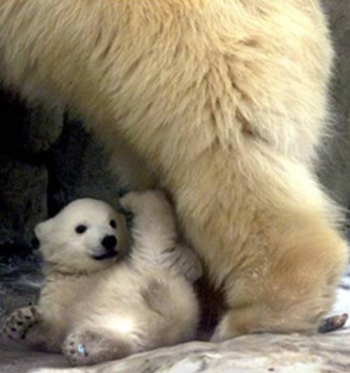
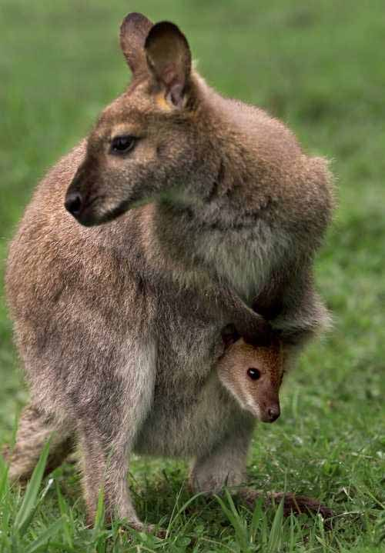
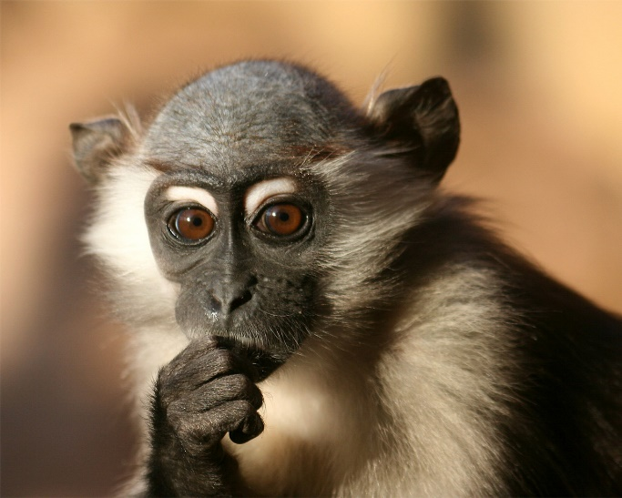
What is the impact of an unknown or
incorrectly estimated date?
Demographic
information
not useable
Needed spaces
taken
Inbred offspring
Notes:
Why does it matter? What are some of the impacts of unknown or incorrectly estimated dates? There are many and the following examples of incorrectly estimated birth dates are just a few.
This bear is very important genetically, but his birth date is recorded as UNKNOWN. Although genetically important to the population, all his demographic information will be excluded from analysis, affecting the accuracy of the demographic analysis.
This little monkey had a transfer recommendation to be a companion animal only, and was to be contracepted. Her birth date was incorrectly estimated so she was not contracepted prior to maturity. This resulted in an undesired offspring. Because the institution had to house this offspring, they did not have room to accept an animal they had been recommended to receive for breeding.
This female wallaby's birth date had been recorded as the out of pouch date and was not estimated back to actual birth date. Due to this she remained in with her sire past maturity, with an inbred joey resulting.
These are just some examples of the impact of an unknown or incorrectly estimated date.

Slide 4
The Types of Estimates
Range
The date was between two known dates
Application calculates the Date Field (mid-date)
All dates included have equal chance that they are correct
Approximately Before
The date was sometime before a known date
Approximately After
The date was sometime after a known date
Approximate Variance
The date was sometime before or after a date
The further away from the midpoint the date is the less likely it is that it was the actual date
Undetermined/Indeterminate
Notes:
Almost all screens have dates fields and almost all of these date fields have the ability to estimate that date. Two very common fields for date estimation are birth dates and acquisition dates, especially if you are entering historical data. To estimate a date simply check the Estimate box and the types of estimate options will pop up for you to select from. A Range estimate means that you know the action happened sometime between two known dates. You will enter a From and a To date and the date field itself will be automatically calculated by the application. An example of where you would use this is if you went on vacation and a birth had not happened. When you came back the birth had occurred but no one had recorded it. You know it happened sometime between the two dates when you were on vacation. All dates have equal chance of being correct.
> Approximately Before means that the date happened sometime before the date you have entered into the date field box. For example you have a Galapagos tortoise that you know arrived on 14 August 1945, but there is no record of its age. The birth date would have to be sometime before 14 August 1945.
> Approximately After means that the date happened sometime after the date you have entered into the date field box but you have no other information. This will probably be used mostly for Deaths or Dispositions.
> An Approximate Variance means that the activity happened sometime both before OR after the date you have entered into the date field box. You can have variances of days, months and years. It is very important to remember that Approximate Variance includes dates BOTH before AND after the date in the date field. You would use Variance if you were told an animal was approximately 3 months old. The further away from the date field the less chance that it was the actual date.
And then you have your two types of unknowns.

Slide 5
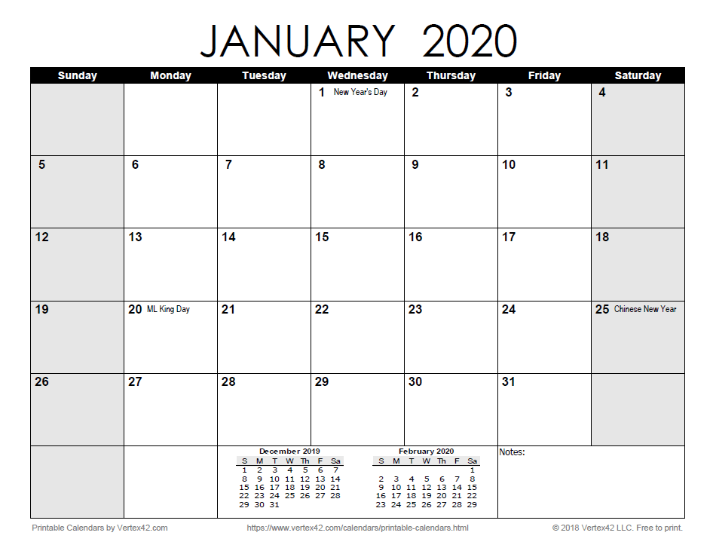
Review of Range
You enter a Start Date and an End Date
ZIMS automatically calculates the Date Field
Mid-point between Start and End Date
Date
Field
Start
End
Notes:
I want to do a review of the difference between Range and Variance as these are commonly confused. Range is sometime between two known Dates. You went on vacation January 6 – that would be the Start Date. You came back to work January13 – January 12 would be the End Date. Sometime while you were out an animal was deposited at your front gate but no one recorded when. Any day between January 6 and January 13 could be the possible arrival date. ZIMS will calculate January 9 for the Date Field. You intend to do further research to try to get an actual arrival date and you also create a form for all departments to record information on Appeared animals so it won’t happen in the future.

Slide 6
Review of Variance
You have an idea of what the date may be
Such as estimated 3 months old as of Accession Date
You enter the Date Field
3 months prior to accession date
You enter the Duration and UOM
Such as Duration of 2 and UOM of Month
REMEMBER! Variance counts backwards from the Date Field AND forwards from the Date Field
Notes:
For Variance we have an idea of when the date may be, such as the bear cub was estimated to be 3 months old when it came out of the den. You enter the Date Field and then what the variance around that field might be. There are a couple ways to envision variance for those of use who are graphically oriented, a target and an architectural compass. For the target example, the Date Field is the bullseye, your best guess date. As the rings go further out the likelihood that it was the date decreases, just like your points decrease in a game of darts or archery the further away from the bullseye you are. In the architectural compass graphic, the Date Field is the point of the compass. How far away from the center the arms go will represent how large the variance is.
It’s very important to remember that Variance counts backwards from the Date Field AND forwards from the Date Field. The forwards bit is often overlooked and can sometimes create illogical dates.

Slide 7
Another Idea
Range is Rigid
Dates between (and including) two rigid dates
Like bookends, all the dates (books) in between are possible
Variance is Vague
Dates around a Date Field
An “ish” date
Notes:
If you like jingles to remember things we came up with this when we last taught the Institutional Records Keeping class. Range is Rigid and Variance is Vague. Range is the dates between two rigid dates. Rather like bookends holding the books in, the Start and End Dates hold the possible dates in. Variance is the variable dates around a Date Field. It is an “ish” date.

Slide 8
What Date is shown on Reports or used in Analysis?
The date in the Date Field will be what is shown on reports (with appropriate estimate indicated)
Calculated by the application for Range option
Entered by the User for the other options
The date in the Date Field is also what is used for demographic analysis.in studbooks
EXCEPT! If the Estimate is recorded as Undetermined or Indeterminate the entire record is excluded from the analysis
Do not create fiction, but for studbook species try to give an actual estimate, even if it is a large one.
But if you don’t know, you don’t know!
Notes:
How do estimated dates display in Reports and used in analysis. For all the estimate options, the date that is entered into the Date Field and the type of estimate will display. As mentioned, this date field is calculated by the application for the Range option. You will need to manually enter the Date for the other estimate options.
>Only the Date Field will be used for any demographic analysis in studbooks, the estimate will not be included in the calculations. However, if an Undetermined or Indeterminate estimate is recorded the entire record is excluded from the analysis. Remember the example of our little polar bear? If possible, for studbook species try to give an actual estimate even if it is a large one. But don’t create fiction! If you don’t know you just don’t know and that is what should be recorded.

Slide 9
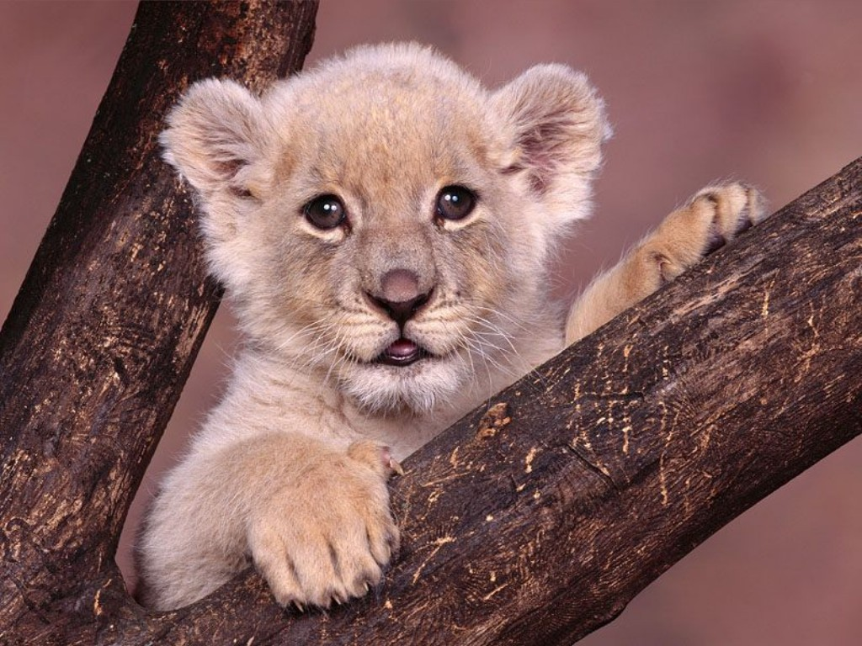
Add a Note
Why and how you estimated the date
Why you changed an estimated date
You won’t remember later
Others won’t know your reasoning
Keyword “date estimate”
Notes:
No matter how you estimated the date it is very important to add a Note to the record as to why and how you estimated the date. You may obtain more information later on and you can adjust the date estimate to a shorter date range so you should note why the date was changed as there may be previous references to the first date. You will not remember why or how you estimated a date in a year from now, and someone else will certainly not know how and they may make changes because they do not have the knowledge about your reasoning that you did. Use Note Type of Animal Events, with appropriate subtype for births and deaths and Transactions Note Type with appropriate subtype for acquisitions and dispositions. Using a Keyword of “date estimate” is helpful.

Slide 10
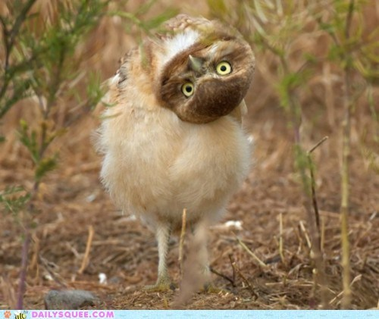
Some Date Challenges
Notes:
Even if you completely understand how to use the estimating options, there can be times when figuring out what date to record can be really challenging. I’ll offer up a few guidelines that I hope will help.

Slide 11
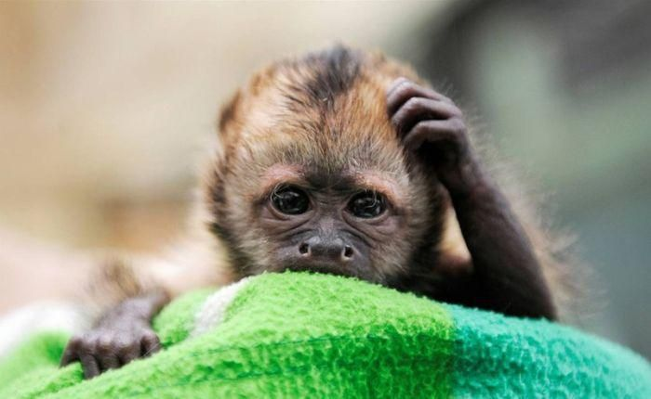
ESTIMATING BIRTH DATES …when you really don’t know
You are recording an adult animal with no idea of Birth Date.
Enter Birth Date as Date of Acquisition
“Undetermined or Indeterminate” Estimate Field
(REMEMBER: these animals will not be included in any demographic analysis so not recommended)
Approximately Before – it had to be born sometime before you received it!
Notes:
What can you do when you really have no idea of what a Birth Date is? There are 2 options, both of which require you to enter the Date Field for the birth as the date of acquisition. You can then either select Undetermined or Indeterminate Estimate, remembering that the animal will be thrown out of any demographic analysis, or use the Approximately Before estimate option.

Slide 12
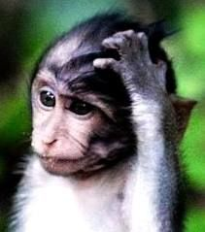
You Have Some Dates
When you have some references to the animal being in your collection but no information on Acquisition or Disposition Date
Acquisition Date
Date Field = date of first reference
Estimate Field - ApproxBefore
Disposition Date
Date Field = date of last reference
Estimate Field = ApproxAfter
Notes:
When you have some dates regarding the animal but no actual references to Acquisition or Disposition Dates the record can be entered. For the Acquisition Date use the date of the first reference and an ApproxBefore estimate. For the Disposition Date use the date of the last reference and ApproxAfter estimate.

Slide 13
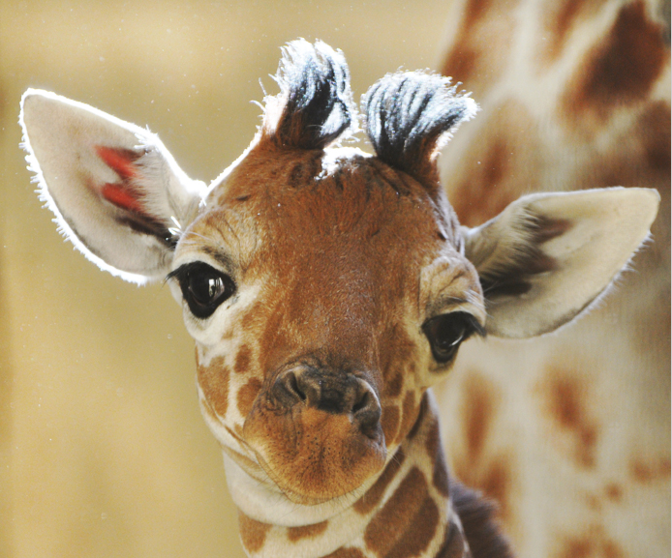
A Giraffe Example
You have this information only:
Vaccinated on 4 March 1950
Foot problem treated on 1 June 1952
Acquisition Date
Date Field = 4 March 1950
Estimate Field = ApproxBefore
Disposition Date
Date Field = 1 June 1952
Estimate Field - ApproxAfter

Slide 14
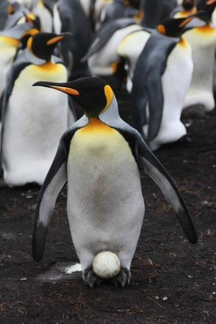
A Penguin Example
You have this information only:
She laid an egg on 7 March 1960
Acquisition Date
Date Field = 7 March 1960
Estimate Field = ApproxBefore
Disposition Date
Date Field = 7 March 1960
Estimate Field = ApproxAfter
NOTE: You may need to adjust time stamp

Slide 15
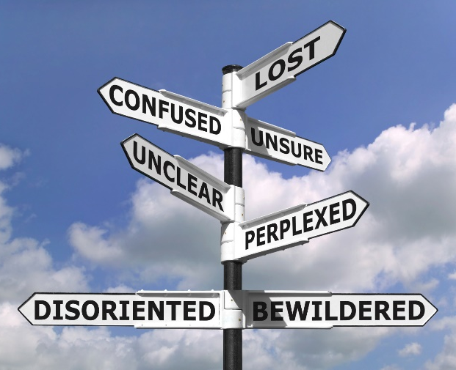
Ambiguous Dates
What do you do with 06/10/1951?
Could be June 10 1951
Could be November 6 1951
There is a Solution!
Select Date Estimate = Range
Start Date = June 10 1951 (the earliest possible date)
End Date = November 6 1951 (the latest possible date)
ZIMS application fills in the Date Field!
Notes:
Even if you have a date it might be confusing. What can you do with 6/10/1951? It could be June 10 1951 or November 6 1951. A student at one of the IRK classes came up with a solution I never thought of. Use Range estimate. Start Date = June 10 1951 (earliest possible date) and End Date = November 6 1951. ZIMS calculates the Date Field of 23 August 1951!

Slide 16
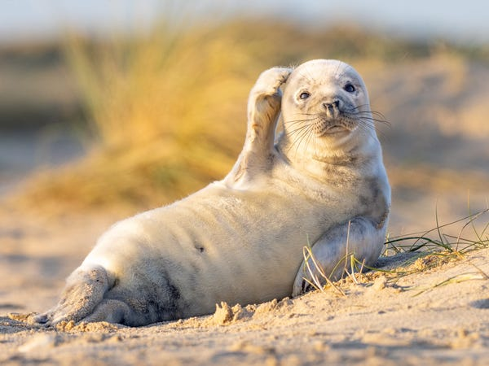
Try Estimating Dates!
Notes:
Now I’d like to try estimating some dates. I’ll present the scenario and give you a few minutes to think about what you would enter. Remember, there may be alternative right answers but how you determined that date is what is very important! Feel free to open up your mic or type in the chat or question box for discussion.

Slide 17
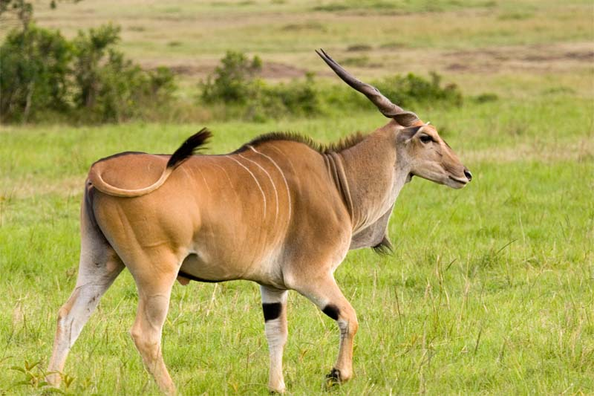
Inventory Increase
Your 1959 and 1960 inventories (dated 1 January of each year) lists 0.1 eland
Your 1961 inventory (dated 1 January 1961) lists 1.1 eland
What would be the Acquisition date for the male?
Variance - Date Field 1 July 1960, Duration 6, UOM Months
Dates covered 1 January 1960 to 31 December 1960 (six months before and after 1 July 1960)
Range - Start 1 January 1960, End 31 December 1960
Date Field of 1 July 1960 calculated by ZIMS
Why not use Date Field 1 January 1960/ApproxBefore?
Because ApproxBefore means it could have been anytime before that date, but the male eland was not listed in your 1959 inventory
Notes:
You can use Variance or Range. I like Range because in my interpretation of Variance, although all dates are still possible, the further away you get from the date field the less likely the date is the actual date. When a Range is use, all dates have equal chance that they were the actual date.

Slide 18
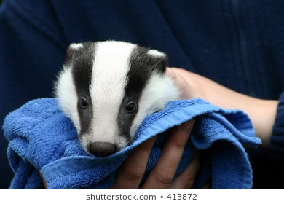
Baby Badger
You find a zoo newsletter dated 1 January 1980
It features list of all the births for the past year
One is a badger. What would you enter for the Birth Date?
Range – Start 1 January 1979, End 31 December 1979
Variance – Date 1 July 1979, 6 month variance
Notes:
You also need to be very careful that other information does not overlap this date estimate. Here you are accessioning a badger that was noted as being born some time in 1979 but you have no other reference. You would record a Range estimate with 1 January 1979 as your Start date and 31 December 1979 as your End date. The application will calculate the mid-date of 1 July 1985. Or you can use a Variance of 6 months around 1 July 1979

Slide 19
Badger Death
Sadly, you find a necropsy report dated 1 November 1979 regarding the baby badger
What do you need to change to keep things logical?
Range – 1 January 1979 to 1 November 1979
Variance – Date 1 June 1979, 5 month variance

Slide 20
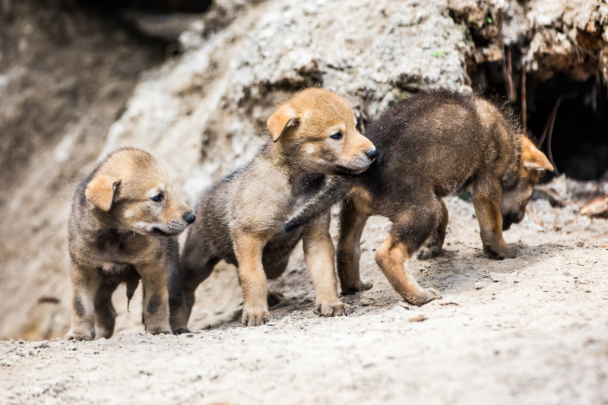
Make Sure it is Logical!
Your litter of three red wolves leaves the den on 10 March 2020
Since you know they exit the den at around 2 months old you estimate their Birth Date to be 10 January 2020 (2 months before den exit) with a Variance of the two months
What is wrong with that estimate?

Slide 21
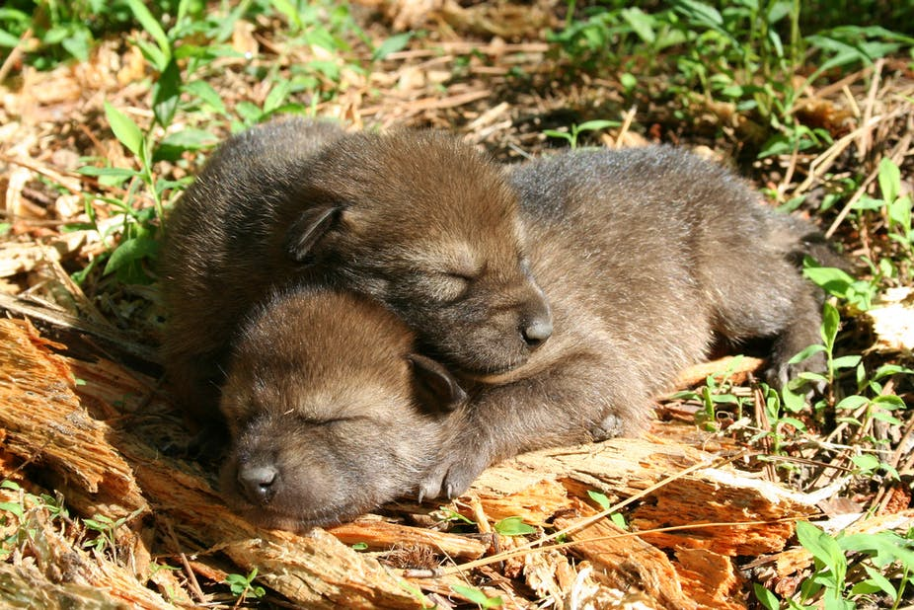
Variance Goes Both Ways!
Using a Variance of 2 months means the pups could have been born 4 months ago (not really logical) or the day before they came out (totally not logical!)
The Date Field is correct, 2 months from exit) but the Duration and UOM should be much smaller, probably 7 days or less

Slide 22
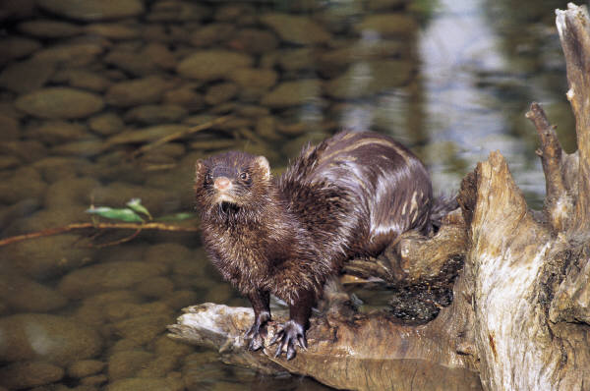
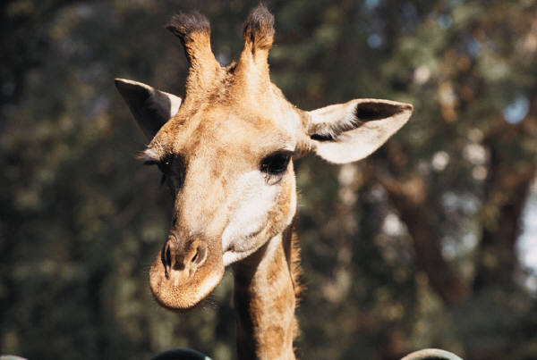
Use Species Biology!
You received both this giraffe and this mink on the same day, 15 July 1990. The paperwork says they were both approximately 3 years old.
What would you enter for their Birth Date?
Notes:
Sometimes you need to use your species biology to help you determine the Estimated Date options. You received both a giraffe and a mink on the same day. The paperwork said they were both estimated to be three years old at the time.

Slide 23
Think About It
The Date Field would be the same – 15 April 1990
But the Duration and UOM would be different
Barring medical issues, a 2 year-old mink looks similar to a 4 year-old mink
Use a variance of 1 year
However, a 2 year old giraffe looks quite different than a 4 year old giraffe.
You should reduce you variance, maybe to 3 months or so

Slide 24
Look closely at your entry:
-Did you document why and how?
-Does it make sense?
(Is every date included in the estimate field possible?)
-Did you watch out for overlap?
-Did you use species biology?

Slide 25
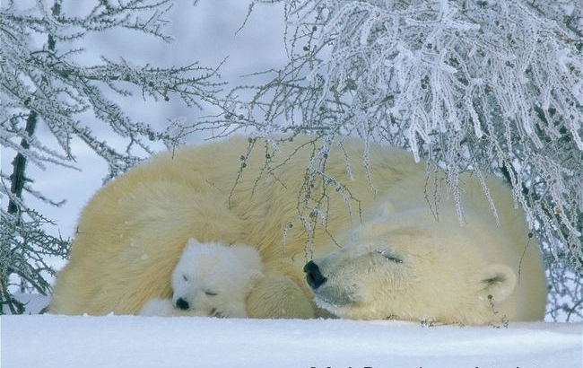
You den your female polar bear up on 1 November 2004. On 1 March 2005 you let her out of the den and with her is a cub. Your Curator says it looks to be about 3 months old, plus or minus a month. He will do further research but wants you to enter the birth date from that guess.
Approximate Variance
Date Field is 1 December 2004 (3 months ago)
Approximate Variance is 1 month (one month
before and one month after)
Dates covered are 1 November 2004 through
1 January 2005 (and they all make sense)
Range
Start Date = 1 November 2004 (when you denned her up)
End Date = 1 January 2005 (at least 2 months old)
Date Field = 1 December 2004
But I like Variance better

Slide 26
The polar bear keeper then
tells you they had heard “baby bear” sounds on 20 December 2004.
Variance
Date Field remains 1 December 2004 (3 months ago)
Approximate Variance is now 20 days
Dates covered are now 11 November 2004 through 20 December 2004 (and they all make sense)
Range
Start Date = 1 November 2004
End Date is now 20 December 2004 (baby bear sounds)
Date Field = 25 November 2004

Slide 27
In conversations with the polar bear
keeper you find out that successful
copulation was seen on 16 May 2004
and female polar bears have a receptive
period of only 3 days. He says the period
of gestation is 195 – 265 days due to
delayed implantation.
Use Range
Start Date is now 25 November 2004 (14 May +195 days)
End Date remains as 20 December 2004 (baby bear sounds)
Date Field is now 7 December 2004 (midpoint between
25 November and 20 December 2004)
Notes:
If receptive for only 3 days, the first breeding could actually have been on 14 May. Find 195 days past for shortest possible gestation and earliest birth date - 25 November 2004. It still could not have been born after the baby bear sounds on 20 Dec. Would you delete the original notes?

Slide 28
Veterinarian tells you they videotaped the birth on 15 December 2004.
(Now why didn’t they tell you that
in the first place???)
15 December 2004 is Date Field
NOTES: Birth Date originally recorded as 1 December 2004 with a Variance of one Month per Curator’s estimate of 2-4 months at time of release from den on 1 May 2005. Estimate later changed to Range from 1 Nov 2004 to 20 December 2004 due to baby bear sounds heard that day as per keeper. After considering gestation period(194-265) from an observed copulation on 16 May, Range changed to 25 Nov – 20 Dec. Actual Birth Date recorded with no Estimate when a video of the birth indicated the actual date.

Slide 29
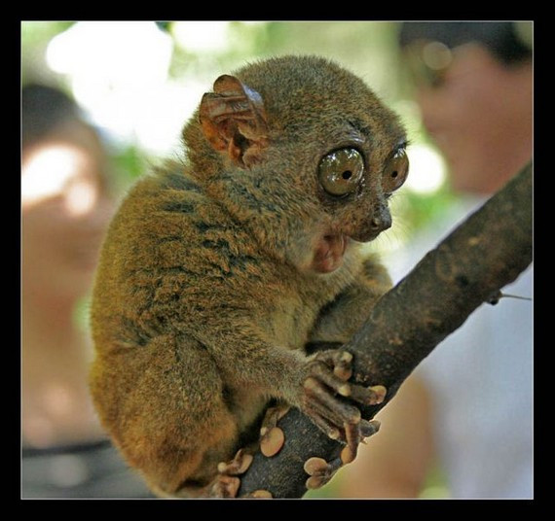
Any Questions?
Estimating Dates Can be Fun!!!

