Slide 1
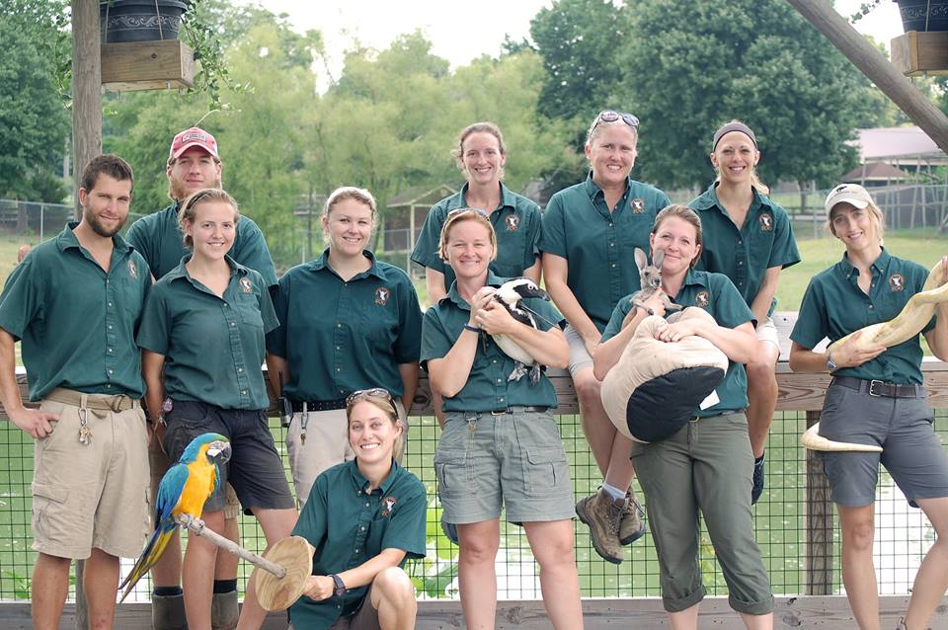
Staff and Roles in ZIMS
July 2020 TNT
Notes:
We have recently been getting a lot of questions about how to add Staff and create/assign Roles to them. The recent happenings in our world have meant that some Staff are temporarily or permanently gone and duties have fallen to other Staff that may not be trained. We thought a review of Best Practices and what happens if? regarding Staff and Roles would be timely.

Slide 2
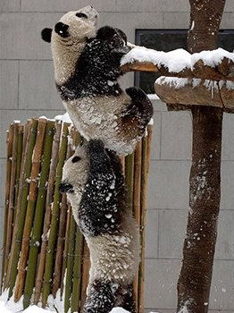
Local Admin
Each institution should have at least two
  One may just be trained in managing Staff and Roles
This ensures that data entry can continue even with Staff changes
  add Staff and assign Roles as things change
  of course unless they both are gone!
Notes:
When ZIMS first rolled out I used to recommend that each institution have at least two Staff members that were assigned the Local Admin Role. I have let that recommendation slip a bit. If there is only one and they get locked out for some reason you will have to wait for support to unlock them. Having two means the second Local Admin can unlock them without a wait.
It also ensures that data entry can continue because Staff and Roles can be managed as things change. That is of course, unless both the Local Admins are gone.

Slide 3
Procedures Document
Listserv chatter
How to contact Species360 for assistance
Institutional rules regarding what Staff is listed in ZIMS (and if they are Public Contacts)
Institutional rules regarding what Staff have ZIMS Roles and the access allowed to them
  These are important because Species360 is getting requests to add Staff and assign Roles (more on that later)
Notes:
Recently there has been a lot of exchanges on various Listservs about Procedures Documents. If detailed enough these can help other Staff members continue without a break in the animal records.
To help, this doc should include how to contact Species360 for assistance. It should also capture your institution’s rules regarding what Staff is entered into ZIMS and if they are marked as visible outside the institution. It should also cover any rules there are regarding what ZIMS access (Role) is allowed for which Staff. We are getting many requests to add Staff and assign Roles and we want to make sure we aren’t going against any institutional policies if we do so. I’ll talk more on that later in the presentation.

Slide 4
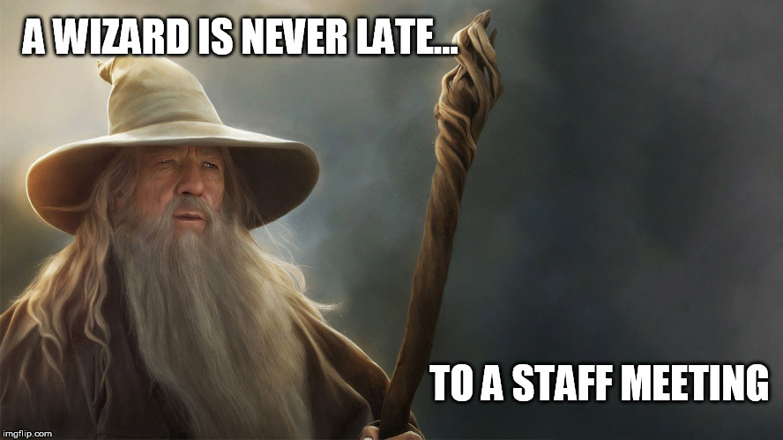
Staff in ZIMS
Notes:
First we’ll talk a bit about adding Staff members. And a wizard is never late for a Staff meeting!

Slide 5
Adding Staff
Email
  Important for receiving communications from Species360
  Must be confirmed before Staff can log in
  Notification if enclosures measurements out of your desired range
  Should be unique
    Help menu – staff email approval – Shared Emails
Job Type
  Get the correct communications!
  Institution Director, Species360 Invoice Recipient, Species360 Representative
Department Name
  Responsible Party
  Calendar Tasks
  Advanced Access Management
Team Name
  Responsible Party
  Calendar Tasks
Make User Visible Outside My Institution
  Next slide!
Notes:
There are only 4 mandatory fields in the Add New Staff screen – First and Last Name, Email and Job Type. It’s obvious why first and last name are mandatory but why Email and Job Type? Email is important so that you receive communications from Species360. It must be confirmed by the Staff member before they can log in to ZIMS. It is used for notifications should your environmental or water quality measurements be out of your desired range (could save an animal’s life!). These Emails should be unique and each Staff member should have their own. However, we know there are times when a group of people need to share an Email address. In the Help menu type in “staff email approval” and scroll down to Shared Emails. You will find instructions on how you can create shared Email accounts so they do not have to be unique. >The Job Type makes sure the right people get the right emails from Species360 and you are required to have at least one Staff member assigned to these Job Types. To make it easy they are at the top of the Job Type list. These are Director, Invoice Recipient and Representative. > Other not mandatory, but important fields include Departments. Departments can be assigned as Responsible Parties and given Calendar Tasks and this is also how AAM is assigned. > Teams can be assigned as Responsible Parties and given Calendar Tasks. If you do not have these created when you are adding new Staff they can be assigned later under Staff Details. > And there is a checkbox for Make User Visible Outside My Institution.

Slide 6
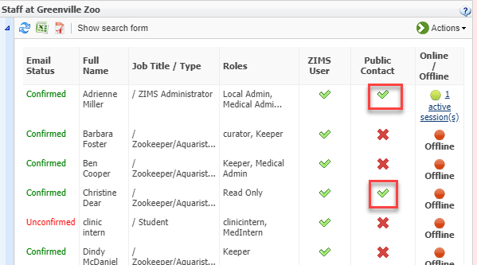
Public Contact
Add New Staff – Make User Visible Outside My Institution
Current Staff – edit under View/Edit Staff Details
View under Staff List Public Contact column
Notes:
When you are adding new Staff you have the option to check the Make User Visible Outside My Institution box. This will make them a Public Contact and colleagues at other institutions will be able to find and view them. Your institutional policies may determine who is marked as a Public Contact Once the Staff member is added, this can be edited under View/Edit Staff Details. In the Staff list any Public Contacts will have a green checkmark in that column.

Slide 7
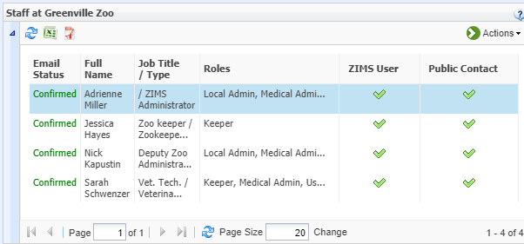
Viewing Public Contacts Way 1
Public Contacts appear in global staff grid
  View Communications Details
Notes:
There are two ways that you can view Public Contacts at other institutions. First, from the Staff grid of the other facility. Here I am another institution looking at the Staff grid for Greenville Zoo. Only those Staff marked as Visible Outside My Institution will display here. Selecting to View Communications Details will display the information recorded at the Staff member’s institution such as phone, fax, address and email. This is one reason why it is important for you to record as much information as possible for your Staff that are Public Contacts.

Slide 8
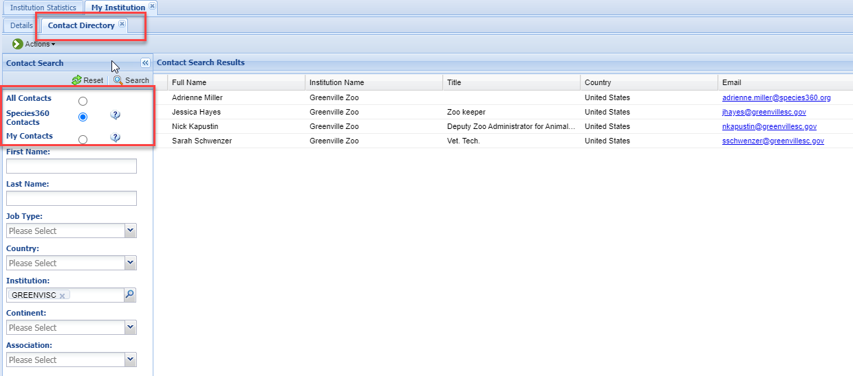
Viewing Public Contacts Way 2
You can also find Public Contacts from the Contact Directory under My Institution
  All Contacts – any contact in the list
  Species360 Contacts – maintained by institutions
  My Contacts – locally added
Notes:
You can also find Public Contacts from the Contact Directory under My Institution. All Contacts will find any contact in the list. Species360 Contacts are visible to all Species360 members and maintained by the institution which recorded the record. In other words, sourced from that Staff list we just saw. My Contacts are those added by your institution which are not part of your Staff list. For example, you could add a Landscaper that you use. You may have to add their company as a local institution because institution is a required field when you add a local contact. Contact Directory also allows you to find contacts by other filters such as Job Type and Country in addition to their name. Remember All Contacts and Species360 Contacts will look in your Staff list for Staff marked as Public Contacts.

Slide 9
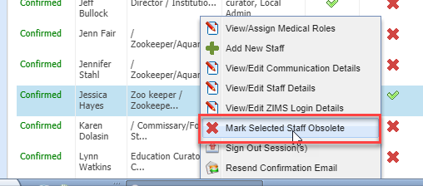
Removing Staff
A Staff member left, what now?
Mark as Obsolete – Actions > Mark Selected Staff Obsolete
  Cannot log into ZIMS
  Removed from active Staff list
  Can’t assign as a new Responsible Party
  No longer Visible Outside Institution (if so marked)
  Can’t be selected in DEM to view records
  Can’t be selected in Activity Report as Entered By
  Can’t be selected as a Responsible Party in Advanced Animal Search
Notes:
So how do you handle removing a Staff member from your Staff list after they leave your institution? You don’t actually delete or remove Staff members, you mark them as Obsolete by selecting their name > Actions > Mark Selected User as Obsolete. This means that they can no longer log in to ZIMS, they are removed from your active list, you cannot assign them as a new Responsible Party for an animal or enclosure record and they are no longer visible as a Public Contact outside of your institution. They also cannot be selected in Data Entry monitoring to view their records, Activity Report cannot be filtered by their name as Entered By and they cannot be searched in Animal Advanced Search as a Responsible Party. We feel the ones in black are correct behavior but we are working to make the ones in blue actionable mainly for historical records searches.

Slide 10
Workaround Option For Now
Meanwhile, an option
  Remove their ZIMS Role (s)
  Uncheck Visible Outside My Institution in Staff Details
  They will not be able to log in to ZIMS and they will not be visible as a Public Contact outside your institution
  But you will be able to search for them in DEM, Animal Advanced Search and Activity Report
Notes:
Meanwhile there is a workaround if you need to be able to search for them in DEM or Animal Advanced search or filter Activity Report by them. Simple remove any ZIMS Roles that have been assigned to them. Then go into Staff Details and uncheck the Make User Visible Outside My Institution checkbox. They will not be able to log in to ZIMS. They will no longer be visible outside your institution, but you will be able to search for them in DEM, Animal Advanced Search and Activity Report.

Slide 11
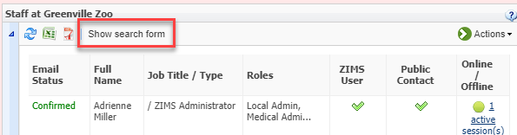
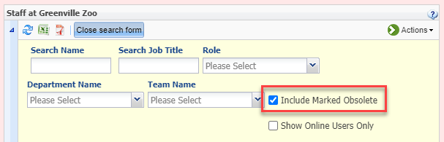
Making Obsolete Active Again
Open the Search Form
Check Include Marked Obsolete box
Notes:
It is easy to make Staff marked as Obsolete active again. Select the Show search form and check the Include Marked Obsolete checkbox.

Slide 12
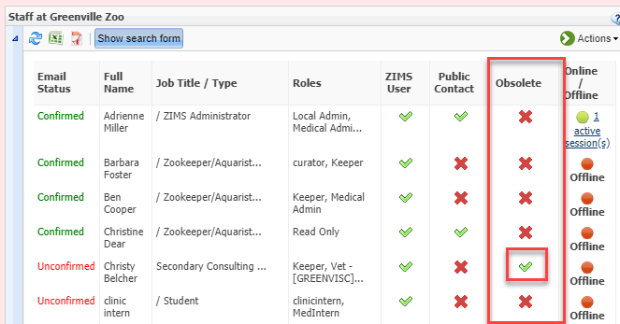
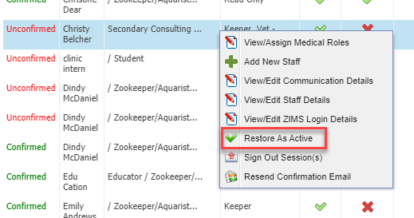
Making Obsolete Active Again
Obsolete column
Highlight and select Restore to Active
Notes:
An Obsolete column will now display. A green checkmark indicates an Obsolete record. Highlight the record and select Restore as Active. The Staff member will re-appear in the active list, they will be able to log in to ZIMS again and enter data as their Role permits. If checked as Visible Outside My Institution they will be found as a Public Contact.

Slide 13
What if I Entered Them Wrong or as a Duplicate?
Edit the Staff Details/Communication/Roles (Login Details) as needed
If a Duplicate or cannot correct by editing and no Role has been assigned, Roll Back the Staff addition in Data Entry Monitor
If a Role has been assigned, even if no data has been recorded, you cannot Roll Back
  Mark as Obsolete
Notes:
What can you do if you entered the Staff incorrectly or duplicated a Staff member? Try to correct by editing their Staff or Communications details. If a Role has been assigned, edit that screen as needed. If you cannot edit to correct or the Staff was entered as a duplicate, and no ZIMS Role has been assigned, you can Roll Back the Staff entry using Data Entry Monitor. However, if a Role has been assigned, even if no data has been entered by the Staff member, you cannot Roll Back the entry, even if you Roll Back the Role assignment. You will need to mark them as Obsolete.

Slide 14
Support Adding Staff
When someone contacts us to add/edit their Staff
  We ALWAYS refer them back to the Local Admins at their institution.
  If that person left, is laid off or furloughed we:
    Look in ZIMS to see who the director is.
    Let you know that we will need to clear it with the director first, then we contact the director ourselves.
    If there is just no one available to verify, the request will go Elisabeth Hunt to process.
  If it is an emergency, we may call you directly.
Once we confirm the person is OK to add/edit, please provide us with all necessary information
  Full Name
  Job Type
  Job Title
  Email
  Phone Number
Notes:
Sometimes there is just no one at your institution that can add or edit Staff. You can contact support in this situation. First we will make sure that their Local Admin is no longer available. If that is confirmed we check ZIMS to see who the Director is and we contact them for approval. If we cannot get verification the request is passed along to Elisabeth to process. If you have let us know it is an emergency we will contact you directly
>If we do receive confirmation from the Director and we can proceed, please provide complete information on the Staff person. We need full name, job type, job title and a correct email address. Any other additional information such as Supervisor Name, Teams and Departments they are members of and phone numbers can help us create a more complete record.
Are there any questions on Staff in ZIMS?

Slide 15

Rolls in ZIMS
Notes:
As you know, once you create a Staff member, if you want them to have access to view or record data you must give them a Role. Hopefully one of the Species360 Template Roles will work for you. If not, you can create custom Roles

Slide 16
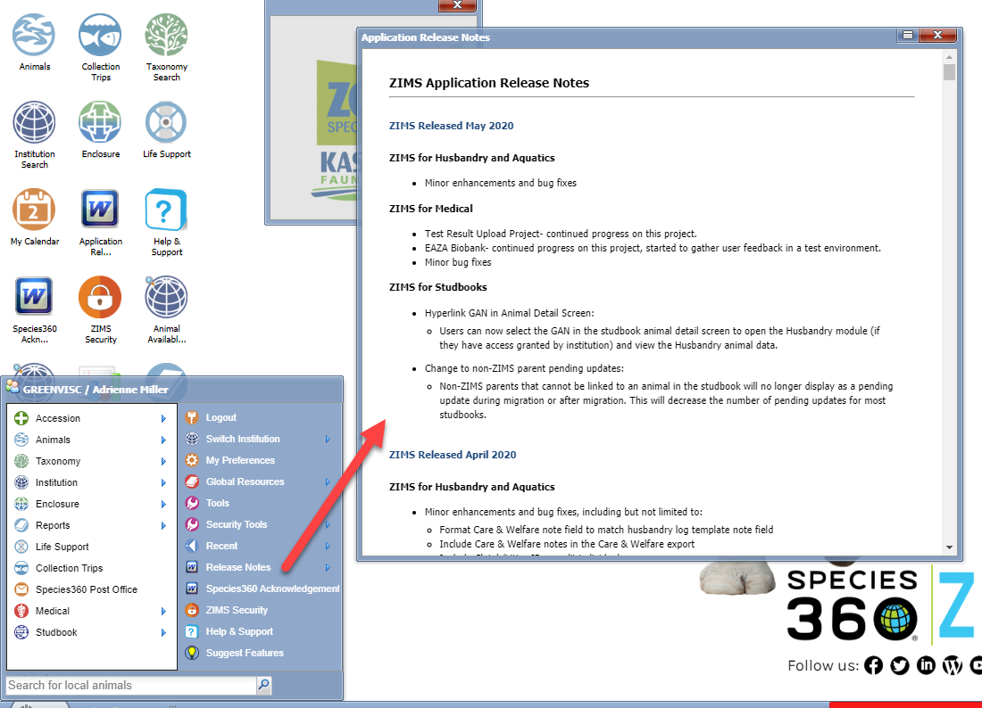
Release Notes
Notes:
The best way to keep updated with new functionality is to read the Release Notes available under the Start menu. These are monthly updates on the projects we have been working on and some may have impact on ZIMS Roles. These notes are updated mid-month of the following month, so June should be updated now as it is mid-July.

Slide 17
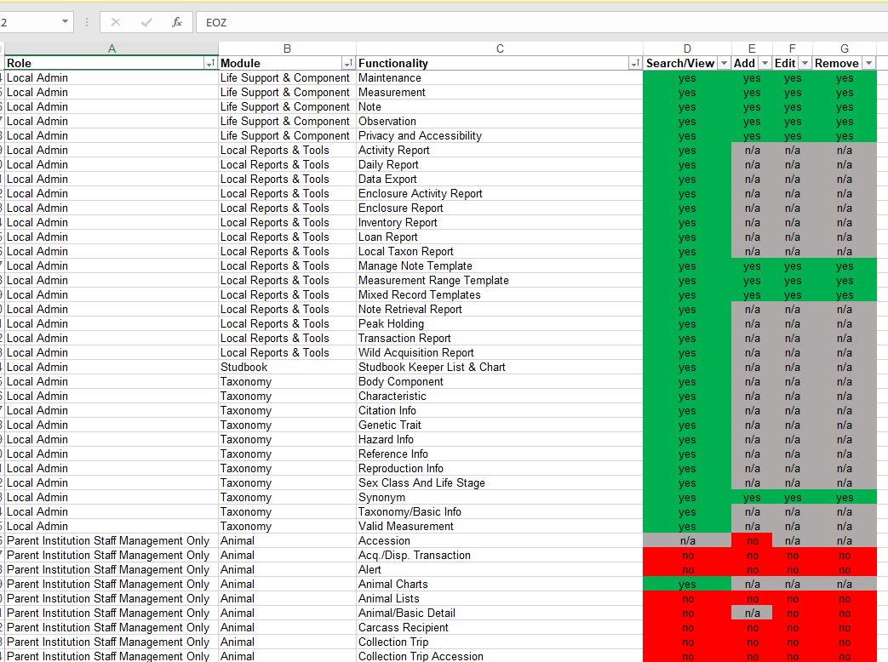

Global Role Access
Help Menu - Global Template ZIMS Roles
Notes:
To view what access each Role has you can highlight the Role in the list and select Manage Role Access from the Actions menu. In addition, you can use the Help menu to find an excel document that lists all the Species360 Roles and their access. Type Global Template Roles in the search box. The document has tabs for Husbandry, Medical and Provisional Roles.

Slide 18

Species360 versus Custom Role?
Species360 Template
  Pro – automatically updated with new functionality
  Con – automatically updated with new functionality
Custom Role
  Pro – as you like it!
  Con – must remember to update with new functionality
Notes:
There are some pros and cons for both Species360 Template Roles and custom Roles. A pro of the Species360 Roles is that they are automatically updated when new functionality is deployed. A con is that they are automatically updated with new functionality but you may not agree with our assignments and we may give a Role some access that you did not wish it to have.
A pro of Custom Roles is that you can create them as you want them. A con is that they will need to be updated as you desire if new functionality comes out.

Slide 19
Creating a Custom Role
From Template
  Species360 or existing custom Role
  Selected Role access will be copied in to new Role
  Pro – saves time!
  Con – may have access you overlooked
From Scratch
  Pro – you know what you selected
  Con – takes more time
Notes:
When creating a custom Role you have two options. You can use a current Role as a Template. This can be a Species360 Role or an existing custom Role. The Role access will be copied in to the new Role. A pro of using a template is that it saves time. A con is that it may have access you overlooked.
A pro of creating the custom role from scratch is that you know exactly what access you selected for it. A con is that it takes more time to create.

Slide 20

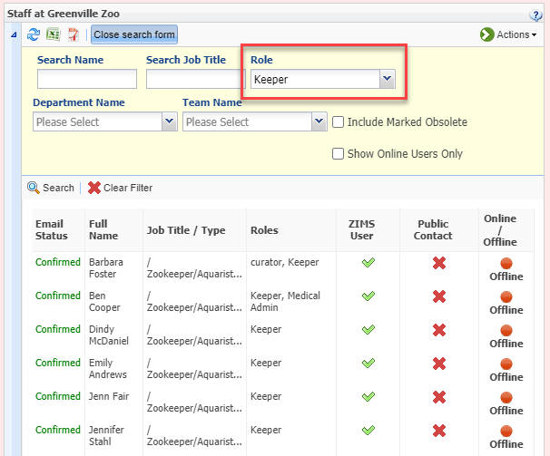
Who Has This Role?
Go to Staff grid
  Show Search Form > Role
Notes:
It’s easy to find who has been assigned a specific Role. You don’t do this from the Role grid but instead from the Staff grid. Open the Search Form at the top and enter the desired Role in the Role box. This is a single select dropdown so you can’t find who has this Role AND this other Role. Once you select Search the list below will fill with those Staff that have that Role assigned. To get back to the full active list select to Clear Filter.

Slide 21
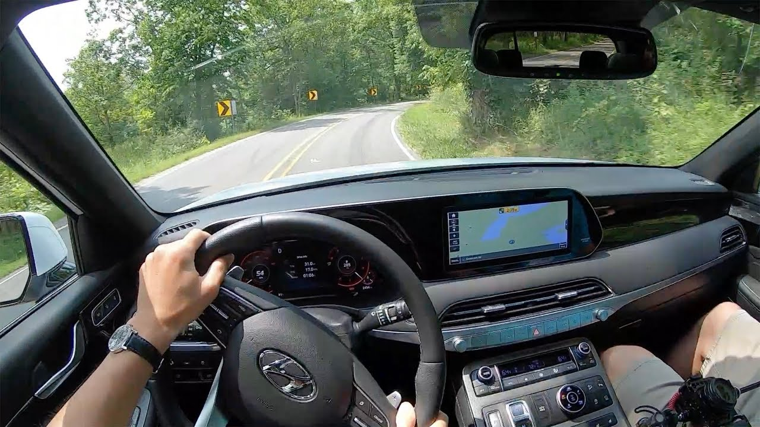
Assigning Multiple Roles?
Assign Roles with the most access
  Assigning a “lower” Role not needed
One Husbandry and one Medical Role
Provisional and “full” access
  Create a single Role
For custom Roles – take them for a test drive
Notes:
It is recommended NOT to assign multiple Roles as it can cause issues with having the correct permissions. The “higher” access will override the “lower” access. Say you have two Roles assigned, one that allows you to Add/Edit/Delete Identifiers and one that only allows View/Search access for Identifiers. The Add/Edit/Remove by default will also have View/Search access, so the second Role is unnecessary. Multiple Roles can also be a challenge for support when they are trying to figure out an issue that may be Role related.
In a perfect world each User would have one Husbandry Role and one Medical Role (if appropriate).
If there are Users that you want to give mostly Provisional data access to but also some full access, such as recording Notes that do not need to be approved, create a custom Role to cover that, do not assign a Provisional Role and a full Role. It’s too easy to get confused with what access they actually have.
If you do create custom Roles, sign in as someone assigned them to test that they do/do not have the correct access.

Slide 22
Review of Studbook Roles
Regional Associations assign the actual Studbook Role to the Studbook Keeper
  Local Admins cannot do this and if asked should refer the asker to their RA
Local Admins do need to
  Create the Studbook Keeper as a ZIMS Staff member
  Assign Husbandry Roles
    Studbook Keeper
    Population Manager – more robust Role
Help menu – Studbook Local Admin Responsibilities
Notes:
Since the ZIMS Studbook module rolled out there have been questions about how Studbook Keepers get access to their studbooks and the option to see studbook animals in the Husbandry module. Regional Associations are responsible for assigning the actual Studbook Role. Your Local Admins cannot do that and if asked should refer the asker to the RA.
However, the Local Admin does need to get the Studbook Keeper added as a Staff member BEFORE the RA tries to assign a studbook to them. In addition, for the best studbook experience they should be assigned a Role in the Husbandry module. There are two Species360 Template Roles that provide this access. Studbook Keeper Role provides minimal access so we recommend the Population Manager Role be assigned to Studbook Keepers.
For more details on what your Local Admin can and cannot do regarding Studbooks, check out the Studbook Local Admin doc in the Help menu.

Slide 23
Staff and Roles in ZIMS
Any Questions?

