Slide 1
Staying together while staying apart
…and more!

Slide 2
Staying together while staying apart
Zoom, Skype, Messenger, Hangouts, Facetime, Slack, Teams, WhatsApp, Blue Jeans…phone calls even!

Slide 3
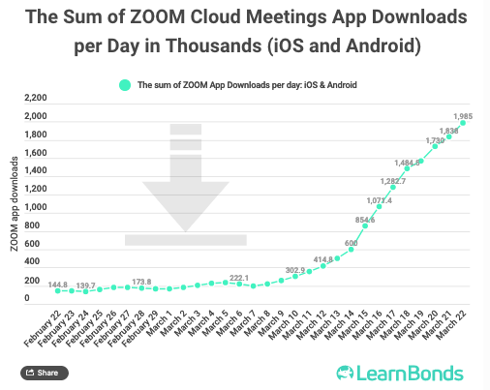
Staying together while staying apart
Securing Zoom
Online classes and meeting + unsecure practices
Zoom is responding
Check your settings! https://zoom.us/profile/setting
Zoom Bombing is “a thing”

Slide 4
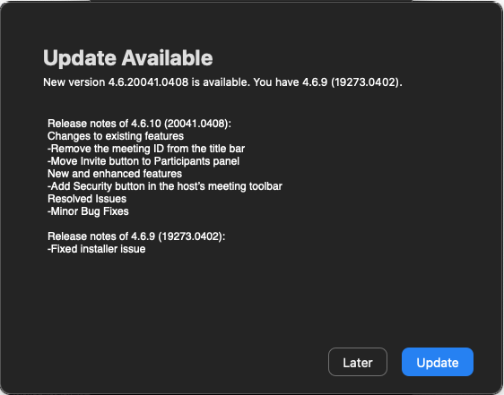
Staying together while staying apart
Securing Zoom
Check your settings! https://zoom.us/profile/setting
Password-Protected Meetings
Join Before Host Disabled
Lock Meeting/Remove Participants
Secure your recordings
Install updates!

Slide 5
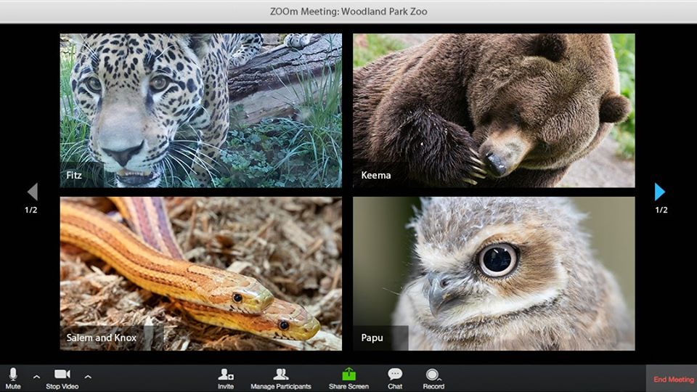
Staying together while staying apart
Checking in
We are social animals!
Photo credit: Woodland Park Zoo

Slide 6
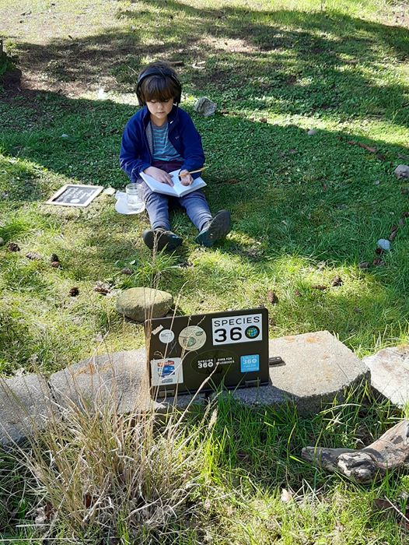
Staying together while staying apart
Checking in – school!
“We finally figured out what Z stands for in Gen Z”
Be flexible!
Be present!
Be responsive!
https://zoom.us/docs/en-us/covid19.html
https://www.khanacademy.org/
Photo credit: Sam Courteau

Slide 7
Staying together while staying apart
Checking in – work!
One of my favorites so far was we were in the product development department team meeting and Doug said he would go through the agenda and then have a time at the end for question and answer. When we got to the end, Laura raised her hand and mentioned her daughter had a question to ask. Doug asked her what her question was, and it was, “Did you hear the loud thunder last night?”
Photo credit: Sp360 HAQ Team

Slide 8
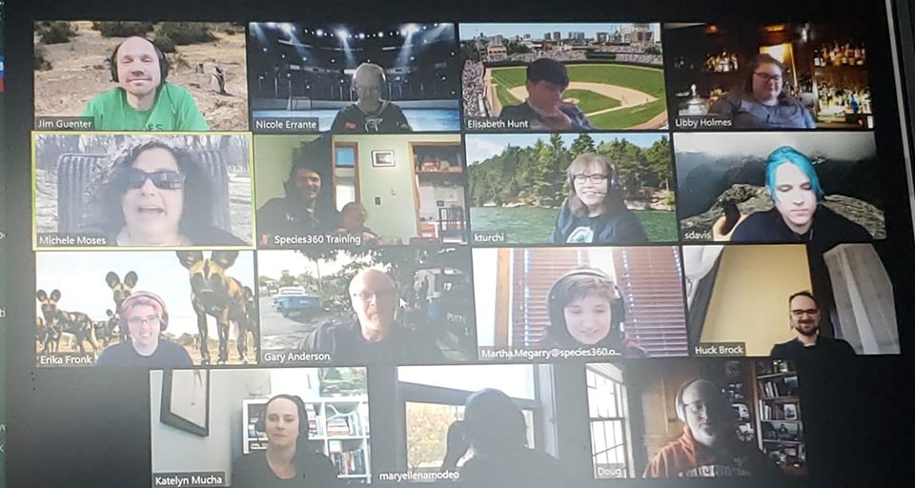
Staying together while staying apart
Checking in – fun!
NetflixParty! - Online Gaming – Lichess.org – Happy Hours
Photo credit: Sp360 Happy Hour

Slide 9
Staying together while staying apart
Checking in – fun!
Virtual Tours (with virtual backgrounds)

Slide 10
Staying together while staying apart
Disconnecting
Especially when our work is our life and our lives are quarantined
Try meditation – https://www.headspace.com/ny
Try yoga
Journal
Garden
Walk in nature
Make space for each other (not just physically – emotionally)

Slide 11
Staying together while staying apart
Aquariums and Zoos Online!
AZA Calendar: https://www.aza.org/livestreams-and-activities
WAZA Education Resource: https://www.waza.org/blog/zoo-and-aquarium-educational-resources/
EAZA ‘Corona virus Forum’ (see EAZA intranet) https://eaza.sharepoint.com/sites/member/
Zoos are livestreaming and creating unique interactive content! https://facebook.com/houstonzoo/ | #PhillyZooAt2 Facebook Live https://facebook.com/cincinnatizoo | #dublinzoofun activity series https://phoenixzoo.org/digital-safari/ | SDZG #WereHereTogether https://tulsazoo.org/kids/ | https://zoobeauval.com/ outils pedagogiques

Slide 12
Staying together while staying apart
Aquariums and Zoos will be back!
Research shows that demand for cultural organizations is being redistributed toward some types of entities and away from others. For instance, likelihood to revisit entities that involve minimal movement in smaller spaces – such as symphonies – has decreased, as has the near-term likelihood to visit touch-based entities such as science centers. On the other hand, the likelihood to revisit larger and (particularly outdoor) spaces – such as gardens and zoos – has increased. Colleendilen.com - Apriil 2020 https://tinyurl.com/to523t2

Slide 13
Staying together while staying apart
Additional ideas?
What’s been most surprising for you in this new remote way of living?
What will you do first when ‘normal’ returns?

