Slide 1
Disaster Preparedness
Tips and Tricks
April 2020
Notes:
Welcome to the April Tips and Tricks. We thought it was timely to share some ideas regarding disaster preparedness. Dorothy wasn’t really prepared for a disaster, although hers was a dream.

Slide 2
Notes:
You may feel like the timing for this session is like closing the barn door after the horse has bolted. When I started at Audubon Zoo in 2005 my first main project was to create a Disaster Preparedness Plan for the records department. One month later I hadn’t gotten to it and then Hurricane Katrina paid a visit and we weren’t prepared. I finally did create one and it was much better than it would have been if I had not actually experienced the disaster that the hurricane brought. So Yes, the horse has bolted, but let’s make sure he doesn’t do it again once we catch him!

Slide 3
Notes:
Although a disaster himself, The Terminator was always prepared for one!

Slide 4
Disaster Preparedness
Notes:
As much as we love him, do not take Snoopy’s disaster preparedness approach. Read slide.

Slide 5
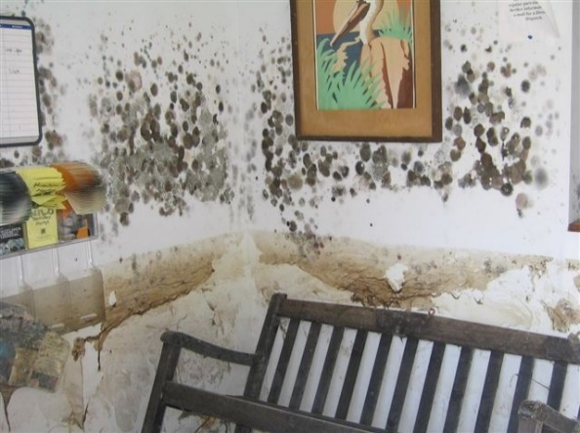
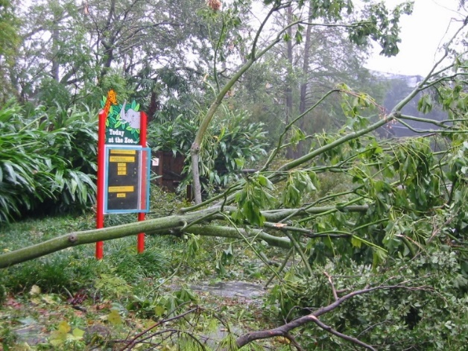
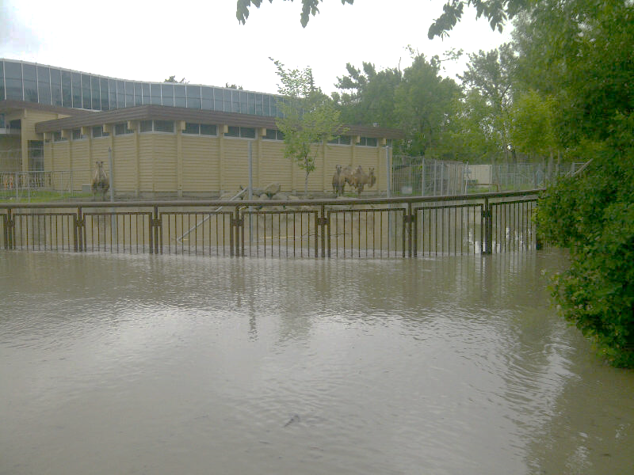
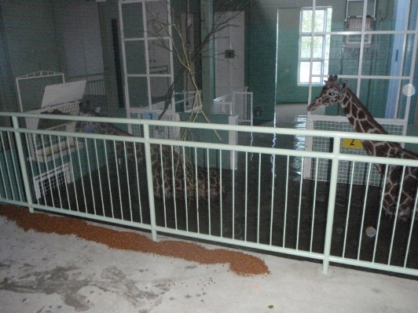
Disasters Come in Many Forms
Weather
Hurricane
Tornado
Flood
Earthquake
Blizzards
Notes:
Disasters are often weather related. Hurricanes you need to be prepared for when you are near the coast. You usually get some warning prior but they do not always follow the modules provided. The top photos are from the Audubon Nature Institute and Audubon Zoo after Hurricane Katrina in 2005. Tornados now can appear anywhere. I grew up in Kansas (Tornado Alley) and we spent our early evenings watching the sky. At that time tornados outside of the Midwest were almost unheard of but that has changed. You get very little warning for a tornado. Floods can be on their own or as a result of a Hurricane. New Orleans made out fairly well from Hurricane Katrina, it was the resulting floods that crippled the city. The Calgary Zoo had extensive flood damage in 2013 from torrential rains. The photos below are from Calgary. You may get a bit of warning about possible flooding but flash floods give little. Earthquakes can happen anywhere but some regions are more prone. Like tornados, you get little prior warning for earthquakes and the subsequent after shocks can cause more damage then the initial quake. Blizzards usually give you some warning but often areas are caught off guard. You need to be aware of what potential weather disasters could head your way.

Slide 6
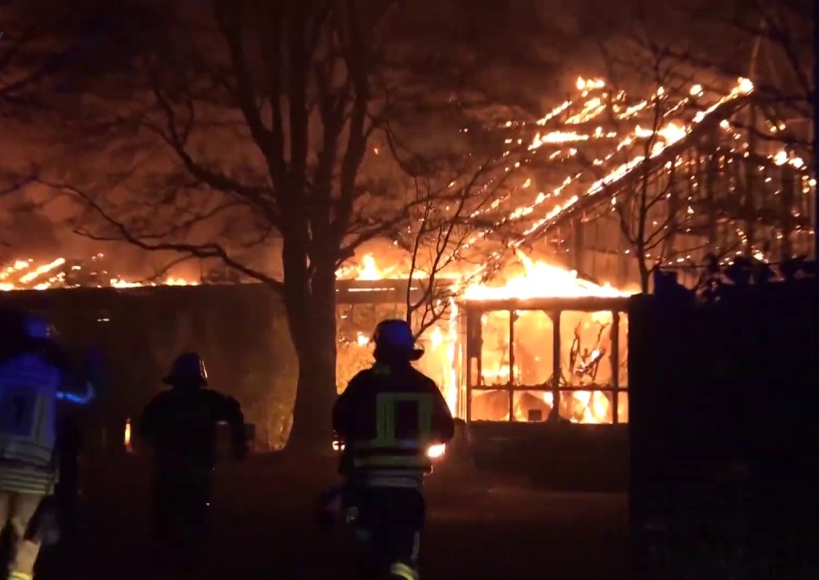
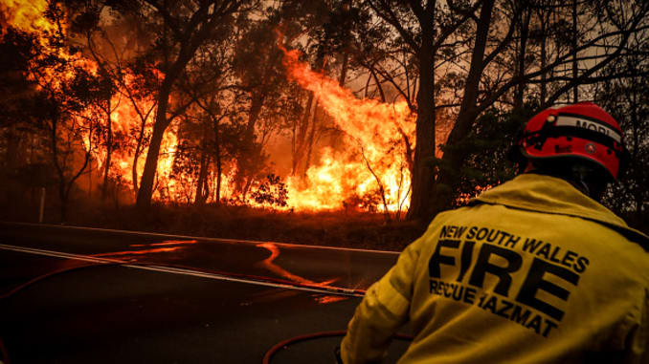
Disasters
Fire
External
Internal
Notes:
Fires can come from external sources such as the extreme bush fires recently seen in Australia and the California blazes. You usually get some warning these may affect your facility. Fires caused by Internal factors such as faulty electricity however give no warning.

Slide 7
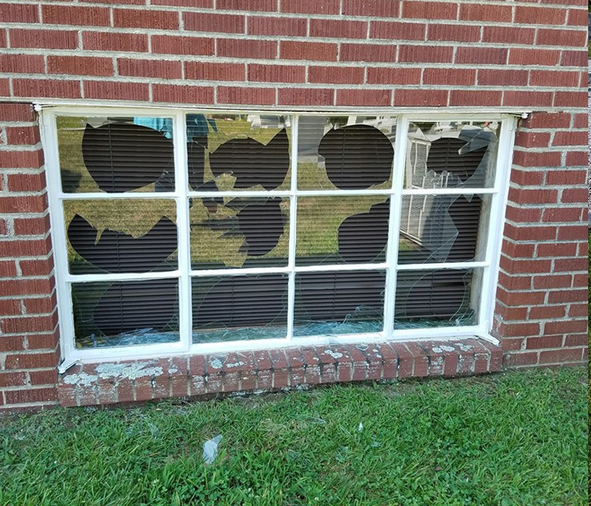
Disasters
People oriented
Vandalism
Physical & Computer
Terrorism
Irate employees
Notes:
Unfortunately we have to consider disasters that are actually caused by people. There can be vandalism to property and computer vandalism and viruses. Irate employees my cause damage. And an act of terrorism may happen

Slide 8
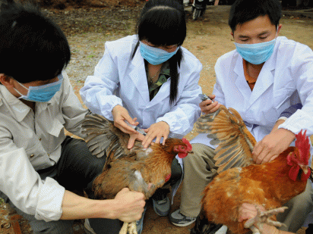
Disasters
Medical
Disease outbreak – human
Disease outbreak - animal
Notes:
And of course disasters can be medical for humans or animals or both. We are all dealing with our current situation with the COVID-19 virus. Recorded human pandemics have gone back to the year 165 AD with the Antonine Plague, often thought to be smallpox or measles. You can prepare for these disasters but you also must follow guidelines given at the time that may impact and possibly override your careful planning.

Slide 9
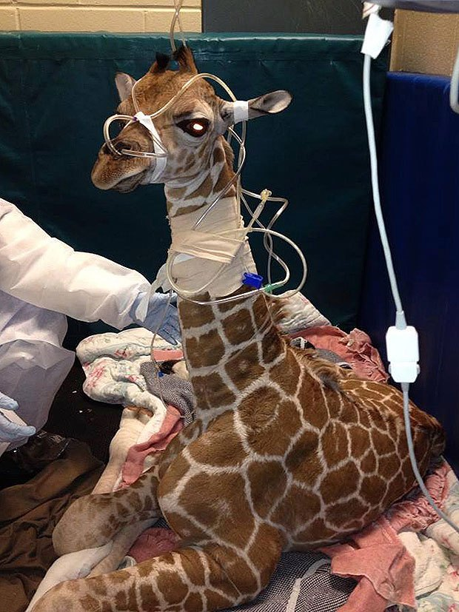
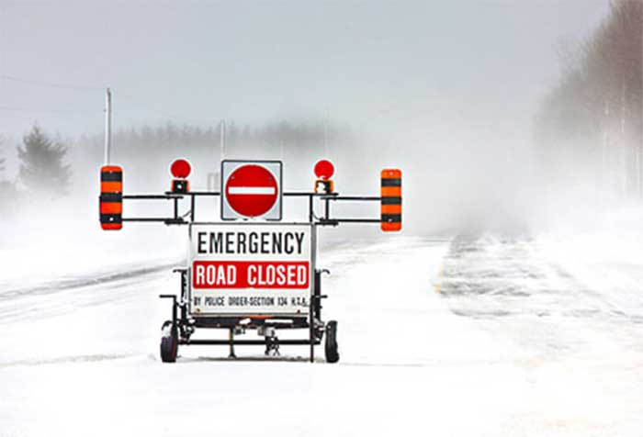
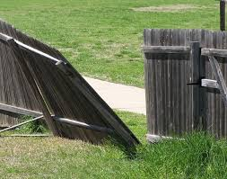
What is the Direct Impact?
Physical Facilities
Building Damage
Enclosure/Exhibit Damage
Animal Collection
Escape
Disease
Injury/Death
Staffing
Ability to get to institution
Disease
Safety
Everything!
Notes:
You need to define what will actually be impacted. Is there potential for building and exhibit damage? Will your animal collection be at risk? Could that facility damage lead to escape , injury or death? How will your staffing be impacted? Will they even be able to get to or leave work? Should they even be at work? Will your staff, animals and facilities all be impacted?

Slide 10
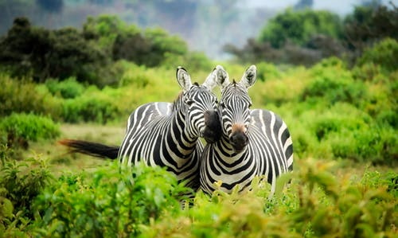
Animal Records Procedures Document
Define what is normal
Can help with time management
You review how you do things
May find better processes to save time, duplication of effort and makes sure the ball doesn’t get dropped
Reference for those remaining
Notes:
I think that the first step in creating a Disaster Preparedness Plan is to step back and define what is normal first. You can do this by creating an Animal Records Procedure Document if you don’t have one already. This might help you remember to capture all the procedures/responsibilities that should be captured in a Disaster Plan.
Creating this document will also help you review your procedures. If looked at with a critical eye you may be able to streamline things to save time and reduce duplication of effort.
This document will be an important reference for those remaining at the facility if you can’t get to work, have evacuated or required to work from home as so many of us currently are.

Slide 11
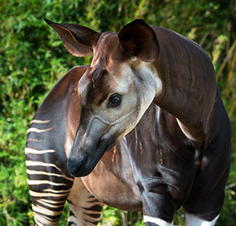
Animal Records Procedures Document
How information is stored
Hard copy
Electronic
Where information is stored
What office and filing space
Electronic folders
Make sure it is available
Hard copy or shared drive
Notes:
This document should include what is stored as hard copies and what is stored electronically. In addition, it should let others know where the documents are stored. For example, original hard copy permits are in the left hand file cabinet, third drawer of the Bird Curator’s office. Scanned transaction forms are filed on the shared Google drive > My Institution > Transaction folder. Upcoming transaction documents are in the Registrars office, red bin on desk. This document should be available to all. Don’t create it and have no one able to access it. A few hard copies for reference would be good in case the internet is not available. And electronically it should be stored where others can easily find it.

Slide 12
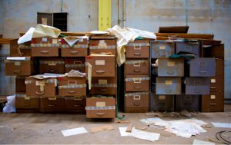
Disaster Preparedness Plan
Can be a part of the Animal Procedures Document
Can be a stand alone document
Accessible to all who may need it
Notes:
Your Disaster Plan can be a part of your Animal Procedures Document or it can be a more detailed stand alone document depending on your needs. The main thing is, like the Procedures doc, it is available to all who need it. Would recommend at least one hard copy in case the disaster has wiped out your computer access.

Slide 13
Create the Plan When Calm
Notes:
One important thing I learned, create this plan when you are not in panic mode. Write it when you are calm and quiet and can think clearly. I learned from Hurricane Katrina that your brain off shuts off in moments of panic. We finally decided to evacuate the day before the hurricane hit. This was a new experience for us as we looked around the house trying to decide what to take and what to leave. We left with our dogs, their food, beds and toys. We left behind our computers. Well we did have the truly important things but we could do no work until my husband snuck back into New Orleans a couple weeks later and retrieved them along with tarping the roof.

Slide 14
Define Roles
Role of the Registrar/Records Keeper
Ensure the safety of the animal records
Ensure all individuals are physically identifiable and the staff knows their location
Ensure that records can continue to be kept
Ensure that emergency transactions can be tracked
Ensure that normal procedures can resume ASAP
Notes:
The document should clearly define the roles all staff will play in the disaster. We will focus on the role of the registrar/records keeper here. Their role will vary by institution. For example, during hurricanes, in some institutions the Registrar was part of the ride out crew. As the Registrar at Audubon Zoo however, I was part of the run away crew. Regardless if you stay or go there are some things that you should address. First you need to assure the safety of the animal records. This could be both paper and electronic. Make sure that all animals are physically identifiable, a House Name isn’t good enough. More on that later. And the staff needs to know where everyone is supposed to be. Try to assure that records can continue to be kept until the disaster is over. Provide a way to track any emergency animal transfers. And finally, once the disaster is over they need to help with resuming normal procedures as soon as possible.

Slide 15
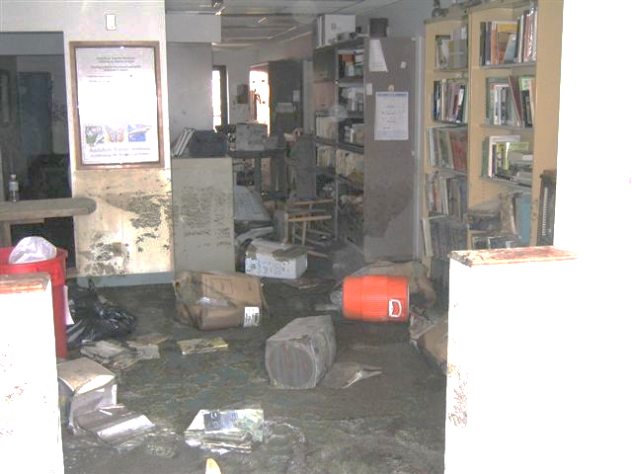
Safety of the Animal Records
Identify vital/critical hardcopy Records
Make provisions for their protection
Outline preventative measures to minimize risk to these vital records
Fire, waterproof cabinets
Scanning, electronic saving
Provide recovery plan to
restore damaged records
Notes:
You need to identify vital and critical hardcopy records. These are often permits, loan and transaction agreements. And photographs are irreplaceable. Define what preventative measures are taken to minimize risk to these records. Fire proof cabinets are really fire resistant but better than standard cabinets for vital records. You may want to scan or electronically save these. Think about how you can recover damaged hardcopy records. For water damage there are water damage restoration companies. If you can’t get one in right away try to reduce the temperature and humidity and increase the circulation in the storage area. You can also place the records in a freezer. Do not open or clean the records first. Some records may have fire AND water damage. Water damage can lead to microbial growth, so address the situation as soon as possible. This picture was the offices in the Audubon Nature Center after Hurricane Katrina.

Slide 16
Safety of the Animal Records
Identify vital/critical electronic Records
Back them up
Best case is auto-backups
ZIMS takes care of the animal database records!
Hosted at a secure, offsite facility
Daily backups at multiple physical locations
Notes:
You also need to identify critical/vital electronic records. If you need to, back them up, but the best option is automatic backups so you don’t need to worry about this. ZIMS is hosted at a secure off-site facility and backed up daily to multiple locations. ZIMS takes care of the database for you!

Slide 17
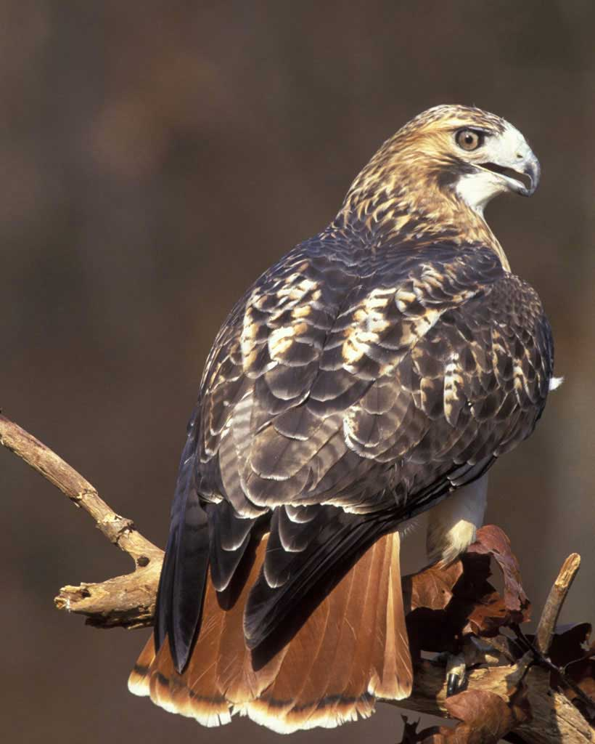
Animals are Physically Identified
Physical Identifiers are a must!
Notes:
All animals should be physically identifiable. A logical identifier is not enough. An example, before Hurricane Katrina hit all the animals at the Nature Center went to the zoo. This was a good thing because the Nature Center was destroyed. After the hurricane many of these animals went to other institutions for temporary holding. One of these was a red-tailed hawk identified only by a House Name. Soon after the hawk was returned to the zoo it was noted that it had a leg band. The Nature Center staff said the hawk never had a leg band and the temporary holding institution insisted they never put one on. Did we get the right bird back? Physical IDs, and actually checking them, are important to help your own staff too. We had a pair of sibling cheetahs that were constantly confused for years, even after one died, because everyone insisted on using their House Names and no one ever bothered to check their tattoos for accuracy. And during a disaster there may be staff caring for animals they have never cared for before. They don’t know who Suzy versus Wanda is. Using the image available in ZIMS can help with this tremendously.

Slide 18
Ensure that records can continue to be kept and transactions tracked
If you cannot actually be at your facility, make sure staff has access to ZIMS
You may need to remove IP restrictions to allow for you or other staff to work off site
Provide the means to keep records
You may need to add ZIMS access to new staff
Provide the means to track transactions
Make sure any upcoming transaction paperwork is available so, if possible, they can continue
Make sure remaining staff has access to requirements for possible unplanned transactions
A list of government agencies and contacts and nearby institutions and contacts
Possibly give ZIMS access to a Registrar at another facility
Always be on good terms with your agencies!
Notes:
You need to try to make sure that records can continue to be tracked during the disaster. If you cannot be at the facility you may need to remove IP restrictions temporarily. You may need to give additional staff ZIMS access so they can maintain minimal records.
If planned transactions can continue make sure staff knows where the paperwork/files are. Make sure they know where to find required information to legally complete any unplanned transactions. A list of government agencies and contacts, as well as a list of nearby facilities and contacts is helpful. You may also consider giving access to your records to another Registrar outside the disaster zone should you anticipate losing internet access. And this last bullet should be something you think about always – be on good terms with your agencies! After Katrina we had to transfer our 3 sea lions twice without prior notification to NMFS. We caught up when we were back to work, but our prior good rapport with them helped us out considerably.

Slide 19
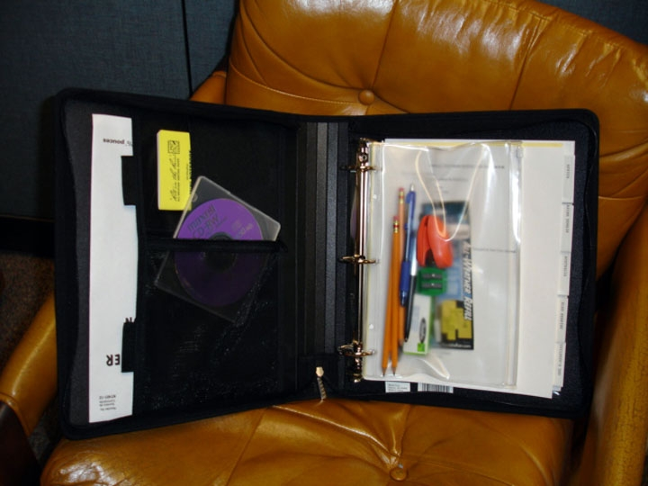
Hurricane Notebook
Shipping labels
Daily report forms
Copies of permits
Office supplies
Blank Transaction forms
Current inventory by enclosure
Rite in the Rain paper and pencils
Documents and policies on disk
List of nearby records and government contacts
Notes:
At Audubon I did a lot of this via a Hurricane notebook that was given to the ride out crew. To me one of the most important documents was the current Enclosure inventory by Occupants that provided a starting point should they need to find out exactly where animals were before the hurricane when they tried to locate them afterward. it contained ….Read Slide.

Slide 20
Resume normal procedures
Gather any documents completed by the staff remaining at the facility
Know where all your animals are
At your facility
At another facility
Deal with legal issues involved for any animals transferred
Connect with whoever you gave ZIMS access to
Notes:
Get back to normal as soon as possible. If you were out of the office, gather any documents created by others. You should double check that your animals are all located either at your facility or at another facility. Running an Enclosure Occupants for your institution sorted by enclosure is a quick way to do this for the animals physically in your care. If any were moved without appropriate documentation, catch up with that. If you did give ZIMS access you should connect with that person for any updates and remove their access.

Slide 21
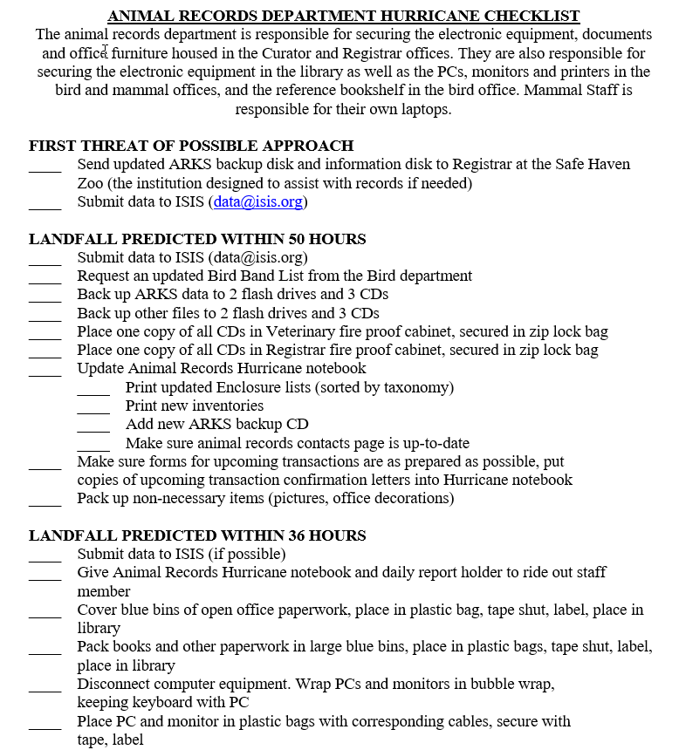
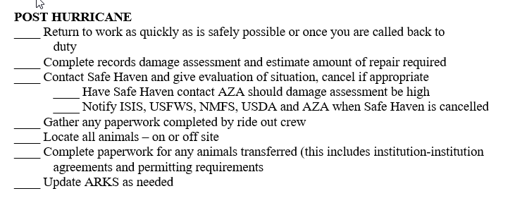
Checklists
Notes:
One easy way to make sure you are following all your guidelines for preparation is to create checklists. These help you as well as other staff who may be filling in for you. This is the checklist I made after Hurricane Katrina (after the horse bolted). The responsibilities of the record department is defined at the top. Because this was a hurricane checklist I divided it up by hours until expected landfall. This approach works well for disasters that you can see coming. This checklist was back in the day when you had to submit data to ISIS (Species360). ZIMS takes that need away! Part of this list was a post hurricane checklist. For any disaster a post occurrence checklist helps take some of the thought process out of a time when your brain still may not be functioning at 100%.
Now is actually a good time for you to come up with a post-COVID-19 checklist to make sure that as we slowly get back to the new normal you don’t forget to do something.

Slide 22
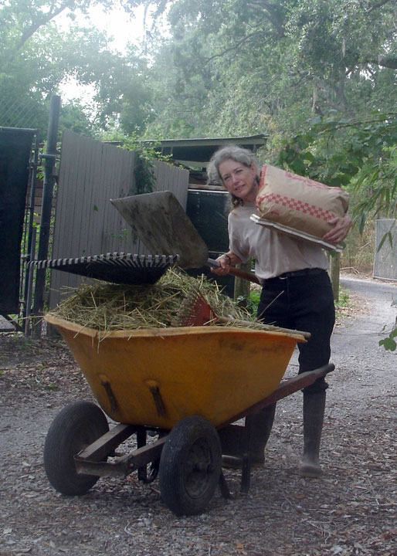
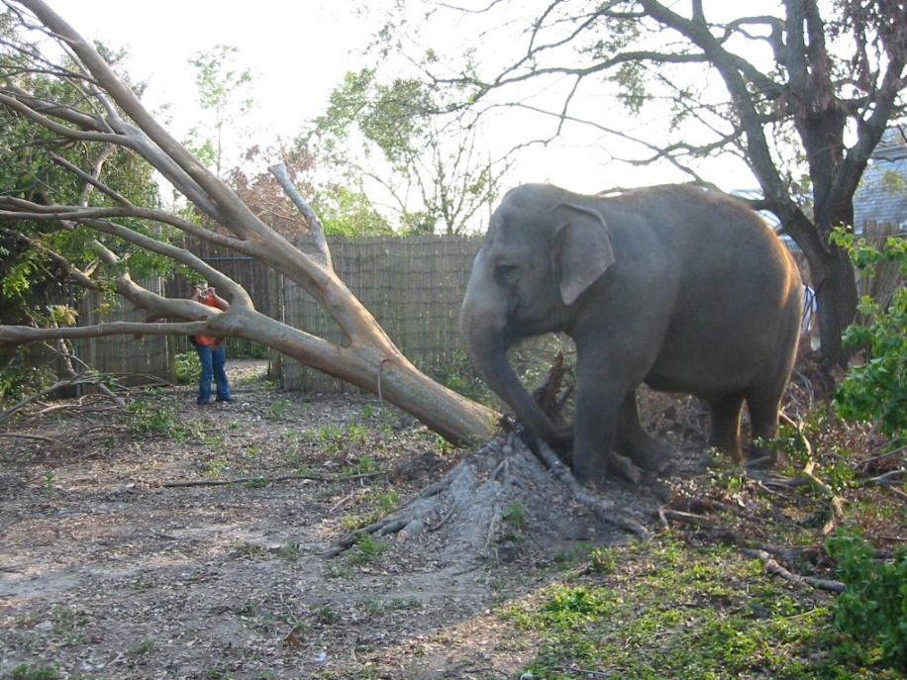
Expanded Job Descriptions
Notes:
Be prepared for and flexible to some changes in job descriptions during a disaster. At Audubon, the elephants were no longer exhibit animals, they were construction workers helping to repair exhibits. And I was a part time rhino keeper for six months, a job I thoroughly enjoyed. Registrar Shelly Roach at Columbus is a part time Australasia keeper as we deal with our current crisis.

Slide 23
Where Are We Now?
Records people are
Working split shifts
Working from home
Getting furloughed/laid off
Are records getting entered?
Many have expanded their ZIMS using staff
Provisional Data Entry helps
Some are catching up on “rainy day” tasks
We have a better grasp of how to prepare for the very worst scenario now
Notes:
So, since none of us really had the chance to prepare for a disaster of the magnitude we are now experiencing, where does this leave us? Records people, and zoo and aquarium staff in general, are working split shifts to maintain social distancing, are working from home when possible, and many have begun being furloughed or laid off. In general, minimal animal records are still being entered. Many institutions have expanded the staff that can do data entry, often with the use of Provisional data. I’ve heard from many Local Admins that are using this time to catch up on rainy day tasks such as clearing their Post office, fixing data entry warnings and errors and entering historical records. We will go away from this with a better grasp of how to prepare for the very worst scenario.

Slide 24
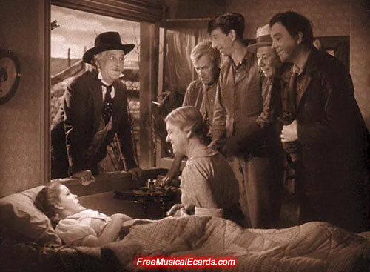
Notes:
Dorothy’s story had a happy ending. Right now we may not see any kind of ending in sight but there recently have been glimmers of hope. If there is anything that Species360 can do during this strangest of times, please do not hesitate to contact us. We’re in this together. You’re smart, courageous and we love y’all!

Slide 25
How Are You Doing?
Use this time to share some experiences, ideas or just say Hi

