Slide 1

The Best of
January 2020 Tips and Tricks

Slide 2
A Note From Jim Guenter, Species360 CEO
Hi everyone,
I wanted to thank you for being such an awesome community and critical part
of the Species360 family. 2019 was a fantastic year for us, thanks to you. You set a
records record… adding the most data ever to the ZIMS database. We also set a
member growth record, with 103 new members in 2019. Our community now has
over 500 studbooks in ZIMS with many regional associations committed to partnering
with us for all of their studbooks. In 2019 we continued to partner with CITES, creating
documents and publishing research to help fight illegal wildlife trade. And we’ve also
signed an MOU with the IUCN Red List leadership to explore integrating some high
level ex situ population data on the Red List – with recognition to Species360 members
for their contributions to ongoing species survival. We are also excited to explore in situ
data collection with a small handful of partners exploring the use of ZIMS for field
conservation projects.
Thank you again for joining us. I hope you enjoy the webinar. If you don’t, please
let us know so we can improve. And if you do, well, we like to hear that too!
Jim

Slide 3
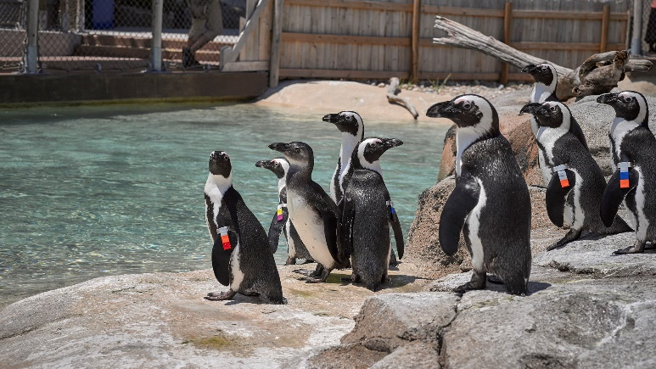
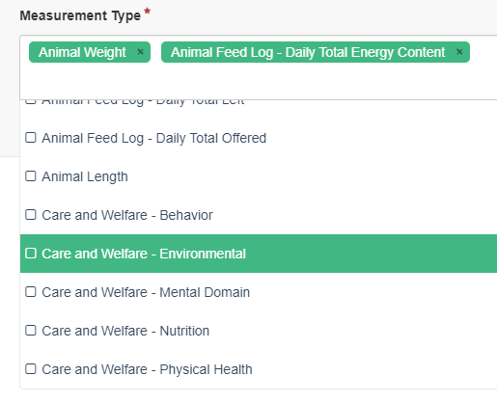
Husbandry/Aquatics Team
Animal Graphing Tool
The Animal Graphing Tool allows you to:
View single measurements for a single animal
View multiple measurements for a single animal
View single measurements on multiple animals
View multiple measurements on multiple animals
The Measurement Type is a multiple select list
that includes Weights, Lengths, Feed Log data
and data recorded in the Care and Welfare module.
2020 Note! Enclosure Environmental/Water Quality
are being added early this year to further expand
the data comparison opportunities!

Slide 4
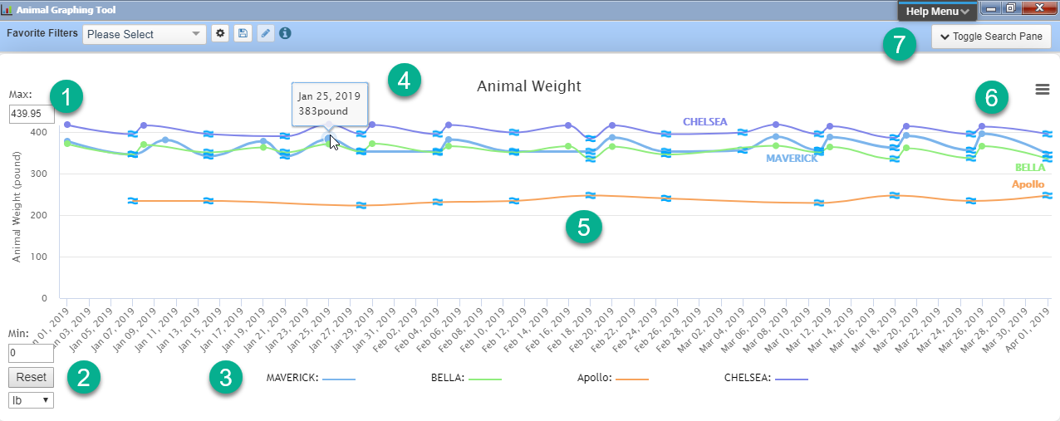
Husbandry/Aquatics Team
Animal Graphing Tool
The graph above is comparing weights for four dolphins. 1.You can adjust the Y axis
as needed. 2.You can reset the Y axis using the Reset button. 3.The color code for the
animals displays at the bottom. 4.Hovering over the point in the graph will display
the data recorded. 5.Estimated weights will be indicated. 6.Using the hamburger icon
you can Print or Download the chart. 7.You can go back to the filter screen using
Toggle Search Pane.

Slide 5
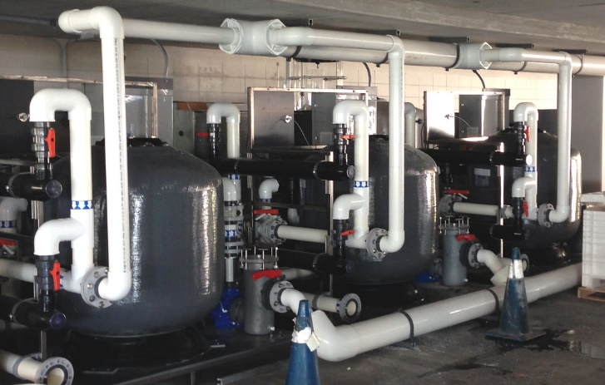
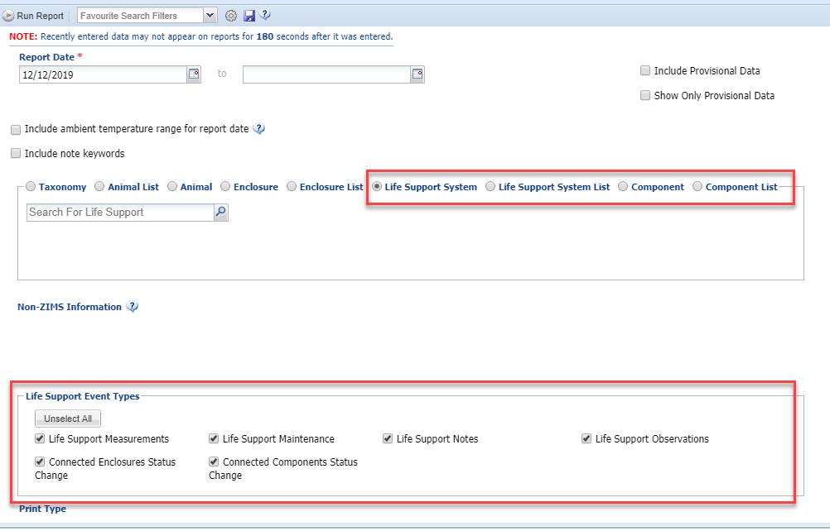
Husbandry/Aquatics Team
Life Support/Component
data on Daily Report
You can now select to include
Life Support or Component
data in a Daily Report. You
can select single entities or
use lists. The Event Types
available will be filtered by
which one you selected.

Slide 6
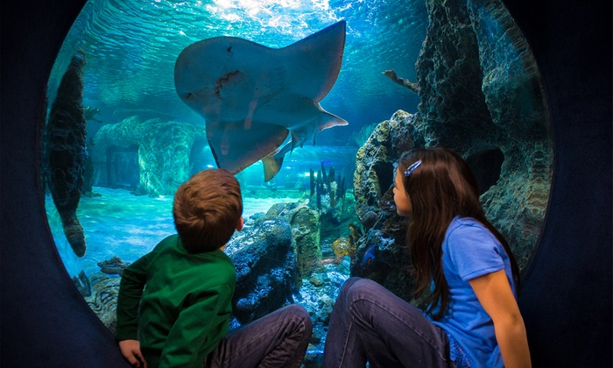
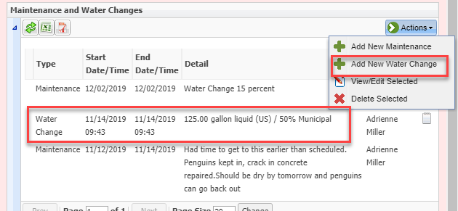
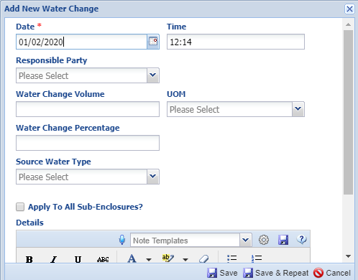
Husbandry/Aquatics Team
Water Change feature
  OK, this is coming out in early January this year
  but all the development was done in 2019!
You now have the ability to capture
Water Changes in the Maintenance
grid. You can select to capture volume
changed, the percentage of the total
changed, or both. Water changes
recorded as part of an Enclosure
Treatment will continue to display as
Maintenance.

Slide 7
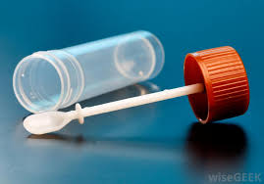
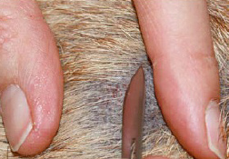
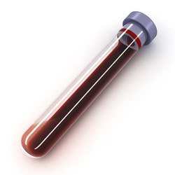
Medical Team
Sample Storage!!!
  The last remaining module from MedARKS

Slide 8

Medical Team
Sample Storage
  During development, Species360 had two rounds of testing to collect User feedback on the Sample Storage module
    A preview session in a test build in fall of 2018 for initial feedback
    Beta release in Live ZIMS in fall of 2019 by select institutions for final comments and development

Slide 9
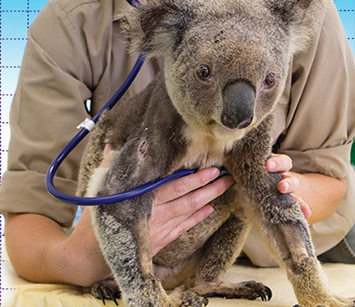
Medical Team
Sample Storage
  If your institution choses to work toward entering future stored samples in ZIMS and leave MedARKS as a place to only search historical samples, there will no longer be the need to execute the ZIMS to MedARKS export, but that is a local institution decision.
  MedARKS sample storage data migration is planned for 2020, no date offered at this point in time
    Med team has Test Result upload queued up next and likely Biobank after that
    BUT, when the migrations are complete, MedARKS can be retired.

Slide 10
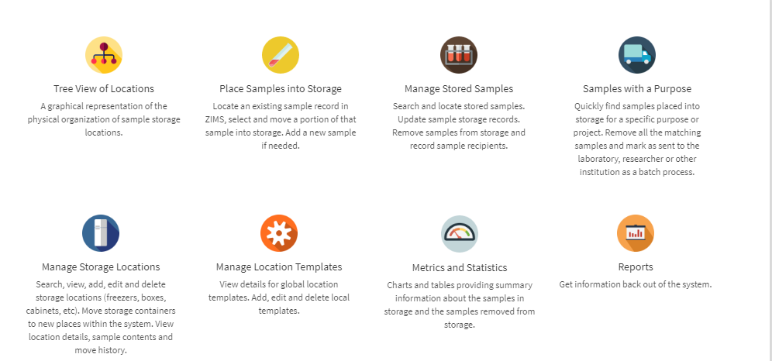
Medical Team
A Look at Sample Storage
The main Sample Storage home page is a visual display of the topics contained within it,
with easy to interpret icons. Open the modules by clicking on the icon.

Slide 11
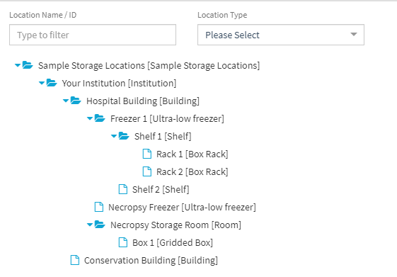
Medical Team
Storage Locations Tree
When you create Storage Locations you arrange them in a Tree very similar to the
Enclosure Tree in the Husbandry module. It is easy to see the Parent/Child
relationships. In the Tree above, Shelf 1 and Shelf 2 are found in Freezer 1 and
Rack 1 and Rack 2 are located on Shelf 1.

Slide 12
Medical Team
Stored Sample Management
  Place Samples Into Storage
    Once your Storage Locations are created you will locate an existing Sample record in ZIMS and move it or a portion of it into storage
  Manage Stored Samples
    Locate the stored sample, move it to a new storage location, remove it from storage for use (testing), discard it or mark it as lost or disappeared
  Manage Storage Location
    Search for, add, edit or delete storage locations or move storage containers to a new location

Slide 13
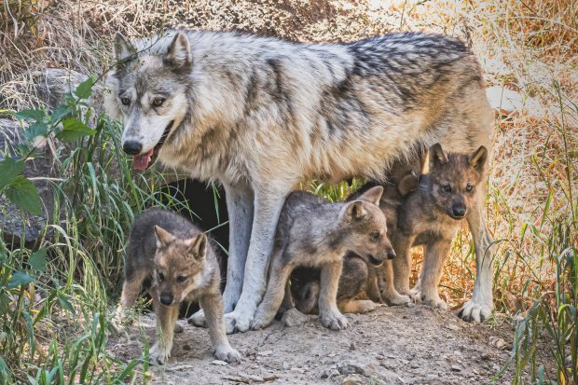
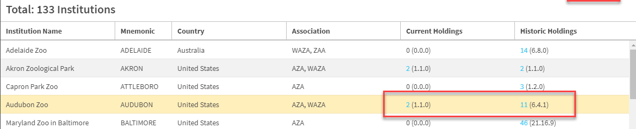
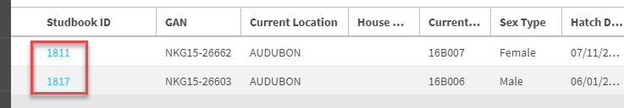
Studbooks Team
Institutional Holdings
The Institutional Holdings Tool allows you to view numbers of the species held currently
and historically. The numbers are hyperlinks to results grids which are hyperlinks into the
record.

Slide 14
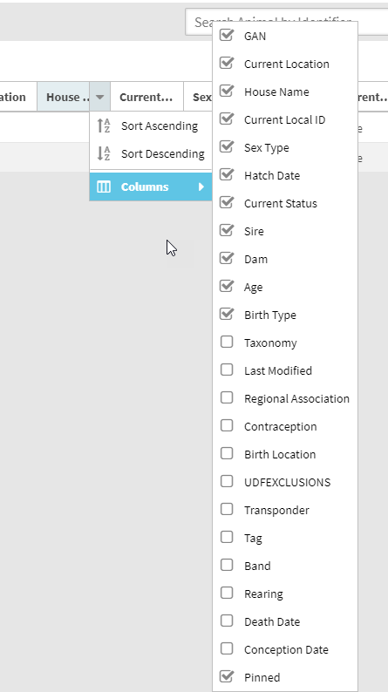
Studbooks Team
Column customization
New column options have been added to help
you better customize your results grids. Some
new options include
User Defined Fields
Regional Association
Birth Location
Contraception Status
Estimated Conception Date
Transponder
Death Date
Tag
Band
Rearing

Slide 15
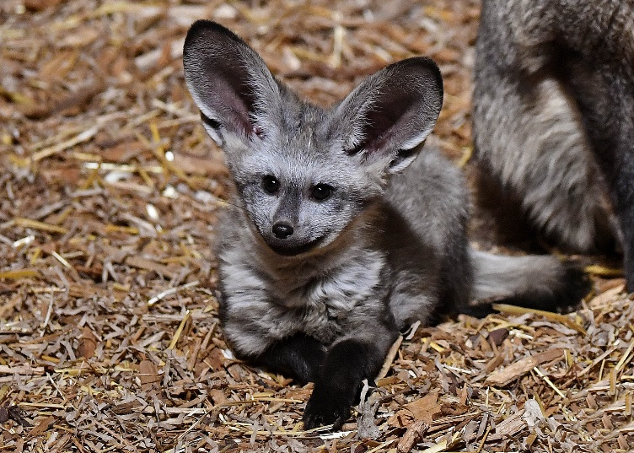
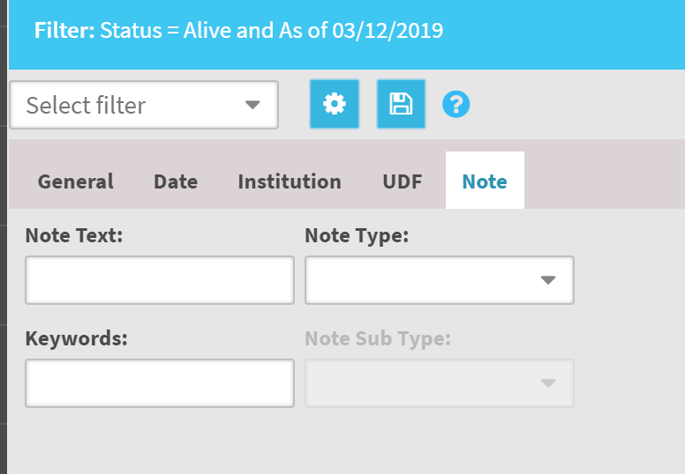
Studbooks Team
Filter by Notes
You can now filter your results
grids by Note Text (free text
field), Note Type (Data Standard
list dropdown), Note Sub Type
(Data standard list driven by
Note Type) and Keyword (free
text field).

Slide 16
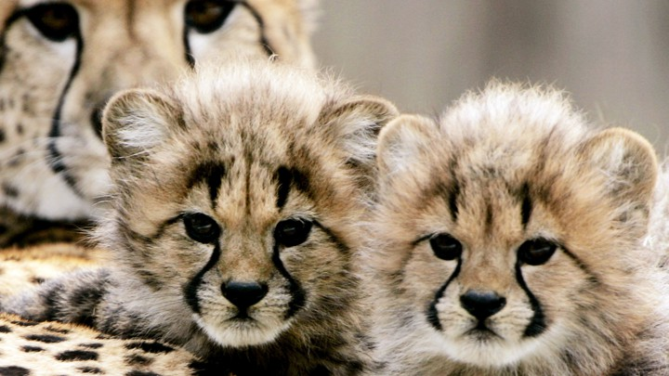
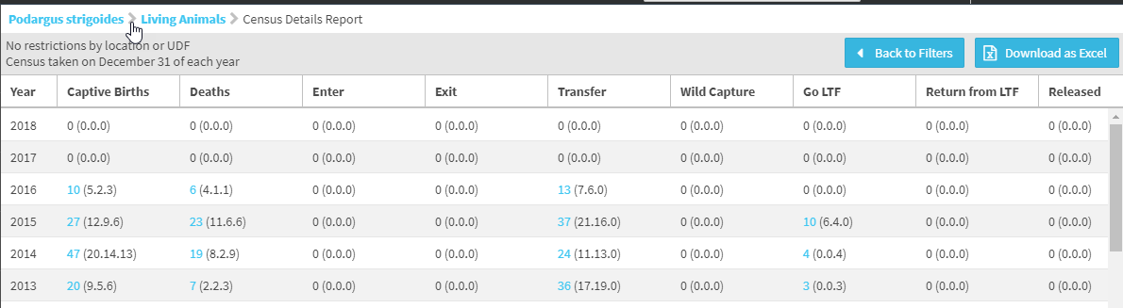
Studbooks Team
Census Detail Report
The new Census Details report captures how the Census was calculated by displaying
the number of Births, Deaths, animals new to the studbook, animals that left the studbook,
transfers, wild captures, LTF, Return from LTF and Released animals.

Slide 17
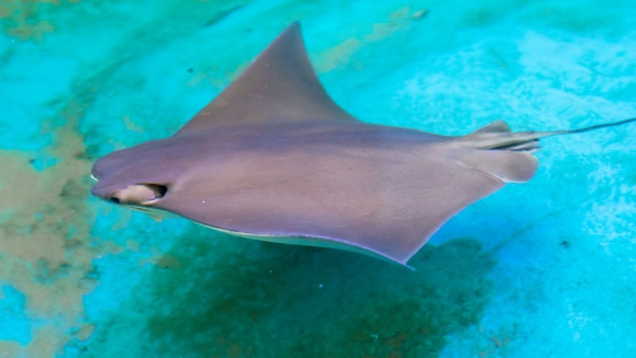
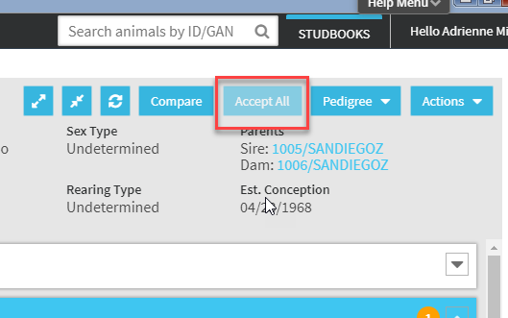
Studbooks Team
Accept All Pending Updates
If the animal with Pending Updates
has been held at one institution, you
have the option to Accept All of the
updates with one click. If the animal
has been held at more than one
institution you will see a warning that
it is not eligible for this option because
it has been held at more than one
facility. These will have to be accepted
one at a time.

Slide 18
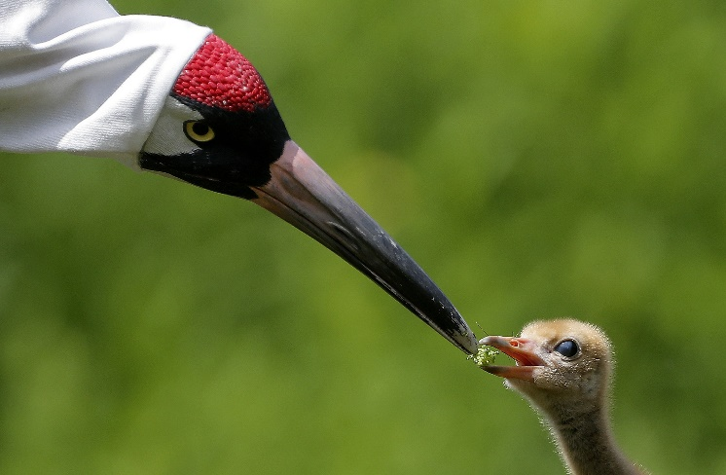
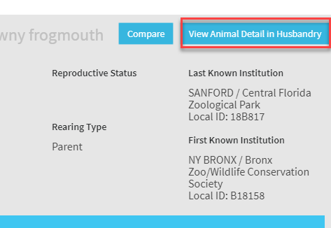
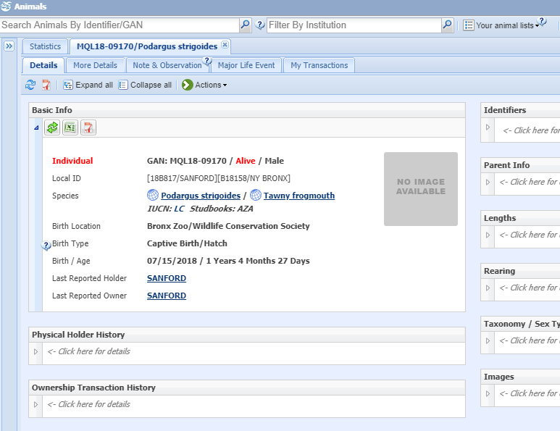
Studbooks Team
View Husbandry Animal Detail
In the Suggested Animals List there is the option
to select “View Animal Detail in Husbandry.”
Selecting this will open up the Husbandry module
record for that animal.

Slide 19
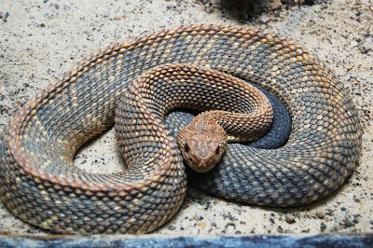
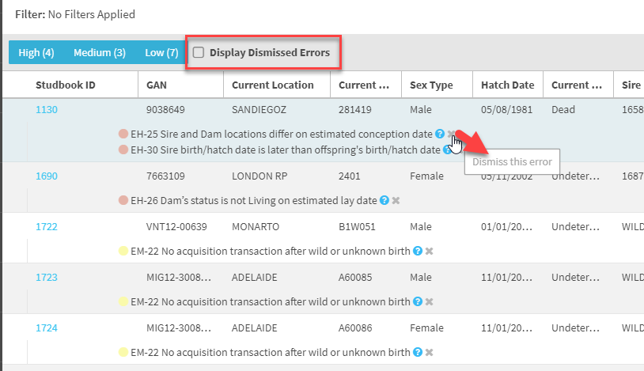
Studbooks Team
Dismiss Data Quality Errors
This feature allows you to
dismiss a perceived error
when the data entered into
the studbook is true but
causes an error to be
displayed. This often happens
with delayed implantation or
embryonic diapause or if an
egg collected from the wild
hatches in captivity. You can
later view these by selecting
Display Dismissed Errors.

Slide 20

Science & Research Team
Using the global Data in ZIMS (the
data that YOU contributed!)
  7 publications and 3 reports
  Published in 7 peer-reviewed
    scientific journals
    1 published in Proceedings of the
    National Academy of Science and
    ranked as one of the top 5% of research outputs ever tracked by Altimetric (tracks on-line activity)
  3 reports as part of consultancy work with CITES

Slide 21
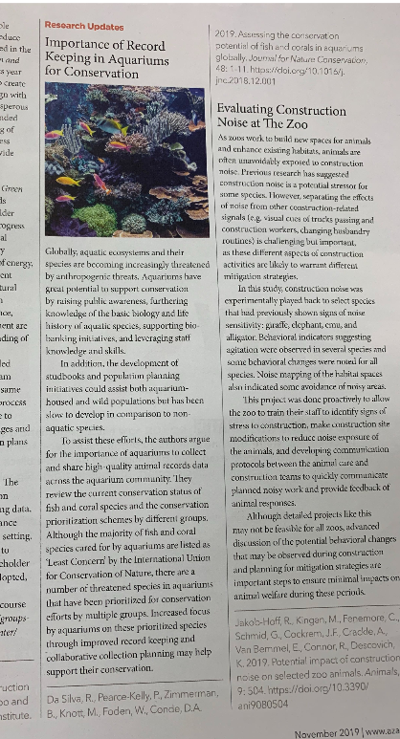
Science and Research Team
The November 2019 AZA’s Connect
magazine highlighted one of these
publications in the Journal for Nature
Conservation – “Assessing the Conservation
Potential of Fish and Corals in Aquariums
Globally.” The publication stresses “the
importance of aquariums to collect and
share high-quality animal records data
across the aquarium community.”

Slide 22

Science and Research Team
Submitted 3 grant applications
Total of $1 million dollars to further support the improvement of data collection and analytics

Slide 23

Science and Research Team
Created 50 plus media clips
Featured in more than 50 international press clips and blogs
BBC, World Economic Forum and the Conversation

Slide 24

Science and Research Team
Capacity Building – investment in the future by the Team
  1 PhD and 1 Master student graduated
  2 Bachelor students completed study projects
  3 Master students started their Master thesis
  Conservation class at Givskud Zoo (33 attendees)

Slide 25
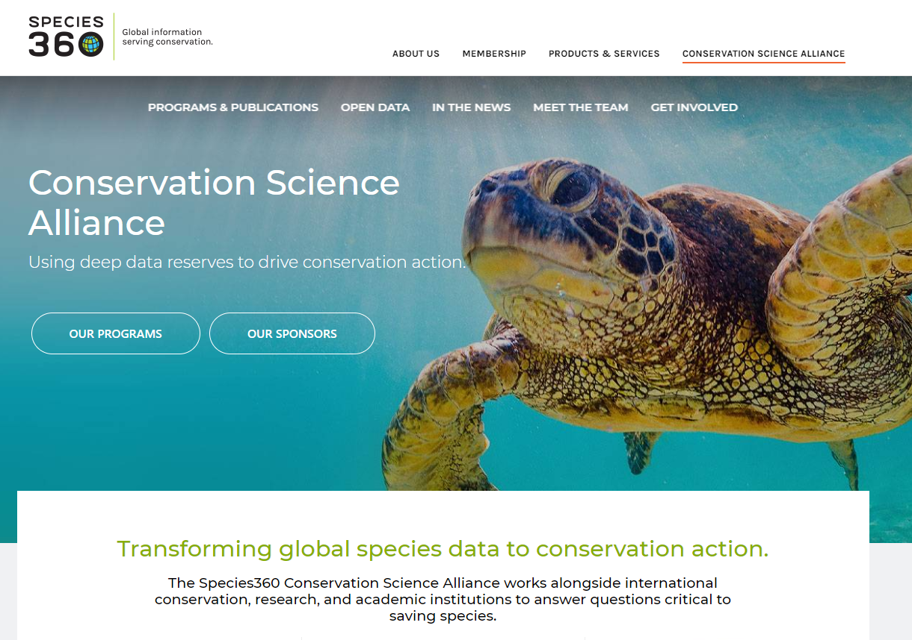
Science and Research Team
Launched new website for the Conservation Science Alliance
https://conservation.species360.org

Slide 26
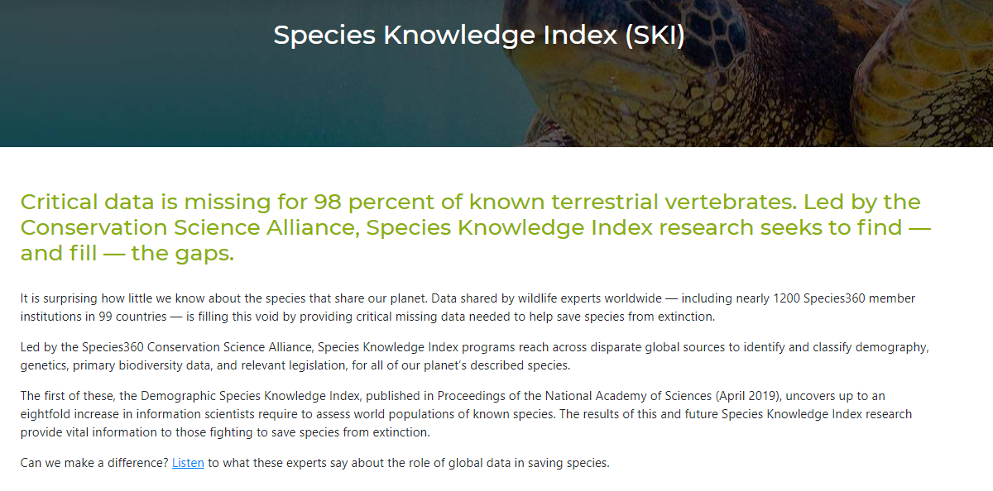
Science and Research Team
Species Knowledge Index is part of the CSA
Using your data to fill the critical data gaps for terrestrial vertebrates
Many member institutions used the press release we provided to let their donors, visitors and local media know they are contributing data to this project

Slide 27

2019
Was a Very Good Year!
Can’t Wait to See What Happens in

