Slide 1


ZIMS Studbooks
Navigation and Functionality

Slide 2
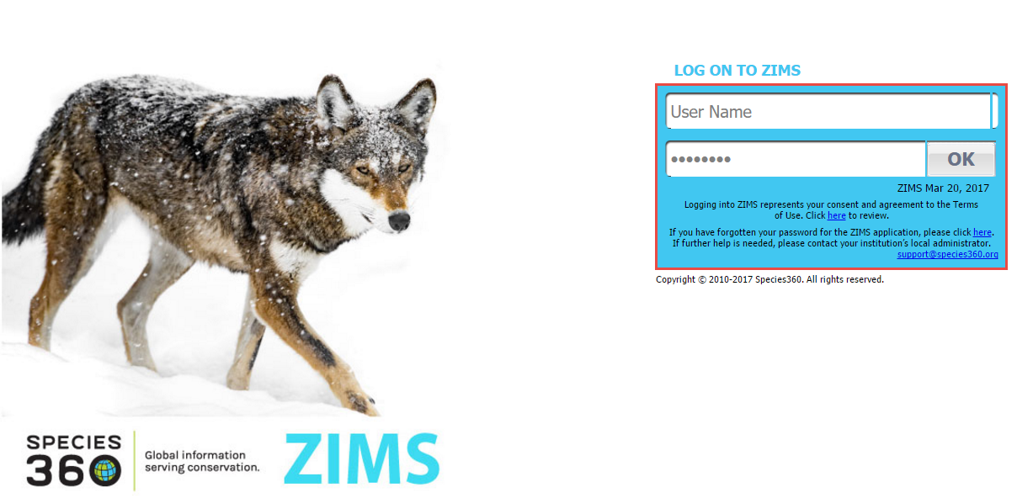
Logging In
To use ZIMS go to zims.species360.org. You will need to log in. Your User Name
and Password will be created by your Local Admin. You can change your User Name
and Password under Start>My Preferences>Account Settings>Change Password.

Slide 3
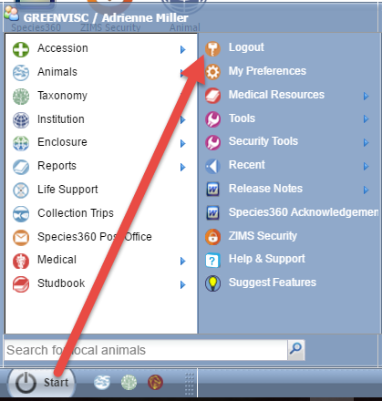
Logging Out
To keep your data secure
always remember to
Logout. Logout is found
under the Start menu.

Slide 4
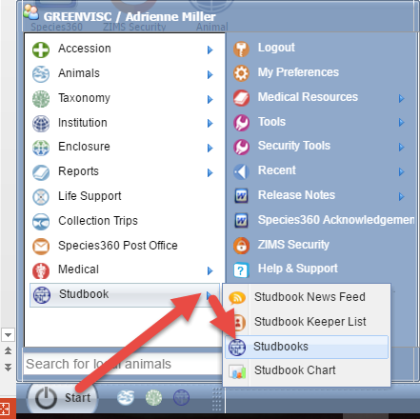

Finding Your Studbooks
Under the Start menu you will
find the Studbook Topics. The
Studbook News Feed provides
institutional updates, the Studbook
Keeper List allows you to search
for Studbook Keepers by various
filters. Studbooks is where you
will find your studbooks. And
Studbook Chart displays a graph
of the number of Studbook
Keeper Assignments in ZIMS. To
save clicks you can drag Studbooks
to your desktop.

Slide 5
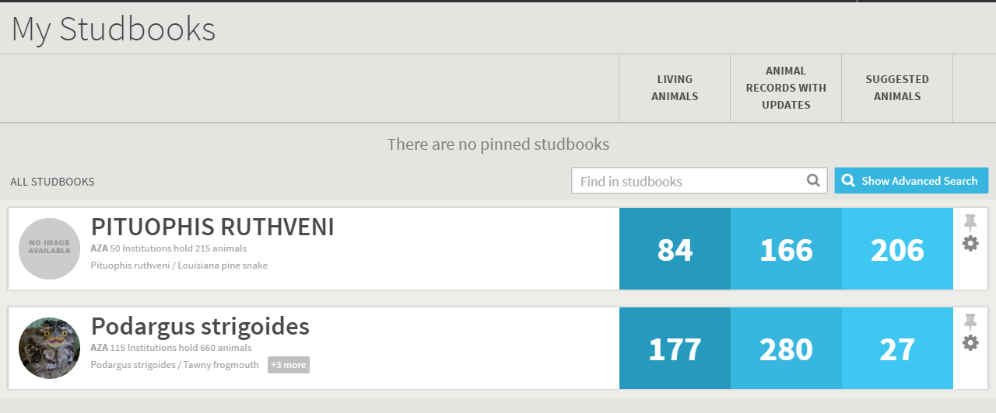
Your Studbooks
This person has two Studbooks. Living Animals indicates how many
current animals there are. Animal Records with Updates displays animals
that are in the Studbook that have been updated at the institutional level
but not yet updated in the Studbook. Suggested Animals are animals that
are in ZIMS but not yet in the Studbook such as new Births or Hatches.

Slide 6
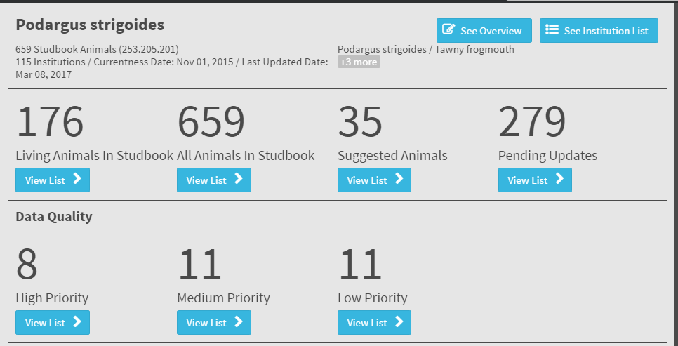
Studbook Dashboard
Selecting the species will take you to the dashboard for that studbook. Here you use the View List buttons to see all the Living Animals, All Animals in Studbook, Suggested Animals (ZIMS records that are not yet in the Studbook) and Pending Updates (new institutional data entered for animals that are in Studbook) . Data Quality by priority is also here.

Slide 7
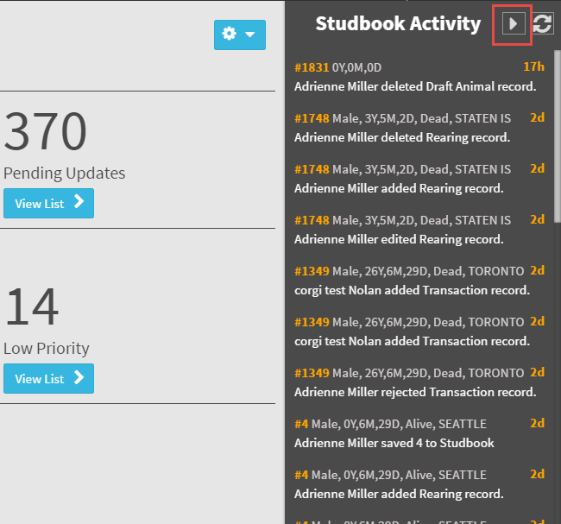
Studbook Activity
You can view recent Activity
in your studbook by expanding
the Studbook Activity box
from the species Dashboard.
This does not display updates by
institutions, it displays activity
that you have recorded in your
Studbook. The Studbook ID is a
hyperlink into the record.

Slide 8
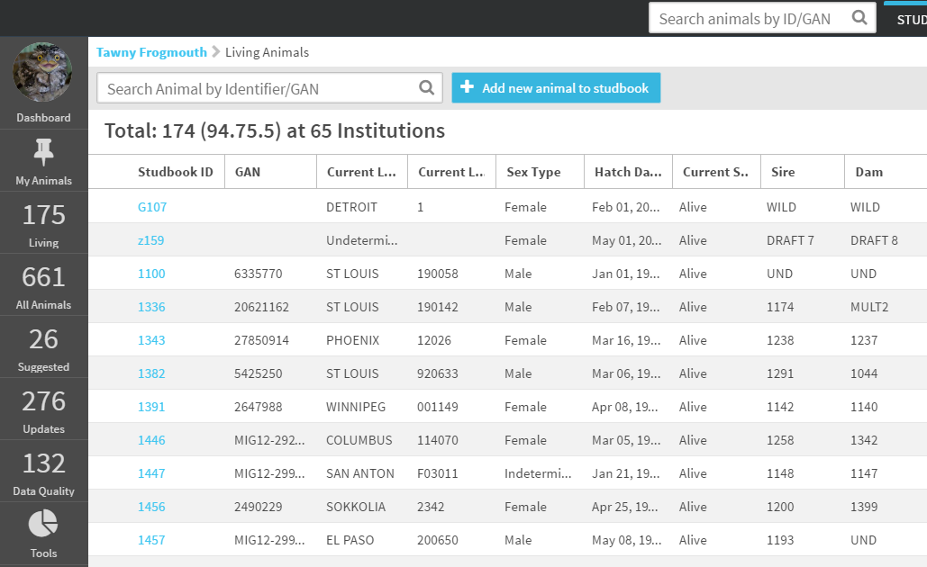
View List of Animals
Selecting the View List for Living Animals
brings up a list of your current animals.
This also activates the left hand side
dashboard that allows for quick navigation.

Slide 9
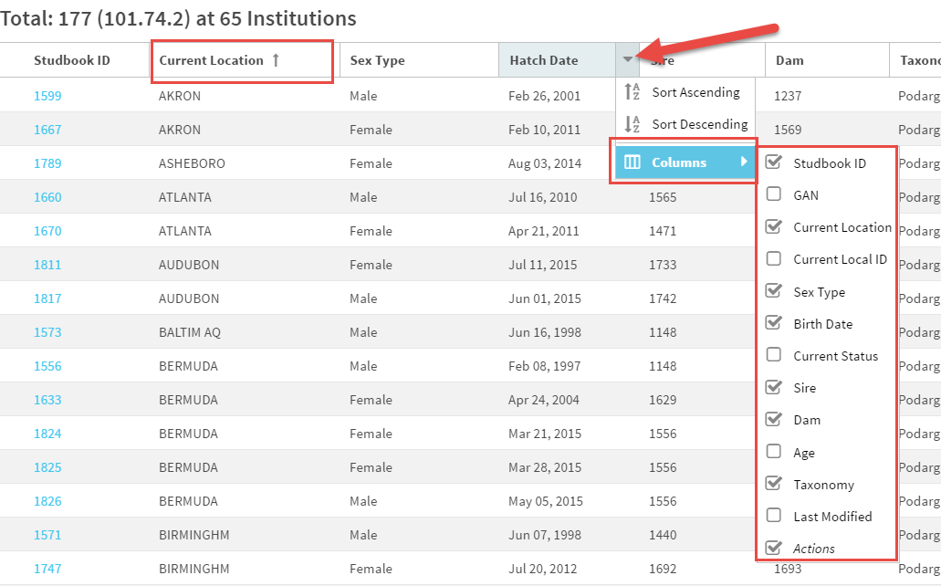
Sort Animal List
You can change the sorting of any of the columns.
Here we are sorting by Current Location,
ascending. You can also customize what columns
are displayed by selecting the arrow beside any
column header, selecting Columns and checking
or unchecking as desired. You can also change the
column order by dragging and dropping.

Slide 10
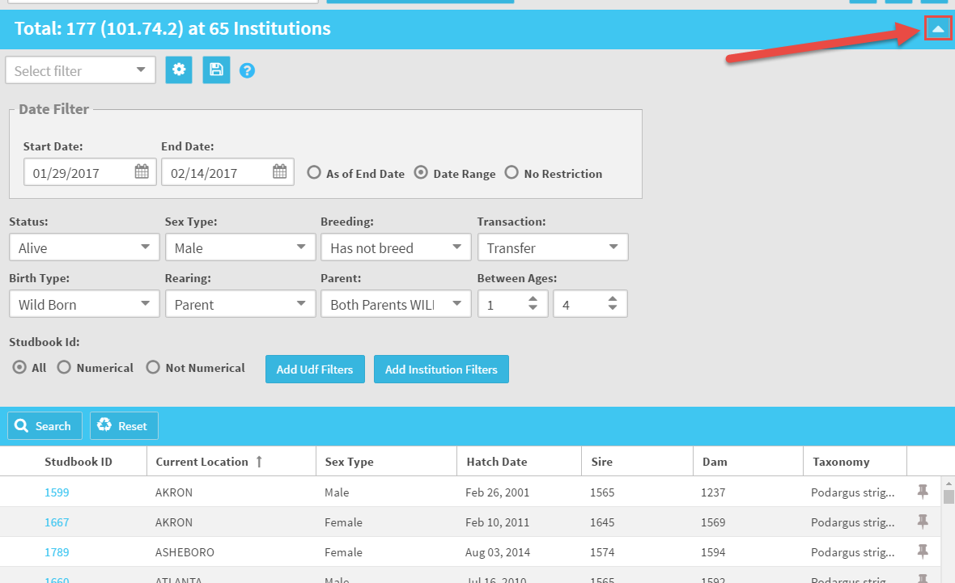
Filter Animal List
The right hand arrow will open a screen
where you can select to filter your animal list by many fields to find animals that meet specific
requirements. These
searches can be used
as reports and exported to pdf or
Excel.

Slide 11
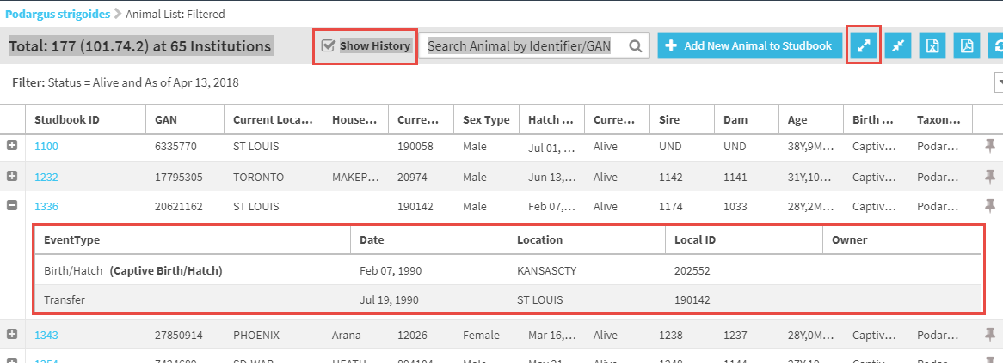
Show Animal History
All of the results grids have the option the display the history of the animal. Select
Show History at the top. To view the history select the “+” icon to the left. The
complete history will expand below the latest record. If you have fewer than 15
animals in the grid you can use the Expand icon at the top to expand them all.

Slide 12
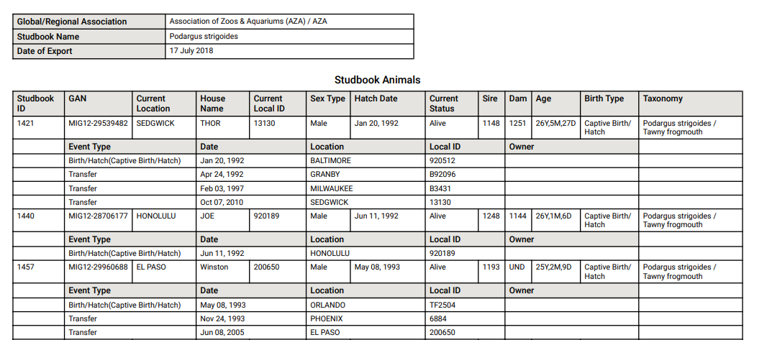
Export Animal History
If the Show History box is checked and you select to export the record to Excel or pdf
the animal history will display. This feature will replace the Studbook Report.

Slide 13
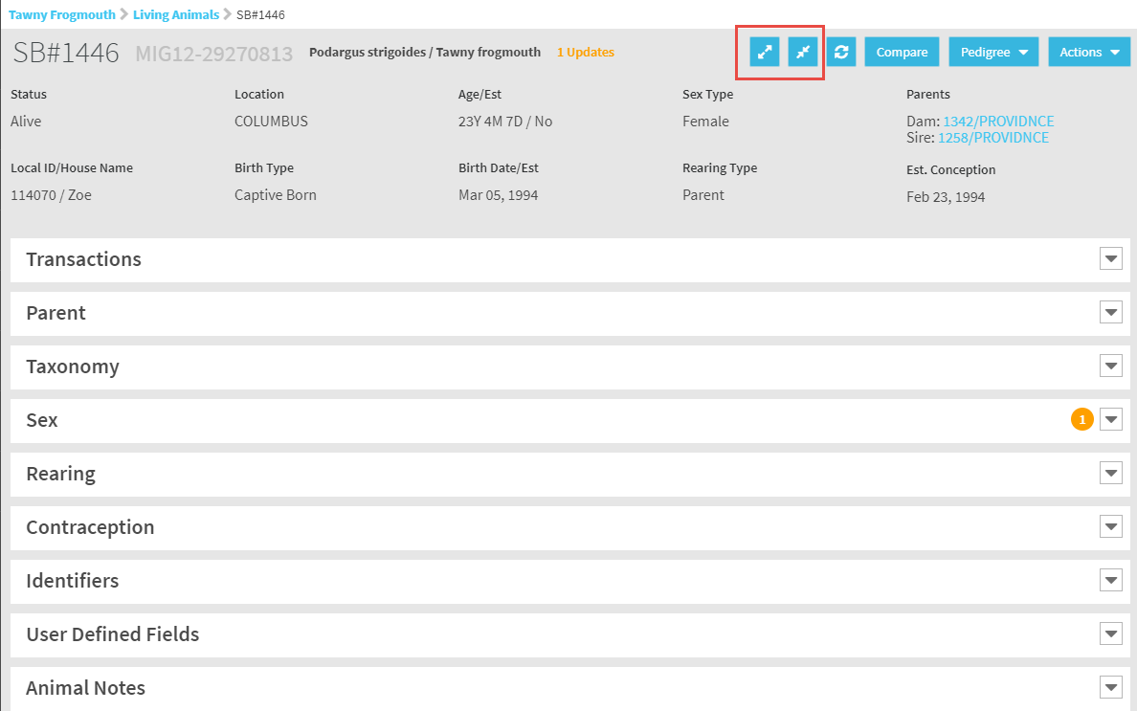
Animal Details
Selecting the Studbook ID
hyperlink from the animal
list will take you into the
animal record to view the
details or add data. You can
expand each grid separately
or use the Expand and Collapse
buttons to open or close them
all.

Slide 14
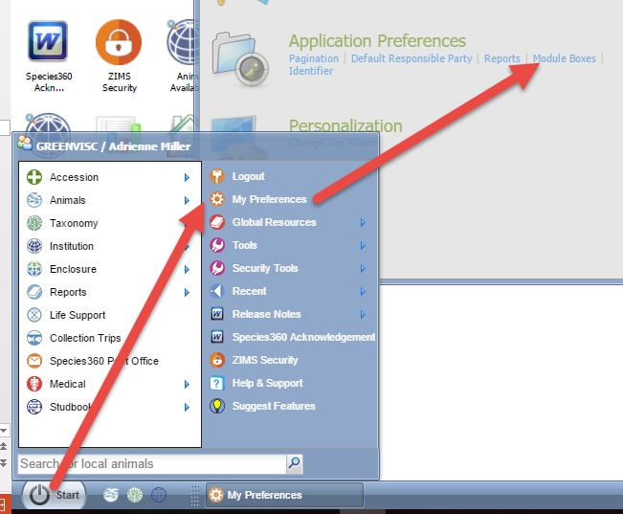
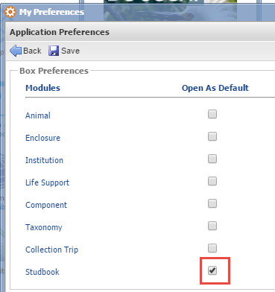
Grid Box Preferences
By default all the grids in the record are
collapsed when you open it. If you want
all the grids to open expanded you can go
to Start > My Preferences > Application
Preferences > Module Boxes. Check the
Studbook box to enable this feature.

Slide 15
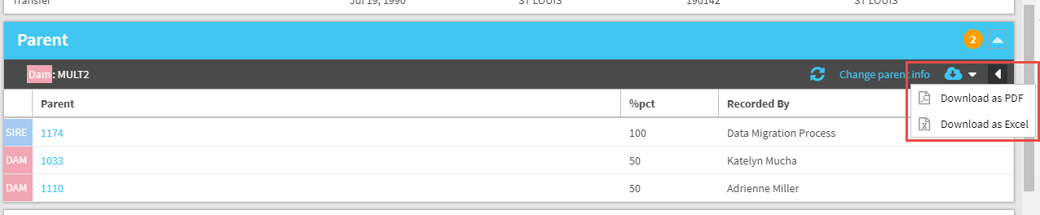
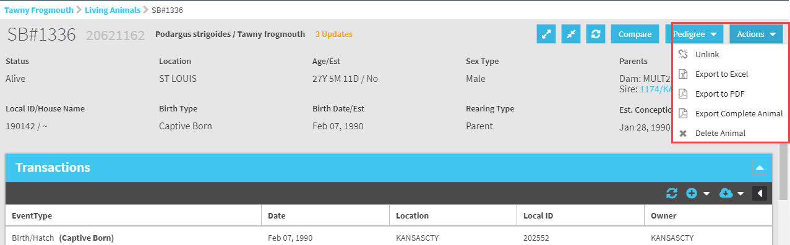
Export the Record
Each grid can be exported to PDF or
Excel (top). You can also Export the
Complete Animal record from the
Actions button (bottom). This is also
where you would unlink a record that
was previously linked or delete an
entire record.

Slide 16
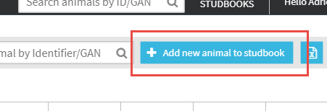
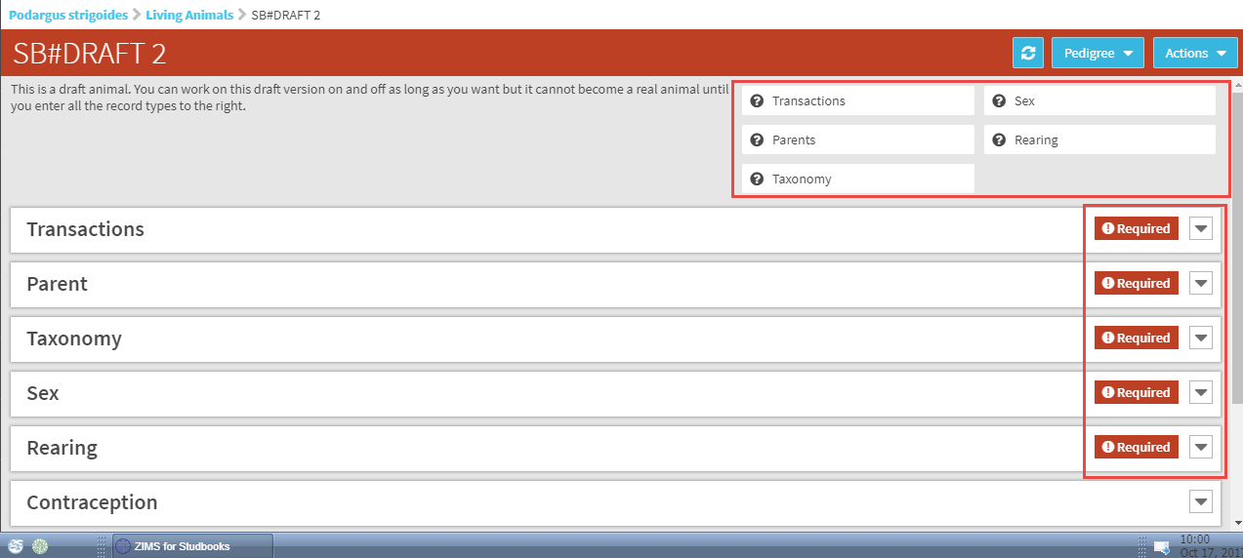
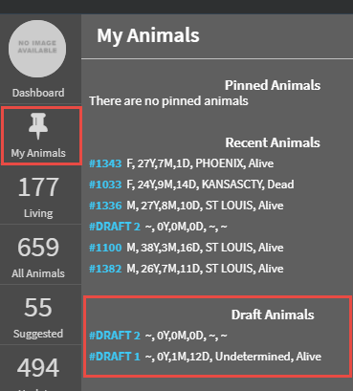
Add New Animal to Studbook
To add a brand new animal to the studbook select Add New Animal button. There are five grids that need to be completed before the record can become a full studbook record. Until then it will be saved as a Draft record under My Animals.

Slide 17
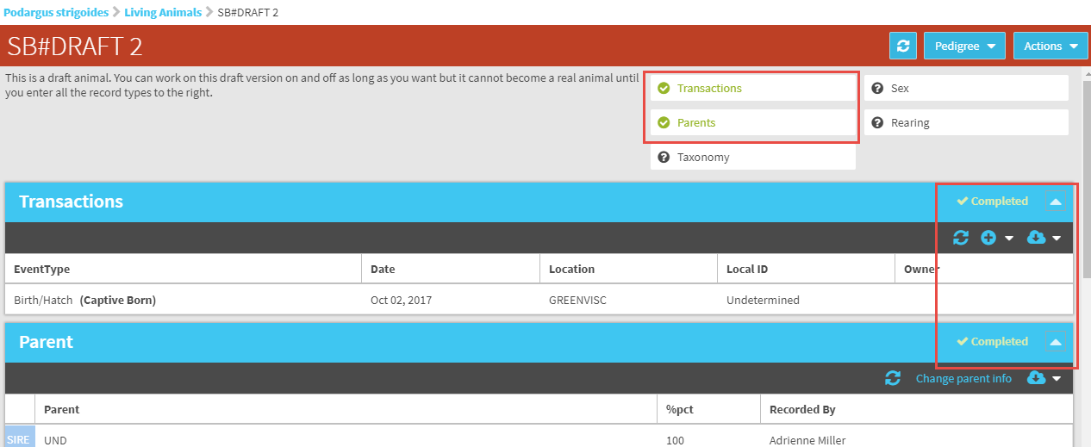
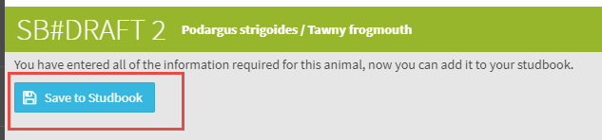
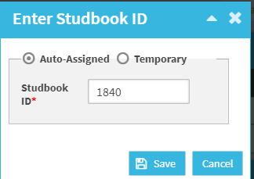
Save to Studbook
Once information in the grid has been recorded the grid will be marked Complete and the topic
will turn to green. Once all the mandatory grids have been completed you receive the message that you can now Save to Studbook. When adding a new animal the application will
automatically assign the next Studbook ID.

Slide 18
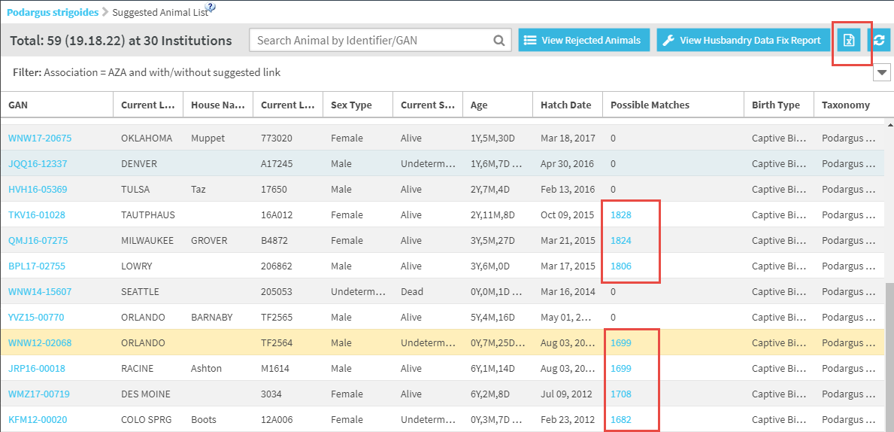
List of Suggested Animals
Selecting Suggested Animals from the dashboard will display a list of animals that are entered in ZIMS but have not yet been accepted into your Studbook. ZIMS will
indicate if it finds any possible matches that are already
in your studbook. These are hyperlinked into the Studbook record. You can export this list to Excel.

Slide 19
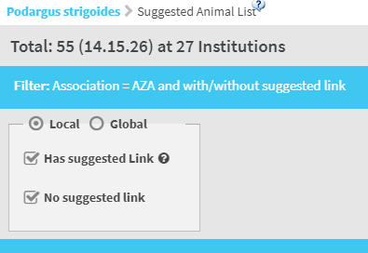
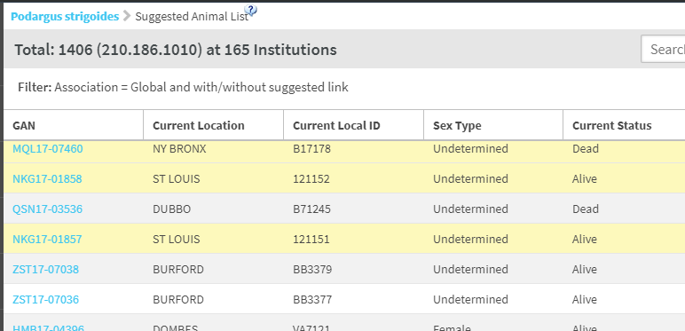
Filter Suggested Animals
You can filter the list of
Suggested Animals by Local,
Global, has suggested link
or no suggested link. If you
Filter by Global, any animals
in your regions will display
in yellow.

Slide 20
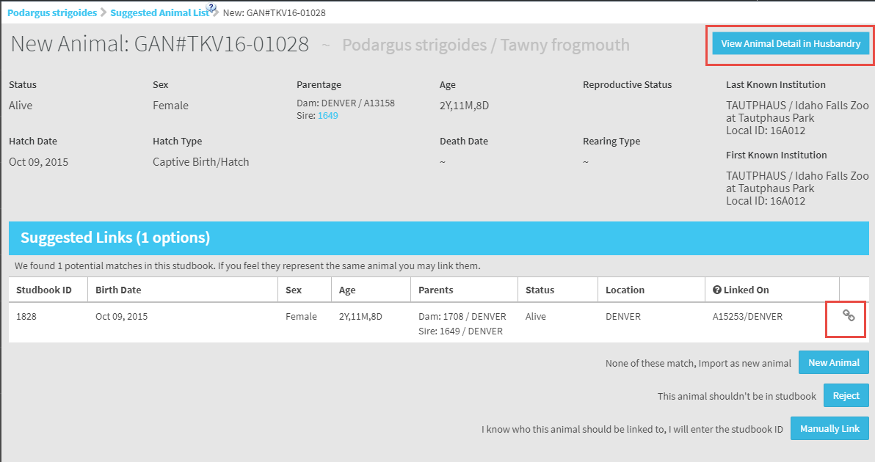
Suggested Animals Matches
The left hand GANs will open the suggested record.
You can view the Husbandry record by selecting View
Animal Detail in Husbandry box. If possible matches
are found you have the option to link to a current
studbook animal by selecting the link icon.

Slide 21
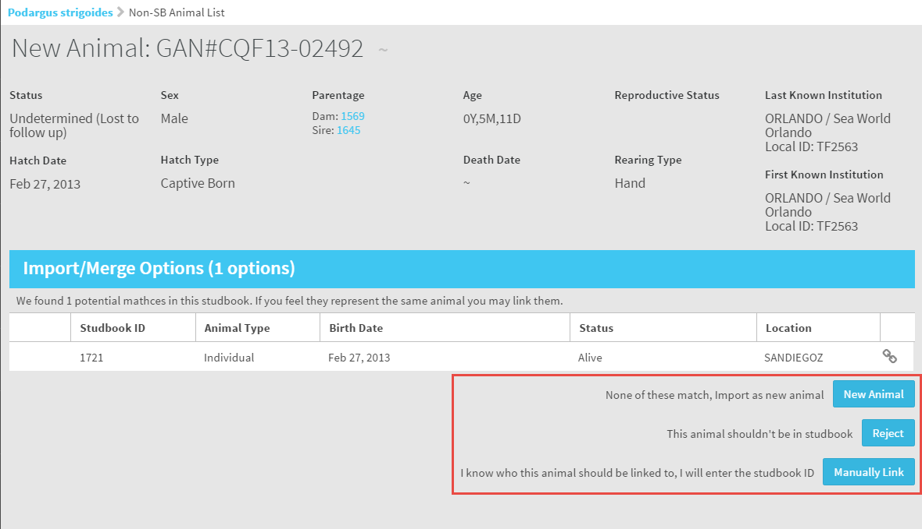
Suggested Animals Matches
You also have the options to accept as a new animal,
reject the record or manually link to a different
animal already in the studbook. Once an action is
taken the record is removed from the Suggested
Animals list.

Slide 22
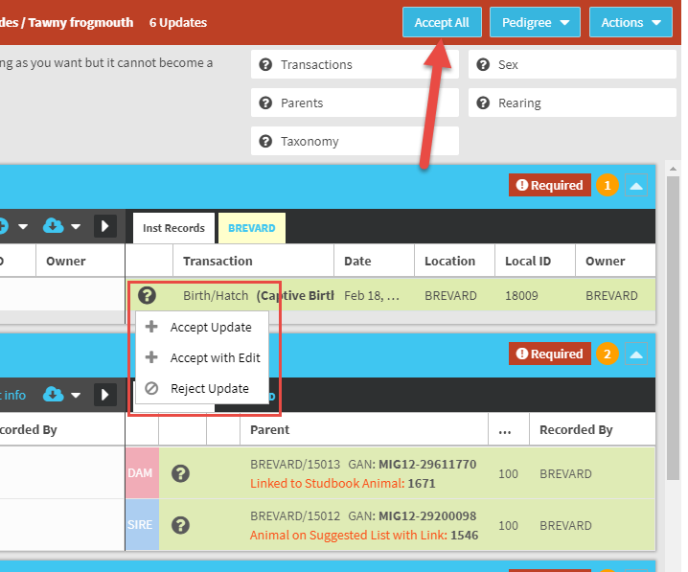
Accepting the Record
If you chose Add New Animal,
selecting the “?” will allow you
to Accept the Update as it is,
Accept it with Edits (that you
make), or Reject the Update.
If the animal has been at only
one institution you also have
the ability to Accept All the data
with a single click.

Slide 23
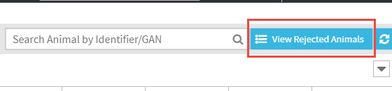
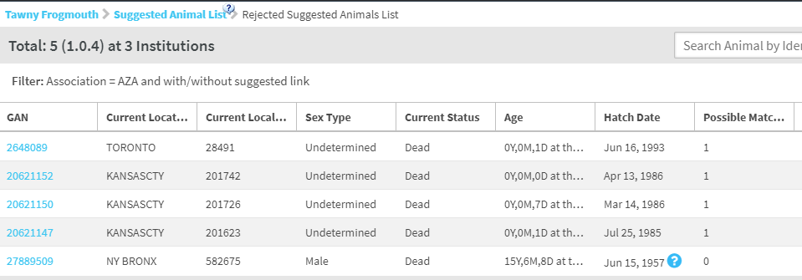
List of Rejected Animals
To view any rejected animals
select the View Rejected
Animals button. You can then
open the record and link or
add new.

Slide 24
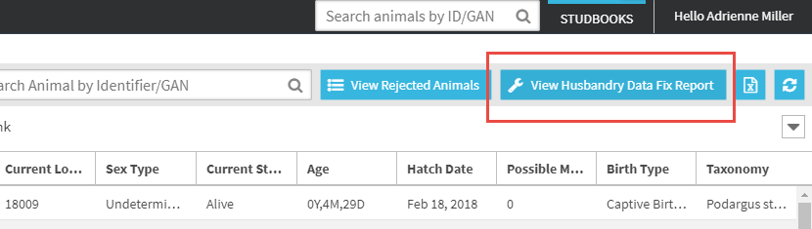
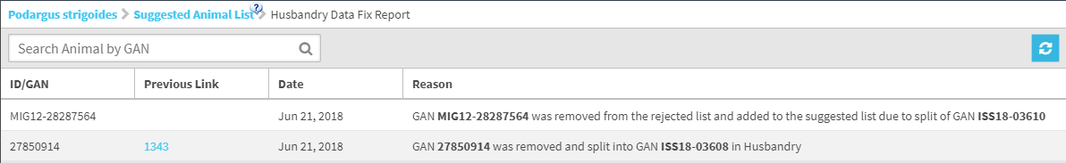
Husbandry Data Fix Report
To the right of the Rejected Animals is the View Husbandry Data Fix Report.
This will display a list of changes in the Husbandry module such as records
that were Merged, Split or Deleted that may affect the studbook data.

Slide 25
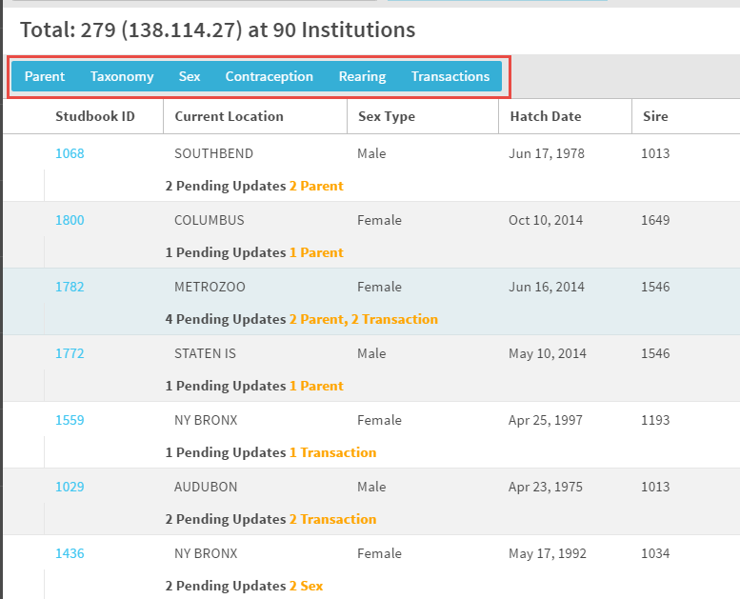
Pending Updates
The Pending Updates will
display any changes that
have been made at the
institutional level for animals
already in your studbook. You
can search for specific updates
as desired using the topics in
the blue box.

Slide 26
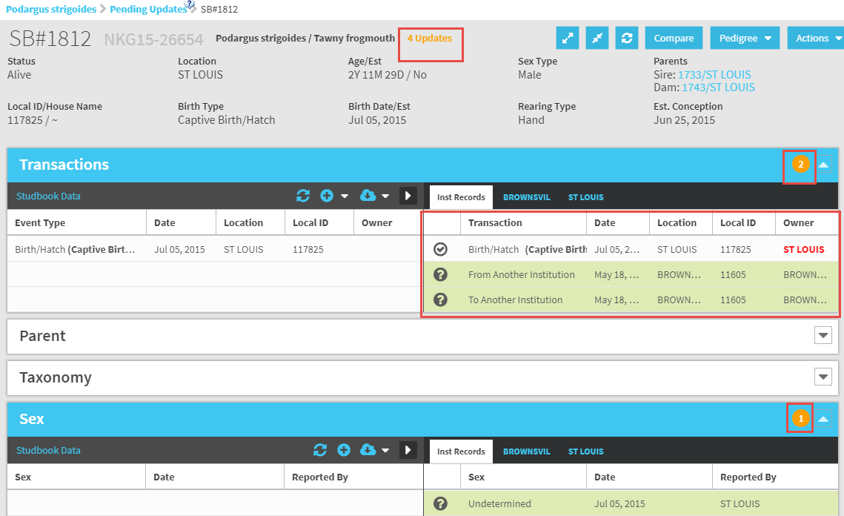
Pending Updates
Within the record the number of updates
displays at the top in the Basic Info grid. An orange
circle indicates which grid the updates are in.
If there is an update the grid will be expanded when
you open the record automatically.

Slide 27
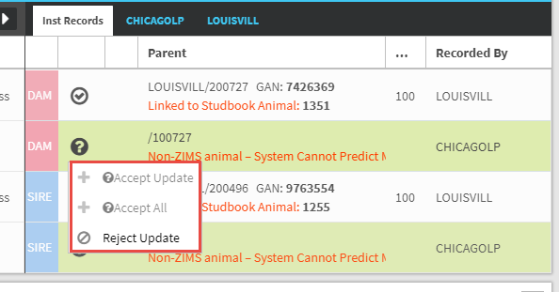
Actions for Parents Updates
For updates in Parents records
you have the options to Accept
Update, which will accept the
single record. Accept All will
accept all the Parental updates
with one click. Records that are
accepted will display in the left
side Studbook Data grid as well
as the right side Institution
Records. If you chose to Reject
Update the data will remain in the
right hand Institution Records (in
red) but will not display as Studbook
Data. You can chose to accept a
record that was rejected.

Slide 28
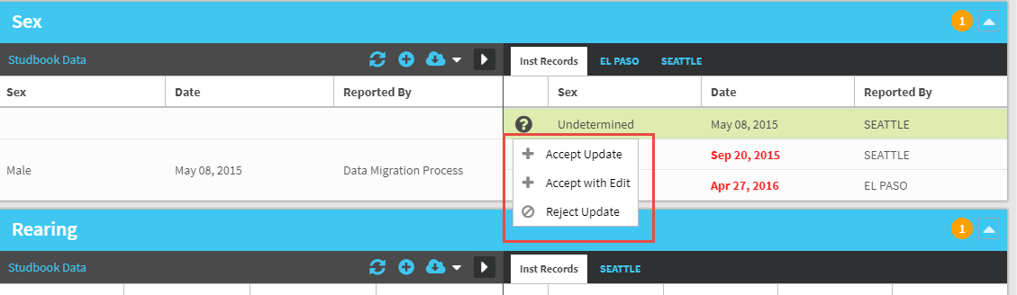
Actions for All Others
For all other updates you have the options to Accept Update and Accept with
Edit. Selecting Accept with Edit will open the record and edits can be made before
saving it. Or you can Reject the record.

Slide 29
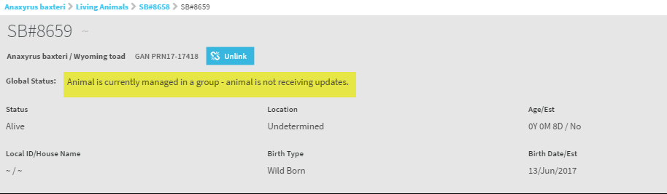
Records Not Getting Updates
There are two situations where you may not be receiving Pending Updates on your studbook records. First, the last holder may not be a ZIMS institution and therefore no updates are available. Second, the animal may be managed as a group in the Husbandry module of ZIMS. Currently studbooks do not handle group records so no updates from groups will be displayed. You will receive a message under Global Status.

Slide 30
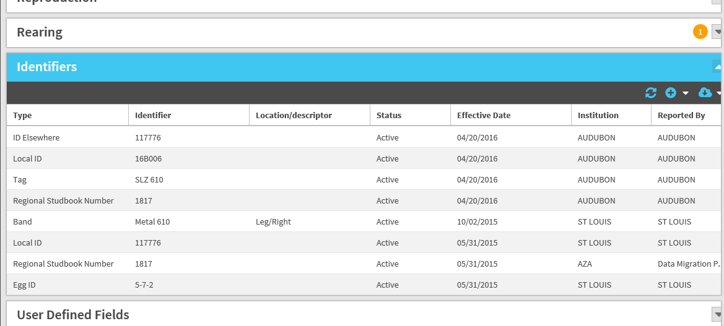
Identifiers Auto Populate
There is a separate box for identifiers in each individual animal record.
Any identifiers that have been entered in the Husbandry module will
automatically populate in the studbook, you do not need to re-enter them.

Slide 31
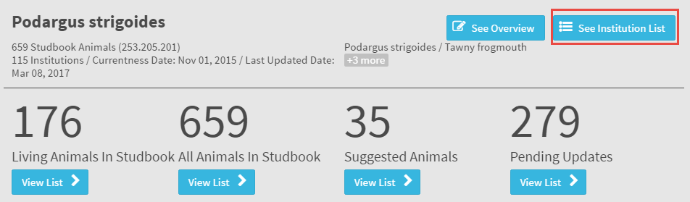
Institution List
To get to the institution list open the Dashboard for a species and
select See Institution List. The list is very robust with contact information
and more details about the facility than previously available.

Slide 32
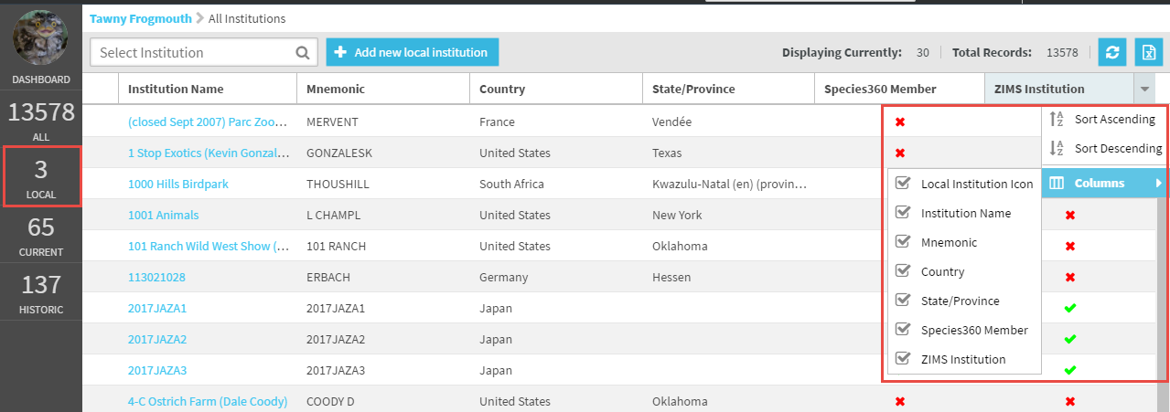
Institution List
A green check indicates the institution is a member of Species360 and if they are using ZIMS. Sorting the ZIMS Institutions by Descending order will bring all of the ZIMS institutions to the top if the list. Just as for your Animal Lists you can select what columns you want to display. The left hand dashboard displays the total number of institutions in ZIMS, the total number of your local Institutions and the numbers of current and historical facilities. Selecting any of the bottom three will filter your Institution List.

Slide 33
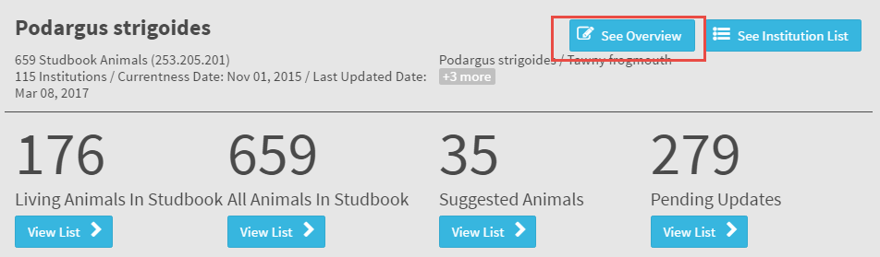
Studbook Overview
To see an overview of the studbook select the See Overview button. The Overview provides information such as incubation/gestation periods, species type (egg laying or live bearer), studbook scope, currentness date and total number of animals in the Studbook.

Slide 34
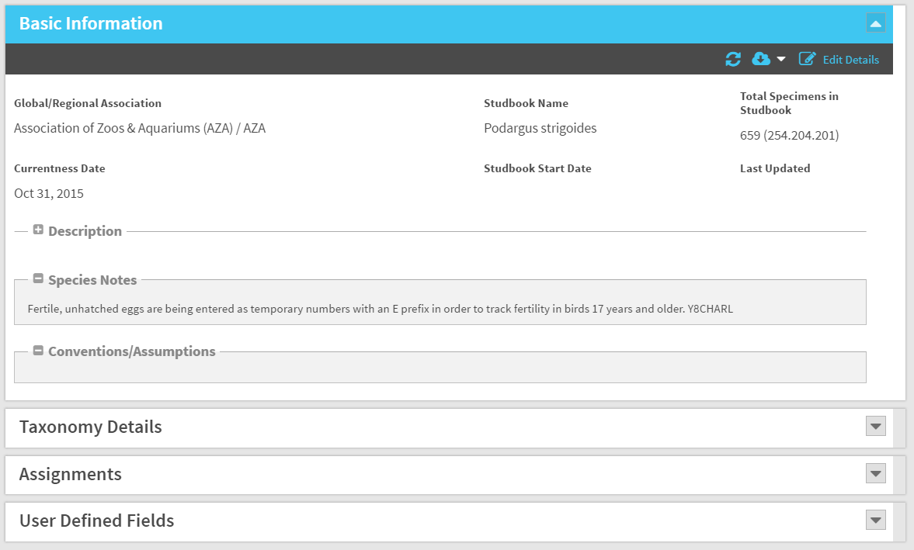
Studbook Overview
The Studbook Overview also contains a description of the studbook, notes on the species, conventions or assumptions you are using, any assignments such as species managers, and your user defined fields.

Slide 35
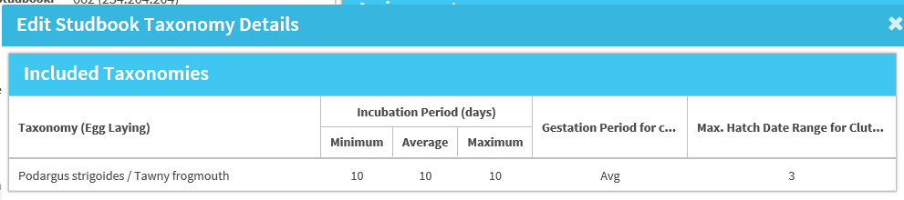
Gestation/Incubation Period
The Studbook Overview allows for the tracking of Minimum, Average and Maximum
incubation or gestation periods. These numbers often can help with the data quality
of the studbook data. For new studbooks the Regional Association sets these defaults but the Studbook Keeper can edit them. This information will be filled in for any migrated studbooks but is editable. The Studbook Keeper cannot add/subtract/edit taxonomy, you must contact the Regional Association to do so.

Slide 36
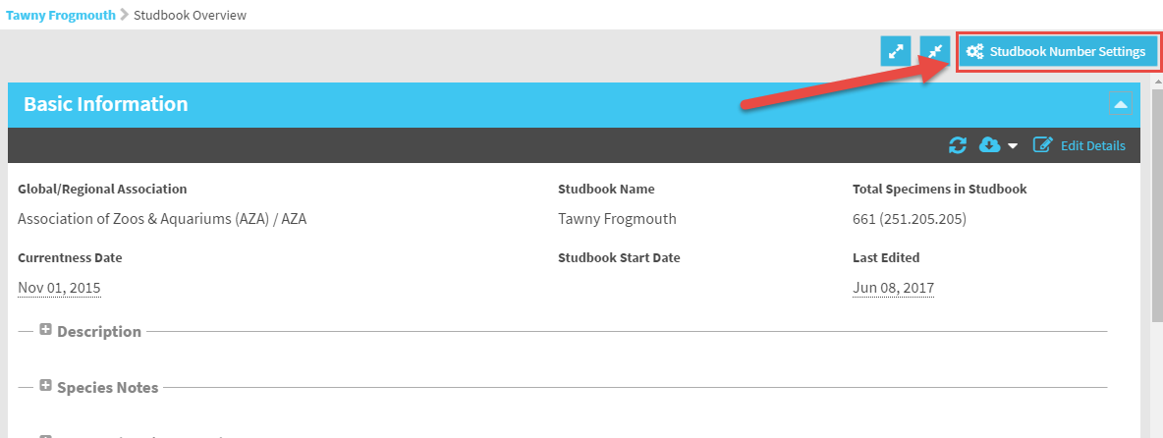
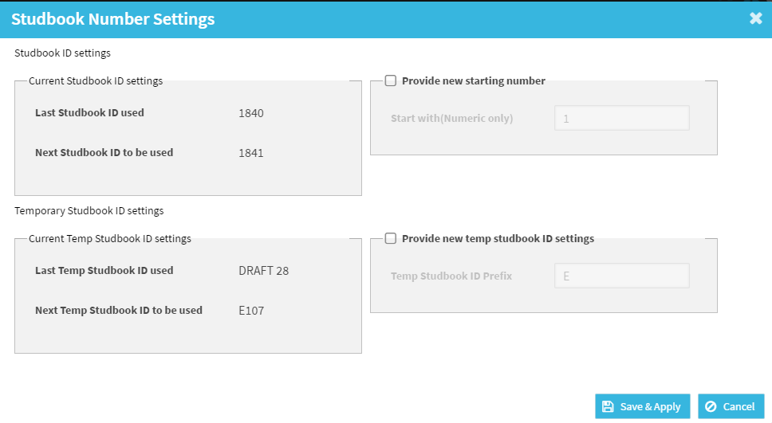
Studbook Number Settings
You can view the next Studbook ID
available and edit if you wish using
the Studbook Number Settings
in the Studbook Overview. This is
where you would edit the next
Studbook ID if you want.

Slide 37
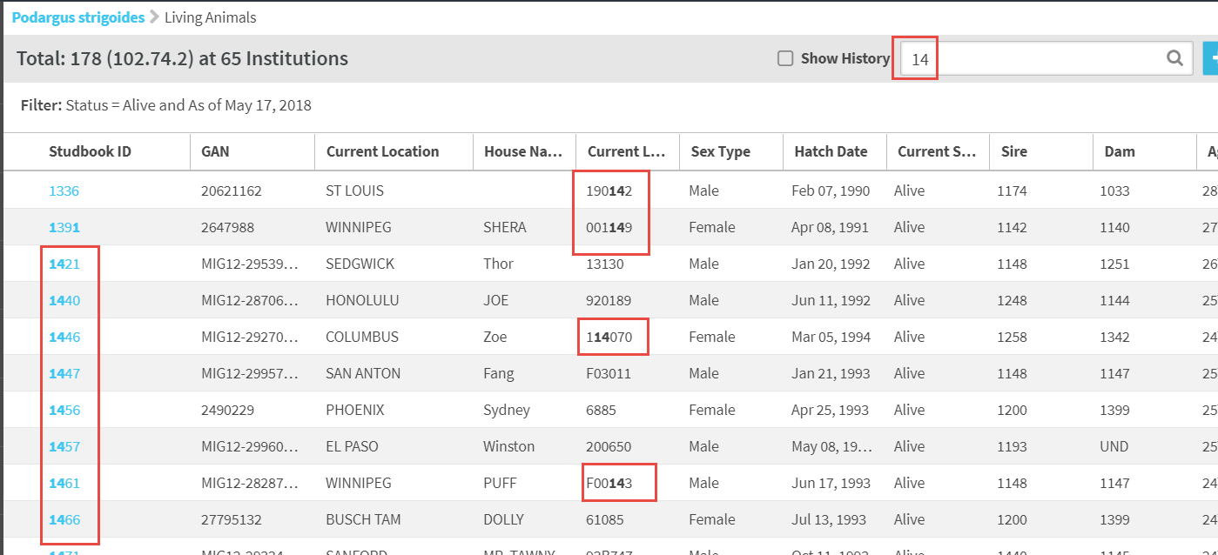
Search by Identifier/GAN
The Search Animal by Identifier/GAN field is where you can find
animals by specific IDs. This is a type ahead lookup and possible
matches will be displayed in the grid. ZIMS looks for matches in
Studbook ID, GAN and Local ID.

Slide 38
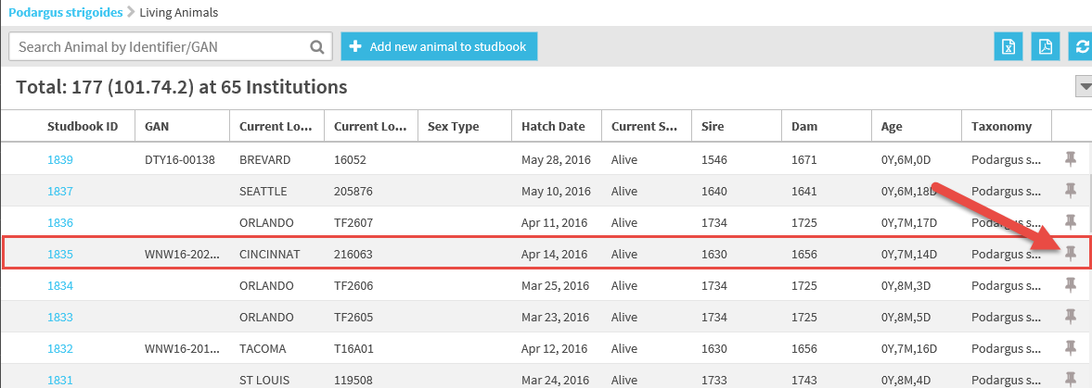
Pin Animal
If there are animals whose records you go into frequently you
can “Pin” them to your Dashboard by selecting the pin icon
to the right in the animal list. This icon will be available only if
you have Actions selected as a column to display.

Slide 39
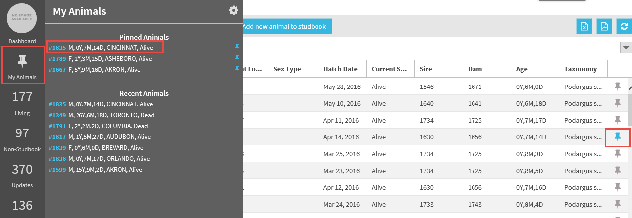
Pin Animal
Pinned animals can then be quickly found using My Animals under the
dashboard. Any pinned animals will display as a blue icon in the animal
list. To unpin the record simply select the pinned icon for the record under
Pinned Animals.

Slide 40
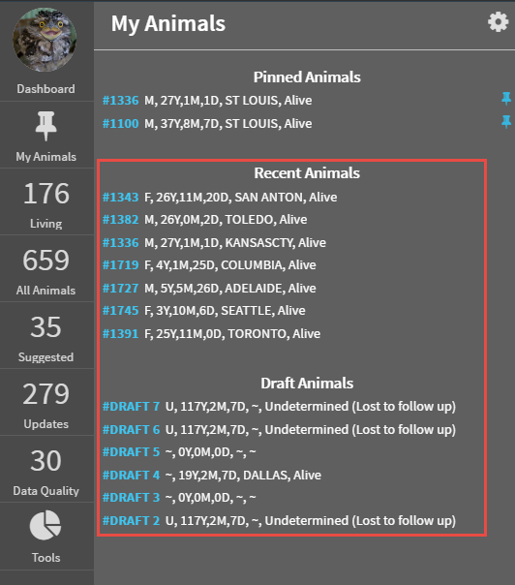
My Animals
My Animals is also where
you will find a list of the
most recent records you
have gone into and any
Draft Animal records. When
you add a new animal to the
Studbook, it will remain a
Draft until you have entered
data into all the mandatory
fields. You will then have the
option to add the draft to
the studbook. The blue
Studbook ID is a hyperlink
into the record.

Slide 41
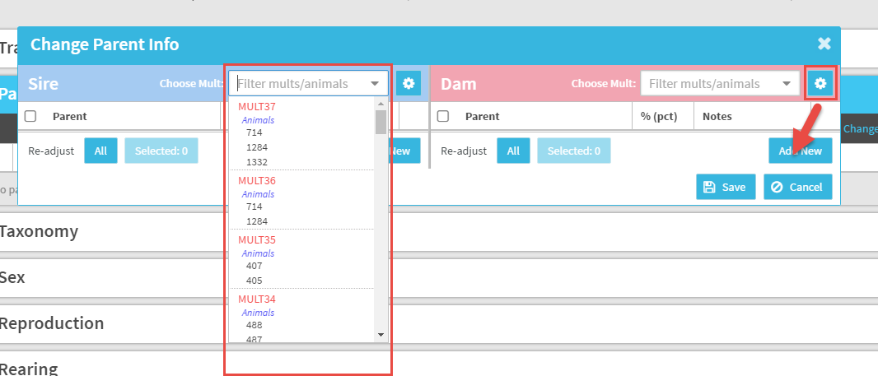

List of MULTs
When recording Parents you can find your possible MULT options from
either the dropdown arrow or the gear icon. The gear icon lets you
know what records these MULTs have been used in.

Slide 42

Auto Assignment of MULTs
When you create a new
combination of parents
such as recording three
possible dams, ZIMS will
automatically assign that
combination the next
MULT # so you do not have
to keep a record of what
your next MULT # is. If ZIMS
recognizes that you have
previously entered the same
combination of parents and
the MULT # already exists
it will auto-populate.

Slide 43


Data Quality
You can find any issues with data quality
in your studbook from either the main
studbook dashboard or the left hand
dashboard.

Slide 44

Description of Error Type
Using either approach you can search by
High, Medium or Low error types. High
error types are indicated by a red circle.
These errors are problems such as the
parents not being in the studbook.
Medium errors are indicated by a yellow
circle and are things such as conflicting
birth/hatch dates. Green circles are low
and can be things that aren’t really an
error such as the Studbook Number being
a temporary “T” ID. There is a Help
document that defines the codes and
how to fix them.

Slide 45

Correcting Errors
By hovering over the
“?” you receive an
explanation about
what you need to do
to correct the error.

Slide 46

Reports and Tools
Under Tools in the left hand
dashboard you have the
available Tools and Reports.

Slide 47

Census Report
The Census Report provides a count taken on a date that you specify for each year that animals have been recorded. It also provides you with the Annual Lambda and the Geometric Mean.

Slide 48

Data Validation Report
The Data Validation Report compares the data in the legacy application and the data in ZIMS.
This is a double check to make sure all of your data migrated correctly. Just because the
numbers are different does not mean that your data did not migrate correctly. The numbers
may be different because:
ZIMS requires the initial transaction be a Birth/Hatch.
Geographic Locations entered as institutions are mapped to actual locations
If your counts are different for any other categories contact support@Species360.org.

Slide 49

Data Quality in DMV Report
At the top of the Data Migration Validation Report you may see some Data Quality
Errors that may have caused problems with migration. These include:
For SPARKS and PopLink:
  Birth/Hatch transaction is not the first event
  Wild capture is not the first transaction or does not follow a release or birth
For PopLink:
  A recapture transaction does not follow a release transaction
  A LTF transaction is not the last transaction or follows a transaction other than
    Return from LTF

Slide 50

Location Validation
The Location Validation Mapping Report lets you
know how any geographic locations you entered
as institutions are now mapped to actual geographic
locations.

Slide 51


Re-number Temporary IDs
Selecting to Re-number Temporary IDs allows you to quickly assign permanent
Studbook IDs to your temporary records. You can do them manually as on the
right, or have ZIMS assign them by selecting Generate All as on the left

Slide 52

Animal Comparison
The Animal Comparison Tool lets you compare two records side-by-side. This is very helpful if you think
you may have duplicate records. This Tool is also
available within the animal record.

Slide 53

MULT List
This is also the place to easily find a list of all your
MULT parents and the records they are used in.

Slide 54

Institutional Holdings
The columns can be sorted, customized and re-ordered. The numbers are
hyperlinks to a results grid where you can go directly into the record

Slide 55

Pedigree Reports
The Pedigree Reports are
available in Tools and
also from directly within
the animal record. You can
select Descendants,
Antecedents (ancestors)
and Siblings. The Unknown
Pedigree Report is
available only under the
Tools menu.

Slide 56

Avoid the Refresh Button
While you are working in
your Studbook it is recommended
not to use the Refresh button.
This will refresh you back to the
main ZIMS dashboard and take
you out of the Studbook
module.

Slide 57

Getting Help
There are two places to
get help should you need it.
You can go to Start>Help &
Support or select the Help
Menu in the upper right
of all screens.

Slide 58


Getting Help
Select Studbook Topics or type in Studbooks in the question field. Some of these
Help topics are pdf documents or PowerPoints. The ones at the bottom are called
WalkMe. WalkMe will take you through the topic step by step in ZIMS to actually
enter the data.

Slide 59

Data Quality Details
One topic that is very helpful in the Help Menu is a link to a document that details the Data Quality codes and what they mean. In addition it is an easy reference for how to fix any errors.

Slide 60

Export to PMx
The Help Menu is also
where you will find
information about how
to export your data to
PMx for analysis.

Slide 61


Suggest Features
Also under the Start menu you will find
Suggest Features. Selecting this opens an
application called Receptive. Receptive
gathers all the good ideas that ZIMS Users
have suggested for the application. If you
have an idea for ZIMS Studbooks this is
where you can submit it.

Slide 62

ZIMS Studbooks
Navigation and Functionality

