Slide 1
An Open Forum on the Care and Welfare Module in ZIMS
Tracking the physical and
mental health of your animals
December 2019 TNT

Slide 2
Registrar Listservs
Recently there has been a lot of chatter on
the Registrar listservs regarding the ZIMS
Care and Welfare module. It has been out
just over a year; some Users jumped right
in to use it and others have waited to see
how it works for others before starting to
use it. There have been some questions,
answers and great ideas for its use on these
listservs. We hope this TNT gives Users a
chance to describe how they are using it
at their institutions and for those thinking
about using it to ask questions. We are here
to help, but this TNT is yours for active
discussion!

Slide 3
Start with Common Questions to Support
How Do I Set it Up?
Three Step Process: Step One - Configure Indicators
The five Indicator domains are taken from the WAZA 5 Domains model: Behavior, Physical Health, Mental Domain, Environment and Nutrition
Configuring means you
Assign a Value Type (how you want to capture the observation): Binary, Numeric Scale, Numeric Value, Percentage
Define the Values
Selected Expected Results

Slide 4
Step Two
Create Templates
Name it
Select to Share and/or allow Edits
Assign Animals
Single Animals, Animal Lists, Enclosure or Taxonomy
More information on impact of how animals are selected follows
Assign Indicators
Only those configured can be assigned
Animal Weights, Body Condition Score and Health Status are pre-configured and available by default

Slide 5
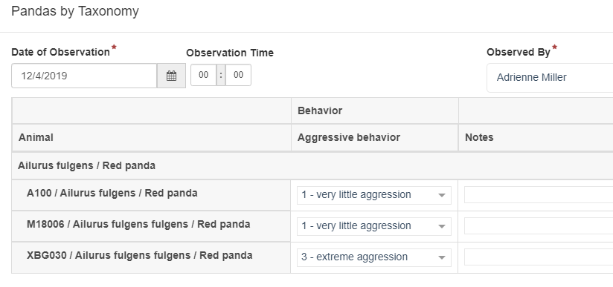
Step Three
Use the Template
Record the Date (Time if desired)
Record the Observer
Record the Data
Save and Repeat or Save & Close

Slide 6
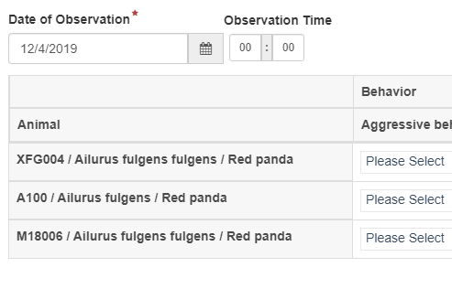
Notes on Single Animal Selection
Order in the Template is the order in which the Animals are selected
It is easy to add or
delete animals by
editing the Template

Slide 7
Notes on Animal List Selection
This option only displays if you have Animal Lists
Order is by Local ID, not how the Animal List is ordered
If an Animal is dispositioned or deceased but remains on the initial list, it is not included in the Template
However, if an Animal is dispositioned or dies after the Template is created from the Animal List and remains in the list, it will remain in the Template UNTIL you refresh it
In order to change the Animals in the Template you must correct the Animal List and then refresh the Template List

Slide 8
Notes on Enclosure or Enclosure List Selection
Enclosure List option only displays if you have Enclosure Lists
Order is by Local ID
When using Enclosure Lists, the Enclosure Names do not display
Animals in Template will auto-update as they are moved, dispositioned or acquired
A refresh is not usually required but a good idea

Slide 9
Notes on Taxonomy Selection
Animal order is by Local ID
Animals of that taxonomy who are out-on-loan will not display
As Animals of the species arrive or depart the Template may not automatically update immediately
To update the Animals included, select to refresh the Template list

Slide 10
What Happens if I Edit or Delete a Template?
Not much!
Data entered using it will still be there
If animals are removed from the Template, their info will remain
Deleted Template will disappear from the Template List
But the data will remain in the module
Edited Template will display as edited going forward
Name, Animals and Indicators can be edited

Slide 11
What Happens if I Edit or Delete an Indicator?
A lot!
Can Edit all Indicators
Notification if Indicator has been used
Cannot Edit Value Type once an Indicator has been used
Edits will affect ALL previous records
Can only Delete Indicators you have added
No notification if used in a record (select Edit first)
If Deleted ALL records using it are removed

Slide 12
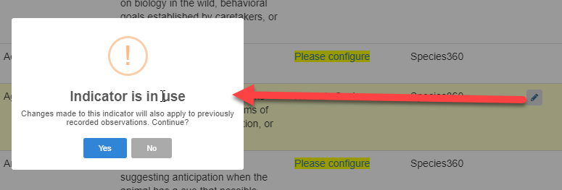
How do I Know if an Indicator has been Used?
Select the Edit Option
No way to know which records it was used in

Slide 13
How Do I Change the Order of My Animals in a Template?
You can’t, so
Order remains as described earlier

Slide 14
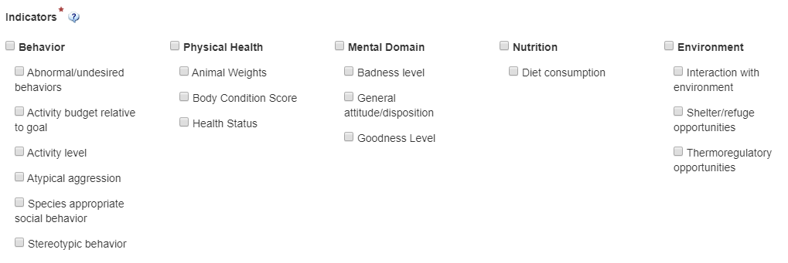
How do I Change the Order of my Indicators in a Template?
You can’t
Order is by Domain (Behavior, Physical Health, Mental Domain, Nutrition, and Environment)
Then Alphabetical within each Domain

Slide 15
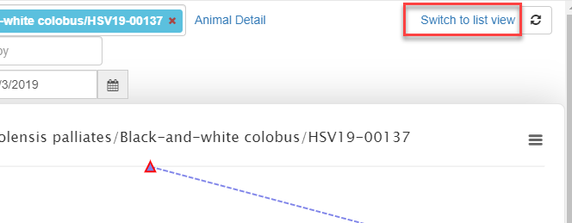
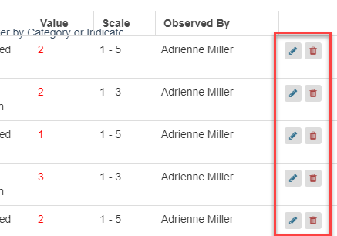
How do I Edit Data?
First create a Chart for the Animal
Switch to List View
Change the Date Range if needed
Use the icons to Edit or Delete

Slide 16
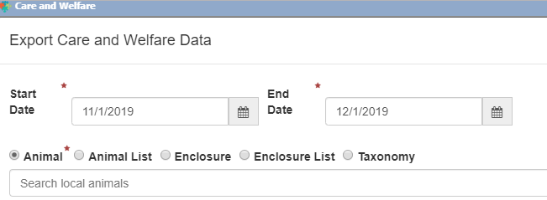
How do I View Data Over Time?
The Charts, List View and Export all have Date Range options at the top

Slide 17
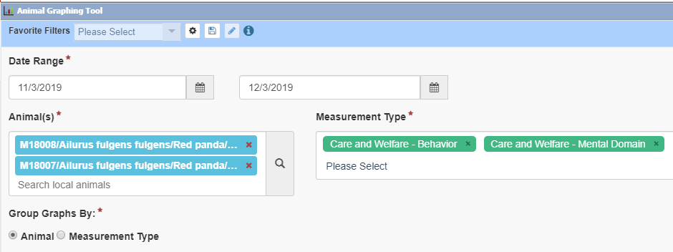
Can I Graph Data for More Than One Animal?
You can graph only one Animal at a time within the Care and Welfare module
However, you can use the Animal Graphing Tool to graph multiple Animals

Slide 18
Does the Data go onto the Animal Record?
Yes and No
Weights, Body Condition Score and Health Status will update in the Animal record when captured in the Care and Welfare module
All other data remains in the module
To see it create a Chart or look at List View
Charts can be printed or downloaded
Data can be exported to Excel

Slide 19
Now it’s Your Turn!
Some Topics for Discussion:
How do you determine the animals to assess?
Who configures the Indicators?
Who creates the Templates?
What are you assessing?
How often are your assessments?
Are you assessing Groups?
Are you using Taxonomic Exceptions?
?????

Slide 20
Care and Welfare
Easy tracking of your animal mental and physical health!

