Slide 1

Back to the Future!
November 2019 TNT
Going Back to Enter Historical Records can Impact the Future!

Slide 2

Historical Records are not a
place for the faint of heart.
Although it may be tempting
to assign their entry to a
volunteer or intern, entering
Historical Records uses all
the components of good
record keeping and Best
Practices with the added
difficulties of incomplete and/or confusing data that
can be decades old! Accurate interpretation of this data is paramount for the accuracy of your current records.

Slide 3

Why Bother? Genetics!
With managed animal
populations it’s very
important that all genetic
information is researched
as this historical data can
greatly impact the current
population if errors are
found or more information
becomes available. Studbook
Keepers love it when they
can get rid of those unknown
parents!

Slide 4

Why Bother? Demography!
The demography, or population
numbers of a species, is also very
important for animal management
and analysis can only be accurate
if all animals are recorded. For
example, if an animal has an
estimated Birth Date it is commonly
discarded in longevity analysis.

Slide 5
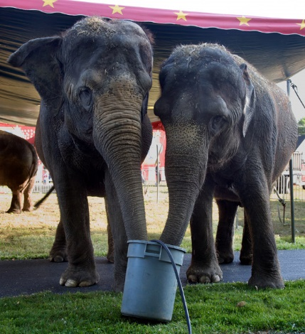
Why Bother? Management Practices!
Information on husbandry issues
such as diet, reproduction and
animal management practices
are often unearthed. This
information can help you understand
why animals were managed the
way they were in the past.

Slide 6
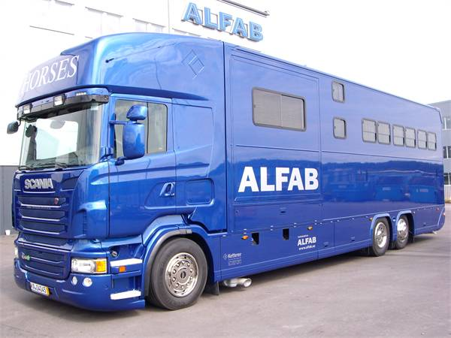
Why Bother? Fill in Unknowns!
Maybe you can fill in those unknown
dealers, transporters and institutions
that you have dealt with. Maybe find
some of those unknown addresses or
find duplicate entries using slightly
different information. You may help
get some additions to the global lists!

Slide 7
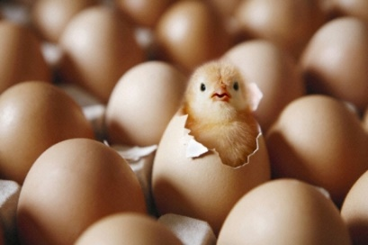
Why Bother? Correct Past
Conventions
Researching historical records can
also show how animal records
keeping has changed over the
years. Did you know that a
common practice in the past
was not to record a birth or
hatch until the offspring survived
for 30 days? Can you imagine
how that affected analysis of
reproductive ability of the parents?

Slide 8

Don’t Create Fiction!
It is important to recognize when you DON’T have enough information to create a record or add to an existing one.
It is better to have an Unknown entry than fiction in a record that is interpreted as the truth. Fake records!!!
This is why a trained records person needs to be charged with historical data entry as decisions must be made.

Slide 9
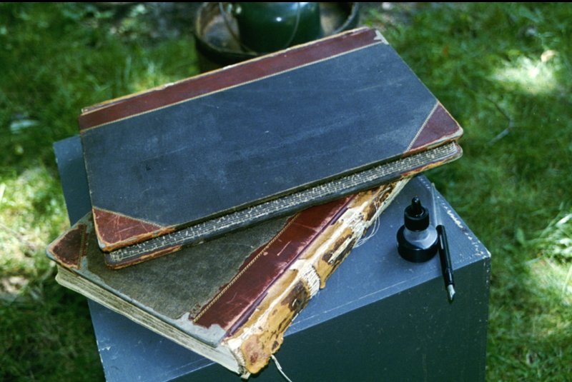
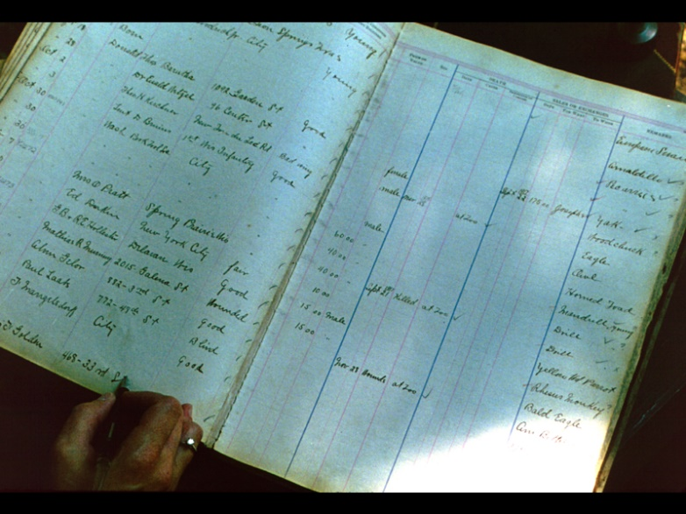
Sources for the Data –
Expedition Logs
There are many sources for this
historical information. Years ago,
zoo's got their animals mainly
through expeditions. Some of these
old log books are still around, as
at Milwaukee County Zoo. In them
they kept track of what animals they
captured, recording date, species
and condition of the animal. They
also used these log books to keep
track of transactions between other
institutions, dealers and private
individuals.

Slide 10
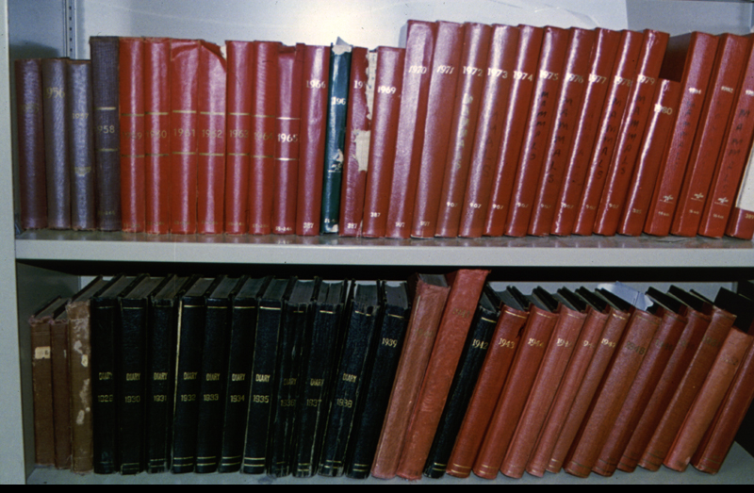
Sources for the Data –
Keeper Log Books
Milwaukee County Zoo still
has daily keeper log books
in addition to its expedition
books. Old accession logs
would be useful also.

Slide 11
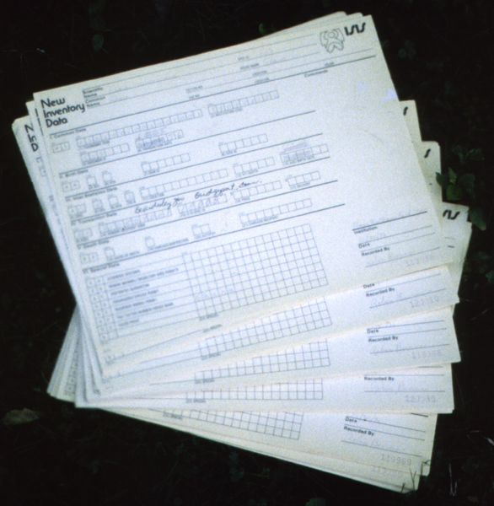
Sources for the Data –
Old ISIS Forms
These are the old ISIS paper forms. Species360
used be called the International Species
Information System. They were duplicates
and you would keep the heavy paper and
snail mail the lighter one to ISIS. Everything
was coded from events (AA= birth, BA = death)
to institutions and taxonomy (lengthy numeric
codes). In those days we charged per record.
So your frog record would cost as much as
your polar bear record. This meant institutions
did not submit all of their records. At my first
institution I found a box of these papers for
birds. Both copies were there so they were
never submitted. This was a gold mine for
those historical records!

Slide 12
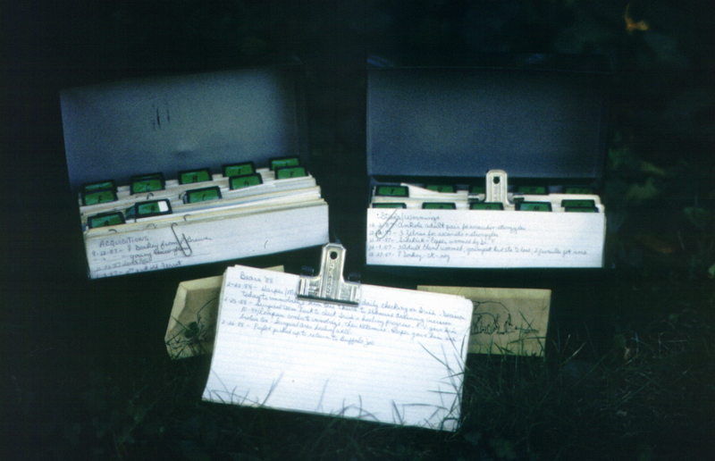
Sources for the Data –
Species Cards
Although we submitted paper forms for
arrivals and departures, all other information was hand written on species cards by the Deputy Director. These cards were filed by species with a running commentary of significant happenings and medical care. There were no individual records kept. Finding information wasn’t always easy. I found the records for our Belgium horses under “H”, which made sense. But our miniature horses were filed under “M”. So much valuable information that was difficult to retrieve.
Notes:
These were how we kept animal records when I first started at RWPZ. The Deputy Director
kept up the species note cards at the top. The were filed by species with a running commentary of
significant happenings and medical care. There were no individual records kept. Finding information
wasn’t always easy. I found the records for our Belgium horses under H. But our miniature horses
Were filed under “M”
On the right are the old ISIS paper forms. These were duplicates and you would keep the heavy
Paper and mail the lighter one to ISIS. Everything was coded from events to institutions and taxonomy.

Slide 13
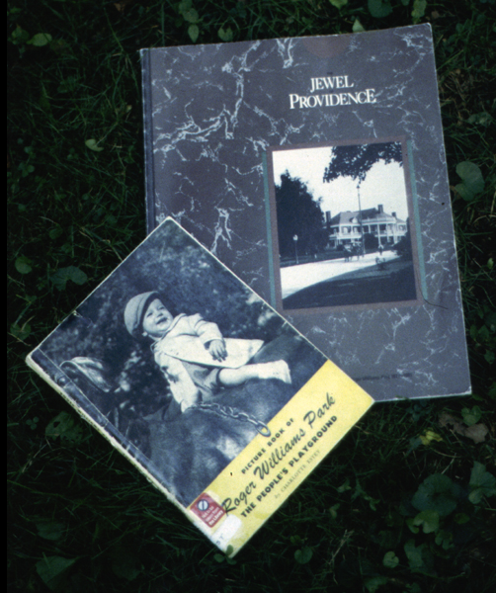
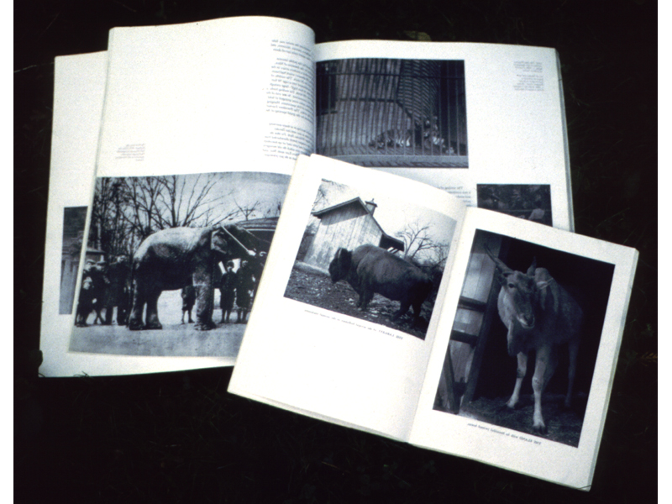
Sources for the Data –
Institution Publications
Institution publications and brochures
can help with dating and species
identification. In addition to articles,
they might have pictures that clarify
species identification and provide
answers to husbandry and exhibit
questions.

Slide 14
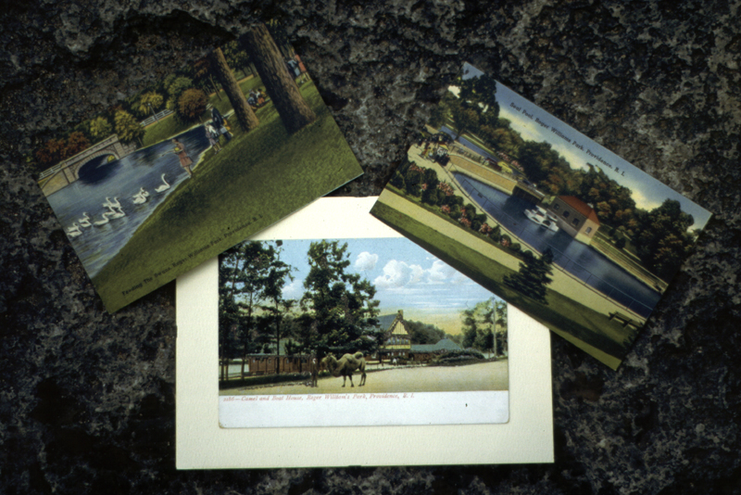
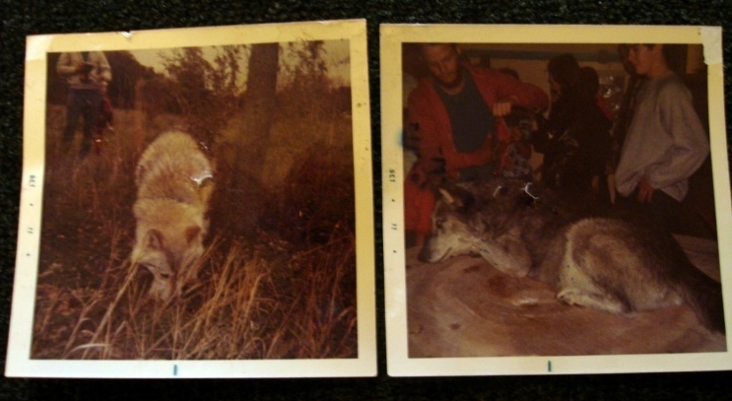
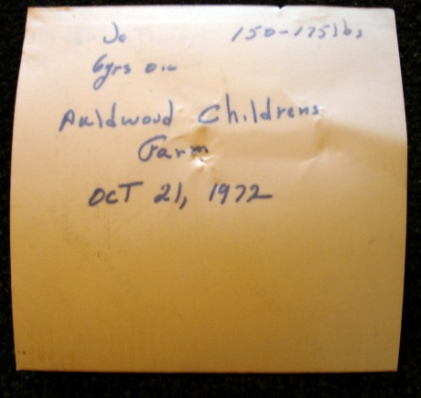
Sources for the Data –
Postcards and Photographs
Old postcards and photos can also be referenced. On the right are historical cards from Roger Williams Park Zoo when the zoo was spread out throughout the park and animals were not behind a perimeter fence. Images, if dated or notes attached, can also be helpful.

Slide 15
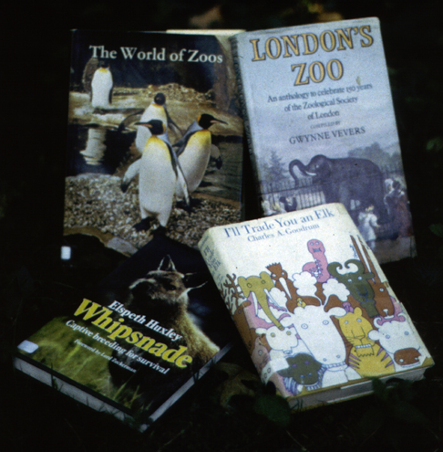
Sources for the Data –
Popular Press
There might be books written about
your institution. Whereas publications
distributed by your facility may be quite
helpful, be very careful using the
popular press as a reference for historical
records information.

Slide 16
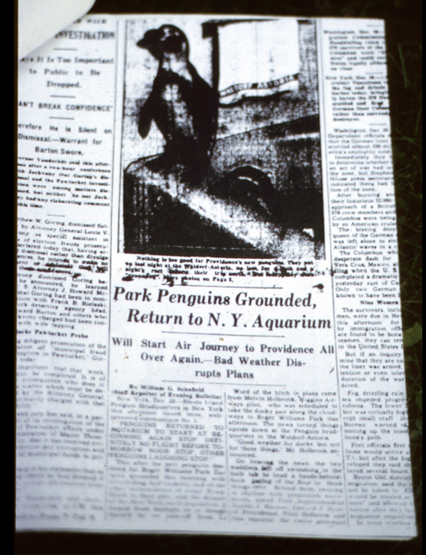
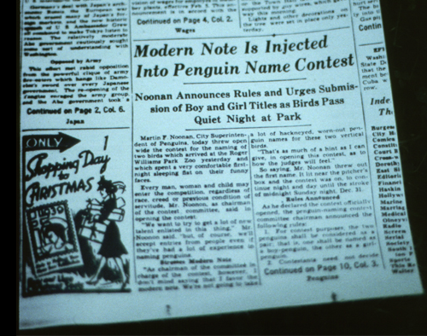
Sources for the Data –
Newspapers
Newspapers are notorious for being unreliable.
While researching historical penguins I found a
newspaper reference to two penguins that were
coming to the zoo. The article on the right could
not be used as the birds were still in New York in
a bathtub in the Waldorf Astoria hotel. But when
I found the article below I could confirm as it
mentions their arrival date and sexes.

Slide 17
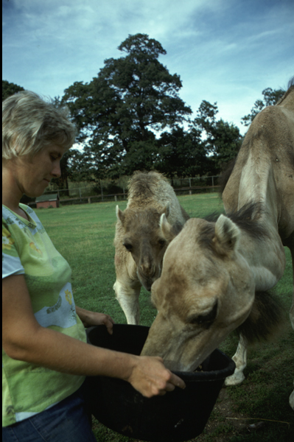
Sources for the Data –
Your Staff!
Don't forget your staff. This is a photo of
RWPZ’s former Deputy Director when she
was a keeper at the zoo. I came across a
record of a pair of fennec foxes being wild
caught in Rhode Island. I asked her about it
and she confirmed that yes, they were
found running wild in the park. When the
studbook keeper questioned me years later
I could confirm to him that this information
was indeed accurate.
staff

Slide 18

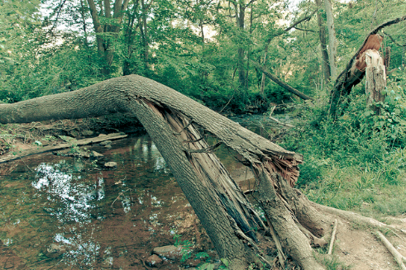
Know Your Sources
Not all sources are created equal
Primary Source – can stand alone
  expedition logs, keeper logs, old ISIS forms, species cards, photographs, staff (if their memory is good!)
Supporting Source – just that, it needs support
  publications, popular press, newspapers
Make sure your source is strong enough to support the data created from it and not one that will collapse leaving you unsupported.

Slide 19
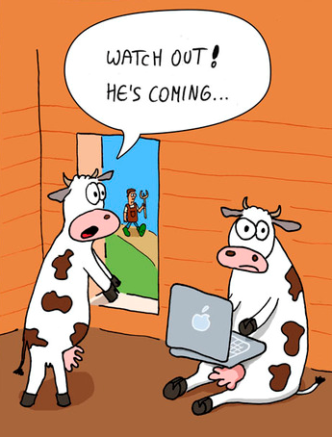
Things to Watch Out For
Name Changes
  Common – or many synonyms
  Scientific – they do change!
    ZIMS can help you track these
  Vendor - Burnet Park Zoo is now
  Rosamond Gifford Zoo; Washington
  Park Zoo is now the Oregon Zoo
    ZIMS can also help track these
Date Challenges
  Lack of
  Confusing – 01/06/98
    January 6 1998 or June 1 1898?
Terms
  Unknown/Unclear
  Conflicting

Slide 20
Best Practices - Dates
When you have some references to the animal being in your collection but no information on Acquisition or Disposition Date
Acquisition Date
  Date Field = date of first reference
  Estimate Field - ApproxBefore
Disposition Date
  Date Field = date of last reference
  Estimate Field = ApproxAfter

Slide 21
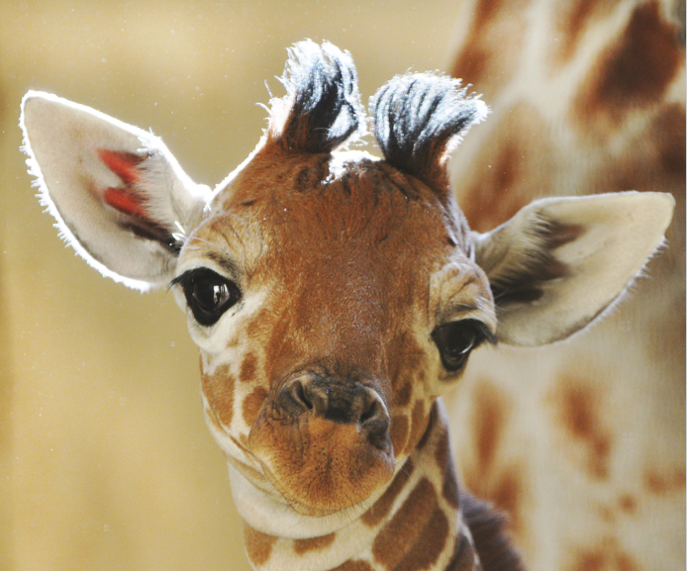
A Giraffe Example
You have this information only:
  Vaccinated on 4 March 1950
  Foot problem treated on 1 June 1952
Acquisition Date
  Date Field = 4 March 1950
  Estimate Field = ApproxBefore
Disposition Date
  Date Field = 1 June 1952
  Estimate Field - ApproxAfter

Slide 22
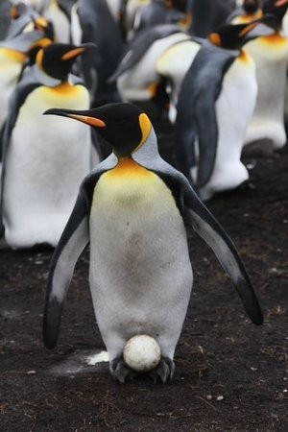
A Penguin Example
You have this information only:
  Egg laid on 7 March 1960
Acquisition Date
  Date Field = 7 March 1960
  Estimate Field = ApproxBefore
Disposition Date
  Date Field = 7 March 1960
  Estimate Field = ApproxAfter
NOTE: You may need to adjust time stamp

Slide 23

Ambiguous Dates
What do you do with 06/10/1951?
  Could be June 10 1951
  Could be November 6 1951
There is a Solution!
  Select Date Estimate = Range
  Start Date = June 10 1951 (the earliest possible date)
  End Date = November 6 1951 (the latest possible date)
  ZIMS application fills in the Date Field!

Slide 24
Unknown Terms/Unidentified Animals
Your 1949 inventory lists 1.1 giraffe and your 1950 inventory lists 1.2 giraffe
  You can assume the addition was a Birth, but too much assuming creates possible fiction (remember – don’t create fake records!)
  Accession Type should be Undetermined / Indeterminate for the new female
Your 1951 inventory now lists 1.1 giraffe again
  Which female is gone?
  Was it a death or a disposition?
  When all you have is inventories you may want to….

Slide 25
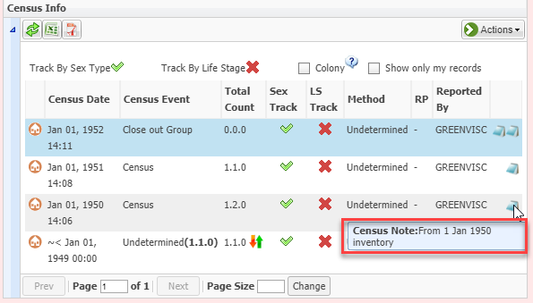
Consider a Group Record
If all you have is inventory
counts you may want to
consider a simple group
record and census counts
to capture the data. Make
sure you record a note
about where the count
came from. If you get to a
point where you can now
individually identify the
group members, split them
out and create individual
members and Close Out
the group. If there is a time
that historically you can
identify some members you
can split them out as
individuals as of that date.

Slide 26
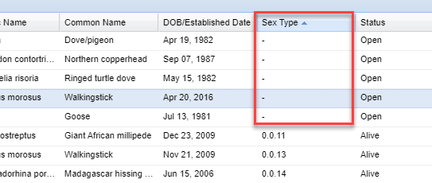
Finding Groups to Close Out
Since we are on Groups, you may have
some Group records that need to be
Closed Out so they do not continue to
appear in searches and on reports. To
find these records run an Advanced
Animal Search for Current Animals >
Animal Type of Group. Sort Sex Type by
Ascending. All of your Groups with a
census of 0.0.0 will display at the top
with a Sex Type of “-”. Review the record
to see if this Group should be Closed Out
(Dispositions > Full Disposition > Death/
Close Out). Groups that have a census
that is not 0.0.0 may still need to be
Closed Out and these are harder to locate.

Slide 27
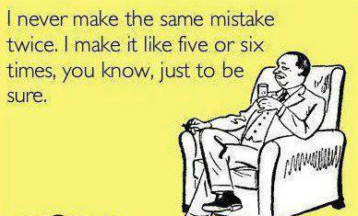
Correcting Historical Data
Sometimes you may not be
entering historical data, you may be going back and editing what was entered because new information
came to light. Or, it was entered incorrectly in the first place. You should document why the data
was changed and what it was prior to the change. Such documentation is
especially important when Parents,
Taxonomy, Life Status (living or dead),
Sex and Transaction Terms are edited.

Slide 28
Correcting Historical Data
Way 1
  Use Note Type “General”
  Use Note Sub Type “Data Change”
Way 2
  Select appropriate Note Type (example “Transactions”
  Select appropriate Note Sub Type (example “Disposition Note”)
  Keyword of “Data Change”
Way 3
  Use the Details box when making the edit
  Include “Data Change”
  Details boxes are not always available.
Most important thing is to be consistent for
data change retrievals
Notes:
Read cartoon

Slide 29

This Note Should Contain:
WHAT the old data was
WHAT the new data is
WHY the data was changed
WHERE the information came from
WHO changed/approved the data
WHEN the data was changed
EXAMPLE
  Bird was initially recorded as Male. Corrected on 6 Sept 2019 to female by Adrienne Miller because an egg was laid on 3 May 1967 as per Keeper Log of that day.

Slide 30

What Date to Use for Notes?
When recording current data,
the Event Date (whenever whatever
it was occurred) is often the actual
Recorded Date (when it was entered
into ZIMS) or maybe just a few days
previous. When recording historical
Notes, the Event Date could have
been decades prior to when the
Note actually got into the record.
There are differences of opinion if
you should use the Event Date or the
Recorded Date for the Note Date.

Slide 31
What Date to Use for Notes?
Use the Event Date
  Pro – the Note will be in the right chronological order
  Con – there may be confusion because that information was not actually available/recorded at that date
Use the Recorded Date
  Pro – You capture when this information actually went in to the record
  Con – the Note will not be in the right chronological order
Whichever you use, you can capture all the information by
  If Event Date is used record the Recorded Date in the Note
  If Recorded Date is used record the Event Date in the Note

Slide 32
Today’s Data Entry is Tomorrow’s History
To help make your current data entry and documentation historically valuable:
  For your data entry
    Use only reliable/primary sources when possible
  In your Notes
    Do not use slang, texting or non-standard abbreviations
    Write professionally
    Record why and how data was estimated or changed
  In your documents
    Reference species and GAN or Local ID
    Date all documents: day in numbers, month written out, entire year

Slide 33
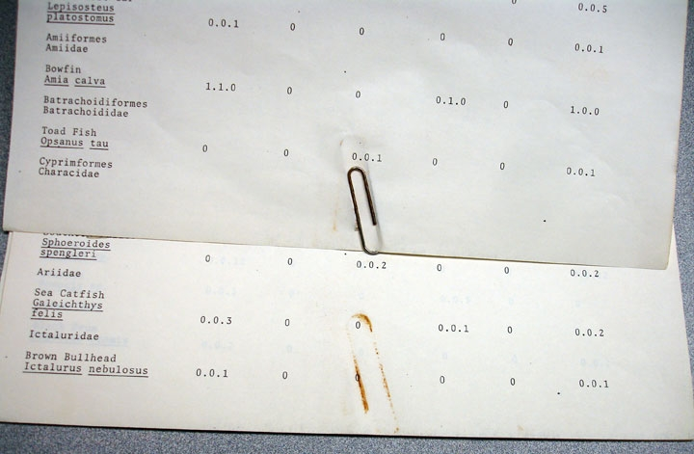

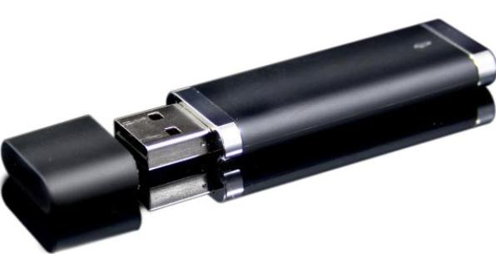
Make your current documents last!
Remove all hardware
Make copies or scan any flimsy faxes
Safe Storage for both hard and electronic files
Notes:
You want to make your records last.
> Remove all paper clips and staples or use plastic coated ones.
> Make copies of FAXes, especially old slippery fax paper ones as shelf life is very short on them.
> Store your documents securely.

Slide 34

Back to the Future!

