Slide 1
Writing Good Notes –
It’s NOT That Simple!
Plus some time saving tips for Notes & Observations
August 2019 Tips and Tricks

Slide 2

Notes
Stephanie Eller, Registrar Philadelphia Zoo, AZA Institutional Records Keeping Instructor:
Confession: I used a lot of her IRK Notes and Observations presentation to prepare this TNT
“While the other data entry fields are the bones
of an animal record, the Notes are the “muscle”
of a complete Animal record”
Notes are free text data entry fields with almost unlimited length (>65,000 characters).
They are often the first access given to new ZIMS Users being trained at institutions.

Slide 3
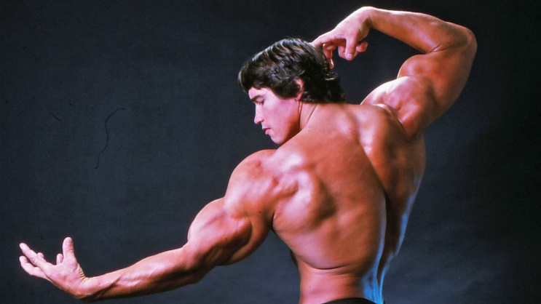
Notes
Notes are used to:
  Capture information not recorded elsewhere
  Provide details for information that is recorded elsewhere
    Why and how you estimated a date
    Why you checked the estimate checkbox in a weight record
    Name and address of the kind lady who donated the parrot that she was sure you were thrilled to get
  Provide details about why data was changed
An extra layer of context and explanation
Writing a good Note should be simple and easy, but it is not as simple as it sounds………

Slide 4
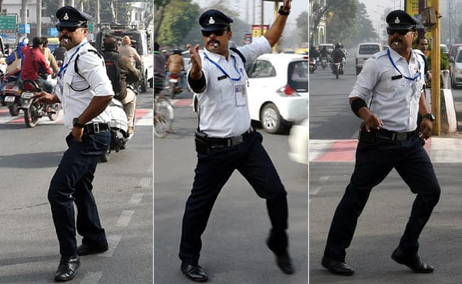
Lack of Standardization
The free text functionality of Notes means that ZIMS is not forcing standardized
data entry using Data Standards as most of the other data entry screens do. This
makes interpretation and retrieval of the data more difficult. Because ZIMS
cannot force standardization within your institution or globally, your institution
is responsible for making sure that the information contained in the Notes is
accurate, complete and standardized. You need someone to control the flow
of Notes, making sure the good ones get through and the bad ones get stopped
and corrected. Otherwise the consistency and the utility of your data will be
compromised.

Slide 5
The Registrar’s Responsibility
In most institutions that policeman is the Registrar
Maintain a high level of professionalism and accuracy in the records
  They may do the data entry themselves
  They may approve the entry (Provisional records)
  They may simply monitor the entries made by others
Ensure that Institution conventions and protocols are followed (Reporting Standards)
  By themselves (I do things differently every time!)
  By other Staff (but this means they need to know what the conventions are!)

Slide 6
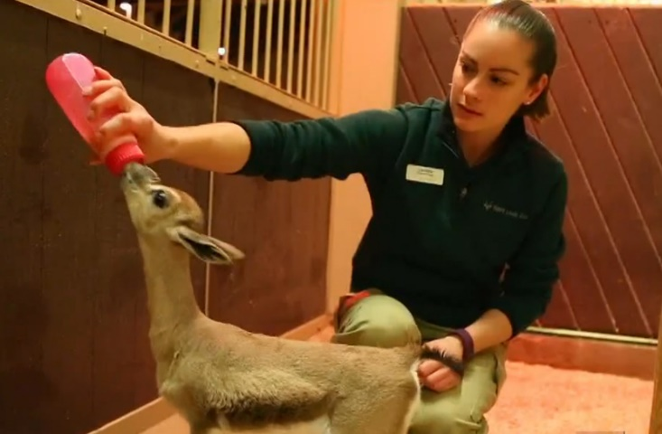
Advantages of Direct Entry
(or at least granting View access to Notes)
Staff can see for themselves the importance of thorough notes (and not just you saying so over and over)
  How successful was a female in rearing in the past
  How frequent the stereotypic behavior is and are there any patterns prior to occurring
  How the slow changes of a chronic illness displayed
Often “insignificant” observations can build on each other and become vital future references

Slide 7
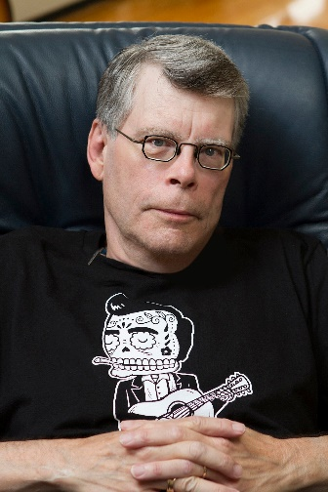
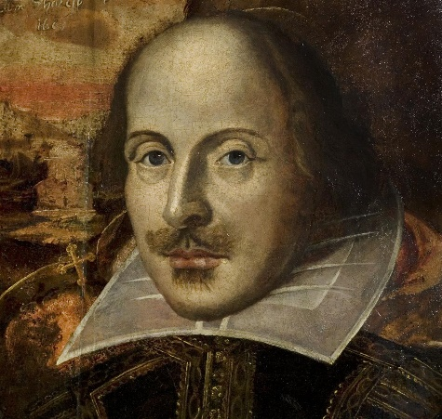
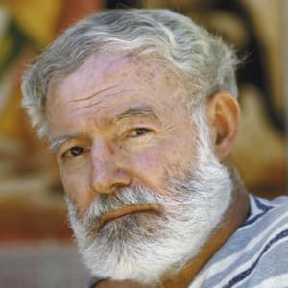

What is a Good Note?
Simply put (more details later) a good Note is………..
  Short and sweet (KISS)
    Don’t write a novel, avoid verbosity
    (too many words)
    Although these guys write great novels
    and plays, they may find it difficult to write
    a good Note
  Clear and understandable
    Use simple, readily understood words
      The cheetah was “indefatigable”?
      The cheetah had tireless energy
  Consistent and Standard, regardless
  of recorder
The ease of global sharing of Notes makes
this even more important

Slide 8
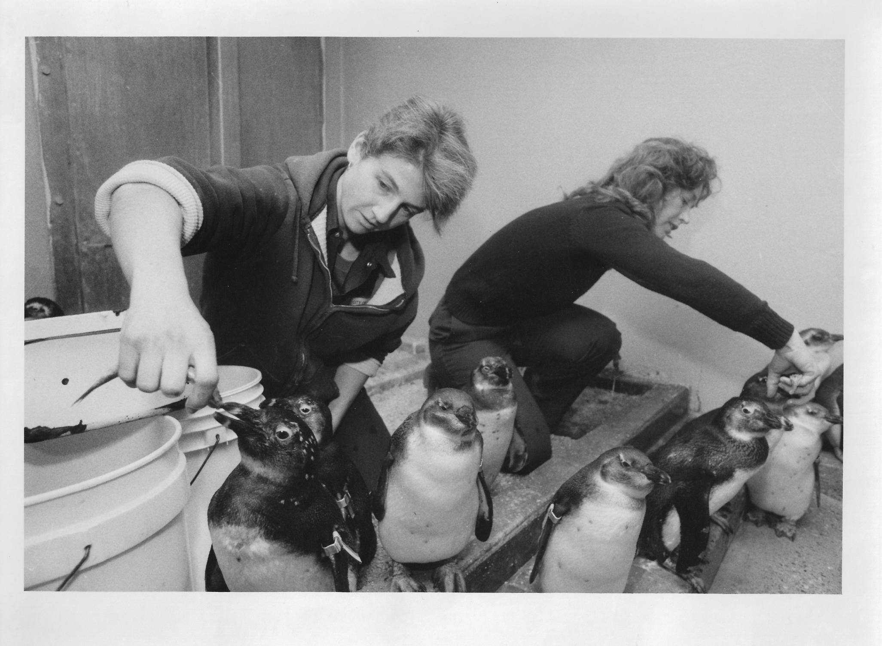
My First Attempts
Many, many years ago, as a penguin keeper
I wrote the following on a Keeper Daily:
“The case of Spike and the rubber band.”
I was called on it by our General Curator –
what did it mean? To this day I can’t
remember what it meant, and someone
else reviewing Spike’s record sure won’t!
That was NOT a good Note. Hopefully this
TNT will help you avoid my errors.

Slide 9

Where you can enter Notes
Note & Observation Tab
  Animals, Enclosures, Life Supports and Components
    Note Type required
    Note Sub Type optional
    Keyword optional
    Observations can ONLY be recorded here
      More on Observations later
  These Notes generally capture information not recorded elsewhere

Slide 10
Where you can enter Notes
Details Box are in almost every data entry screen
  These are a good place to record why and how you recorded the data the way you did. These Notes expand on and explain data that has been captured.
    The Measurement was estimated because the animal would not hold still
    The penguin Life Stage was updated because he molted out of his juvenile feathers
  These Notes get copied into the Notes & Observation grid, write them so they are clear without the context of the screen
    For the Measurement
      DO: The animal would not hold still so the Measurement was marked as Estimate.
      DON’T: So squirmy!
    For the Life Stage
      DO: Molted out of juvenile feathers, Life Stage updated to Adult
      DO NOT: molted

Slide 11
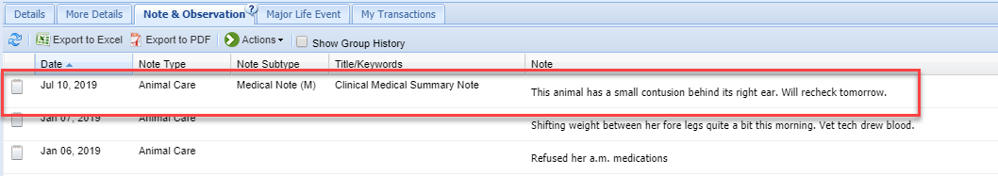
Where did that Medical Note Come From?
When your Vet records Clinical Notes the Notes stay within the Medical module.
However, there is a type of Clinical Note called Animal Care Staff Medical Summary that does get copied into the Note & Observation tab in the Husbandry module.
There are also notes that go into Husbandry in the Necropsy and Biopsy Medical modules
You cannot edit or delete these Notes, so hopefully the author is trained on how to write a good Note!

Slide 12
Is it a Note or an Observation?
Observation Fields Include:
  All the Note Fields
  Observation Quality
  Observation Location
  Start Time & Duration
  Observer Type
  Observer
  Scheduled checkbox
  Observation free text box
It depends on how much information you have or how much information you want to capture
Notes Fields Include:
  Date
  Keywords
  Note Type
  Note Sub Type
  Note free text box

Slide 13
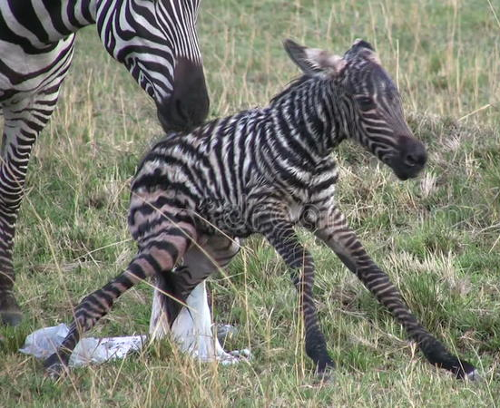
My Standard Example:
You check the zebra yard first thing and
there is your long awaited foal! This
would be a NOTE in both the foal and
dam record, and maybe the sire’s too if
that is your convention.
You notice that the female zebra is going
into labor at end of day. Because the dam
has a history of difficult births, you have
a staff member remain after hours. They
watch the labor, birth, standing and
eventual nursing of the foal. This would be
an OBSERVATION (if your institution uses
them). You have an Observer, a Start Time,
a Duration of the Observation and the
Observation Quality.

Slide 14
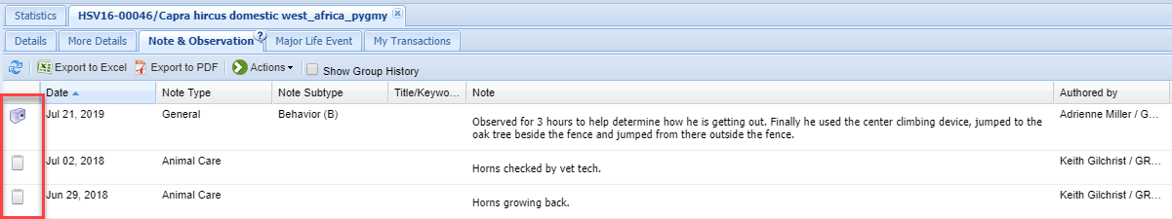
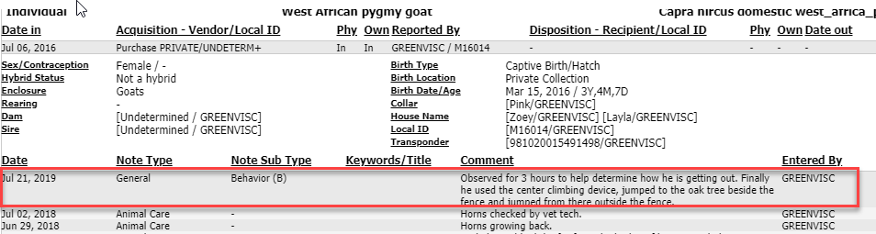
Display in Record and Reports
In the animal record, Observations will display as a camera icon and Notes will display as a notepad icon (top). In the Specimen Report there will be no indication that it was an Observation if you choose to combine Notes and Observation (below).

Slide 15
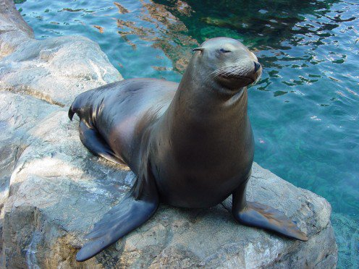
Reporting Standards
(a Note Training Manual)
The Standards provide both you and other Staff guidance
Clearly states what is expected
It should include:
  What should be Recorded
  Standardization of Entries
  Terms to be Used
  Acceptable Acronyms
  Acceptable Abbreviations
  What Date to Use
  How to Explain Changed Data
  What NOT to do!

Slide 16
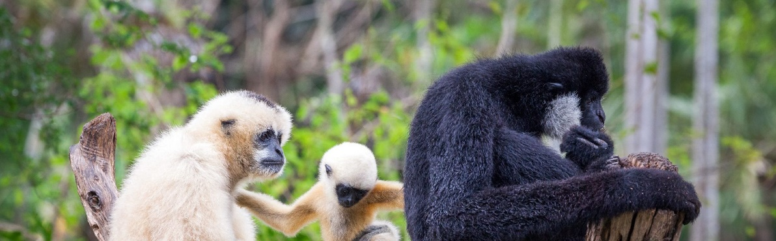
What Should be Recorded - Stress Consistency
It is very important to stress consistency in what is reported as a Note. All Staff should
report at the same level. For example (this is from my experience as a Registrar
interpreting keeper dailies years ago):
1.Gibbon Keeper Sally recorded every move the gibbons made, including great details
about what the circumstances were when they could not be successfully locked in for
the night.
2.Gibbon Keeper Kendra only recorded major observations such as copulation or injury.
3.The result was that the Notes did not paint a complete picture and were actually
misleading. Because Sally provided information when the animals were not locked in and
Kendra did not, the records gave a false history of their shifting behaviors. HINT: A Note
Template for Night Shift Issues may have encouraged Kendra to record the data!

Slide 17
Stress Standardization
Note order
  If you are still doing hand written or electronic dailies, let the Staff know the order the Note should be entered.
  Common practice: Local ID, species (some institutions require taxonomic name), physical Identifier (to make sure you are in the correct record), and then the Note text. Some institutions want the person recording the Note on the daily to be identified. If doing direct ZIMS entry this is easy by selecting the signed in User to be the Responsible Party.
Note Types and Sub Types
  All Staff should select the same Note Type/Sub Type for the same topic entry. Makes data retrieval so much easier.
Keywords
  If using them, all Staff should use the same ones. Again for better data retrieval

Slide 18
Include Local IDs in Batch Note
Include Local IDs in Note option
  Detail in what situations the other Local IDs would be included. Just because you are recording a Batch Note, knowing what other records it went into may or may not be important.
    Was a physical exam done on all your river hogs? Probably not needed.
    Did extreme aggression appear between your river hogs? Probably a good idea to include all those involved.
  HINT: Always enter your Note Text in front of the “This Note added….” text so it appears first in the Note when you read it.
Some institutions want an Identifier included within the body of the Note. Why?
  Easier to correct if the entry was made in the wrong record.
  Including a physical ID can guard against the entry going in the wrong record in the first place. I dealt for years with confusing entries on cheetah brothers because
  the staff could not agree who was who and no one bothered to read the tattoos
  when possible and add to the Notes to help end the confusion!

Slide 19
Terms to Use
  The words you use in a Note should be professional. Remember they could be used in a court of law or read by others who may not correctly interpret them if your records are requested under the U.S. Freedom of Information Act (FOIAed). Not all institutions are required to provide documentation when FOIAed so it is a good idea to find out if your institution is considered a federal agency or not.
  Examples
    When describing a breeding encounter
      Use “Copulation” not “Making Whoopy” (I did get that once!)
    When describing a surgery
      Use “Immobilization” or “Anesthesia” not “Knock Down”
    Try to use words that are recognized internationally, or at least regionally
      Is your fizzy carbonated beverage a soda, a pop or a coke? Is your lunch a grinder, a sub, a hoagie or a hero?
  Including a list of these Terms, in addition to a list of Keywords in your document will help you and your Staff be consistent and professional

Slide 20
Why Does Word Choice Matter?
An animal suffers bouts of loose stool. Vet wants keepers to make daily Note records on the condition to figure out the pattern and determine the cause.
  Monday – Kendra records “stool is loose”
  Tuesday – Fred records “feaces is normal”
  Wednesday – Sally records “defecation is extremely loose”
  Thursday – Kendra records “poop is normal but a weird reddish color”
  Friday – Steve records “scat appears normal but not in the usual amount”
On Saturday the Vet wants to see all the days that the feces (her preferred term) was recorded as being normal. She runs a Note Retrieval Report using a Text String for “feces” and “normal”. Nothing shows up! She is now very concerned about the animal. Nothing showed up because the days the feces was normal Fred used “feaces” (he is from the UK), Kendra used “poop” and Steve used “scat”.

Slide 21
Acceptable Acronyms?
Term formed from the initial letters of a longer name
Examples
  Organizations
    FWS or USFWS – United States Fish and Wildlife Service
    EAZA – European Association of Zoos and Aquaria
  Animals
    BFF – black-footed ferret (not best friends forever)
    GLT – golden lion tamarin
Organization acronyms can change over time as names or focus change, so be careful
  EAZA used to be ECAZA
  AZA used to be AAZPA
Again, develop a list of approved acronyms
Recommended to spell it out the first time it is used in a record

Slide 22
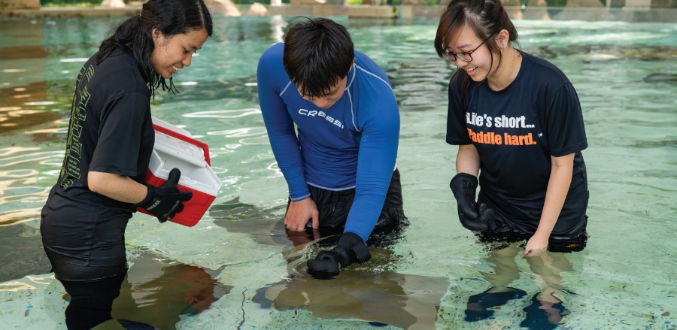
Acceptable Abbreviations?
Shortened form of a word
Be careful – not all are recognized internationally, or even regionally
They can save time so….
  Develop a list of accepted abbreviations
  The first time the abbreviation is used in the record, define it! That way others will have a reference for exactly what you meant.

Slide 23
What Date to Use?
Generally, the Date entered for the Note should be the Date the event took place
There are exceptions for historical Note entry when you may be recording the Note decades after the event occurred, if you even know the actual Date
  If you use the event date as the date field make sure to record the date that you recorded it in the Note details
    This is important because it lets someone reviewing the record know that this information was not known until a later date
  If you use the recorded date as the date field make sure to record the date that the event occurred (or an estimated date) in the Note details

Slide 24
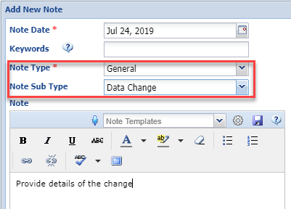
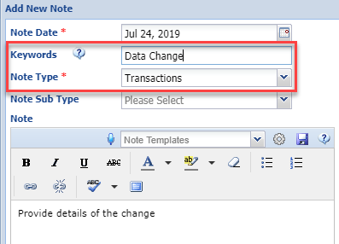
How to Explain Changed Data
In a perfect world, the data you entered would never change. But in the real world it does. When you change data, especially data that may have a great impact on a record such as Parentage, Taxonomy and
Dead/Alive Status, you should add a Note to explain the why of the data change. There are two ways you can record this. One, use
Note Type of General and Sub Type of Data Change (top). Two, select the appropriate
Note Type and enter a Keyword of “Data Change” (bottom). Both methods are easily searchable in a Note Retrieval Report. The important thing is that you are consistent at your facility.

Slide 25
What NOT To Do!
Texting – Don’t Do It!
  The Vet checked F2F 2d and may check again by EOD or no L8R than 2nte. He is JC that PAW, which they are. He thinks the video monitoring we mentioned SLAP but he wants to W8 AFAIK. AAMOF he is planning YAM on the topic.
  The Vet checked in person today and may check again by end of day or no later than tonight. He is just checking that parents are watching, which they are. He thinks the video monitoring we mentioned sounds like a plan but he wants to wait as far as I know. In fact, he is planning another meeting on the topic.
Slang – Don’t Do It!
  “Wicked” means good in some North American regions but its definition is “evil or morally wrong”. Its use could confuse your colleagues!

Slide 26
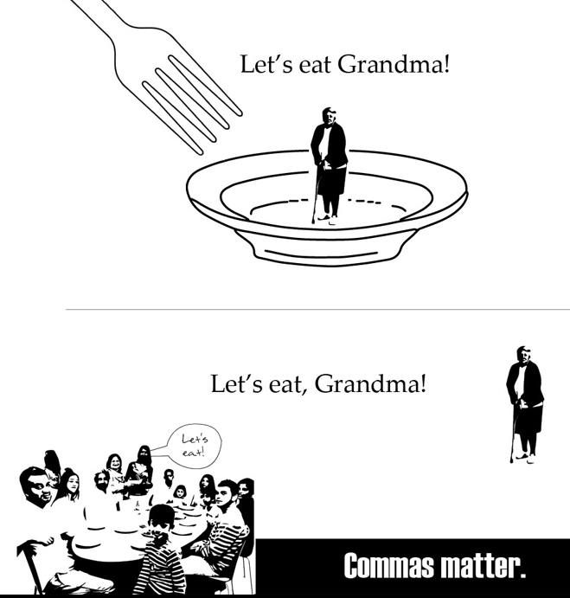
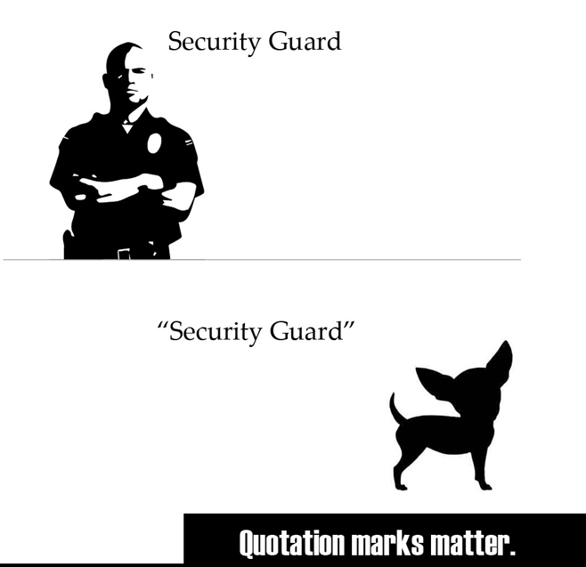
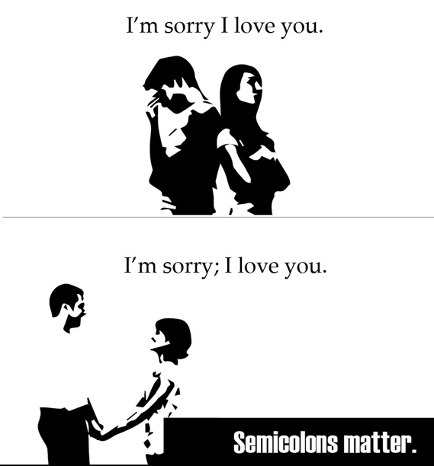
Use Correct Punctuation
The correct punctuation may be quickly overlooked
when time is short and you are trying to get your
data entered. However, used incorrectly, punctuation
can completely change the meaning of a sentence.

Slide 27
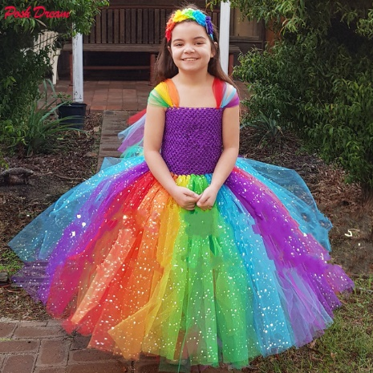

Use Correct Grammar
Misuse of Apostrophes (so common!)
  The cheetah was licking it’s tail.
  The cheetah was licking its tail.
Modifiers
  When cleaning the otter pool drain I found a sparkly girl’s bracelet.
  When cleaning the otter pool drain I found a girl’s sparkly bracelet.

Slide 28
Use Correct Speling
Some of the greatest authors were bad spellers
  F. Scott Fitzgerald, Ernest Hemingway, Jane Austin, John Keats and Winston Churchill
  But they had editors to correct them!
With the global sharing that is ZIMS, correct spelling in any language becomes even more important as others may be trying to translate your Note
If you are transcribing data from other entries such as dailies, or if you are approving or monitoring entries, don’t let yourself become an editor for others!
Some top misspelled words in English you might use:
  Definately (Definitely)
  Goverment (Government)
  Seperate (Separate)
  Occured (Occurred)
  Untill (Until)
  Recieve (Receive)
  Wich (Which)
  Accomodate (Accommodate)
  Calender (Calendar)

Slide 29
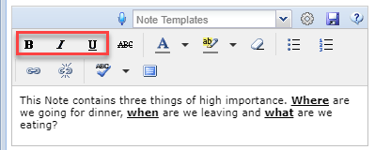
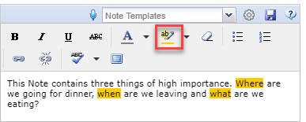
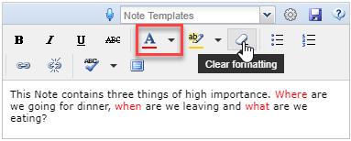
Have you Thought of Formatting?
Make the most out of the functions
available within the Note screen.
To draw attention to specific parts of
your Note you can use the various
formatting options available. You can
make specific words or phrases BOLD.
You can highlight them. And you can
make them different colors. Use the
eraser icon to clear the formatting
if you need to.

Slide 30
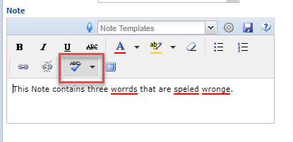
Are You Using Spelcheke?
Although automatic spellcheck
is not yet an option, it can be used.
Use the down arrow to select
English (US), English (UK) or Spanish.
It is not yet available in Russian or
Japanese, the other languages that
ZIMS is available in. Then click on the
ABC icon. The misspelled words
will be underlined in red to correct.

Slide 31
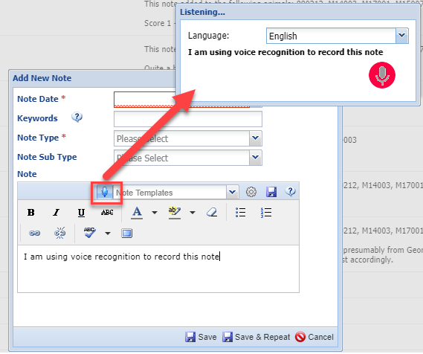
Voice Recognition
You may find that using Voice
Recognition can be a time
saver. Select the microphone
option and the language
desired. Then simply start
talking! ZIMS will type along
with you. One note of advice
though – read what has been
typed! In front of a workshop
of almost 50 people, ZIMS
interpreted what was said as
referencing various body parts,
nothing that should have gone
into an animal’s record!

Slide 32
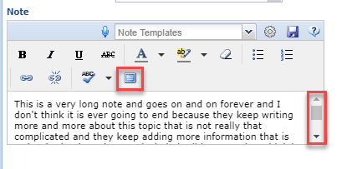
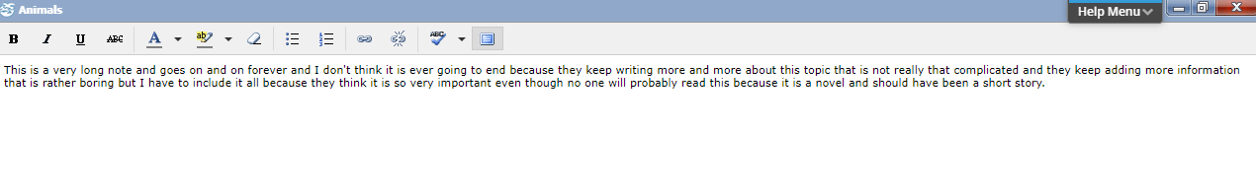
Will Full Screen Help?
Although it is usually best to keep Notes as short as possible to accurately and completely
capture the information, there are times when a lengthy Note is required. In the normal view
you will not be able to read the entire Note without scrolling. Instead, select the Fullscreen
icon to view (or type) the entire Note.

Slide 33
Batch or Template or Both?
Batch
  The same, or similar, Note in multiple records
  Example: You just did a health check on a litter of African hunting dogs
  You can record the same Note in each animal record or customize each Note
  Batch = fast!
Template
  Ensures that you capture what you need in the Note in the order that you want, or you don’t have to retype something
  Example: You want to make sure you capture all the data required for an initial health check
  Template = capture it all in the order you want!
Both!
  Enter Notes in multiple records that capture all the information needed
  Example: Record a Batch Note on the litter using the Health Check Template
  Both = capture it all how you want it and fast!

Slide 34
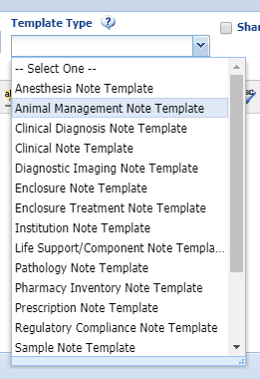
Creating a Template
You can create a Template from Start >
Tools > Manage Note Templates or from
within the Note record. If creating from
the Manage Note Templates option you
will need to select the Template Type.
If created from with a Note record the
Template Type will default to what
module you are in. The Template Type is
important because the Template will
display for selection ONLY when in the
appropriate record such as an animal
record for an Animal Management Note
Template or an enclosure record for an
Enclosure Note Template.

Slide 35
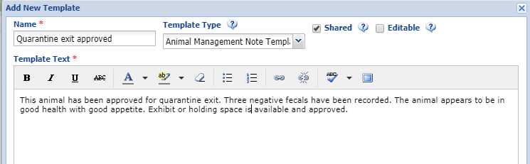
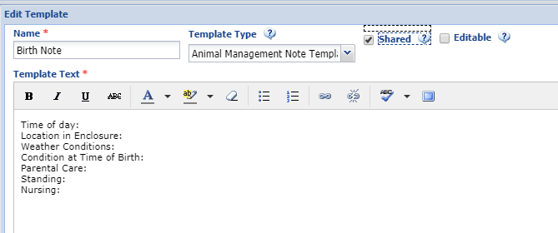
Creating a Template
Templates can be created
with a text stream such
as the Quarantine Exit
Template (top). This saves
someone typing the same
information every time an
animal exits quarantine.
Templates can also be
created as lists to help you
capture the information
desired in the order you want
such as the Template to capture
Birth information (bottom).
If you check to Share or Edit,
anyone with access to
Templates can use it or edit
it.

Slide 36
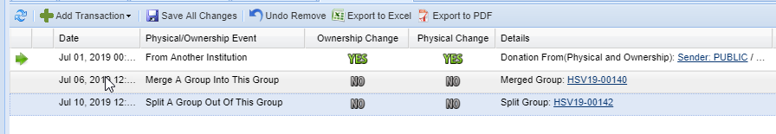
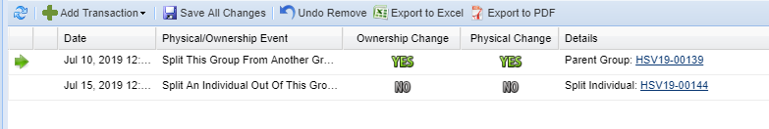
Show Group History
The Show Group History functionality allows
you to view Notes for other records that may
be associated with the record in focus because
it had been a part of another Group. For our
scenario we received a Group, merged another
Group into it and Split out a Group (top). We
then Split an Individual from the Split Group
(bottom).

Slide 37
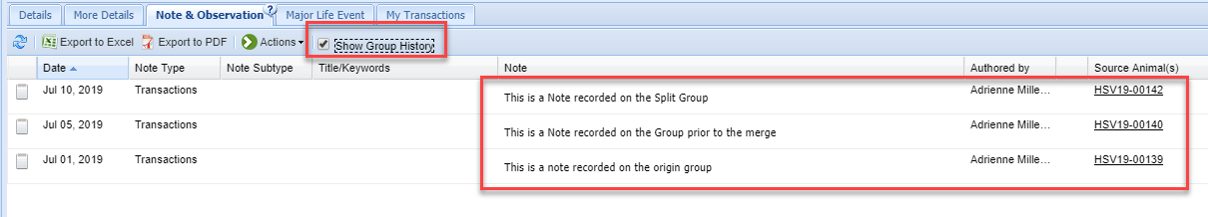
Show Group History
Because the Individual was part of the origin Group, and was part of the Group when
the other Group was merged into it (there is no way of telling if it was actually in the
origin Group or the merged Group ), AND a part of the Group that was Split, selecting
to Show Group History will display Notes related to all. The source of the Note is
displayed in the right hand Source Animal(s) column. This option is also available on
a Specimen Report (more on that next!)

Slide 38
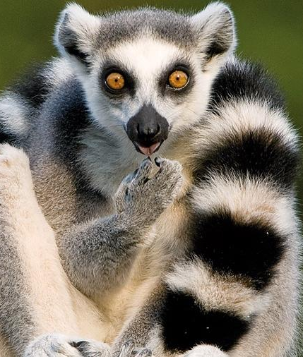
Reports that Include Notes/Observations
Activity Report
  Animal Notes and Observations, no selection by Type
Daily Report
  Animal Notes and Observations, no
  selection by Type
Enclosure Activity Report
  Enclosure Notes/Observations, no
  selection by Type
Note Retrieval
  We’ll look at this one
Specimen Report
  We’ll look at this one
Taxon Report
  Animal Notes/Observation, include All or specific Note Types
  No indication if a Note or an Observation

Slide 39
Note Retrieval Report
Can select Animal or Enclosure Notes
  If Animal selected you can search by Taxonomy or specific Animals. Search by Animal List is not available.
  This will drive the Note Types available to select from
  All Notes will show by default but you can clear and make selections
Search for Text String
  Select “and’ and “or” carefully!
    “and” requires that BOTH text strings be found in the Note
    “or” requires only one of the text strings be found
  Partial words will be found
    If searching by “ear” it will also find “rear”
Remember to Group the Report as you want it
  Taxonomy, Local ID, GAN, Note Date or Note Type

Slide 40
Note Options in Specimen Reports
Combine Notes and Observations
  Will be listed together grouped by date
  Observations will display the additional fields available
Notes
  Will be displayed in its separate Notes section
Observations
  Will be displayed in its separate Observations section
Group History Notes
  Notes from related records (more next slide!)
Exclude notes from other grids
  Details from other grids will not be displayed (duplicate data) (more in the slide after next!)

Slide 41
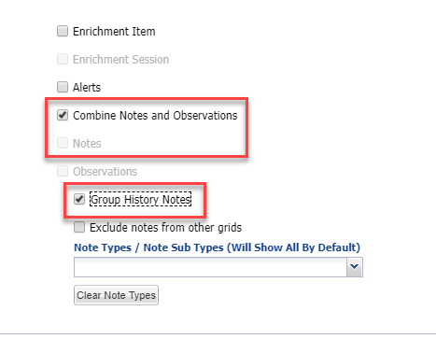
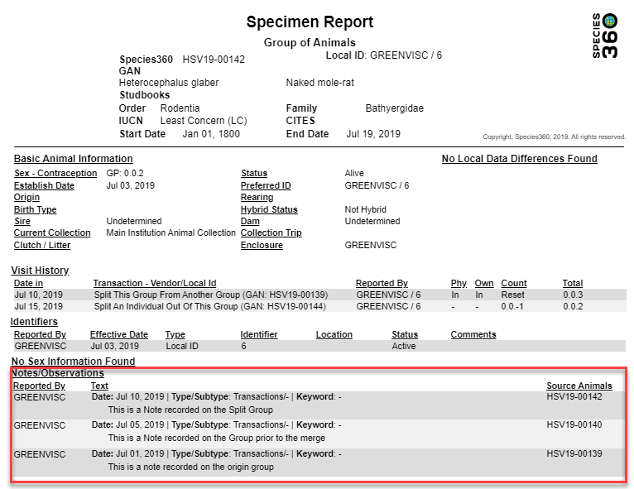
Show Group History in SR
In the Optional Sections area in the
Specimen Report filters screen, if
you check either Combine Notes
and Observations or Notes, the Group
History option is activated. This does
NOT become active if Observations
alone are checked. The Notes sourced
from the relevant Groups will display.

Slide 42
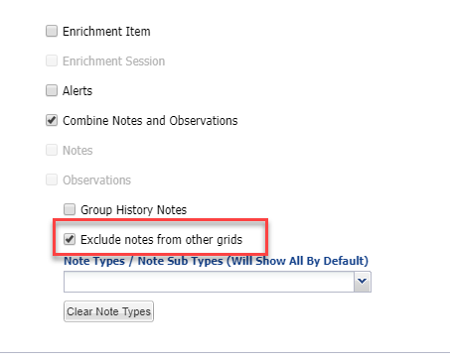
Exclude Notes From Other Grids
As noted earlier, the Notes recorded
in the Details boxes in grids other
that the Note & Observation screen
will also be displayed in the Note &
Observation grid. Often these may be
duplicates, making the Report lengthy,
or they lack the context of regular Notes.
From the Optional Sections area of the
Specimen Report filter you can choose
to have them not display in the Report
by checking the Exclude notes from
other grids box.

Slide 43
Review of Best Practices
Make them clear and understandable. Will it make sense to you in 5 years? Will it make sense to someone at another institution now? It may help to have someone else read your Notes off and on.
Develop conventions for what Note Type and Sub Type will be used
Use only approved Abbreviations and Acronyms
Do NOT use texting or regional slang
Write in a professional manner using the correct terms
Use proper grammar, spelling and punctuation
Include an Identifier in the Note
Date the Note for date of occurrence (usually)
Create Templates for consistency and time saving

Slide 44
The Real Best Practice is to Read what you Write!
Mucous on ground still coughing
Bloody stool and Betadine applied to scratches
The fawn is no longer bothered by the keeper’s presents
I pulled the black-footed cats bones and they were put back together around 2:30
Steaks put around pond in Pampas yard for fencing
Vet tech says he has low levels of coccidia
Blood was drawn, picked up by forklift
The damn and ducklings went back to the nest where the damn brooded the ducklings
Relief keeper left a mess in holding. Cat is angry.

Slide 45
Good Notes!
They CAN Be Easy!

