Slide 1
We’re Here for You!
Species360 Support and Training Teams
June 2019 Tips and Tricks

Slide 2
The Species360 Support and Training Teams are here to help you get the most out the ZIMS application. They should be your first (and hopefully only) stop if you have a question about using ZIMS to
accomplish your goals or if you have encountered something that you don’t think is working correctly.
support@Species360.org
training@Species360.org

Slide 3
The Support Team – Institution Assignments
4 full time and 2 ½ time support 1,000 + institutions
Using a list of the Team, when a new institution comes on board, the next person on the list is assigned it, so it is random and fair. This ensures that each Support Representative has a diverse representation of institution type and geographic location.
An exception is Russian institutions who are always assigned to the Eurasian Regional Coordinator.

Slide 4
The Support Team – Deployment
Deployment is when data in the old ARKS database is migrated into ZIMS (Almost 100% of ARKS using institutions have deployed)
It is also when studbooks in SPARKS or PopLink are migrated into ZIMS Studbooks
The Support Representative communicates any steps involved with the migration, deadlines and training materials available
All questions are directed to and answered by the Support Representative

Slide 5
The Support Team – Onboarding
Onboarding is when a new institution joins Species360 and they have no ARKS data to migrate
The Regional Coordinators are responsible for finding new members and guiding them through the process to join Species360
As soon as a new (or returning member) joins they are assigned a Support Rep who starts the process
A returning member who has never deployed to ZIMS may have ARKS data to migrate
This involves providing a welcome letter, a training call, follow-up emails and/or calls until the member is comfortable using ZIMS
They then start Health Checks (more later)

Slide 6
Onboarding - DMT
Some institutions new to ZIMS are completing Data Migration Templates
This allows new institutions to enter their current collection in an Excel file that is then migrated into ZIMS
This means they can get data into ZIMS without having to learn how to use it to do so – a great potential time-saver for them
If a DMT is used the Support Rep starts the process and answers questions while the institution fills out the template
Once completed and ready to go to the developers, the Support Rep will turn the process over to the Project Owner for DMTs.

Slide 7
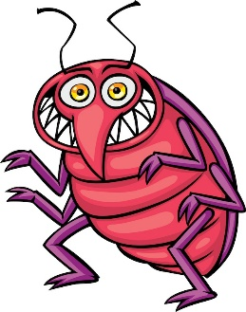
The Support Team – Bug Submission & Testing
When a member reports a Bug (something is not working properly) Support checks to see if it has already been reported
If already reported, the new reporting institution is added to the ticket
If not, Support will test to replicate the Bug
They try to replicate the exact scenario, then a similar scenario with different circumstances
They also test to see if the Bug is institution specific, User specific, record specific and browser specific
This can be 30+ test scenarios and very time consuming especially if it is an obscure Bug or one in a complicated area such as transactions or groups
Once successfully replicated they submit a Bug to the developers with the steps they took to replicate it
Once the Bug is fixed the testing resumes in a development build of ZIMS (not Live ZIMS)
All of the original testing must be repeated
The developers will list all the fields that potentially may have been touched by the fix and these will need to be tested
Once that testing passes it is moved to a final “staging” ZIMS environment (almost Live) and all the testing is done again
If it passes it is moved to Live ZIMS where it is tested again!!
When Support lets you know a Bug is fixed please test it
yourself and let us know all is well!

Slide 8
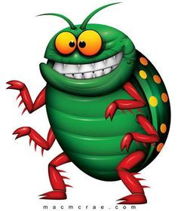
For Example………
A Bug is reported in the magnifying glass search in the taxonomy field in Animal Simple Search
ALL the magnifying glass searches in ALL the modules must be tested
Their motto is……..
Test All The Things!!!

Slide 9
The Support Team – Health Checks
Health checks are a way for institutions to let their Support Rep know how they are doing with ZIMS
Health Checks are scheduled for every 3 months, averaging 5 institutions per day per Rep
If the institution and the Support Rep have been communicating regularly the Rep will note it and not send a special Health Check communication
They will also email ZIMS tips or news to check in and see if anyone has questions or needs help

Slide 10
To Support & Beyond!
Many of the Support Team members
have been directly involved with
ZIMS development
ZIMS Studbook module, translations work, aquatics functionality development, ZIMS Medical module and Care & Welfare module
all benefitted from the involvement of a Support
Representative on their development Team,
sometimes leading the work!

Slide 11
A Pretty Graph!
In April, Support had 566 issues submitted by members! Sounds high but…..
28.9% were Member Usability (more on that in Training)
24.2% were Other Things (like SPARK/MedARKS and onboarding questions)
18.4% were Data Problem or Fix (like records merges)
Only 6.7% were actual Bugs!
For all submissions we try to respond within 24 hours!

Slide 12
Support – Some April Stats!
% of issues solve by first response – target 85%, actual 87%
% of issues resolved well – target 95%, actual 98%
Average satisfaction rating – target 4.80 out of 5.00, actual 4.85
% new members entering data within 100 days – target 55%, actual 59%
Non-English language use
Japanese – 20 users/6 institutions
Spanish – 174 users/34 institutions
Russian – 79 users/32 institutions

Slide 13
Internal Periodic Checks
These checks make sure we are keeping up!
Closed Bugs that are still assigned to a Support member or closed Bugs with open issues – we may have forgotten to let you know the Bug is fixed!
Data standard requests that are done but still assigned to a Support member – we may have forgotten to let you know it has been added!
Any overdue Health Checks that have not been done
Any issues where you have responded to a question and are waiting for a response from us

Slide 14
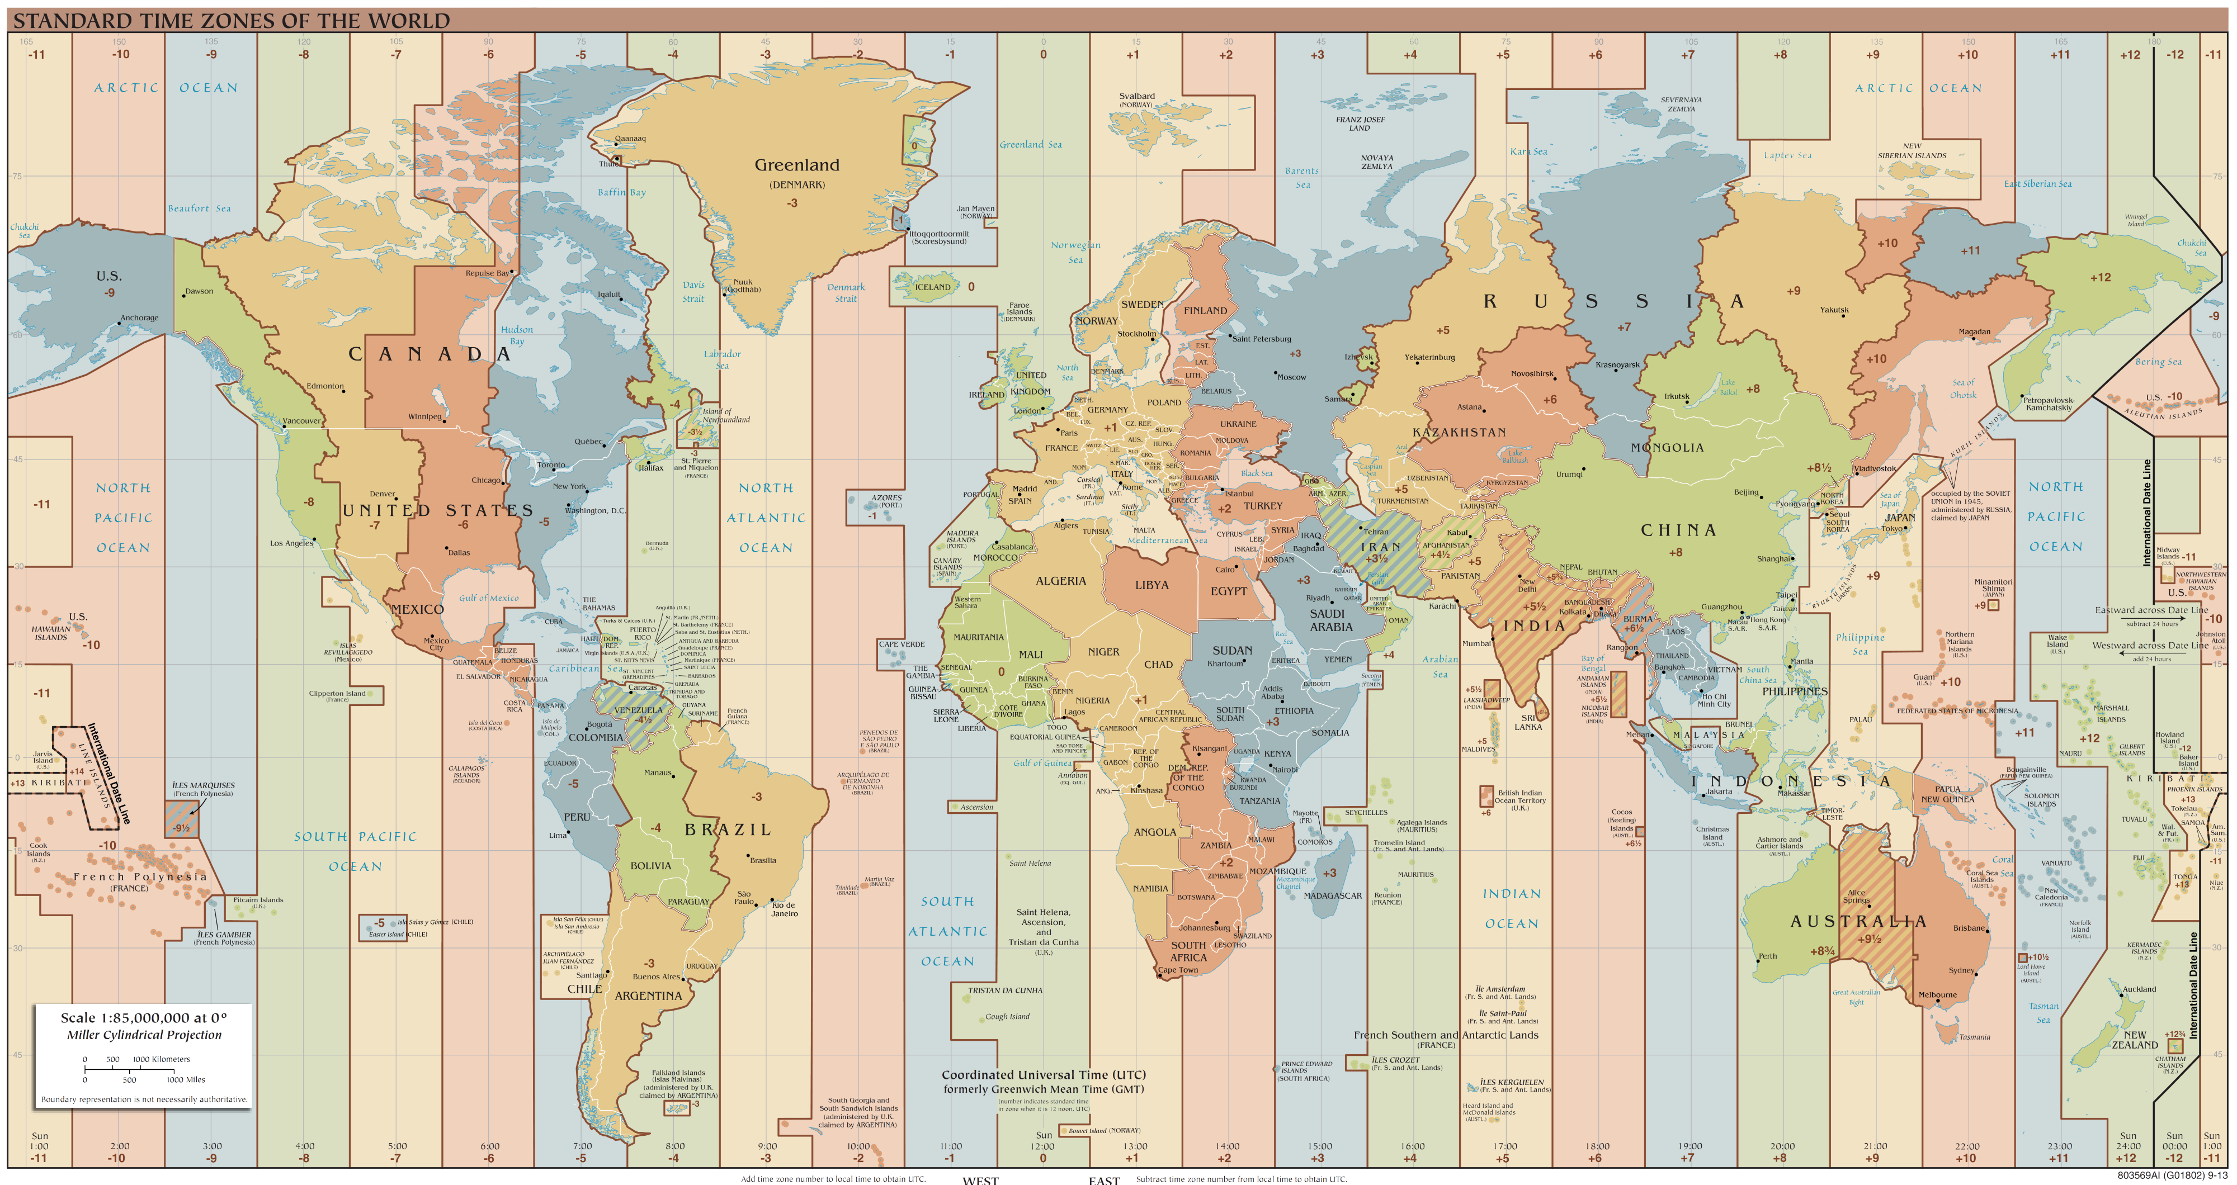
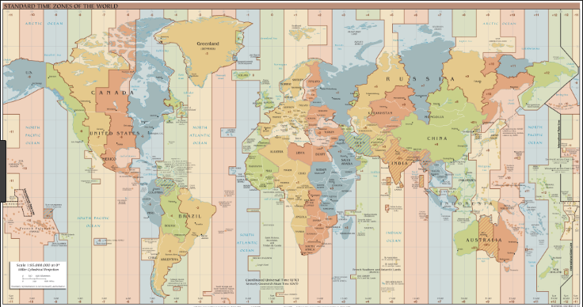
9 to 5 Job?
Being a Support Rep for a global membership means we may be on a support or training call at 4 am or 11 pm any day. Every day brings new questions and opportunities with our members so there is never a dull moment!

Slide 15
The Training Team!
Training Staff
1 full time, 1 ½ time dedicated staff members
Assistance from Support Team, Medical Team, Studbook Team, Regional Coordinators and two contracted staff persons
Develop training documents
PowerPoints
HELP documents
WalkMe tutorials
Videos
Keep the Help Menu updated
Webinars
Monthly Tips & Tricks
Monthly ZIMS Studbook
New/Potential members
On site training
Education License Members

Slide 16
What Materials Need to be Created?
We use many approaches to determine what training materials need to be created
Animal records-keeper listservs
Discussions often point to a need
Member Usability
Sometimes a Bug is submitted to Support that is actually simply the member not knowing how to do something. These are marked as Member Usability and forwarded to the Training Team as needing training material
Webinars
During Webinars we will often get questions that would benefit from Help materials
Conferences
Members often bring their questions to us during conferences
On Site Training
Trainers often return from on-site training sessions with ideas for new material
Let us know!
Contact us with your ideas

Slide 17
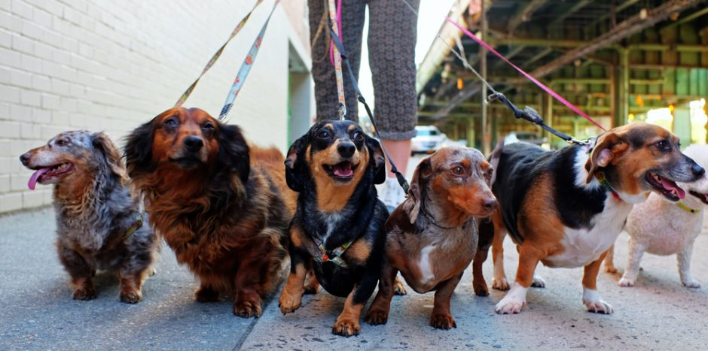
WalkMe – Helps Us Help You
WalkMe is a software company that helps Users navigate the features of other web-based services
Used for everything in the Help Menu, pop-up messages, hover over information and walk-throughs (interactive guidance)

Slide 18
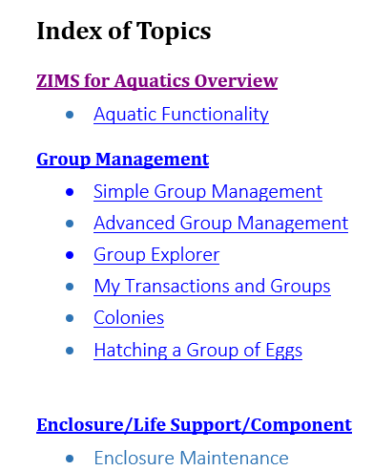
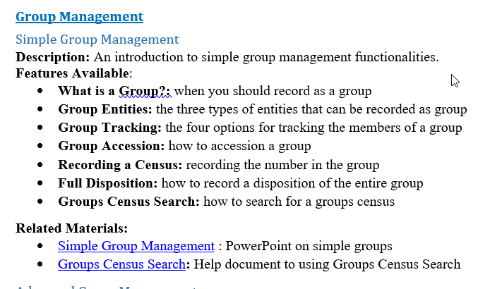
Module Indexes!
Available now
Studbook
Aquatics
In the works
Medical
Local Admin
Husbandry

Slide 19
Educational License Members
Educational Partners use a version of ZIMS (LearnZIMS) without the global data as a teaching tool for students from high school through Doctorate programs
26 schools from 8 countries use LearnZIMS to enhance their curriculums
Graduates get ‘real world’ skills and enter the zoological workplace with competitive, state-of-the-art record keeping skills.

Slide 20
Training – Some Stats!
We serve over 16,000 unique Users of ZIMS
Have a library of almost 800 Help documents, PowerPoints and Videos
36,477 Help Menu searches performed
283 guided walkthroughs have been used
129 contextual links are available
“?” hover overs
> play buttons
‘feature updated’
760,748 Engagements (any interaction with a WalkMe product) in last year
2.7 million sessions (someone logged in) in last year

Slide 21
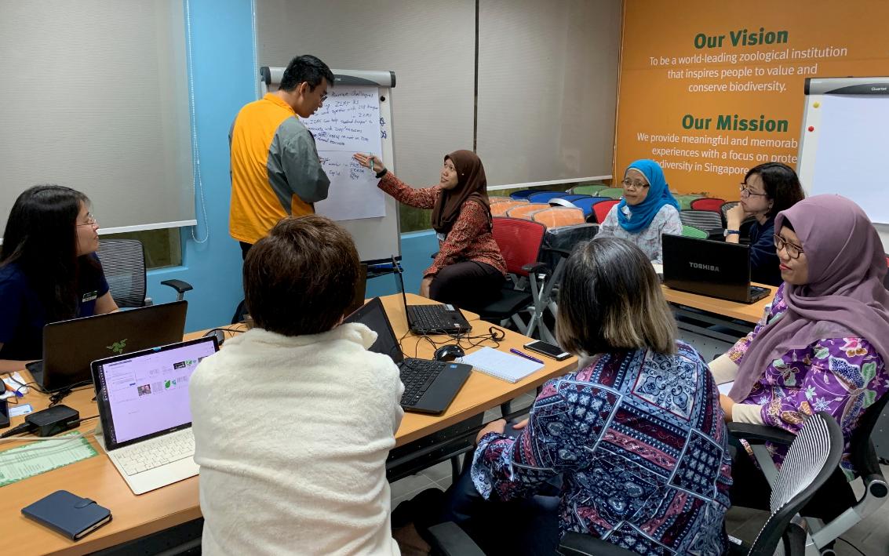
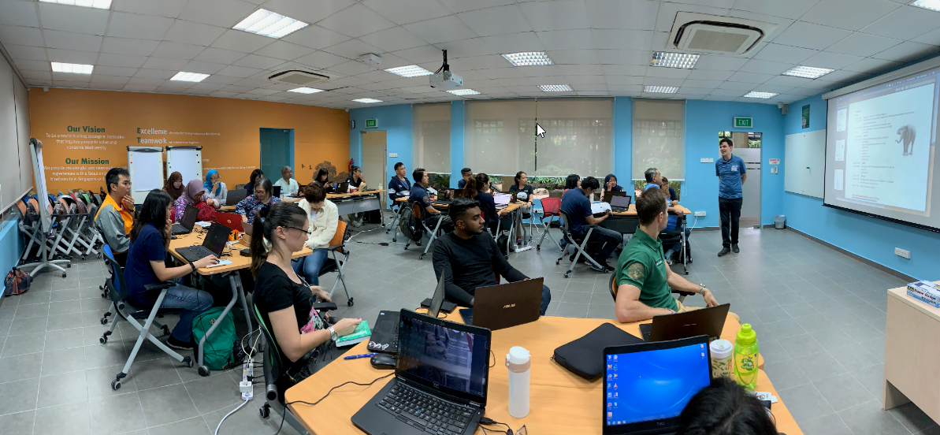
Training – Some Stats!
Have held 66 training events (in person or Webinar) in the past year
> 1,000 Users
> 400 institutions
19 countries

Slide 22
Training – Some Stats!
Although Avengers: Endgame broke all records we have some pretty good video stats ourselves!
6,405 videos played
27 days of watch time
Average 6.08 minutes per view

Slide 23
Meet the Team!
Job Title
How long at Species360
Where they work from
A hobby or two
Why they enjoy doing what they do at Species360
Any anecdotes that might help Users understand our challenges and accomplishments

Slide 24
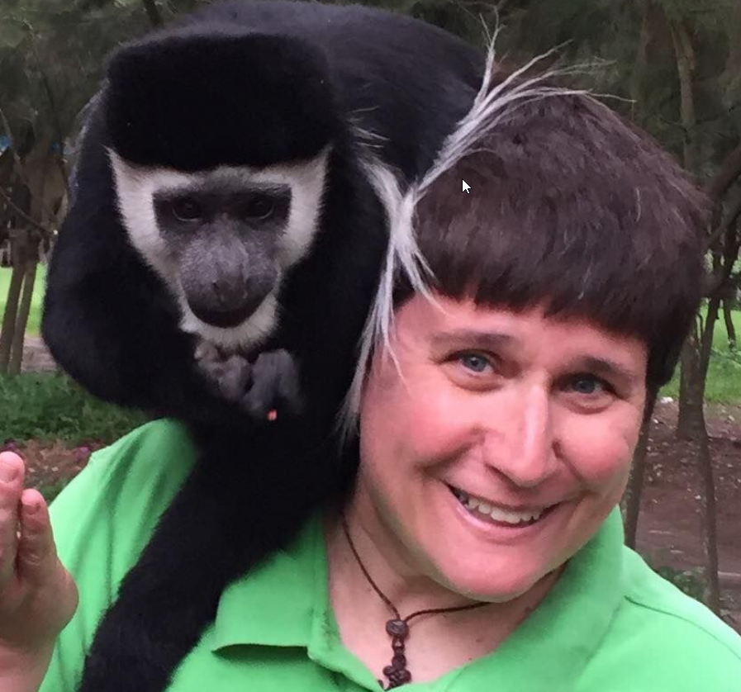
Elisabeth Hunt
Member Support and Training
Director (she’s the boss of us!)
17 years
Bloomington, MN office
Taekwon-do and bass clarinet
Helping members discover how cool ZIMS data is
We work with a huge variety of members, large and small. I can remember being on a support call and the member had to put me on hold because she was selling tickets at the same time!

Slide 25
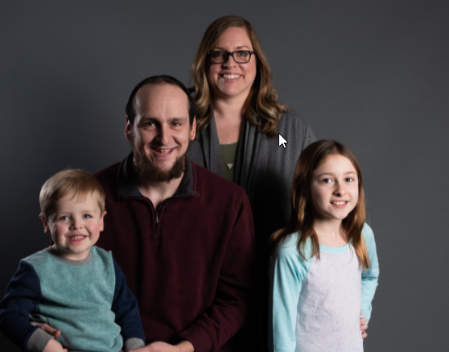
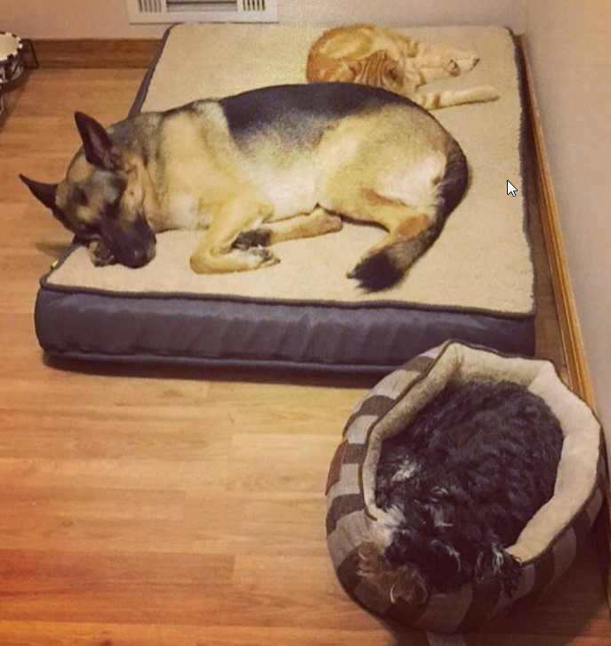
Kim Larson
Lead Member Support Rep
Aquatics, Translation and In Situ
8 years
Bloomington, MN office
Camping, going to my family cabin, annual trip to the Boundary Waters Canoe Area with my girlfriends from college
No two days are the same! We have such a wide variety of questions that come in, every day is different. Believe it or not I think it’s fun to try and figure out why a bug is happening and if there is a workaround until the development team can fix it
One challenge is having a small team to serve over 1,000 member institutions (with multiple users at each institution). We all take on side projects and responsibilities that sometimes go along with our interests or experience so we try our best to stay 100% in the know with our members. Sometimes it takes a bit of re-reading old issues to remind us where we left off!

Slide 26
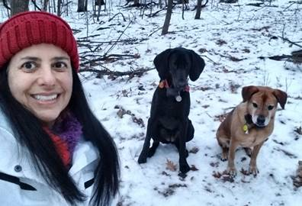
Michele Moses
Member Support Representative
and Certified Veterinary Technician
8 years
Bloomington, MN office
Active with a K-9 missing persons search and rescue team with her American foxhound mix Baci
I love the ability to stay in the zoo field and connect with the members
Main challenge is that we are very committed to our members and because we have all worked in the zoo field we totally empathize with their time constraints and want to resolve submissions as soon as possible. We have a personal connection with our members and want them to have the best response possible. The challenge is with each of us supporting some 200 members we don’t want to disappoint a single one.

Slide 27
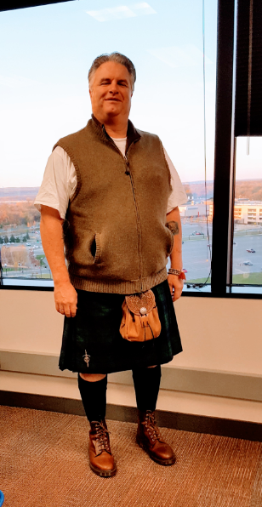
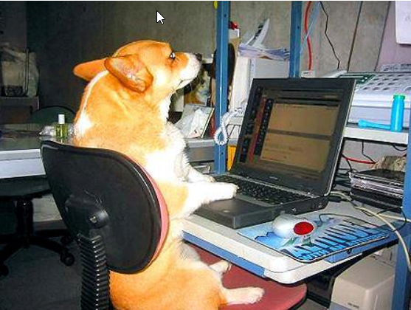
Nolan Harvey
Member Support Representative
8 years
Bloomington office and Amore Coffee
My wife, my dogs, music and travel
Every day is a new day when I walk in the office and everything is one giant puzzle. I have met some of the best people through interacting with Registrars and at Species360.
I view what I do as being a traffic cop, I am here to keep traffic moving between my members and developers. I really want everyone to feel good about what they are doing both from a user experience and from the developer’s side of making the application really work for them. I always love to see what is happening with new developments for our members and how they utilize ZIMS to hopefully make their job better and more efficient.

Slide 28
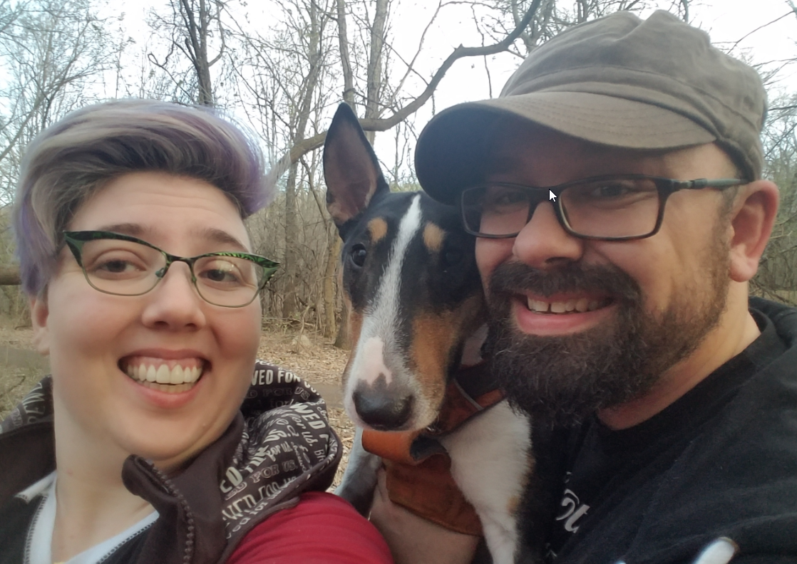
Erika Fronk
Member Support Representative
Studbook Specialist
7 ½ years
Bloomington office
Outdoor adventuring with my dog and partner in real life, adventuring in Dungeons and Dragons with anyone who is interested
Animals are my passion and I truly believe in the power of collaboration, so the Species360 mission has always appealed to me. I’m really proud to be helping our members contribute to the database for the greater good of wildlife
Captive breeding/reintroduction was my conservation “first love”, so I was eager when I had the opportunity to help the Studbook Team shape the new program. It gave me a deeper understanding of the challenges our Development Team faces. And I get great joy seeing features I designed, like a simple button, used by studbook keepers worldwide. I am also the Support Team night owl and often do training calls late at night Minnesota time. It’s exciting to hear what’s happening in the African savannah or the Australian outback! And members often have to tell their animals to be quiet on the call, too!

Slide 29
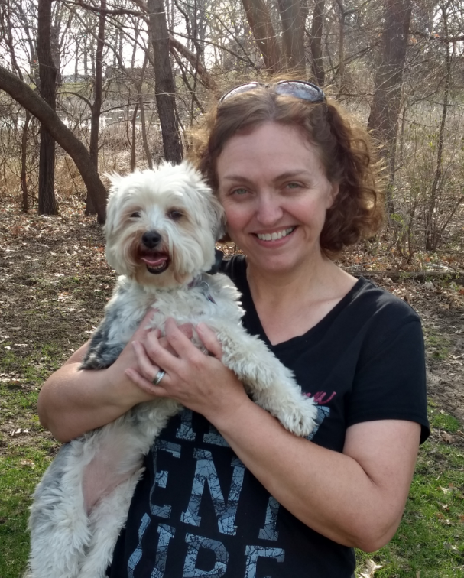
Nannette Driver-Ruiz
Half Member Support, half Project
Owner (Data Migration Team)
4 years
Bloomington office
Spending time outside, travel and reading
I love interacting with our members, supporting our community and working for an organization that serves conservation
We are a small but devoted team. I don’t think many of our members know how many employees we actually have, and although we are small, we do big things!

Slide 30
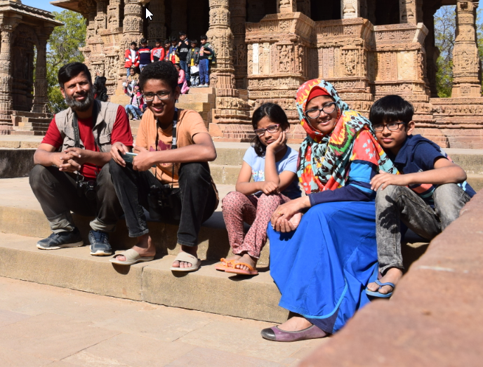
Moin Ahmed
Regional Coordinator for India and
South Asia
9.5 years
New Delhi, India
Photography, teaching (his children are
home schooled), tutoring International General Certificate of Secondary
Education and International Baccalaureate students
Loves animals and Species360
During a training the Vet followed me to my room and asked questions and entered data until 2:00 when I fell asleep. When I awoke at 7:00 am the Vet was still there entering data. At one training all rupee notes of 500 & 1,000 were devalued. I had 300 rupees, not enough to reach the airport. I spent 3 days there. At one training the Director refused all help, no internet, no computer. I scanned files on my phone and went after hours to meet with the biologist for training using his laptop and internet.

Slide 31
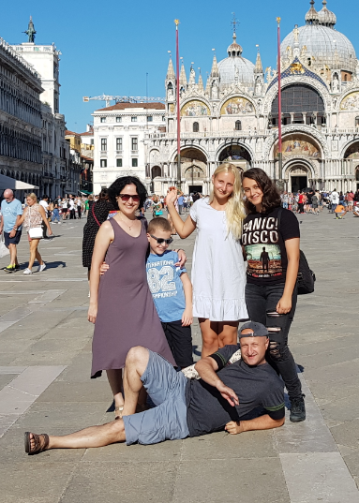
Alex Kantorovich
Eurasian Regional Coordinator,
Support Representative, Trainer
5 years
Kiryat Motzkin, Israel and planes
Visiting zoos (430 +!), photographing animals at zoos (zooinstitutes.com), soccer
Improve the level of zoo animal record keeping in my region.
Already the fourth time I conducted a training in Kazakhstan. Every year happens with a new director, I think they pass me as a dropped baton!

Slide 32
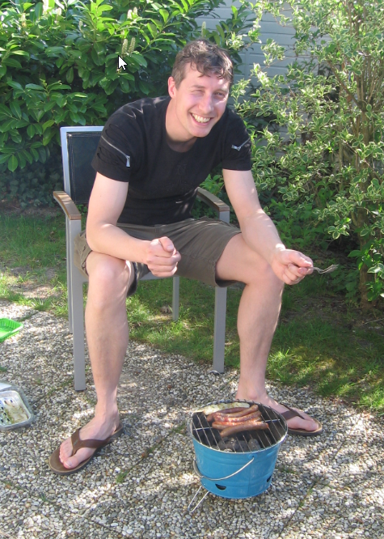
Sander Cozijn
Species360 European, African and Middle
Eastern Regional Coordinator
13 years
EAZA Office in Amsterdam
Family time with kids and wife, writing dragon fantasy during the night hours, gaming (be it analog, pc or Nintendo switch, it’s all good!), and Crypto (Blockchain for Wildlife!)
Diversity of the job certainly is one thing, but also meeting people from the community during training events and/or conferences. For the past decade I’ve seen both Species360 and EAZA professionalize in a way that is very exciting. Now, with the new conservation efforts and approaches to show aquaria the benefits of working together, there’s still many things to explore within this job.

Slide 33
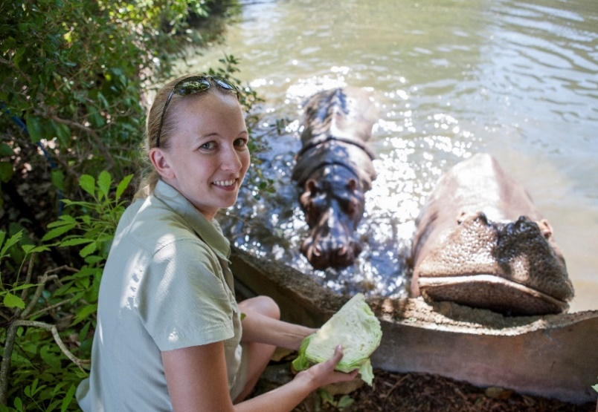
Tineke Joustra
Australasian Regional ZIMS Trainer, Consultant for
Auckland Zoo, Population Management and Animal
Records Lecturer at Unitec Institute of Technology
~ 1 year, previously on ZIMS early adopter Team
Auckland, New Zealand
Beach walks, swimming, snorkeling, learning new skills ( learning to speak “te Reo Māori”) and reading (though rare to find time with three children)
I am very passionate about population management and animal record keeping, in particular teaching others how to do this well. Teaching people how to use ZIMS to its full potential is very satisfying and they learn faster ways to keep better records. I thoroughly enjoy meeting (potential) members on-site to see first hand how we can make ZIMS meet their needs. I believe the more people we can move into ZIMS, the bigger the impact we can have on species management and conservation.
We use a variety of tools when training people in ZIMS, and each training session is fully adjusted to our member’s needs. This means that there are thousands of training packages available. This not only helps us to ensure that each session can be more efficient and effective for the institution, it also adds a personal touch making it more enjoyable for attendees!

Slide 34
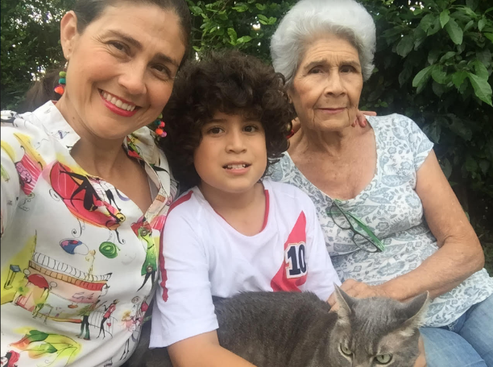
Myriam Salazar Jaimes
Regional ZIMS Trainer, Environmental and
Sustainability Consultant
Latin America and Spain Regional Coordinator 2012-2016, 2019 ZIMS Trainer
Pereira City, Columbia
Squash and painting
I am passionate about teaching people to use ZIMS and facilitating adapting its use to satisfy their conservation and institutional needs. I receive in return new friends and lovely memories.
A painful memory – I was training on a Webinar and, just at the climax of the best data management example and the whole classroom focused on her computer, the city energy company decided to do a maintenance energy cut. I never loved my 4G phone so much!

Slide 35
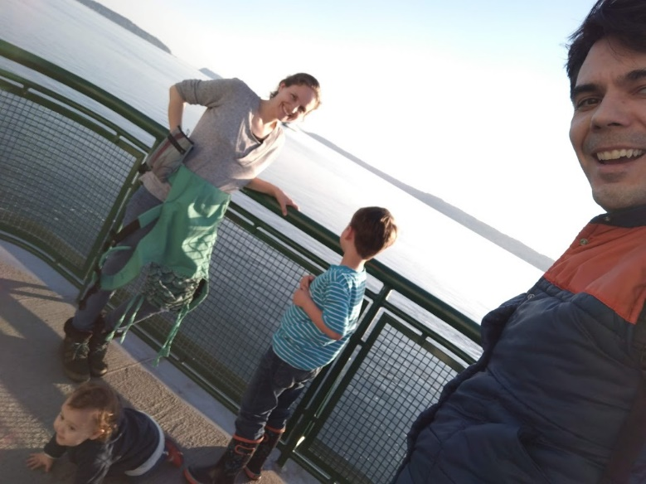
Josh Courteau
Training Manager
10 years
The gap between the US and Canada in the Puget Sound
Raising children & drinking coffee
Supporting an international community of conservationists #SavingSpecies and #ServingConservation!
With ~16,000 Users in 96 countries, we strive to make training content that is always available and relevant to everyone. It’s a fun, if not daunting, challenge!

Slide 36
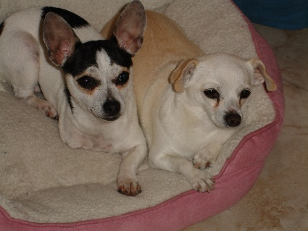
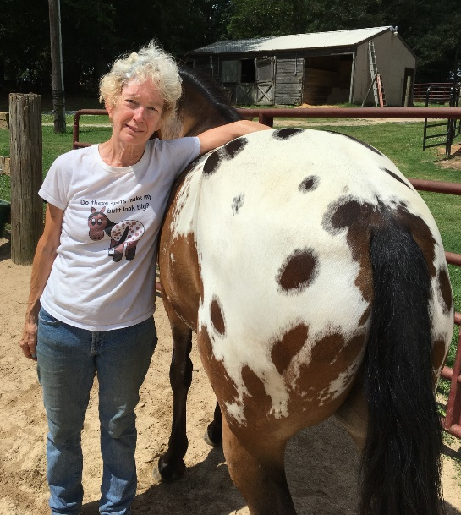
Adrienne Miller
Training Content Developer
10 years
Greenville, South Carolina
Weight lifting, spending time with my 2 Chihuahuas and my Appaloosa, therapeutic horseback riding volunteer
Enjoy seeing/helping the ZIMS application grow in functionality
I miss direct interaction with Users, most contact is via Webinars. I love it when attendees ask questions and provide feedback as we are constantly reviewing and updating our training materials. I remember early on doing a ZIMS Webinar presentation with Copenhagen I was a good 30-45 minutes into it and checked the attendee list and there was no one there! All of Copenhagen had lost internet as I rambled on. Talk to me!

Slide 37
Any Questions?
We are here for You!

