Slide 1
Are You Studbook Keeper Friendly?
Working together for the best Studbooks possible!
May 2019 Tips and Tricks

Slide 2
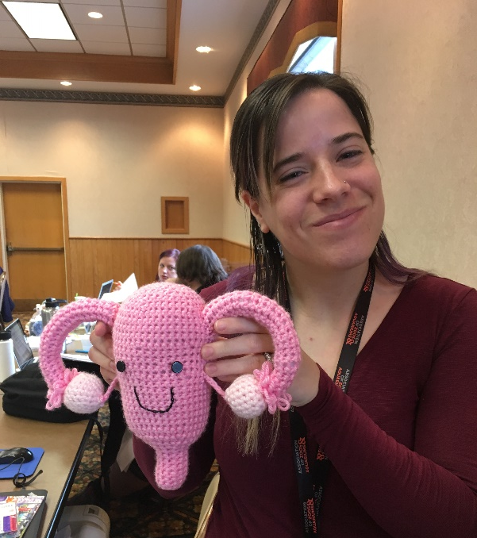
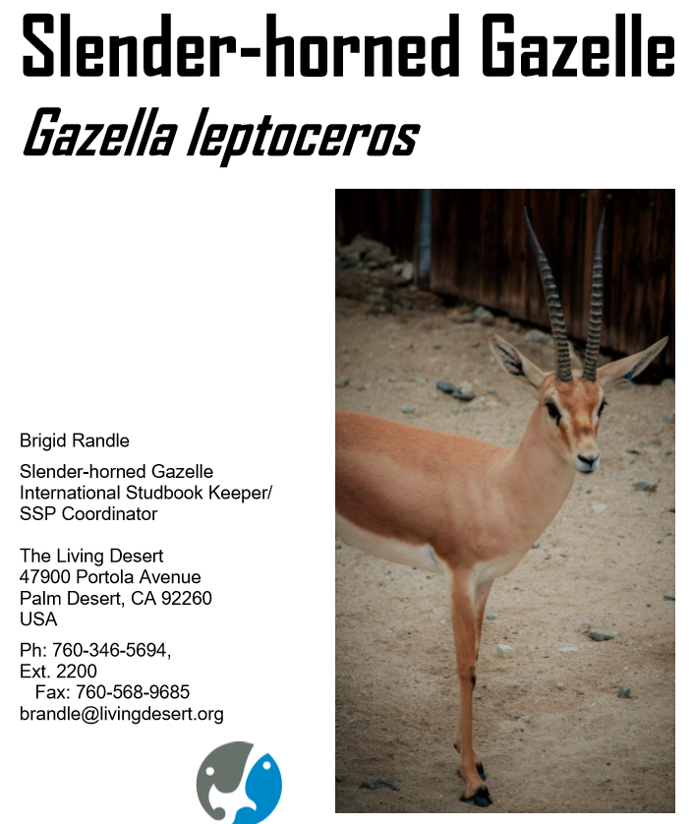
Many thanks to Brigid Randle
from The Living Desert! She
lives in three worlds –
Registrar, Studbook Keeper
and SSP Coordinator. She
helped create the content
for this Webinar.

Slide 3
Tie between Husbandry and Studbook Records
Studbook Keepers have always depended on high quality institutional animal records
Taxon Reports used to be the main method of providing what was recorded at the institutional level to Studbook Keepers
In ZIMS, Studbook Keepers no longer need to depend on institutions providing them with updated information when they need it
But it is important for institution records keepers to know what information Studbook Keepers need to produce a high quality studbook

Slide 4
Population
Management
Plans
Population Management
Plans base their breeding
recommendations through
analyzing the studbook
data. A high quality studbook
will result in the best Plan
for the species. If the data
being provided for the
Studbook Keeper is of poor
quality or incomplete, the
final Plan may not represent
what is best for the species.
Studbooks
Institution
Records

Slide 5
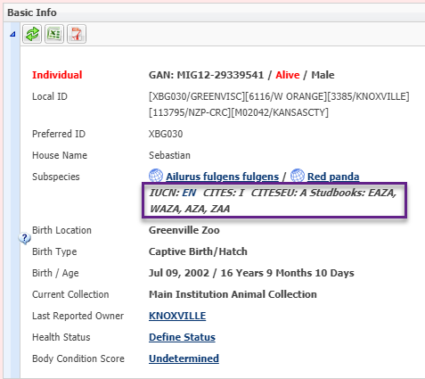
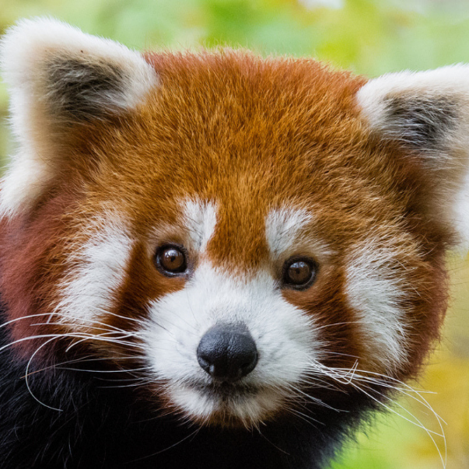
Identifying Studbook Species in your Collection
The first step to being Studbook
Keeper Friendly is to know what
species in your collection have
studbooks associated with them.
It is easy to identify species
that are part of a studbook
by looking at the information
provided in the Basic Info for
an animal. The species will show
as managed by a region if there is
a studbook in that region. The
animal in context may or may not
actually be in the studbook. This
species (red panda) is covered
under studbooks held by EAZA,
WAZA, AZA and ZAA.

Slide 6
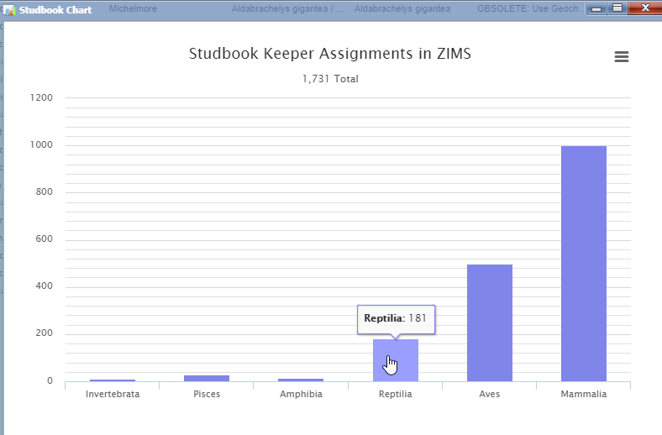
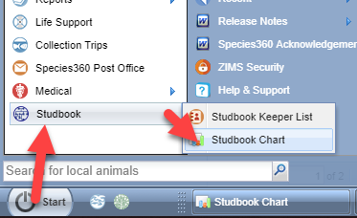
Studbook Chart
You can also use Studbook Charts to find
studbook species. Go to Start > Studbook >
Studbook Chart. Hovering over the bar will
display the number of that taxonomic Class.
There are 181 reptile studbooks.

Slide 7
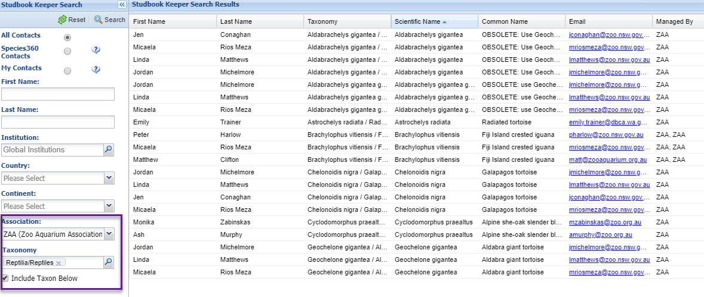
Studbook Chart
Left clicking on the bar will open a results grid.
Using the search screen we have limited the
results to just our region, in this example ZAA.
We sorted the Scientific Name in ascending
order. You can quickly scan this list to identify
any species you hold that have studbooks. You
can also identify who the Studbook Keeper is
and their email.

Slide 8
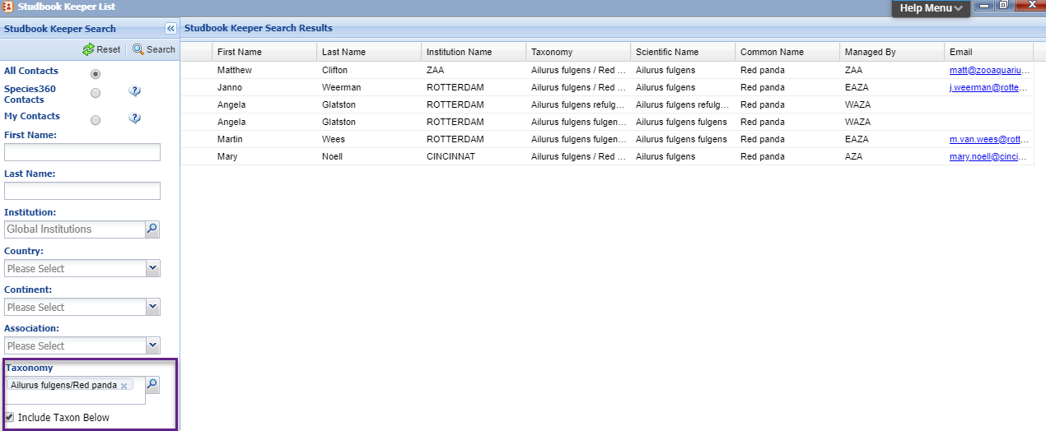
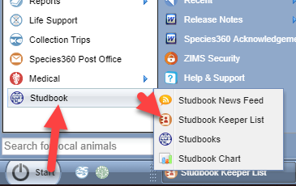
Identifying the Studbook Keeper
You can also find Studbook Keepers
using the Studbook Keeper List. Go
to Start > Studbook > Studbook
Keeper List. You can search by many
filters to find what you are looking
for. We wanted to find the
Studbook Keepers for the red panda
we showed earlier.

Slide 9
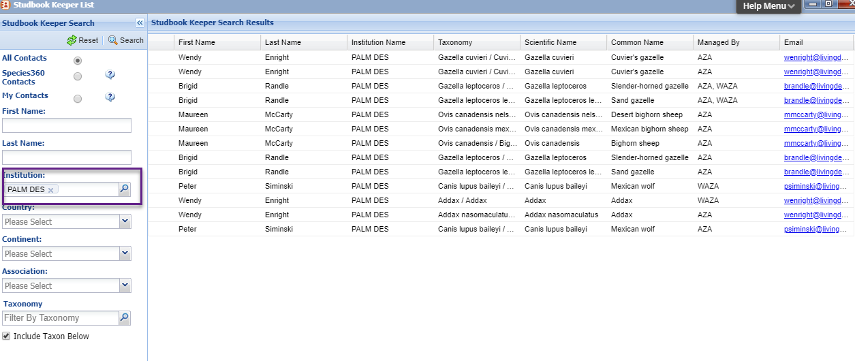
Studbook Keepers at Your Institution
You can also use this search to identify any Studbook Keepers
at your institution. In this example we work at The Living Desert
in Palm Desert, CA. If your institution does have Studbook
Keepers, take advantage of the close proximity and talk with
them about how they use institutional data and what they need
from you as a records keeper.

Slide 10
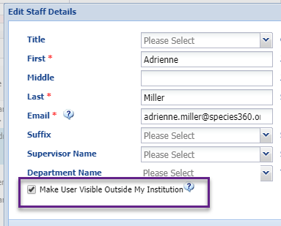
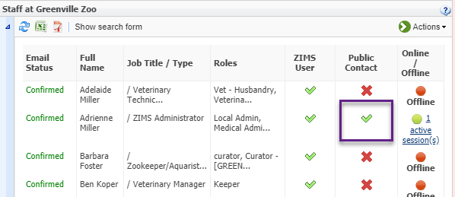
External Institution Contact
Although Studbook Keepers no longer need to contact each holding institution
for Taxon Reports, they may need to contact you with any questions regarding
your institutional data. Make sure that you have the appropriate person at
your facility marked as a Public Contact so that they can easily reach them.
Check the box under View/Edit Staff Details. Also, make sure that their
Communications Details are provided.

Slide 11
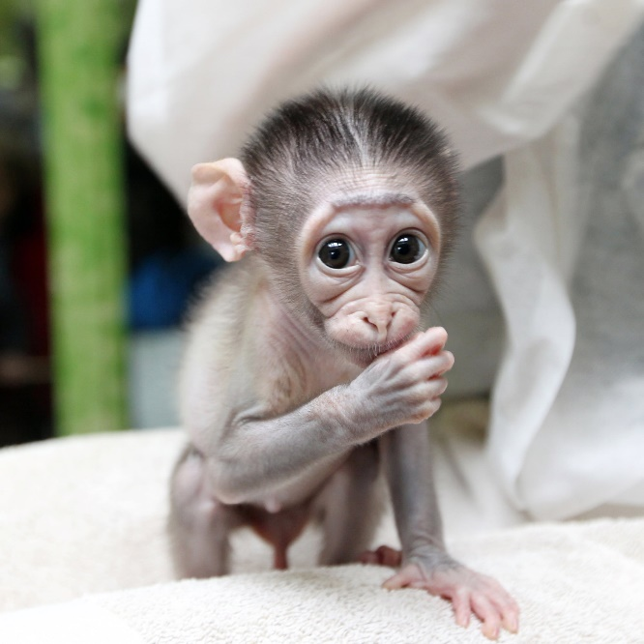
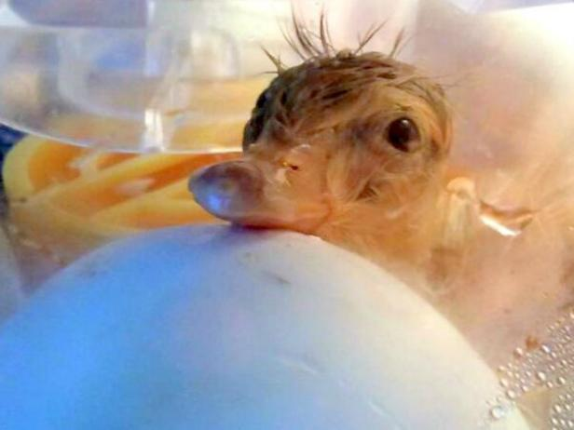
Origin Transaction
One change in the ZIMS Studbooks module
from the legacy software (SPARKS and PopLink)
is that the initial transaction in the studbook
MUST be a Birth or Hatch. This makes it very
important that any Birth/Hatch information
you have recorded is correct. You may want to
review any records you have with Undetermined/
Indeterminate Birth Types in case more information
has been found. Use Advanced Animal Search >
Birth Type = Undetermined or Indeterminate to
find these records. If you make any changes, the
Studbook Keeper will be notified via Pending
Updates (covered later).

Slide 12
Husbandry Data to Studbook Data
Some of the information you enter in the Husbandry module is automatically available to the Studbook Keeper
New Accessions = Suggested Animals
Record changes to current studbook animals = Pending Updates
Identifiers

Slide 13
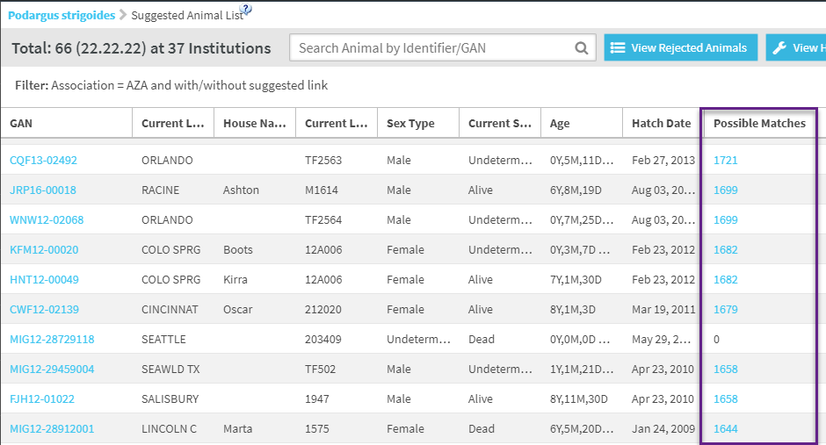
Suggested Animals
Whenever you record a new animal in the
Husbandry module (Birth/Hatch, Appeared,
Collected From Wild, from a non-ZIMS
institution) it will appear in the Suggested
Animal list in the studbook for that region.
If ZIMS finds a possible link that is already
recorded in the studbook it will appear as
a Possible Match. The Studbook Keeper will
determine if they are the same animal and
link them, or they will enter them as a new
record in the studbook.

Slide 14
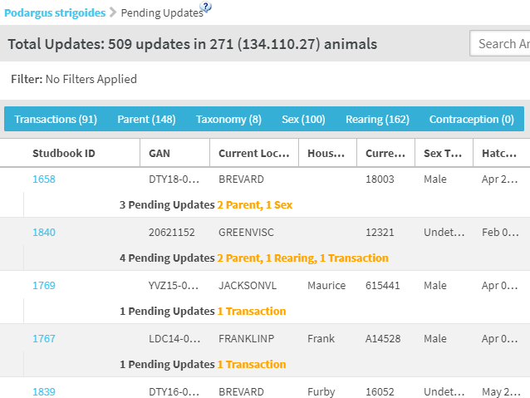
Pending Updates
Whenever you make a change to
the following record types, the
change will appear in the Pending
Updates list in the studbook for
that region. The Studbook
Keeper can Approve or Reject:
Transactions
Parents
Taxonomy
Sex
Rearing
Contraception

Slide 15
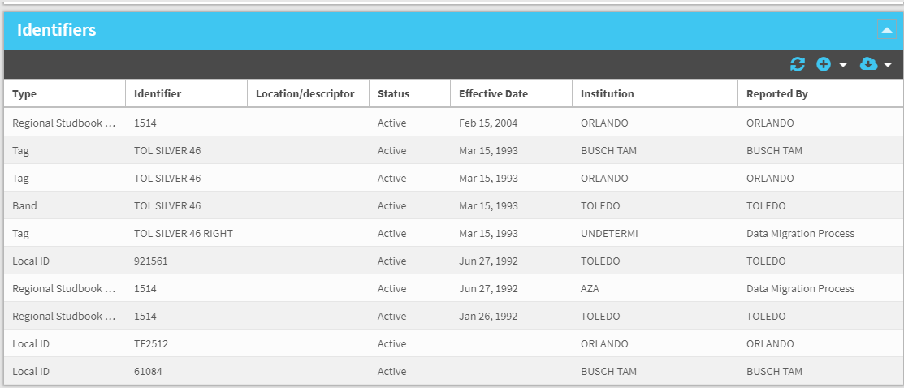
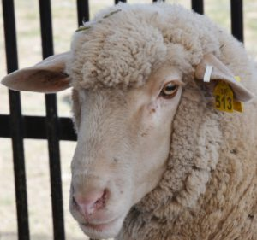
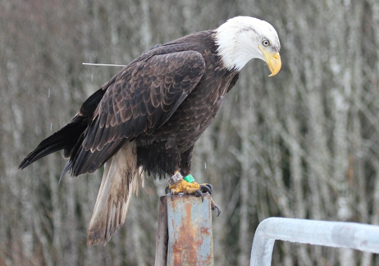
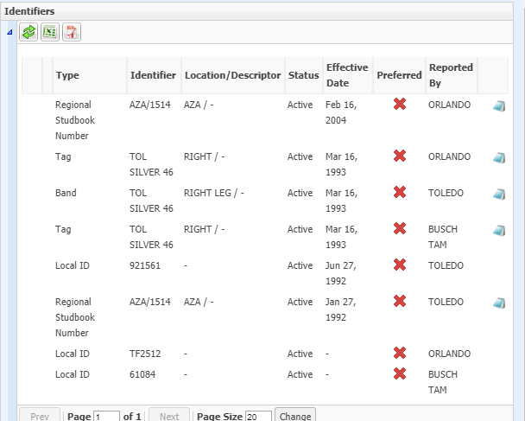
Identifiers and Studbooks
Studbook Keepers do not
have to Approve or Reject
identifiers. All identifiers
entered into the Husbandry
module (below) are automatically
reflected in the Studbook
module (above).

Slide 16
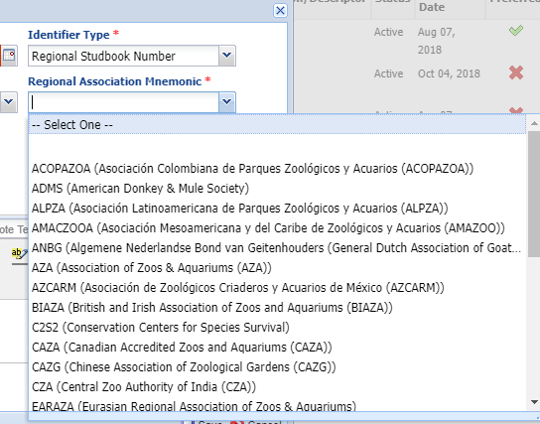
Recording Studbook IDs in Husbandry
Currently the Studbook ID does not
automatically go into the Husbandry
Identifier grid but it is a planned
enhancement to automatically link
the Studbook ID in Husbandry when
the Studbook Keeper assigns it. If you
do not get notification feel free to
contact the Studbook Keeper. It is
very important that you enter the
studbook number appropriately as
Regional (select the correct region!)
or International.

Slide 17
Data will not be directly available to the Studbook Keeper when:
Individual animals in the studbook are managed as a group in the Husbandry module
The animal resides at a non-Species360 member institution
Animals held in ZIMS Collections marked as “Local”
Incomplete Accessions
Pre-births/hatches. The animal must be born or
hatched before the Studbook Keeper can see it
The Studbook Keeper will need to do manual entry in these situations

Slide 18
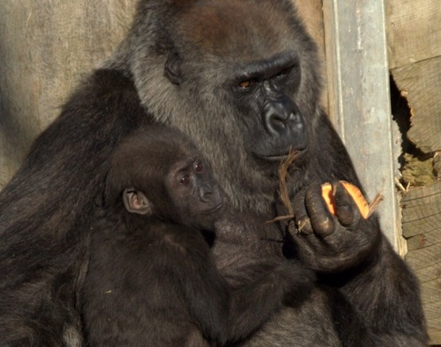
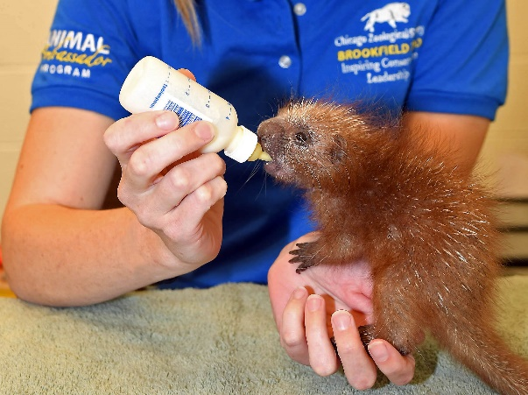
Rearing – it’s Mandatory!
Although easy to overlook when recording an accession, Rearing is MANDATORY
in the ZIMS Studbook module. It will help the Studbook Keeper if you make sure
that you have recorded this information for all of the animals born/hatched at your
facility. Perform a Local search for the studbook species. Make sure that Birth/Hatch
Location is included in your columns. Sort that column so all births/hatches at your
institution are together. Check each record for Rearing and correct if needed.

Slide 19
Contraception
Contraception is not a mandatory
grid in the ZIMS Studbooks module.
However, it is a VERY important
field when it comes to breeding
recommendations and Studbook
Keepers need this information in
the studbook record. A permanently
contracepted animal cannot be part
of breeding recommendations and an
animal that has been contracepted for
a long period of time may have trouble
getting reproductively active again.
Make sure that this is kept up-to-date
in the Husbandry records. As it
changes, Studbook Keepers will be
notified via Pending Updates. If it is
entered only in the Medical module
there will be no Studbook notification.

Slide 20
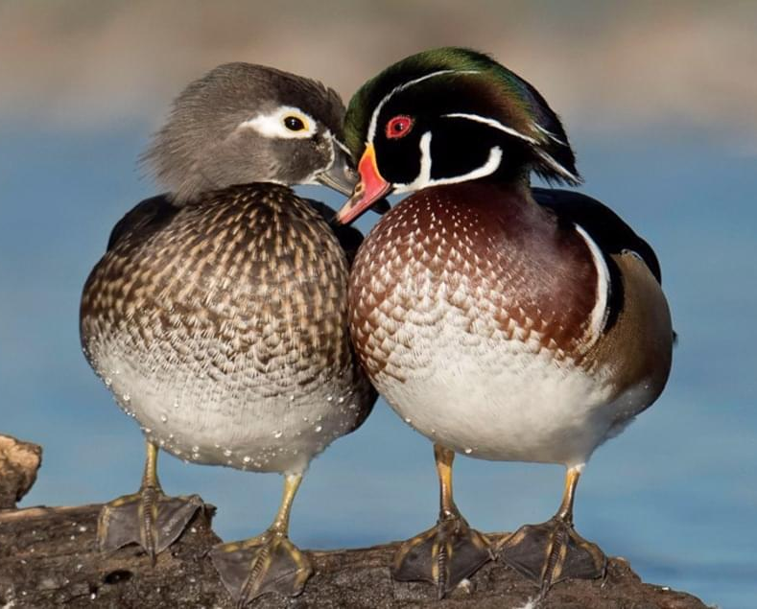
Recording Sex
It is very important to record
the sex of the animal, even if
the individual is dead or a
stillbirth. Sex is used in
demographic analysis.

Slide 21
Impact of Poor Institutional Records
Parents
Breeding Recommendations Impacted!
Tracking and entering multiple potential parents
Do your research!
Non-ZIMS parents
Add as much information as possible
They can be added to the studbook if not already there
Avoids duplication if they are already in there
Taxonomy
If you are not managing your animals with the taxonomies recognized by the studbooks in your region, your animals will not populate in the studbook’s Suggested Animals list and the Studbook Keeper will not know they exist.

Slide 22
A Review
Know the studbook species in your collection
Know if there are Studbook Keepers at your institution
Make sure Studbook Keepers have the right contact at your institution
Try to fix any unknown Birth/Hatch information
Record Rearing!
Keep Contraception up-to-date
Record sex for all animals

Slide 23
Be Studbook Keeper Friendly!
Any Questions?

