Slide 1
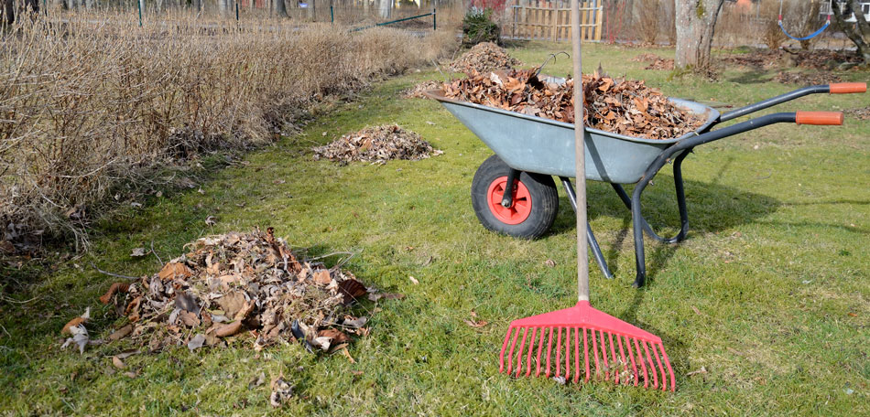
Spring Cleaning!
Tips and Tricks April 2019

Slide 2
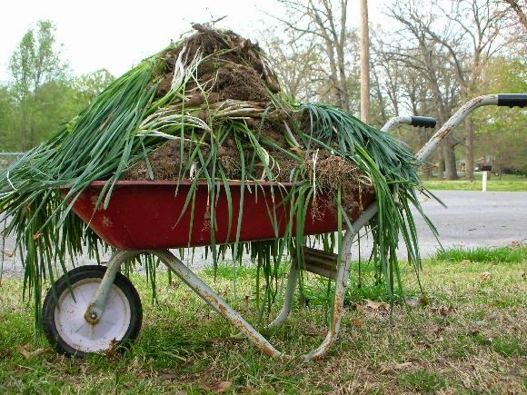
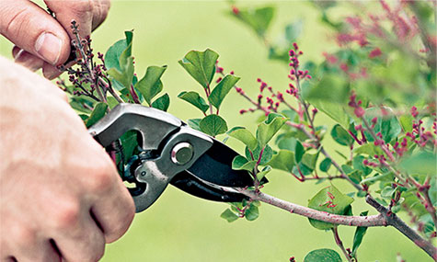

At least once a year you should
look at your ZIMS database and
clean it up.
You should rake up and discard
(mark obsolete or inactive)
information that is no longer
needed or relevant.
You should freshen up and
review your existing data so
it is complete and grows more
robust.
And you should plant some new
ideas to make your data entry
quicker, better and easier to
retrieve!

Slide 3
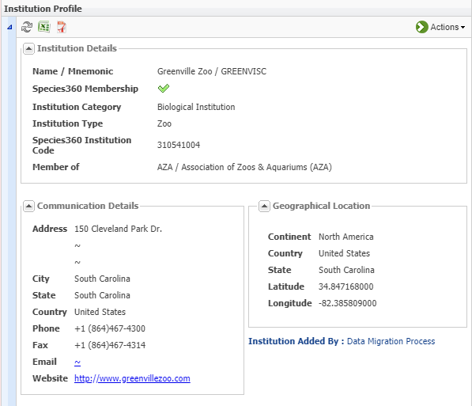

Husbandry – Institution Profile
Start by reviewing your Institution
Profile. Does it need to be updated?
Is the address, phone and fax numbers
and Website still correct? Remember,
this is what your colleagues will see
about your institution so you want to
make it as complete as possible.

Slide 4
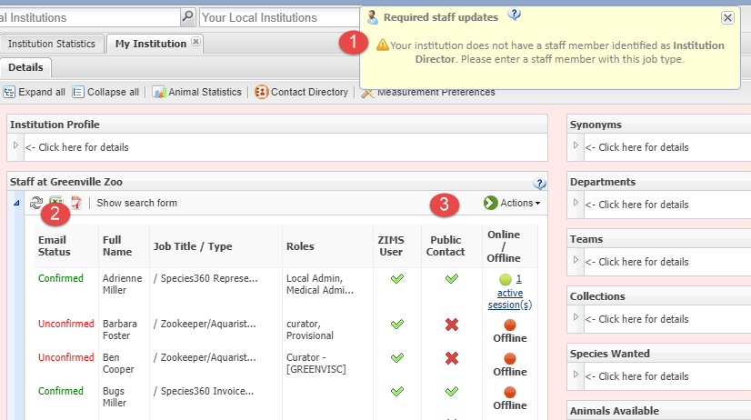

Husbandry – Staff List
Review your Staff list. 1)If you are getting the warning that you do not have anyone identified for a required Job Type then you should assign one. This is important to make sure that the right person is receiving the right communications from Species360. 2)Make sure that everyone who is assigned a ZIMS Role has confirmed their email address. If they have not they will not be able to log into ZIMS. 3)Check that you have the correct Staff marked as a Public Contact. Your colleagues can only see those Staff members marked as Public Contact when they are looking to contact someone at your facility. Then review the list to make sure that no one needs to be marked as Obsolete.

Slide 5
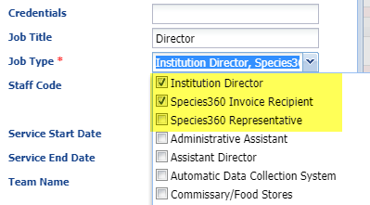
Husbandry – Job Types
The required Job Types are at the top of the list for easy access. You can assign multiple Job Types to the same person
Institution Director
  Receives only top level communications such as Board decisions and changes in membership
Species360 Invoice Recipient
  Gets the bill!
Species360 Representative
  ZIMS updates and news

Slide 6
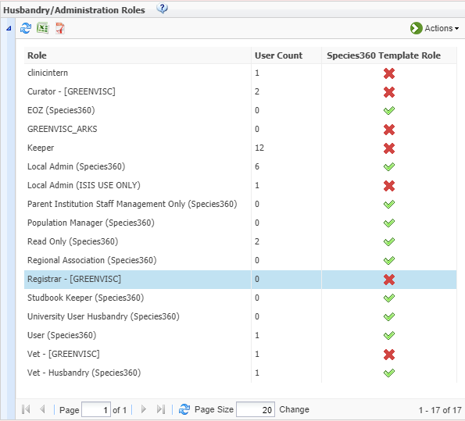
Husbandry – ZIMS Roles
Review your ZIMS Roles.
1)If you have created a custom Role but have never assigned anyone to it you may want to delete it.
2)Check Species360 Roles for any new
functionality that is assigned to them. You may want to change Role assignments should we have made new functionality
assignments not to your liking.
3)Check any custom Roles for new functions that you may want to assign to
them.
4)Then check what Roles are assigned to
which Staff member. You may need to change them.

Slide 7
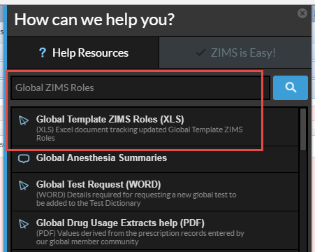
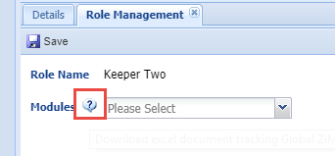
Finding Role Functionality
In the Help Menu you can find an
Excel file that has all the Species360
Global Role assignments to help you
stay updated with new Role
functionality. And you can also
select the Role and go to Manage
Role Access under Actions and
view each module’s access. You can
also open the Excel doc from here.

Slide 8
Provisional Data Entry
If you already use it:
  Review the roles assigned
  There may be staff that you can promote to full rights if the quality of their entries has routinely been good enough
  When reviewing Provisional entries in Data Entry Monitoring we suggest looking at those for possible rejection first. This makes the time saving Approve All work better
If you don’t use it:
  Talk with your Staff as they may be willing to start
  Ask your support representative to turn it on
  Local Admin will need to activate it at your facility
  Create Provisional Roles as desired and assign to appropriate Staff

Slide 9
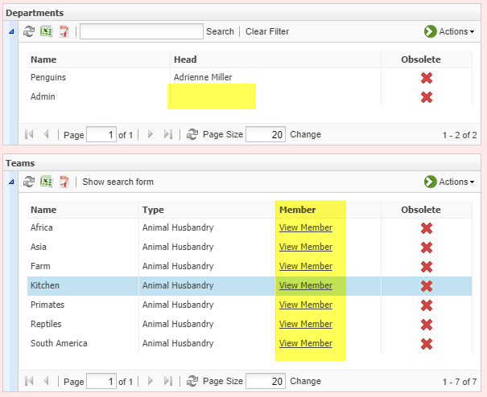
Husbandry – Teams and Departments
Look at your Teams and Departments.
Is there a Head assigned to all of your
Departments? To view the members
you will need to select to View/Edit.
Are your Team members correct? It
is easy to view who is on a Team by
selecting the View Member hyperlink.
Do any need to be marked as
Obsolete? Teams and Departments
can be assigned as Responsible Parties
and Calendar Tasks so you may want to
re-organize.

Slide 10
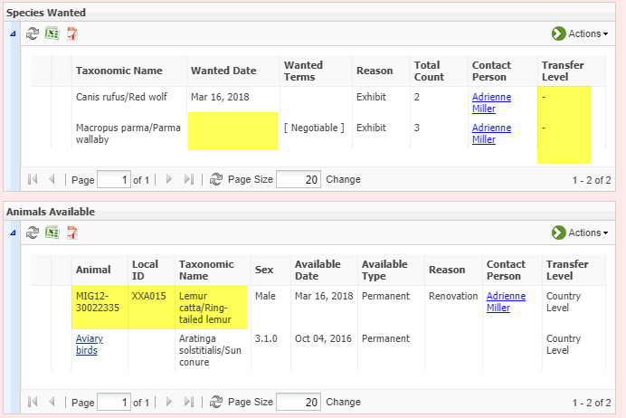
Husbandry – SW and AA
Review your Species Wanted
and Animals Available lists.
Are you still looking for the
species? Is there any information
that should be added such as
Transfer Level in this example?
Are the animals still available?
ZIMS does not automatically
remove an entry from this list
due to disposition or death so
it is your responsibility to keep it
updated. In this example the
lemur is deceased and needs to
be removed from the AA list.

Slide 11
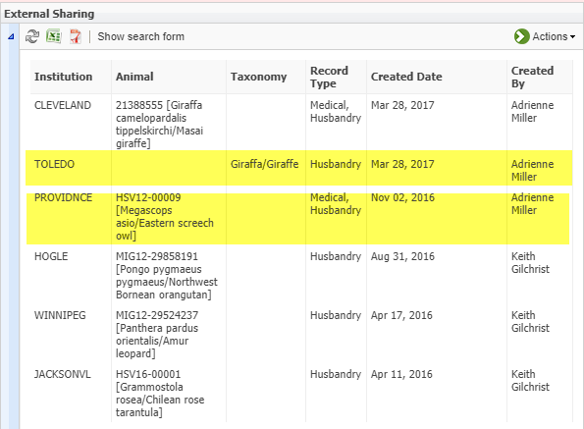
Husbandry – External Sharing
Review your External Sharing
grid and confirm that the
records should continue to be
shared. In this example Toledo’s
research on giraffes is done
and the proposed transfer of
the screech owl was cancelled.
These records should be
deleted from the External Sharing
grid.

Slide 12
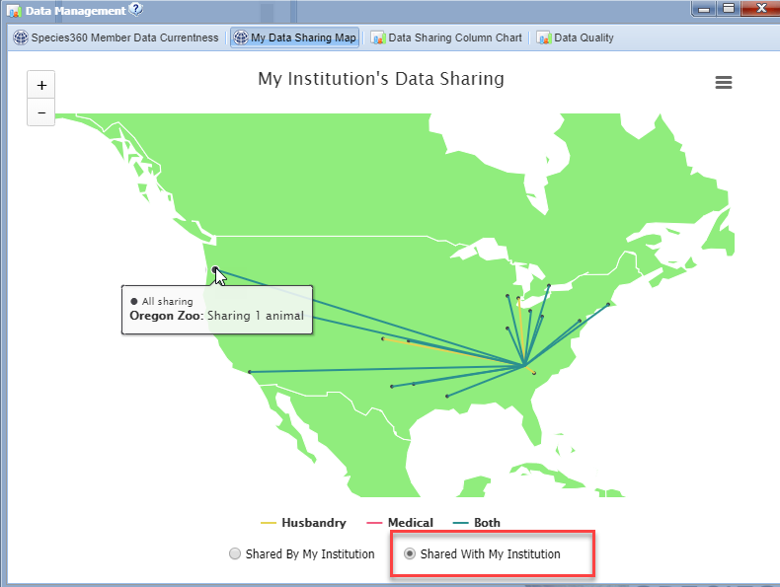
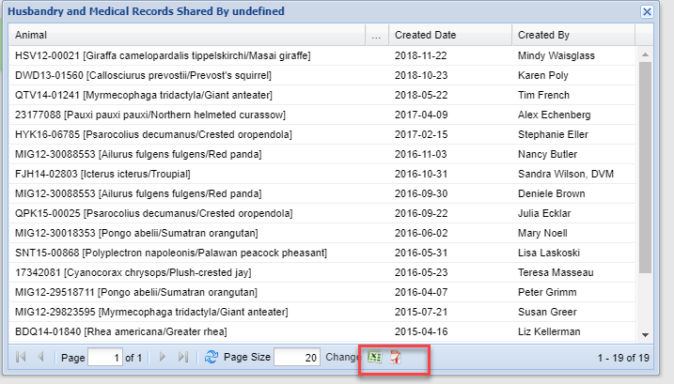
Husbandry – External Sharing
Make sure that your staff knows
what records are being shared
with YOU by other institutions.
Go to Start > Institution > Data
Management > My Data Sharing
Map > Shared With My Institution.
Hovering over the circle will display
the institution and the number of
records shared with you. Clicking
on any line will bring up a list of all
animals shared. You can export this
list to share with your staff.

Slide 13
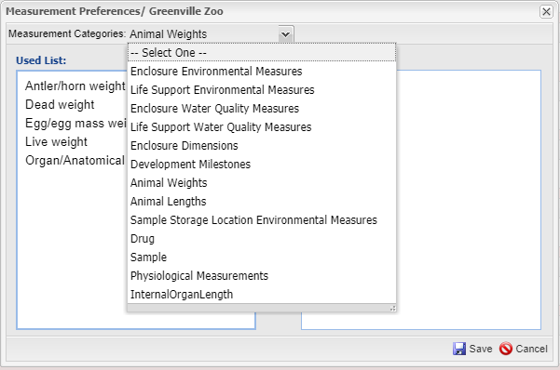
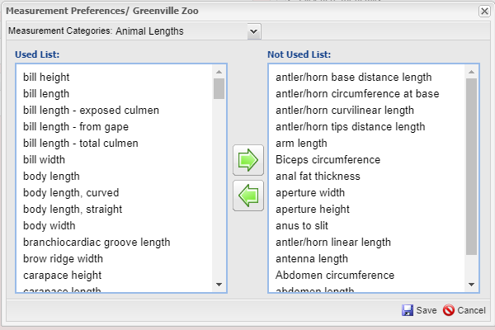
Husbandry – Measurement Preferences
If you have not already done so
you may want to address your
Measurement Preferences found
at the top of My Institution. This
functionality allows you to remove
terms from various data standard
lists making it much quicker and
easier for your Staff to select from
as only appropriate terms are
displayed. In this example our
institution is an Aviary. We will
never be measuring things such as
antler or arm length. Removing
these from the list greatly shortens
the scrolling required by you or
other staff.

Slide 14
Husbandry - Institution
Review your Institution Preferences as you may want to change some if you have staff buy-in
  Allow Multiple Enclosure Assignment
  Allow Re-use of Transponders
  Enable Auto-incrementing Local ID
  Display Medical Weights in Husbandry
  Default Group Tracking
Session Settings
  Force Single Session
    Institution level or Staff level
  Limit Access by IP Number
    Recommended to assign at Staff level

Slide 15
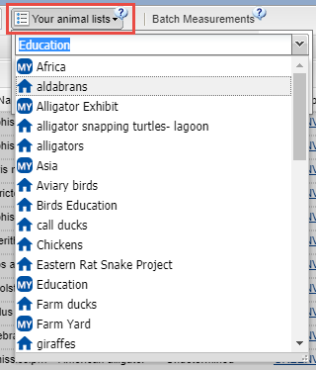
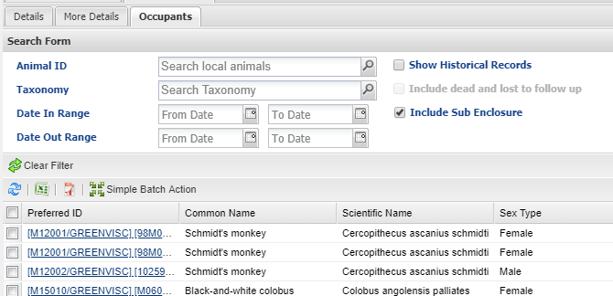
Husbandry – Animal Lists
Review and update your Animal Lists. Remember
that ZIMS does not automatically update these lists
as animals are moved, dispositioned or die. If you
created Animal Lists by Enclosure you may not even
need those lists anymore with the increased
functionality of the Enclosure Occupants tab (below)
regarding search filters and Batch Actions using
Enclosure Occupants.

Slide 16
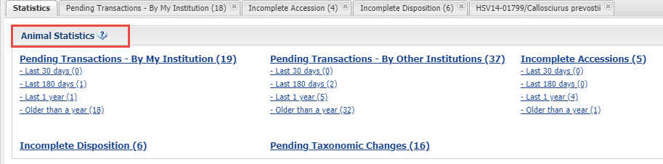

Husbandry – Animal Statistics
The Animal Statistics tab should be reviewed. Address as
many Pending Transactions – By My Institution as possible.
You may need to nudge other facilities to address Pending
Transactions – By Other Institution. Incomplete Accessions,
especially recent ones, should be made into Full
Accessions. And deaths should be recorded for those animals
in the Incomplete Disposition list. Remember, if you do not
have enough information to complete any of these
transactions you can always archive them to be dealt with
at a later date.

Slide 17
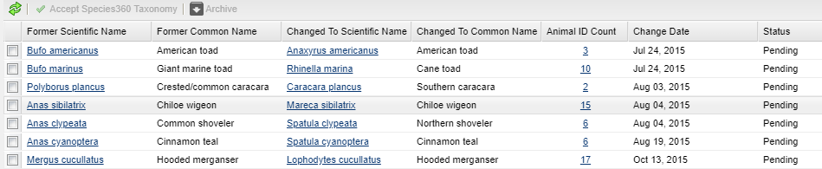
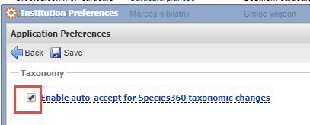
Husbandry – Taxonomic Changes
The last topic in Animal Statistics is Pending Taxonomic Changes to keep your records up-to-date with the current ZIMS taxonomy. When changes are made ZIMS will not automatically up date your local records, you will need to do so. This feature displays the species that need updating and the count of animals impacted which is a hyperlink into the records (top). You can chose to update all the records in a species, or just some. If you wish to automatically update your records when ZIMS updates taxonomy you can check the Enable Auto-accept for Species360 Taxonomic Changes box in Institution Preferences > Application Preferences > Taxonomy (below). You will still receive a Post Office message regarding the change and you can also opt for email notification so you
will be kept informed regarding what was changed.

Slide 18
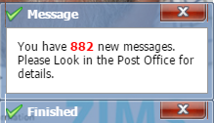
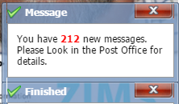
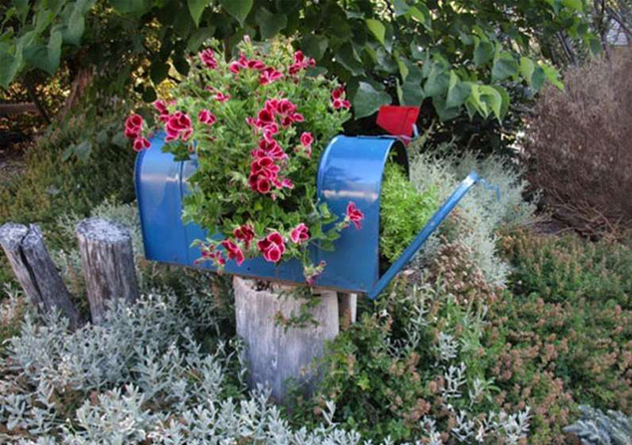
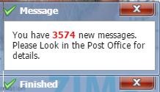
Husbandry – Post Office
The Species360 Post Office,
is there to notify you of activity
in ZIMS that may warrant you
taking an action. Most of what
is shown in the Post Office is not
displayed elsewhere in ZIMS.
Addressing your Post Office
messages will help you clean
up your data.

Slide 19
What’s in the Post Office?
Taxonomy Changes
  As discussed these are also displayed in Pending Taxonomic Changes in Animal Statistics
Modifications to medical terms you have used
  Definition edits & formulation changes
  A local term made global
Sex Type changes to animals you have had
  This may help you clean up those duplicate Parental GANs!
Animal you own placed on Available Animal list
Animals merged by Species360
Pendings
  No Information Available
  Not recorded in ZIMS
These are some of the topics you will receive
as Post Office messages. Those displayed in
red will have the greatest impact on your
records.

Slide 20
Managing the Post Office
Post Office messages are like Outlook. When someone takes an action on a message it will only be reflected in THEIR Post Office
It is recommended that you give Post Office access only to those staff members who may actually take action on the messages
The only Species360 template role that has Post Office access is Local Admin
It is highly recommended that you go through your Post Office messages and address any actions you need to take and move to trash
However, that is the perfect world. You can…….

Slide 21

Plant a new PO Resolution!
Resolve that you are going to start reading your Post Office messages.
Export your current messages to Excel so you lose nothing should you find time later to read and act on them.
Move all messages to Trash and delete.
Start reading and acting on your Post Office messages daily. Then move them to trash and delete.

Slide 22
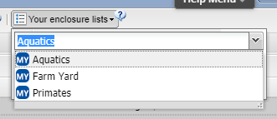
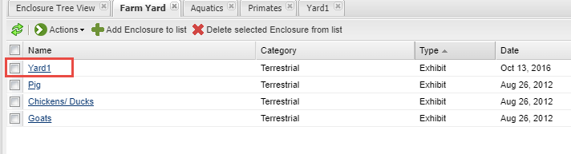
Husbandry – Enclosure Lists
Just like your Animal Lists, your Enclosure Lists
should be reviewed. Below we opened up our
Farm Yard list. Yard1 was renovated six months
ago into a primate exhibit. It should be removed
from the Farm Yard list and added to the Primates
list.

Slide 23
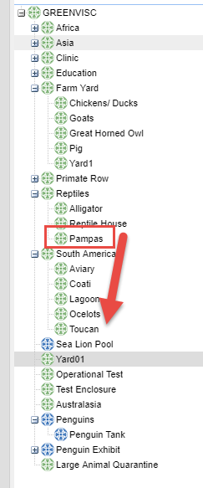

Husbandry – Enclosure Tree
Open up all nodes of your
Enclosure Tree and check that
the Parent/Child relationship
is correct. In this tree the
Pampas exhibit somehow is
a child of Reptiles. Use the
“drag and drop” feature to
move Pampas back where it
should be, a child enclosure
of South America.

Slide 24
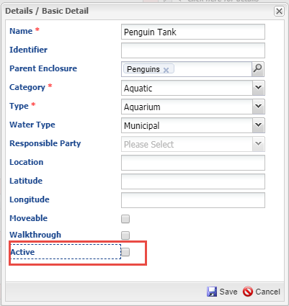
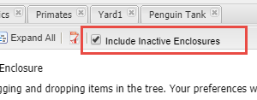
Husbandry – Active Enclosures
While you are looking at your
Enclosure Tree make sure that
all the Enclosures are still Active.
If they are not, choose to Edit
Details in the Basic Detail screen.
Uncheck the Active box and Save.
The enclosure will be removed from
the tree. To find it again in the tree
check the Include Inactive Enclosures
box above the Tree. To find it in a
search remember to check the
“Include Inactive Enclosures” box.

Slide 25
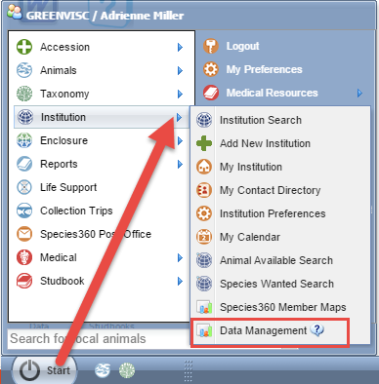
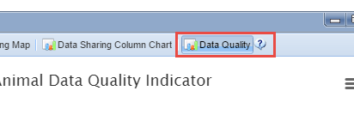
Data Quality Indicator
Your next stop for cleaning up your
data is to use the Data Quality
Indicator. This is found under Start>
Institution>Data Management.
Data Quality is the last tab on the right.

Slide 26
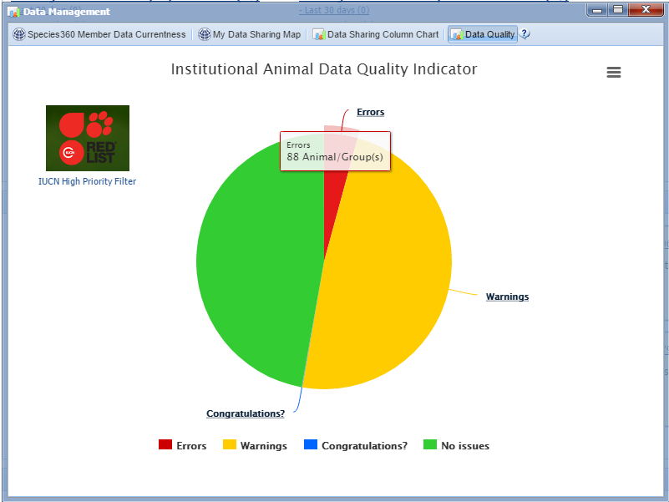
Data Quality Indicator
The Data Quality Indicator
is a pie chart that displays the
records with no issues and
those with three types of
possible data quality
issues. Obviously you want
your biggest slice to be
green (No Issues) and your
smallest slice to be red
(Errors). A large
Congratulations? slice may
not actually be a good thing.
Hovering over the slice will
display the number of records
in each category.

Slide 27
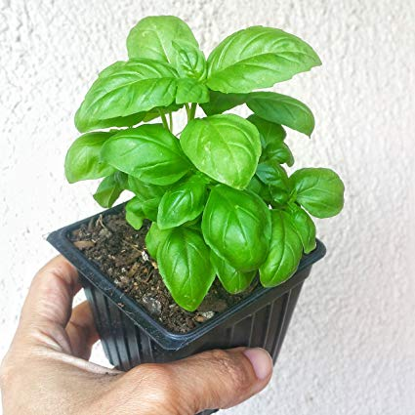
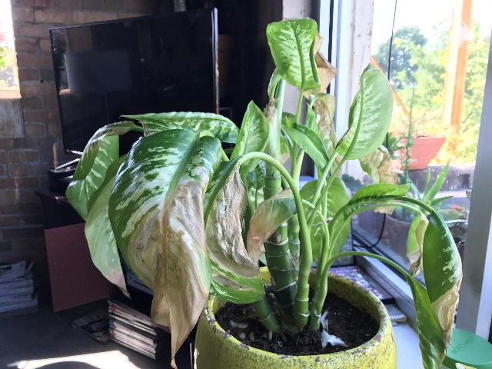
Data Quality Indicator
No Issues (green)
  Great! No data quality issues are found
Warnings (yellow)
  Of possible concern. You will want to address
    Pending Transactions
      Really just a heads up
    Parents not in ZIMS
      Also just a heads up
    No parents recorded
      These will need to be fixed

Slide 28
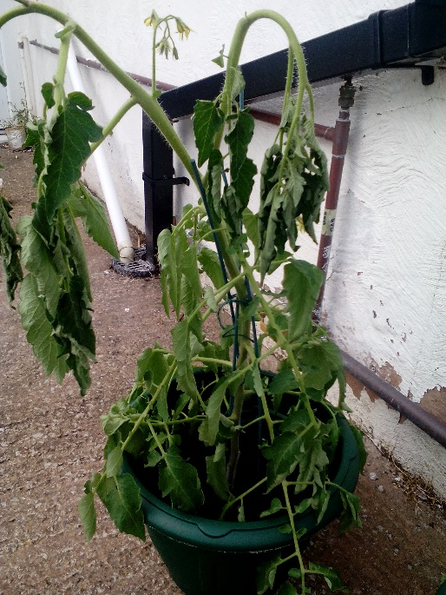
Data Quality Indicator
Errors (red)
  Bad! Need to Fix
    Obsolete taxonomic name
    Extra Physical transactions
    Extra Ownership transactions
    Parent GANS identical to each other
    Unrealistic dates
    Missing Term
    Gap Between Parent Death and Offspring Birth
Congratulations? (blue)
  Possible oldest animal(s)

Slide 29
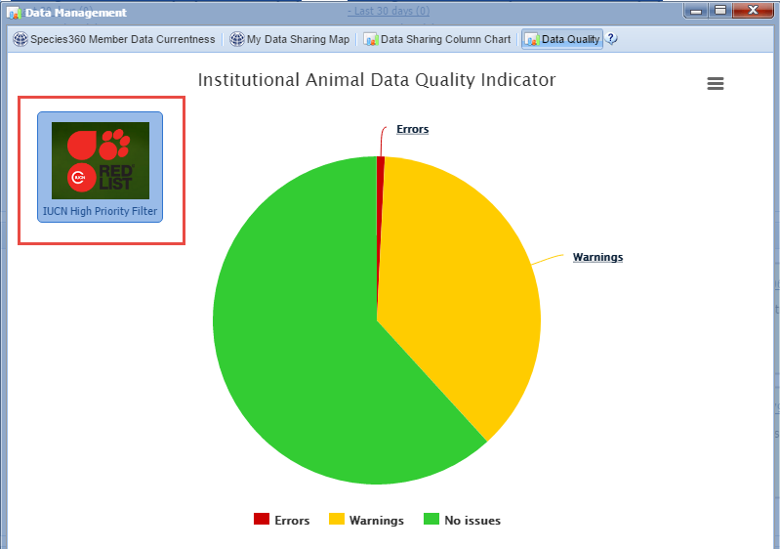
Data Quality Indicator
If you don’t know
where to get started
it is recommended
to apply the IUCN High
Priority Filter. This
will ensure that you
are cleaning up the
data for high priority
animals first. Note that
using this filter greatly
reduced the size of the
Error slice and increased
the size of the No Issues
slice.

Slide 30
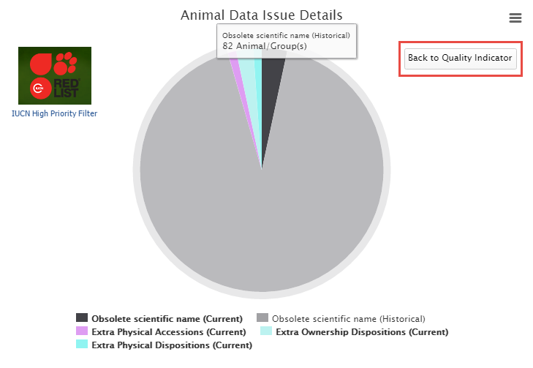
Data Issue Details
Left clicking on the pie
slice will drill down in
the chart for more
details. Here we have
selected our Errors.
We have current and
historic Obsolete
Taxonomic names,
Extra Physical Accessions
and Dispositions and
Extra Ownership
Dispositions. You can go
back to the previous
chart using the “Back
to Quality Indicator”
button.

Slide 31
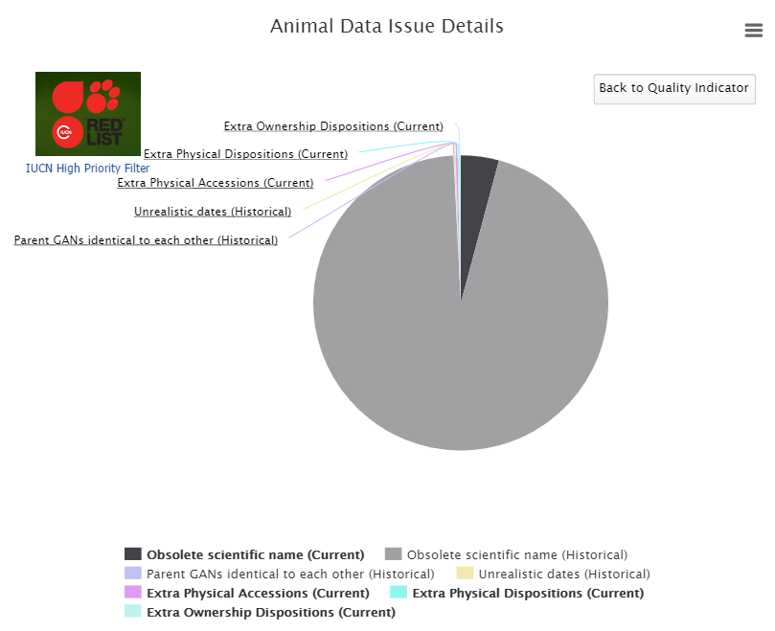
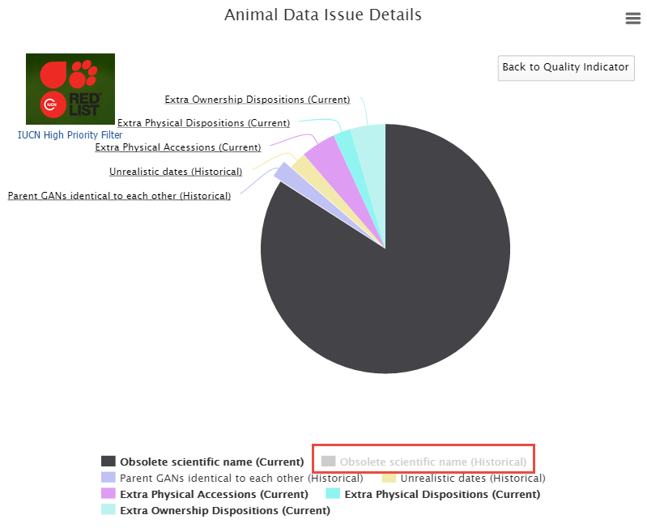
Expanding the Pie Slices
If some of your pie slices are too small to read (as on the left) removing other slices
by clicking on the topic below the chart will expand the others. Here we have removed
Obsolete Scientific Name (historical) (now greyed out) to better view the other slices.

Slide 32
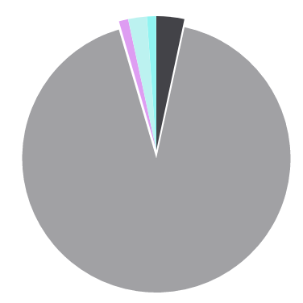
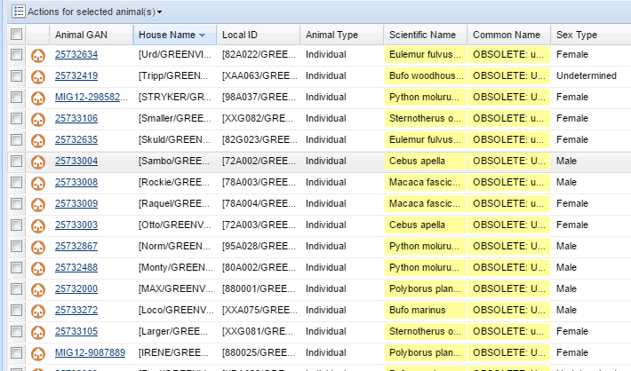
Locating the Records
Clicking on the pie slice will bring up a list of the animal records that contain the data
that created the Error or Warning. Here we opened the slice for Obsolete Taxonomy
(historical). Using the Pending Taxonomic Changes in Animal Statistics should clear
these up.

Slide 33
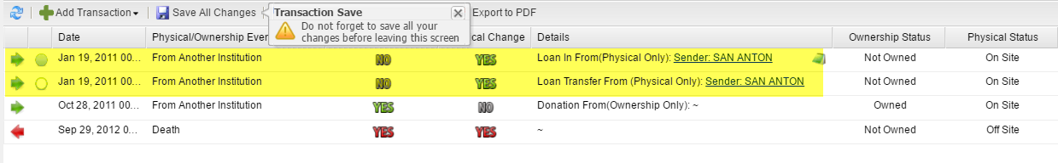
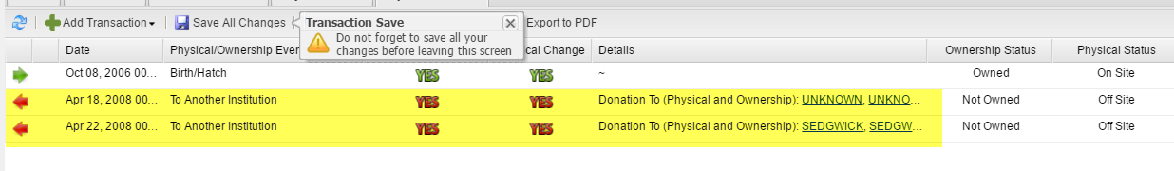
Fixing Extra Transactions
Extra Transactions are usually found only in records migrated from ARKS. ZIMS should
not allow you to create these. At the top you have recorded receiving the animal twice
with two slightly different Loan terms. At the bottom you have recorded sending out
the animal twice. These should be researched and the incorrect transaction removed.
Always add a Note should you have to do this!

Slide 34
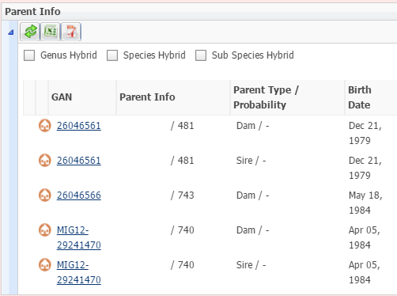
Fixing Identical Parent GANs
Identical Parent GANs means
that the same animal has been
entered as both a Sire and a
Dam. This is not always an
Error because that is what is
recommended to enter when
an animal who is a possible
Parent is unsexed. However,
there is a possibility that since
the record was created the
animal has been sexed. In this
record we checked the sex for
GAN 26046561 and it has since
been sexed as a female. It can
be deleted as a Sire record (and
add a Note!).

Slide 35
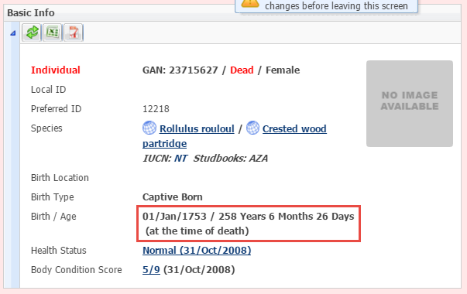
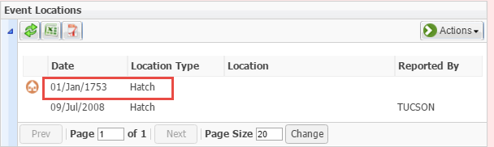
Fixing Unrealistic Dates
Finding the Unrealistic Dates may
require a bit of detective work as
they are not always obvious. But
here we have a 258 year old wood
partridge (fairly unrealistic). Although
My Transaction stream has the Hatch
Date correctly recorded as 9 July 2008,
someone recorded 01 January 1753 in
Event Locations. These dates can only
be corrected by the originating
Institution.

Slide 36
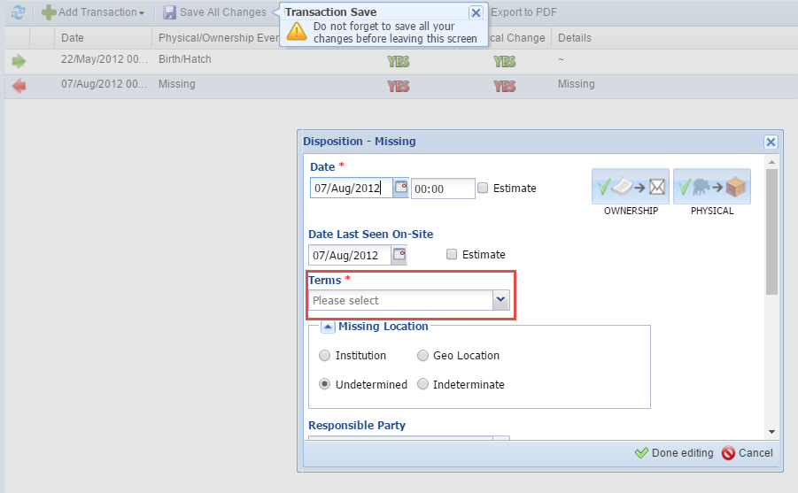
Fixing Missing Terms
Missing Terms are caused by migration
from ARKS. Most are typically found
in a transaction of Missing because
there were no Terms required in the
ARKS application for a Missing transaction.
However, other transactions can still
contain blank Terms although these are
far fewer. Simply find the blank field by
opening My Transactions records and
select the proper Term.

Slide 37
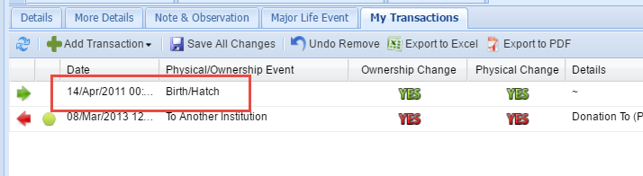
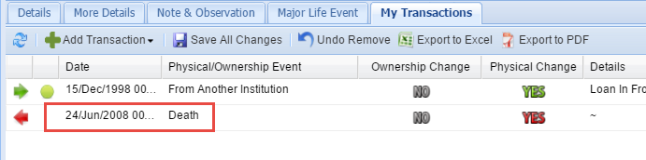
Fixing Gap Between Parent Death and Birth/Hatch
Fixing Errors for Gap Between Parent Death and Offspring Birth will also require a bit of detective work. The record that will open will be that of the offspring. This penguin (top) was hatched on 14 April 2011. However, when you open the dam’s record you note that she died on 24 June 2008 (bottom). There are several possibilities here:
1) the incorrect dam was recorded
2) the incorrect hatch date for the chick was recorded, or
3) the incorrect death date for the dam was recorded.
You will need to look at both records, don’t forget to look in the Notes, to determine which record needs to be corrected.

Slide 38


Congratulations?
Congratulations? Is an
indicator that you may
possibly have the oldest
individual of a species.
To open this (usually
very small) pie piece you
click on the hyperlink
instead of the pie slice
if there is no slice to open.

Slide 39

Congratulations?
The results grid will display the animals that you may be deserving of a
Congratulations! In many cases though, this longevity is due to an error such
as not recording a death on the right date, or even not recording it at all! You
may need to review any Notes in the record to determine if the dates are
accurate or if they need to be corrected. If the record is indeed correct then
congratulate yourself and maybe use it for a Public Relations spot!

Slide 40


Calendar – Mark Complete
It is a good idea to review your Calendar Tasks for
any that have not been marked as complete. You
may have forgotten to do something! Any open
tasks will have a red “!” to the left in the calendar.
If something was not completed and needs to be
re-scheduled the task can easily by dragged and
dropped into the appropriate date.

Slide 41


Studbook – Data Quality
The Data Quality tools in the Studbook Module are found in the main Dashboard
(left) and also in the left hand dashboard (right). Once open you can filter by
High, Medium or Low Priority.

Slide 42


Studbook – Data Quality
High Priority is red and needs
to be fixed. These are problems
such as a blank Studbook ID or
Blank Parents. Medium Priority
are yellow and are problems
such as incompatible origins.
Low Priority are green and may
not actually be an issue such as
a Temporary Studbook ID.
Hovering over the “?” will tell
you what you need to do to
fix things. There is also a Help
Doc with definitions of the codes
and how to fix them available under
the Help Menu.

Slide 43



Studbooks – Husbandry Data Fix
Sometimes records are Split (one made into two), Merged (two or more made into one) or Deleted in the Husbandry module. These actions may
affect Studbook data. The Husbandry Data Fix Report found under Suggested Animals will identify these records so the Studbook Keeper
is aware.

Slide 44

Medical – Health Status
When we first came out with this Health Status warning of possible data conflict we were asked if there was a way to turn it off and why did it even matter? The truth is it matters A LOT! Many of the ZIMS Global Medical Resources, for example the Expected Test Results, are based off of “results obtained from healthy animals”. If you are recording data on an animal who has a Health Status of Normal that data may become part of the Global Resources when in reality it should not because the animal has an active medical problem. To maintain the accuracy of our Global Resources these possible conflicts should be addressed.

Slide 45


Medical – Medical Apps
At the top of the Medical Records main dashboard is a drop down for Medical
Apps. The first two of these – Data Clean-up for Animal in Focus and Batch
Data Clean-up for Removed Animals can help you with Spring cleaning your
Medical records. ZIMS loops through each record checking for potential data
quality problems.

Slide 46
Medical – Medical Apps Data Clean-up
Diagnosis records
  with no resolution date
  with resolution date after the disposition date
Prescription records
  with an end date after the disposition date and no termination date
  with an end date after the disposition date and a termination date also after the disposition date
Non-pathology type calendar event after the disposition date
Death transaction with a most recent health status other than “not applicable”

Slide 47


Medical – Medical Apps Data Clean-up
The Data Clean-up for Animal in Focus will look only in that record. The Batch Data
Clean-up for Removed Animals will look in all Medical records for animals that were
dispositioned (death, sent elsewhere, missing, released) during a specified date range
that does not exceed 92 days.

Slide 48


Medical – Anesthesia DQ Search
The Anesthesia Data Quality
search found under Anesthesia
search in the Medical dashboard
can help you to clean up those
unfinished records to create a
complete Anesthesia record. The
results will display as a pie chart.

Slide 49

Medical – Anesthesia DQ Search
Clicking on a pie slice
will bring up a results
grid for records with
the selected issue so
the Anesthesia record
can be completed.

Slide 50


Medical - Relevant Death Information Analysis (Incomplete/Conflicting Necropsies)
The Morbidity & Mortality Analysis can help you find any incomplete or conflicting necropsy records. This is available under Global Resources (left)
and also from the Medical module (right).

Slide 51

Medical - Relevant Death Information
Select Relevant Death Information Analysis and My Institution scope. You can limit
by taxonomy or select Animalia and check Include Taxon Below to find all the
records you need to complete for your entire collection. You can also limit the results
to animals that actually died under your care, removing information from animals
out on loan that died elsewhere. You can also select a Death Date range.

Slide 52

Medical - Relevant Death Information
The first graph displays the records with Uninformative
RDI records, Useful RDI records, and Records with Conflicting, Suspect or Incomplete RDI records. Hovering over the bars will display the number of records of each type.

Slide 53

Medical - Relevant Death Information
Clicking on the bar title hyperlink or the bar itself will drill down to display another graph. Here we opened the graph for records that are Conflicting, Suspect, or Incomplete.

Slide 54


Medical - Relevant Death Information
When you open your final bar a
list of animals with records will
be displayed. Here we see all
records where Undetermined/
Indeterminate AND useful RDI
has been recorded. In this record
Undetermined and Neoplasia
have been recorded. The
Undetermined entry should be
removed.

Slide 55


Medical - Relevant Death Information
You can correct the Relevant Death Information from
either the Finalize tab in the necropsy record (medical
module on left) or the Death record in My Transactions
(husbandry module on right).

Slide 56

Any Questions?
On ZIMS Spring Cleaning

