Slide 1
Mingling Modules
Tips & Tricks March 2019

Slide 2
Who Mingles with Who
Although most of the data entered into the three ZIMS modules stays within the module where it was entered, some data is mingled with other modules.
Some data entered into the
Husbandry module goes into
the Medical module and some
entered in Medical goes into
Husbandry.
Some data entered into the
Husbandry module goes into
the Studbook module. Currently
no information entered into
the Studbook module goes into
the Husbandry module.
There is no data shared
between the Medical and
the Studbook modules

Slide 3
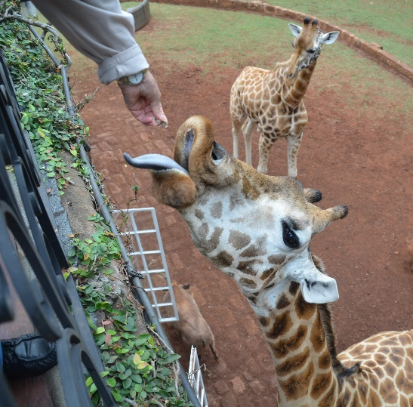
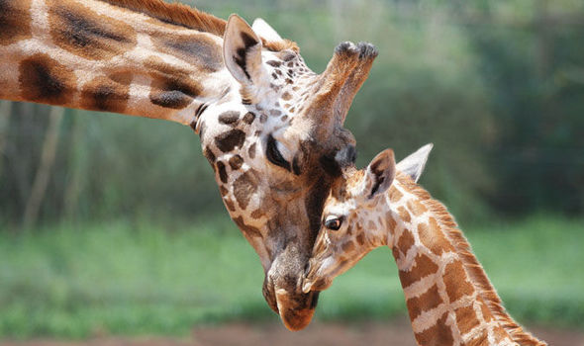
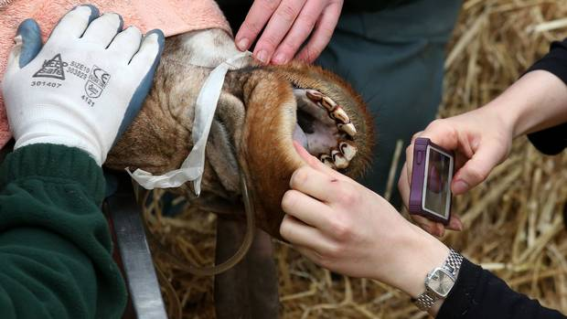
Husbandry
Knowing what data is mingled between
modules may encourage better data
entry:
1.People with other job responsibilities
may need to interpret what you recorded
so you need to be especially clear.
2.Data entry errors may affect the
accuracy of the data in the other module
so you should do it right the first time!
Studbook
Medical

Slide 4
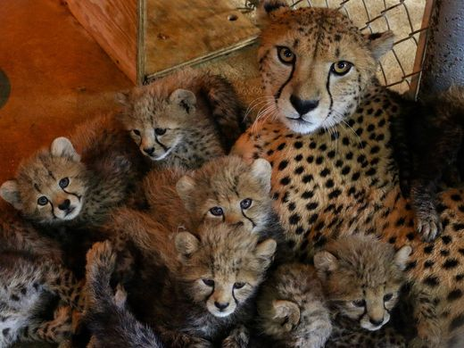
Husbandry to Studbook – Suggested Animals
If a new accession is recorded in
ZIMS it becomes part of the Suggested
Animals list in the Studbook. New
accessions would include births and
hatches and receiving an animal from a
non-ZIMS using institution. The animal is
not yet part of the ZIMS database.
Transactions between ZIMS member
institutions would create a Pending
Update, not a Suggested Animal. The
studbook keeper has the options to
Accept the record or Reject the record.
If Accepted it become part of the ZIMS
studbook database.

Slide 5
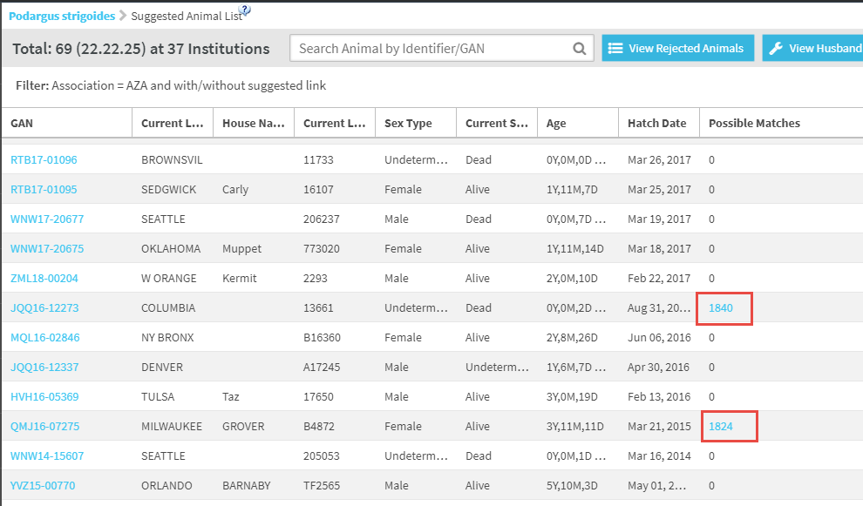
Suggested Animals
This is a list of Suggested Animals for this studbook.
If ZIMS thinks that it has found a possible match that is
already in the studbook it will display the Studbook ID
as a hyperlink. If the studbook keeper determines they
are indeed a match they can link the Suggested Animal
to the studbook animal with one click.

Slide 6
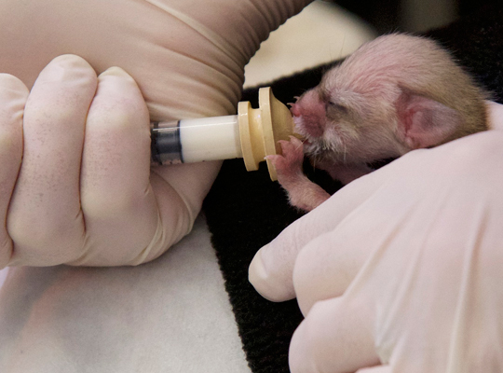
Husbandry to Studbook – Pending Updates
If changes are made to an animal that is
already in the ZIMS database these
changes will become part of the
Pending Updates list. Changes to any
of the following are included:
Transactions
Parents
Taxonomy
Sex
Rearing
Contraception
As for Suggested Animals, the studbook
keeper has the options to Accept the
updates or Reject them. If Accepted they
become part of the studbook database.

Slide 7
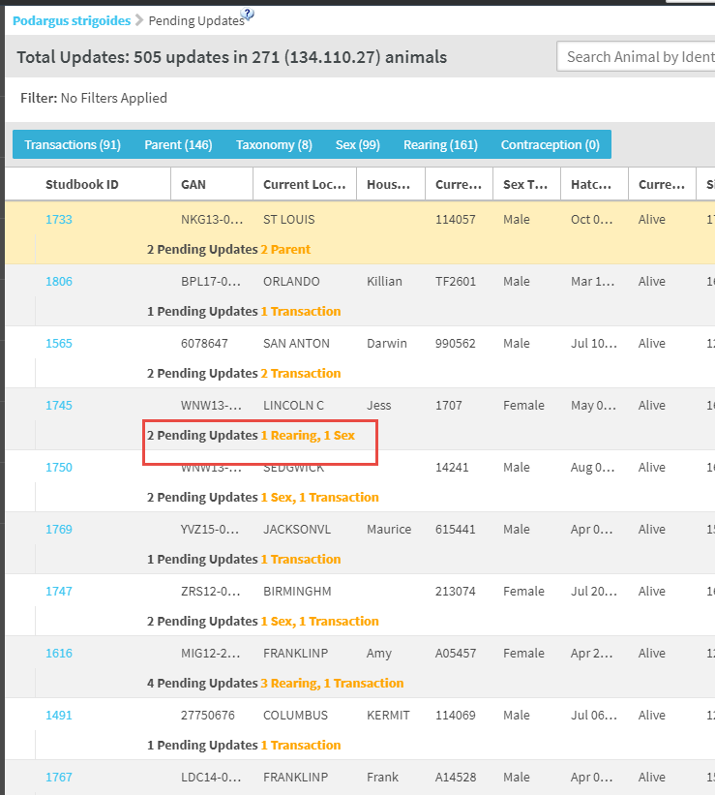
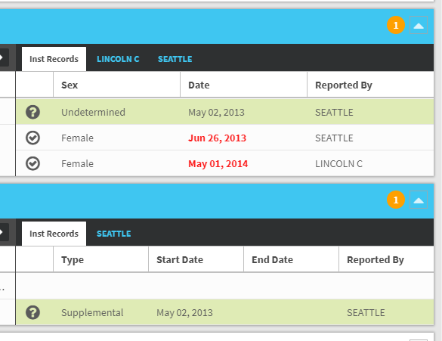
Pending Updates
This is a list of Pending Updates
for a studbook. The number and
type of update are displayed in
orange. Using the Studbook ID
hyperlink the studbook keeper
can open the record. Any grids
with updates will be open by
default and the number of
updates indicated.

Slide 8
Husbandry to Studbook – Identifiers
Any identifiers entered in
the Husbandry module will
auto-fill into the Identifiers
grid in the Studbook module.
Unlike the previous mingled
data that has to be approved
by the studbook keeper,
identifiers do not need to be
approved to become part of
the studbook.

Slide 9
Studbooks to Husbandry
Currently, no data entered in the
Studbook module mingles with
the Husbandry module. A future
enhancement is to have the
studbook number auto-fill in
the Identifiers grid in the
Husbandry record.

Slide 10
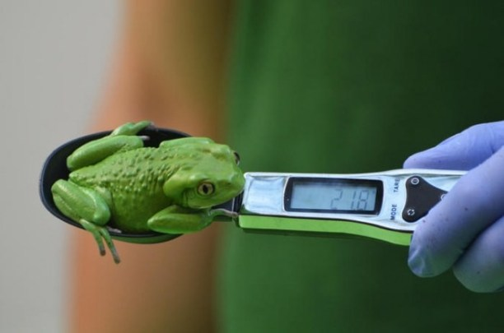
Husbandry Medical – Animal Weights
Some data goes back and forth
between the Husbandry and Medical
modules. Animal Weights is one
example. The most recent weight
recorded (often in the Husbandry
module) is referenced in the
Prescription and Anesthesia
Medical modules for correct drug
and anesthesia calculations. New
weights can also be recorded in these
Medical modules and they will
display in the Husbandry grid.

Slide 11
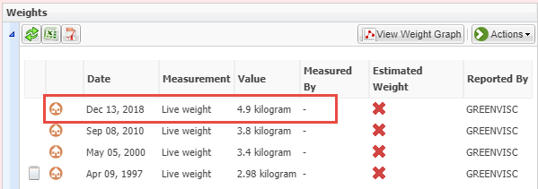
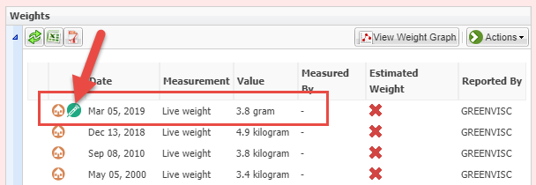
Animal Weights
A weight of 4.9 kg was recorded
in the Husbandry module on 13
Dec 2018 (top). In the Anesthesia
module that weight will display
to use. There is also the option to
record a new weight (middle). You
record a weight of 3.8 gr. That weight
now displays in the Husbandry grid.
The symbol indicates the weight was
recorded in the Anesthesia module
(bottom). This weight will now display
as the most current weight. The
weight cannot be edited from the
Husbandry grid, it can only be
edited from the Anesthesia module.

Slide 12
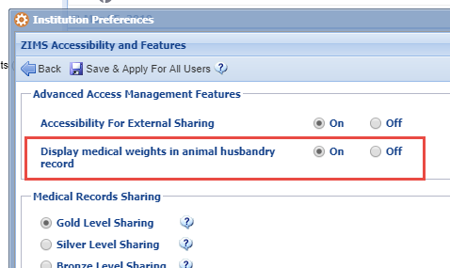
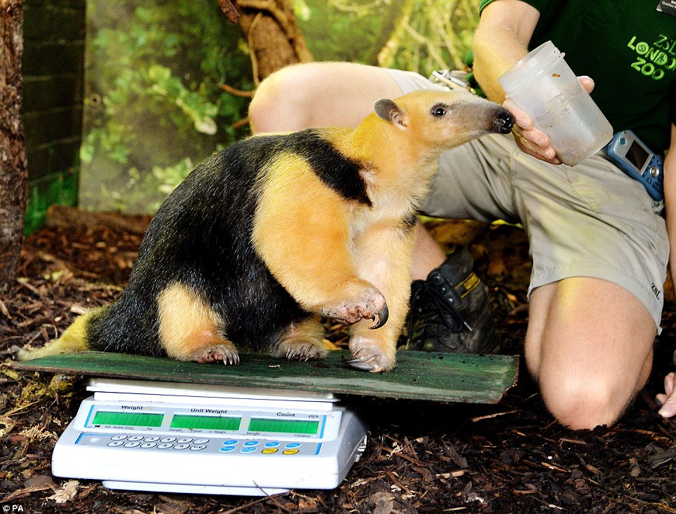
Animal Weights
If you do not want weights
recorded in the Medical module
to display in the Husbandry
module you can do so. Under
Institution Preferences > ZIMS
Accessibility and Features
check the “Off” radio button.
Weights recorded in the
Medical module will now only
display in that module.

Slide 13
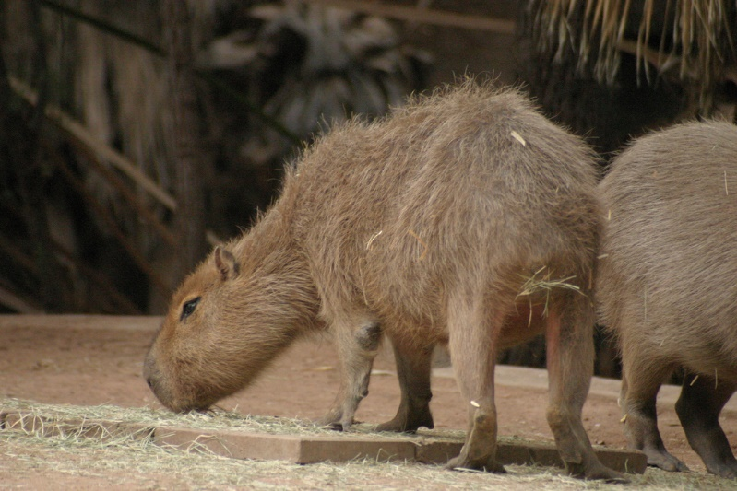
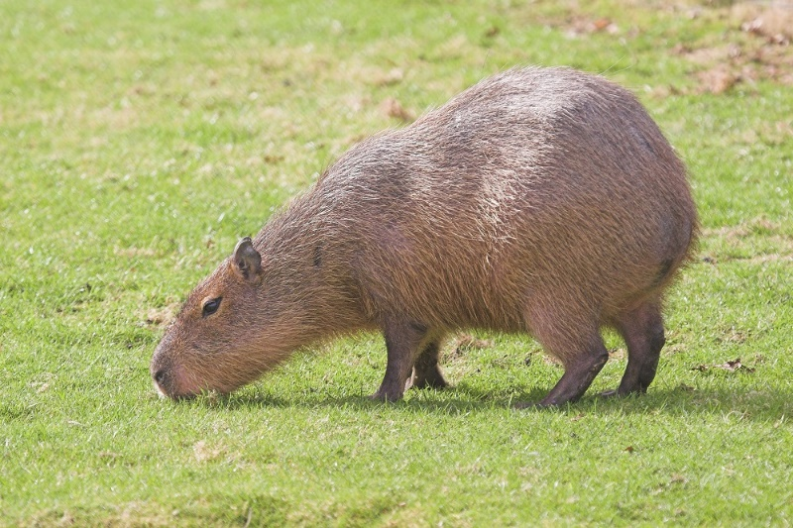
Husbandry Medical – Body Condition Score
The Body Condition Score (BCS)
captures the overall condition of
the animal’s body using a nine
point scale – 1 is emaciated, 9 is
obese. If your institution prefers
a five point scale use the odd
numbers. BCS can be edited from
both the Husbandry and the
Medical modules.

Slide 14
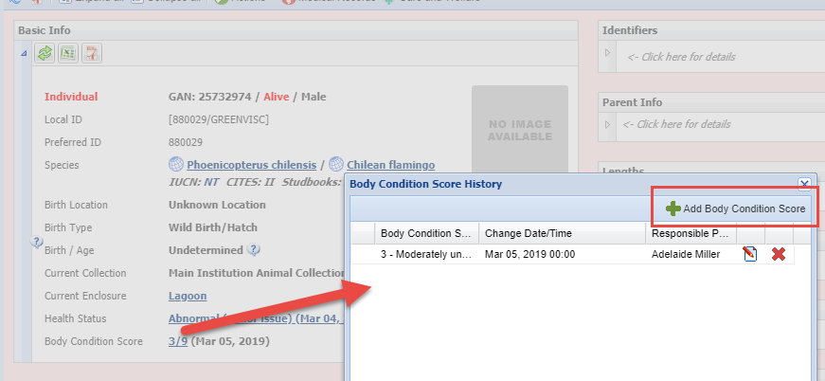
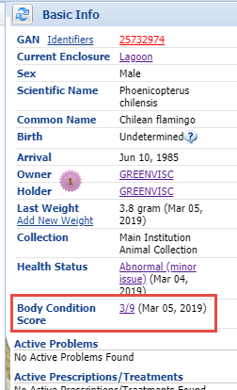
Body Condition Score
In the Husbandry module (top) BCS is found
in the Basic Info grid. The number is a hyper-
link to the BCS History and where you can add
a new BCS. In the Medical module it is found
under the right hand Basic Info screen (right).
Whatever is the last score entered will display
in both Husbandry and Medical.

Slide 15
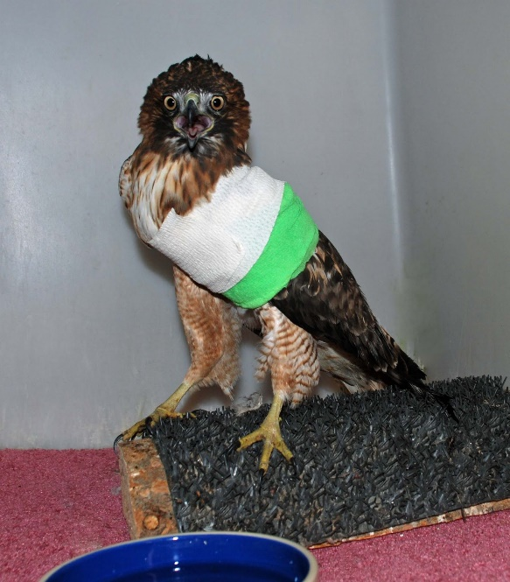
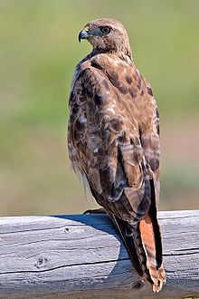
Husbandry Medical – Health Status
Health Status also displays in both
Husbandry and Medical modules.
The statuses are Normal, 3 types of
Abnormal and Not Applicable. The
correct Health Status is very
important because the Global
Reference Intervals are results
ONLY from animals whose Health
Status is Normal.

Slide 16
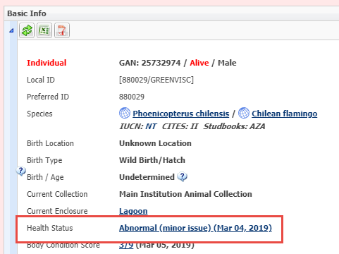
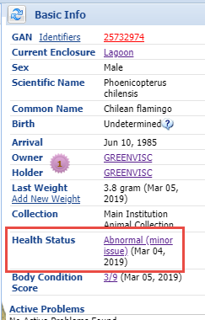
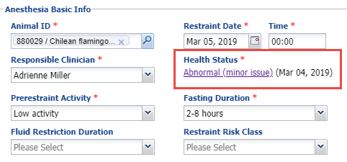
Health Status
Health Status is also
found in the Basic Info
grid in Husbandry and the
right hand Basic Info in
Medical. In addition you
can also update Health
Status from within the
Anesthesia module. The
most recent status recorded
will display in all of these
screens.

Slide 17
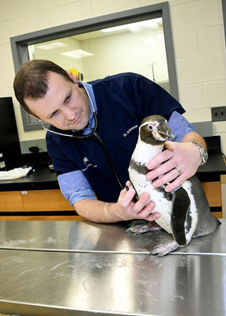
Medical to Husbandry – Clinical Notes
Clinical Notes are a commonly used
area in the Medical module. They allow
free text to be captured as a four-part
SOAP entry (Subjective, Objective,
Assessment and Plan) or as a one-part
Notes entry. These Clinical Notes may
be hard to interpret by those who are
not medically trained. At the bottom
of the Clinical Notes screen is a box for
Animal Care Staff Medical Summary
entries. Text entered here will be copied
into the Notes screen in the Husbandry
module and allow other Staff to have
access to a more understandable entry.

Slide 18
Clinical Notes
The Animal Care Staff Medical Summary as written in the Medical module is
shown at the top. The Note as it displays in the Husbandry module is at the bottom.
The Note title is Clinical Medical Summary Note. This note cannot be edited in the
Husbandry module and can only be edited within the Medical module Clinical Note.

Slide 19
Husbandry Medical – Death Information
Death records can be started in both the
Husbandry and the Medical modules.
When a death is recorded in the Husbandry
module first, the Manner of Death (euthanasia
or natural) and the Relevant Death
Information are copied into the Necropsy
module in Medical.

Slide 20
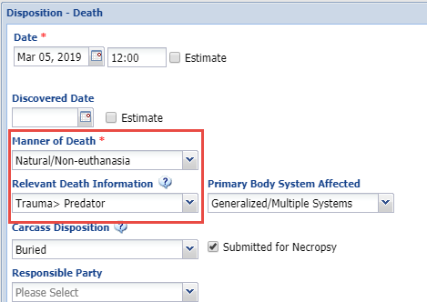
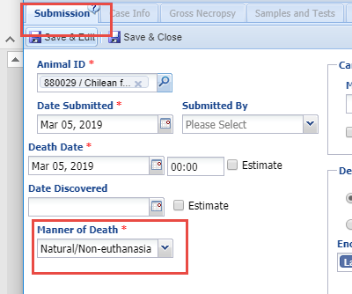
Death Information
The box to the left shows the Death entry
in the Husbandry record. The Manner of
Death will prefill in the Submission tab of
the Necropsy module. The Relevant Death
Info will prefill in the Finalize tab of the
Necropsy module. Both are editable from
either Husbandry or Medical modules. The
most recent entry is what will display in both.

Slide 21
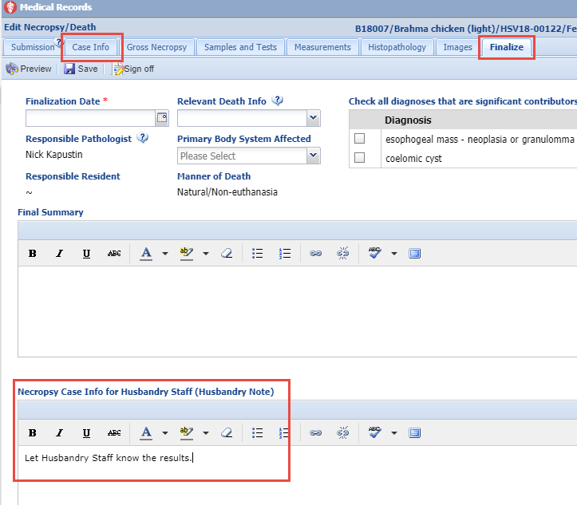
Medical to Husbandry – Necropsy Case Info
In both the Case Info and Finalize tabs in the Necropsy module is an area to provide information to other Staff by using the Necropsy Case Info for Husbandry Staff text box. This note will display in the Husbandry module with a title of “Pathology Necropsy Summary”. This can only be edited from the Necropsy module. If nothing is entered in the Finalize tab the note from the Case Info will display in Husbandry but once a note is entered in the Finalize tab that is what will display.

Slide 22
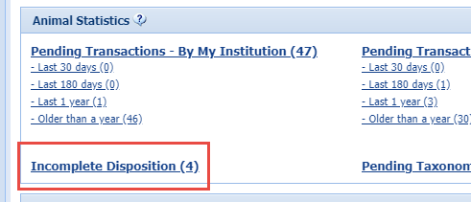
Medical to Husbandry – Incomplete Disposition
When a Medical Necropsy record is started before a Death is recorded in the Husbandry module an Incomplete Disposition is created that displays in the Animal Statistics tab in Husbandry.

Slide 23
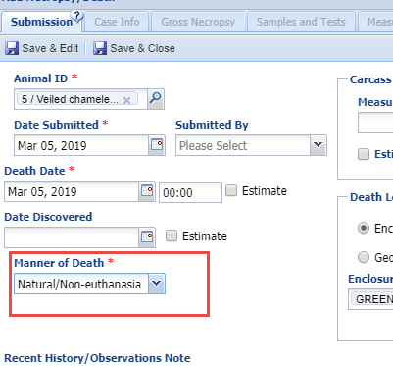
Incomplete Disposition
An Incomplete Disposition is created
when the Necropsy Submission tab is
completed, including the Manner of
Death. When the record is selected
from the Incomplete Disposition list
in the Husbandry module there will be
a Death record that is pending.

Slide 24
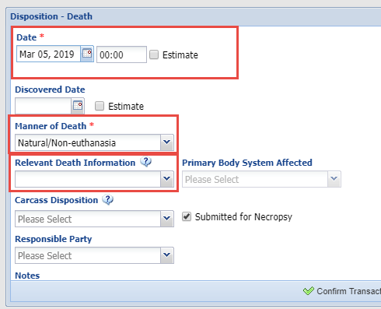
Incomplete Disposition
The Death Date and the Manner
of Death will prefill as the data
was entered in the Necropsy
module. What is entered for
Relevant Death Information
will fill into that field in the
Finalize tab of the Necropsy
module. If the Necropsy module
had been finalized the Relevant
Death Information would be
prefilled in this Husbandry record.
All of these fields shared between
Husbandry and Medical are editable
from either module.

Slide 25
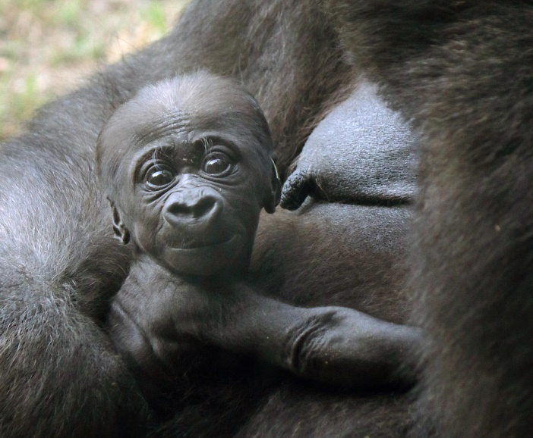
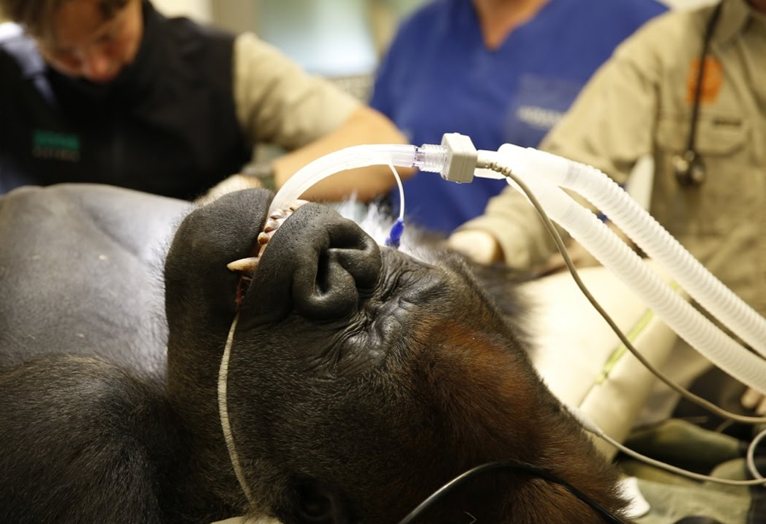
Studbooks to Medical and Medical to Studbooks
As mentioned, currently no data goes from Studbooks into Medical or
Medical into Studbooks.

Slide 26
Any Questions?
On Mingling Modules

