Slide 1
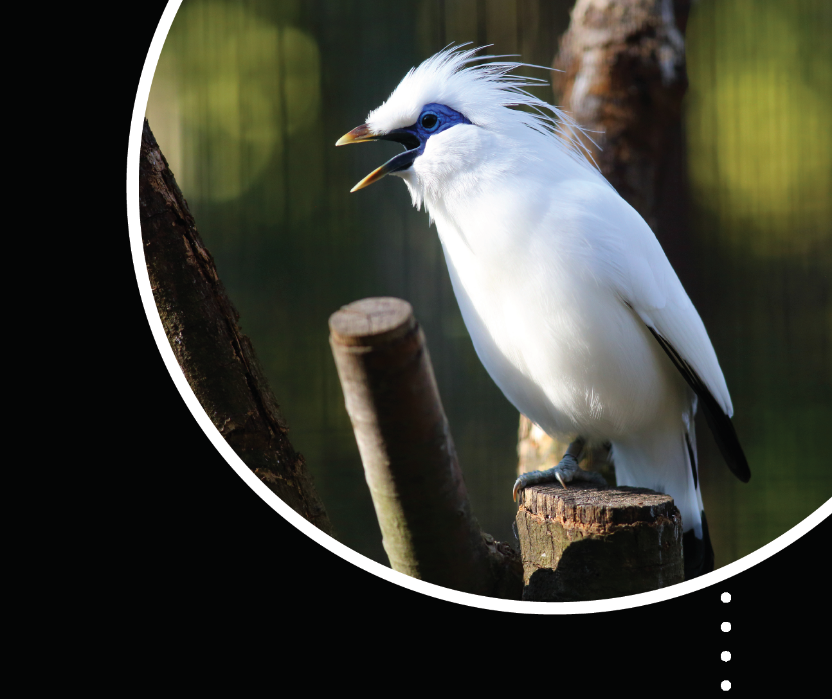

ZIMS for Studbooks 2018 Review
Katelyn Mucha
Katelyn.Mucha@species360.org

Slide 2
Highlights of 2018 Studbooks Functionality
Overlays
Institutional Holdings Report
Dismiss Data Quality Errors
Usability Improvements
  Accept All, Accept with edit, Accept all parents
  Dashboard left navigation
  Animal detail basic info freeze
  Hover overs – taxonomy, rearing, DQ errors
  Preference settings
Death transaction business rules
WalkMe
Animal Detail Activity Stream
Transaction improvements for origin and recapture transactions
Animal History filter/export
House name & birth type columns in animal lists
MULT list added to tool bar
Suggested List improvements:
  New columns
  Hyperlinks
  View Husbandry animal

Slide 3
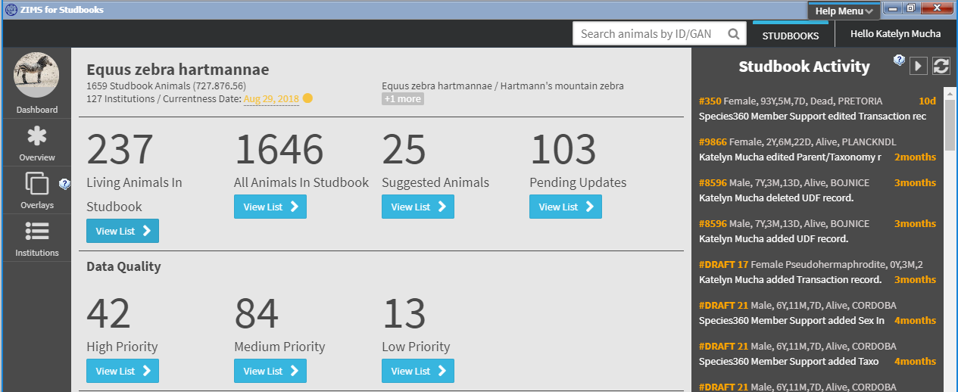
Dashboard Navigation Improvements
Dashboard left hand navigation – Overview, Institution List, Overlays now moved to left side of dashboard.

Slide 4
Animal List Additional Columns
Additional columns for House Name and Birth Type were added to all Animal Lists (Living, All, Suggested, Pending Lists).

Slide 5
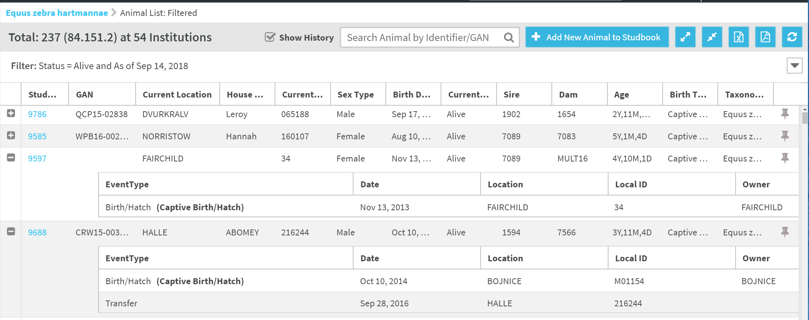
Animal History Filter
Animal History Filter - Filter that displays transaction history of individuals from within the animal lists.
  Available in living, all animals, and pedigree lists and can be applied with other filters selected.
  User can apply this filter and export to view the history of all animals selected within the animal list.

Slide 6
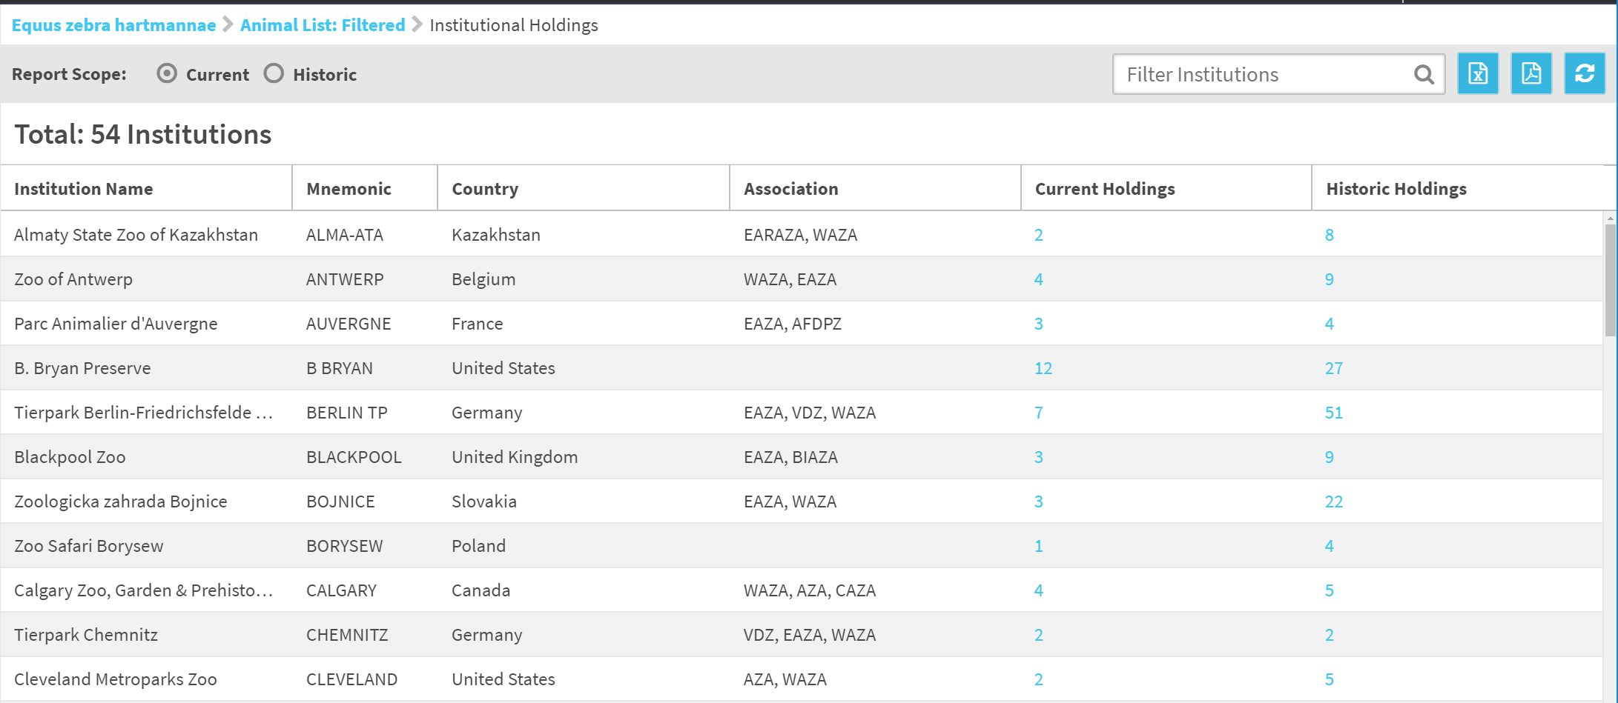
Institutional Holdings Report
Displays the number of animals an institution has held within its collection currently and historically (global and local institutions).
Hyperlinks allow the user to view animals held by the given institutions.

Slide 7
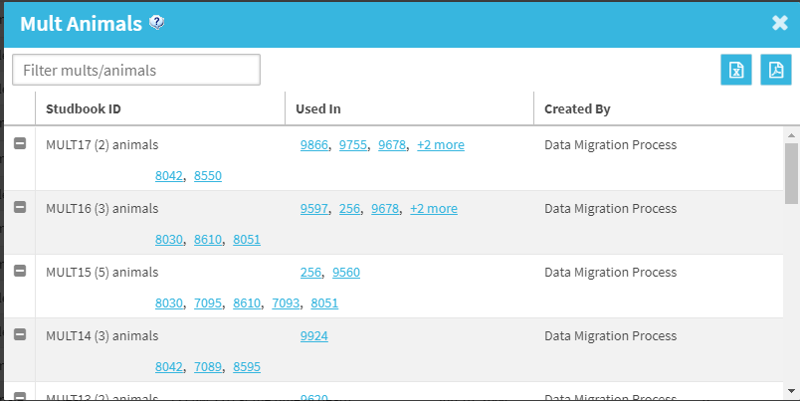
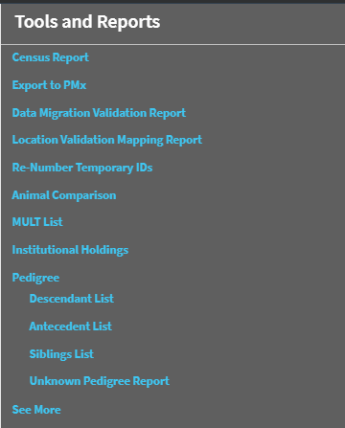
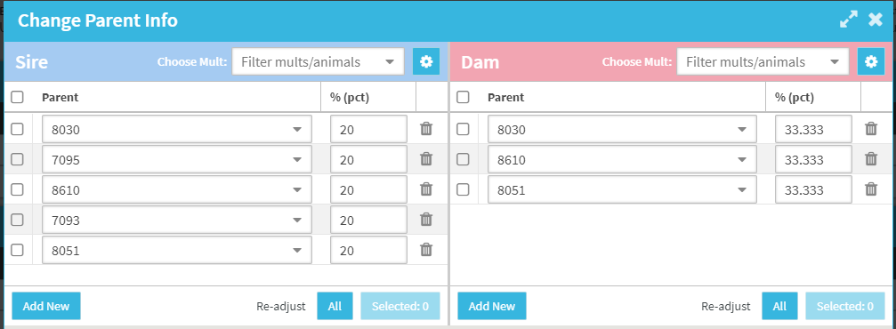
MULT List in Tool Bar
Historically the MULT list was only accessible through the parent grid. Now users can open the list through the Tools bar.
The MULT list only displays in the Tools bar if there are MULT in the studbook.

Slide 8
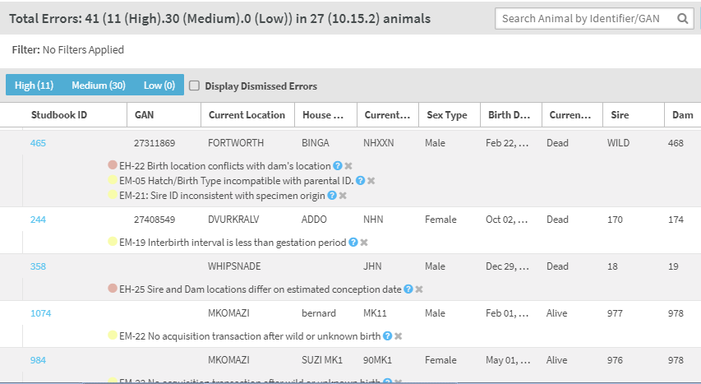
Dismiss Data Quality Errors
Dismiss “true errors” from the data quality list and view them later by selecting “Display dismissed errors”
  For use when the data entered into the studbook is true but causes an error. Ex. Wild collected animal hatch in captivity
  Can view dismissed errors by selecting “Display Dismissed Errors” checkbox

Slide 9
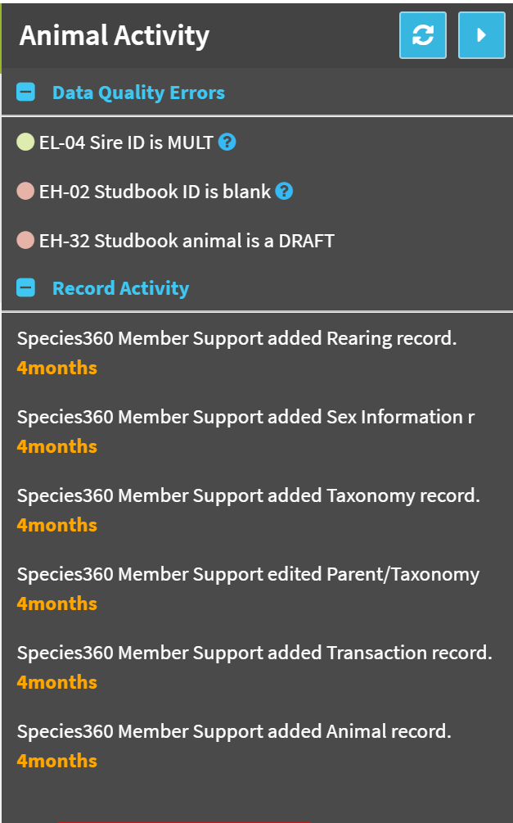
Animal Detail Activity Stream
Tracks event changes per animal though time and displays them to the user on the right hand side of the Animal Detail screen.
In addition to record changes, this tool also shows the current data quality errors for the individual making it easier for the user to fix these errors while the animal is in context.

Slide 10
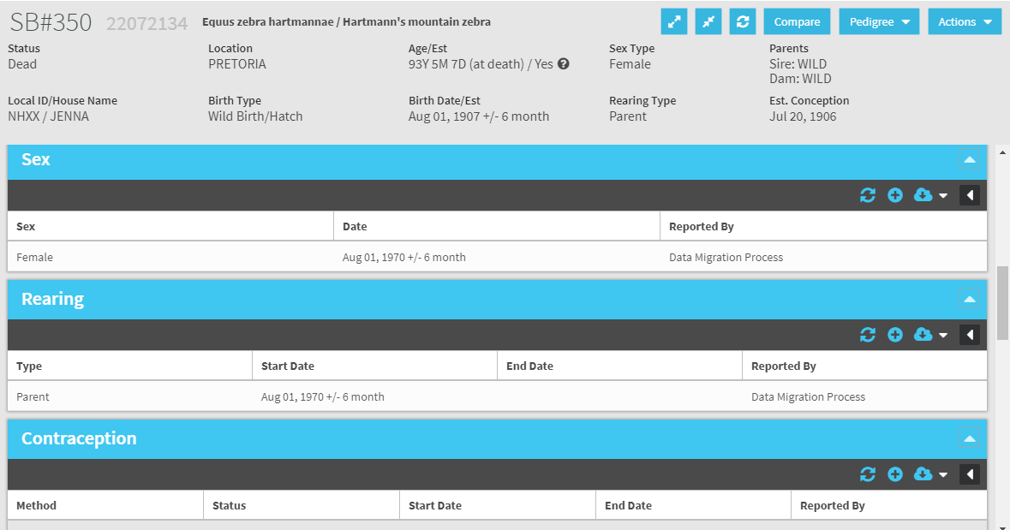
Animal Detail – Basic Info Freeze
Animal details is now frozen to allow user to scroll down to view/edit/add records with the basic information in context.

Slide 11
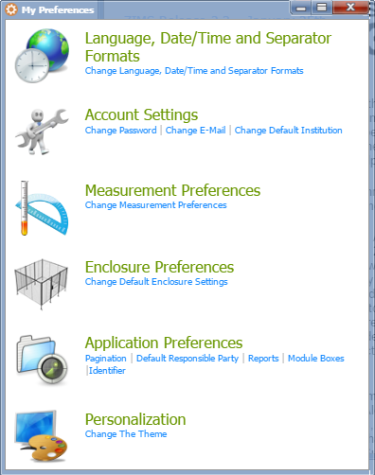
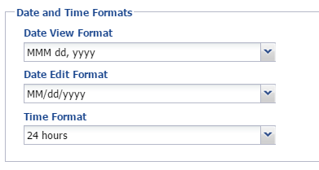
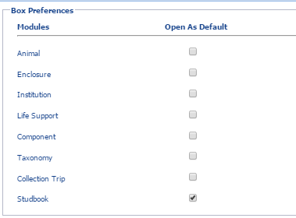
Preferences
Under Start Menu > My Preferences
Options for setting the date and time format
Box preferences: Choose to have module boxes opened or closed by default.

Slide 12
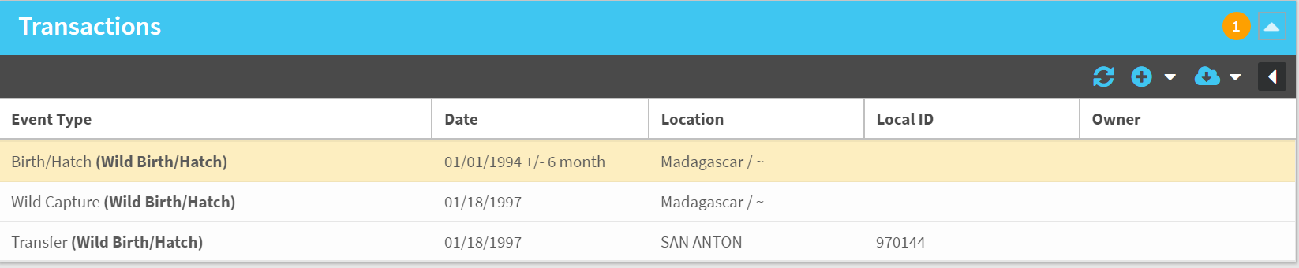
Birth Transaction Improvements
Prior to September 2018, all animals were required to have an “origin” transaction which required specific transactions depending on the Birth Type selected.
Originally the origin transaction was intended to standardize data entry and ensure correct transaction streams. However, this removed some of the historic flexibility to data entry.

Slide 13
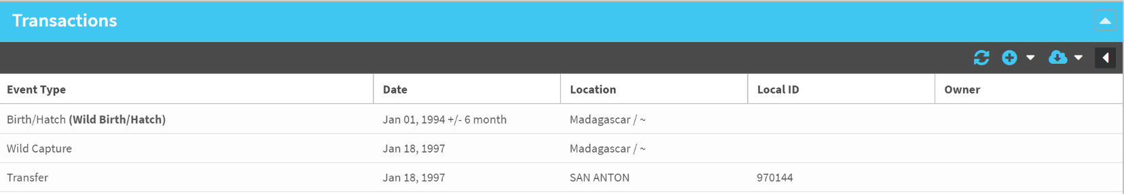
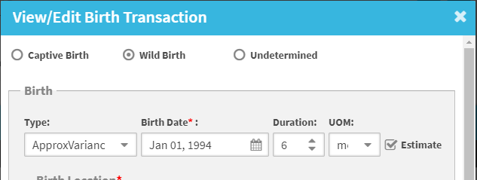
Birth Transaction Improvements
Currently, origin transactions are no longer an option in the system.
Instead, all animals are required to have a Birth/Hatch as the first event. Animals must have a birth/hatch before other transactions can be entered.
Within the birth/hatch record, the birth/hatch type is indicated but this selection does not drive the transactions the user must enter.

Slide 14
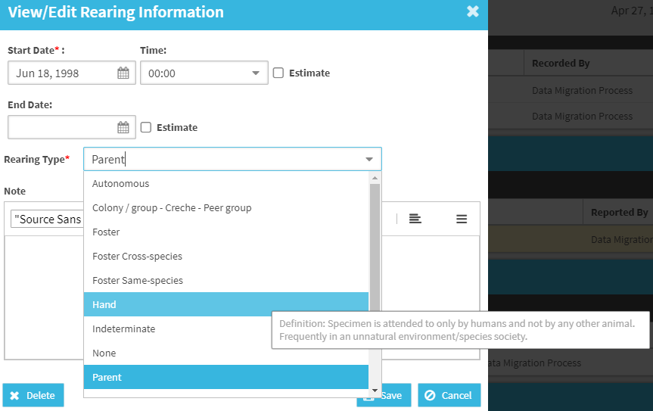
Hover Overs
Additional hovers added for the following areas:
  Rearing: Definitions for Rearing Types
  Taxonomy: Definitions added for Taxonomy Determination
  Data Quality: Improved hover overs so that the definitions do not disappear until user navigates away

Slide 15
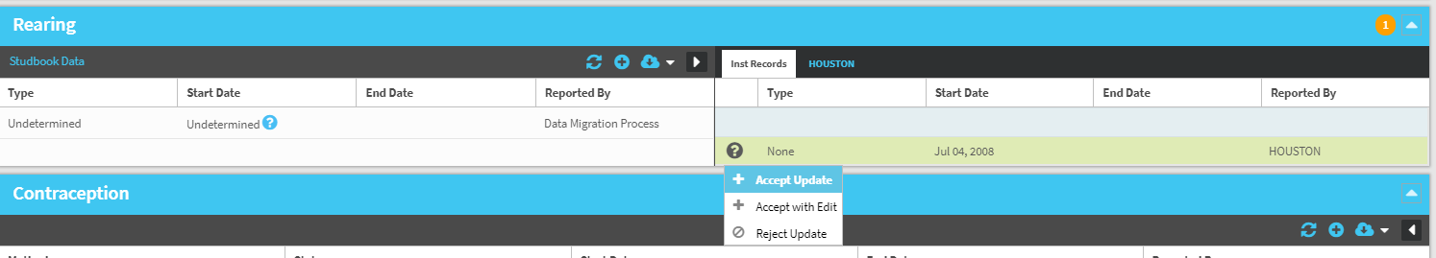
Accept Record Improvements
Accept – accepts record into studbook with one click.
  Exception: if the record is missing required field, it will open pop-up for user to enter required information.
Accept with edit – accept record with pop-up to add or edit information
  Prior to August 2018, this was the “Accept” option
Accept all parents – accept all institution entered parents with one click.

Slide 16
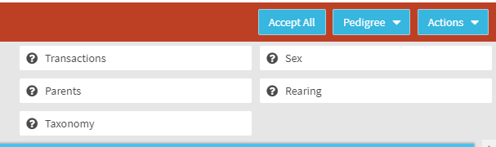
Accept Record Improvements
Accept all for animals at one institution – Accept all records with one click for animals that have only been at one location.
  Allows users to review all pending updates for an animal then confirm acceptance with one click.
  Add new births/hatches more quickly
  Animals that have been at multiple institutions will not have this option available and users will have to decide and accept the records.

Slide 17
Death Event Business Rules
Death Event Rules:
  Only one death event can be added for an animal.
    User can edit the death event but not add more than one.
  Once a death event has been added the option to add a death transaction is removed from the transaction list.
  If the user deletes the death transaction then the option to add a death transaction becomes available again.
  If there is a pending update that is a death transaction, and the animal already has a death the user cannot accept the record.
    If the user wants the record in the studbook to match the Husbandry record they can edit the studbook record to match or delete the studbook record and accept the Husbandry record.
    If the user does not want the record in the studbook to match the Husbandry record, they can reject the record.

Slide 18
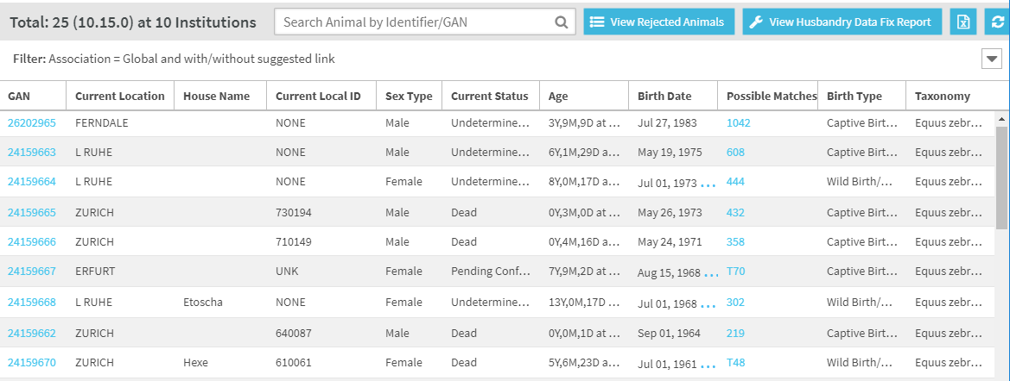
Suggested List Improvements
Export Suggested list now available
Possible matches now display as hyperlink – can select to take you directly to the suggested link or use to sort the list to see if the same studbook animal is suggested to link to multiple Husbandry animals (could indicate duplicate animals in Husbandry).

Slide 19
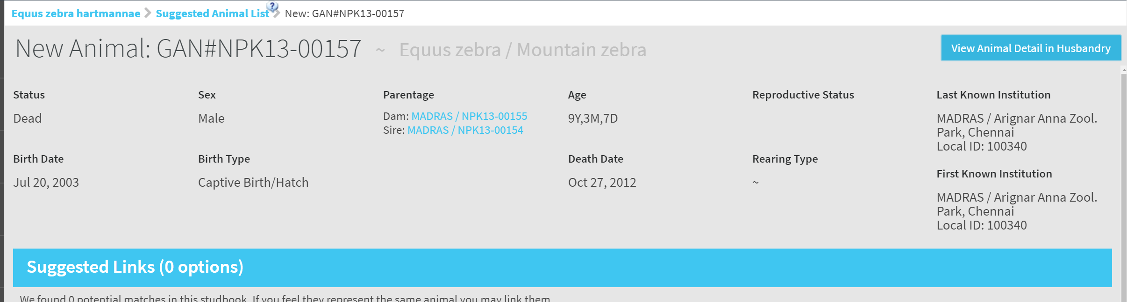
Suggested List Improvements
View Animal Detail in Husbandry now option in the Suggested Animal Detail screen.
When selecting this option one of two things will occur depending on user access:
  User has some level of access to the Animal Module assigned by their institution and the module opens to display whatever view of the Animal Module that they have access to.
  User does not have role access to Animal Module - in this case, the user will receive a warning when selecting the button: "You do not have access to the Husbandry Animal Module. Please contact your institutional admin to gain access to this module.“

Slide 20
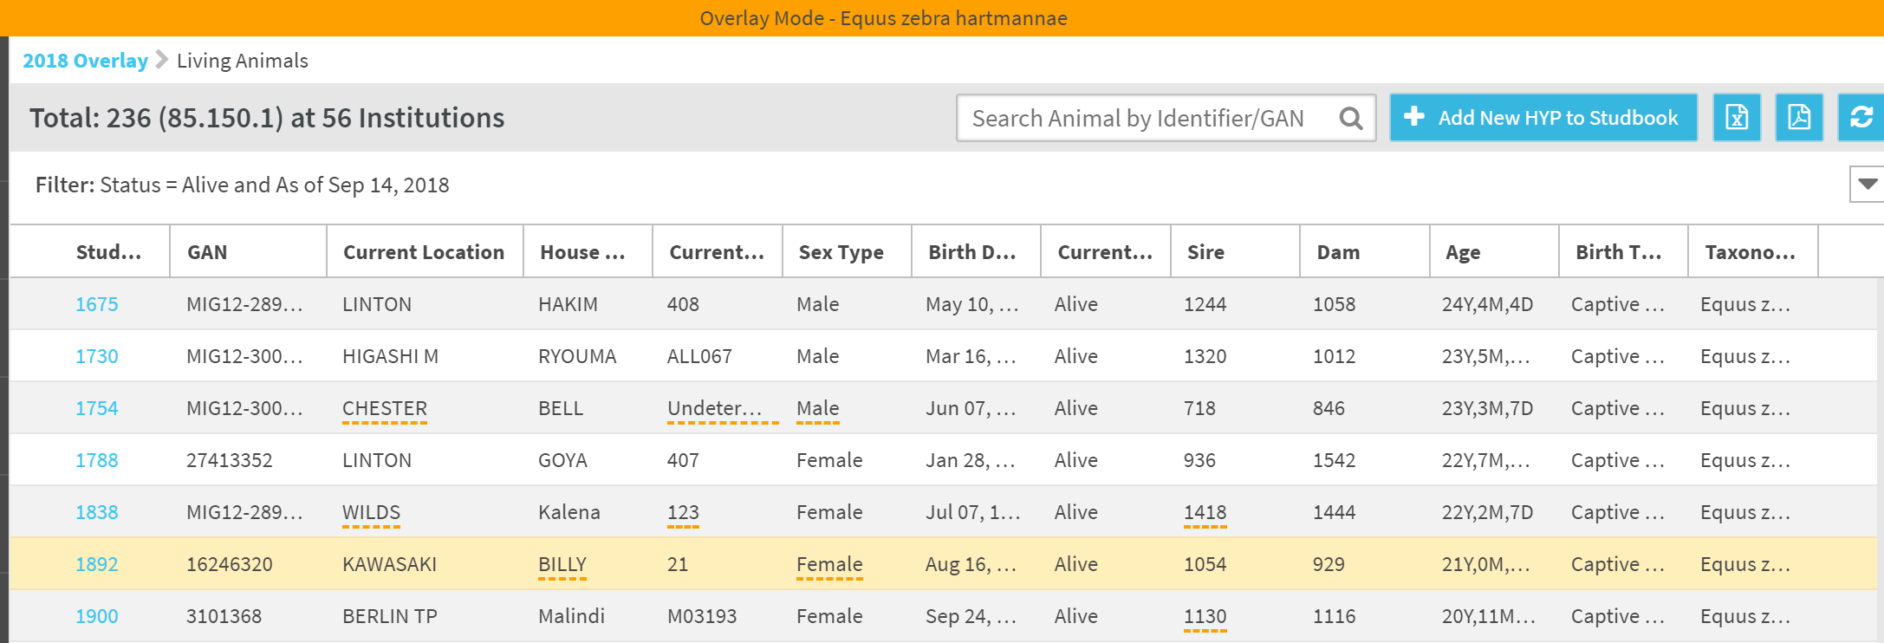
Overlay Functionality
Allows users to apply assumptive data to their studbooks and export this data to PMx for analysis.
Overlay capabilities:
  Managing overlays – create, edit, delete, copy overlays
  Edit animal records within the overlay mode (parents, transactions, sex, notes)
  Add a hypothetical animal to the overlay
  View a list of all animals with assumption data applied
  Pedigree reports displaying overlay data
  PMx export with overlay applied

Slide 21

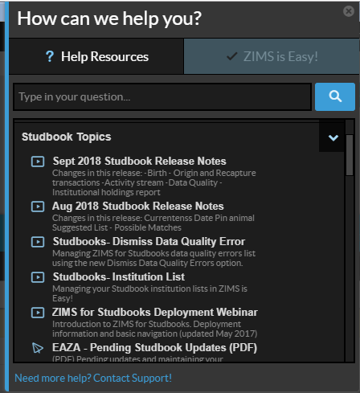
Training/Resources
WalkMe tool in ZIMS
  PowerPoints
  PDFs/Stand alone materials
  “WalkMes” – walk you step by step how to do a specific task
  “?” icons – click to open supporting training materials
  Videos
    http://training.species360.org/studbookvideos/
Monthly webinars/demos hosted by Species360
  http://training.species360.org/studbookwebinar/
Support assistance
  Support@species360.org
Notes:
All of these training resources are available to you during and after migration

