Slide 1
ZIMS Tools & Ideas to Ease Your/Their Workload
November 2018 Tips and Tricks

Slide 2
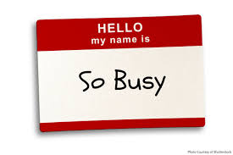
ZIMS has many tools that can
help make data collection and
entry very easy and less time
consuming. Some of these may
require some time to set up, but
in the end that time spent will
be worth it many times more.
If you have other Staff members
collecting and entering data, you
may have to do the initial set up
for them. If this is the case, make
sure you work with those Staff
members so that all are happy
with the end product.

Slide 3
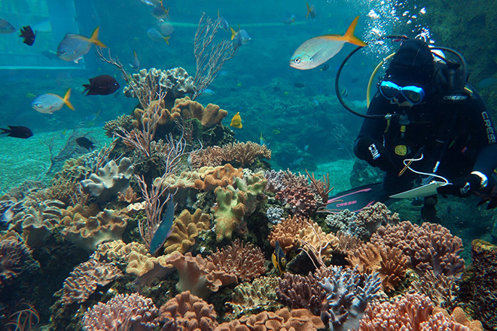
This Tips & Tricks is a little bit different
than most of the TNTs. We will not be
talking about how to navigate through
ZIMS for your data entry. We will be
presenting various scenarios and
discussing the various ZIMS Tools that
could make your, or your staff’s, life
in ZIMS easier and quicker and with
better data resulting!

Slide 4
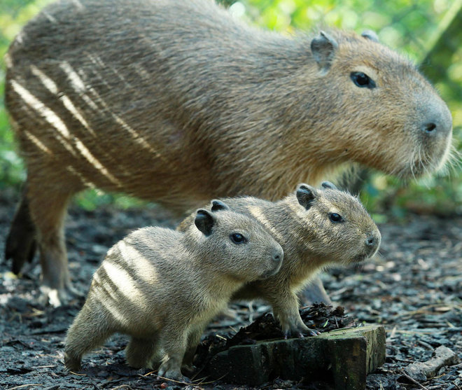
Note Template
The keepers have Provisional rights to
record Notes on the animals in their
care. With her busy day, Kendra Keeper
has trouble remembering all the data that
Reginald Registrar wants her to record
in Notes for births or hatches. She is
always getting calls from Reginald for
more information, thus slowing down
the completion of the new record. Both
Kendra and Reginald are frustrated.
Solution? Reginald creates a Note
Template for Births/Hatches!

Slide 5
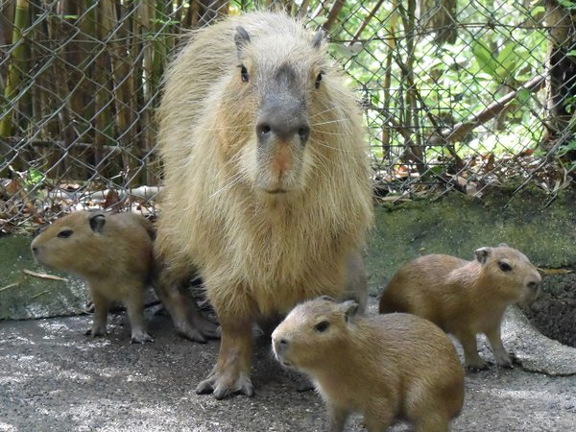
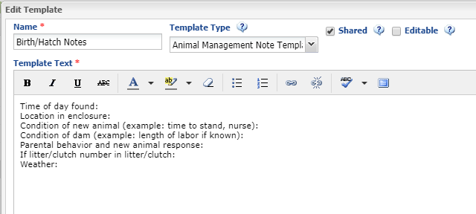
Note Template
Some hints:
Name template so it is easily found and obvious.
Select the correct Template Type (will only appear in dropdown in that module).
Make sure it is shared (but in this case probably not editable).
Text can always be edited later as needed.
The result: Reginald gets all the info he needs and Kendra doesn’t have to remember.

Slide 6
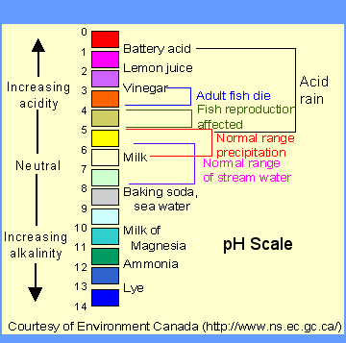
Measurement Range Templates
Carrie Curator and Andy Aquarist are
having a discussion. The aquatics team
has been having trouble maintaining
the desired pH in a tank. Andy said that
he notified Carrie of this days ago.
Carrie does not remember receiving
any notification. Before the friendly
discussion escalates Reginald has the
solution! He creates a Range Template for
the tank and the pH, and any other
measurements the team takes on it.

Slide 7
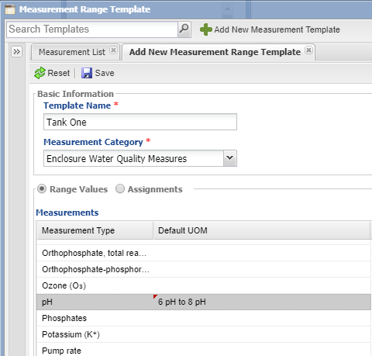
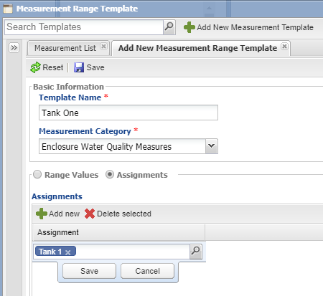
Measurement Range Template
Some hints:
The name should be unique, but you will not be searching for this template unless
you want to edit it. ZIMS will be looking for it when a measurement is recorded.
The Measurement Category is very important as only entities that match it will be
available for selection in Assignments.
Confirm with Carrie what the desired Range Values should be.
Confirm with Carrie what entity Assignment(s) should be made.

Slide 8
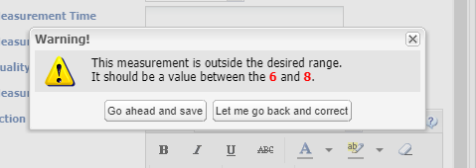
Measurement Range Template
Now when a measurement is
out of the desired range there
is a warning when saving, and
the value will display in red in
the grid. However, this only
helps if you are the one doing
the data entry, or if you review
the measurement grids daily.
Reginald has one more step to
keep Andy and Carrie’s
friendly relationship intact.

Slide 9
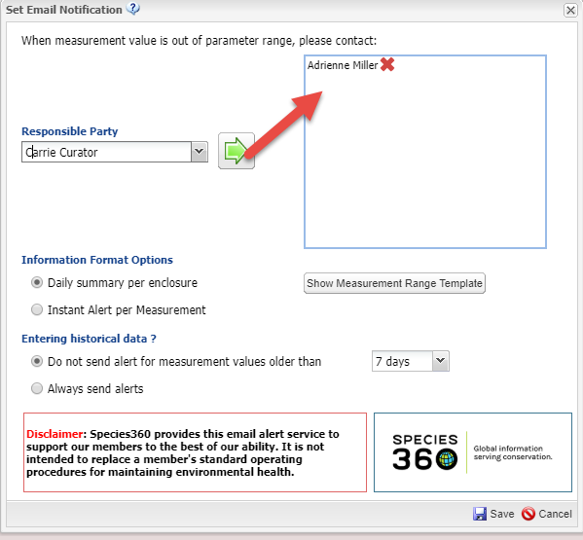
Email Notification
Once a measurement has been
recorded the Set Email Notification
button is activated.
Some hints:
Select as many people as you
want by finding in the list and
using the green arrow to move into
the box. You probably want every day
covered by at least one Staff member.
You can select for them to receive
a daily summary or an instant alert.
Because water quality can be so
important it is often a Best Practice
to receive instant notifications.
Carrie now gets instant Emails when
a measurement is outside the
desired range. And Andy is
confident that she is notified.

Slide 10
Quick Multiple Accessions
ZIMS has several options to help make accessioning multiple animals quick and easy
Batch
Save & Repeat
Take a Copy
But when should you use which one?

Slide 11
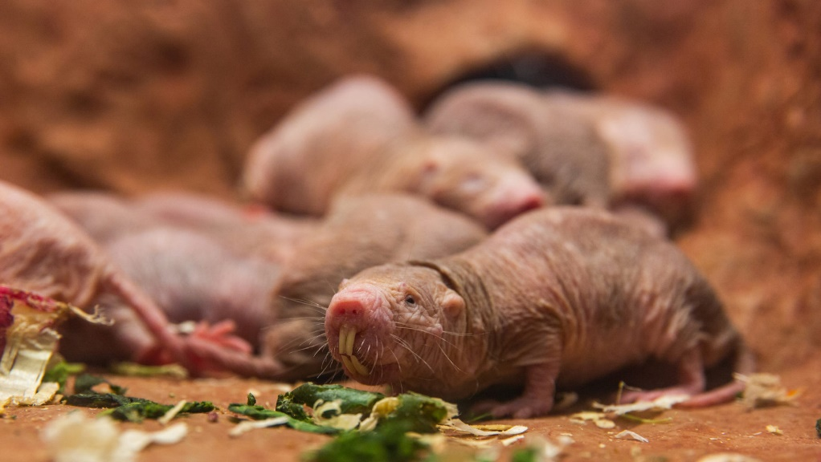
Batch
You just got in a group of 2.18 adult naked mole rats. Carrie Curator wants them
accessioned as individuals because she is researching good ways to identify the
wrinkly critters. The birthdates and parentage are unknown. Reginald uses Batch!
Some hints:
Use Batch for new accessions, not to create visits.
Most of the information should be the same (parentage, sex, birth date).
Don’t forget to go back and edit any info that is not the same. In this example
20 females would be accessioned and then two changed to males.

Slide 12
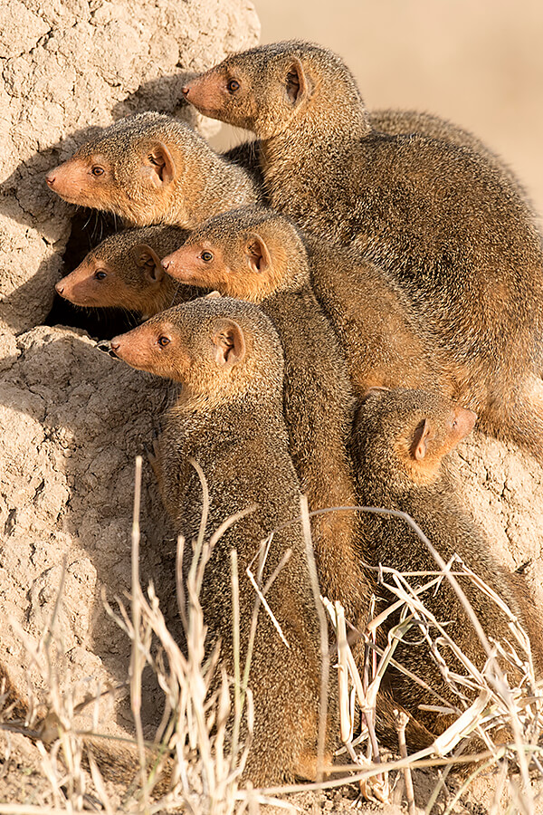
Save & Repeat
You just got in a group of 2.8 dwarf mongoose.
They are all transpondered. There are two
different sets of parents involved and three
different birth dates that can be associated
with specific animals. Reginald uses Save & Repeat!
Some hints:
Use Save & Repeat for new accessions and
not when recording a visit.
Most of the information does not have to be
the same (in fact none of it has to be!).
The accession will be saved but the screen
will remain open as entered for edits as needed.
There is no need to remember to go back into
a record to make changes.

Slide 13
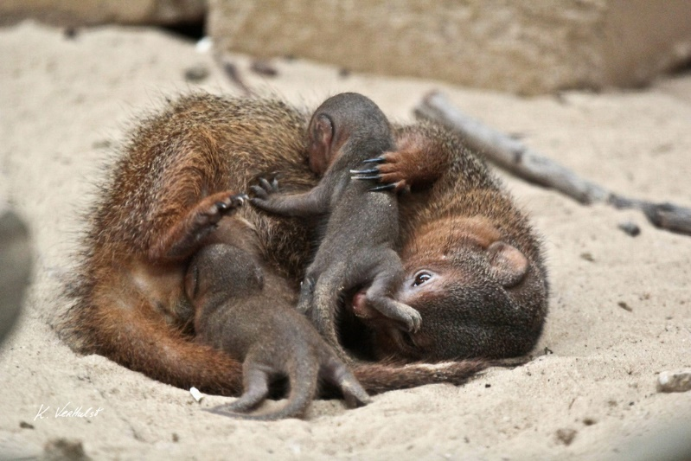
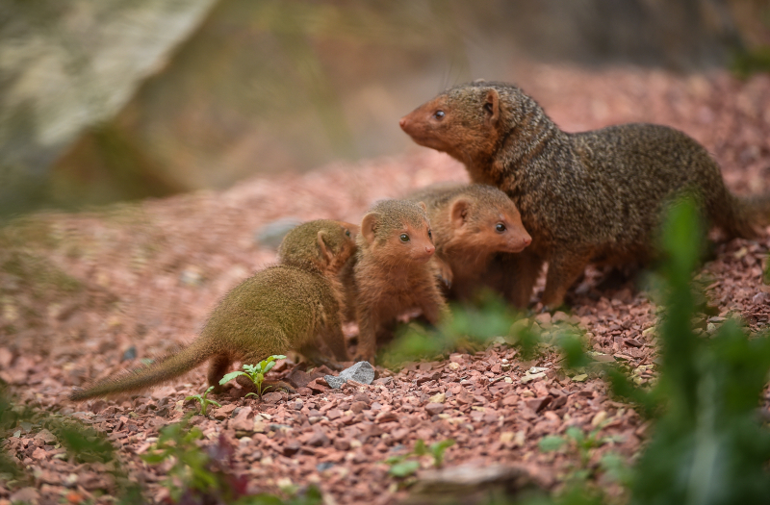
Take a Copy
Two super cute dwarf mongoose kits have
started venturing above ground and were
seen with their dam. Reginald uses a Batch
accession for the two. A week or so later
you see three kits out with their dam. He
uses Take a Copy!
Some hints:
Take a Copy is very useful for litters
and clutches where there may be more
then counted at first.
The accession screen for the record
you select will display.
Edit as needed or simply provide a
new Local ID if all the info is the same.

Slide 14
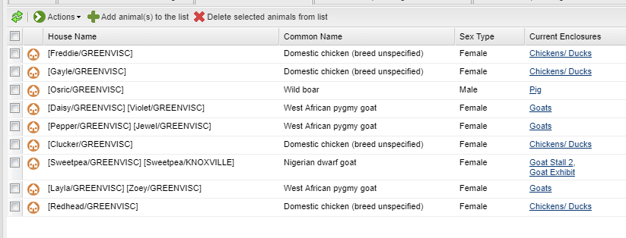
Animal Lists
Your keepers are starting to do more of their own data entry. Kendra Keeper continues
to have trouble finding her animals in ZIMS quickly. Reginald’s solution is to create
an animal list for her area that other area keepers can also use.
Some hints:
Show Kendra how to customize her columns so she sees only what she needs.
Column customization applies only to the logged in User.
Kendra opens her list, finds the record by House Name and opens it by double clicking.
Remember to keep the list updated as animals arrive, die, are dispositioned or change
enclosures.

Slide 15
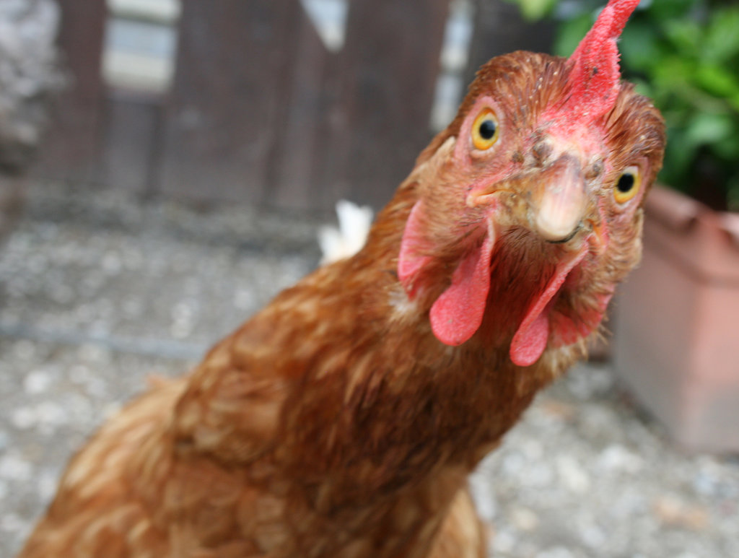
Animal Lists - Batch Actions
Animal Lists are also great for
doing Batch Actions. Today is the
day all the chickens get weighed.
Reginald shows Kendra how to use
her Animal List to quickly record the
weights without opening each
record by checking in the list and
selecting Batch Actions. Kendra is
really getting confident using ZIMS,
freeing Reginald up for other tasks.
Some hints:
Animal Lists open up with all
animals checked.
If you only want to select a few
of these, uncheck all using the
top left hand box, then reselect
only those you need.

Slide 16
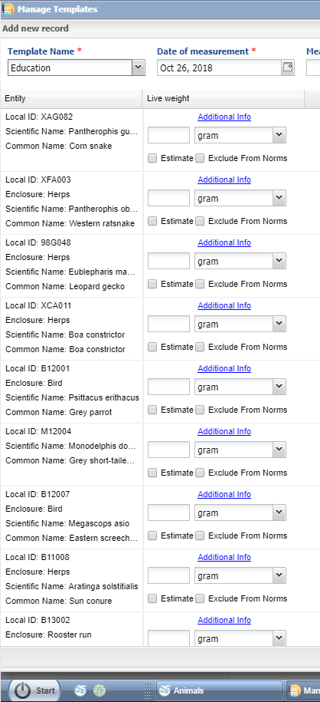
Animal Measurement Templates
If the animals you need to record measurements on are not in a list and not easy to search for as they are different taxonomies and in different enclosures you can create Animal Weight and Animal Length templates. Here Reginald has created a list to record weights for their education animals that are frequently weighed to closely monitor their health.
Some hints:
The order the animals are entered is the order they display in the template. Think about this first.
You have the option to include identifiers other than Local ID in the template. Remember to select any that will help the person recording the data to make sure they are in the correct record.
Because you can mix taxonomies in the list, select the UOM that is appropriate for most so you only need to edit a few entries.

Slide 17
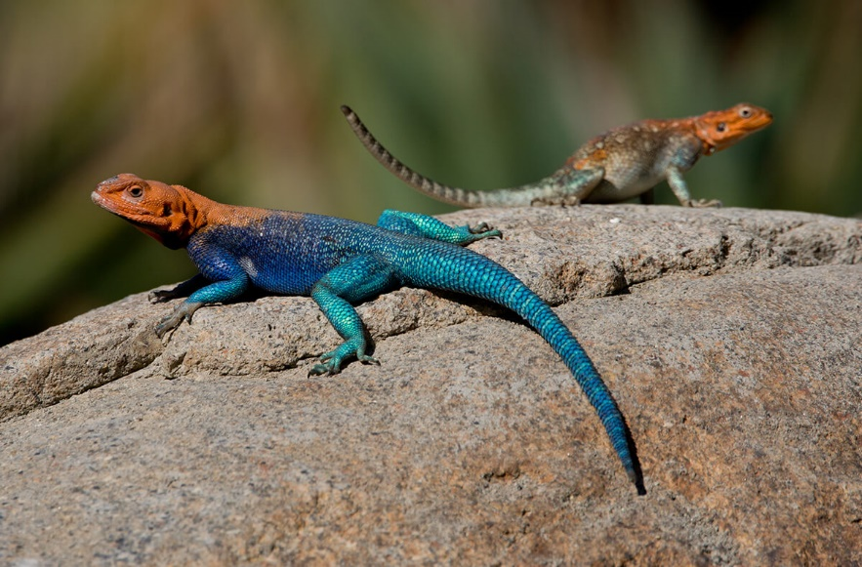
Enclosure/LS/Component Measurement Templates
Kendra Keeper is being trained as a relief
keeper in the Reptile Building. So many
exhibits/tanks that she has to daily monitor
the temperature for! To help her out, and
the other keepers in the area, Reginald
created a template that includes all the
exhibits in the building for Hotspot
Temperature and Air Temperature. The
keepers now breeze through recording
of their daily measurements.
Some hints:
The Entity you select (Enclosure, LS or
Component) and the measurements you
select (Environmental or Water Quality)
will impact what assignments will
display for selection.
In this template the order can be adjusted
by using Up and Down arrows.

Slide 18
Aquarist Daily Log
Andy Aquarist sees the template
created for the Reptile Building. He
asks Reginald to make one for his tanks.
He tells Andy he can make him some-
thing even better and creates an Aquarist
Daily Log for all the tanks in the
Aquarium. In addition to Water Quality
Measurements he included Feed Logs,
Maintenance and Notes. Andy can now
record all of his daily tasks in one place
and his record keeping time is greatly
reduced, giving him time to do more
educational talks for the guests.
Some hints:
Multiple entities can be selected,
they do not have to be Aquatic, the
log works for Terrestrial entities also.
The order of both the entities and the
data types can be changed using the
Up and Down arrows.

Slide 19
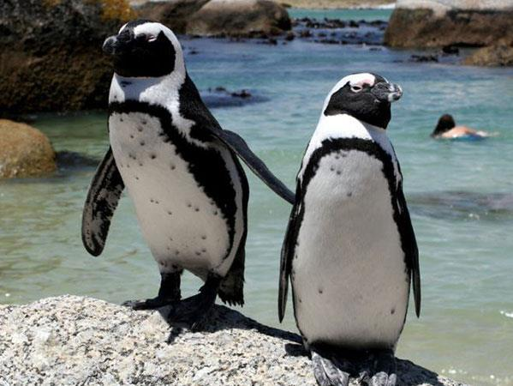
Husbandry Log Template
Patti Penguin Keeper sees Andy’s Aquarist Daily Log and asks Reginald to create one for her two penguin pools. He tells her he can do even better than that and creates a Husbandry Log Template. The first tab contains all of the penguins and captures the daily Feed Log information. The second tab is for the two pools and the holding area. The water quality measurements taken are selected for the pools and air temperature for the holding area. A maintenance column is also included. Patti now records her daily tasks in one place.
Some hints:
Remember to select any identifiers you want displayed in the template
The column order can be changed as desired
Create a desktop icon for frequently used
HLTs (or any template) – a real time saver!

Slide 20
What’s the Difference?
Aquarist Daily Log
Single page
Record actions on Enclosures, Life Supports or Components
Select the Entities and then the Data Fields
Template is a vertical list of entities and columns for the Data Fields
Husbandry Log Template
Can have several sheets
One for Animals and one for Enclosures for example
Record actions on Animals AND Enclosures, Life Supports and Components
What you select drives the Type of action you can select
Template is a horizontal grid of entities with columns underneath for the action Type
Rows can be added while using the Template to continue to capture information on the entity

Slide 21
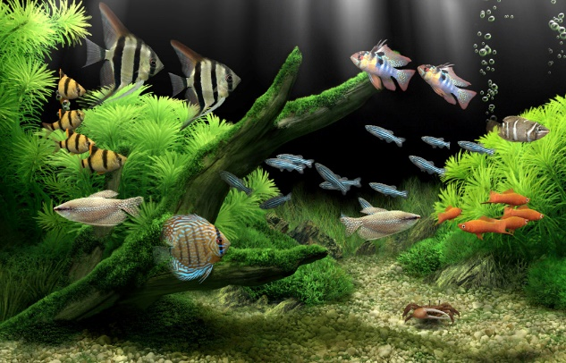
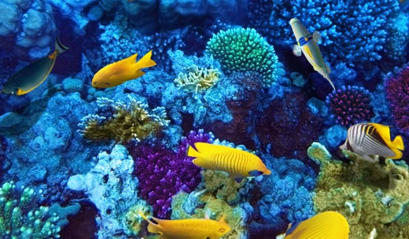
Environmental Quality Graph
Reginald overhears Carrie and Andy talking about the
Water Quality measurements of three of the tanks. They
wish there was a way to compare the measurements
without going back and forth between the records.
Reginald shows them the Environmental Quality Graph.
They enter the three tanks and the measurements they
want to compare. All the information is displayed in one
graph for easy comparison!
Some hints:
The EQG is available under Tools. But if you select to
View Measurement Graph within a record you will
be redirected to the Tool to add other tanks or
measurements you want to compare.

Slide 22
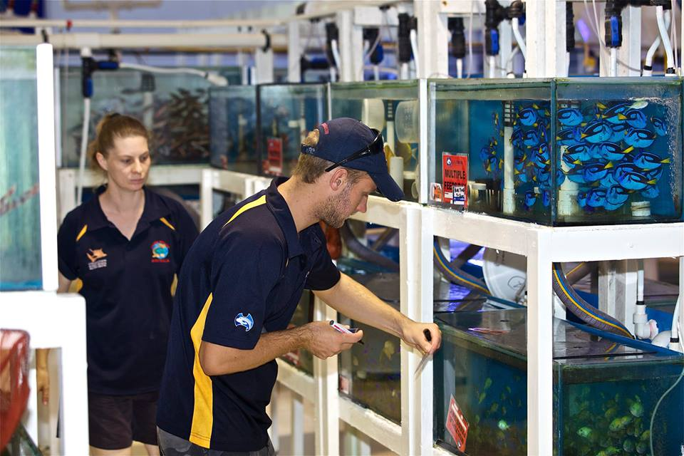
Environmental Quality Graph
Some more time saving hints for the graph:
You can select an Enclosure List! This saves you entering multiple enclosures as all the enclosures in the list will appear in the graph.
You can select a Responsible Party! The enclosures that person is responsible for will appear in the graph without having to be entered one at a time. This is a quick and easy way to check that staff are taking
measurements in a timely manner.

Slide 23
Environmental Quality Graph
If one measurement on one enclosure is chosen to graph, ZIMS will
reference any Measurement Range Templates you have created for the
enclosure. Red indicates the measurement is outside the desired range.
Green means it is within the range.

Slide 24
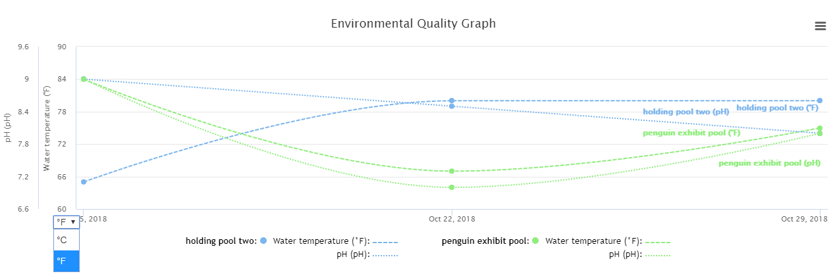
Environmental Quality Graph
You can compare multiple measurements on multiple enclosures. Each
enclosure will have its own color and each measurement its own type
of line. If the measurement has conversion factors (such as Water
Temperature does), the Y axis units can be changed.

Slide 25
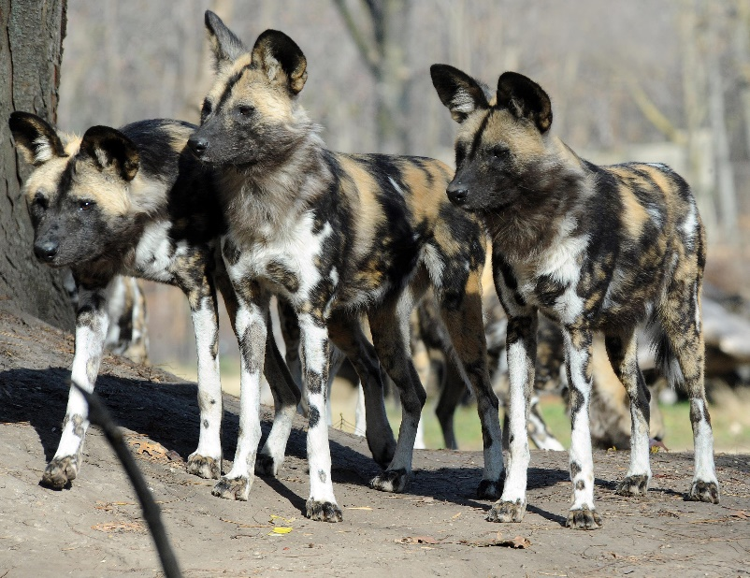
Care and Welfare
New construction is scheduled to begin right next to your African wild dog exhibit. Carrie wants to monitor any negative effects this might have on the wild dog group. In the Care and Welfare module, Reginald configures the Indicators of Behavior-Use of
Environment, Stereotypic Behavior, Abnormal/undesired Behavior and Activity Level. He creates a Template for the wild dog group using these Indicators. Two weeks before construction begins, Kendra starts using the template. Two weeks after the start of construction Carrie reviews the Charts for the group.

Slide 26
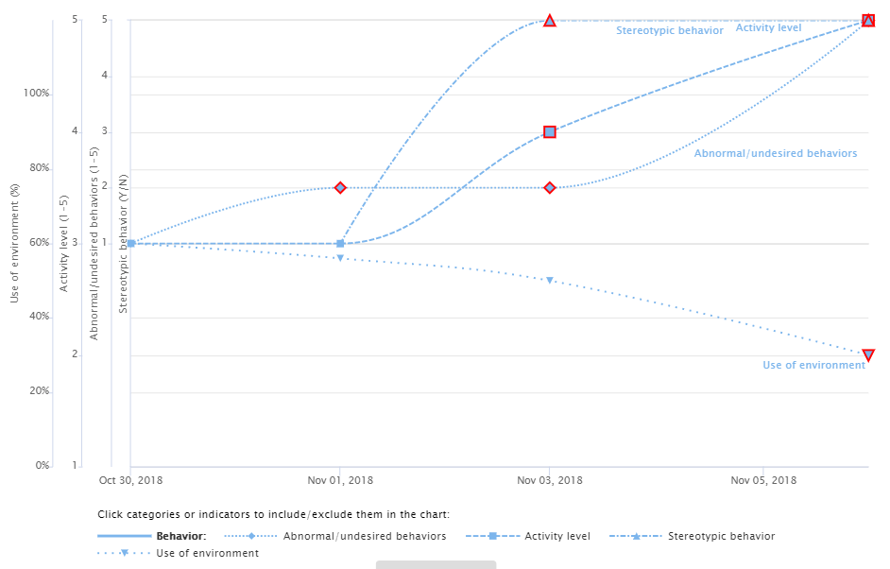
Care and Welfare Chart
She quickly sees that
Use of Environment
has greatly diminished
but the Behaviors of
Abnormal/undesired,
Stereotypic and Activity
Level have increased.
She considers moving
the animals or increasing
the barrier next to the
construction site.

Slide 27
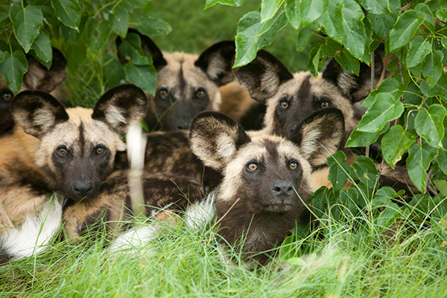
Care and Welfare
Some hints:
Configure only the Indicators that you will be using, no need to do them all.
Read the Description, some Indicators sound alike but are not.
Try to use Global Indicators when possible (future global sharing).
Remember to update the Templates as needed for births / deaths / transfers.
PLAN AHEAD!!!! Once used in a record, much of the Indicator cannot be reconfigured.

Slide 28
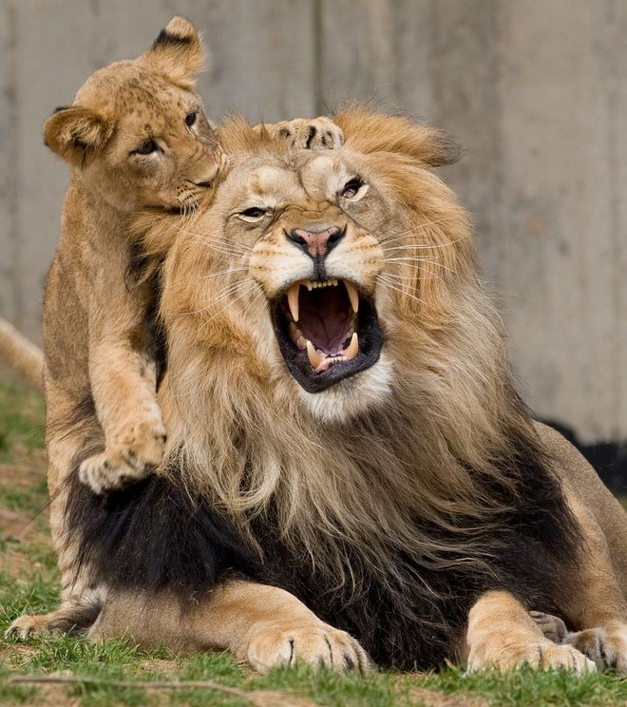
Favourite Filters -Searches
Reginald finds that he keeps doing
many of the same Advanced Animal
Searches over and over using the same
filters. He saves himself time by
selecting the filters and saving them as a
Favourite Search Filter. Now instead
of scrolling through the many filters
available he can simply select the
desired favourite from the drop down
list.
Some hints:
Make sure the Name is something
you will remember.
Consider checking the Share With Others
checkbox to help save them time too!

Slide 29
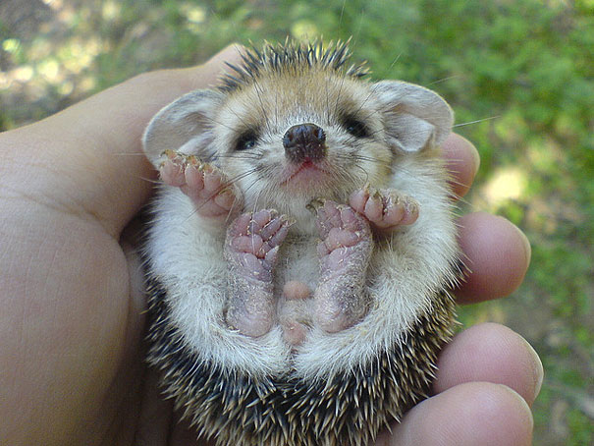
Favourite Filters– Reports
Every week Carrie Curator asks you
to run an Enclosure Report for the
enclosures she is responsible for. In
addition, she wants only animals in
the Main Collection and any Diet
and Reproductive Notes. She also
wants all Identifiers included. Reginald
thinks that Carrie can run the report
herself but she keeps forgetting to
include all the filters she wants. He
helps her out by creating a Favourite
Report filter. Now she just opens the
report, selects that filter from the
dropdown, edits the dates and gets
what she wants. Both your time and
her time are saved!
Some hints:
Each report has different filters.
Before you create a Favourite
Filter make sure you have selected
all that you need.

Slide 30
Auto Increment Local IDs
Selecting to Auto Increment Local IDs in Institution Preferences > Application
Settings can make accessions much easier because you do not need to remember
the last used Local ID. It is especially useful for Batch Accessions. Instead of manually
typing in the next 20 (or how many you need) Local IDs, just tell ZIMS how many
you need and select Generate. No risk of duplicating IDs (and having to go back and
select a new one) or missing recording an ID because you miss counted.
Some hints:
This can’t be used with some Local ID coding such as M###### for mammals and
B##### for birds.
If prefixing with the year remember to update Local ID Settings each year.

Slide 31
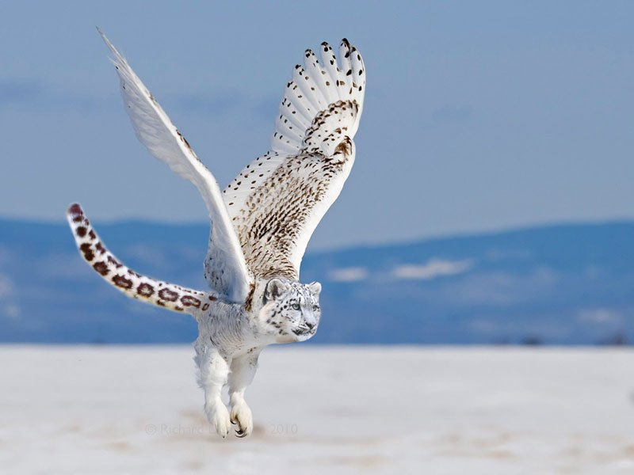
Pending Taxonomic Changes
Species360 is always trying to keep up
with the most recent changes in
taxonomy. You receive emails (if you
signed up for them), Post Office messages
and Pending Taxonomic Changes in
Animal Statistics. Did you know that
you can automatically accept any
taxonomic changes? Go to Institution
Preferences > Application Preferences >
Taxonomy and check the box. You will
still receive emails/PO messages so you
will be updated, but this option makes
one less task for you to do!

Slide 32
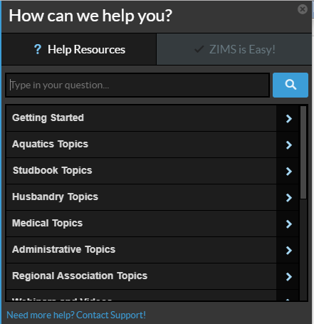
Don’t Forget HELP!
Are you confused about how to
do something? Species360 Support
Staff is always there to help you, but
don’t forget to check the ZIMS Help
Menu. You may get an instant answer.
You can either type in your question
or a topic, or you can open the topics
and scroll through. Species360 is
constantly updating these topics and
adding new ones as new functionality
rolls out.

Slide 33
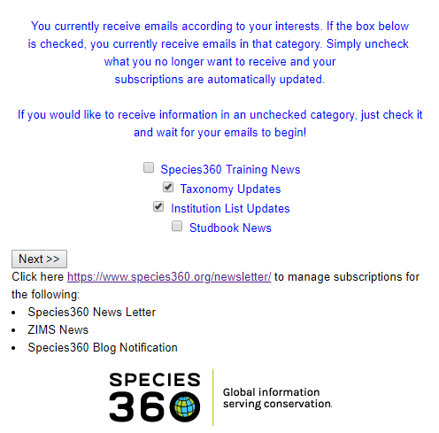
Subscribe to Emails
You can receive Emails for more
than just Taxonomy Updates. Type
“Subscribe to Species360 Emails”
in the Help menu. Check (or uncheck)
the topics as desired. This is where
you can also manage your
subscriptions for Species360
newsletters and Blog notifications.

Slide 34
Any Questions?
Any other suggestions that you have found
to help ease your/their workload?

