Slide 1
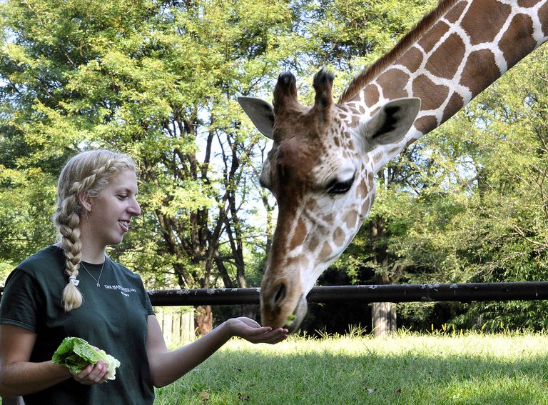
ZIMS for Care and Welfare!
Coming in Fall 2018!!!!
August 2018 Tips &
Tricks

Slide 2
Many Thanks to our Contributors (and SMEs) for this Project!
Chicago Zoological Society – Brookfield Zoo
Lance Miller
Disney’s Animal Kingdom
Mandi Schook
North Carolina Zoological Park
Bonnie Baird
Saint Louis Zoological Park
David Powell
Taronga Zoo
Claire Ford
WAZA
Sabrina Brando
Woodland Park Zoo
Nancy Hawkes
Birmingham Zoo
Calgary Zoo
Columbus Zoo & Aquarium
Los Angeles Zoo
Point Defiance Zoo & Aquarium
B Bryan Preserve
Caldwell Zoo
Fundacion Zoologica de Cali
Cameron Park Zoo
Dickerson Park Zoo
Hai Park Zoo
Kaliningrad Zoo
Kiev Zoological Park
Moscow Zoological Park
Nikolaev Zoo
Zoologischer Garten Wuppertal

Slide 3
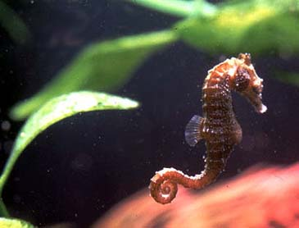
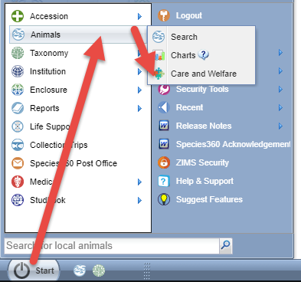
What is Care and Welfare?
The Care and Welfare module is the
newest functionality available in
ZIMS. This feature allows you to
easily capture information vital to
analyzing the overall wellness of
your animals, both physically and
mentally. This is done by creating
templates and adding indicators.
These templates and indicators are
institution specific so you design
templates to YOUR needs.
Access to the module is under Start >
Animals > Care and Welfare. You may
want to drag it to your desktop for easy
access.

Slide 4
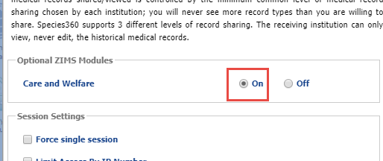
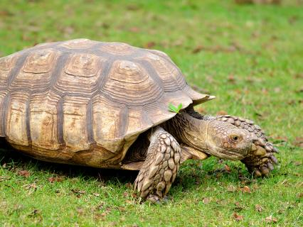
Activating Care and Welfare
The functionality is available by default
Your Local Admin will need to turn it on
Institution Preferences > ZIMS Accessibility & Features

Slide 5
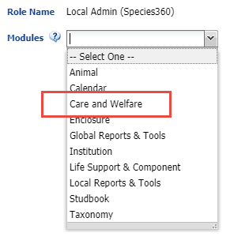
Access via Roles
As with all ZIMS functionality the access to Care and Welfare is via your Role
Local Admin is the only Species360 template that has access to it
For all others you will need to create, or add it to, a custom Role
Add/Edit Indicator and Indicator Value are required to be able to manage Indicators

Slide 6
Care and Welfare Dashboard
When you open the Care and Welfare module the dashboard is displayed. On the left you see three options – Templates, Indicators and Charts. The Templates and Indicators have filter options at the top.

Slide 7
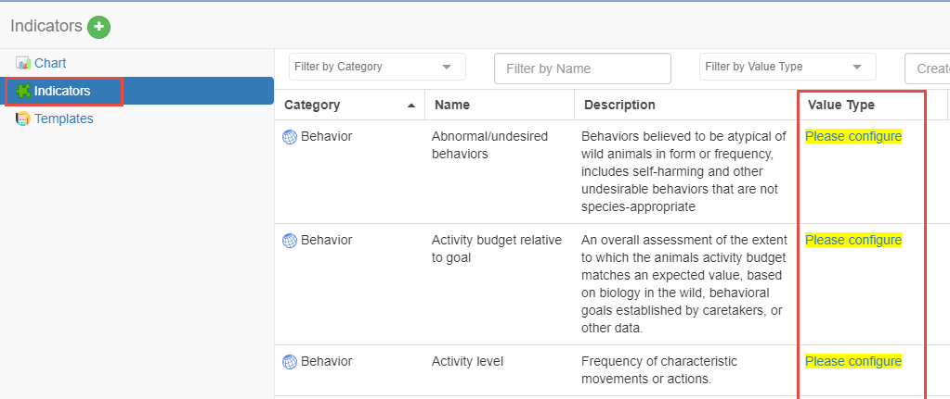
Configure Your Indicators
You will first need to
configure your Indicators.
Select Indicators from the
upper left to activate. If the
Value Type says “Please
Configure”, that Indicator has
not yet been configured. You
do not need to configure
all the Indicators, only those
you decide to use in your
templates. Indicators will not
appear for selection in templates
if they are not configured.

Slide 8
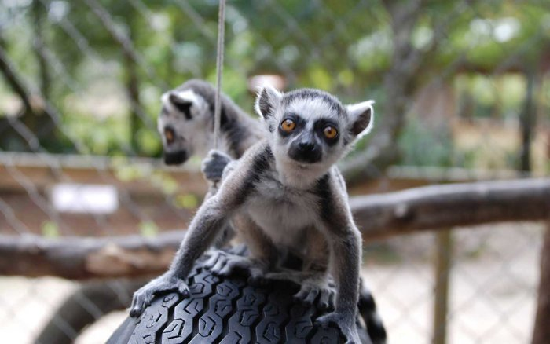
What Indicators to Select
Any Accreditation requirements
Any legal requirements (does your state or city require certain monitoring?)
What your Board wants to know
What your Staff wants to know

Slide 9
Five Categories of Indicators
The five categories were taken from the “Five Domains” model from “Caring for Wildlife – the World Zoo and Aquarium Animal Welfare Strategy”
http://www.waza.org/en/site/media/publications-1264077522/waza-strategies
Behavior
Indicator’s that reflect the animal’s responses to their surroundings
Activity level, aggression, reproductive, parenting
Environment
Indicators that relate to environmental parameters
Enclosure access, shelter, external impacts
Mental Domain
Indicators that reflect the affect or disposition of the animal as observed by caretakers
Attitude, use of environment, general assessment
Nutrition
Indicators that reflect the animal’s interaction with food and feeding processes
Consumption, food choices
Physical Health
Indicators related to the animal’s physical and physiological responses to factors such as disease, parasites, injuries, and developmental abnormalities
Evidence of discomfort, fecal quantity & quality, mobility and appearance

Slide 10
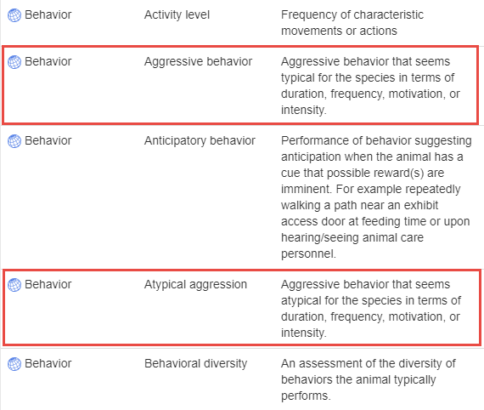
Understand the Descriptions
You should read all the
Descriptions to help you
select the correct Indicator
and Name. For example,
you have a Board directed
requirement to track all
aggression that is outside
the norm for the species.
Reading the definitions you
would select Behavior / Atypical
Aggression and NOT Behavior /
Aggressive Behavior due to the
Description.

Slide 11
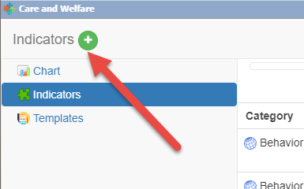
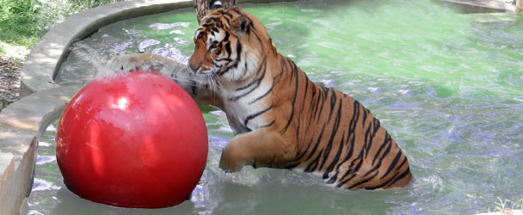
Adding Local Indicators
If you do not find an Indicator and a
Description that meets your needs
you can add a local one by selecting
the green circle/plus sign Add New
icon. We will discuss adding local
Indicators after we cover Value Types.

Slide 12
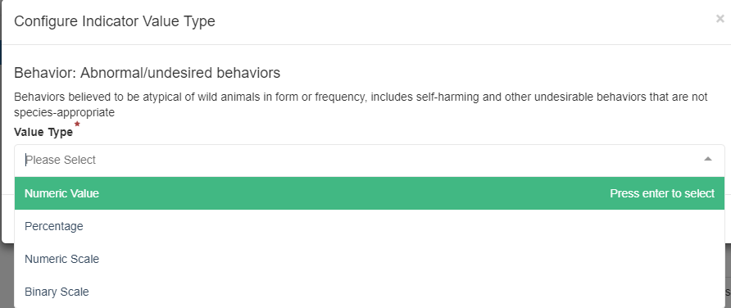
Indicator Value Type
The first thing you will be asked when you select the Please Configure option
is to select the Value Type you want assigned.

Slide 13
Four Value Types
What information you hope to record will drive the Value Type
Binary
Yes or No options as defined
Numeric Scale
Numbers with definitions. Example a “1” means excellent whereas a “5” means poor, or negative, neutral or positive
Numeric Value
Free choice numbers with no definition
Percentage
A rate out of 100

Slide 14
Numeric Scale
In our example for Behavior: Abnormal/undesired behaviors we selected Numeric Scale. We chose this Value because it will allow
us to capture the degree of these behaviors, from none to many.
We are then asked to “Define Scale”.

Slide 15
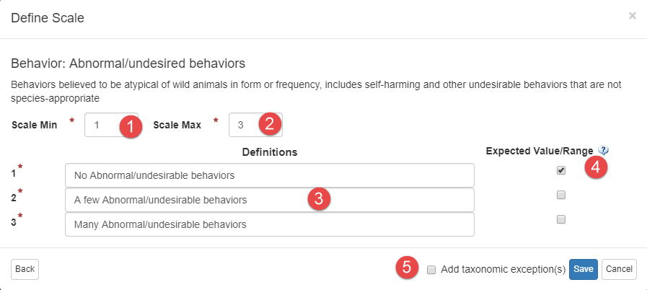
Define Scale
Use Scale Min to reduce the number of lines (1). Use Scale Max to increase the number of lines (2). Define what the numbers mean (3). Select what you want as the Expected Value (4). Although indicating the Expected Value is optional, if anything other than that is entered you will get a warning in red that it is not what you desired it to be. To define a different scale for a different taxonomy check this box (5). We will select this option later.

Slide 16
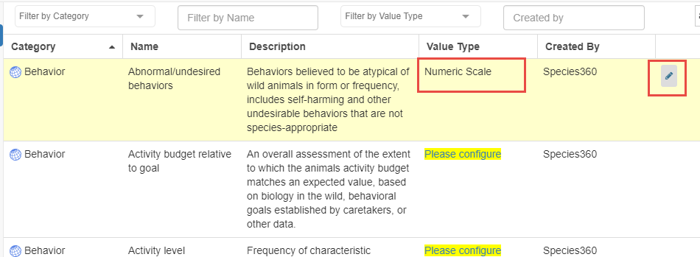
Value Type Configured
Once the Value Type is Configured the Value will display in that column.
If you want to edit the Value Type select the Edit icon. For most of our
animals we want to capture only the 3 Values. But for our Primates we
want more detail. We select to Edit.

Slide 17
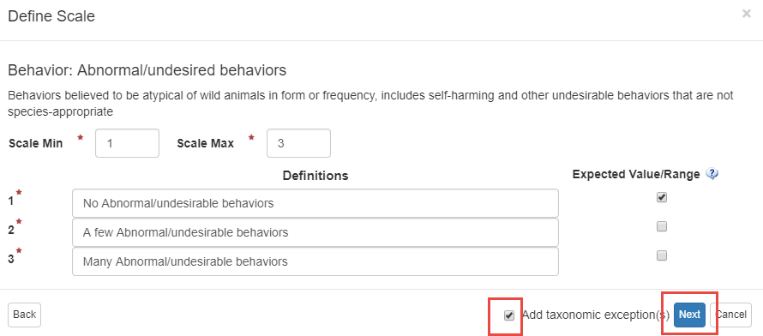
Add Taxon Exceptions
In the Define Scale screen we check the Add Taxonomic Exceptions box.
The taxonomy selected can be at any node of the tree and you can select
to include taxa below or not. Note that the Save button now says Next.

Slide 18
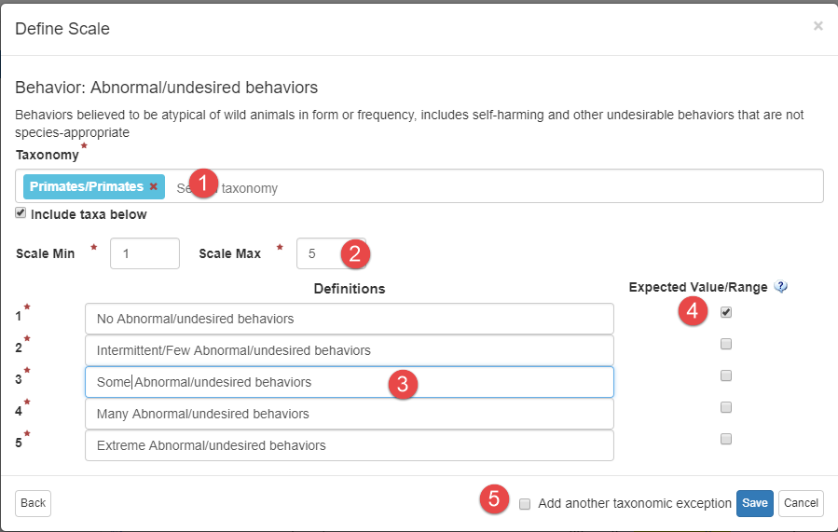
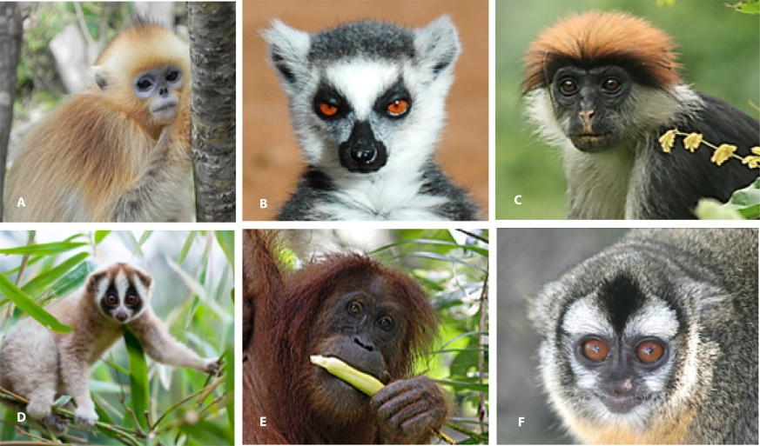
Add Taxon Exception
Because we want more detail in what we gather for our Primates (1) we have expanded the lines from 3 to 5 (2). We redefined the number scale (3) and checked our expected value (4). We do not want to add another taxonomy exception so we have unchecked that box (5) and Save.

Slide 19
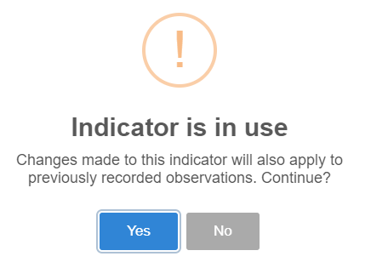
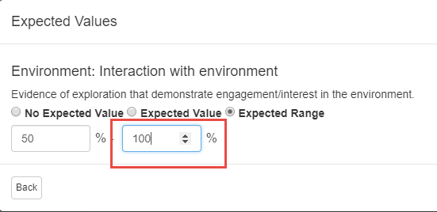
Editing an Indicator
For Environment: Interaction with
Environment we have chosen a
Value of Percentage. However, we
recorded an Expected Range of
50-80% and we want to change it.
When we select to edit we receive
a warning that the Indicator is in
use (top). We select Yes, understanding
that any changes will also apply to
previous records. Because the Indicator
has been used in previous records we
cannot edit the Value Type (middle).
We can, however, change the Expected
Values and we change the Expected Range
maximum from 80 to 100, meaning we
would like to see the animal use the
entire enclosure.

Slide 20
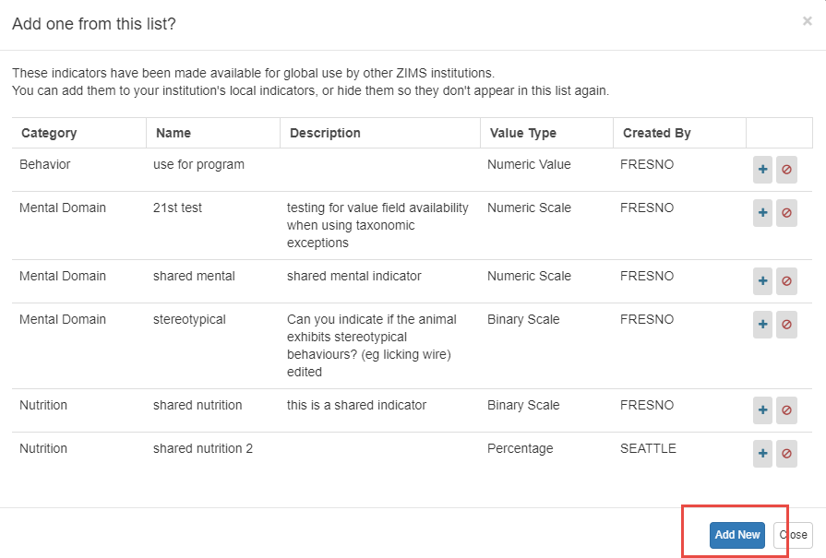
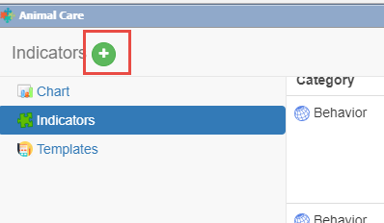
Creating a Local Indicator
The keepers have noticed that some members of our penguin colony are exhibiting excessive vocalizations. They would like to capture and compare it with other factors to see what may be causing it. There is not a Global Indicator that captures this so we will create a Local one. We select the Add New icon (left). The
first screen that pops up is for Local Indicators
that have been shared. We will look at these
later. For now we select Add New.

Slide 21
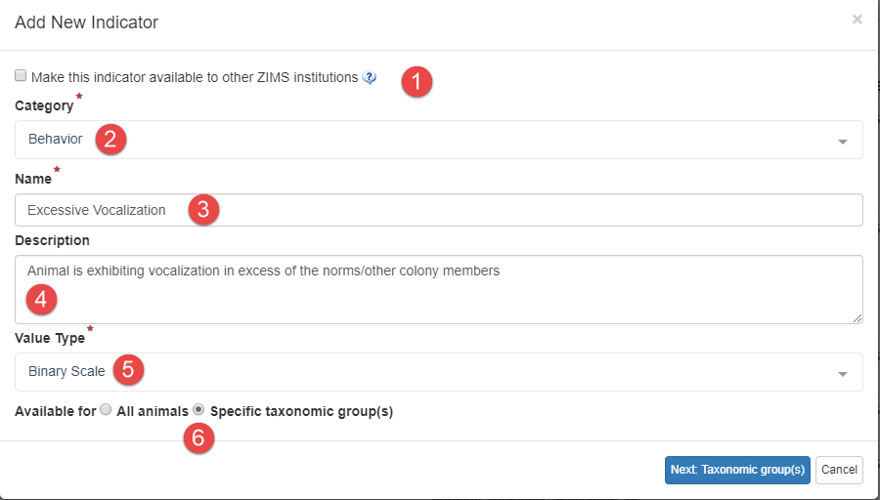
Creating a Local Indicator
1-If you want to share this Template with other institutions you will check the box. Right now we do not want to share.
2-Select a Category from the five options
3-Name it so you will remember
4-Describe what you are trying to capture
5-Select Value Type. We have selected a Value Type of Binary because we want a simple Yes or No for the behavior.
6-We want this Indicator available only for our penguins so we check the Specific Taxonomic Groups checkbox.

Slide 22
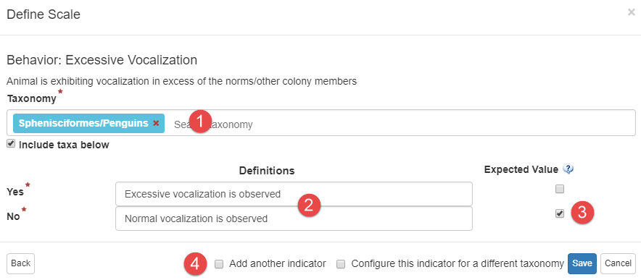
Defining Scale
We limit the Taxonomy to penguins (1). We then define the Yes or No responses (2),
checking the desired Value of normal vocalization (3). We then have the options to
add another indicator or another taxonomy. We are done so we Save.

Slide 23
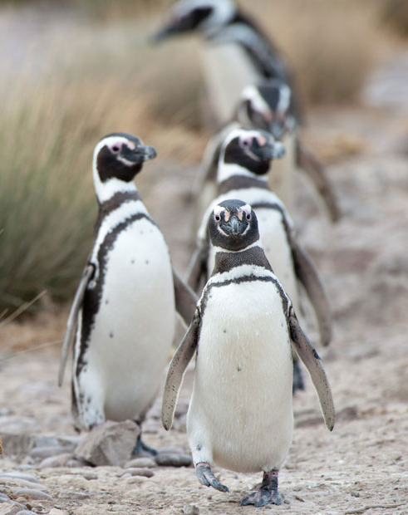
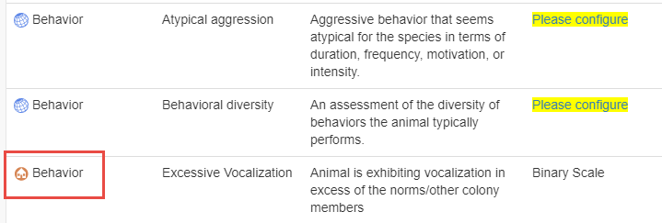
Added to Indicator List
The Behavior is added to your list of Indicators. The house icon
indicates that it is a Local Indicator. Only your institution will
have this Indicator available as a selection.

Slide 24
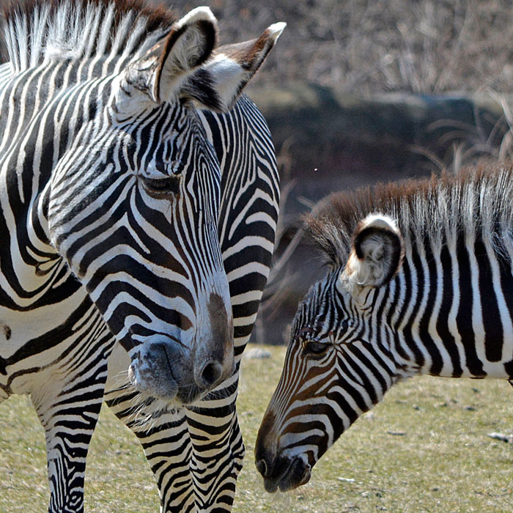
Why Share Indicators?
An institution or Regional Association can
create an Indicator and make it available
globally. You can also edit an existing Local
Indicator and make it available globally.
Another institution can use that Indicator
and edit to have their own Expected Values.
No other details can be edited. This is the
first step towards giving Program Managers
the ability to set certain parameters that they
want tracked. They can create Indicators and
an institution can create Templates using
them. Eventually, there will be shared Templates
created by Program Managers that institutions
can just accept as a whole!

Slide 25
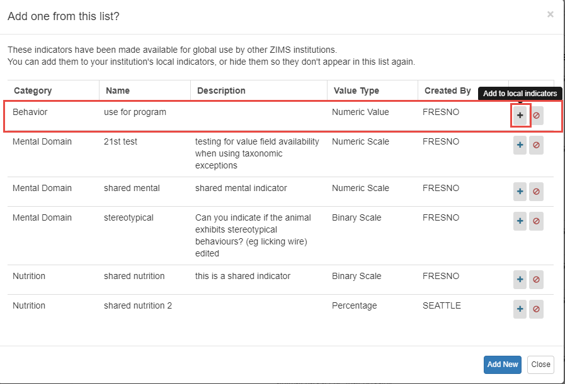
Adding a Shared Indicator
As noted earlier, the first screen that appears when
you are creating a Local Indicator is a list of shared
Indictors. In this example, FRESNO
has checked the box for Make this Indicator
Available for Other ZIMS Institutions for several
of their Local Indicators. This can be done when
first creating the Indicator or by editing an existing
Local Indicator. From this list you can add them to
your institution’s list or hide them if you are not
interested. We want to add the Behavior Indicator
of Use for Program. Select the “+” icon.

Slide 26
Adding a Shared Indicator
The Indicator Category, Name and Value Type are not
editable. Select Next (top). FRESNO did not select an
Expected Value but you want an Expected Range of
0-1 (bottom). This means if the animal is used for more
than one program a day you will get a warning that it was
outside the desired use range. If you want to add Taxonomic
Exceptions you can do so. Then Save.

Slide 27
A Shared Indicator
The shared Indicator now appears in your list with the shared icon. It will
be selectable when you create a Template. FRESNO is also indicated as the
originator of the Indicator. It is removed from the available shared
Indicators list.

Slide 28
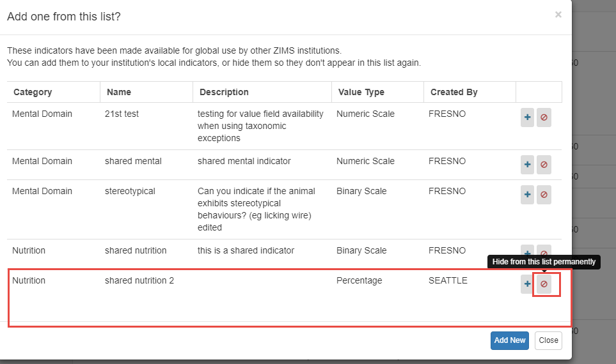
Hiding Shared Indicator
In addition to adding shared Indicators to your list, you can hide
them from view if you are not interested in them. We are not
interested in the Nutrition Indicator added by SEATTLE. Select
the “no” Icon. You will be asked if you are sure that you want to
hide the Indicator permanently. If you select Yes, it is removed
from the list.

Slide 29
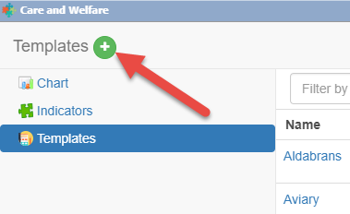
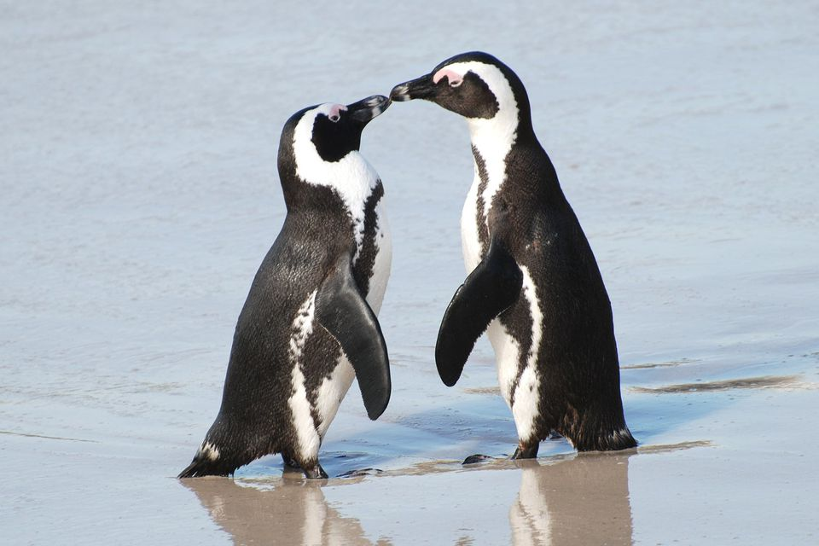
Create a Template
To create a Template using the
Indicators that you have configured,
select Templates and the Add New
icon.

Slide 30
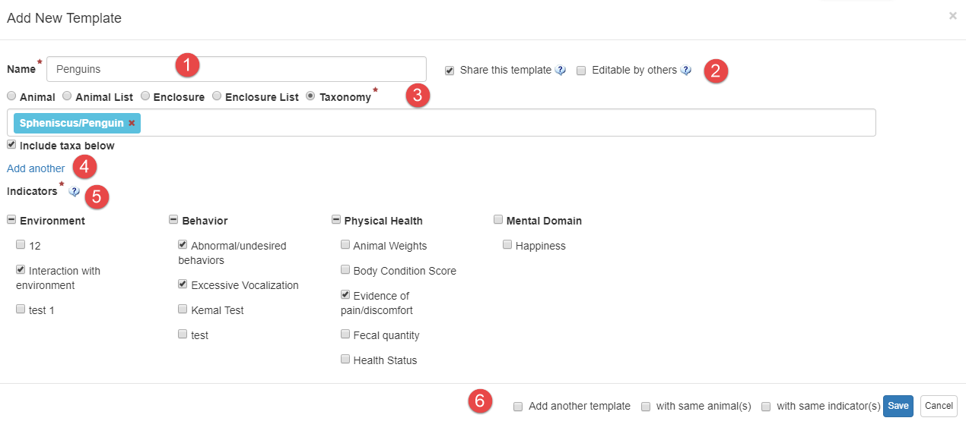
Create a Template
1-The name must be unique.
2-Select if you want to share with others or allow others to edit the template.
3-Select the entity you want the template to cover. If you do not have Animal or Enclosure Lists those options will not display for selection.
4-If you want to add another entity select Add Another. You can mix and match Animals, Enclosures and Taxonomy. When selecting Enclosures it will pull from the current Occupants.
5-Select your Indicators. Checking the top level Category will select all the Indicators under it.
6-You can easily Add Another Template from here. You can select the same animals and/or the same
Indicators.

Slide 31
Using the Template
To use the Template select the hyperlink from the list of Templates.
this is also where you would edit or delete a template.

Slide 32
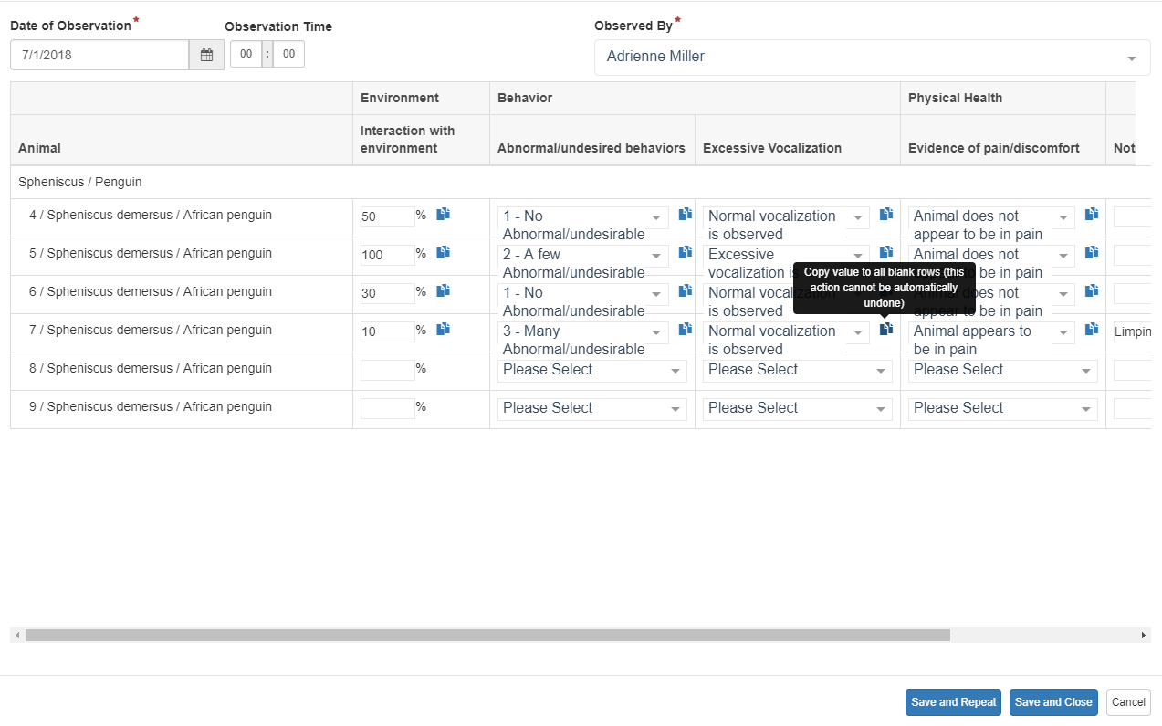
Using the Template
Complete the template. Selecting the copy icon will copy the value in the
remaining records in that column for any animals with the same Configuration
for that Indicator. You do not have to complete all the fields to Save. Save and
Repeat will save the data and keep the template open for additional entries.

Slide 33
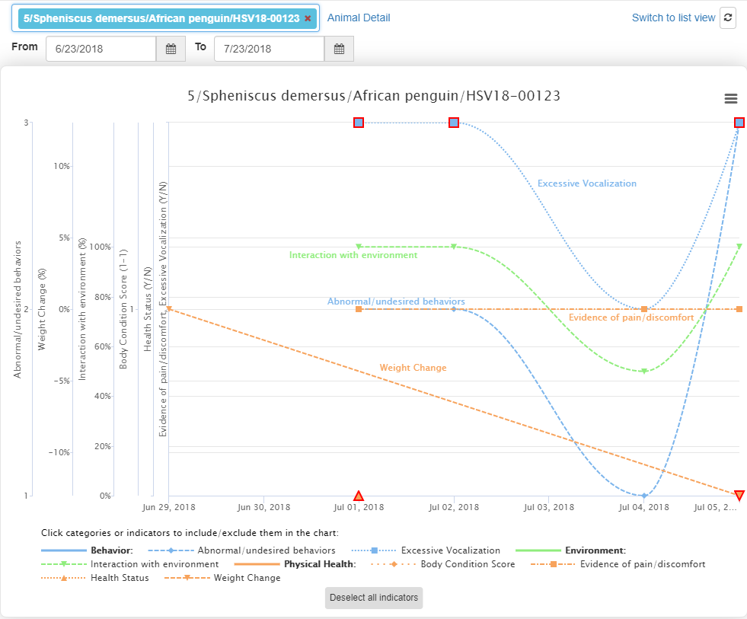
Viewing the Chart
To view the Charts, select Chart
and enter a GAN or other
identifier (above). The Chart will
display the data recorded during
the selected date range.

Slide 34
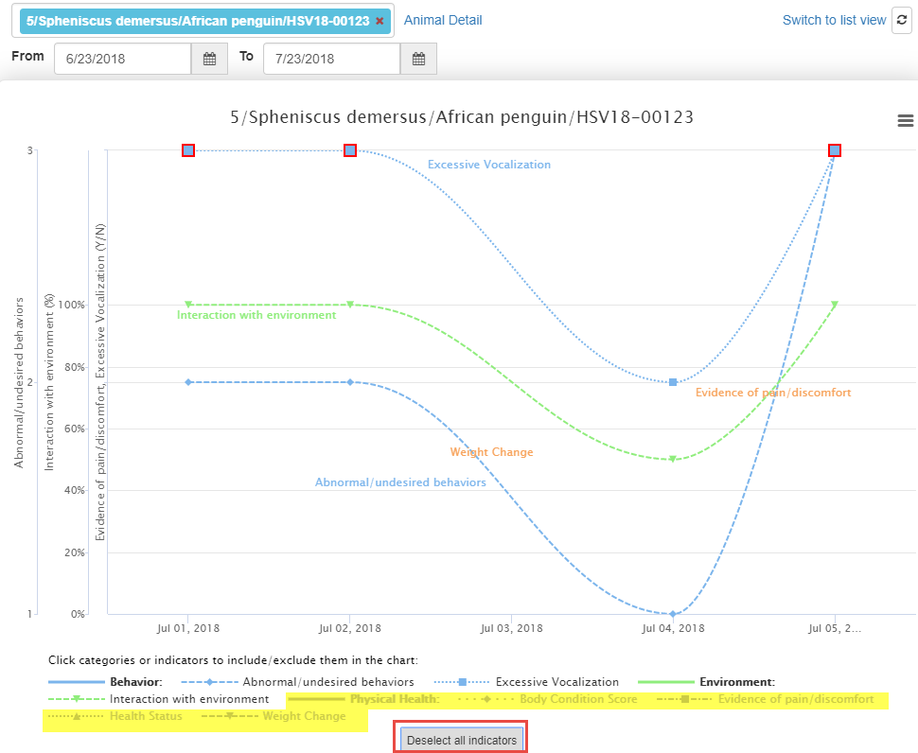
Filtering the Indicators
You can filter the Indicators
to make the Chart easier to
read by clicking on them
(see yellow below). If they
are greyed out they will not
display in the chart. By
removing some Categories
we can easily see that
Excessive Vocalization,
Interaction with Environment
and Abnormal/Undesired
Behaviors appear to be
related.

Slide 35
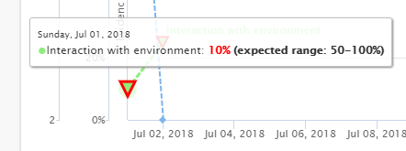
Outside of Expected Values
If an Observation is outside
the desired Value/Range it
will be outlined in red on the
graph. Hovering over will display
the desired Value.

Slide 36
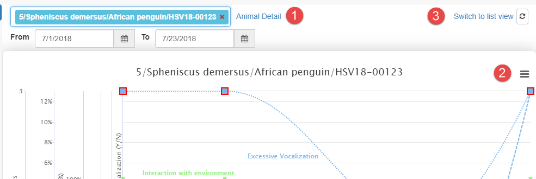
More Options
1-Selecting Animal Detail will take you directly into the animal record
2-Selecting the hamburger icon allows you to print the Chart
3-Switch to List View will change the view

Slide 37
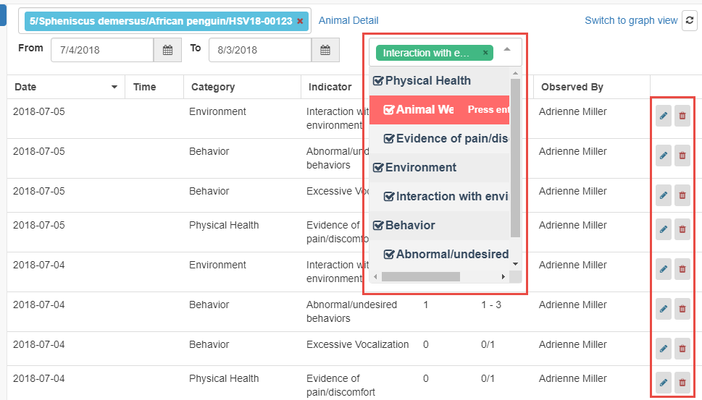
List View
List View shows the Observations in a list. The columns can be sorted in ascending or
descending order. If you want to filter the list to fewer categories simply uncheck (or
press Enter when highlighted) the categories you do not want to see. If you need to
edit or delete an observation you would do it from List View. List View is where any
Notes would display. You can also edit or delete data using List View.

Slide 38
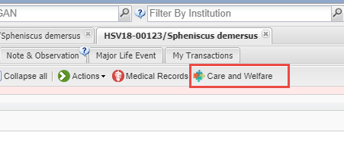
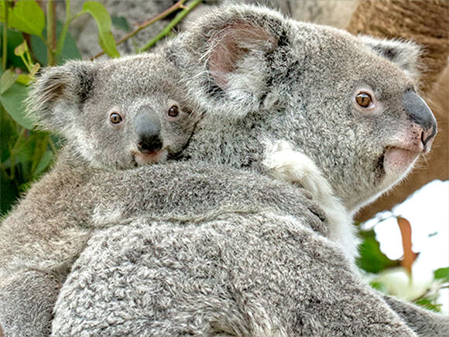
From the Animal Record
From within the animal record
you can open the Chart and have
access to the List View by selecting
the Care and Welfare tab at the top
of the record.

Slide 39
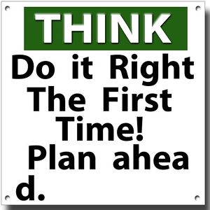
Some Best Practice Suggestions….
Try to get the involvement of all
Staff members who will be using
the Care and Welfare module to help
plan how it will be used and who
will be using it. You only want to
configure the Indicators and
create the Templates once. The
expected usage is:
1-Indicators are owned by the welfare
officer at your institution
2-Templates are used by the animal
care staff
3-Charts are Curatorial, Veterinary
and others with animal collection
oversight

Slide 40
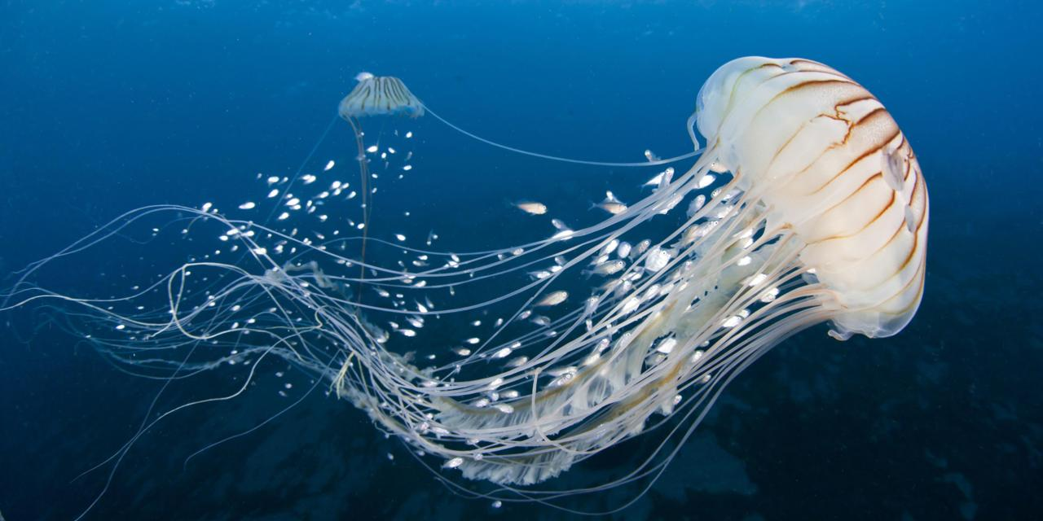
BP – Use Global Indicators
Whenever possible try to use the Global Indicators
Care and Welfare information is not currently shared but hopefully it will be in the future
Using standard Global Indicators will assist with this sharing

Slide 41
BP - Creating Local Indicator
Try to use the default of assigning to All Animals when possible
Best to “add exceptions” rather than use “specific taxonomic group(s)”
Taxonomic exceptions cannot be changed after observations are recorded
If “specific taxonomic group(s)” is used you cannot go back and select All Animals – you would need to create a new Indicator
Carve away rather than build up

Slide 42
BP - Editing an Indicator
Name, Category and Description can be edited
Warning will be given if associated with any records
Value Type cannot be edited after records have been added
Expected Value can be modified even if records have been added
Value cannot be changed for Numeric Scale after using the Indicator in a record
If an Indicator is edited, you should add a batch Note to animals affected that includes what was changed on date “x”

Slide 43
Taxonomic Exclusions in Templates
All of the Indicators that have been Configured will display to select from when creating a template
If an Indicator has been used for a taxa, you cannot remove that taxa from the exception
When actually using the template, if a taxa is not included in the indicator the data entry will be greyed out and a “NA” displayed by default, data cannot be recorded

Slide 44
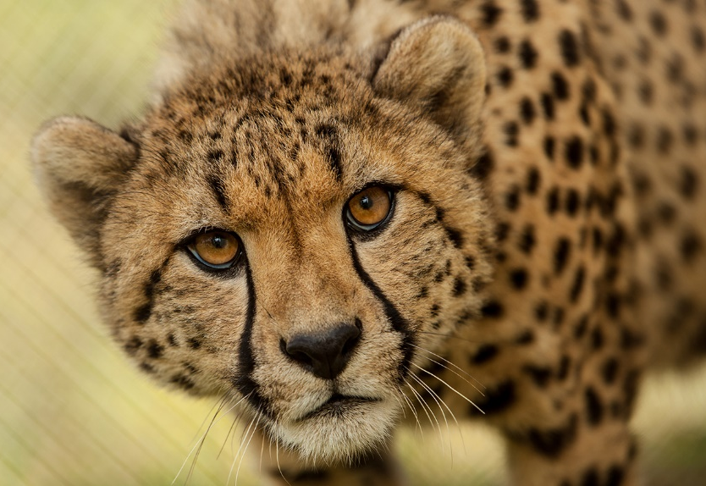
BP – An Example
Indicator A
Numeric scale is 1-5
Taxa exclusion = cheetah
Numeric scale for cheetah is 1-10
Data is recorded on cheetah
Oops – you really wanted cheetah to be 1-5
Not going to happen – skews data already recorded
Oops – you don’t care about cheetah being an exception
Not going to happen – skews data already recorded
Numeric Scale can only be changed BEFORE data entry has occurred
Expected Value/Range can always be changed

Slide 45
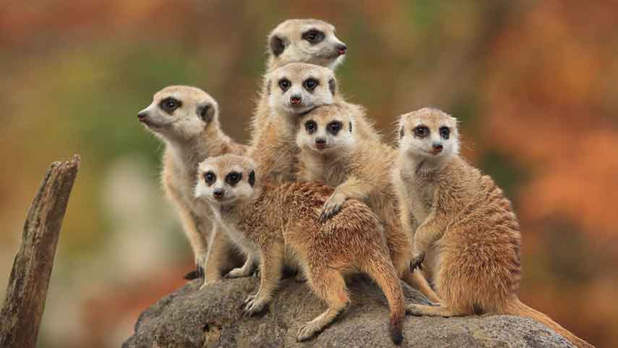
BP – Deleting an Indicator
Care and Welfare data does not go into the animal record, they are retained in the module
Deleting an Indicator will delete all the observations recorded using it
You have 3 months to “Roll Back” a deletion using Data Entry Monitor

Slide 46
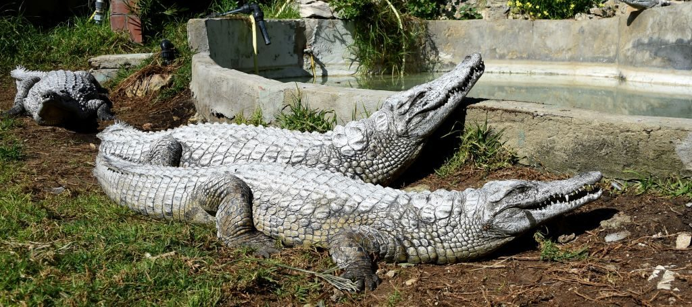
Chart Considerations
Weight, Health Status and Body Condition Score automatically populate the Charts
They do not display on List View
List View allows you to edit the date, time, value and observed by fields
List View is also where any Notes will display

Slide 47
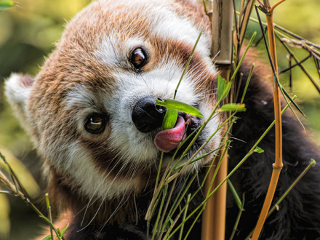
ZIMS for Care and Welfare
Any Questions?

