Slide 1
Preferences in ZIMS
Tips and Tricks July 2018

Slide 2
There is a television show called
“Lucifer”. The concept is that
the devil comes to earth because
he is bored and unhappy. He is able
to manipulate people by asking
“What is it that you truly desire?”
The Institution and My Preferences
available in ZIMS allow you to
make ZIMS function as “you truly
desire.”

Slide 3
What You Truly Desire
Some Preferences affect data entry
Some Preferences affect reports and data viewing
Some Preferences can help you limit what you see in data standard lists to simplify selection
Some Preferences affect ZIMS functionality
Some Preferences affect how ZIMS looks
Make ZIMS truly work for your desires!

Slide 4
Some Terms to Understand
Institution Only Preferences
Cannot be changed using My Preferences
These affect some functionality of ZIMS that must be consistent across ALL Users
Two kinds of Save
Save – Will apply to all new Users created
Save & Apply to All Users – Will apply to All Users, even current ones (their My Preferences will be over-ridden)
My Preferences
Set defaults as you want them
Manage your account yourself

Slide 5
Log Out!
Any changed Preferences will
not take affect until you log
out and log back in again. If
you are not seeing your changes
in the way ZIMS is behaving you
may not have done so.

Slide 6
Institution Preferences Only
Usually only Local Admin can select (or someone with a custom role with the access)
Start > Institution > Institution Preferences
Allow Multiple Enclosure Assignment
Allow Re-use of Transponders
Enable Auto-incrementing Local ID
Default Colony Inventory Count
Default Group Tracking
Enable Auto-accept for Species360 Taxonomic Changes
ZIMS Accessibility and Features
Advanced Access Features
Records Sharing

Slide 7
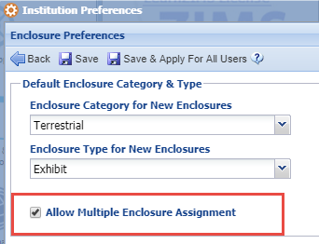
Enclosure Preferences > Allow Multiple Enclosure Assignment
This preference allows you to put animals in more than one enclosure at the same time. For example, this tiger could be in the exhibit, an outdoor holding area and an indoor holding area all at the same time. When this option is activated ZIMS will not automatically create a Move Out Date if a new enclosure is added as the application has no way of knowing if the animal still has access.

Slide 8
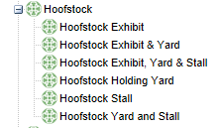
Multiple Enclosures
This option may impact how you set
up your enclosure tree because with
single enclosure assignment, if you
want to reflect the animal has access
to all, you would need to create an
Enclosure for all of the possible
enclosure combinations (top). With
multiple enclosure assignment you
only need to create each enclosure
(bottom).

Slide 9
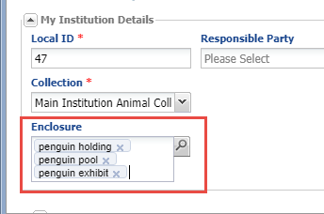
Recent Improvement!!!
Users found that they could not
enter multiple enclosures during
accessions. They had to remember
to add the remaining ones after
the accession was saved. This was
fixed in a recent release and now
all accession screens have the
option to enter all enclosures
during the accession!

Slide 10
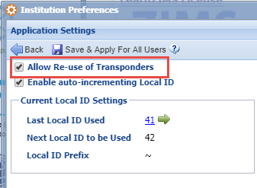
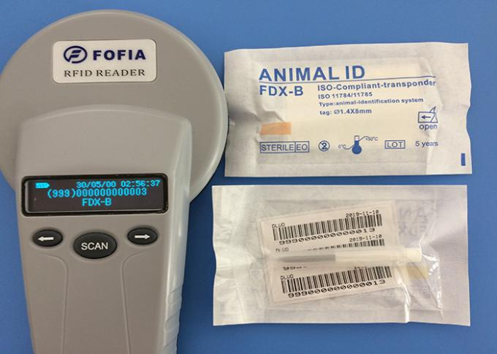
Application Setting – Allow Re-use of Transponders
By default, you cannot re-use a
transponder once it is removed from
an animal. Checking this option
allows you to do so. However, ZIMS
does have a Business Rule that you
cannot record re-using it in the same
species to avoid confusion of which
is the correct animal.

Slide 11
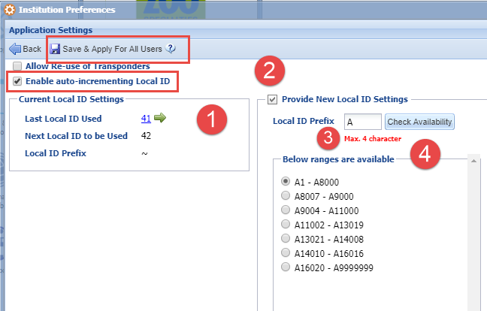
Application Settings – Enable Auto-incrementing Local ID
Selecting to auto-increment
your Local IDs means that you
do not have to record a Local ID
during an accession. The next
available number will pre-fill.
This can save you data entry time
and help guard against the data entry
error of not entering the next
available number. The Current Local
ID Settings displays the last Local ID
used and the next one to be used (1).
By checking Provide New Local ID
Settings (2) you can add a Local ID
Prefix (3) and/or check for availability
(4). ZIMS will display number ranges
where more than 50 are available.

Slide 12
Application Settings – Enable Auto-incrementing Local ID
Allowing Auto-increment Local ID is especially helpful for Batch Accessions.
Simply record the number of Local IDs needed and select Generate (1). The
Local IDs will prefill below (2).

Slide 13
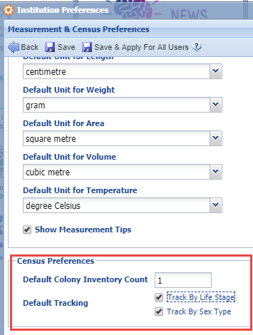
Measurement & Census Preferences – Census Preferences
The Census Preferences allow you to
set defaults for your Colony Inventory
Count and Default Group Tracking.
Colonies are groups of animals that work
together for the benefit of all, have numbers
too high to count or estimate correctly
or who share the same genetic makeup such
as corals. Usually the colony count is a “1”
but this option allows you to change your
default for that count. Groups can be
tracked by simple censuses, by Sex Type,
by Life Stage or by both. This option allows
you to change the default tracking for
groups during an accession. Both of these
can be edited from within the record.

Slide 14
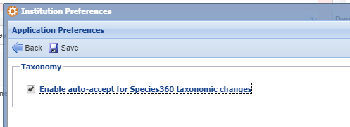
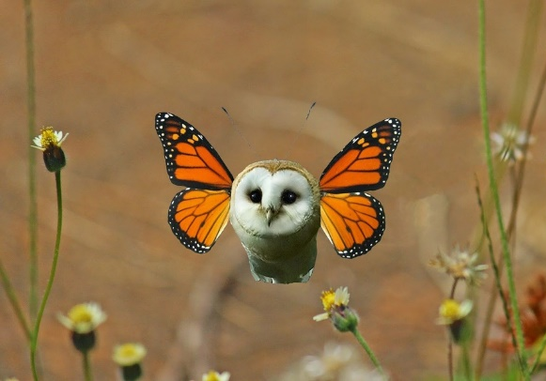
Application Preferences- Enable Auto-accept for Taxonomy Changes
When Species360 makes a change to taxonomy, both scientific or common name, you receive notification via a Post Office message. You also have the option to sign up for email notifications. These changes will also display in Animal Statistics > Pending Taxonomic Changes. This is where you would chose to accept the changes in your records. If you want you can select to automatically accept the changes by checking Enable auto-accept for Species360 taxonomic changes under Application
Preferences. You will still receive a Post Office message and an email (if you have opted to do so) so you will continue to be aware of any changes but you will not need to take the time to go in and accept them. This does not accept any changes that are already in your Pending Taxonomic Changes list and you will need to manually accept those.

Slide 15
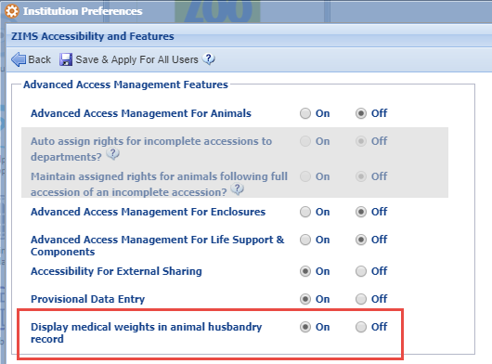
ZIMS Accessibility & Features – Advanced Access Features
All of the topics under Advanced Access Management Features must be activated by the Species360 Global Administrator except for Display Medical Weights in Animal
Husbandry Record. This is turned on by default. If you do not want to see any weights that were recorded in the Medical module
display in the Husbandry module your Local Admin will have to turn it to Off.

Slide 16
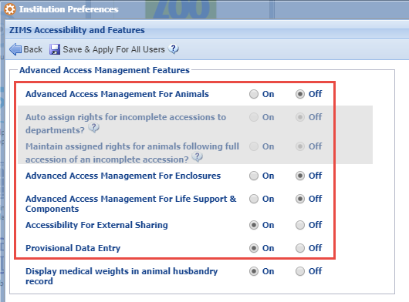
ZIMS Accessibility & Features – Advanced Access Features
If you do not see any of these topics and you want to use them please contact Species360 support. They will have the Global Admin activate them for you. You will then need to turn them on to use them.
Advanced Access Management allows you to limit Staff access to Animals, Enclosures, Life Support and Components using Departments. For more information contact Species360 support.
Accessibility for External Sharing turns on that functionality for the Husbandry module only.
Provisional Data Entry activates the option for Users to record information that must be approved prior to becoming a part of the ZIMS database. For more information contact support.

Slide 17
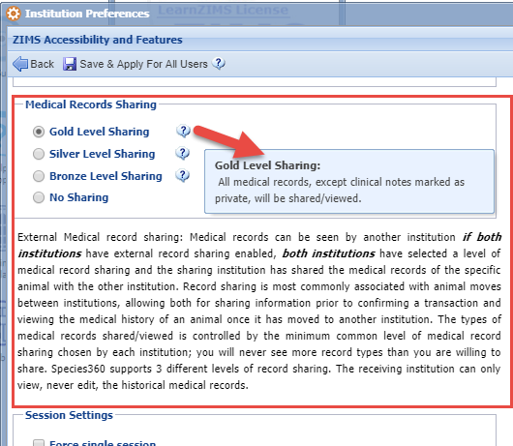
ZIMS Accessibility & Features – Medical Records Sharing
You must have Role access to Medical
Records Sharing to see these options
in ZIMS Accessibility & Features. This
is where you would select the level of
sharing that you want. Hovering over
the “?” will let you know what features
are shared at each level. Medical Records
are shared at the lowest common
denominator between the facilities.
For example, if you have opted to share
at Gold, the highest level of sharing, but
the institution you are sharing your records
with has opted to only share at the lower
Bronze level, they will only see the records
for your facility at that level.

Slide 18
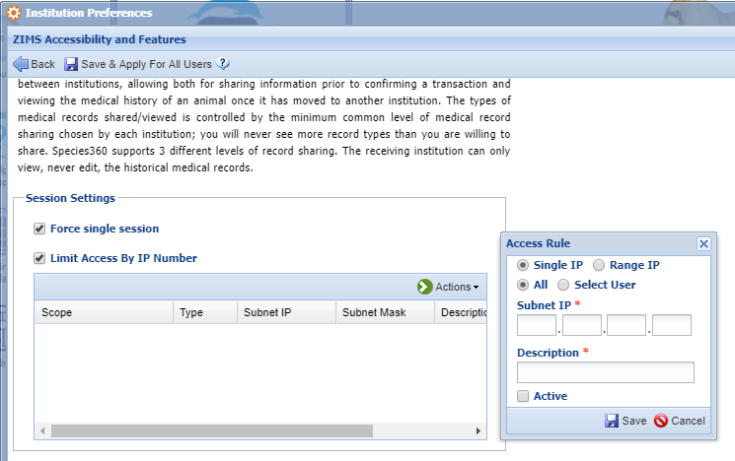
ZIMS Accessibility & Features – Sessions Settings
The last section is for Session Settings.
Selecting to Force Single Session means
that Users can log into ZIMS on only one
computer at a time. If they try to log in
on a second one the ZIMS session on the
first one will be terminated. Limit Access
by IP Number means that you can access
ZIMS only from IP addresses listed here.
It is recommended to limit IP access at the
individual User level. Doing so here can
actually risk you locking yourself out.

Slide 19
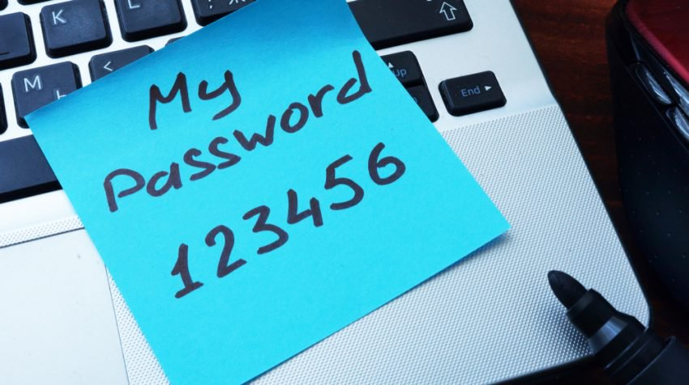
My Preferences Only
Start > My Preferences
Allows you to manage your ZIMS account
Account Settings
Change Password
Change E-mail
Change User Name
Change Default Institution
This is only for Users at institutions that have a Parent institution and they move between the facilities in ZIMS
Personalization
Change the color

Slide 20
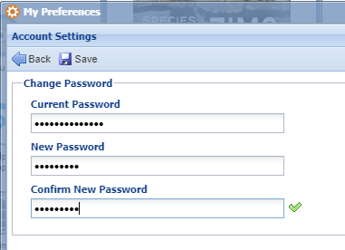
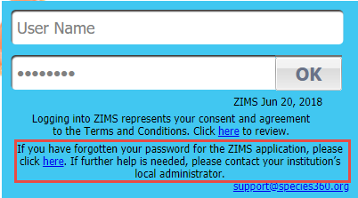
Account Settings – Change Password
You may want to change your
Password if you do not like the
one that was assigned by your
Local Admin or if you feel that
it has become compromised
somehow. If you do not
remember your Password it
cannot be changed here. Ask
your Local Admin to do so or
use the link on the Log In
screen.

Slide 21
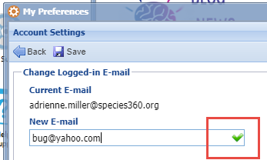
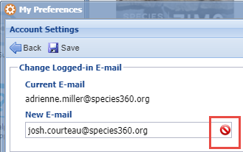
Account Settings – Change E-mail
To change your E-mail simply
enter the New E-mail. It is
important to remember that
the email address must be
unique within ZIMS. If it is,
a green check will display (top).
If it is not then a red “No” will
display (bottom) letting you
know that you cannot use it.

Slide 22
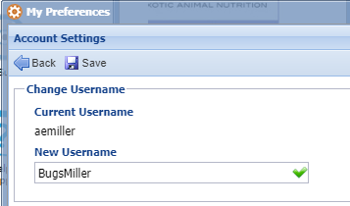
Account Settings – Change User Name
You can also change your User
Name. As for the E-mail, it must
be unique within ZIMS. If it is, a
green checkmark will display. If
it is not the red “No” icon will
display. If you are trying to use
an E-mail or User Name that is
NOT unique in ZIMS but was
used by a User who is now marked
as Obsolete, your Local Admin can
free up the Password and User
Name by selecting Delete Login
Info in their ZIMS Login Details.

Slide 23
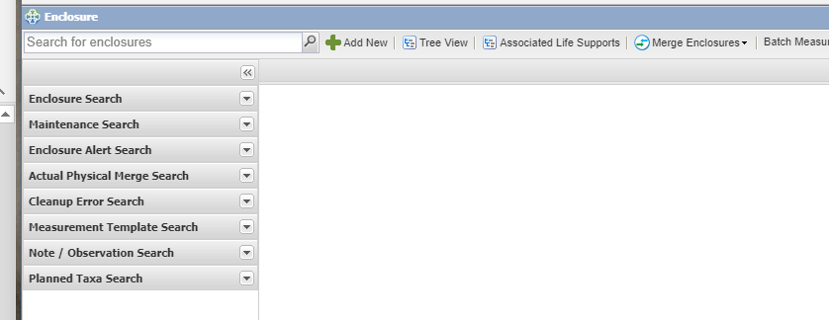
Personalization – Change the Theme
Under Personalization
you can change the color
of the theme to blue or
grey. One may be easier
on your eyes then the
other. It’s a small thing
but worth a try!

Slide 24
All the Other Preferences
Take the Time to Save Time!!! The remaining Preferences are available as both
My Preferences and Institution Preferences. They will help you to save data entry
time as many of the fields will default to what you usually enter. These fields can
all be edited at the time of data entry if needed.

Slide 25
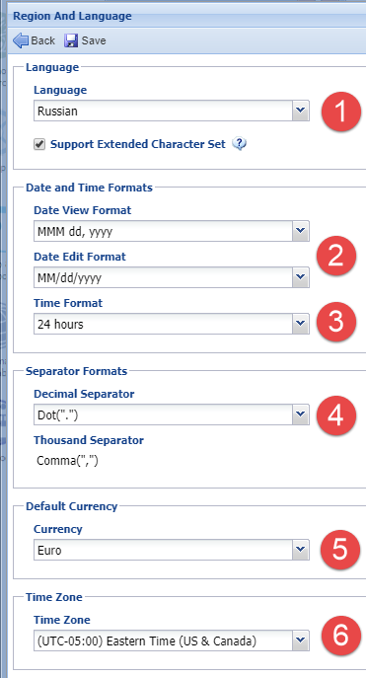
Language, Date/Time and Separator Formats
(1) ZIMS is available in three languages – English,
Spanish and Russian. If you select Spanish or
Russian remember to check the Support Extended
Character Set box.
(2) You can select how you want to enter dates and
how you want to view them.
(3) For screens that capture the time you can select
a 24 hour (sometimes called military) or a 12 hour
day. If you select 12 hour you will need to indicate
AM or PM on your entry which may slow you down.
(4) Some regions use a “.” to separate decimals and
others use a “,”.
(5) There are screens that ask for price such as some
accessions screens and enclosure maintenance grids.
Defaulting to your currency will save you data entry
time.
(6) Having the correct Time Zone set can be very
important for those scenes that capture time as that
information may be useful for data such as Feed Logs
and Enrichment.

Slide 26
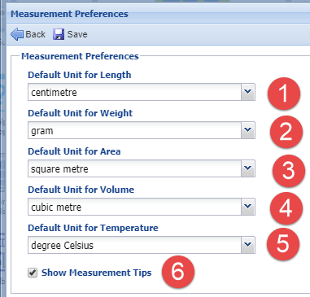
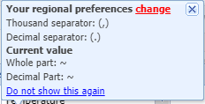
Measurement Preferences
(1) The default unit of length will display in
both animal and enclosure records.
(2) The default unit of weight will display in
any fields asking for weights, for example
a Prescription.
(3,4,5) These default units apply to enclosures,
life supports and components.
(6) Show Measurement Tips will display a pop
up indicating what your current preferences
are. Unchecking this box will stop the pop up
from displaying. You can change these by
selecting the “change” hyperlink in the pop up.
You can also stop the pop up by selecting the
“Do not show this again” option.

Slide 27
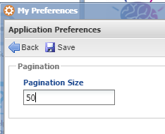
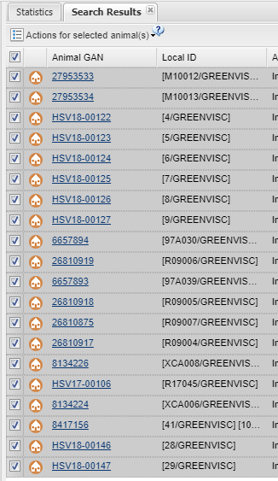
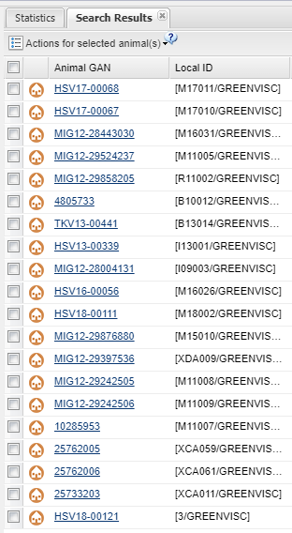
Application Preferences – Pagination
The Pagination refers to how many
lines will display on a results grid
page. The default is 20 but it may
save you time if you increase the
number so you don’t have to go
from page to page. In addition,
actions, such as Batch Actions, taken
on a results grid affect ONLY the open
page. We selected all on page 1 (left),
but note that nothing is selected on
page 2 (right).

Slide 28
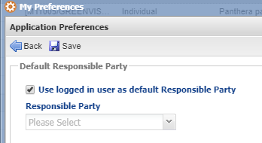
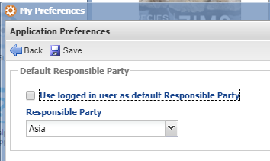
Application Preferences – Default Responsible Party
You can select a default Responsible
Party to help save data entry time.
Use logged in user as default (top) means
that whoever is logged in at the time
of data entry will pre-fill in the
Responsible Party field. This may be a
good idea if other staff are allowed to
record their own data but may not save
time if one person is doing the data entry
as there will probably be multiple parties
they need to select from. If this is checked
the Responsible Party field below is not
editable. If you do not check to use logged
in User you can assign a single person, team
or Department as the default Responsible
Party (bottom).

Slide 29
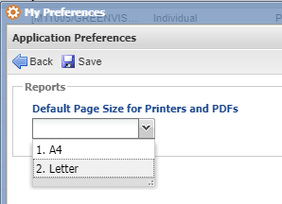
Application Preferences – Reports
The Reports Preference allows you
to select the page size for printed
reports and exported pdf documents.
This page size is usually regionally
driven. Few countries use letter. Most
of the world uses A4.

Slide 30
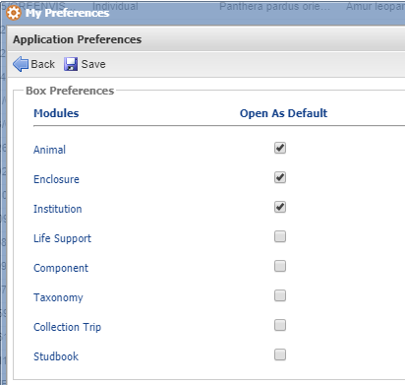
Application Preferences – Module Boxes
By default, most of the grids in each
module, except Basic Info, are collapsed
when you open a record. The Module
Boxes Preference allows you to select
to have them expanded by default. You
can still use the expand all/collapse all
options within the record or expand/collapse
each grid independently.

Slide 31
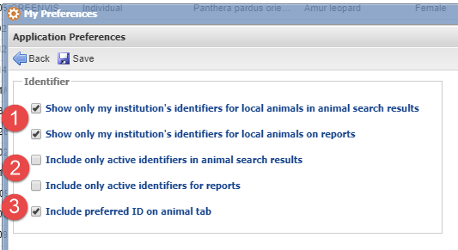
Application Preferences – Identifier
The Identifier Preferences allow you
to select what Identifiers you see in
search results grids or on reports.
(1) You can select to see only those
identifiers recorded by your institution
or those recorded by another that you
have chosen to accept as local.
(2) You can select to see only active
Identifiers regardless of who they
were entered by.
(3)You can also select to have your
Preferred ID display along with the
GAN on the animal tab. If you often
have many tabs open this can make it
easier to find the correct animal.

Slide 32
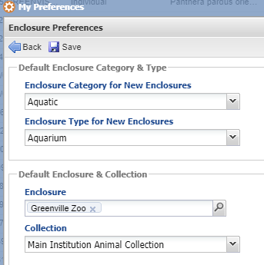
Enclosure Preferences
If your Role gives you access to
record new enclosures and/or
Accessions or Visits, you may
want to adjust the Enclosure
Preferences to default to what
is most often entered. For new
enclosures you can select the default
Category and Type. For Accessions
or Visits you can select the default
Enclosure and Collection to put the
animal in. These are all editable
within the record.

Slide 33
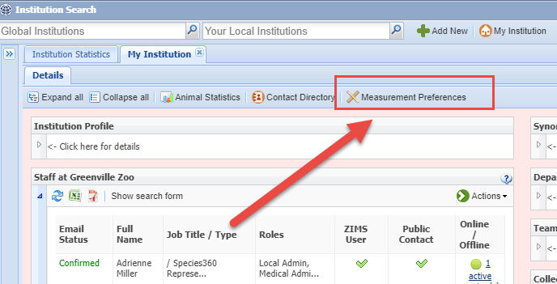
Institution Measurement Preferences
Institution Measurement Preferences are not found under Preferences, they are
at the top of the My Institution module. These Measurement Preferences allow
you to shorten measurement data standard lists so only the measurements you
actually use appear. These preferences function as Institution Preferences and
will affect all Users.

Slide 34
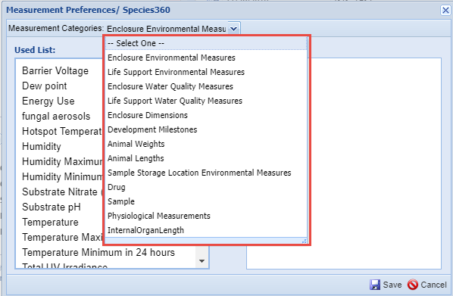
Select the Measurement
There are over a dozen
measurement types that you
can select from. We will select
Enclosure Water Quality
Measurements.

Slide 35
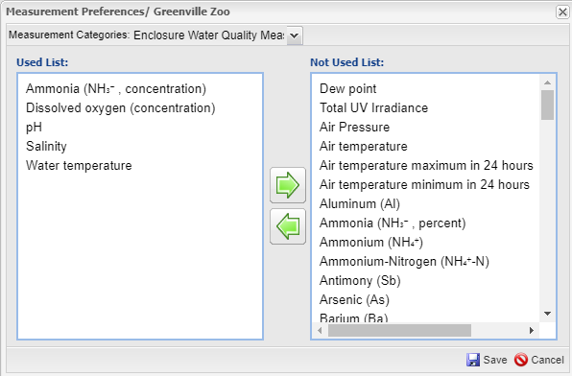
Move to Not Used List
There are over 100 measurements available for Environmental Water Quality. We
only record 5 of these – Ammonia, Dissolved Oxygen, pH, Salinity and Water Temperature.
Using the arrows or double clicking on the term we have moved all measurements
except those into the Not Used List. It is easy to move multiple terms by using the
“shift” key.

Slide 36
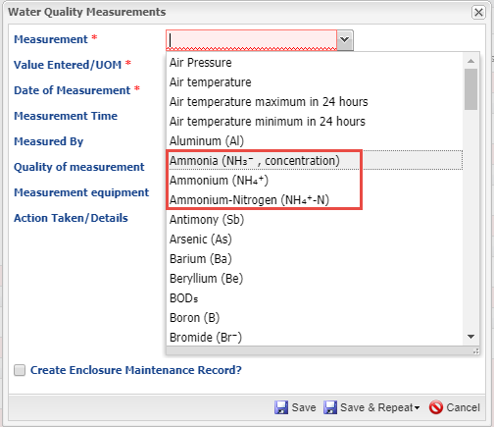
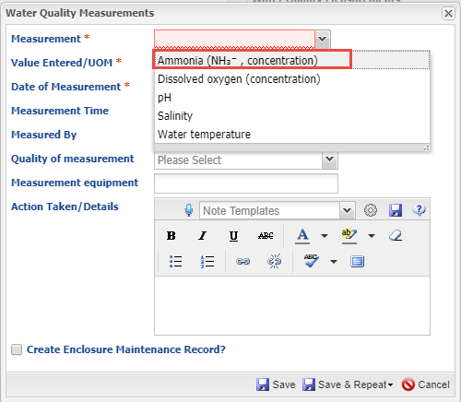
Easier/Quicker Selection
Within the measurement entry screen you see all the measurements available on the
left. If you start typing “Am” for Ammonia 3 terms display and you have to select one. On the right, since we have removed the measurements we don’t use, when you start typing “Am” only the measurement you want will appear. This saves data entry time and helps protect against
possible data entry errors should the wrong term be selected.

Slide 37
Preferences!
Making ZIMS function as you truly desire!

