Slide 1
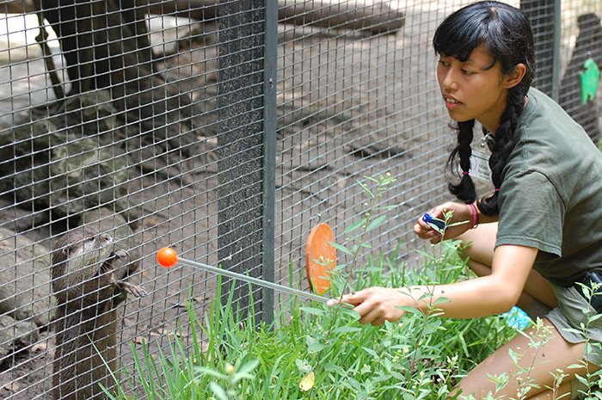
Husbandry Log Template
June 2018 Tips & Tricks

Slide 2
What is the HLT?
Allows you to create a template to capture your workload
It saves data entry time
It helps you remember all your tasks
You can use on a tablet or phone
Chrome is the recommended browser
Can be designed to meet a variety of requirements for data entry such as…………

Slide 3
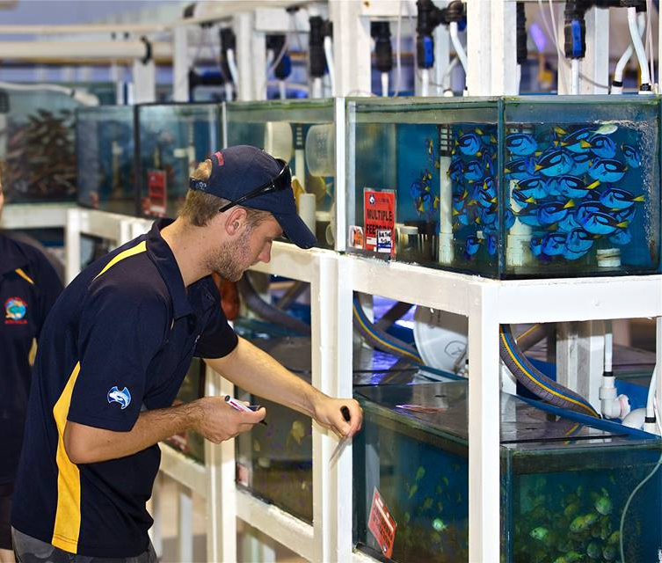
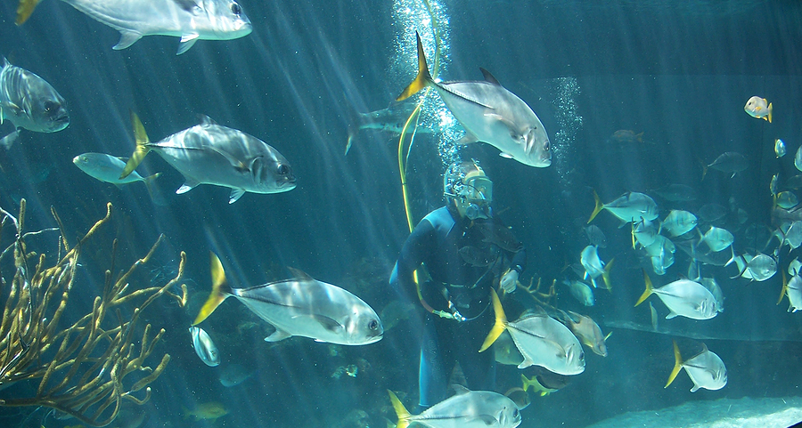
Aquarist
Enter your tanks and the measurements you need to take on them
Record Animal/Enclosure Feed Logs
Record tank maintenance

Slide 4
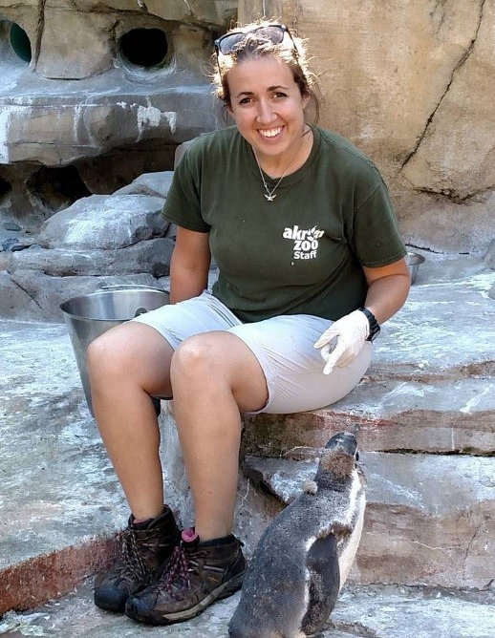
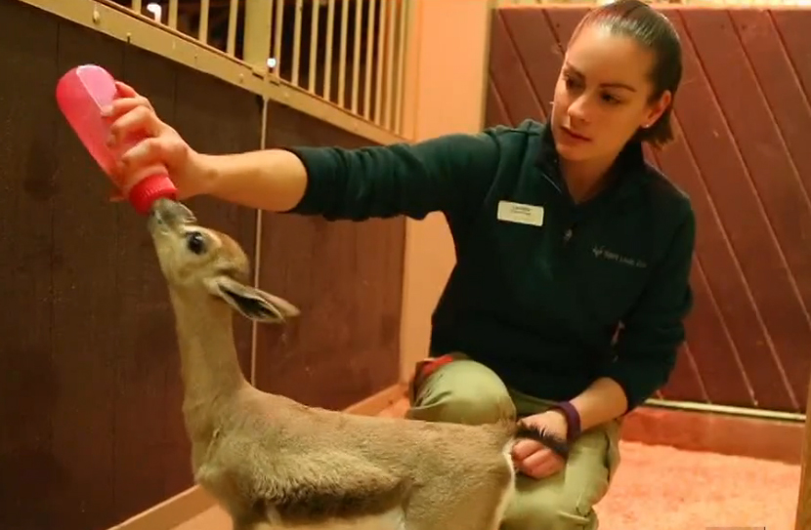
Keeper
Add Notes to your animals quickly
Use the Animal Checklist to make sure you check all animals daily
Record Feed Logs

Slide 5
Night Keeper
Use the Enclosure Checklist Item to make sure you don’t miss checking an exhibit or a lock

Slide 6
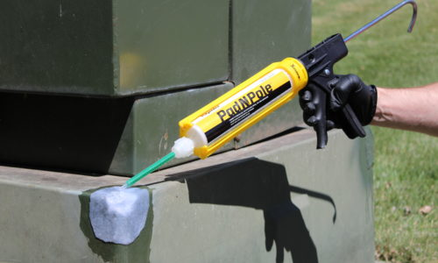
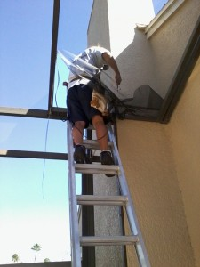
Curator
Keep up-to-date on exhibit maintenance

Slide 7
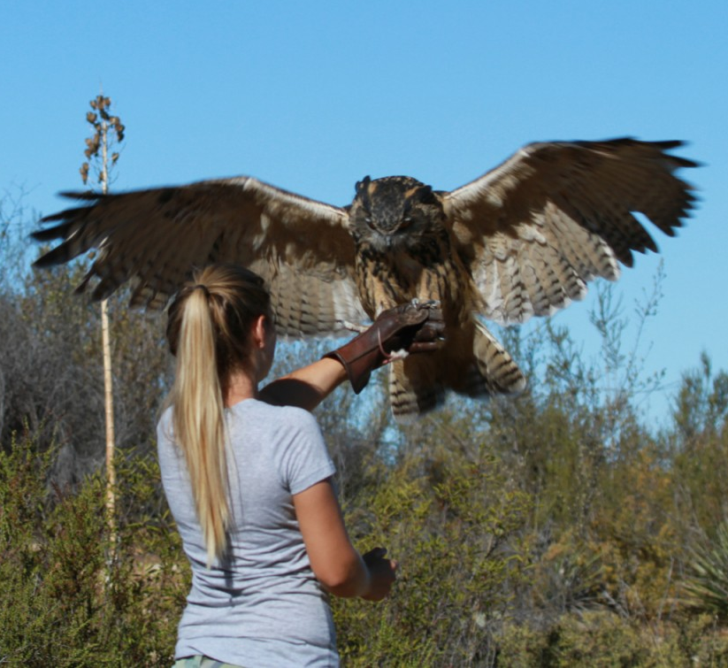
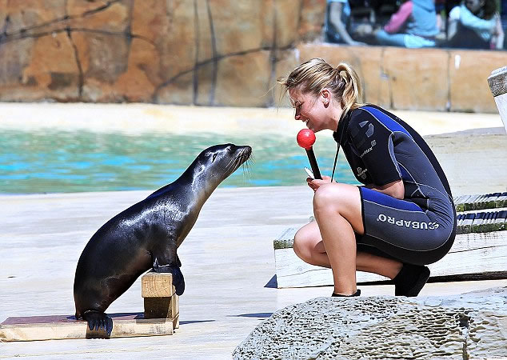
Animal Trainer
Capture each animal you are training and their behaviors

Slide 8
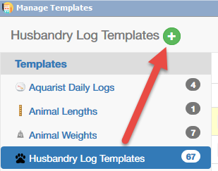
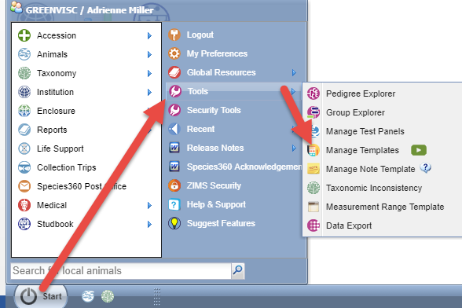
Creating a Template
Go to Start > Tools > Manage Templates
Select Husbandry Log Templates
Select the Add New icon

Slide 9
Organizing the Template
Templates can be organized however YOU want them to be
One suggestion is to have one sheet per animal/enclosure with all the tasks you want to record
Another way is organize by task with all the animals or enclosures you need to perform them on
We will be creating a HLT to record our penguin’s food consumption and information on their enclosures

Slide 10
Creating the Template
Name the Template so you can identify which one it is. The name must be unique (1)
Decide if you want the share the Template with others and if you want others to be able to edit it (2 & 3)
Name the sheet (4)
To add information select the Add New icon (5)

Slide 11
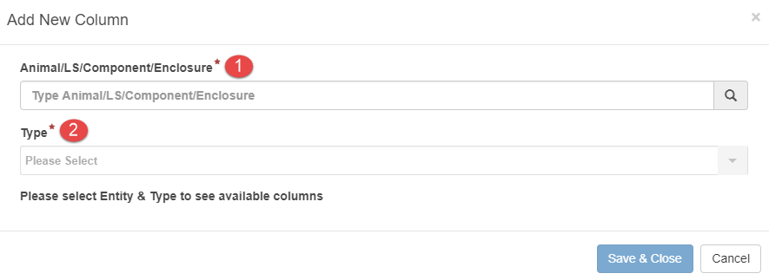
Creating the Template
What you select for the Entity (1) will drive what is available in the Type field (2)

Slide 12
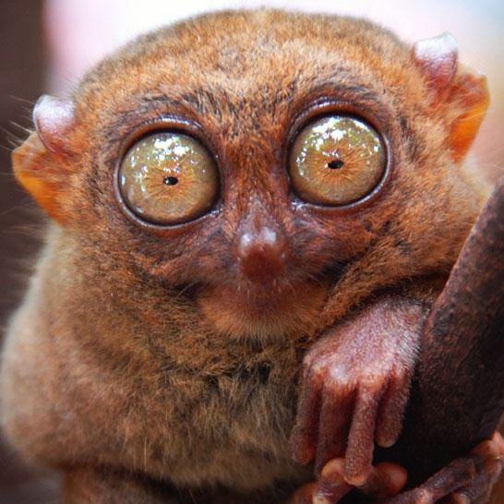
Finding the Entity
Type ahead lookup
What it looks for
Animals
Scientific name
Common name
GAN
Local ID
Preferred ID
Local search for currently held animals
Templates will not auto update for dispositions or deaths
Enclosures/Life Supports/Components
Name
Templates will not auto update Inactive enclosures

Slide 13
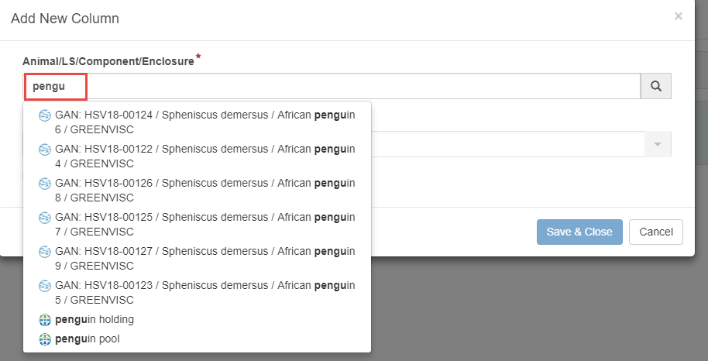
Finding the Entity
Start typing “pengu”
All the penguins as well as the penguin enclosures are found

Slide 14
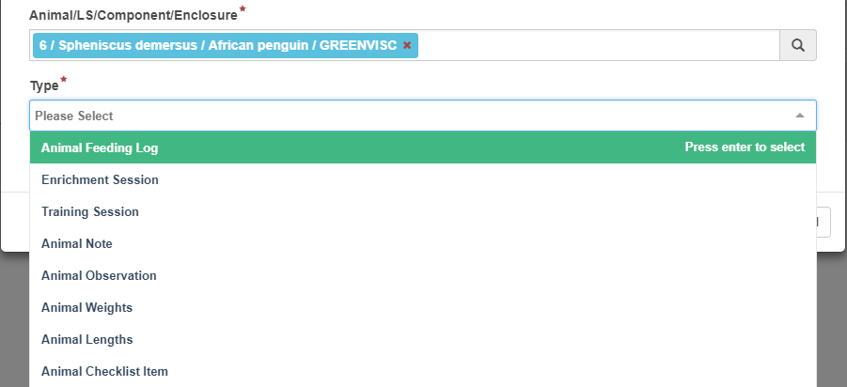
Entity Drives Type
A penguin was selected
Therefore the options under Type are all animal related
Animal Feeding Log selected

Slide 15
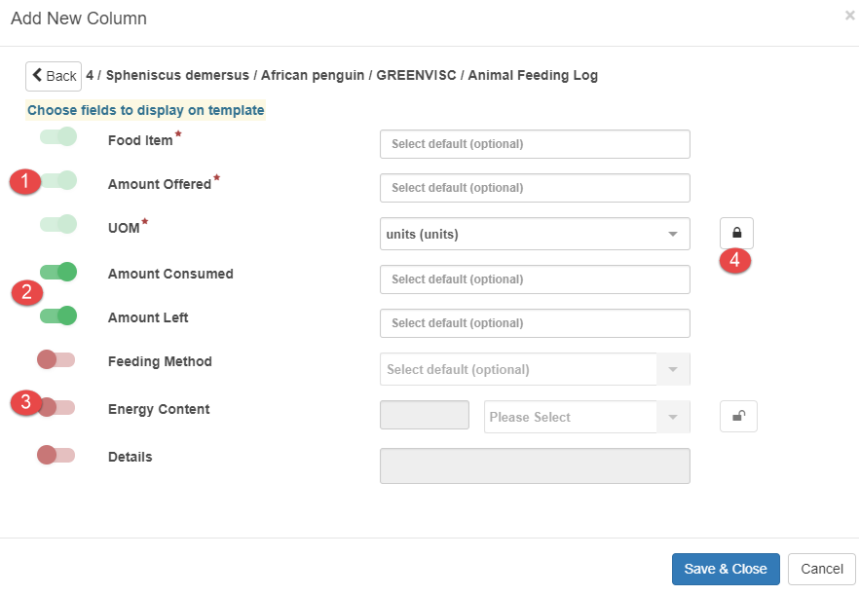
Selecting the fields
Any fields that are “on” (green slider) will display in the Template
Any mandatory fields are marked with a red asterisk and light green slide bar (1)
We turned on two additional fields by sliding the bar to the right (2)
We did not turn on the three remaining fields (3) so they will not be displayed in the template
We chose to “lock” the UOM (4). Once locked the field cannot be edited in the Template

Slide 16
Adding the Other Penguins
Continue on and add the remaining penguins and Animal Feeding Log by selecting the Add New icon
For each new penguin a column is added
Because we locked the UOM it displays by default

Slide 17
Some Hints
You can add multiple fields like Animal Feed Log, Notes and Weights
The columns will be added to the right in the order they are entered
If you want all of your tasks for an animal grouped together enter them before moving on to the next animal
If you want like tasks grouped with multiple animals enter it and all the animals before moving on to the next task

Slide 18
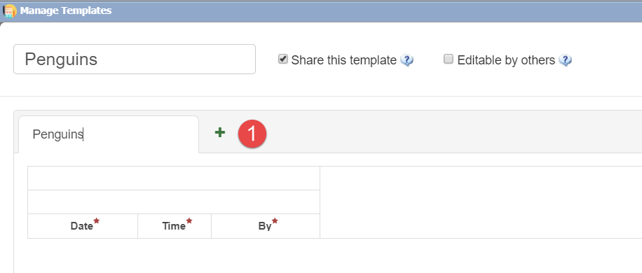
Adding a Second Sheet
To create a sheet for the enclosure information select the Add New icon to the right of Sheet 1

Slide 19
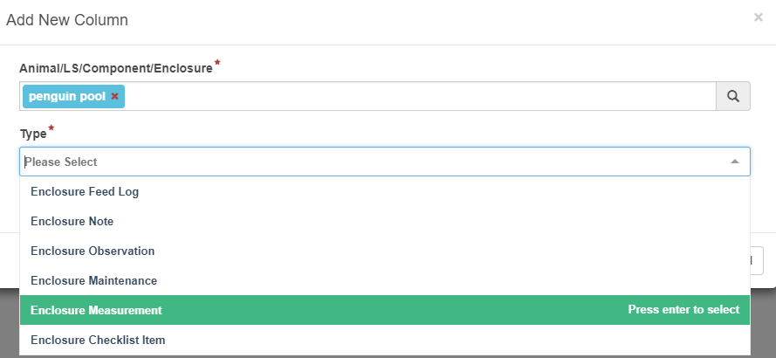
Select Enclosures
Because we selected an Enclosure as the Entity the Type options are enclosure related

Slide 20
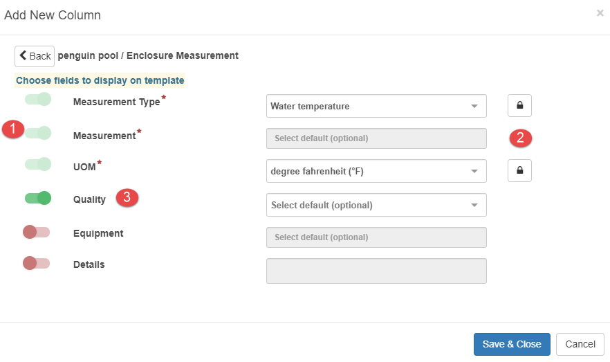
Select Fields to Display
We selected Enclosure Measurement
For the mandatory fields we selected Water Temperature and Degree Fahrenheit (1)
We also locked both of those fields (2)
In addition we added Quality as a field (3)

Slide 21
Enclosure Checklist Item
Because the pool needs to be checked daily for the proper level we added a checklist item for “Pool Level”

Slide 22
Locked Fields
Because we locked the Water Temperature and the degrees for the pool these display in the template grid (1)
For the Penguin Holding we did not lock the Measurement Type or the UOM (2 & 3). When we use the template they will default to what we entered but will be editable

Slide 23
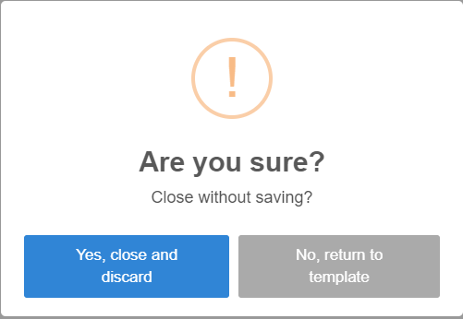
Save the Template
Once you are done remember to Save & Close the Template
If you select Cancel you will be asked if you really want to lose what you have entered

Slide 24
Manage Templates
Once you have created HLTs the number you have will display to the right (1)
You can use the Template by selecting the name hyperlink (2)
You can edit (3) and delete (4) the Template from here

Slide 25
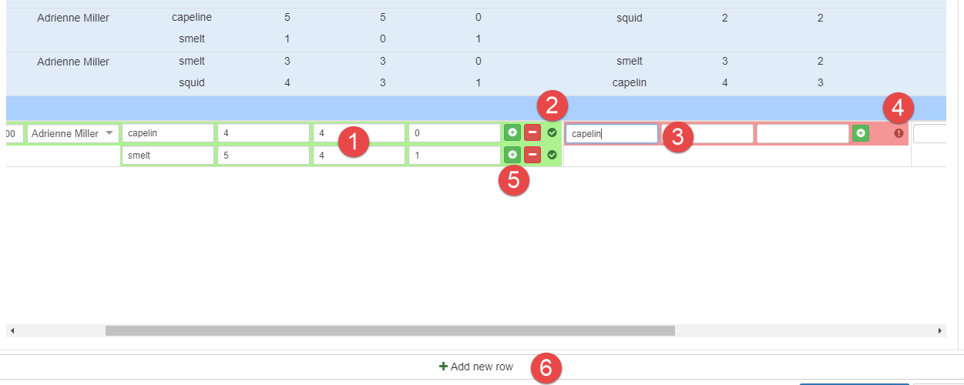
Using the Template
To use the template select the name hyperlink
Once all mandatory fields in a column are completed the column will turn green and will be saved (1) and a checkmark will display (2)
Columns without all mandatory field completed will be red (3) and an exclamation mark will display (4)
If you want to add a row for the single animal select the green “+” button (5)
If you want to add a row for the entire template select the “Add New Row” option (6)

Slide 26
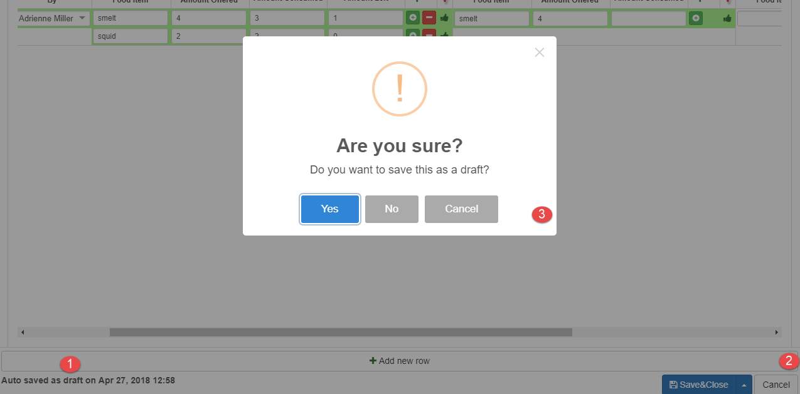
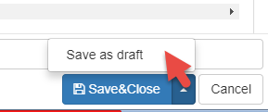
Saving a Draft
The Template data will continually be saved (1)
Because you will be taking your enclosure measurements later you want to save as a Draft
Select Cancel instead of Save (2 & 3)
Or you can select to save directly as a Draft using the Save as Draft option

Slide 27
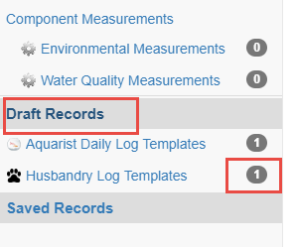
Finding Drafts
Your draft records will be found near the bottom of the Manage Templates grid

Slide 28
Complete Enclosure Info
Open the Draft and select Enclosure Info tab
Because we did not lock the measurement in the holding area we can add a new row and edit it to Humidity
If you have a Measurement Range Template for the enclosure and measurement recorded ZIMS will reference that and you will receive a warning and email if the measurements are out of range.
Select Save & Close to capture the data recorded in the Template into the actual records

Slide 29
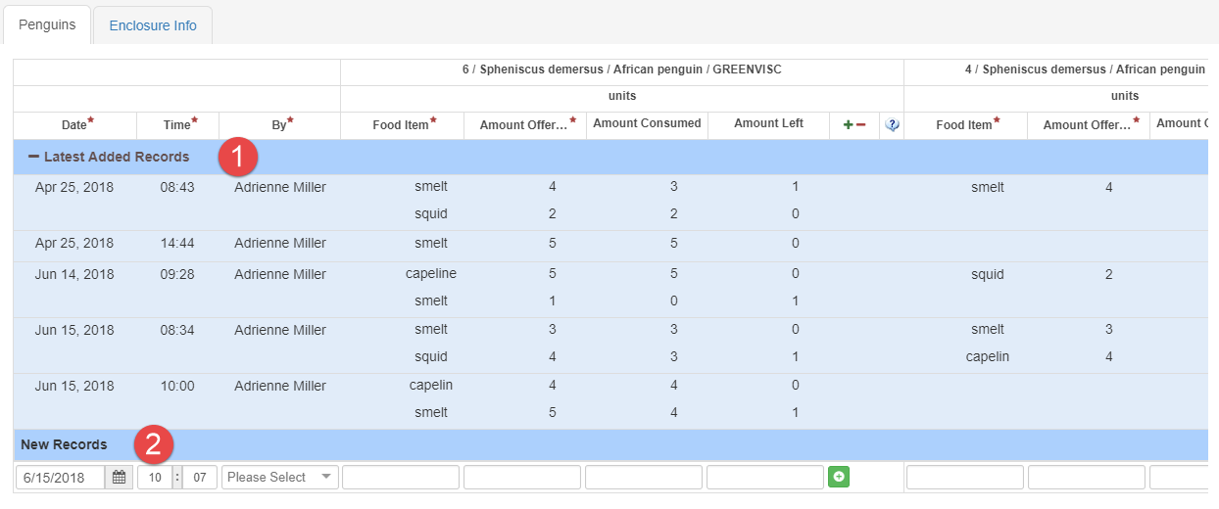
Latest Records
The next time you use the Template the last five records will display at the top (1)
To use the Template again start entering data under New Records (2)

Slide 30
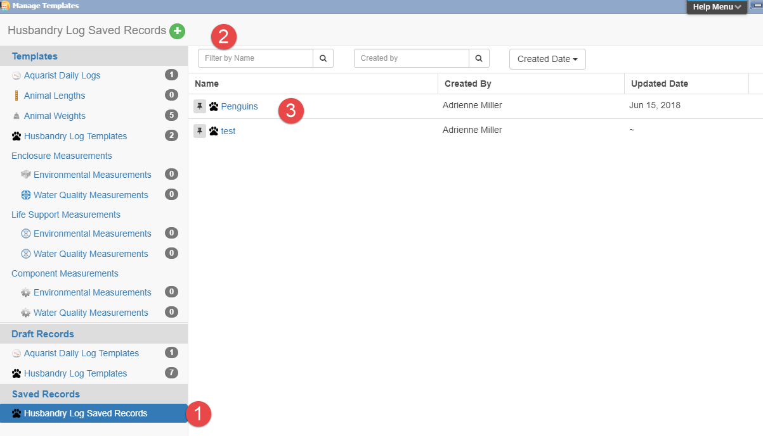
Saved Records
Saved Records are found in the Saved Records section
of the Manage Templates screen (1). If you have lots of
Templates you can shorten the list by filtering by Name,
Created By and Created Date (2). To view the Saved
Records select the Name hyperlink (3).

Slide 31
Saved Records
To view Saved Records:
Must be a template where records are entered
Date Range elected must have records recorded
Template must be shared if it is not yours

Slide 32
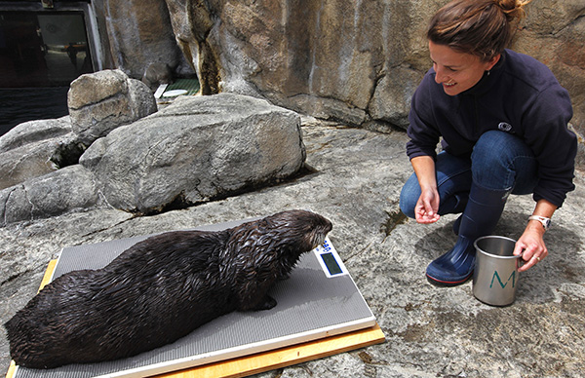
Otter Keeper
Sheet 1
Enclosure and Life Support measurements
Water Temperature
Flow Rate
pH
Filter Pressure
Enclosure maintenance
Cleaning
Window Washing
Checklist
Check Sump Level
Sheets 2-4
One sheet per otter
Feed Log
Enrichment
Training

Slide 33
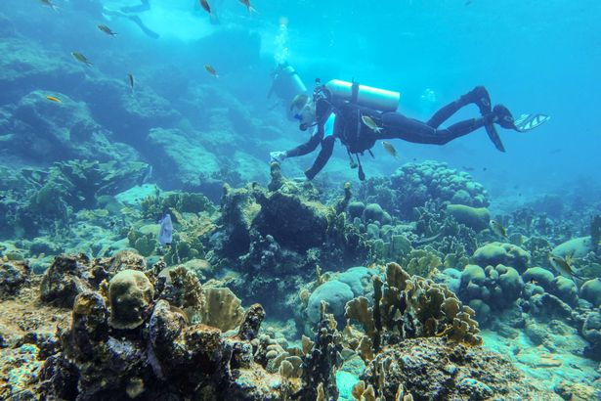
Ocean Tank
Sheet 1
Animal Feed Log for 3 sharks and 1 sea turtle
Enclosure Feed Log for general broadcasting
Sheet 2
System Measurements
Water Temperature
Flow Rate
Salinity
pH
Enclosure
ORP
Component
Filter Pressure
Sheet 3
Maintenance
Life Support
Backwash
Enclosure
Clean windows
Siphon Substrate

Slide 34
Night Checks
Sheet 1
Enclosure Checklist Items
Life Support Checklist Items
Sheet 2
Animal Checklist Items

Slide 35
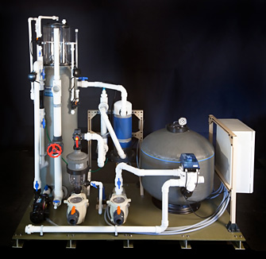
Life Support Staff
Ray Pool
Life Support
System Check? Checklist Item
Maintenance – Backwash Filter
Component
Measurements
Pressure
Flow Rate
ORP
Clean Protein Skimmer? Checklist Item

Slide 36
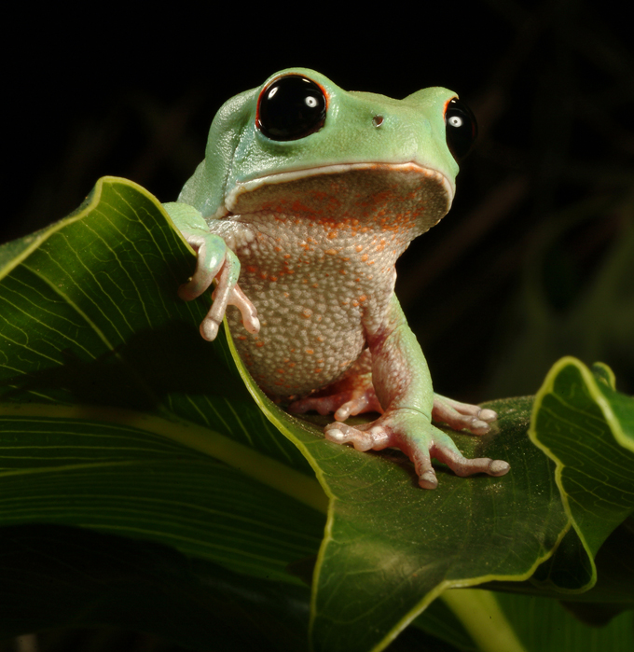
Frog Quarantine
Sheet 1 – Daily Schedule
Enclosure Maintenance
Fecal Collection? Checklist Item
Animal Feed Logs
Sheet 2 - Weekly Weigh In
Animal Weight
Animal Note

Slide 37
Any Questions?
On Husbandry Log Template

