Slide 1
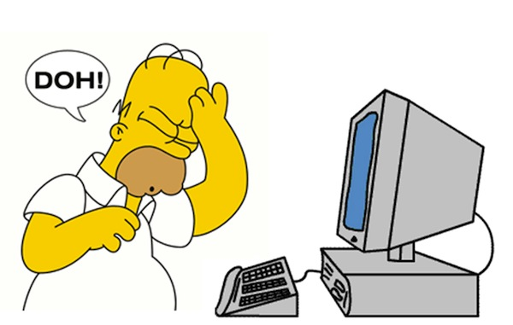
Oops! I Did it Again!
Tips and Tricks May 2018
Correcting data entry errors and editing data

Slide 2
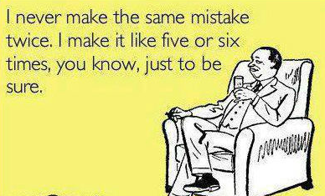
Mistakes Do Happen!
No matter how careful we are
we will make mistakes in our
data entry. Or, we may need
to add data that we did not
record at the appropriate
time or edit data that was
believed to be correct at the
time it was recorded. But
hopefully we won’t make the
same mistakes over and over
just to be sure.

Slide 3
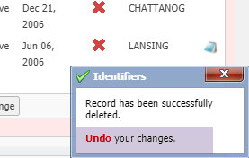
Immediate Correction – 10 Second Undo!
The first chance is to correct
your data immediately! With
most data entry screens you
have 10 seconds to Undo an
entry that you realize was
incorrect the second you hit
the Save button. Selecting
Undo will take you back to
the Details or More Details
tab, whichever you were
working in.

Slide 4
Immediate Corrections – Transactions
The Accession Transactions do not have this Undo popup. Instead, once you Save
you have the option to Undo Accession Transaction (above). Selecting this will take you
back to the Accession screen to correct or close. Dispositions do not have this Undo
Option. If you recognize you made a mistake highlight the Disposition and select Delete.

Slide 5
Data Entry Monitoring
Performing any of these options (Undo from pop-up, Undo Accession or Delete
Disposition) will display in Data Entry Monitoring as Rolled Back Transactions.
Data Entry Monitoring is find under Start > Security Tools > Data Entry Monitoring.

Slide 6
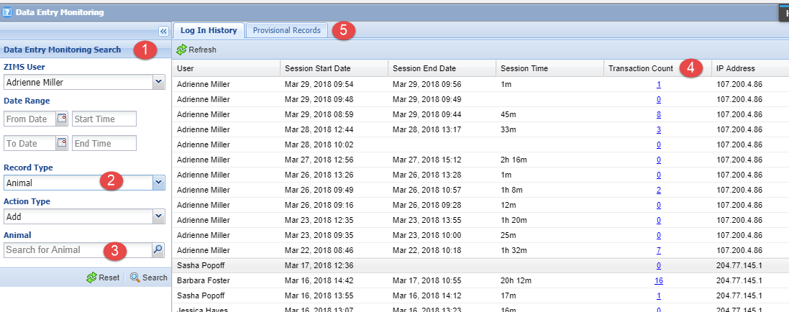
Data Entry Monitoring
Data Entry Monitoring will display the past 3 months of data entry. To find entries
by a specific User, Date Range or Record or Action Type use the filters in the left hand
search box (1). What is selected in the Record Type (2) will drive the last filter box (3).
The Transaction Count (4) will bring up a list of the records meeting any of your
selected filters. If you have Provisional data entry activated, the Provisional Records
tab (5) is where you would go to Approve or Reject those records.

Slide 7
Data Entry Monitoring
To Roll Back a piece of data entry, highlight the desired line in the grid and
select Undo Selected. It will then display as Rolled Back in the right hand
column with the date, time and User who rolled it back. IMPORTANT!
You CANNOT Undo a rolled back record! So if you make a mistake in
correcting a mistake you will need to re-enter the data. Hopefully correctly
this time.

Slide 8
DEM and Bad Batch Entry
DEM is especially helpful should you create an incorrect batch entry. Above we recorded moving eight ducks into a new enclosure only to discover later that we had used the incorrect Animal List. Instead of having to go into each record and correct, you can Roll Back the enclosure move for all the records with two mouse clicks.

Slide 9
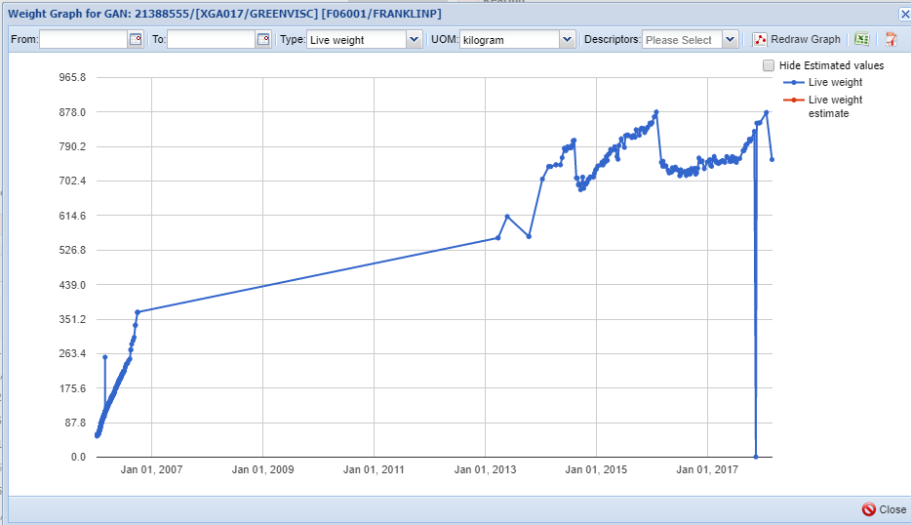
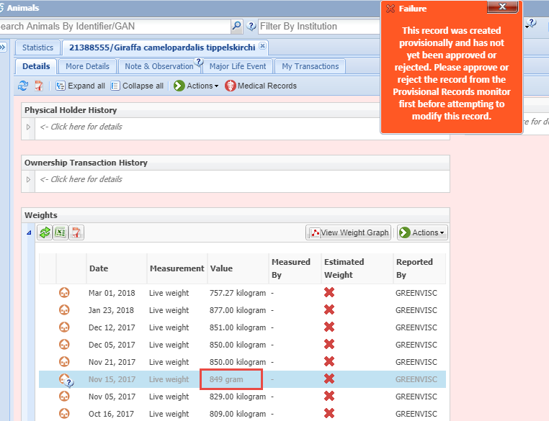
Editing Provisional Data
You run a weight graph on one
of your giraffes and spot an
obviously incorrect weight. You
check the record and find an
incorrect Unit of Measure was
recorded. You try to edit the
record but get a warning that it
is a Provisional entry! You can
either use DEM to Accept the entry
and then edit it yourself, or Reject
and ask the User with Provisional
rights to correct it. And remind
yourself to stay up-to-date on the
Provisional entries in DEM.

Slide 10
Oops! We didn’t pay our bill!
This is a major Oops! But easy to
fix. First you should check that
you have the correct person
assigned as your Invoice Recipient.
To find who is assigned open the
Search Form in the Staff grid and
type Invoice in the Search Job Type
Field. You find that Daffy Duck has
this Job Type assignment
(probably not a good idea) AND
Daffy has never confirmed his
Email address so he probably
never got the communication
from Species360 regarding the
invoice. Assign the correct User
and make sure they confirm their
Email. ZIMS also tried to give you a
warning about Daffy so remember
to read any popups!

Slide 11
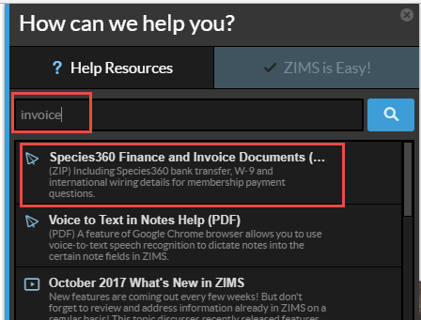
Oops! We didn’t pay our bill!
Then go to the Help Menu and type in
Invoice. Species360 Finance and Invoice
Documents will display. Three
documents are found here:
Bank Letter for International Wires
Species360 W-9
Wire Transfer Instructions
These documents should be what you
need to pay your bill.

Slide 12
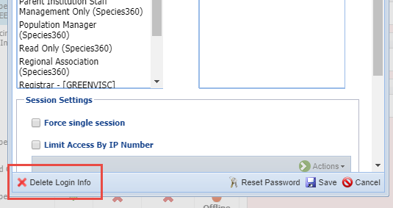
You Need to Reuse a User Name or Email
This can easily be done by going to View/
Edit ZIMS Login Details. In the lower left
select Delete Login Info. You will receive a
message that the User will no longer be able
to log into ZIMS. You will also get a message
asking if you want to mark that Staff as
Obsolete if you have not already done so.
This frees up both the email and the User
Name for re-use.

Slide 13
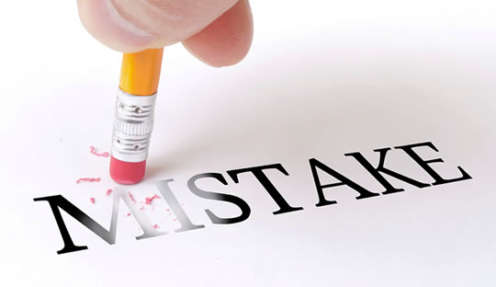
Who and Where?
Regarding correcting ZIMS data you need to know
two things. First is who entered the data? If your
institution recorded it you should be able to
correct it. If another facility recorded it then you
cannot edit it. On many screens you can create your
own version of the data that will display locally. This
will create a conflict and display in red. Second, you
need to know where to go to edit it.

Slide 14
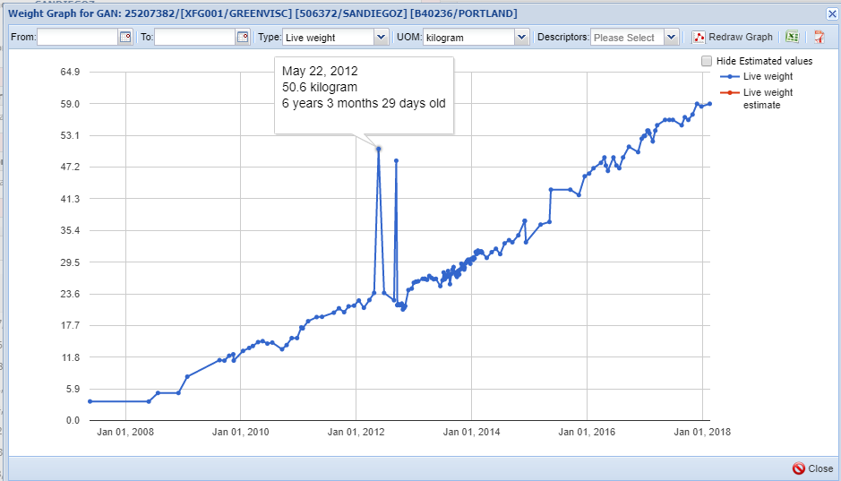
Measurement Graphs - Animals
Every once in a while when recording
animal measurements it is recommended
that you view the measurement graphs
to help you catch any Unit of Measure
errors. We caught one in our giraffe
mentioned earlier. This orangutan showed
typical weight gain as he matured except
for a couple questionable weights. Hovering
over the point on the graph showed these
weights were recorded in kilograms
whereas the rest of the weights were
recorded in pounds.

Slide 15
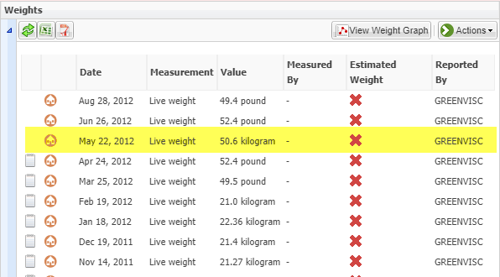
Measurements - Animals
Using the dates displayed in the hover over
you find the questionable weights in the grid.
If you are the recorder of the data, in this case
GREENVISC, you can simply edit the UOM. If
you are NOT the recorder of the data you will
need to contact whatever institution was to
get this corrected.

Slide 16
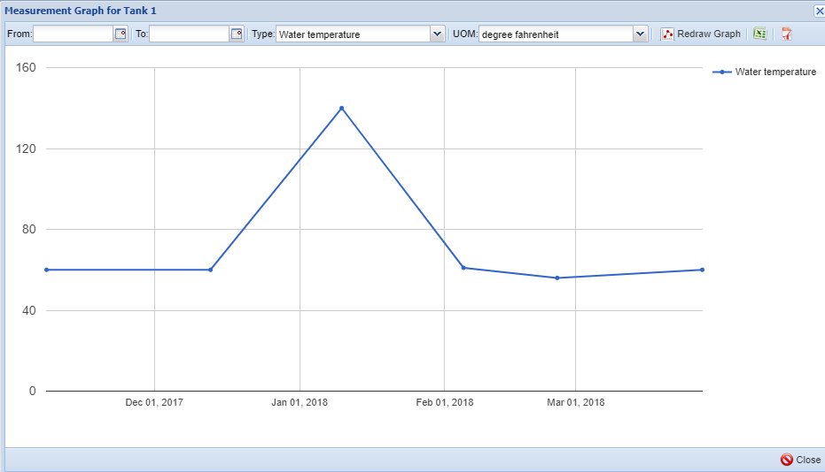
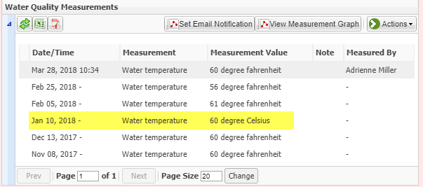
Measurement Graphs – Enclosures
Just as for animal measurements, enclosure measurements can be graphed and these graphs should be reviewed from time to time. This tank has had stable water temps
except for one recording. Looking at the grid shows that was also a UOM error and can easily be corrected. This type of error can easily be prevented by ……………

Slide 17
Templates Save the Day!!!
Create Measurement Range Templates
These templates allow you to assign Min and Max measurements to your Enclosures and Life Supports
If you record an incorrect UOM you will receive a warning because it will probably be outside of your desired range
Start > Tools > Measurement Range Template
Create Batch Templates
These templates allow you to quickly record specific measurements on specified enclosures/tanks using a grid
When you create a batch template you record the desired default UOM
Because it defaults you will be unlikely to record a UOM in error
Start > Tools > Manage Templates

Slide 18
Editing Birth/Hatch Date
I received an animal from a non-ZIMS Institution but I recorded the Hatch
date incorrectly. I cannot change it from My Transactions even though I
recorded it during the accession! This is because the Birth/Hatch dates are
only stored with the accessions for an initial transaction of Birth or Hatch.
For all other transactions you will need to go to More Details > Event
Locations. If you recorded the data you can change it here. If you try to change the Birth/Hatch date under Event Locations for a Birth/Hatch you will be redirected back to the My Transaction screen.

Slide 19
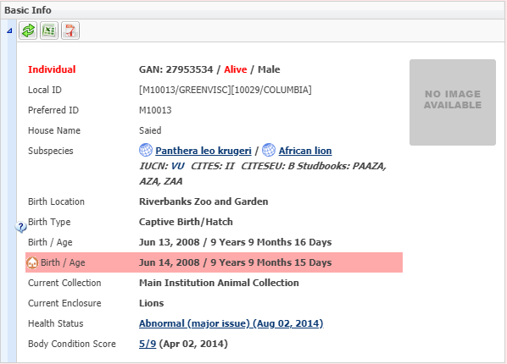
Birth Date Conflicts
I can’t get rid of the annoying red conflict
for Birth/Age in my record! This is also
handled by going to Event Locations. In the
software that proceeded ZIMS (ARKS)
you had to re-enter a Birth/Hatch date
during an accession. If you entered it
incorrectly it created a conflict in ZIMS.
You can correct this from Event Locations
either by editing your data to match (only
if you believe the other date is correct!)
or by simply deleting your record.

Slide 20
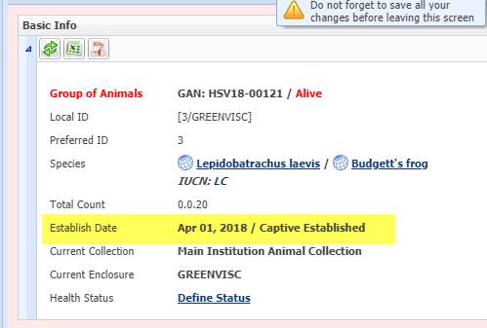
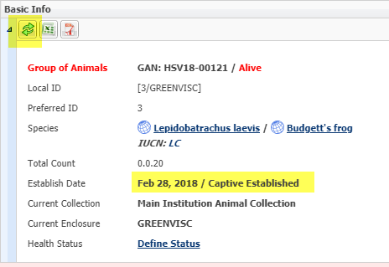
Editing Group Established Date
You recorded the incorrect Establish Date for a group! And going back in to My Transactions
doesn’t offer the option to correct it there. Event Locations is also where you would go to
correct this. Select View/Edit from the Actions button and correct the date as needed. After
you Save remember to Refresh the Basic Info to have the correct date display.

Slide 21
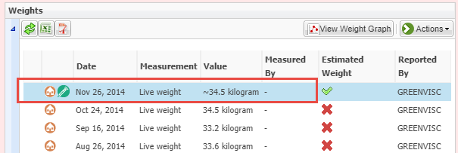
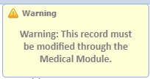
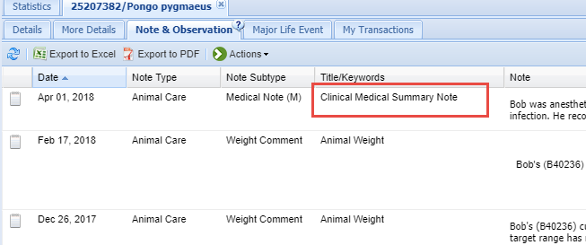
Editing Data Entered in Medical
In short, you cannot. If something
was entered in the Medical module
and came over into the Husbandry
module, that data MUST be edited
from the Medical entry. For weights
there is an icon that displays to let
you know right away that you cannot
edit from Husbandry. For Notes the
Title is Clinical Medical Summary Note
and there is no other indication that
it cannot be edited from Husbandry
other than no Edit option once you
select to View/Edit the Note.

Slide 22
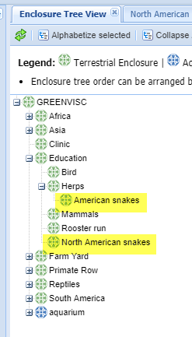
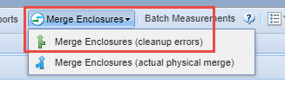
Merging Duplicate Enclosures
You have several Users with the access to
create new enclosures and move animals.
You discover that two enclosures were
created for the same exhibit. At the top of
the Enclosure module select Merge
Enclosures > Merge Enclosures (cleanup
Errors).

Slide 23
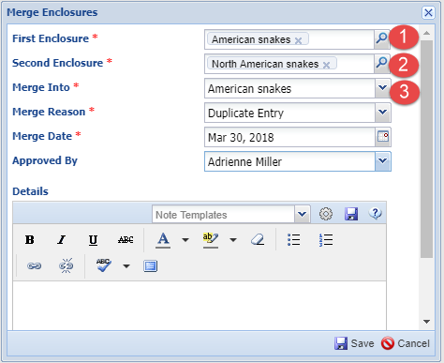
Merging Duplicate Enclosures
The order that you record the
first and second enclosures
(1 and 2) doesn’t matter. What
does matter is what you select
for the Merge Into enclosure (3)
as this is the enclosure that will
remain. The other one will
disappear. In this example all
references in enclosure moves
for North American Snakes will
be replaced with American snakes.
An automatic Note regarding this
change will be added to the
enclosure move in the animal record.

Slide 24
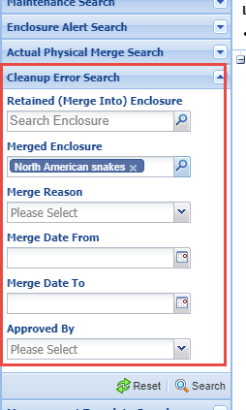
Merging Duplicate Enclosures
You will be asked if you want the notes from the
merged enclosure included in the retained
enclosure. This includes information such as
maintenance and measurements in addition to
notes. You can search for either the merged
enclosure or the retained enclosure using the
Cleanup Error Search in the expandable
enclosure search box.

Slide 25
Add/Edit Nest ID
You added a Nest ID during your accession but you recorded the wrong one.
Going back into My Transactions to correct you can find no Nest ID field to edit!
Nest ID is actually stored in with the Parents. If you recorded one it will display
here and it can be edited under the Actions menu. If you did not record one
but want to you can add it here.

Slide 26
Oops! You Found Duplicate Animals!
Creating a new accession instead of accepting a Pending
Accessioning an animal from a non-ZIMS institution that had previously been at a ZIMS facility
Two Users accessioning the same animal at the same institution
An institution not accessioning the entity as sent (ie group was sent but receiver accessioned as individuals and vice versa)

Slide 27
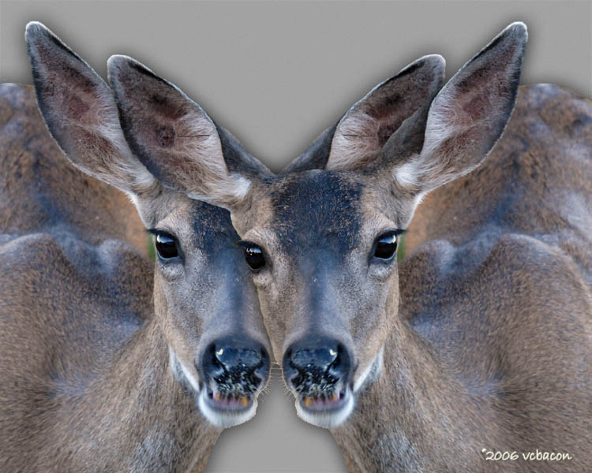
Requesting an Animal Merge
Criteria is a match in both records for:
Taxonomy
Date of Birth
Gender
Birth Location
At least one of:
House Name
Studbook Number
Transponder
If all match can be merged without approval of other institution
If all don’t match then approval must be obtained
Send request to support@Species360.org, provide both GANs

Slide 28
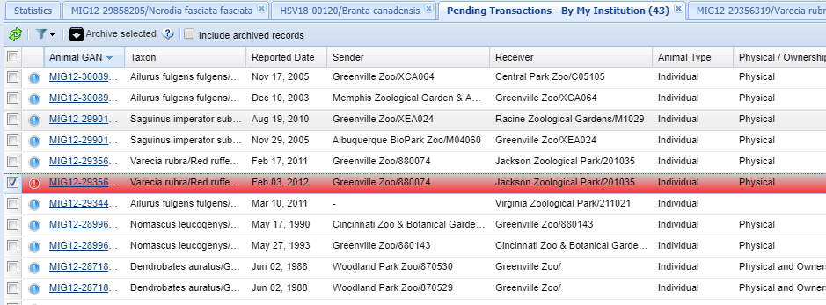
I Have a Pending in Red!
Pendings in red mean that the other institution has selected Deny for a
transaction that you recorded with them. How you fix these will depend
on why they may have denied it.

Slide 29
Denied Transactions
The easiest ones to fix are those where you realize you either recorded sending the
wrong animal or sent the right animal to the wrong place. You will simply edit your
My Transactions stream to reflect what was correct. Here we opened the record and
saw in the hover over that it was Denied by JACKSON. Looking in the details, you
recorded sending the animal twice, on two different dates but with the same terms.
To correct this delete that last transaction from your records.

Slide 30
Changing Your Records
Reasons you may need to edit:
Settle a discrepancy between institutions ONLY IF YOU AGREE!
User Error – you (or someone else at your facility) entered it incorrectly in the first place
New information is available that makes the original entry incorrect
Notes:
ADRIENNE
One aspect of Best Practices is when to change your records, and when not to. And the procedures taken for changing them should you decide to. In ZIMS any data that was recorded by your institution should be editable by your institution by staff who have the access to do so. You cannot edit information that was entered by another institution.
>There are several reason that you may want to edit your records – 1)to settle a discrepancy but ONLY if you agree, 2)the data was entered incorrectly in the initial entry and 3) new information has come to light.
Can you think of any other reasons you would change your records?
>If you do decide to change a record you should document the change. We recommend using a Keyword of DATA CHANGE using the appropriate note type.

Slide 31
Document Why
Select the most appropriate Note Type
Use DATA CHANGE as Keyword, or
Select General Note Type
Select Data Change Note Sub-type
The Note should include
what the information was prior to the change
what the information was changed to
the date the change was made
who made the change
the reason for the change, including the source of the information

Slide 32
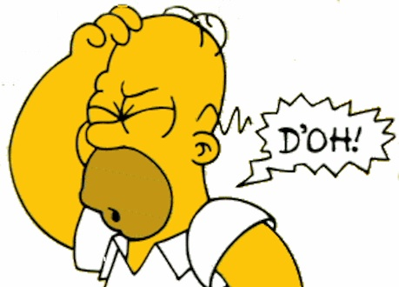
Any Questions?
On Oops! I Did it Again!

