Slide 1
The Best of 2017!
An overview of what was new in ZIMS in 2017

Slide 2
It was a very good year
2017.
It was a very good year.
It was a very good year for ZIMS studbooks and medical things.
And lots of aquatic stuff. The best year we’ve seen.
2017.

Slide 3
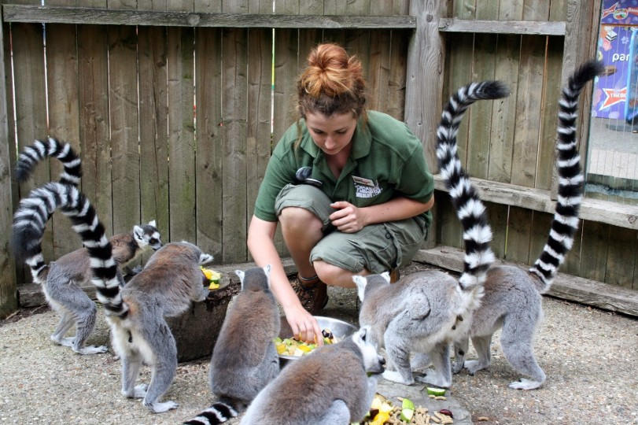
Husbandry/Animal Management

Slide 4
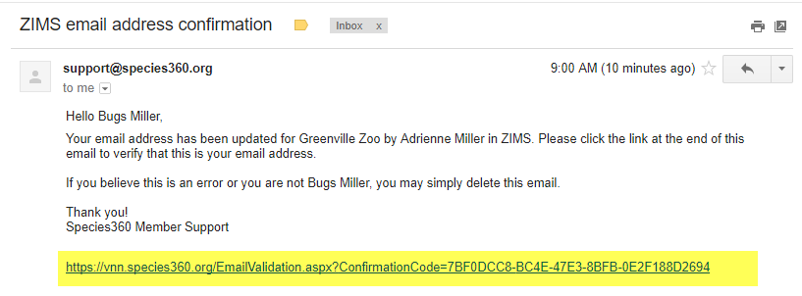
Email validation
Staff members who have access to
ZIMS are required to have valid email addresses. This is a standard security measure used by most on-line systems. It ensures that the address was typed correctly,
sends the out-of-range measurement notifications to a real address and makes sure that you are receiving emails that
are relevant to your responsibilities.

Slide 5
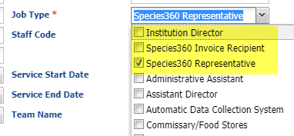
Job Type Mandatory
We have made Job Type a
mandatory field when adding
a Staff member. Each facility is
required to identify an Institution
Director, a Species360 Invoice
Recipient and a Species360
Representative. This ensures that
communication from Species360
will get to the correct people. These
required Job Types are at the top
of the list. Institution Director is who is
in charge of your entire facility. They will
receive communications only at the
highest level such as notification of any
changes in membership or Board
decisions.

Slide 6
Improved performance speed
Although this functionality
cannot be captured in a screen
shot to show, 2017 included
greatly improving ZIMS
performance speed when
loading record lists, detail
screens and many other screens.
We know that your time is
very valuable and we are trying
to make sure that ZIMS moves
as fast as it can.

Slide 7
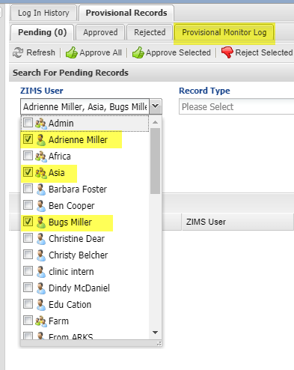
Filter Provisional Data
One of the last improvements in
2017 was providing the ability to
filter the Provisional Data Monitor
Log by Teams, Departments and
multiple individuals. This is a great
time saver since you do not have
to perform multiple searches to
find the Provisional Data entries
that you are looking for.

Slide 8
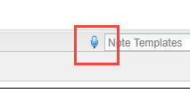
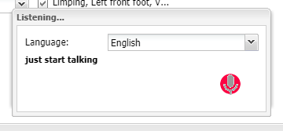
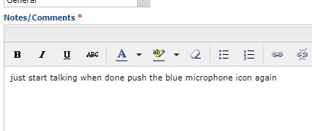
Voice Recognition
Any field that displays the blue
microphone icon has voice recognition
functionality. This functionality is available
only in Chrome. To activate it click on
the microphone. You will need to select
your language and just start talking.
The text will display in the box and then
be copied into ZIMS. As long as the red
microphone is pulsating ZIMS is
recording your speech. To stop voice
recognition select the blue microphone
again. Always remember to read what
ZIMS types!

Slide 9
Available in these screens
Medical
Clinical Notes
Animal Care Staff Medical Summary
Necropsy Report/Description
Necropsy Case Info for Husbandry Staff
Biopsy Case Info
Biopsy preliminary exam
Animal
Training Definition
Training Session Details
Feed Log Details
Enrichment Item Caveats
Enrichment Item Details
Enrichment Session Details
Note & Observation
Enclosure
Maintenance Note
Maintenance Request Details
Feed Log Details
Measurement Action Taken Details
Enclosure Treatment Notes
Note & Observation
Life Support
Note & Observation
Maintenance Note
Measurement Action Taken Details
Component
Note & Observation
Measurement Action Taken Details
Maintenance Note

Slide 10
A LOT of Bug Fixes!
The ZIMS developers
put the fear into bugs
in 2017 and were able
to fix a lot of them.

Slide 11
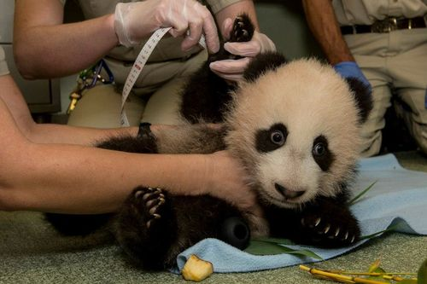
Medical

Slide 12
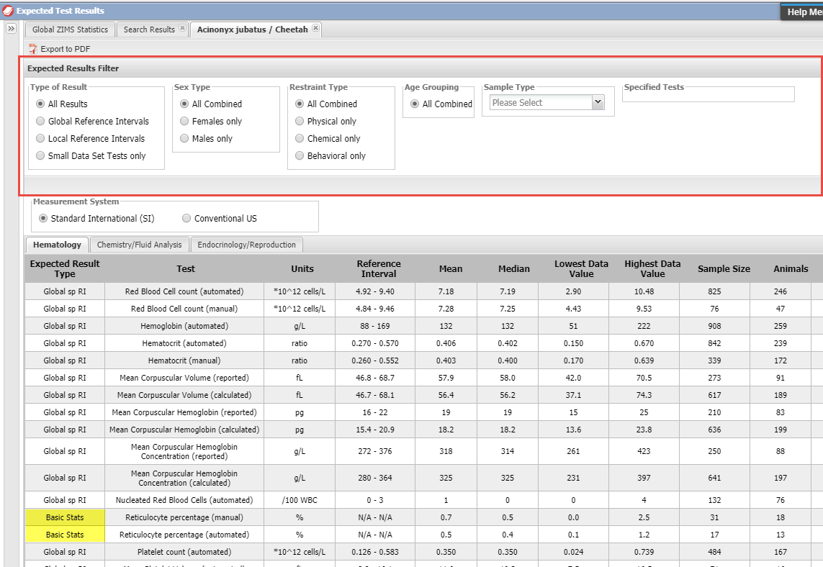
Expected Test Results
The Physiological References were
replaced with Expected Test Results.
Basic Stats display results with 15 – 39
sample size. Global sp RI have more
than 40 in the sample size. The Test
Results have multiple filters to help you
fine tune your results grid to display
specifically what you need. These
results are based on healthy animals.

Slide 13
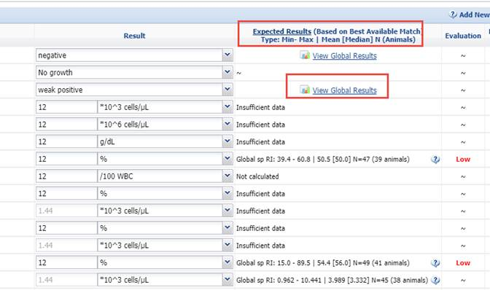
Updates to test and result data entry screens
From within the animal medical
record for Tests & Results, there
are direct links to the Expected
Test Results. In addition the
expected results (for healthy
animals) is displayed.

Slide 14
Health Status/Clinical Diagnosis
We have added a warning if the animal’s Health Status is contradicted by an active medical problem. As mentioned, the Expected Test Results are driven only from those results on healthy animals. If the Health Status doesn’t match the medical status of the animal then these results are compromised.

Slide 15
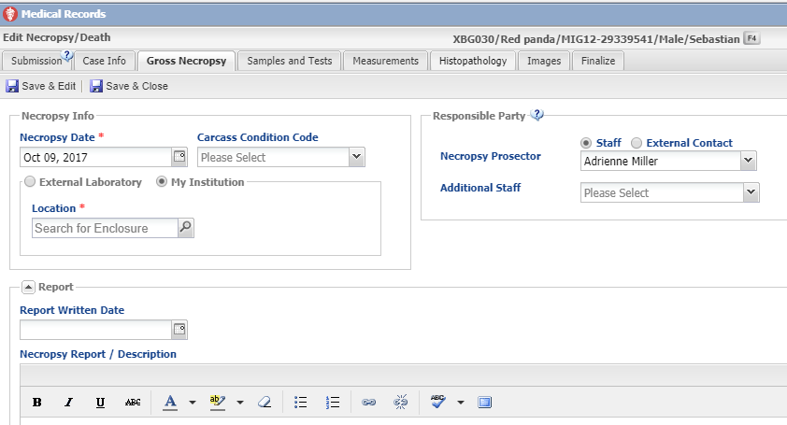
Necropsy record lock
If several people have access to recording/
editing necropsy records, once one of them
has opened the necropsy record it is locked
from other users trying to edit at the same
time. This assures that data doesn’t get lost
during the Save process.

Slide 16
One weight per day
In some of the medical modules, such as Anesthesia and Prescriptions, you can enter multiple animal weights on the same day. Now only one weight per day will display in the Husbandry module weight grid even if
multiple weights are recorded in the Medical module. If you want weights from the Medical module to display in the Husbandry module make sure
that it is checked “On” under Institution Preferences > ZIMS Accessibility.

Slide 17
Aquatics

Slide 18
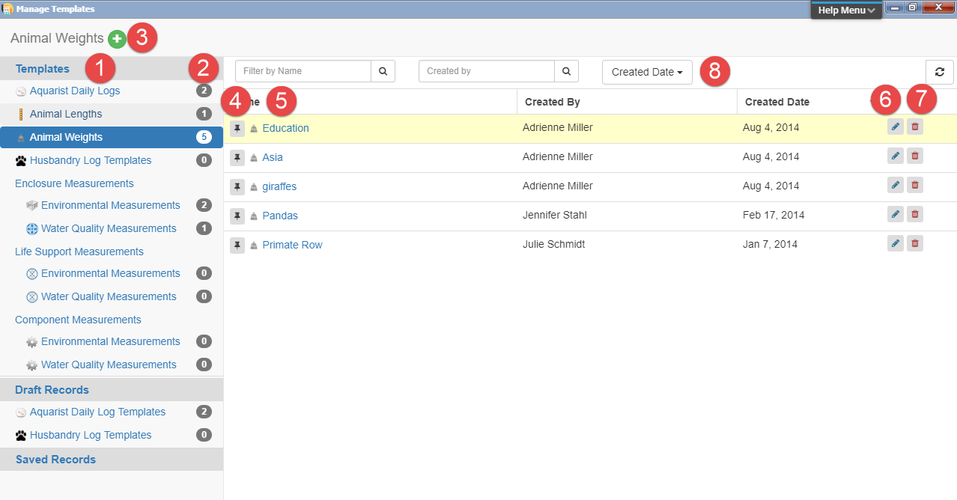
Manage Templates
All your templates (except for Note and Measurement
Range templates) are managed from one screen now.
1.List of all your templates
2.Number of templates of that Type
3.Add New template for highlighted Type
4.Pin the template to the top of the list
5.Hyperlink into the template
6.Edit the template
7.Delete the template
8.Filters to search for a template

Slide 19
Animal Feed Log
The Feed Log is now a grid where you can record feeding multiple different
types of food. The grid line will remain red until you have recorded data in
all the mandatory fields (as top screen). The line will turn green once all
the mandatory fields are completed (bottom screen). Only those lines that
are green will be saved.

Slide 20
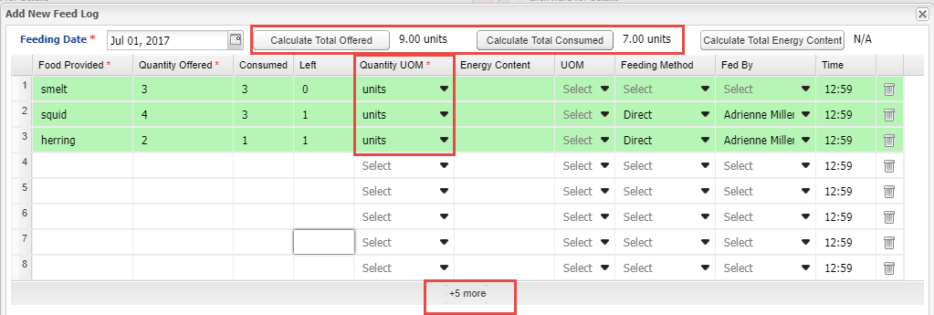
Calculations
If the Units of Measure are the same you can Calculate the Total Offered as well
as the Total Consumed. If you know the Energy Content you can record that and
calculate Total Energy Content also if the Units of Measure are the same. If you
need additional lines to add food items select the “+5 more” to add five lines to
your grid.

Slide 21
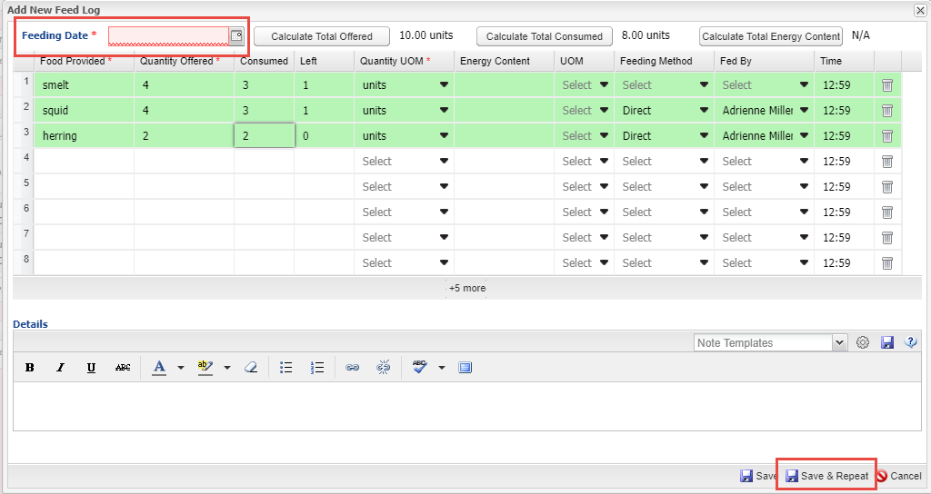
Save & Repeat
If you are entering multiple days worth of Feed Logs you can select the
Save & Repeat option. You will be required to enter a new date. You can
keep the data as recorded in the original entry or edit, add or delete as
appropriate.

Slide 22
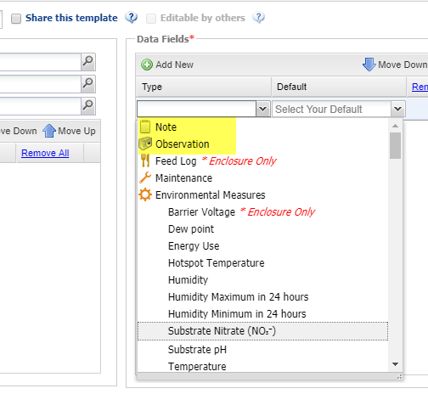
Additions to Aquarist Daily Log
The ability to add Notes and Observations to the selected Data Fields was added to the
Aquarist Daily Log.

Slide 23
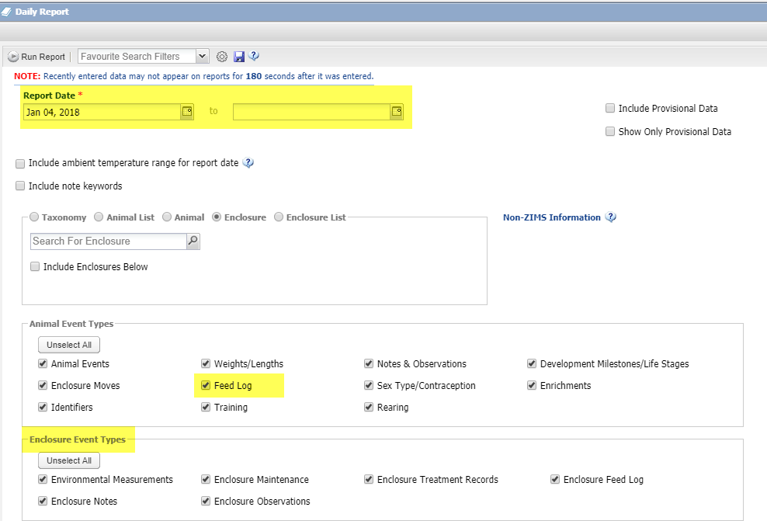
Changes/Additions to Daily Report
The Daily Report was made much
more robust with the addition of
the option for a Date Range. The
new Animal Feed Log grid displays
and several Enclosure Event Types
were added when an Enclosure or
Enclosure List is selected. We also
clarified the rules around what should
display. For example, if you run by
enclosure but select animal records,
you'll also see occupant records
related to the event types you selected.

Slide 24
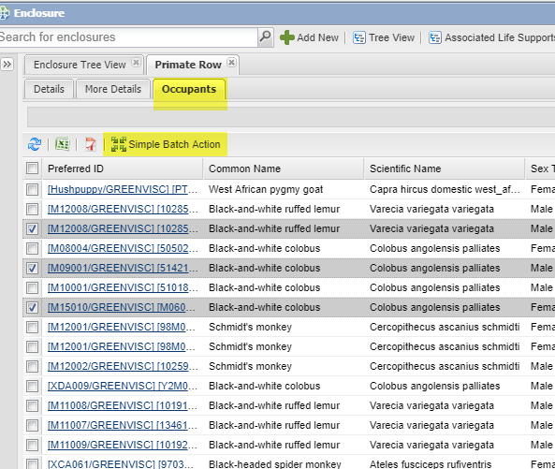
Enclosure Occupants Batch Actions
The ability to perform Simple
Batch Actions from the
Occupants tab in enclosure records
was added. This is a real time saver
because the Animal Lists you
create are static but enclosure
occupants are often fluid. Using
the Date Range you can find historical
records for the enclosure to perform
a Batch Action on.

Slide 25
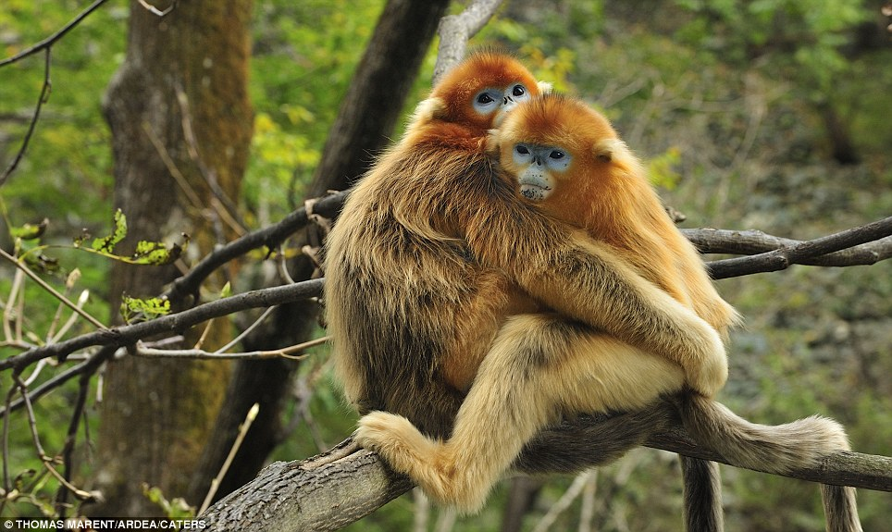
Studbooks

Slide 26
The Entire Module!!!
This entire module was new in 2017. Since it went live in the spring
138 studbooks were migrated into ZIMS in 2017! ZIMS for Studbooks
has some functionality that the legacy studbook applications
(SPARKS and Poplink) do not. Such as…………….

Slide 27
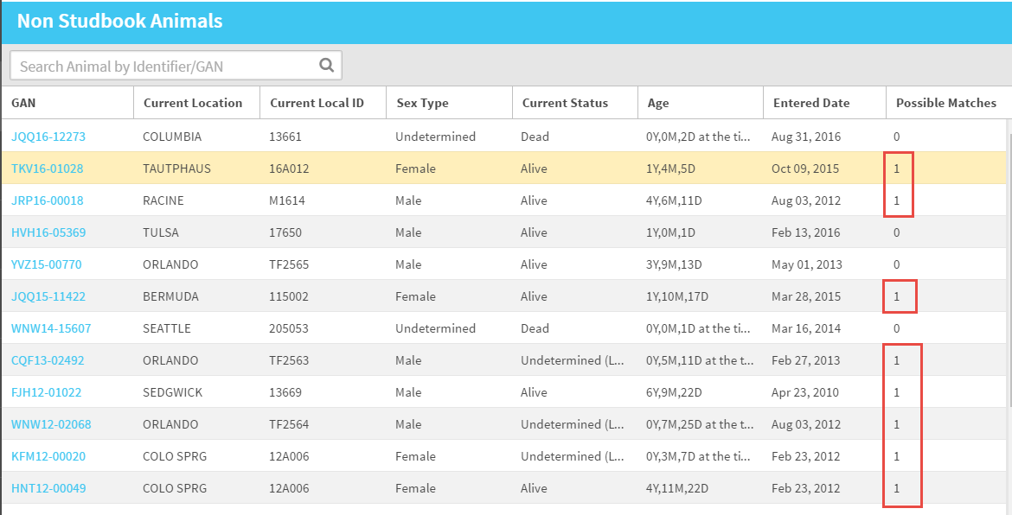
List of Suggested Animals
Suggested Animals displays a list of animals that are entered in ZIMS but have not yet been accepted into your Studbook. ZIMS will indicate if it finds any possible matches that are already in your studbook.

Slide 28
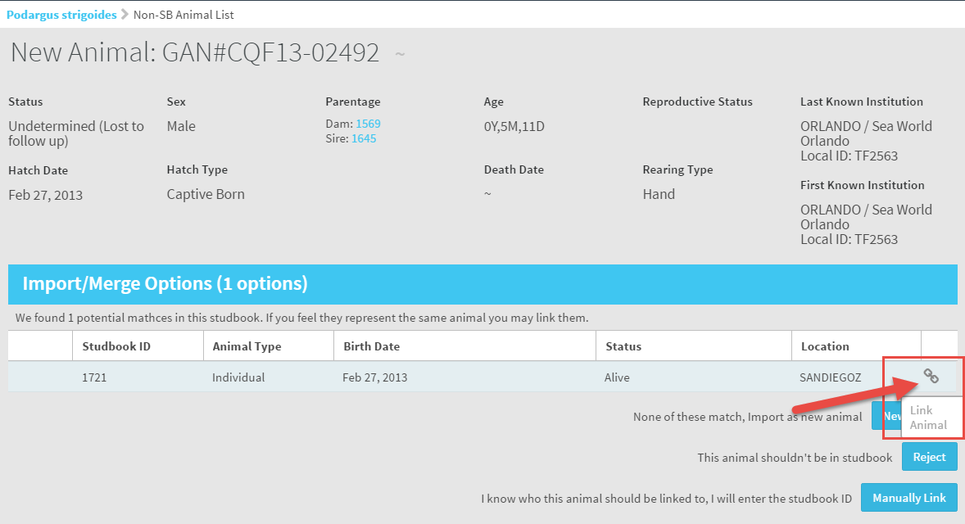
Suggested Animals Matches
If possible matches are found in your Suggested
Animals you have the option to link to a current
studbook animal by selecting the link icon. One
click and it is in the Studbook! You can also enter
as a new animal, reject the record, or link to a
different studbook record.

Slide 29
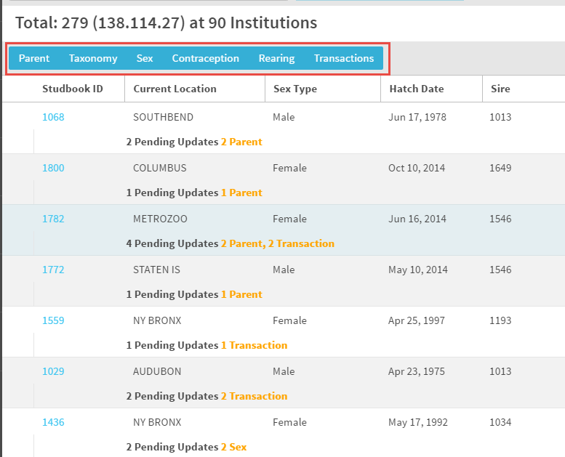
Pending Updates
The Pending Updates will
display any changes that
have been made at the
institutional level for animals
already in your studbook. You
can search for specific updates
as desired using the topics in
the blue box.

Slide 30
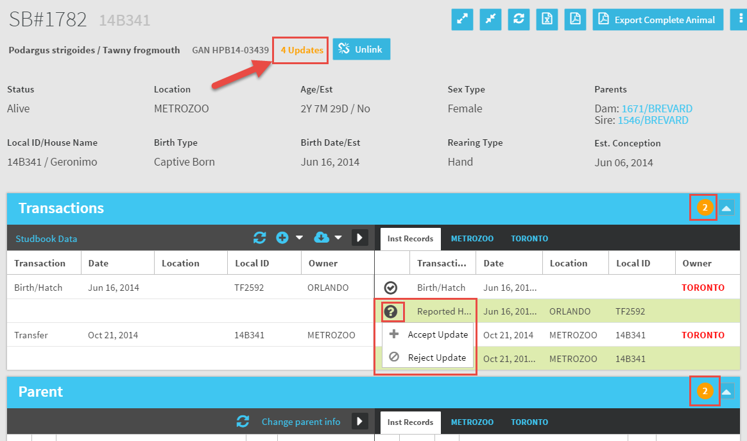
Pending Updates
Within the record the number of updates
displays at the top in the Basic Info grid. These
updates are changes made in the animal
record at the institutional level. An orange
circle indicates which grid the updates are in.
Selecting the “?” allows you to Accept the data
update into your studbook or Reject the update.
No re-typing required!

Slide 31
Records Not Getting Updates
There are two situations where you may not be receiving Pending Updates on your studbook records. First, the last holder may not be a ZIMS institution and therefore no updates are available. Second, the animal may be managed as a group in the Husbandry module of ZIMS. Currently studbooks do not handle group records so no updates from groups will be displayed. You will receive a message under Global Status.

Slide 32
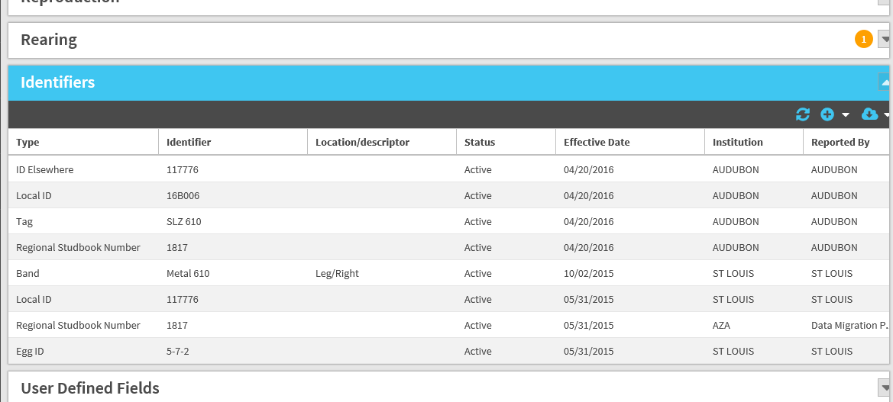
Identifiers Auto Populate
There is a separate box for identifiers in each individual animal record.
Any identifiers that have been entered in the Husbandry module will
automatically populate in the studbook, you do not need to re-enter them.

Slide 33
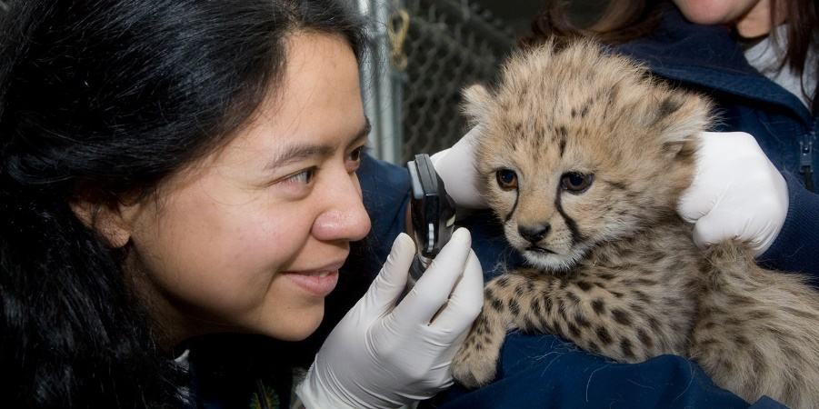
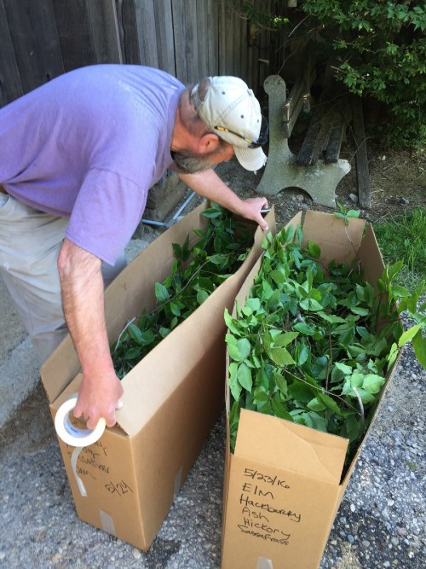
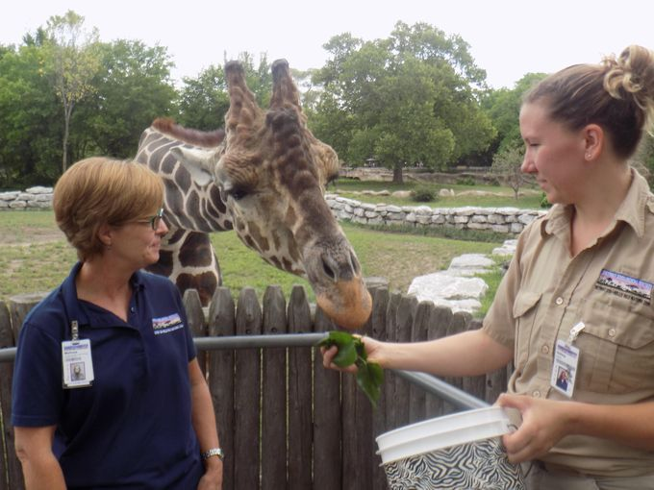
Regional Associations Assign more than SBK
Regional Associations also have the ability to assign more
than just the Studbook Keeper to a studbook. They can add
Nutrition and Vet Advisors and SSP Coordinators and TAG
Chairs to name a few other roles. Most of these will have
Read Only access to the studbook. However, more than one
person can be assigned access to data entry in the
studbook. This allows multiple Users to be able to update
the studbook data.

Slide 34
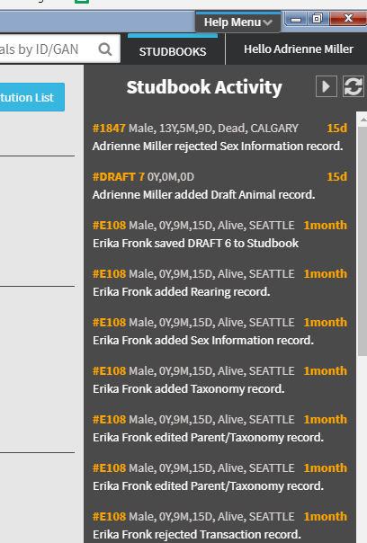
Studbook Activity & Hyperlinks
The Studbook Keeper can easily
track the recent activity in their
studbook using the Studbook Activity
box. The Studbook IDs are hyperlinks
into the studbook record. Throughout
the module all Studbook IDs are
hyperlinks into the actual record.

Slide 35
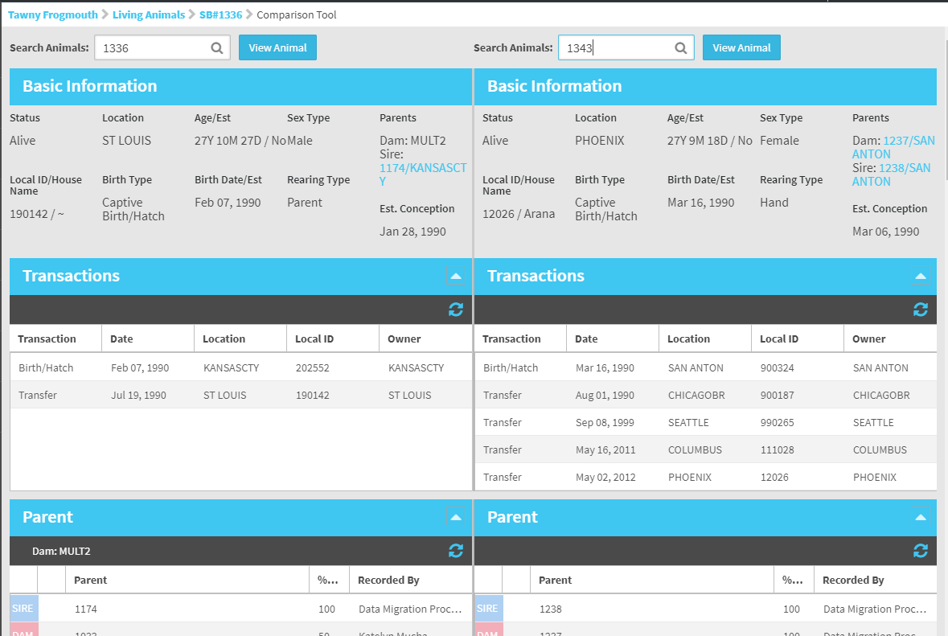
Comparison Tool
The Comparison Tool
allows for looking at
two records side by side.
This is very helpful if
you think you may have
duplicate records and
eliminates the slow
and confusing process
of going back and forth
between records.

Slide 36
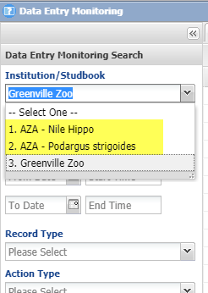
Data Entry Monitoring
If you are a Studbook Keeper your
studbooks will be listed in Data
Entry Monitoring. This allows you
to view recent activity as well as
roll back any incorrect entries.

Slide 37
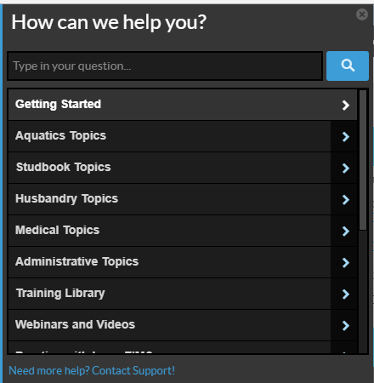
All Modules – Walk Me Tools!!
For all modules the training and
documentation assistance has
continued to grow. More topics
have been added to the Help Menu.
Additional hover over “?” help have
also been added throughout the
application.

Slide 38
Any Questions?
On 2017?

