Slide 1
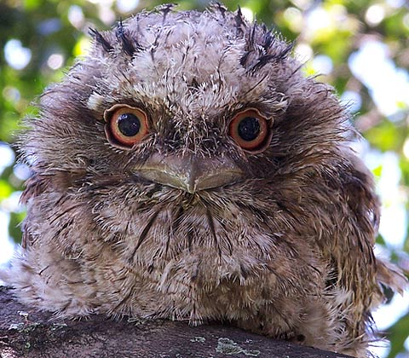
Husbandry to Studbook Interface
What data in the Husbandry Module goes into
the Studbook Module

Slide 2
Husbandry
Studbook
Some of the data you enter into the Husbandry module of ZIMS is
displayed in the Studbook module. In most cases the Studbook
Keeper needs to accept the data before it actually displays in the
true studbook. At this time it is a one way street, there is no data
entered into the Studbook module that is displayed in the Husbandry
module.

Slide 3
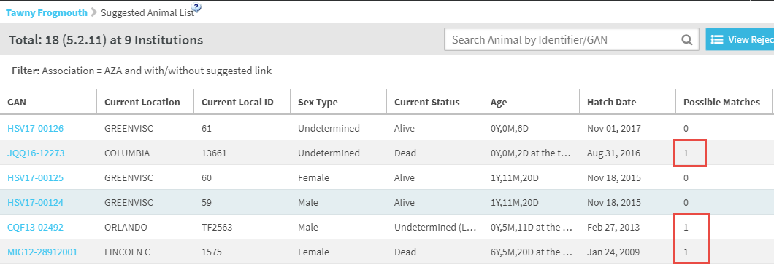
Suggested Animals
Suggested Animals are records that are found in ZIMS but not yet identified as
being recorded in the studbook. If ZIMS locates any possible matches in the studbook
they will be indicated. In most cases these are new births or hatches and a possible
match would not be found. Suggested Animals can also be created when new institutions
start using ZIMS or when current ZIMS institutions enter historical data into their records
that may actually already be captured by the Studbook Keeper. In these cases possible
matches may be found. The left side GAN is a hyperlink into the record.

Slide 4
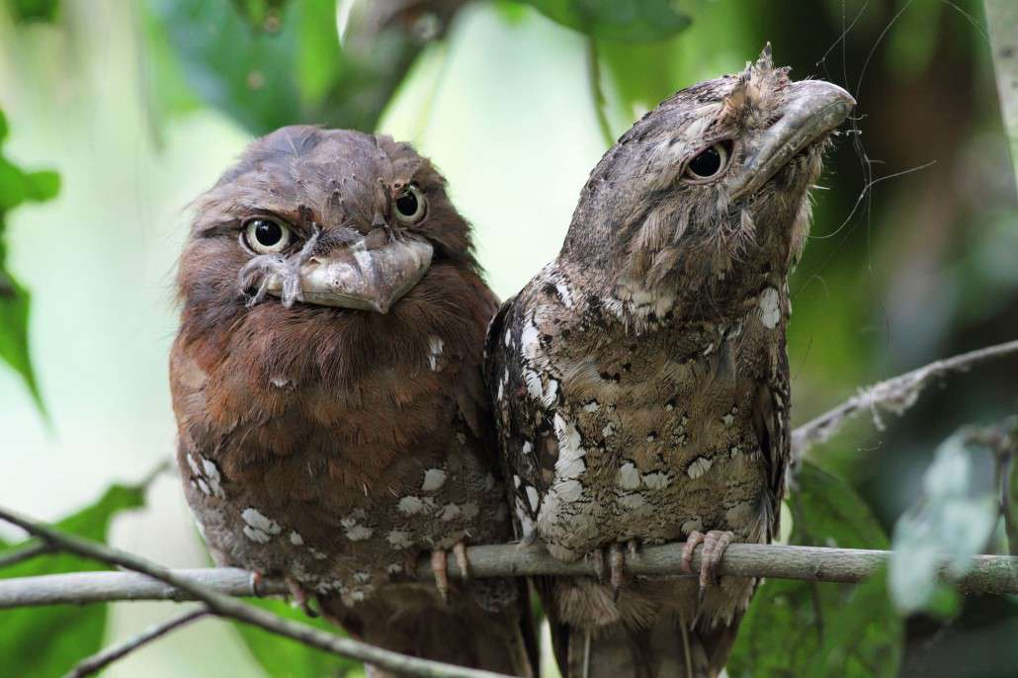
How Possible Matches are Found
At least one of the following
Mnemonic/Local ID match
Studbook ID/Taxonomy match
Transponder/Taxonomy match

Slide 5
Husbandry Records that will NOT display in Suggested Animals
Groups – only individual animals at this time
Incomplete Accessions – only animals that have been fully accessioned
Pre-birth/hatch records – will display once born or hatched
Already linked records – husbandry records already linked to a studbook record

Slide 6
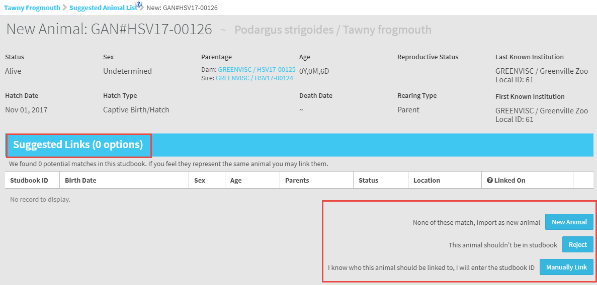
Suggested Animals
This is a record for a new hatch that was
recorded by Greenville Zoo. There are no
records in the studbook that ZIMS thinks
is a possible match. The Studbook Keeper
has three options:
Add a New Animal
Reject the record (will not be part of studbook)
Manually Link (a studbook record exists that it
should be linked to but ZIMS didn’t find it)

Slide 7
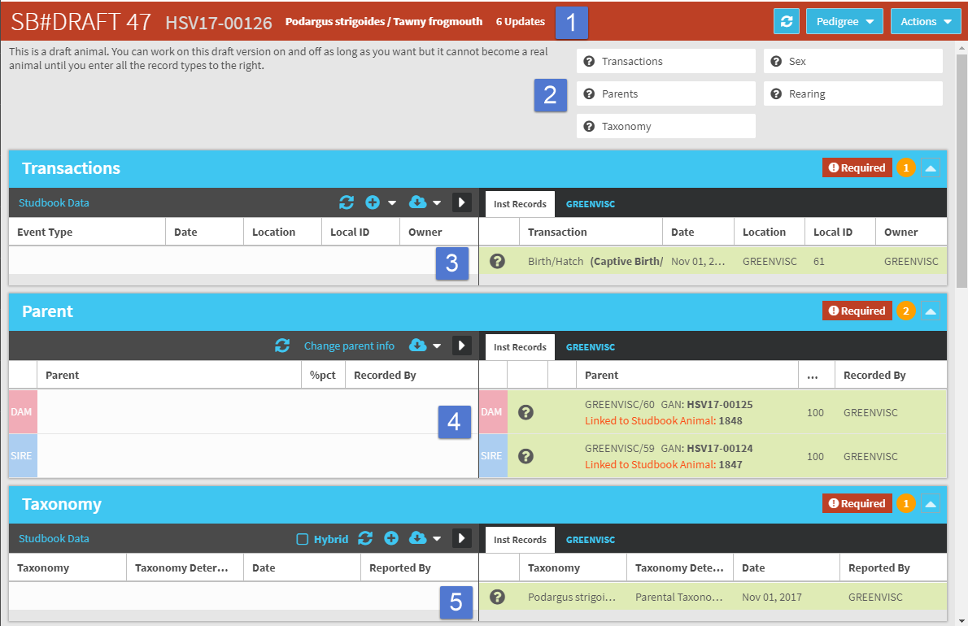
Creating the Studbook Record
When the Studbook Keeper starts creating
the studbook record it begins as a Draft
record (1). There are five pieces of data
that must be recorded before the Draft
can become a full studbook record (2).
The data that was recorded in the
Husbandry record is displayed on the right
side under Institution Records (3, 4 and 5).
In addition to those three the Sex and
Rearing that were recorded will be displayed.

Slide 8
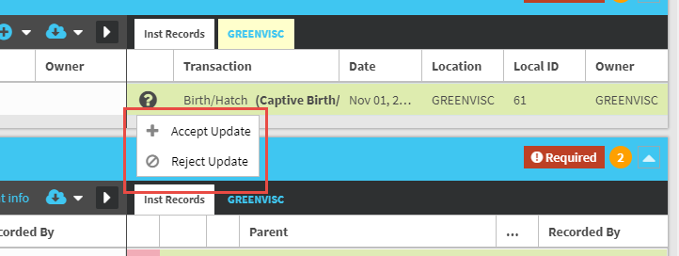
Creating the Studbook Record
Clicking on the “?” gives the option to either Accept the Institution Record
or Reject it. The Studbook Keeper does have the option to Reject an
Institutional record and record what they believe is correct. In this case
the Institutional record would display in red to indicate a conflict.

Slide 9
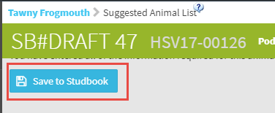
Creating the Studbook Record
If the Institution record is Accepted, it becomes part of the Studbook Data.
Once all the required fields have been completed, the Studbook Keeper
has the option to Save to Studbook. It is no longer a Draft record and a true
Studbook ID is assigned.

Slide 10
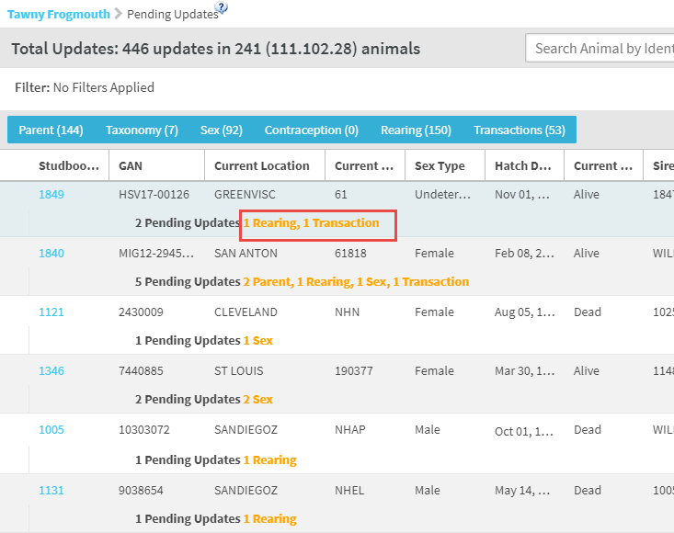
Pending Updates
Pending Updates are changes
made at the Institution level
to records that are already
recorded in the Studbook.
These updates include data
for any of the required fields –
transactions, parents, sex,
taxonomy and rearing. The
tawny frogmouth record that
was created using the Suggested
Animals functionality has had
changes made at the institution
level for rearing and transactions.

Slide 11
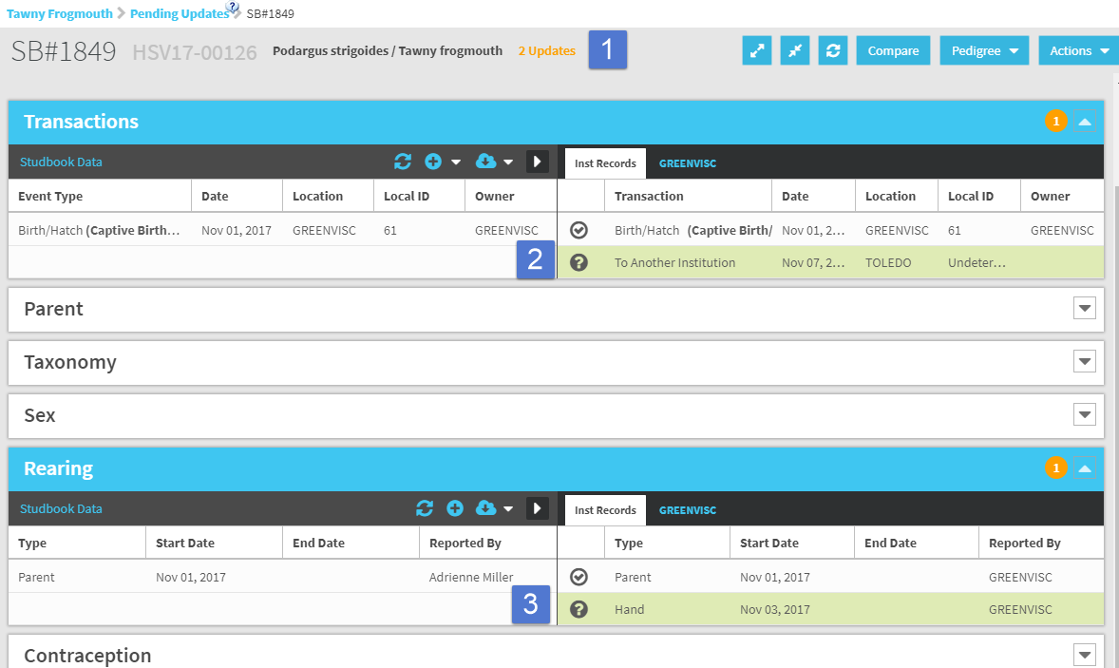
Pending Updates
In the Studbook record the number
of updates is indicated at the top (1).
Any grids with updates automatically
open with the Institution data
displayed, making it easy for the
Studbook Keeper to identify any
records they may need to address
(2 and 3).

Slide 12
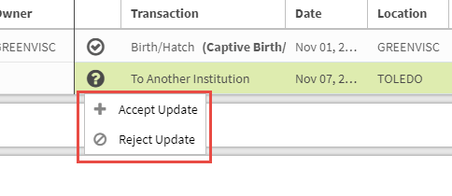
Pending Updates
Just as for Suggested Animals,
the Studbook Keeper has the
option to Accept or Reject the
data. Once accepted it becomes
part of the Studbook Data. If Rejected
it does not.

Slide 13
When Pending Updates are NOT Available
If a Studbook animal is managed as a Group in Husbandry there will not be a Pending Update created in the Studbook
If a Studbook animal is currently held at a non-ZIMS institution there will not be a Pending Update created in the Studbook
The Studbook record indicates there will be no Pending Updates received

Slide 14
What About Local Collections?
If an animal is held in a Local Collection the studbook will not receive any info as a Suggested Animal or Pending Update
If an animal was previously held at an institution in a Global Collection but is held at yours in a Local Collection the previous information will display but your Local info will not
If an animal was previously held at an institution as a Local Collection but is held at yours as a Global Collection, only your information will display
If you change the Collection from a Global one to a Local one the information will remain in the studbook but the link to the record will be inactivated
If you change the Collection from a Local one to a Global one, all information will display and the link will be activated.

Slide 15
Identifiers
When an Identifier is updated at the Institution level the grid is automatically updated in the Studbook. The Studbook Keeper does not have the option to Accept or Reject an Identifier. Here Greenville Zoo added a House Name and a Band to the Institution records. They
were automatically added to the Studbook. If an Identifier is deleted
at the Institution level it is also deleted in the Studbook.

Slide 16
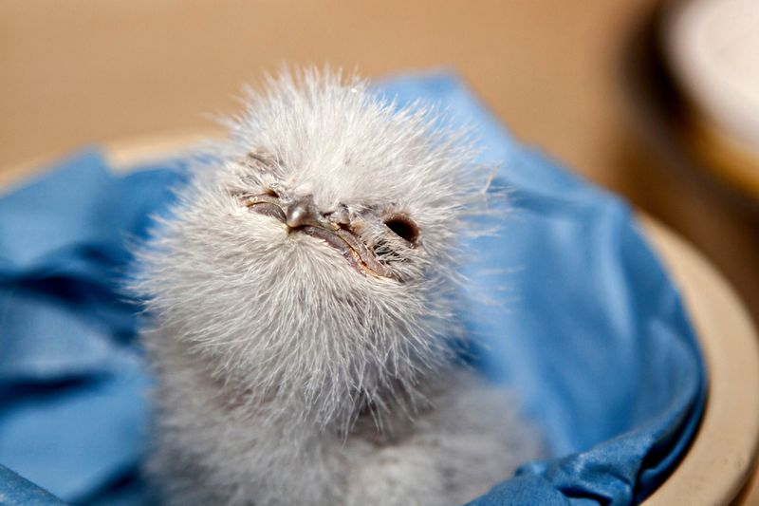
Husbandry to Studbook
Suggested Animals and Pending Updates (Studbook Keeper can Accept or Reject)
Transactions
Parents
Taxonomy
Sex
Rearing
Auto Update
Identifiers

Slide 17
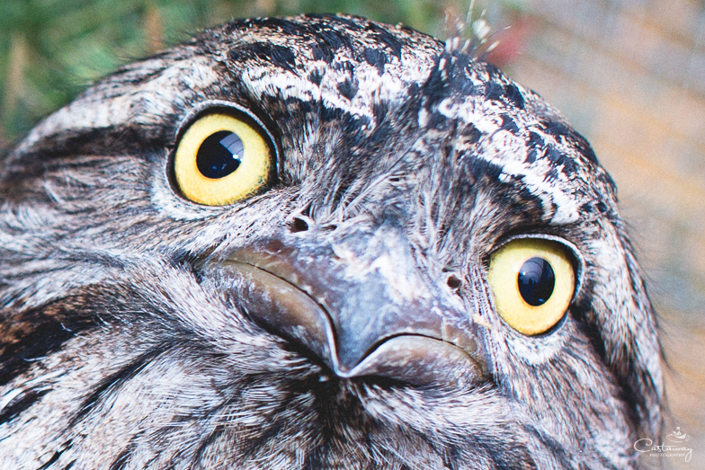
Any Questions?
On the Husbandry to Studbook Interface

