Slide 1
What’s New in ZIMS!
October 2017 Tips & Tricks

Slide 2
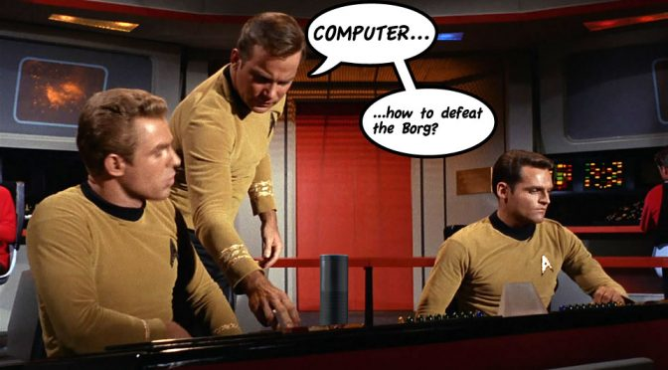
Say What?
Previously the ZIMS Medical module had a
few options for voice recognition. This
functionality has been greatly expanded in
both the Medical and the Husbandry modules.
It won’t help you defeat the Borg but it will
save you significant data entry time.

Slide 3
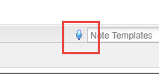
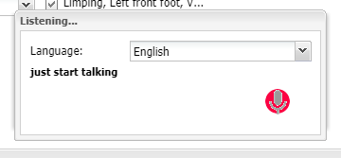
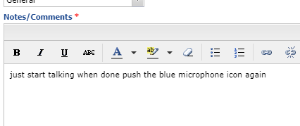
Look for the mic
Any field that displays the blue
microphone icon has voice recognition
functionality. This functionality is available
only in Chrome. To activate it click on
the microphone. You will need to select
your language and just start talking.
The text will display in the box and then
be copied into ZIMS. As long as the red
microphone is pulsating ZIMS is
recording your speech. To stop voice
recognition select the blue microphone
again.

Slide 4
Available in these screens
Medical
  Clinical Notes
  Animal Care Staff Medical Summary
  Necropsy Report/Description
  Necropsy Case Info for Husbandry Staff
  Biopsy Case Info
  Biopsy preliminary exam
Animal
  Training Definition
  Training Session Details
  Feed Log Details
  Enrichment Item Caveats
  Enrichment Item Details
  Enrichment Session Details
  Note & Observation
Enclosure
  Maintenance Note
  Maintenance Request Details
  Feed Log Details
  Measurement Action Taken Details
  Enclosure Treatment Notes
  Note & Observation
Life Support
  Note & Observation
  Maintenance Note
  Measurement Action Taken Details
Component
  Note & Observation
  Measurement Action Taken Details
  Maintenance Note

Slide 5

Read the Entry!
This talk to text functionality
does not mean you do not
have to actually read what ZIMS thinks you said. Just as you would reread text that you had typed for clarity and
correctness, it is very important that you confirm what ZIMS heard is actually what you said.

Slide 6

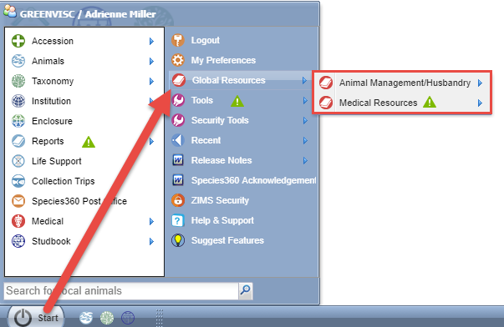
Global Resources
The global data resources that used to be under Reports or Tools
have moved and now have a new home! They can be found under
Start > Global Resources and are divided into Animal Management/
Husbandry and Medical Resources.

Slide 7
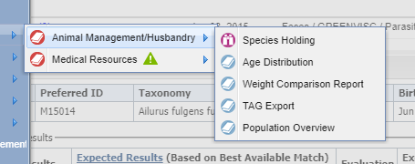
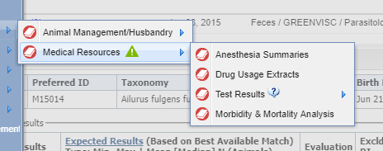
Global Resources
Species Holdings, Age
Distribution, Weight
Comparison, TAG Export
and Population Overview
are found under Animal
Management/Husbandry.
Anesthesia Summaries,
Drug Usage Extracts, Test
Results and Morbidity &
Mortality Analysis are
found under Medical.

Slide 8
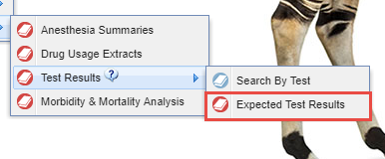
Physiological Reference Ranges
Expected Test Results
Also, the Physiological Reference Ranges have a new name – Expected Test
Results – and is found under the Test Results menu under Medical Resources.

Slide 9
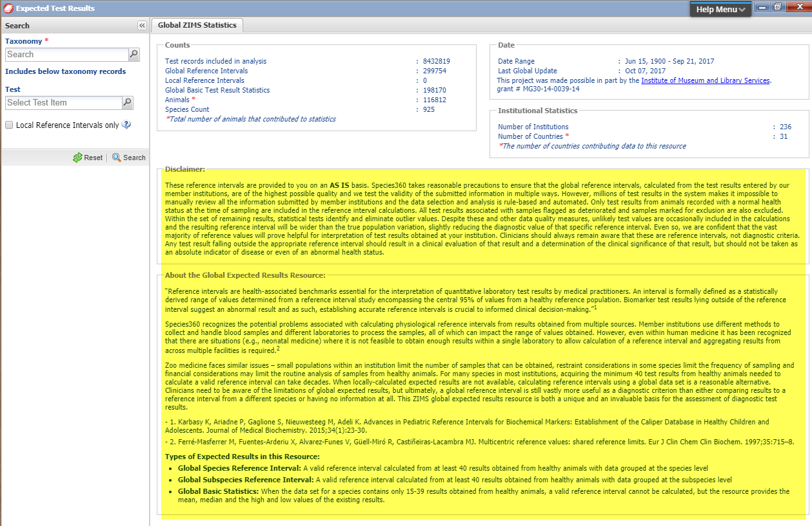
Expected Test Results
Before using this redesigned resource we highly recommend that you read both the Disclaimer and the About the Global
Expected Results Resource so that you will better understand what is displayed in your results.

Slide 10
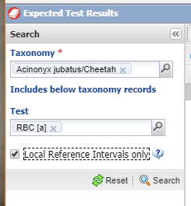
Expected Test Results
In the search box you can filter
by Taxonomy, a specific Test
and also limit the results to
your Local Reference Intervals
only. Only Taxonomy is mandatory.
If Test is left blank then all the Tests
for the species in the ZIMS database
will be displayed.

Slide 11
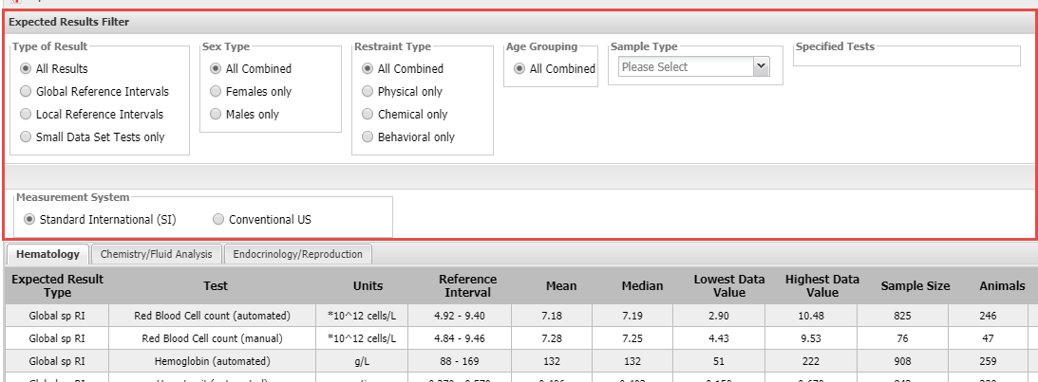
Filtering Expected Test Results
At the top of the results grid are additional filters that can be applied such as
Sex Type, Restraint Type and Sample Type making this a very powerful
and easy to use resource.

Slide 12
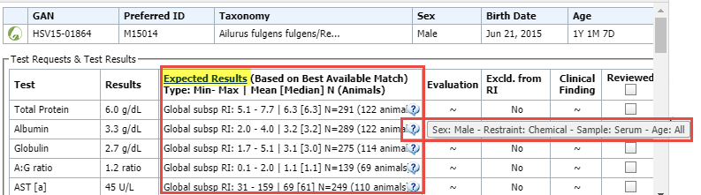
Results Display in Medical Record
Within the medical record itself the Expected Test Results will display
next to your actual test results, allowing for an immediate comparison
of your results with the global data. Hovering over the “?” will display
the data set it is sourced from. Selecting Expected Results will take you
directly into the Expected Test Results resource.

Slide 13
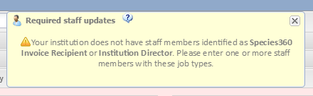
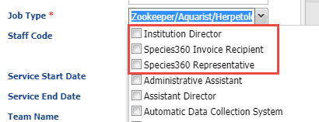
Required Staff Type
You may have noticed when you open the Staff grid that you receive a reminder that you do not have staff members identified with certain Job Types. We are requiring that you indicate who your Institution Director, your Species360 Invoice Recipient and your Species360 Representative are. This ensures that communications from Species360 go to the correct people at your facility. The three required Job Types are at the top of the Job Type list making them easy to find. These Types can be assigned to multiple people

Slide 14
What are the Emails?
Institution Director
  Change to Privacy Act
  Change to Member Agreement
Species360 Invoice Recipient
  Invoices or billing related
Species360 Representative
  Often the Registrar
  ZIMS related announcements
  Communications regarding ZIMS maintenance

Slide 15

Email Confirmation
Historically, when you created a
ZIMS User you could assign them
any Email you wanted, as long as
it was unique. It did not actually
HAVE to be that person’s true Email
address. Now ZIMS is requiring that
all Email addresses be confirmed.
But why did we do this?

Slide 16

1. Security
Requiring Users to validate
Emails is a standard security
measure used by almost all
on-line systems. For example,
it helps prevent an inappropriate
person from resetting your
Password.

Slide 17

2.Ensures Accuracy
Validating your Email address
ensures that it was typed correctly
when it was recorded. Example:
John.Smith@gamil.com

Slide 18

3. Emails From ZIMS
ZIMS is beginning to include the
ability to send Emails. For example,
we have already implemented the
functionality to send an Email
notification to specified Staff should
a Water Quality or Environmental
Measurement be outside of your
desired range. We want those Emails
to go to a real address!

Slide 19
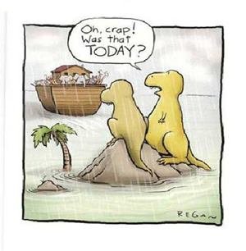
4. Emails From Species360
Finally, this is a way to ensure that
Emails coming from Species360
are actually getting to the right
people. Emails we send out are
often filtered by your Job Type to
make sure that you receive those
Emails that are relevant to your
responsibilities. If they are not
going to a true Email you may be
missing some valuable information.

Slide 20
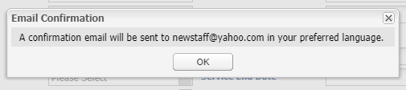
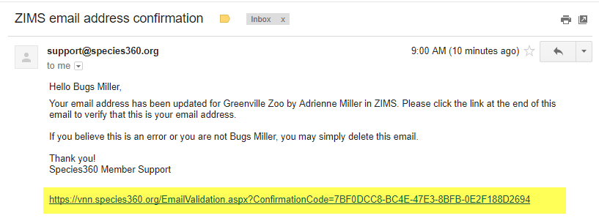
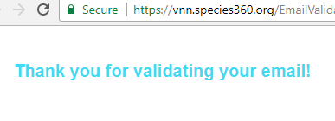
To Confirm Email
When a new User is created
you will get a message that
an Email will be sent.
The Email will come from support and the title will be ZIMS email confirmation. After you open simply click on the link at the bottom. You will receive a message that your Email has been validated.

Slide 21
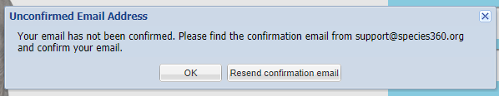
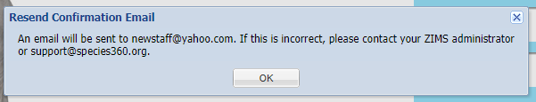
Unconfirmed Emails
If you have not confirmed your Email, when you try to log in you will receive a message. You can chose
to resend the confirmation Email. If the Email address is incorrect you are told to
contact your Local Admin
or support.

Slide 22
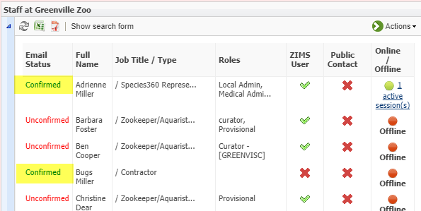
View Confirmed Emails
From the Staff grid you can quickly see who has confirmed their email and
who has not. All previously entered Staff members will receive Email
confirmation requests, not just new Users.

Slide 23

ZIMS Lockout
Starting 18 October 2017 if you have not confirmed your Email you
will be locked out of ZIMS until it is confirmed.

Slide 24

Batch Actions from
Enclosure Occupants List

Slide 25
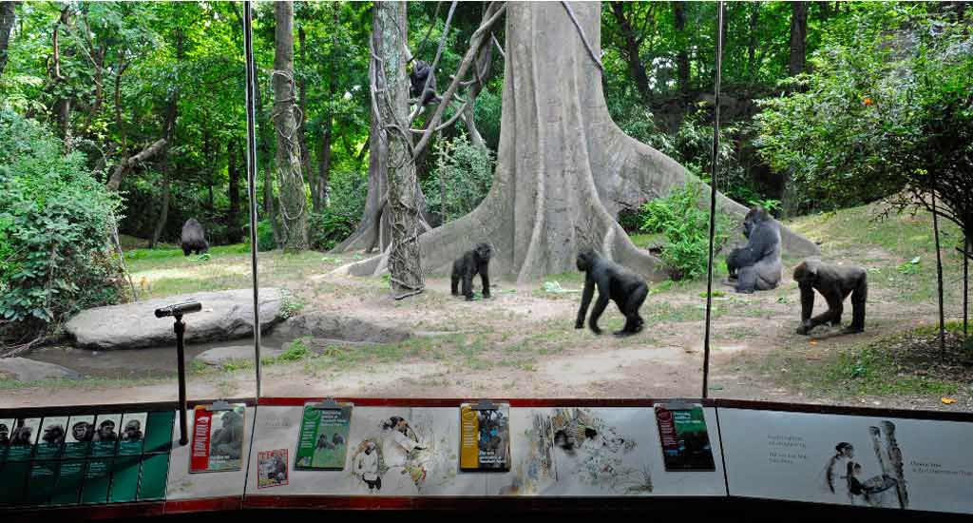
Occupants are not static
Animal Lists are great for
performing Batch Actions
to save you data entry time.
But these lists do not update
as animals change enclosures.
For Batch Actions on all, or
some, of the animals in an
Enclosure use the Batch
Actions from Enclosure
Occupants option.

Slide 26
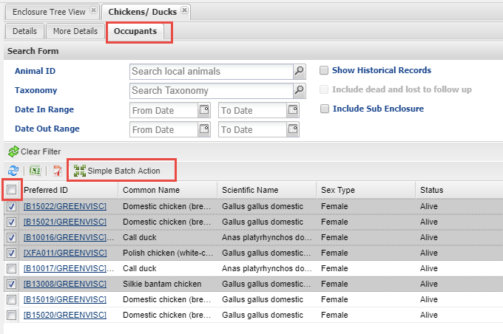
Occupants tab and Search
To use this functionality
open the Enclosure record
and select the Occupants
tab. The results grid will
display the current animals
in the enclosure. If you need
to include historical occupants,
or want to filter the list, use
the Search form. Check all the
appropriate records. You can
Check All or Uncheck All by
selecting the box at the top
of the list. Then select Simple
Batch Action.

Slide 27
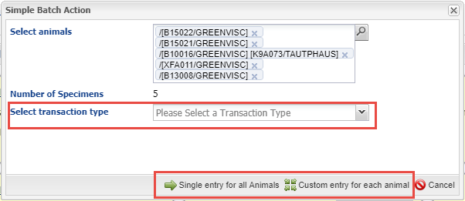
Create the Batch Action
Select the Transaction Type and whether you want a Single Entry for all or a
Custom Entry. You can add more animals to the list using the lookup or by
simply typing the GAN or an Identifier into the Select Animals grid.

Slide 28
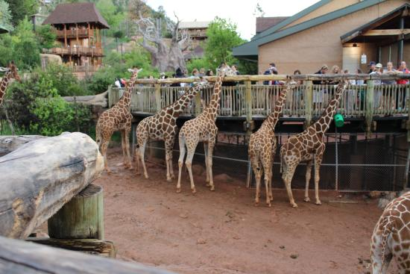
Complete the Batch Action
Then complete the
Batch Action! Since
the Enclosure Occupants
list automatically updates
as animals come in or go
out you don’t have to
think about keeping an
Animal List based on an
enclosure updated!

Slide 29
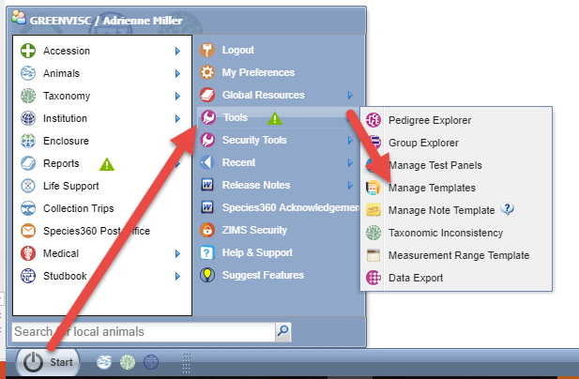

Manage Templates – so new it’s not there yet!
How you manage your various
templates has been greatly
improved with most templates
now combined on one easy to
navigate screen. To get to this
screen go to Start > Tools >
Manage Templates. Or, select
the Batch Measurements tab
in the Animals, Enclosures, Life
Support or Components
modules. Note Templates and
Measurement Range
Templates are not part of this
new functionality and remain
as their own entities under
Tools.

Slide 30
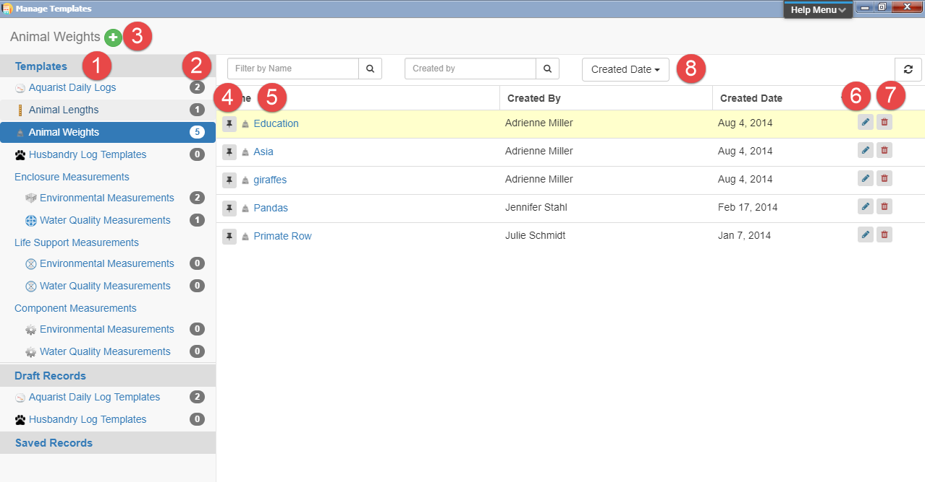
Manage Templates
1.List of all your templates
2.Number of templates of that Type
3.Add New template for highlighted Type
4.Pin the template to the top of the list
5.Hyperlinnk into the template
6.Edit the template
7.Delete the template
8.Filters to search for a template

Slide 31
Any Questions?
On What’s New in ZIMS

