Slide 1
ZIMS Maintenance
August 2017 Tips & Tricks

Slide 2
Why Bother?
With our Agile deployments (biweekly Bug fixes and Enhancement rollouts) big major releases are rare
New functionality can sneak in on you and you want to keep updated
Current functionality may need to be re-assigned
Your animal collection changes
Your staff changes

Slide 3
Create a Schedule
The schedule for these maintenance tasks will be different for each institution
If you have high staff turnover or seasonal workers, you may need to address the staff functions more frequently then an institution with more stable staffing
You may want to schedule the animal functions for late spring or fall after a busy transport season has changed your animal collection
As we go through the topics think about what your schedule might be

Slide 4
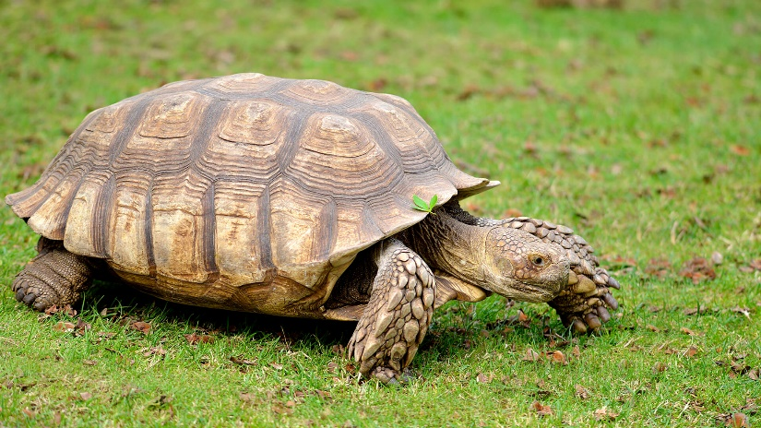
Review Institution Preferences
If you are the Local Admin you are responsible for setting the Institution Preferences, including those Preferences that are not available as My Preferences and affect ZIMS functionality. Discuss with your staff to see if you want to change them.
Multiple Enclosure Assignment
Allow Re-use of Transponders
Enable Auto-increment Local ID
Default Colony Inventory
Default Group Tracking

Slide 5
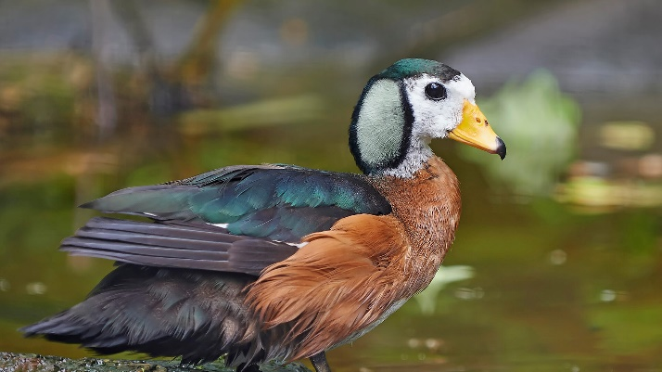
Update My Preferences
Remind your staff to review/update their My Preferences
Remind them that they can change their own Password (if they remember their current Password) under Account Settings
Also remind them that if they forget their Password they do not have to wait for help from Support
As Local Admin you can change their Password without knowing their current one under Staff > View/Edit Login Details
From the login screen they can request a Password reset themselves

Slide 6
Institution Profile
Make sure your Institution Profile is correct and up-to-date
Institution Details
Communication Details
Website
Geographical Location
Your colleagues may use this information

Slide 7
Staff List
Have any left and need to be marked Obsolete
Have any returned and need to be marked Active
Have there been any name changes
Do you have appropriate staff marked as Public Contacts
Has everyone confirmed their Email address
Have you completed communication details

Slide 8
Job Types
Species360 filters the Emails we send by Job Type
It is important that you have someone assigned to the following Job Types under Staff Details
Species360 Representative
Species360 Invoice Recipient
Director

Slide 9
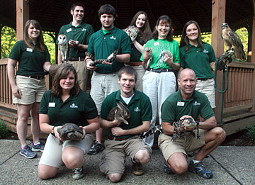
Teams and Departments
Are the members correct
Do you need to add new members
Do you need to delete members
Team/Department could have changed
No longer employed
Is the Department Head still correct

Slide 10
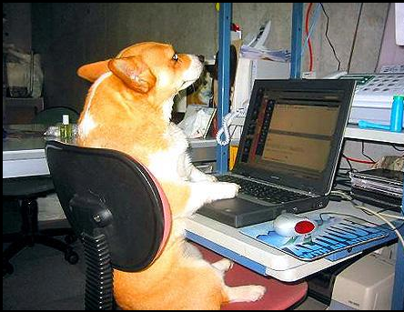
Staff Transactions Statistics
This is found under My Institution > Institution Statistics tab
It displays the User name and the number of transactions recorded in the last 1, 7, 15 or 30 days
Transactions here are any piece of data entry
It is a quick check to see if those who are supposed to be entering data are indeed doing so
It is also a quick check for possible inappropriate use

Slide 11
Staff Transactions Statistics
Some institutions use these statistics to tally how many transactions (piece of data entered) each staff member does in a year (or other time frame) and give awards
Others use them as proof of ZIMS usage to their governing authority
You might want to schedule a monthly check of these numbers on your ZIMS calendar

Slide 12
Contact Directory
Do you need to add any external contacts
Does information need to be updated
An easy way to see what communication information needs to be added for your staff is to search Contact Directory by your institution

Slide 13
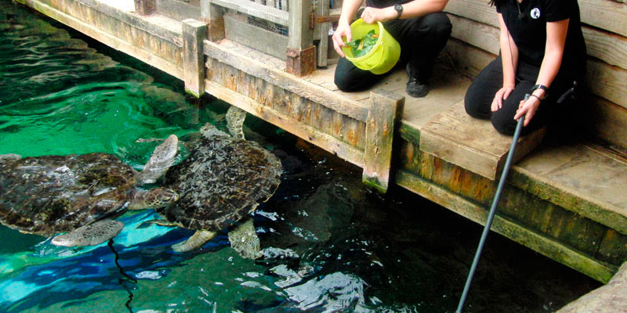
Check Roles for New Functionality
Template Roles
Did Species360 assign a new functionality to a Role that you may not want Users assigned that Role to have
Assign different Role or create custom Role
Custom roles
Do you need to add new functionality to one or more of your custom Roles

Slide 14
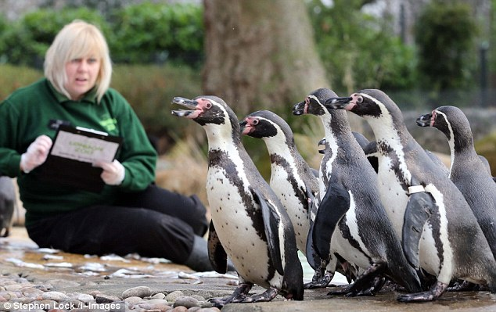
How to Check Role Access
Help Menu
Global Template ZIMS Roles
My Institution > Roles Module >Manage Role Access
Open each module and review

Slide 15
Roles & Assignments
Check for any custom Roles that could be deleted (User Count = 0)
You cannot delete Species360 Template Roles

Slide 16
Collections
Are they still Active
You cannot delete a historical Collection that has animals recorded in it but you can mark it Inactive
Is the scope correctly indicated
Remember a Global Scope is preferred

Slide 17
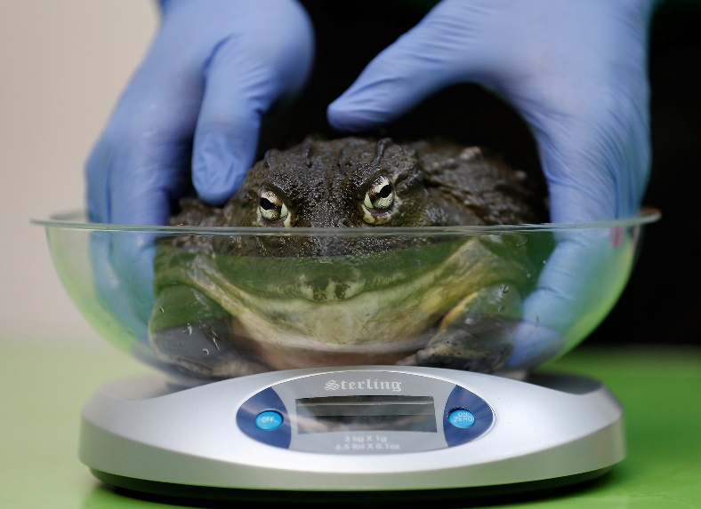
Measurement Preferences
The Measurement Preferences tab lets you limit measurement terms to only those you use
These are available for animals, enclosures, life support and development milestones
Check to make sure you have these filtered as desired

Slide 18
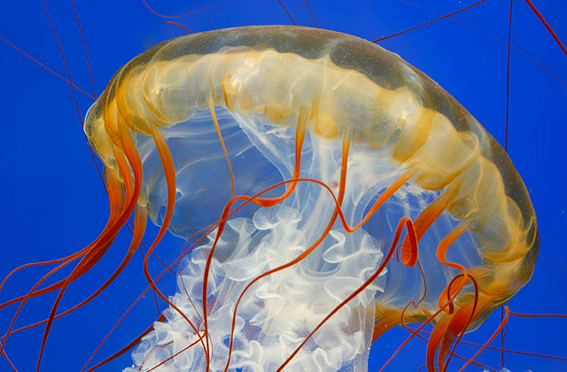
Species Wanted & Animals Available
Are you still looking for the Species Wanted
May have acquired what you wanted
Plans may have changed
Should new ones be added
Is the Animal still available
Possible death or disposition
Medical issues
Plans may have changed
Should new ones be added

Slide 19
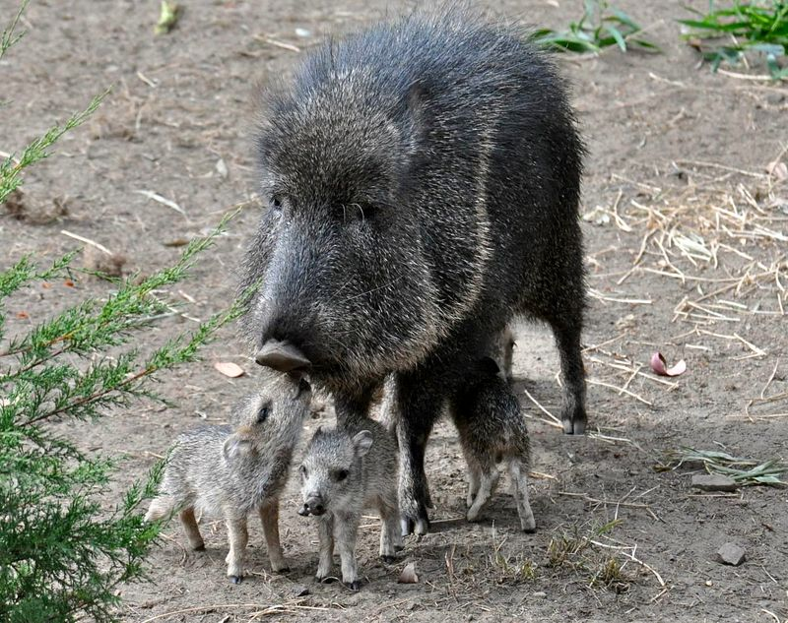
Update Animal/Enclosure Lists
Review of your Animal and Enclosure Lists is recommended
ZIMS will not automatically update these lists
Did you add those new babies and delete the ones from last year that you dispositioned

Slide 20
Update Columns and Order
It is good to review the columns displayed and the order in your results grids
Remind your staff that they can customize what they see
Keepers may want to see House Name but Veterinarians may prefer to see Transponders
And remember the column order can be adjusted
You can always select to “reset” to the default columns and order

Slide 21
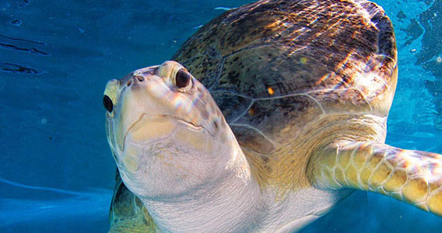
Check Archived Pendings
You may have archived some Pendings that you may now be able to deal with
Select Include Archived in your Pendings list and they will appear in red
You cannot Unarchive a Pending at this time, but you can address an Archived one

Slide 22
Check Incomplete Accessions
Review any Incomplete Accessions that have not been Completed
Remember to check for any you may have Archived
You can re-activate Incomplete Accessions

Slide 23
Review/delete/update Templates
Batch Measurement Templates
Animal/Enclosure
From left hand search box
Note/Observation Templates
Start > Tools > Manage Note Template
Within Note record
Measurement Range Template
Start > Tools > Measurement Range Template
Aquarist Daily Log
Enclosure > Batch Measurements > Manage Templates
Start > Tools

Slide 24
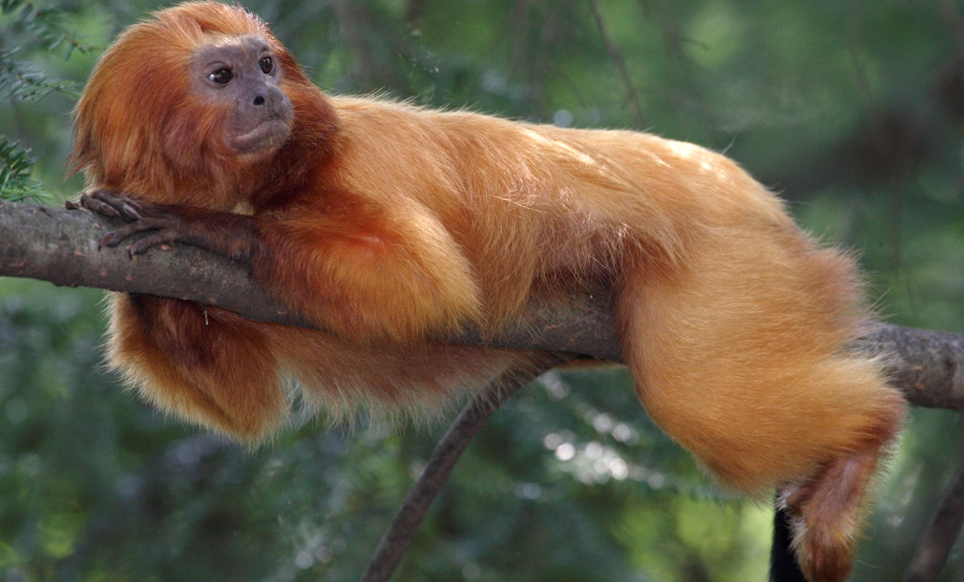
Management Plans
If you are using the Management Plan grid you should review at least annually
Are all the animals that are in a managed plan indicated as such
Search is found in Advanced Animal Search

Slide 25
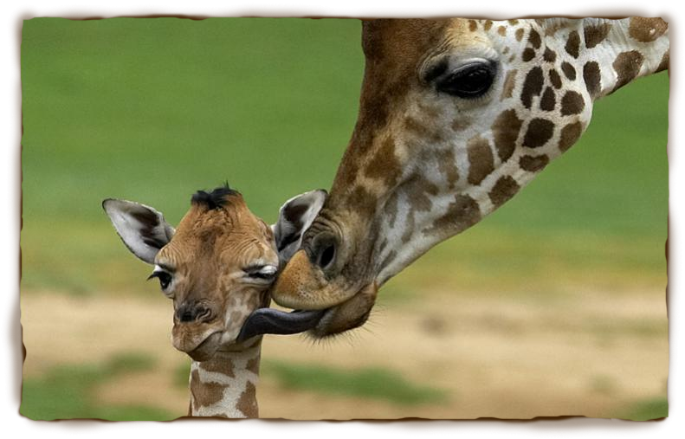
External Sharing List
Any records need sharing to be removed?
Transactions did happen
Transactions did not happen
Remove institution
Deaths
Any additions to sharing
Ownership changes
Institution changes
Collection changes

Slide 26
Any Questions?
On ZIMS Maintenance

