Slide 1
New and Improved!
Email Confirmation and Feed Logs
July 2017 Tips and Tricks

Slide 2

New! Email Confirmation
This functionality should be released
in early August. Historically, when
you created a ZIMS User you could
assign them any Email you wanted,
as long as it was unique. It did not
actually HAVE to be that person’s
true Email address. Now ZIMS is
requiring that all Email addresses
be confirmed. Eventually you will
not be able to log into ZIMS using
an unconfirmed address.
But why did we do this?

Slide 3

1. Security
Requiring Users to validate
Emails is a standard security
measure used by almost all
on-line systems. For example,
it helps prevent an inappropriate
person from resetting your
Password.

Slide 4
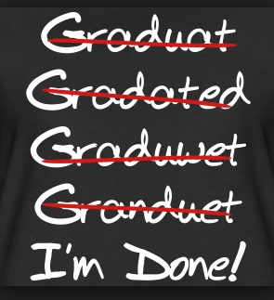
2.Ensures Accuracy
Validating your Email address
ensures that it was typed correctly
when it was recorded. Example:
John.Smith@gamil.com

Slide 5

3. Emails From ZIMS
ZIMS is beginning to include the
ability to send Emails. For example,
we have already implemented the
functionality to send an Email
notification to specified Staff should
a Water Quality or Environmental
Measurement be outside of your
desired range. We want those Emails
to go to a real address!

Slide 6
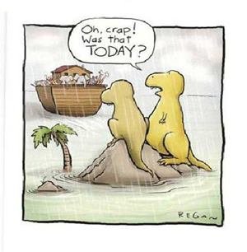
4. Emails From Species360
Finally, this is a way to ensure that
Emails coming from Species360
are actually getting to the right
people. Emails we send out are
often filtered by your Job Type to
make sure that you receive those
Emails that are relevant to your
responsibilities. If they are not
going to a true Email you may be
missing some valuable information.

Slide 7
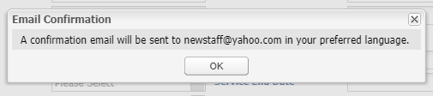
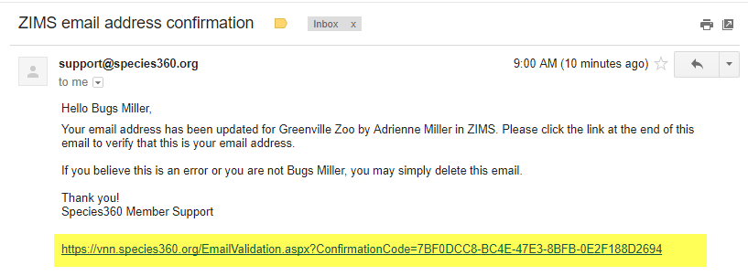
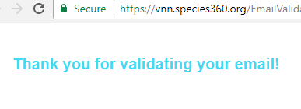
To Confirm Email
When a new User is created
you will get a message that
an Email will be sent.
The Email will come from support and the title will be ZIMS email confirmation. After you open simply click on the link at the bottom. You will receive a message that your Email has been validated.

Slide 8
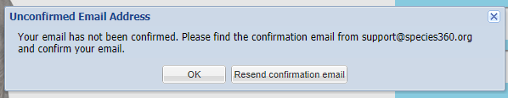
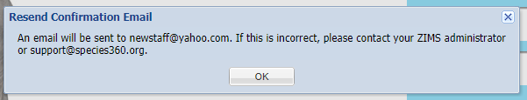
Unconfirmed Emails
If you have not confirmed your Email, when you try to log in you will receive a message. You can chose
to resend the confirmation Email. If the Email address is incorrect you are told to
contact your Local Admin
or support. When this
functionality first deploys you will not be blocked from getting into
ZIMS. However, in the near future you will be, so remember to confirm your Email!

Slide 9
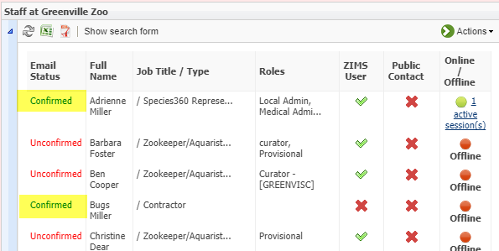
View Confirmed Emails
From the Staff grid you can quickly see who has confirmed their email and
who has not. All previously entered Staff members will receive Email
confirmation requests, not just new Users.

Slide 10

Any Questions on Email Verification?

Slide 11
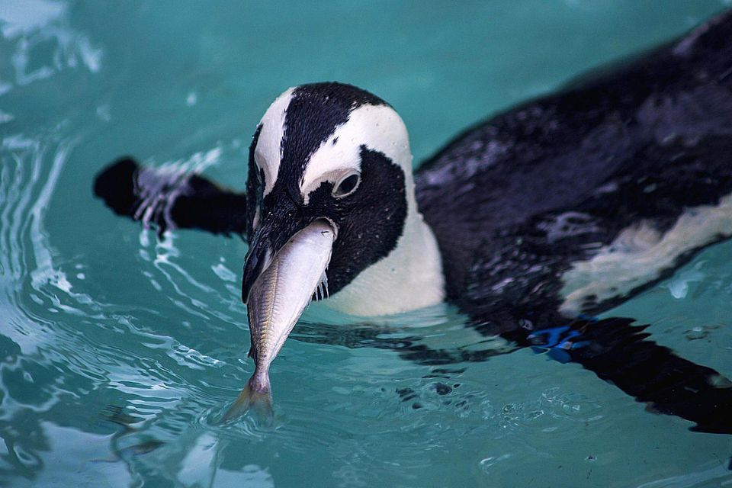
Improved! Feed Logs
As part of our steps to
improve ZIMS functionality
for aquariums, and at the
same time benefit zoos,
the Animal Feed Log has
been completely revamped
into an easy to use grid.
All previous Feed Log entries
will be transferred into this
grid format. We are looking
at improvements to the
Enclosures module and
Feed Log changes for them
are planned for the future.

Slide 12
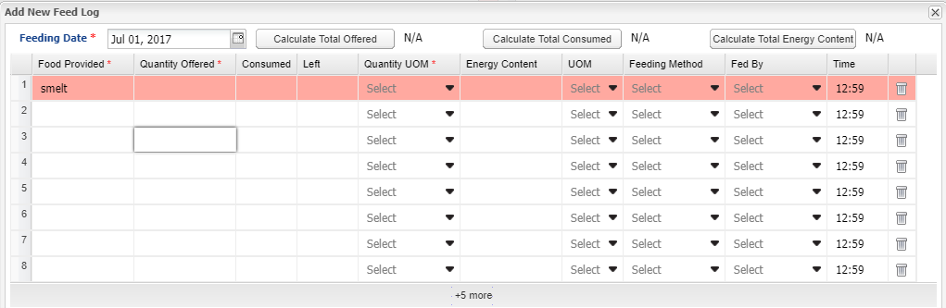
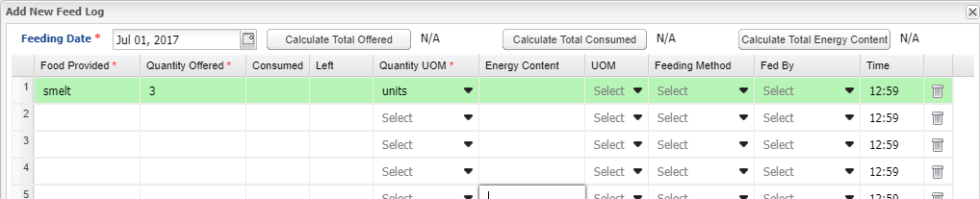
Completing the Grid
The Feed Log is now a grid where you can record feeding multiple different
types of food. The grid line will remain red until you have recorded data in
all the mandatory fields (as top screen). The line will turn green once all
the mandatory fields are completed (bottom screen). Only those lines that
are green will be saved.

Slide 13
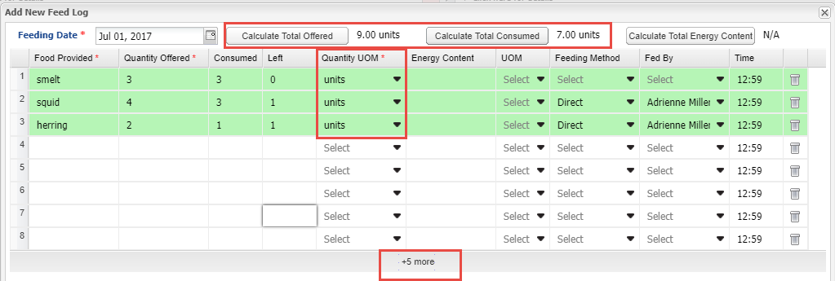
Calculations
If the Units of Measure are the same you can Calculate the Total Offered as well
as the Total Consumed. If you know the Energy Content you can record that and
calculate Total Energy Content also if the Units of Measure are the same. If you
need additional lines to add food items select the “+5 more” to add five lines to
your grid.

Slide 14
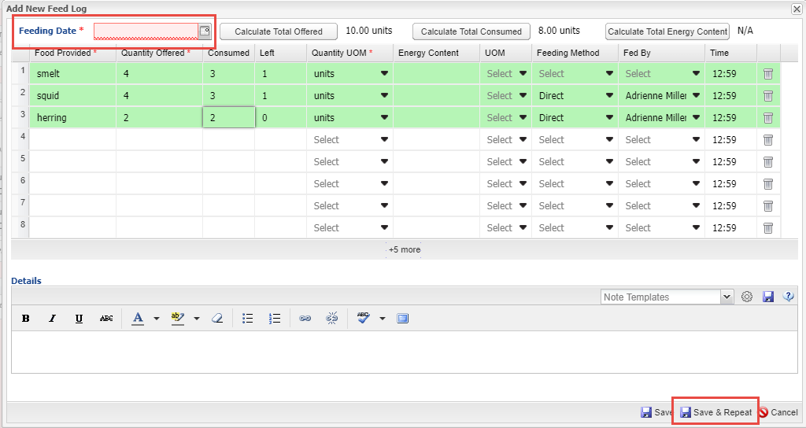
Save & Repeat
If you are entering multiple days worth of Feed Logs you can select the
Save & Repeat option. You will be required to enter a new date. You can
keep the data as recorded in the original entry or edit, add or delete as
appropriate.

Slide 15
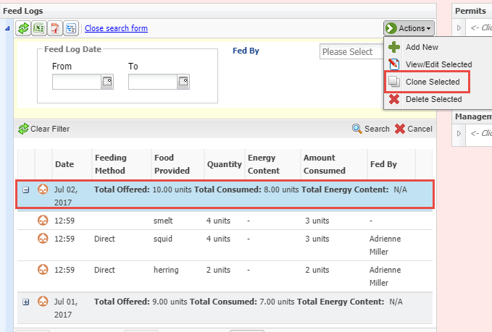
Clone Selected
Another time saver
should you frequently
feed similar food items
and amounts is to
select Clone Selected
from the Actions
Menu.

Slide 16
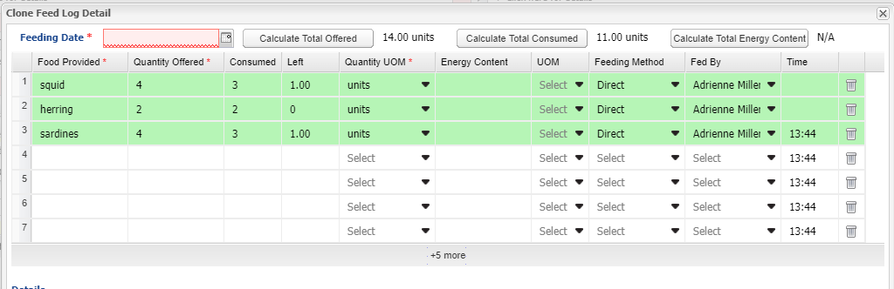
Clone Selected
The data from your selection will prefill. You will need to record a new feeding date.
Then you can add, edit or delete data as appropriate. There is no Save & Repeat for
a cloned record.

Slide 17
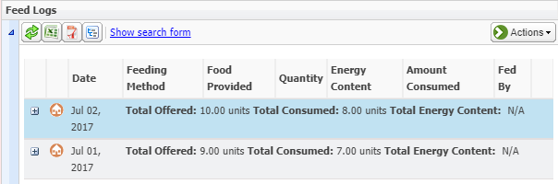
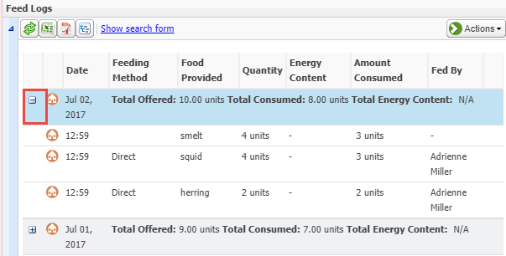
Display in Record
The record will display as
collapsed (top). To look at the
complete record details you can expand each line separately using the “+” (bottom).

Slide 18
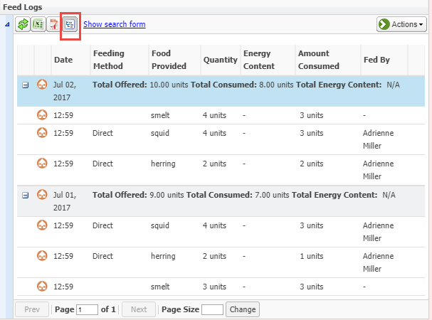
Display in Record
You can also use the
Expand All button at
the upper left to
expand all of the records
in one click. If you export
the record to Excel or PDF
the details will export
regardless of whether the
grid is expanded or not.

Slide 19
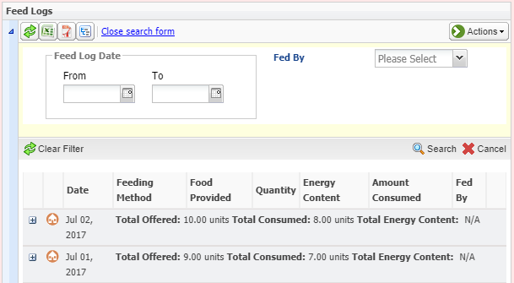
Search Form
The Search Form allows
you to search by a Date
Range or a specified
Fed By. The results of
this search are all that
will export should you
wish to filter your
exports.

Slide 20
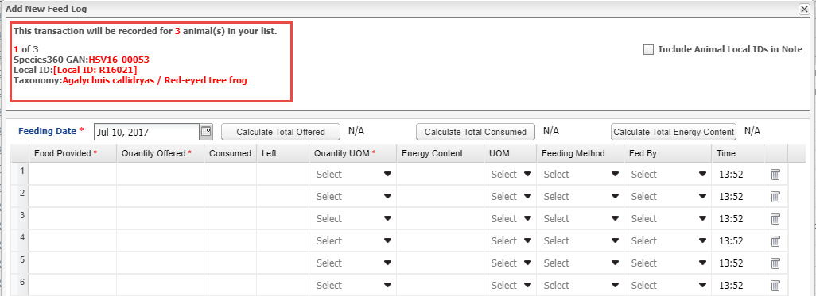
Batch Feed Log Entries
Even with the new grid format, Feed Logs remain available as a Batch action,
with either a single entry for all or a custom entry for each record.

Slide 21
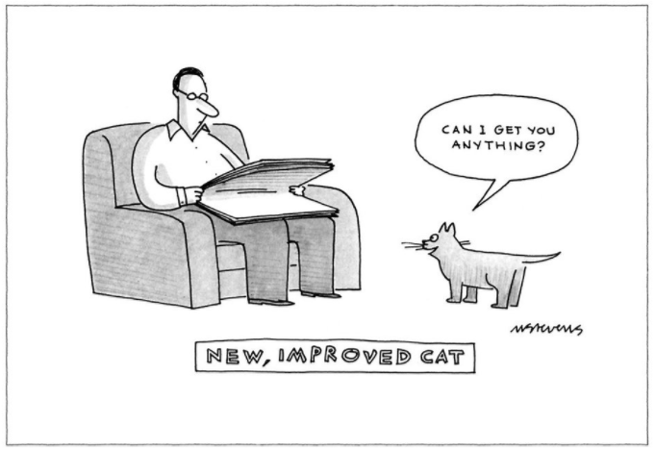
Any Questions?
On New Email Confirmation and
Improved Feed Logs

