Slide 1
Studbook Intro
The Husbandry/Studbook Interface in ZIMS
May 2017 Tips and Tricks

Slide 2


Husbandry/Studbook Interface
With the release of the ZIMS for Studbooks module the Studbook Keeper’s
life has been made much easier! There is no waiting for reports from institutions
regarding collection changes for their species and there is no re-entering of
Institutional data. This is because certain pieces of data go from the Husbandry
module directly into the Studbook module for the Studbook Keeper to accept
or reject. This is a one-way road, no information from the Studbook module
goes directly into the Husbandry module.

Slide 3
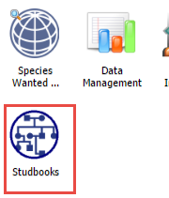
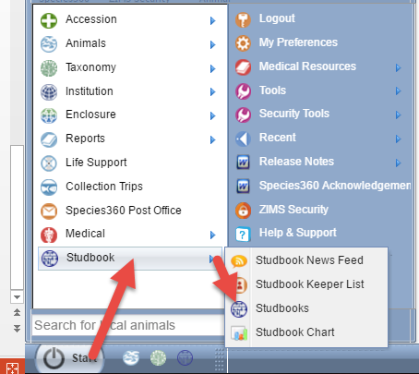
What the Studbook Keeper Sees
A Studbook Keeper gets to their
studbooks by selecting either
the studbooks desktop icon or
Start>Studbook>Studbooks.

Slide 4
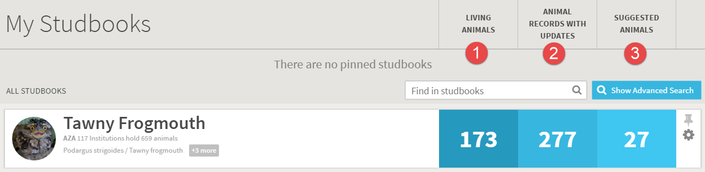
My Studbooks
Any studbooks held by the Studbook Keeper will display in the My
Studbooks screen.
Living Animals is the count of current animals in the studbook
Animal Records With Updates are animals already in the studbook that have had some sort of data updated at the institutional level
Suggested Animals are animals entered into ZIMS that may be eligible for a studbook entry

Slide 5
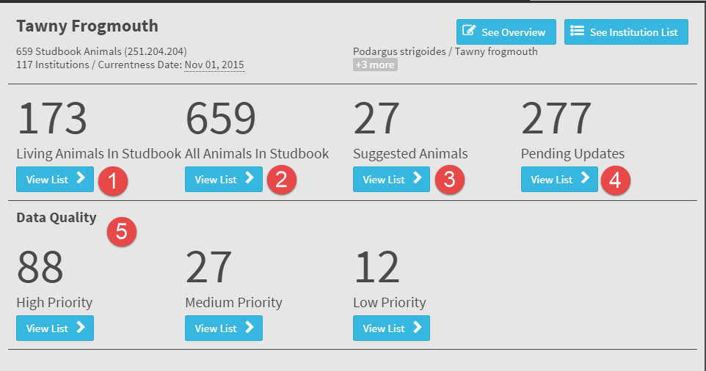
Studbook Dashboard
Selecting the studbook will open the Studbook
Dashboard where the Studbook Keeper can view
and take action on:
Living Animals in the Studbook
All Animals in the Studbook
Suggested Animals
Pending Updates
Data Quality issues with varying Priorities
#s 3 and 4 are pulled from Husbandry data

Slide 6
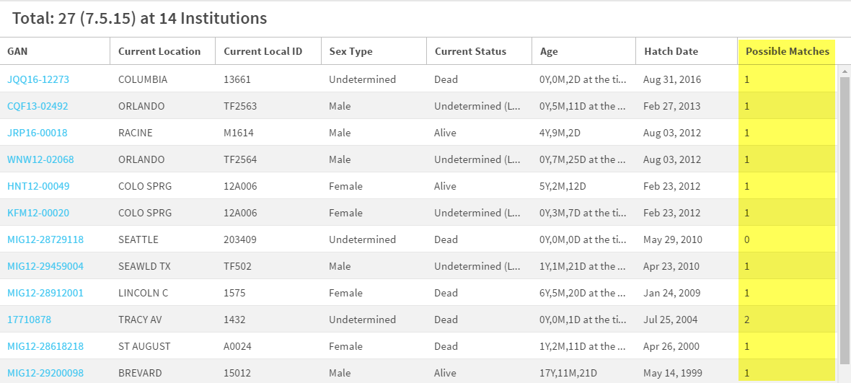
Suggested Animals
Suggested Animals are records that have been entered
into the Husbandry module but have not yet been
incorporated into the studbook. If ZIMS finds any
possible matches that are already in the studbook,
these matches will be indicated in the Possible Matches
column.

Slide 7
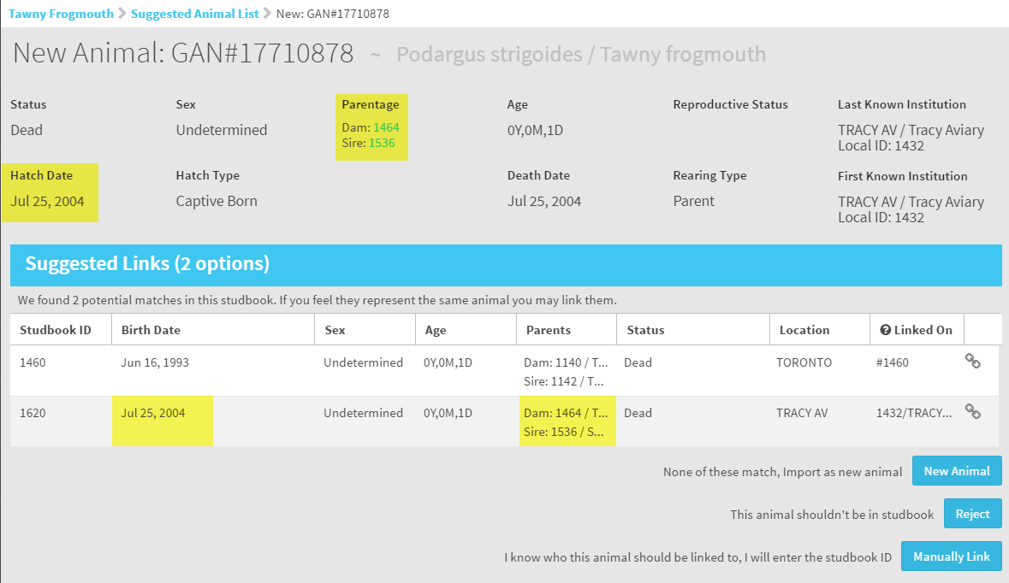
Possible Matches
We opened the record for an animal with 2 Possible
Matches. Comparing the Parentage and Hatch Date
we believe that SB#1620 may be a match.

Slide 8
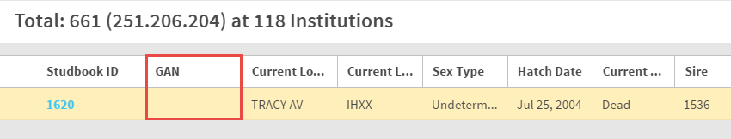
Possible Matches
We want to look at the record for #1620 to confirm that it is a
match and can be linked. Note that #1620 has no GAN
assigned to it. This means that this studbook record is not yet
linked to a record in ZIMS.

Slide 9
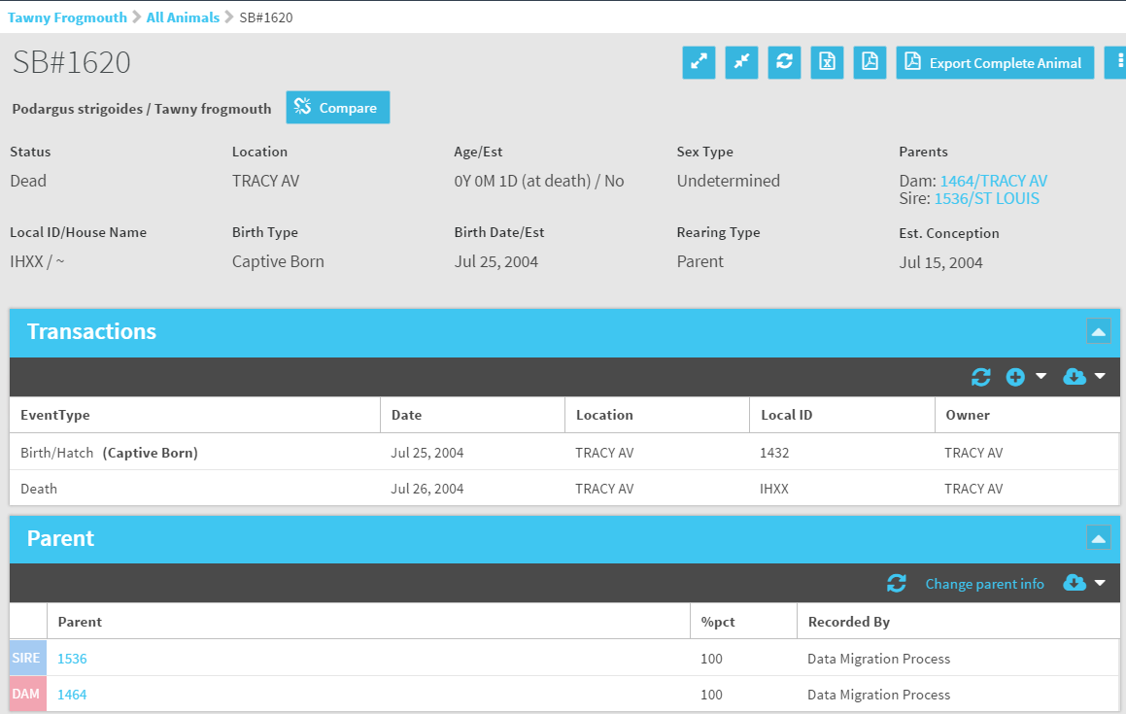
Possible Matches
To be completely certain we open the
studbook record for #1620 and review
the data.

Slide 10
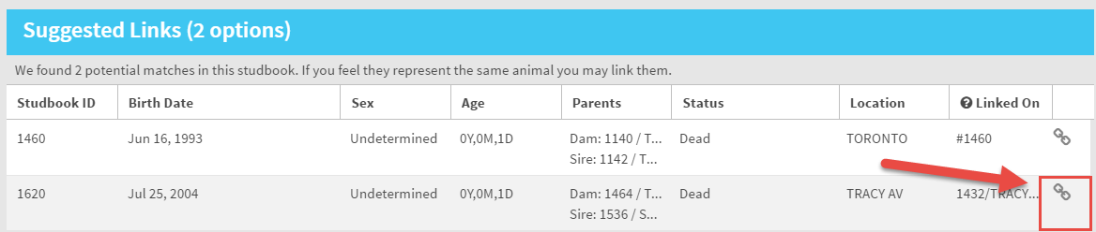
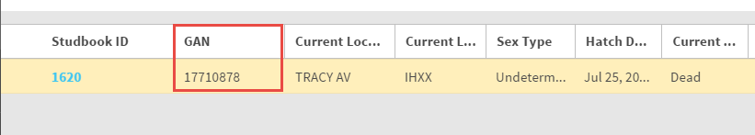
Linking the Records
We are confident that #1620 and GAN 17710878 are the same animal. We select the
link icon to link the records. Note that #1620 now has a GAN associated with it. GAN
17710878 will be removed from the Suggested Animals list.

Slide 11
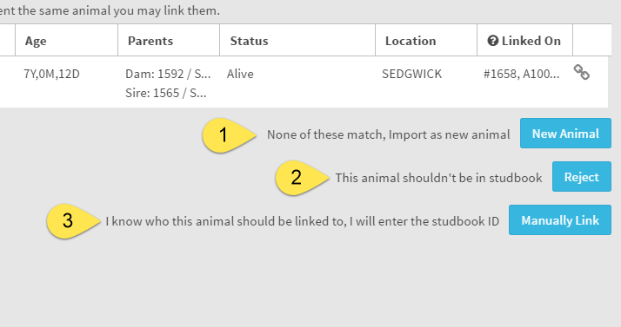
Other Options
If there are no Possible Matches found, or if we do not agree with the matches, there
are three other options available:
1.New Animal – the record will not be linked with a studbook record and a new record
will be created
2.Reject – the record will not be included in the studbook
3.Manually link – there is a different record in the studbook that this record should be
linked to

Slide 12
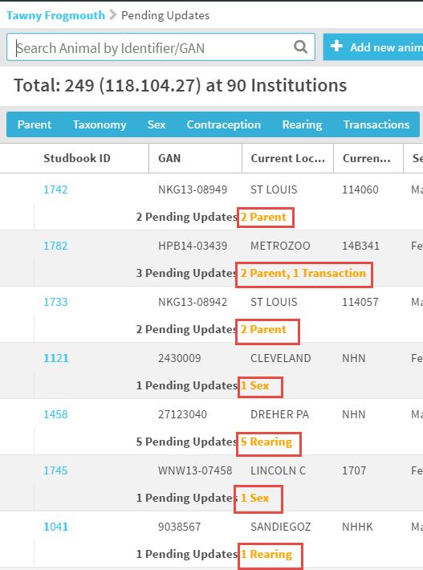
Pending Updates
Pending Updates are created
when edits/additions are
recorded in the Husbandry
module for animals that are
already in the studbook. They
are also created when the
data that migrated with the
studbook differs from some
Institutional data. The
number of updates and the
grid that needs to be
updated are indicated.

Slide 13
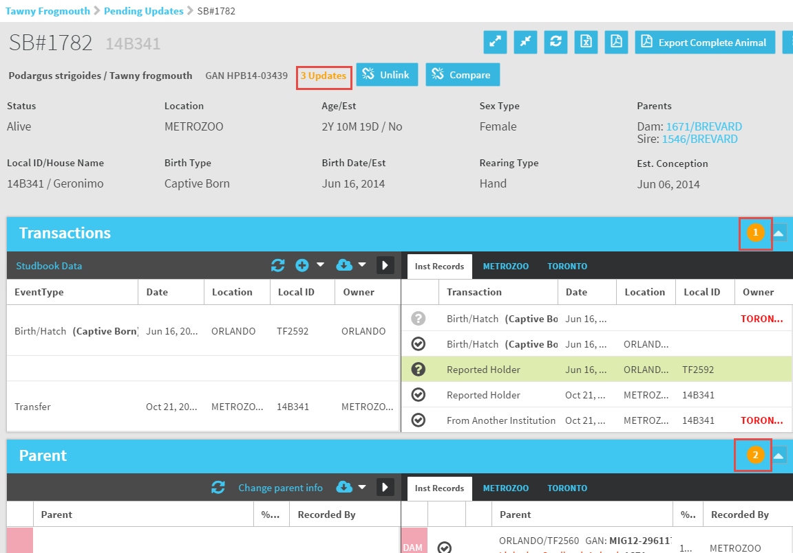
Pending Updates
In the studbook record the number of
updates displays next to the GAN. Grids
that contain the updates will display the
number involved. This record has 3
updates, 1 in the Transaction grid and
1 in the Parent grid. The studbook data
displays on the left, the institution data
displays on the right.

Slide 14
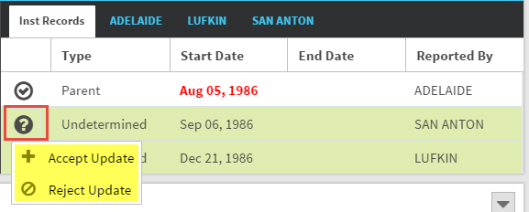
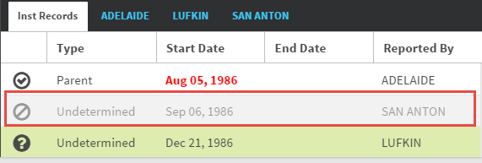
Accepting/Rejecting the Updates
Selecting the “?” we have the option to Accept
or Reject the institution update. If we Reject it
the data will remain on the institution side,
greyed out, with the Reject icon next to it. If we
Accept it will remain on the institution side with
a checkmark next to it. It will also become part
of the studbook data on the left hand side.

Slide 15
What comes from Husbandry?
Transactions
Parent Information
Taxonomy
Sex
Rearing
Contraception
Identifiers
Whenever the information on
the left is edited in ZIMS, that
data automatically becomes a
Pending Update in the studbook!
The Studbook Keeper will
review and decide whether to
Accept or Reject the addition
or edit.

Slide 16
Any Questions?
On the Husbandry/Studbook Interface

