Slide 1
Spring Cleaning!
Tips and Tricks April 2017

Slide 2
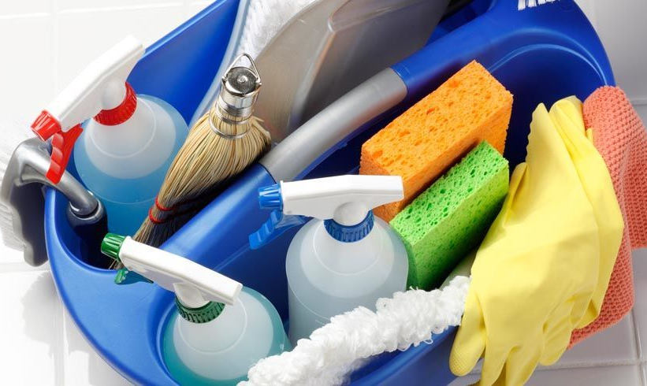
Clean Data Checklist!
Husbandry Module
Data Quality Indicator
Post Office
Medical Module
Relevant Death Information Analysis
Incomplete/Questionable Necropsies

Slide 3
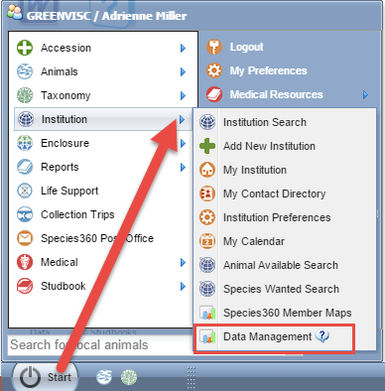
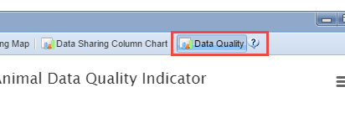
Data Quality Indicator
Your first stop for cleaning up your
data is to use the Data Quality
Indicator. This is found under Start>
Institution>Data Management.
Data Quality is the last tab on the right.

Slide 4
Data Quality Indicator
No Issues (green)
Great! No data quality issues are found
Warnings (yellow)
Of possible concern. You will want to address
Pending Transactions
Really just a heads up
Parents not in ZIMS
Also just a heads up
No parents recorded
These will need to be fixed

Slide 5
Data Quality Indicator
Errors (red)
Bad! Need to Fix
Obsolete taxonomic name
Extra Physical transactions
Extra Ownership transactions
Parent GANS identical to each other
Unrealistic dates
Missing Term
Gap Between Parent Death and Offspring Birth
Congratulations? (blue)
Possible oldest animal(s)

Slide 6
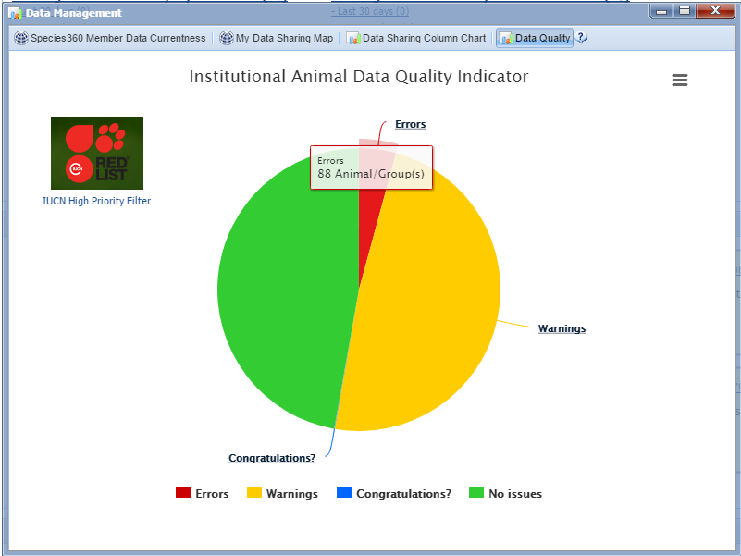
Data Quality Indicator
The Data Quality Indicator
is a pie chart that displays the
records with no issues and
those with the three types of
possible data quality
issues. Obviously you want
your biggest slice to be
green (No Issues) and your
smallest slice to be red
(Errors). A large
Congratulations? slice may
not actually be a good thing.
Hovering over the slice will
display the number of records
in each category.

Slide 7
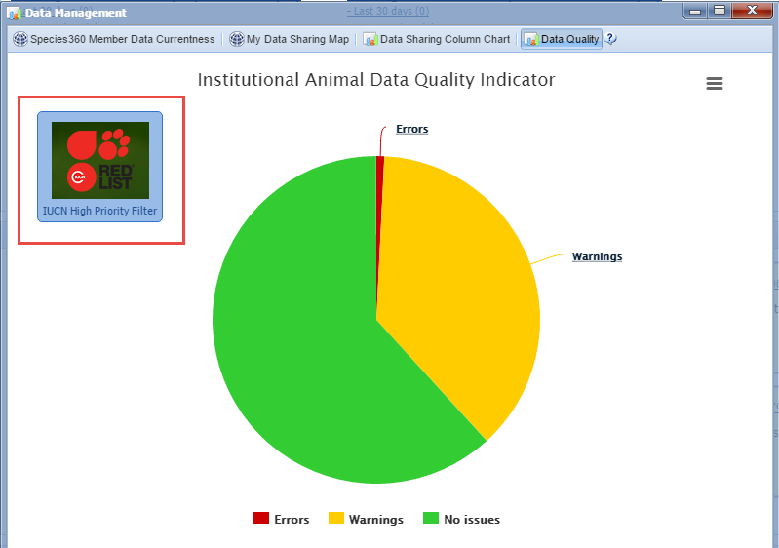
Data Quality Indicator
If you don’t know
where to get started
it is recommended
to apply the IUCN High
Priority Filter. This
will ensure that you
are cleaning up the
data for high priority
animals first. Note that
using this filter greatly
reduced the size of the
Error slice and increased
the size of the No Issues
slice.

Slide 8
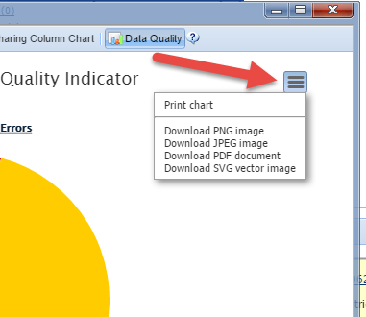
Chart Context Menu
Using the “hamburger” icon
on the right you can download
any of the charts to various
formats to include in
presentations or documents.

Slide 9
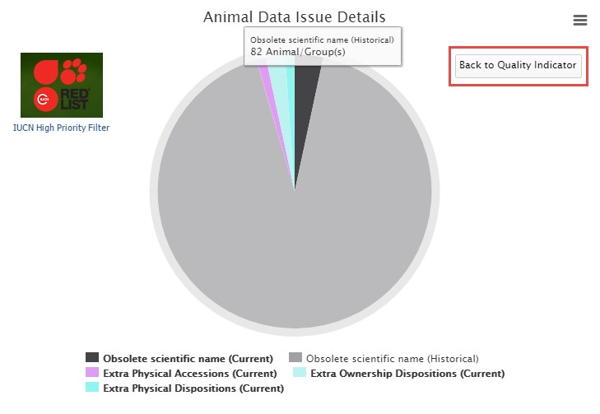
Data Issue Details
Left clicking on the pie
slice will drill down in
the chart for more
details. Here we have
selected our Errors.
We have current and
historic Obsolete
Taxonomic names,
Extra Physical Accessions
and Dispositions and
Extra Ownership
Dispositions. You can go
back to the previous
chart using the “Back
to Quality Indicator”
button.

Slide 10
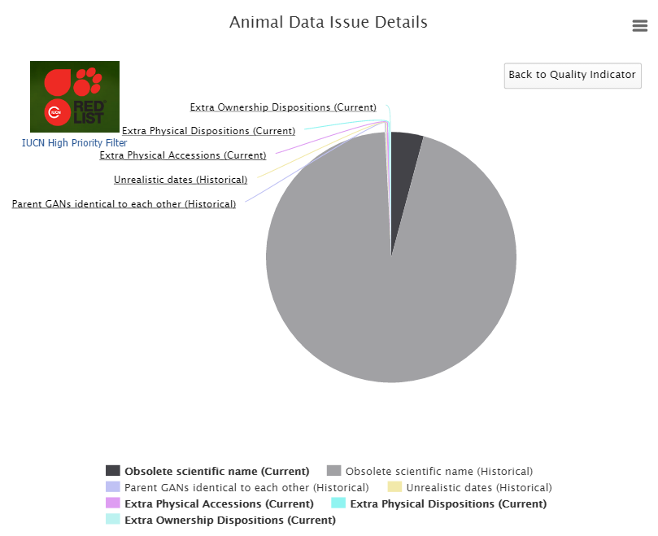
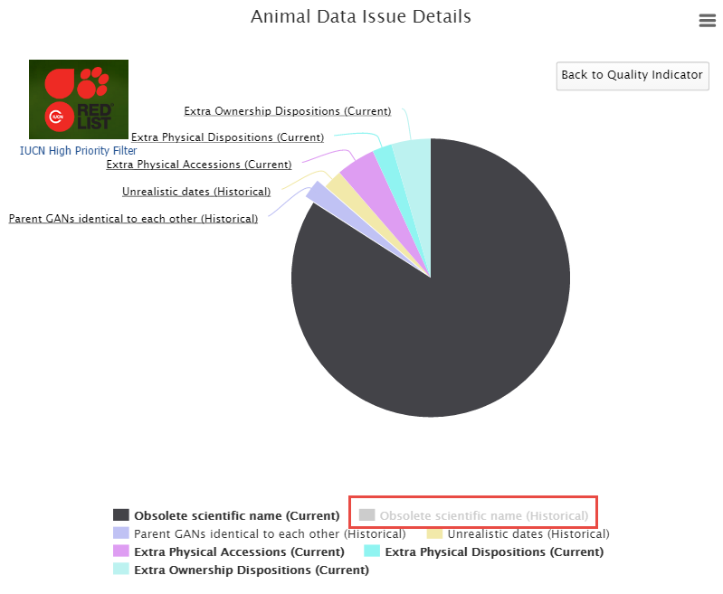
Expanding the Pie Slices
If some of your pie slices are too small to read (as on the left) removing other slices
by clicking on the topic below the chart will expand the others. Here we have removed
Obsolete Scientific Name (historical) (now greyed out) to better view the other slices.

Slide 11
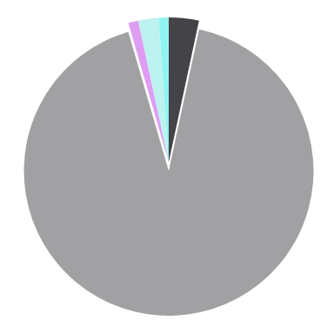
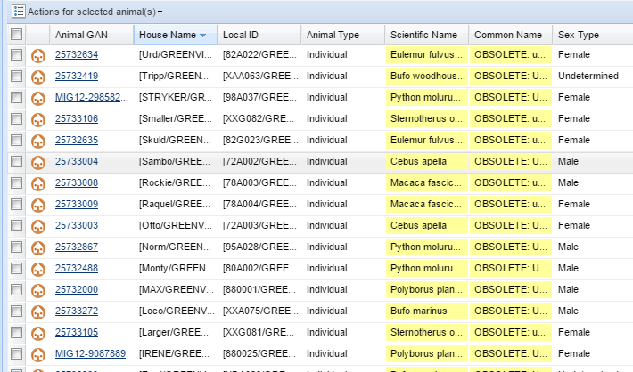
Locating the Records
Clicking on the pie slice will bring up a list of the animal records that contain the data
that created the Error or Warning. Here we opened the slice for Obsolete Taxonomy
(historical).

Slide 12
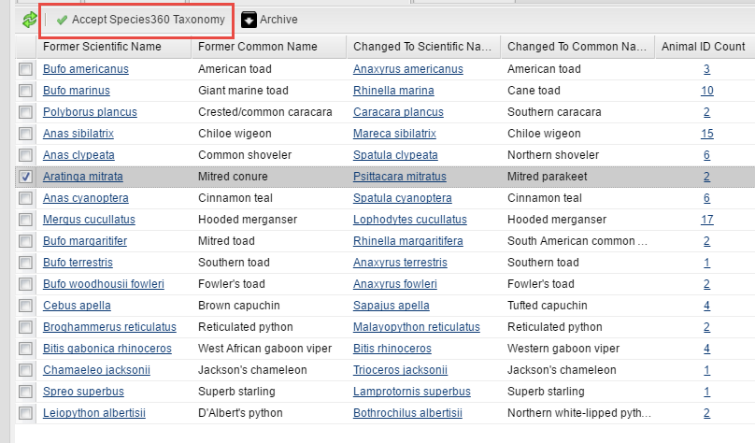
Fixing Obsolete Taxonomy
You can fix these Obsolete Taxonomies
one by one from within the record
and editing the Taxonomy. However,
the easiest and quickest way to fix
Obsolete Taxonomy is to accept the
Pending Taxonomic Changes found
under Animal Statistics (right). The
Animal ID count will give you a list of
the records that will be affected. Simply
check the taxonomy change you want
to accept and then select Accept
Species360 Taxonomy (above).

Slide 13
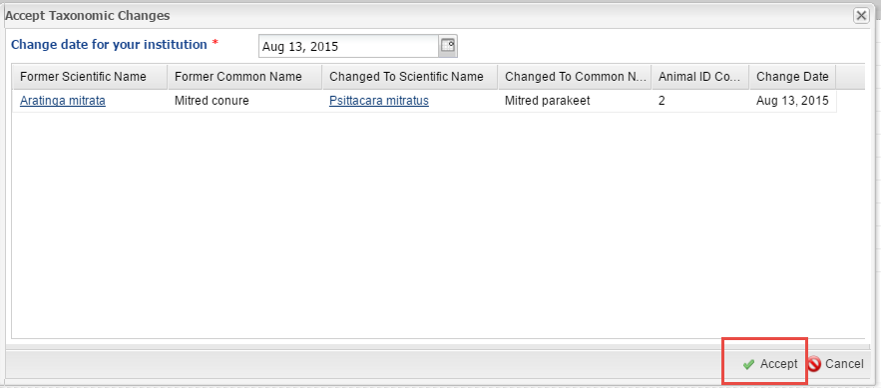
Fixing Obsolete Taxonomy
The taxonomy information will display as well as the change
date that will be used. That date is the date that Species360
updated the taxonomy. Select “Accept” to fix the Obsolete
Taxonomy.

Slide 14
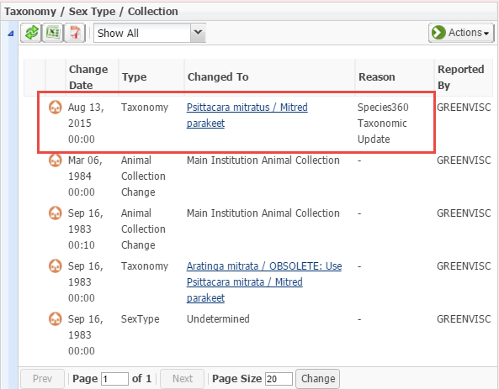
Fixing Obsolete Taxonomy
The Taxonomy will update in the
record. These records will no
longer display in the Data
Quality chart as an Error. It may
take up to 15 minutes for the
taxonomy in the Basic Detail to
update itself and remove the
conflict that was shown when
the obsolete taxonomy was in
use so be patient. If you do NOT
want to change all the records
using an Obsolete Taxonomy you
should NOT accept the changes and
will need to change from within
each record.

Slide 15
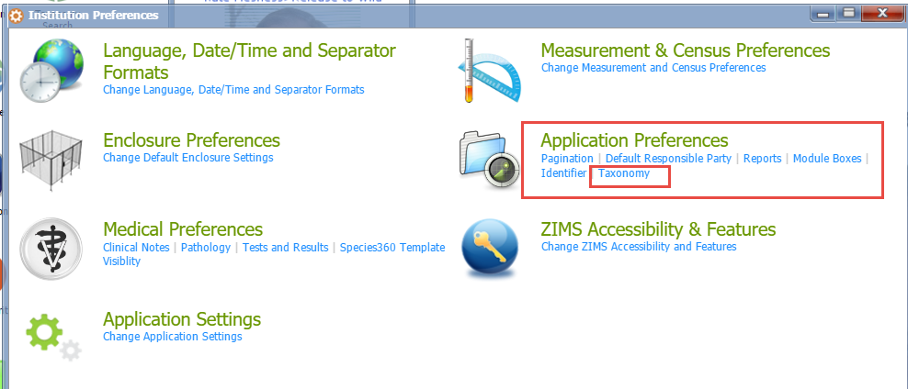
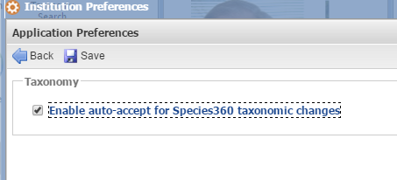
Auto Taxonomy Accept
If you do not want to deal with
the possibility of having Obsolete
Taxonomies in your records you
can select Taxonomy under
Application Preferences. If the
Enable Auto-accept box is checked,
any time that Species360 updates
a taxonomy your records will be
automatically updated. This is an
Institution Preference only and is
not available under My Preferences.
You will still receive a Post Office
message when a taxonomy is
updated so you will remain informed
of the change.

Slide 16
Fixing Extra Transactions
Extra Transactions are usually found only in migrated records. At the top you
have recorded receiving the animal twice with two slightly different Loan
terms. At the bottom you have recorded sending out the animal twice. These
should be researched and the incorrect transaction removed. Always add a
Note should you have to do this!

Slide 17
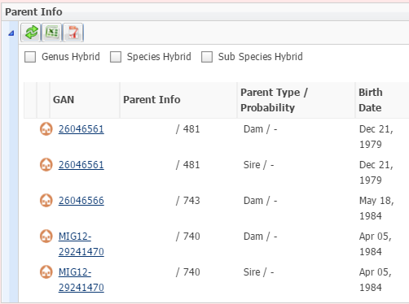
Fixing Identical Parent GANs
Identical Parent GANs means
that the same animal has been
entered as both a Sire and a
Dam. This is not always an
Error because that is what is
recommended to enter when
an animal who is a possible
Parent is unsexed. However,
there is a possibility that since
the record was created the
animal has been sexed. In this
record we checked the sex for
GAN 26046561 and it has since
been sexed as a female. It can
be deleted as a Sire record (and
add a Note!).

Slide 18
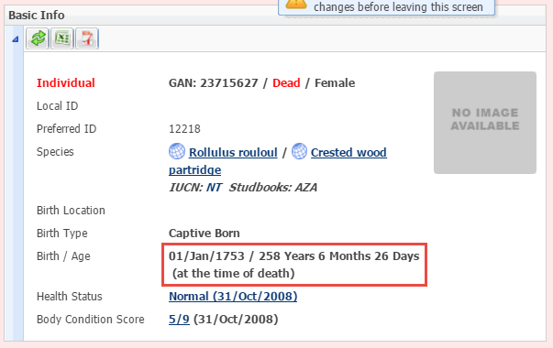
Fixing Unrealistic Dates
Finding the Unrealistic Dates may
require a bit of detective work as
they are not always obvious. But
here we have a 258 year old wood
partridge (fairly unrealistic). Although
My Transaction stream has the Hatch
Date correctly recorded as 9 July 2008,
someone recorded 01 January 1753 in
Event Locations. These dates can only
be corrected by the originating
Institution.

Slide 19
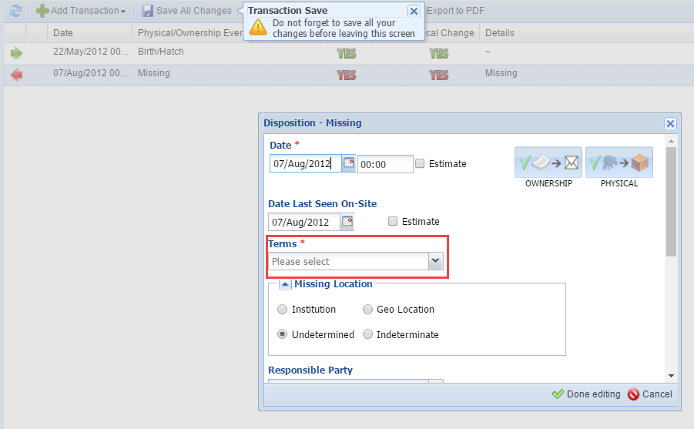
Fixing Missing Terms
Missing Terms are caused by migration
from ARKS. Most are typically found
in a transaction of Missing because
there were no Terms required in the
ARKS application for a Missing transaction.
However, other transactions can still
contain blank Terms although these are
far fewer. Simply find the blank field by
opening My Transactions records and
select the proper Term.

Slide 20
Fixing Gap Between Parent Death and Birth/Hatch
Fixing Errors for Gap Between Parent Death and Offspring Birth will also require a bit of detective work. The record that will open will be that of the offspring. This penguin (top) was hatched on 14 April 2011. However, when you open the dam’s record you note that she died on 24 June 2008 (bottom). There are several possibilities here: 1) the incorrect dam was recorded 2) the incorrect hatch date for the chick was recorded, or 3) the incorrect death date for the dam was recorded.
You will need to look at both records, don’t forget to look in the Notes, to determine which record needs to be corrected.

Slide 21
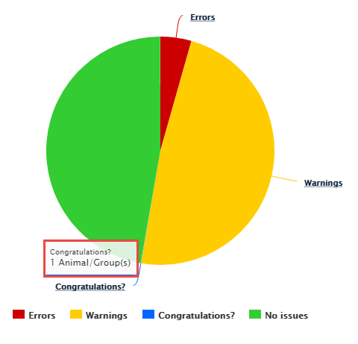
Congratulations?
Congratulations? Is an
indicator that you may
possibly have the oldest
individual of a species.
To open this (usually
very small) pie piece you
click on the hyperlink
instead of the pie slice.

Slide 22
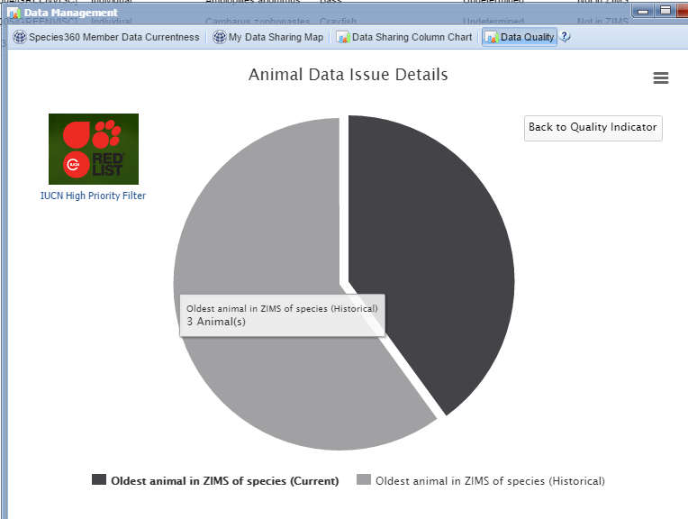
Congratulations?
The chart is divided into
Current and Historical
records.

Slide 23
Congratulations?
It will display the animals that you may be deserving of a Congratulations!
In many cases though, this longevity is due to an error such as not recording
a death on the right date, or even not recording it at all! You may need to review
any Notes in the record to determine if the dates are accurate or if they need
to be corrected. If the record is indeed correct then congratulate yourself and
maybe use it for a Public Relations spot!

Slide 24
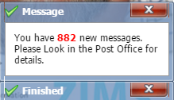
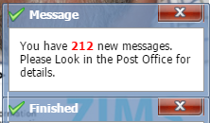
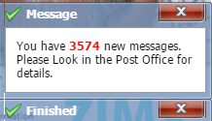
Post Office
The Species360 Post Office
does not have to be a scary
thing! It is there to notify
you of activity in ZIMS that
may warrant you taking an
Action. Most of what is shown
in the Post Office is not
displayed elsewhere in ZIMS.
Addressing your Post Office
messages will help you clean
up your data.

Slide 25
What’s in the Post Office?
Taxonomy Changes
these are also displayed in Pending Taxonomic Changes in Animal Statistics
Modifications to medical terms you have used
Definition edits & formulation changes
A local term made global
Sex Type changes to animals you have had
This may help you clean up those duplicate Parental GANs!
Animal you own placed on Available Animal list
Animals merged by Species360
Pendings
Denied
No Information Available
Not recorded in ZIMS
These are some of the topics you will receive
as Post Office messages. Those displayed in
red will have the greatest impact on your
data quality.

Slide 26
Managing the Post Office
Post Office messages are like Outlook. When someone takes an action on a message it will only be reflected in THEIR Post Office
It is recommended that you give Post Office access only to those staff members who may actually take action on the messages
The only Species360 template role that has Post Office access is Local Admin
It is highly recommended that you go through your Post Office messages and address any Actions you need to take and move to trash
However, that is the perfect world. You can…….

Slide 27
Make a Spring Cleaning Resolution!
Resolve that you are going to start reading your Post Office messages
Export your current messages to Excel so you lose nothing should you find time later to read them
Move all messages to Trash and delete
Start reading and acting on your Post Office messages daily. Then move them to trash and delete

Slide 28
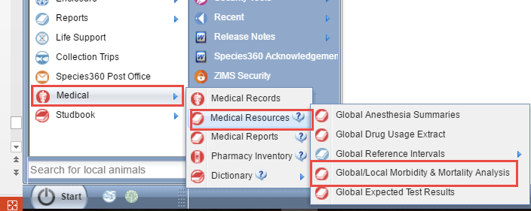
Relevant Death Information Analysis (Incomplete Necropsies)
The Global/Local Morbidity & Mortality Analysis under Medical Resources
can help you find any incomplete necropsy records if run at the Local level.

Slide 29
Relevant Death Information
Select Relevant Death Information Analysis and My Institution scope. You can limit
by taxonomy or select Animalia and check Include Taxon Below to find all the
records you need to complete for your entire collection. Then select to View Graph.

Slide 30
Relevant Death Information
The first graph displays the records with Uninformative
RDI records, Useful RDI records, and Records with Conflicting, Suspect or Incomplete RDI records. Hovering over the bars will display the number of records of each type.

Slide 31
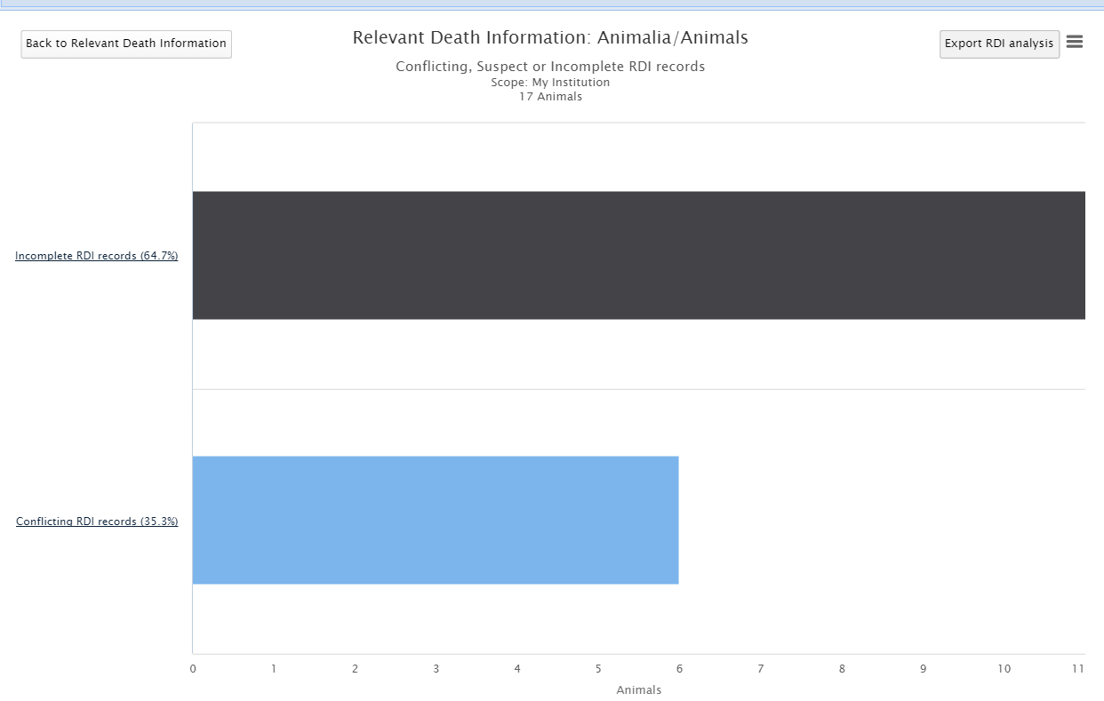
Relevant Death Information
Clicking on the bar title hyperlink or the bar itself will drill down to display another graph. Here we opened the graph for records that are Conflicting, Suspect, or Incomplete.

Slide 32
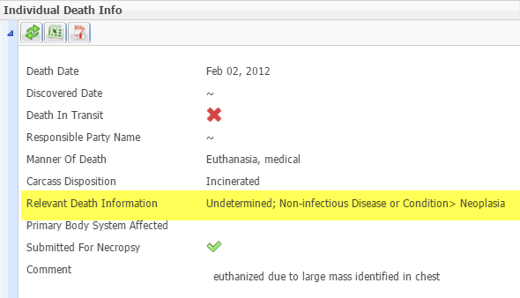
Relevant Death Information
When you open your final bar a
list of animals with records will
be displayed. Here we see all
records where Undetermined/
Indeterminate AND useful RDI
has been recorded. In this record
Undetermined and Neoplasia
have been recorded. The
Undetermined entry should be
removed.

Slide 33
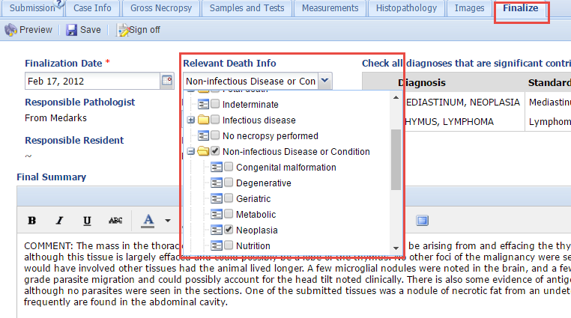
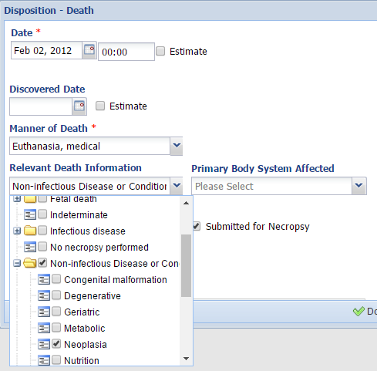
Relevant Death Information
You can correct the Relevant Death Information from
either the Finalize tab in the necropsy record (medical
module on left) or the Death record in My Transactions
(husbandry module on right).

Slide 34
Any Questions?
On Clean Data

