Slide 1
ZIMS Charts, Maps
& Data Management
March 2017 Tips & Tricks
Information Back to You and Quality Controls

Slide 2
How do Animal Charts Help Me?
Animal Charts were designed to answer questions that people repeatedly asked Species360.
We figured you were also getting the same questions about your collections
The Charts help answer questions about what percentage of your collection is
  At risk in the wild (using IUCN Red List)
  Captive/Wild born
  CITES listed
  Specific taxonomic class
They help answer questions on your facilities contribution to conservation
You can compare your percentages with all of the ZIMS data
Start>Animals>Charts

Slide 3
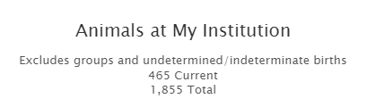
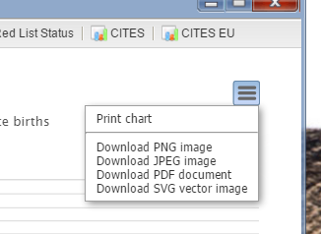
Animal Charts
To properly interpret the
Animal Charts note any
disclaimers at the top. This
Animal Chart is displaying
your local animals but all
Groups and Undetermined/
Indeterminate births have
been excluded.
Using the hamburger icon
in the upper right you can
download all the charts to
several formats to use as
desired.

Slide 4
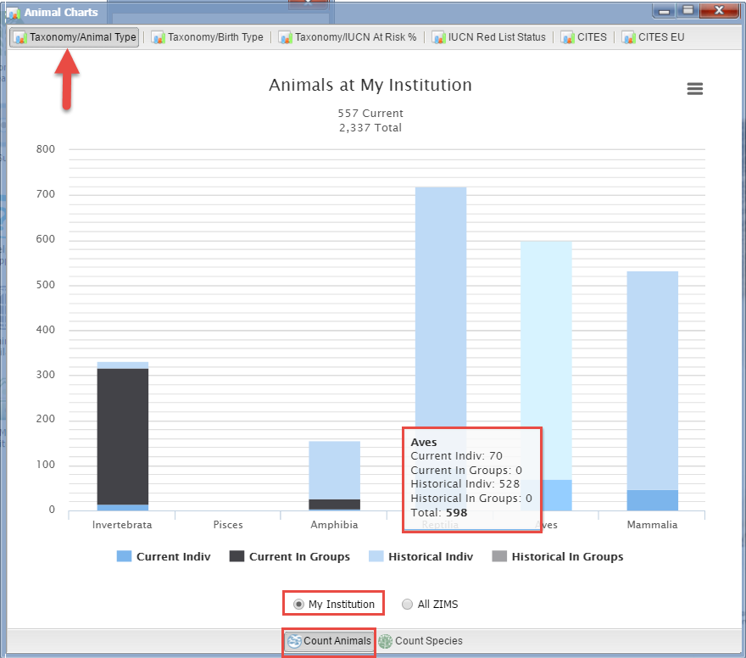
Taxonomy/Animal Type
The Taxonomy/Animal Type
Chart displays the count by
number of animals or by
number of species by Class.
It separates out by Groups
or Individuals and Current or
Historical records. Hovering
over the bars will display the
actual count for each
Class. This Chart can be run
at the Local level or all of ZIMS.
This Chart is showing the Local
animal count.

Slide 5
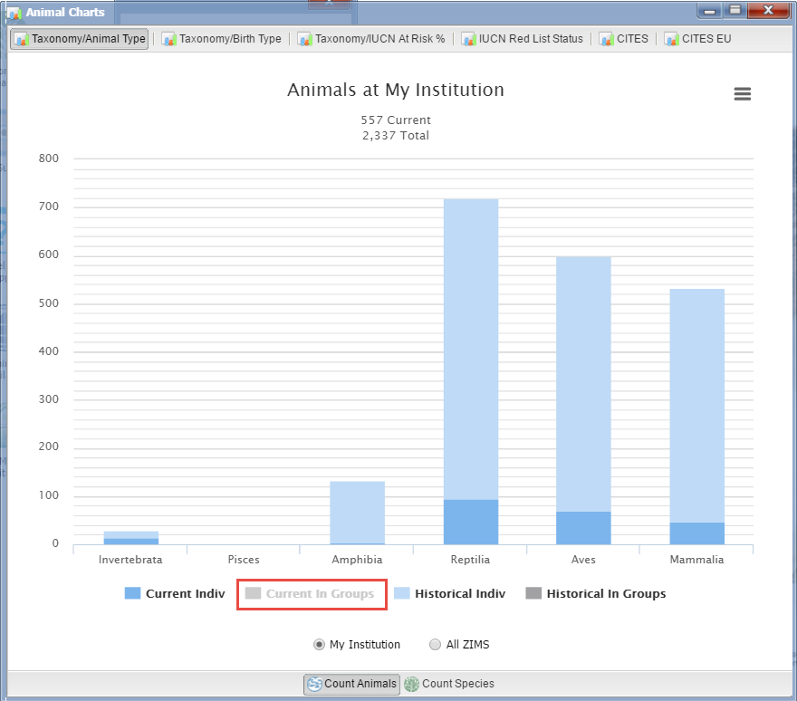
Removing a Category
For all of the Charts and Maps
clicking on a category label will
remove it and the Chart/Map
will be redrawn. The removed
category is greyed out. To
bring it back simply re-click on
it. Here we have removed
Current in Groups from the
calculations.

Slide 6
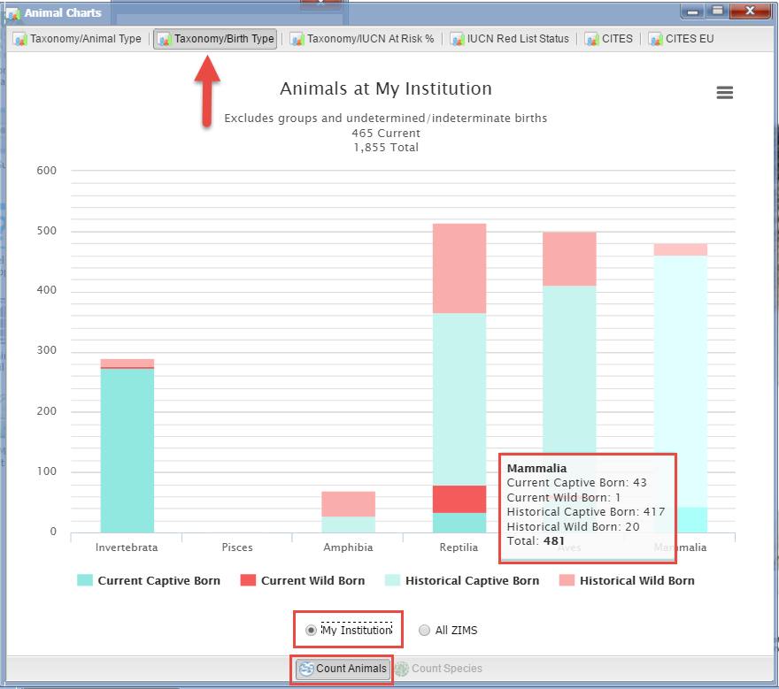
Taxonomy/Birth Type
The Taxonomy/Birth Type
Chart displays the number
of Captive or Wild births
by Current or Historical
records. This Chart can be
run only by the number
of Animals and not by
Species. As in the last chart,
hovering over the bar will
display the actual numbers.
This Chart can be run for
both Local or Global results.
Here we see the Local
animal count.

Slide 7
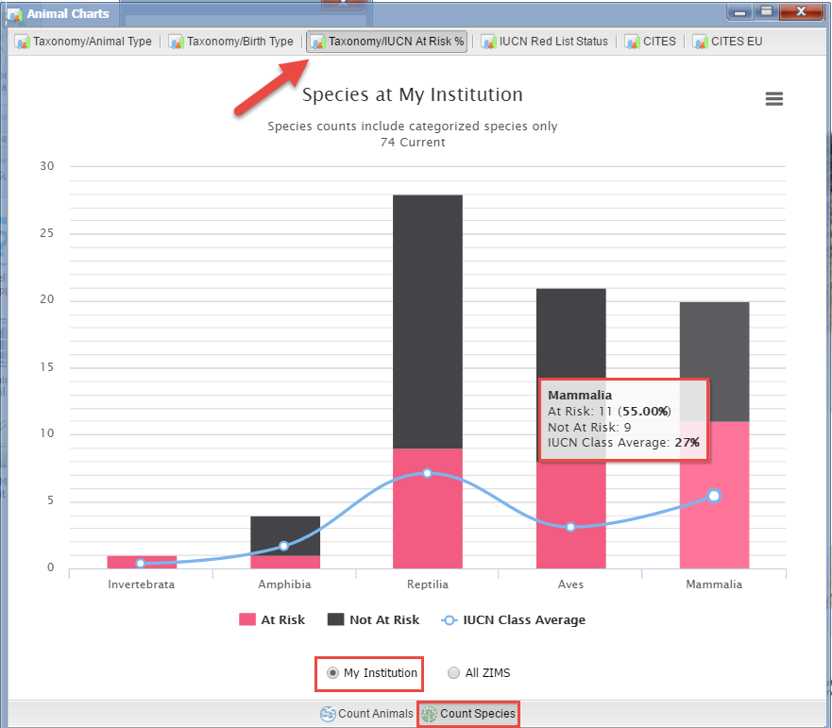
Taxonomy/IUCN at Risk %
The Taxonomy/IUCN at Risk %
Chart shows the conservation
focus of the institution using
IUCN at Risk status. The line
through the dots shows what
the IUCN Class average is. This
institution holds less than the
average number of species of
amphibians at risk but is well
represented in the other
Classes. This Chart is showing
the Local species count.

Slide 8
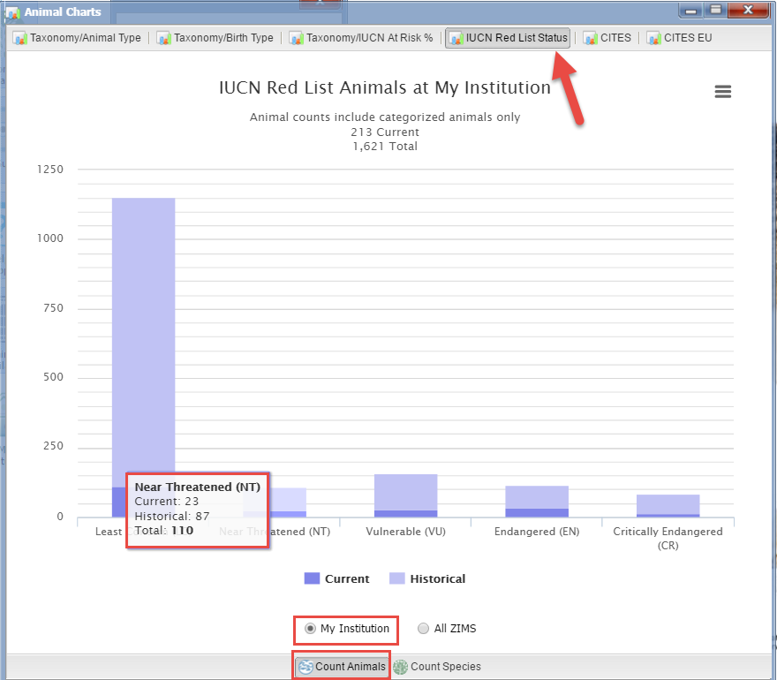
IUCN Red List Status
The IUCN Red List Status
looks at the number of animals or species using the IUCN conservation status categories. As for the other Charts, this can be run at the Local level and compared to the Global database by running it for All ZIMS.
This Chart displays the
Local animal count.

Slide 9
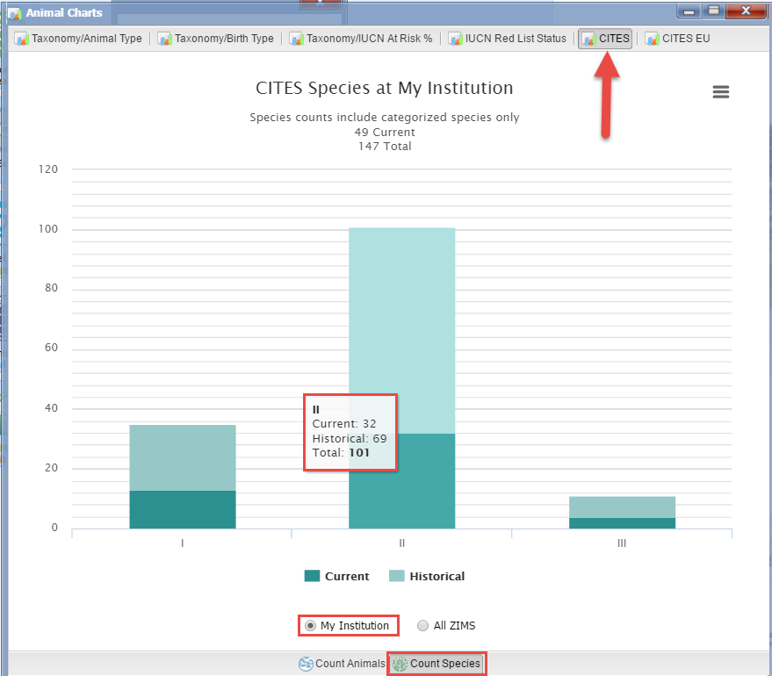
CITES
The CITES Chart shows
the count of animals or
species you currently hold
or historically have held
for each of the three
CITES listings. Here we are
looking at the Local species
count.

Slide 10
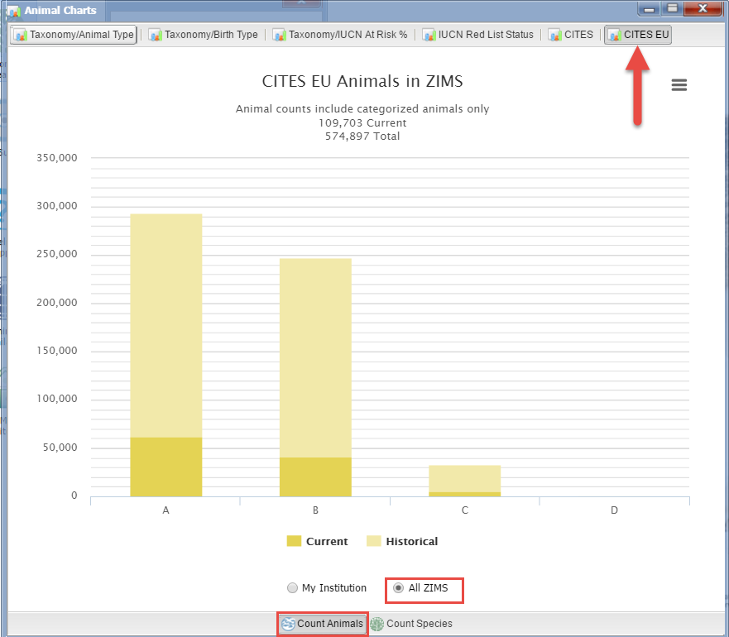
CITES EU
The number of animals
or species listed by
CITES EU are also available
as a Chart. Here we are
looking at the animal count
in all of ZIMS.

Slide 11
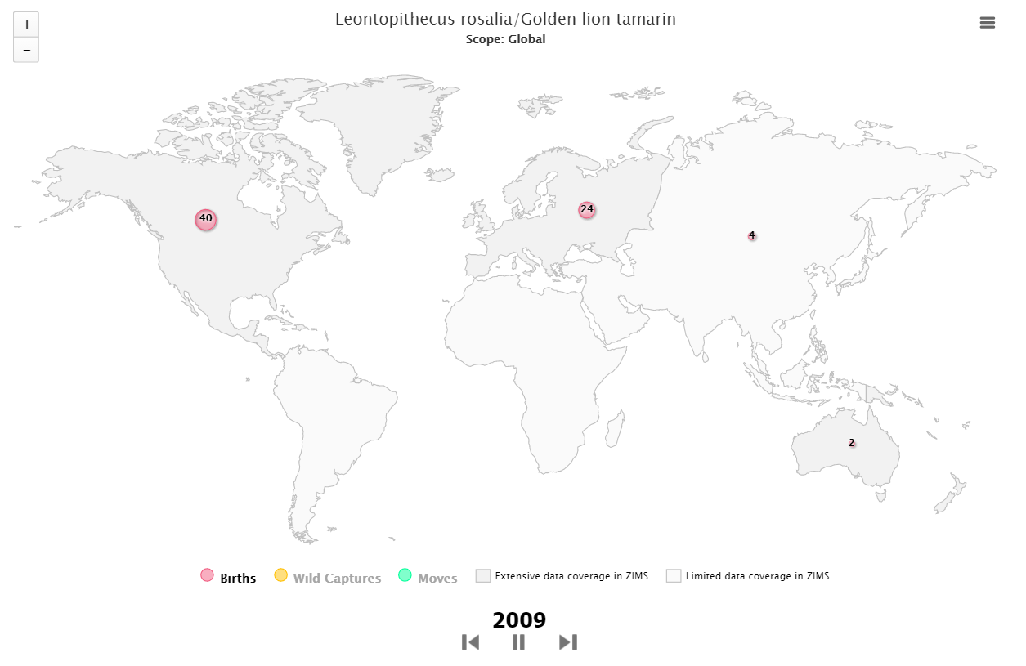
Species Event History Movie
Found under Reports,
the Species Event History
Movie is a graphic display
by year of Births, Wild
Captures and Moves.
Please read the Limitations document found when you set your filters for the Movie to better understand the display. This screen shows the number of Births in 2009.

Slide 12
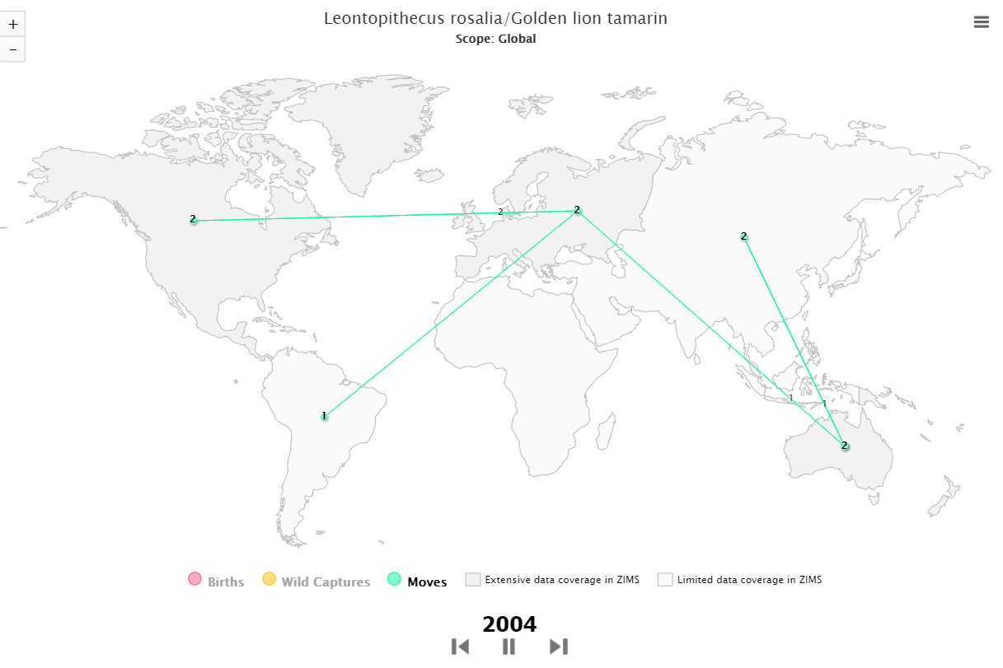
Species Event History Movie
Regions with extensive data
in ZIMS are darker grey than
those regions with limited
data in ZIMS. You can filter
this report by various scopes
(Global to My Institution) and
Taxonomy. This capture shows
the Moves in 2004. Pick your
favorite species, grab
some popcorn and watch
a few!

Slide 13
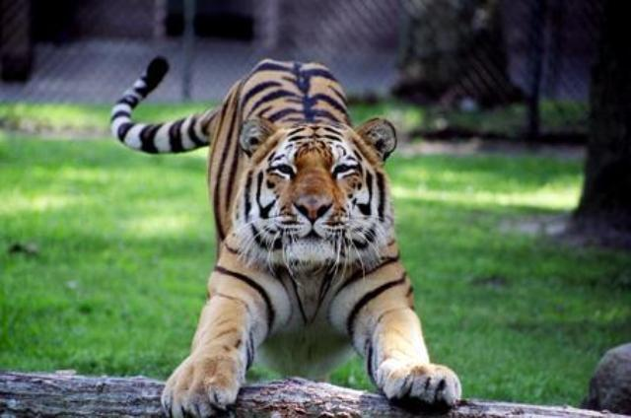
Any Questions?
On Animal Charts

Slide 14
How do Member Maps Help Me?
Member Maps are for overall understanding of where the data in ZIMS is coming from
They help with answering PR questions
They show how the ZIMS application is being used
Start>Institution>Species360 Member Maps

Slide 15
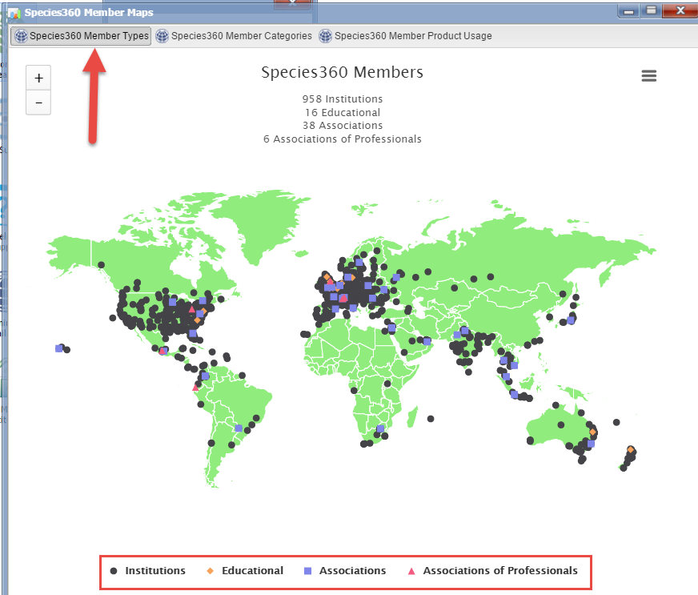
Member Types
The first Member Map
displays the four Types
of members throughout
the world. This is a very
quick option for finding
facilities in a specific
region.

Slide 16
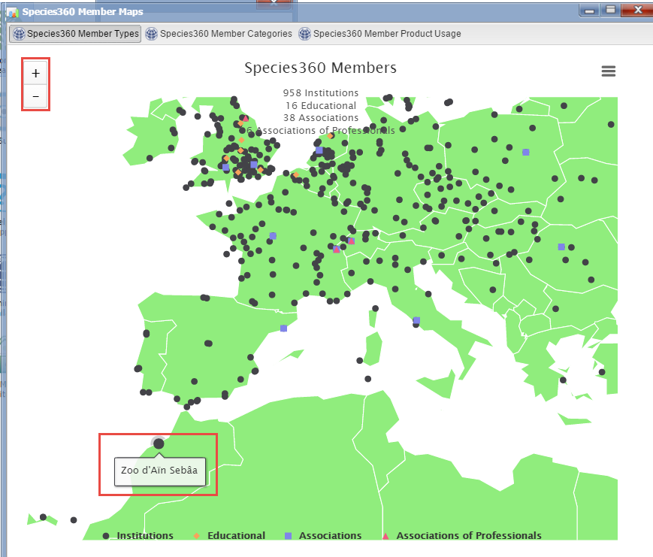
Navigating the Maps
You can use the “+” and
“-” options to adjust the
the map detail. Hovering
over the dot will display the
institution name. Double
left clicking on the dot
will open the institution
record in Global view.

Slide 17
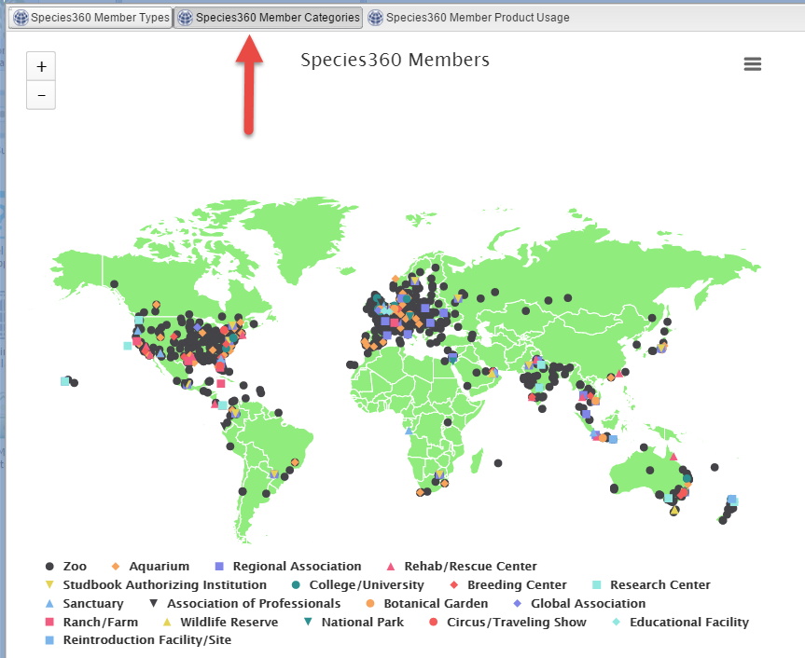
Member Categories
The second Member
Map further divides the
four Member Types into
the 18 Member Categories.
This allows you to further
refine your search for a
specific category of
institution.

Slide 18
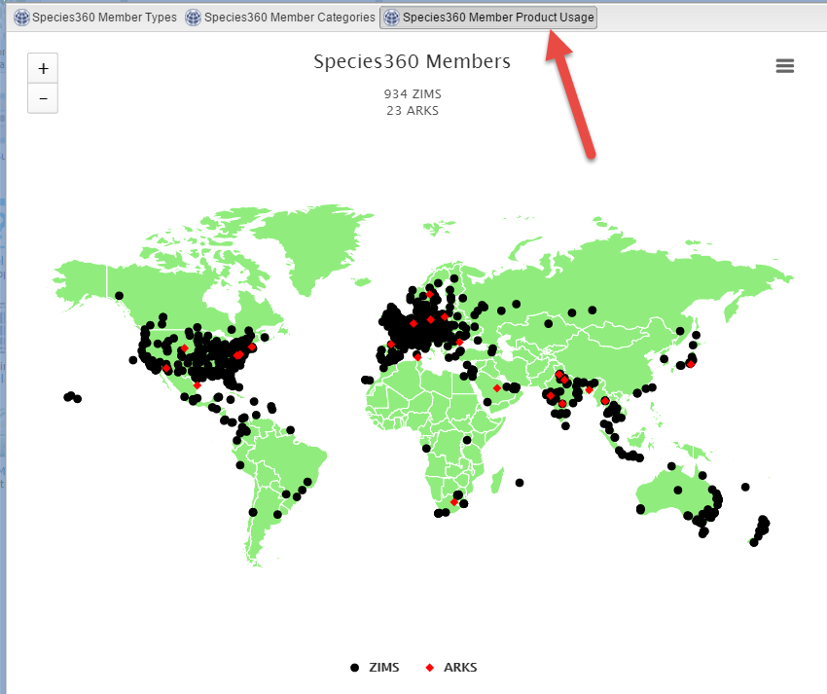
Member Product Usage
Although the vast
majority of Species360
members are using ZIMS,
there are some institutions
still using ARKS. The main
reason in some areas is
poor internet connectivity.
This map can help you
determine if you can share
a record with another
facility or not.

Slide 19
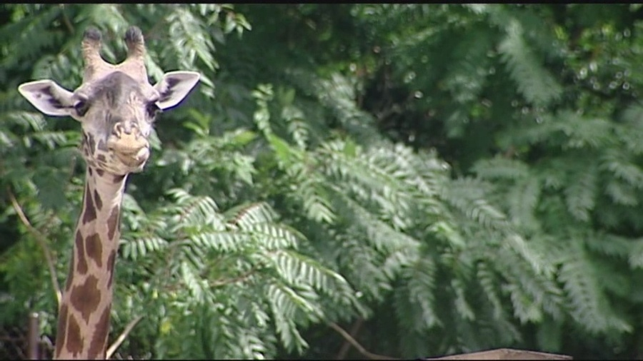
Any Questions?
On Member Maps

Slide 20
How Does Data Management Help Me?
Shows how current members’ data is
  Affects Species Holdings
  Your staff can monitor your currentness
Can see External Sharing at a glance
  Medical/Husbandry
  Shared by You/Sharing by Others
Assists with Data Quality
May note a Congratulations you deserve!
Start>Institution>Data Management

Slide 21
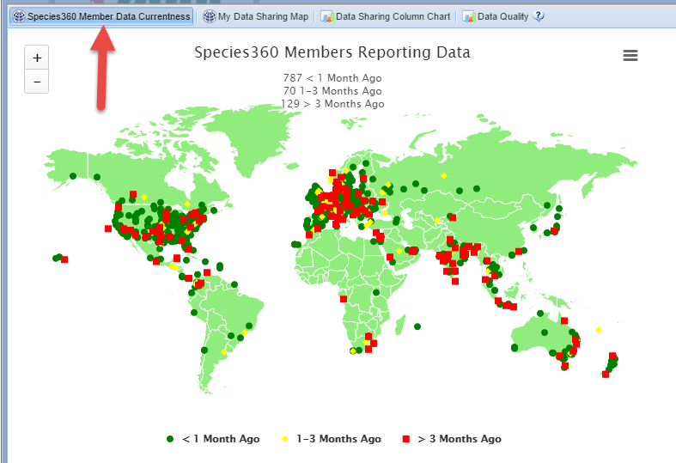
Member Data Currentness
The currentness of an
institution’s data is very
important for good
animal and population
management. Species
Holdings can be impacted
if the data is not up-to-
date. The Member Data
Currentness map displays
if data has been entered
less than 1 month ago,
1-3 months ago, or more
than 3 months ago.

Slide 22
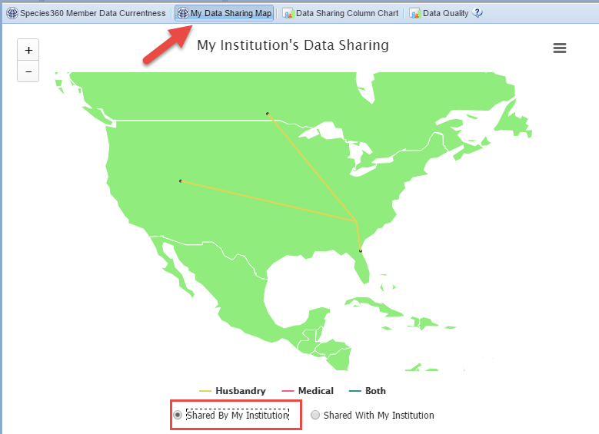
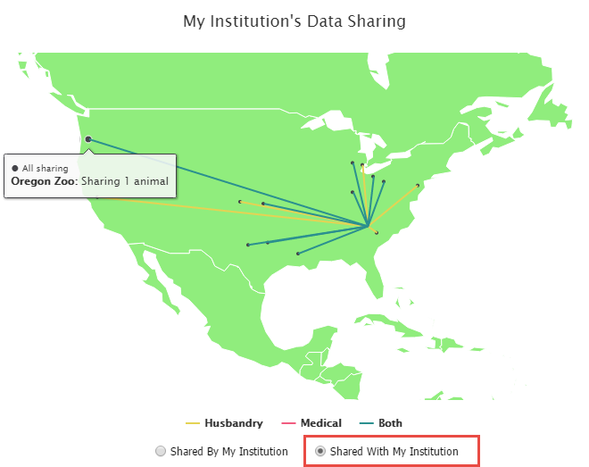
My Data Sharing Map
My Data Sharing Map displays what institutions you are sharing records with and what
institutions are sharing records with you. The different colors indicate Husbandry,
Medical or Both record types. Hovering over the dot will display the institution and the
number of records being shared.

Slide 23
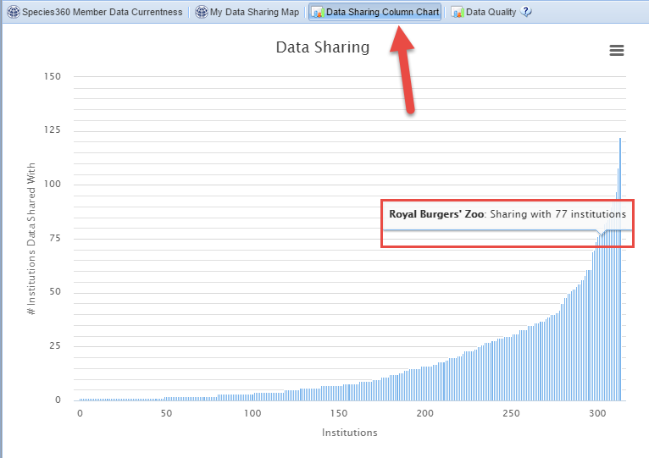
Data Sharing Column Chart
The Data Sharing
Column Chart shows
which institutions are
sharing the least/most
with other institutions.
Hovering over the bar
will display the name
and the number of
institutions being
shared with

Slide 24
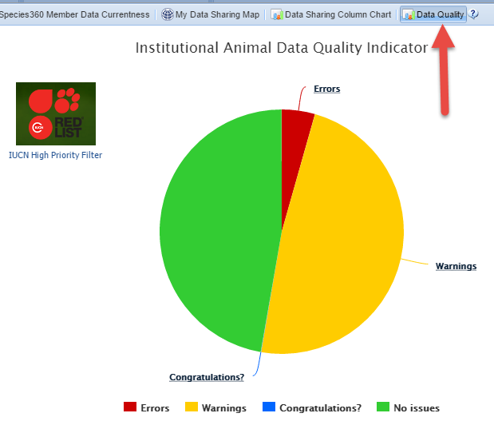
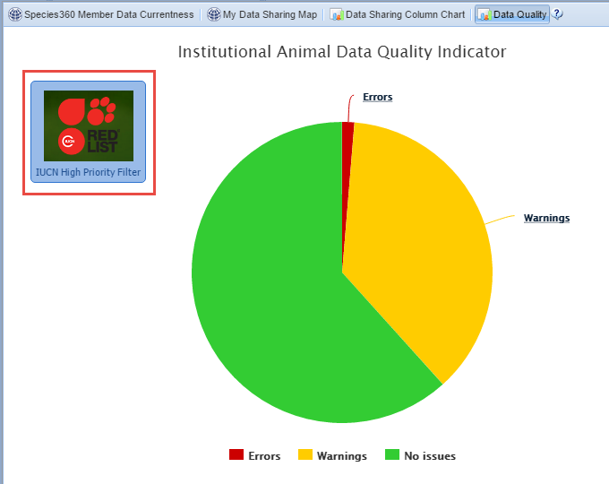
Data Quality
The Data Quality pie chart lets you know the number of records with possible
data quality issues. To help you decide which records should be dealt with first
you can filter the chart by selecting the IUCN High Priority Filter.

Slide 25
Data Quality
No Issues (green)
  Great! No data quality issues are found
Warnings (yellow)
  Of concern. You will want to address
    Pending Transactions
    No parents recorded
    Parents not in ZIMS
Errors (red)
  Bad! Need to Fix
    Obsolete taxonomic name
    Extra Physical transactions
    Extra Ownership transactions
    Parent GANS identical to each other
    Unrealistic dates
Congratulations! (blue)
  Possible oldest animal(s)

Slide 26
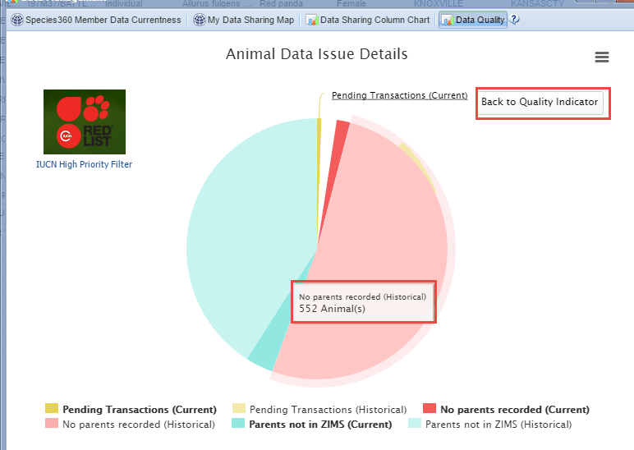
Data Quality Warnings
Left clicking on the
Warnings section
opens a chart that
displays the number
of records with data
you may want to
correct. You can get
back to the original
Chart by selecting the
Back to Quality
Indicator button.

Slide 27
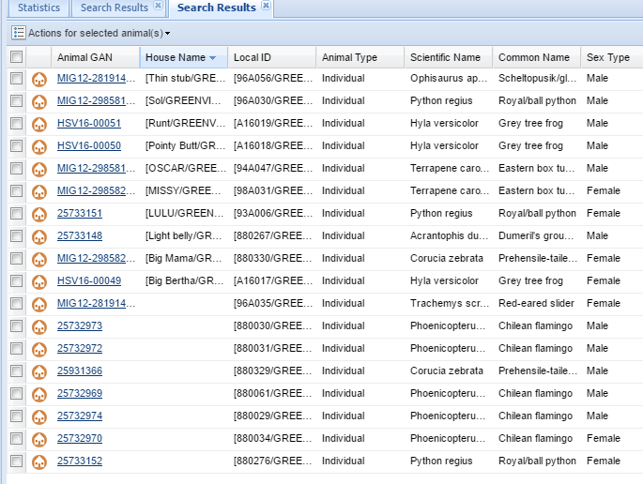
Data Quality Warnings
Left clicking on the pie
slice will open a list of the
records that contain the
selected Warning so that
you can begin to address
the issues.

Slide 28
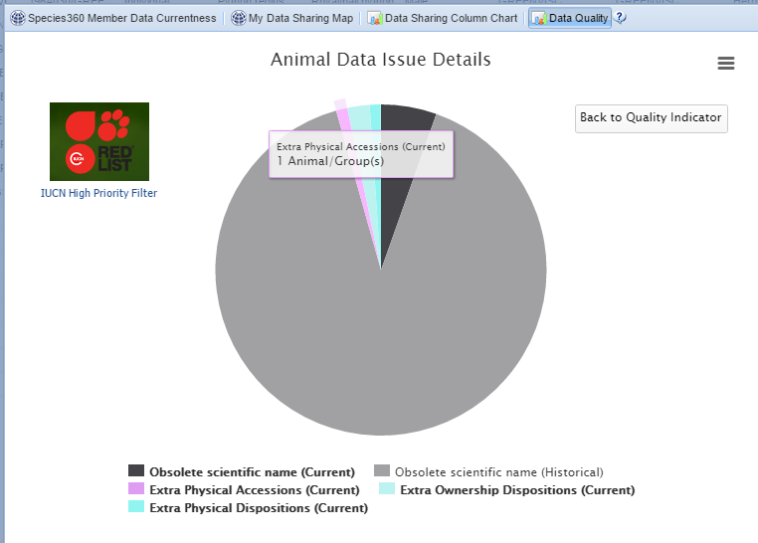
Data Quality Errors
Data Quality Errors
have a bigger impact
on your data than the
Warnings. These
should be addressed
as soon as possible.
Again, you can filter by
the IUCN High Priority
Filter to limit the
records to at risk
species to get you
started.

Slide 29
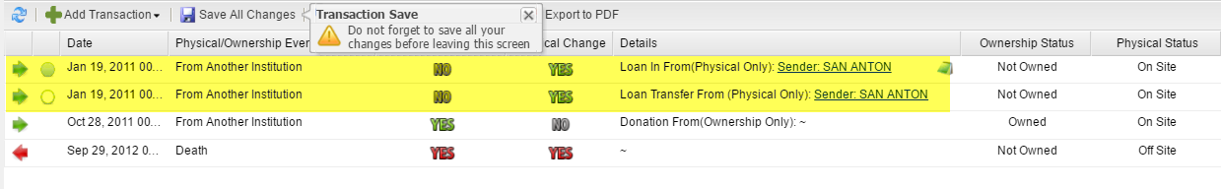
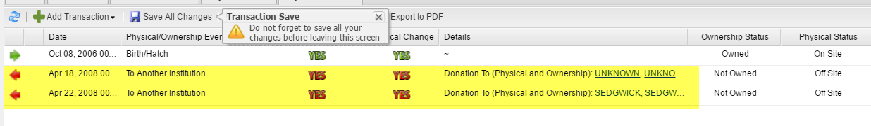
Extra Transactions
Extra Transactions are usually found only in migrated records. At the top you
have recorded receiving the animal twice with two slightly different Loan
terms. At the bottom you have recorded sending out the animal twice. These
should be researched and the incorrect transaction removed. Always add a
Note should you have to do this!

Slide 30
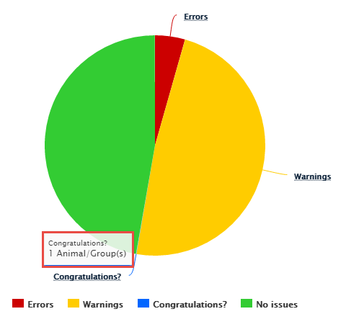
Congratulations?
Congratulations? Is an
indicator that you may
possibly have the oldest
individual of a species.
To open this (usually
very small) pie piece you
click on the hyperlink.

Slide 31
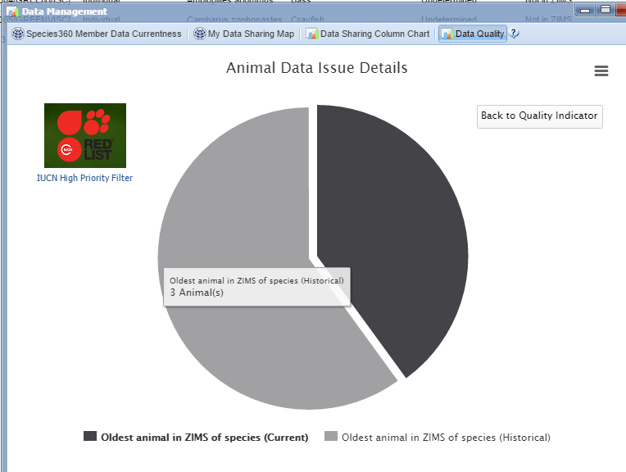
Congratulations?
The chart is divided into
Current and Historical
records.

Slide 32
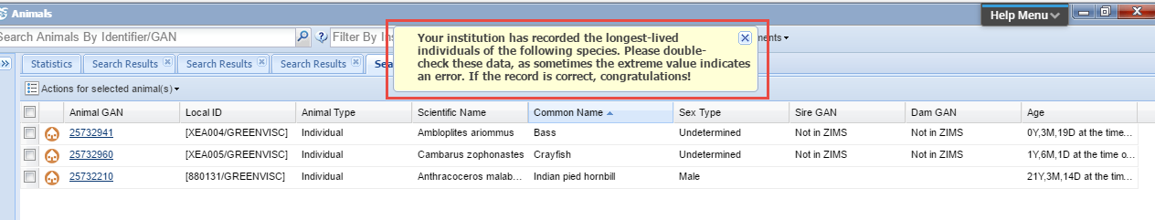
Congratulations?
Clicking on the pie piece brings up the animals that you may be deserving of
a Congratulations! In many cases though this longevity is due to an error
such as not recording a death on the right date, or even not recording it at all!
If the record is indeed correct then congratulate yourself and maybe use it
for a Public Relations spot!

Slide 33

Any Questions?
On Data Management

Slide 34
Thank You

