Slide 1
Tips & Tricks – Release 2.3 Husbandry Update!
January 2016

Slide 2
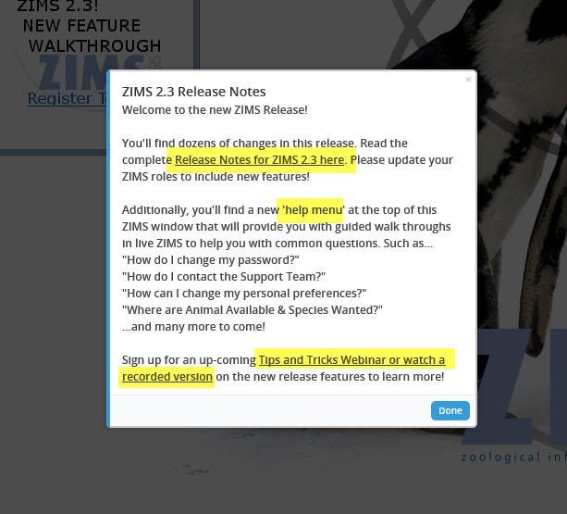
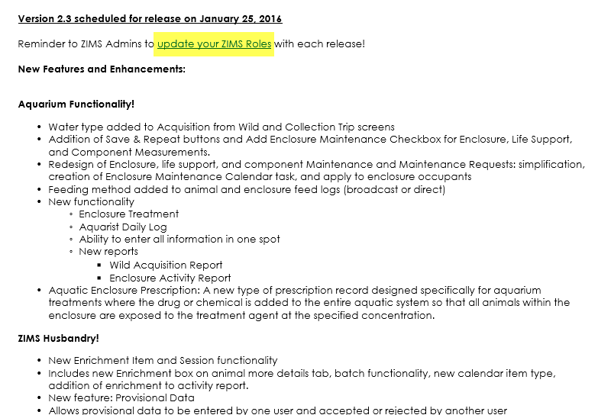
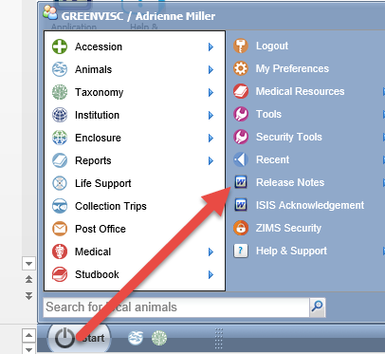
Release Notes
When you first log into the new release a Dialogue
box appears with links to the Release Notes and the
Tips & Tricks Webinars in addition to a note about the
new Help Menu. This should only appear the first time
you log in. The Release Notes are always found under
The Start menu. Note the reminder to update any
of your custom Roles with new functionality as
desired. In addition, check the Species360 Template Roles
to make sure that the new functionality assigned
to those Roles continues to meet your needs.

Slide 3
The Highlights!
Provisional Date Entry
Improved Aquarium Functionality
Additions to Studbook Module
New & Improved Reports
Data Visualization
Enrichment Grid
And more!

Slide 4
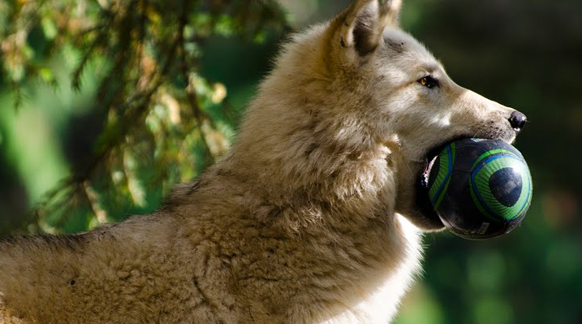
Enrichment Grid
Early last year the ZIMS User Group voted on Enhancements and the
development of an Enrichment grid was a top priority. An 18 member
sub-set of the group worked to develop this module to help you better
track the enrichment given to your animals. The initial phase of this
module rolled out with the 2.3 Release.

Slide 5
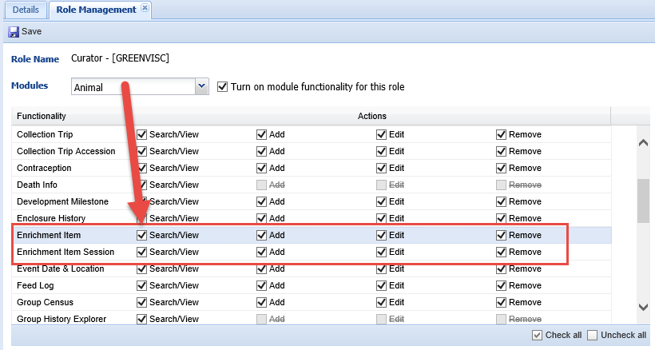
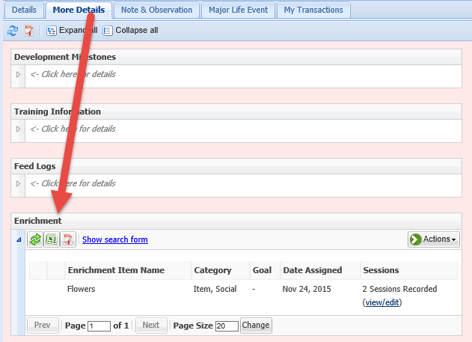
Enrichment Grid
Species360 added access to the Enrichment grid to the Local Admin, Read Only and User
Roles. Remember if you have created any custom roles you will need to add access
as appropriate. Enrichment Item allows you to add an item to your database
and assign it to an animal. Enrichment Item Session allows you to create an
enrichment session within an animal record.
The Enrichment grid is found in the animal record under the More Details tab.

Slide 6
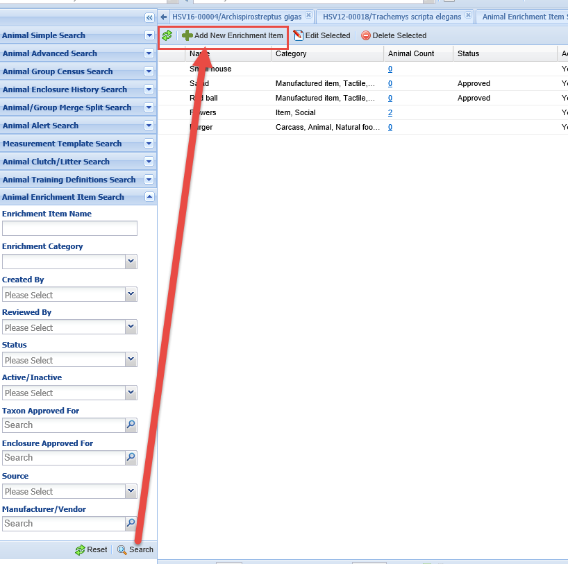
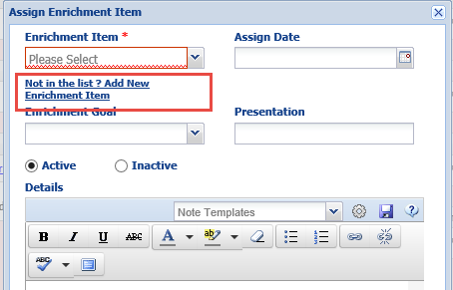
Enrichment Grid – Add Item
You can create a new
Enrichment Item from
the results grid for the
Enrichment Item search
or from within the animal
record by using the Not
in the List? link.

Slide 7
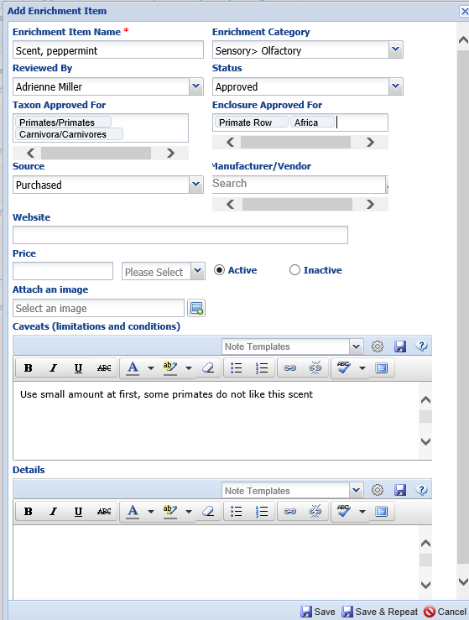
Enrichment Grid – Add Item
You can capture a lot of information in the
Enrichment Item grid but only the Enrichment
Item Name is mandatory. Because the Item
search looks at the beginning of the name, it
is recommended that if you have different
types of similar items you name them by type
first and then the specifics. Here we are adding
a scent that is peppermint. We could also add a scent, lilac and scent, orange. Another example would be various balls would be named ball, red and ball, blue. If you assign an Item to a Taxon you will be able to assign the Item only to members of that Taxon, or below. You cannot assign this item to a bongo as it is assigned to Primates and Carnivores. The same is true for Enclosures. Items can be assigned to Animalia and your institution as the top level enclosure, or not assigned at all.

Slide 8
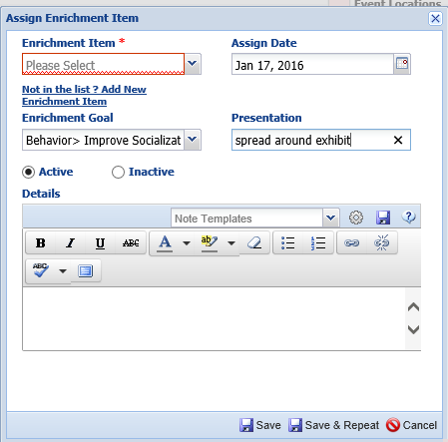
Enrichment Grid – Assign Item
Only Enrichment Items assigned to the
species (or a higher taxonomy) or with
no Assignment will display in the Assign
Item grid. You cannot create a Session for
a date earlier than when the Item was
Assigned. The Goal is a cascading multi-
select dropdown and the Presentation
is a free text field.

Slide 9
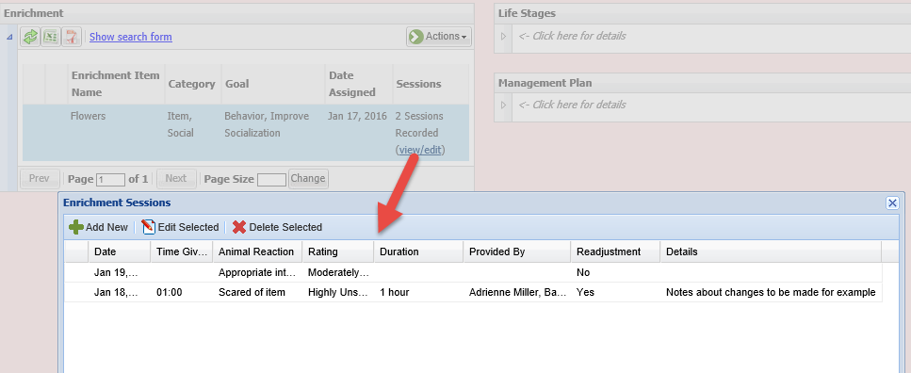
Enrichment Grid – View Sessions
You can view the Sessions from the View/Edit link. You can Add a
New Session, or Edit or Delete a Session from this grid.

Slide 10
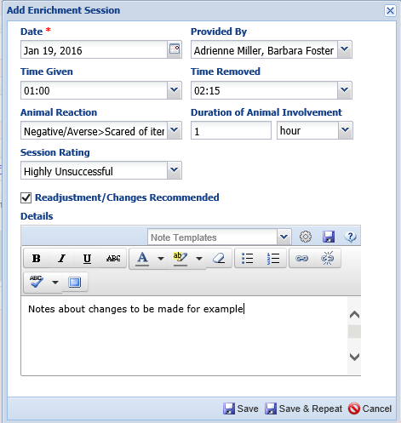
Enrichment Grid – Add Session
When adding a Session the Date
cannot be before the Item was
assigned. Date is the only mandatory
field. The Animal Reaction is a multi-
select cascading dropdown. If
adjustments need to be made you
can record them in the Details box,
or use this free text field as needed.

Slide 11
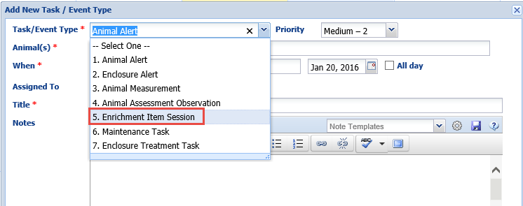
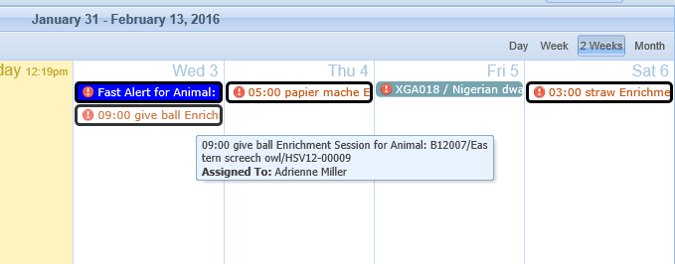
Enrichment in Calendar
You can also schedule Enrichment Sessions using the Calendar Task
Functionality.

Slide 12
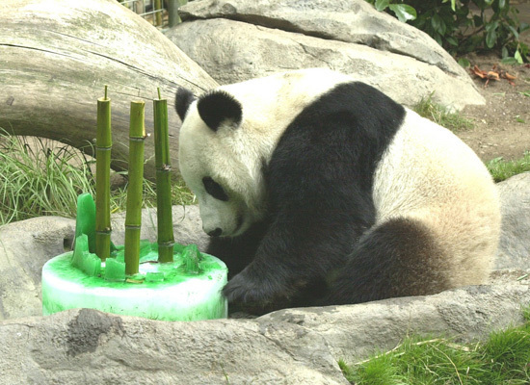
Any Questions on the Enrichment Grid?

Slide 13
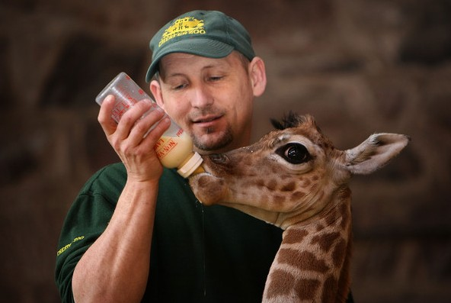
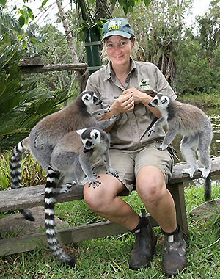
Provisional Data
The initiation of the ZIMS Provisional Data started at the 2015
Institutional Records Keeper course and a conversation between
Josh Courteau and Sunset Zoo’s Curator, Brian Davoren.
The zoo was redesigning their electronic Keeper Daily reporting
and both he and Josh saw the benefit of building it right into
ZIMS.

Slide 14
Provisional Data Contributors
Abilene
Alexandria
Artis
Audubon
Baton Rouge
Calgary
Cameron Park & Botanical Gardens
Central Florida
Chattanooga
Chewhaw Park
Dickerson Park
Ellen Trout
Fresno Chaffee
Little Rock
Living Desert
Louisville
Phoenix
Sedgwick County
Seneca Park
Sunset
Tulsa
Virginia
And happily so did a lot of other institutions
who contributed to the project! Many thanks to them all! Provisional Data allows a ZIMS User to enter provisional (temporary) data that is accepted, edited or rejected by another User. The typical scenario is Keepers doing their own data entry and Registrars then viewing and accepting or rejecting for
final entry into the ZIMS database. It includes a new Daily Report as well as the ability to include or exclude Provisional Data on Activity, Enclosure Activity and Note Retrieval Reports.

Slide 15
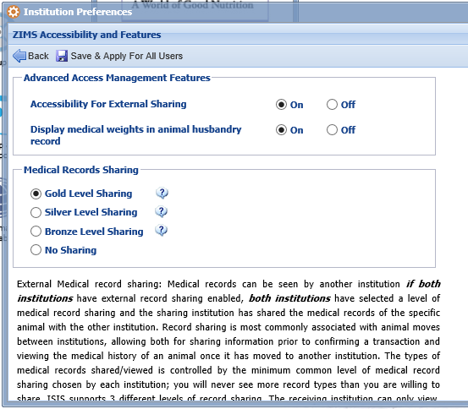
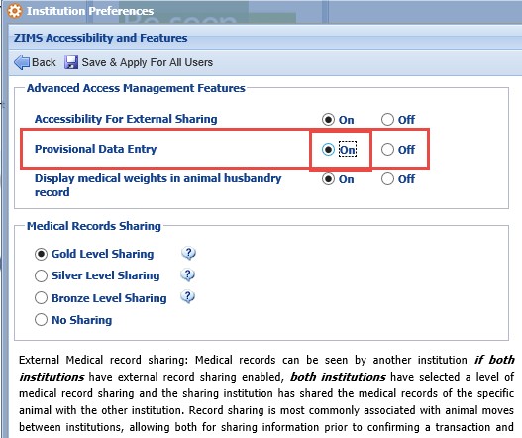
Activation for Provisional Data
The Species360 Global Admin must first turn on the functionality for Provisional
Data entry. The institution on the left has not yet had it turned on. The
Institution on the right has had it turned on. The Local Admin then needs
to complete the activation by selecting the “On” radio button. Remember
to Save & Apply For All Users” (the only Save option).

Slide 16
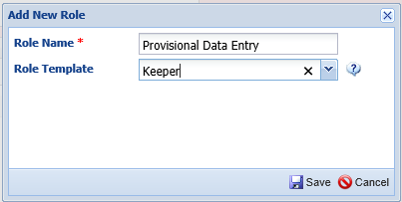
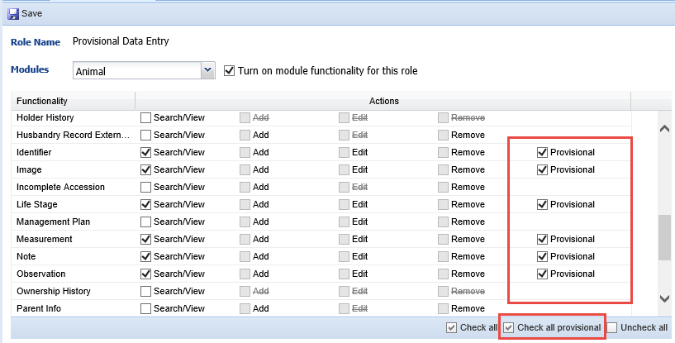
Creating the Role
Provisional Data has not been added to any of the Species360 Template Roles. You can adjust a custom Role already created to include it, or create a new Role, whatever works best. If Provisional is selected then the ability to Add/Edit or Remove are taken away by default. The same Role can have a mix of Provisional and Standard access for data entry. Provisional Data is available in Animal, Enclosure, Calendar and Life Support in the Husbandry module as well as Treatment Administration in the Medical module. Search/View Basic Details will need to be checked even if only Provisional Data is allowed.

Slide 17
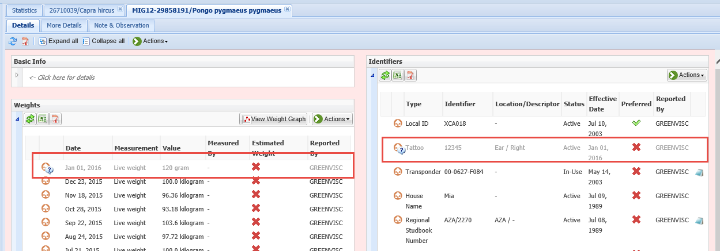
Entering the Data
As a keeper with Provisional Data entry access I have entered two pieces of information on an orangutan – a Tattoo and a Weight. There are two indicators that this is a Provisional Data entry. Primarily the record is greyed out. In addition, some records display a “?” that when hovered over. At this point the keeper can go back into the record and Edit or Delete their entry.

Slide 18
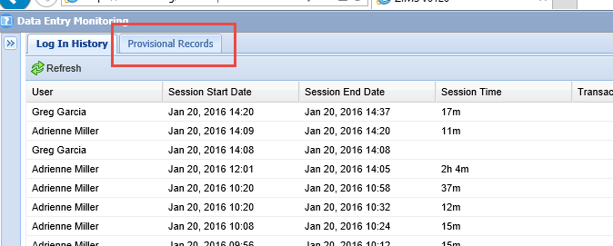
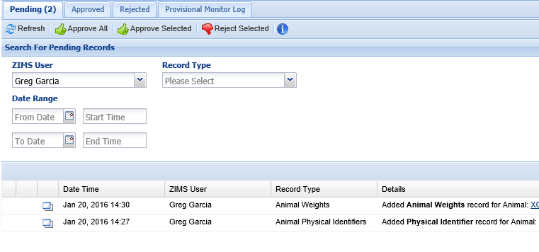
Provisional Records Monitoring
As the Registrar I have logged in and pulled up the Data Entry Monitoring screen
(more on a change here later). There is a tab called Provisional Records.
Selecting the tab brings up a search screen for Pending Provisional Records and a
grid displaying what Provisional Records have not yet been dealt with. We see the
two that the keeper just entered on the orangutan.

Slide 19
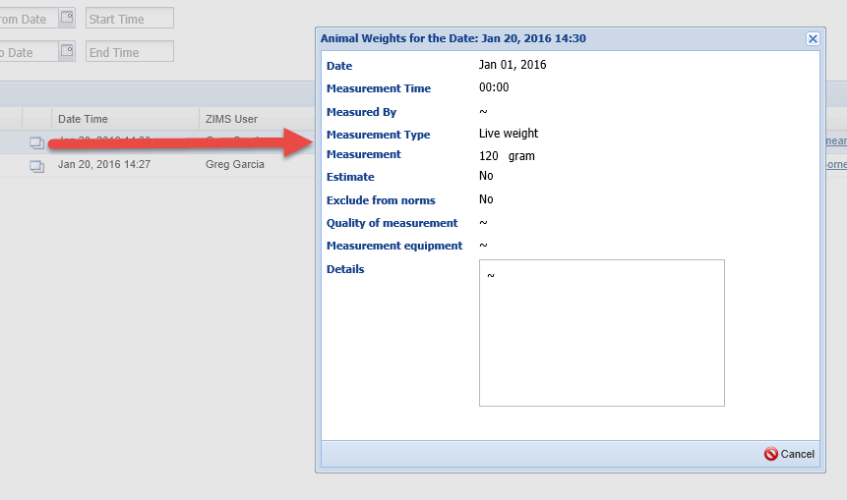
Provisional Data Monitoring
Selecting the View Details icon pops up a view screen for what was entered.
You note the Unit of Weight for the measurement was recorded in grams. This
is a record for an adult orangutan and that would be a very small animal. You
do not want to Approve this entry. Depending on how you decide to handle records
that are not acceptable you have 3 options: 1)Reject the record and ask the person
who entered it to re-enter, 2)Notify the recorder to correct so you can Approve, or 3)
Approve the record and edit yourself when it is “normal” data.

Slide 20
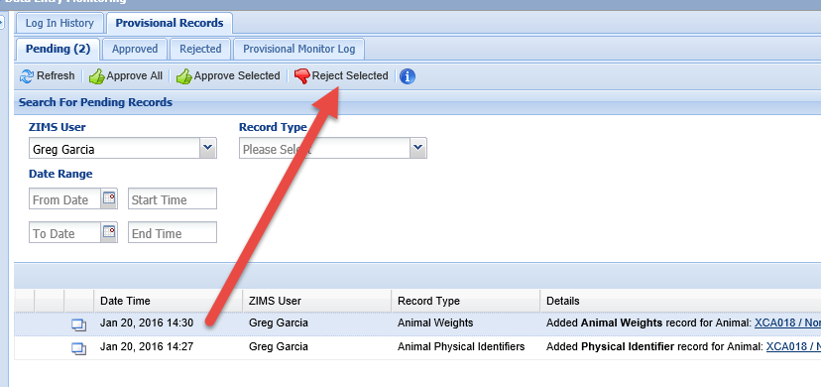
Provisional Data - Reject
You highlight the entry and select Reject Selected and the entry is removed from the
list. Any Rejected Records will display in the Rejected tab for 90 days after the rejection. You should notify whoever entered the rejected data to correct it. If edits need to be made you should contact whoever entered the record to fix it instead of Rejecting the entire entry.

Slide 21
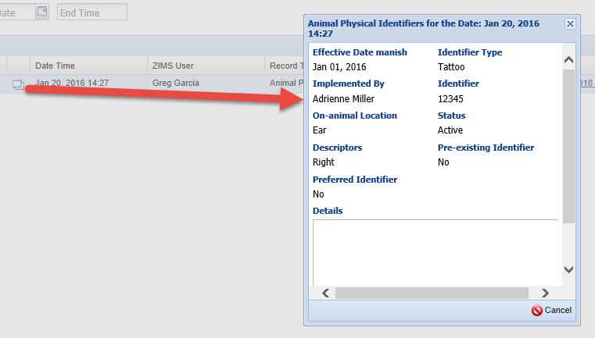
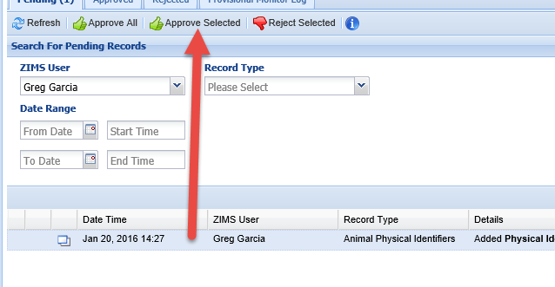
Provisional Data - Approve
You open the details for the next record, the entry for the Tattoo. All looks correct
so you highlight the entry and Approve Selected. Just as for Rejected records,
Approved records will display in the Approved tab for 90 days after the Approval.

Slide 22
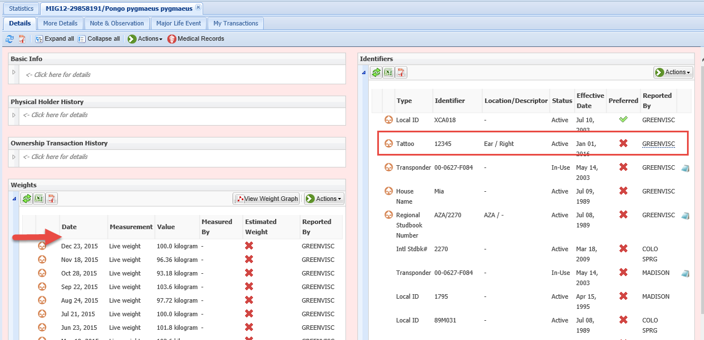
PD – Changes in the Record
Going back into the record you can see that the Tattoo is not greyed out as it is no longer Provisional Data because it has been Approved. Hovering over the Reported By gives you information for who recorded and who approved the data. The person who recorded the data can no longer Edit or Delete it as it has been Approved. In the Weight grid the entry with the incorrect Unit of Measure has been deleted as it was Rejected.

Slide 23
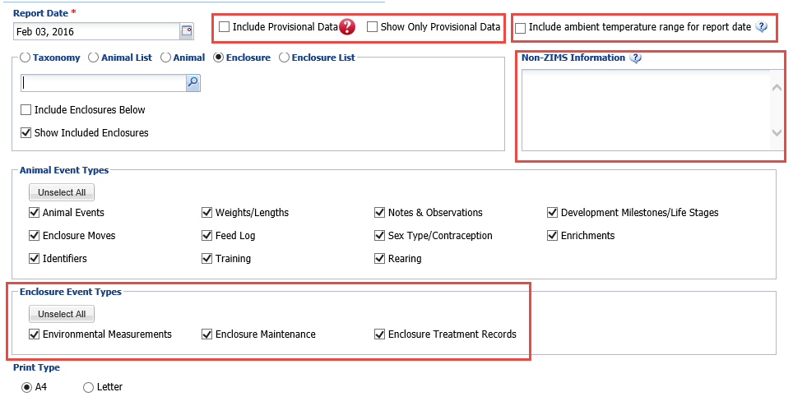
Daily Report – New!!!
In conjunction with the development of Provisional Data, a new Daily Report was developed that allows you to include Provisional Data. This report can be run at various levels, such as using Lists, to get only the information you need. If Enclosure or Enclosure Lists are checked you have the option to include Enclosure Events. In addition there are two options for including information that is not found in other reports. Ambient temperature for the day is sourced from measurement information recorded in your top level enclosure. The non-ZIMS information free text box is to use however it is needed and this information is not stored in the ZIMS database.

Slide 24
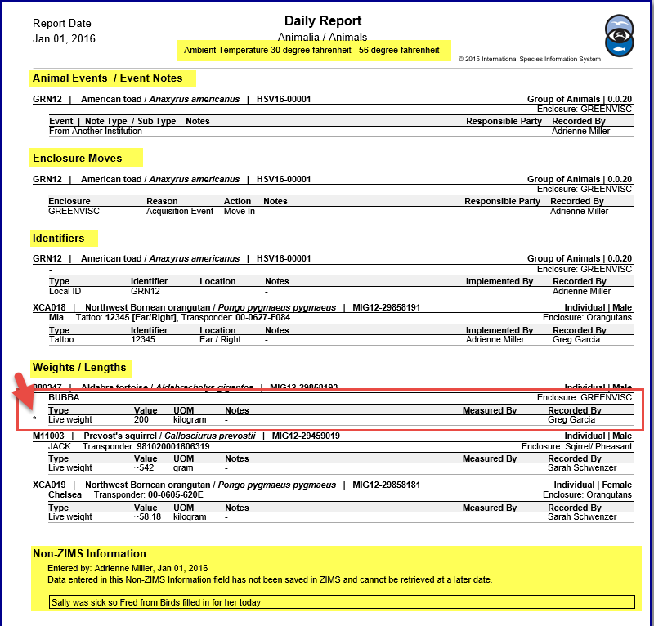
Daily Report Layout
The report is sorted by
topics such as Animal Events,
Enclosure Moves, Identifiers
and Weights and Lengths
for ease of locating specific
information recorded for
a single day. The temperature
displays at the top and any
Non-ZIMS Information at the
bottom. Any data that remains
Provisional will display with an
“*” next to the row.

Slide 25
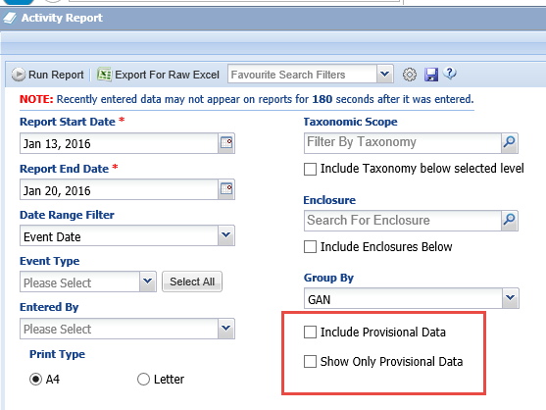
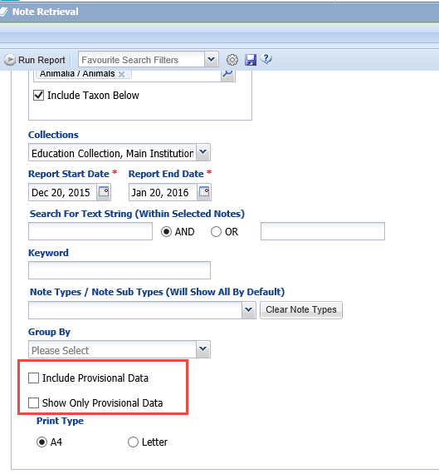
Provisional Data in Other Reports
The ability to include Provisional Data has
also been added to the Activity Report,
Enclosure Activity Report and the Note
Retrieval Report.

Slide 26
Any Questions on Provisional Data?

Slide 27
Functionality to Help Aquariums!
With the addition of our Aquarium Subject Matter Expert we
were able to add functionality that will specifically benefit
Aquariums (but will be useful for Zoos too!) in this release.

Slide 28
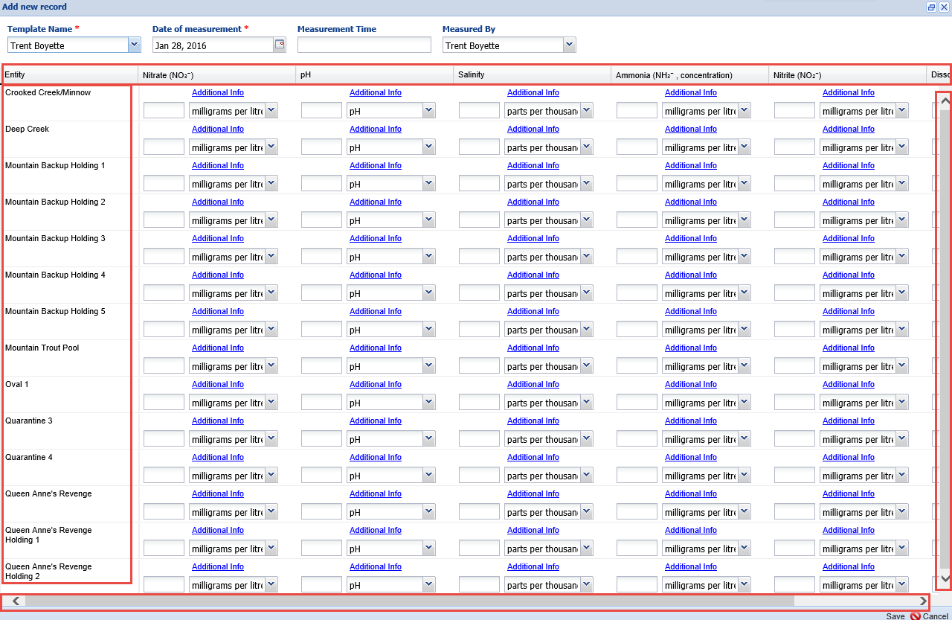
Water Quality Template
The Water Quality Template has been improved for easier use. Fixed scroll bars have been added when needed and the screen is expanded by default to view more Enclosures and more Measurements. The column and row headers are fixed so if you need to scroll they remain visible.

Slide 29
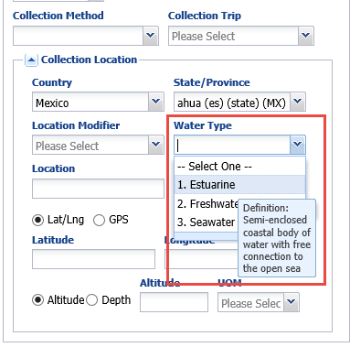
Addition of Water Type
Water Type has been added to
both the Collected From Wild
screen and the Collection Location
grid in Collection Trips. This
information is very important for
aquariums to complete their
reporting requirements. This Water
Type can be searched for in the new
Wild Acquisitions report we will look
at later.

Slide 30
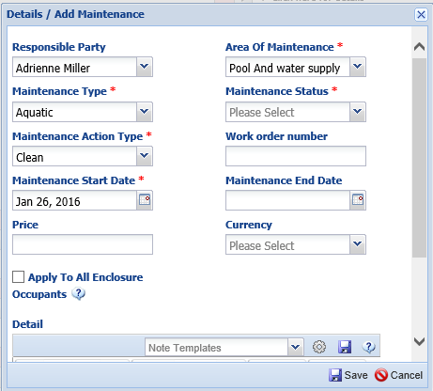
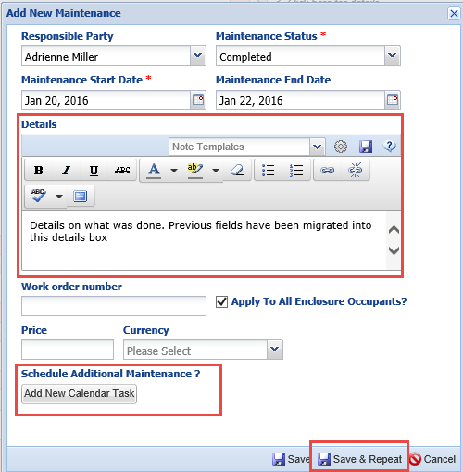
Redesign of Maintenance Screen
The Enclosure, Life Support and Component Maintenance screens have been redesigned (right hand). We found the Previous design with multiple data Standard dropdown lists was confusing to Users, many were not using it, and we were not getting useful data from it. You now gather more free text entries. Maintenance Type, Action Type and Area of Maintenance have been migrated into the Details Box. You can search for your entries using the Maintenance Search by Details Text. Selecting the Add New Calendar Task will open the screen to create a Calendar Task. We have also added the Save & Repeat function to save data entry time.

Slide 31
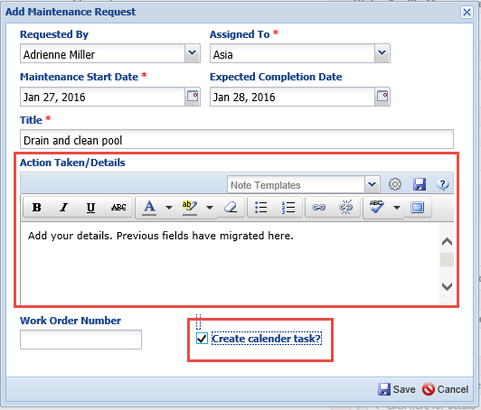
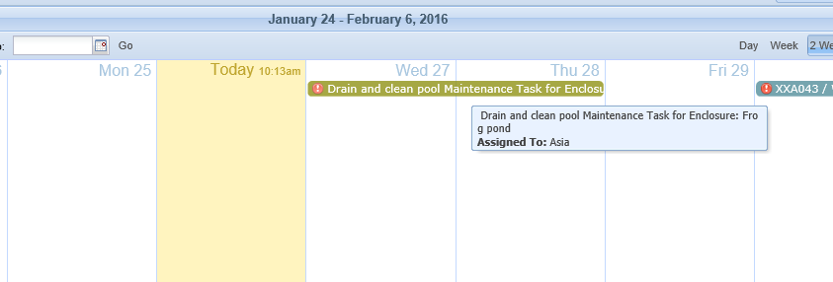
Redesign of Maintenance Request
The Maintenance Request screen has also been redesigned and simplified.
Anything entered in previous screens has been migrated into the Action Taken/
Details box. Checking the Create Calendar Task will automatically create a task
in the Calendar from the information entered on this screen.

Slide 32
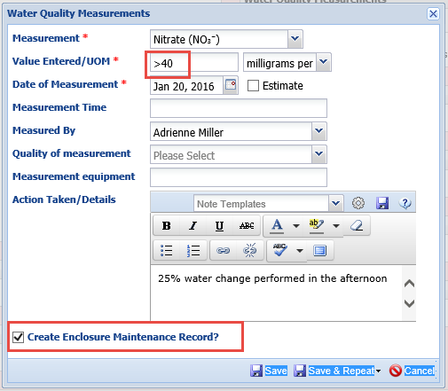
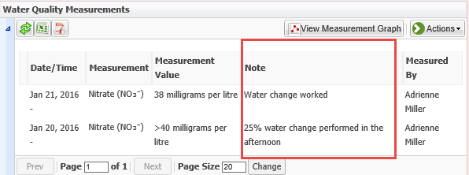
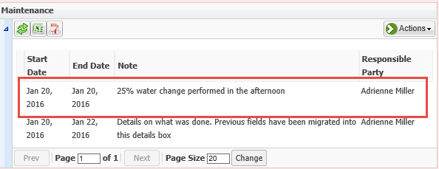
Additions to Measurements
The ability to add characters such as “<“ and “>” has been added to Enclosure (etc.)
Measurements. Information entered into the Action Taken/Details box will display in the Measurement grid. In addition, a checkbox for “Create Maintenance Record” has added. If checked this will automatically create a Maintenance record from the Details box entry.

Slide 33
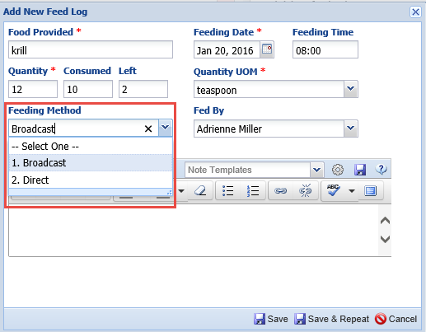
Addition of Feeding Method
Feeding Method has been
added to both Animal and
Enclosure Feed Log entries.
This enables you to better
interpret the data as it
indicates if the amount was
fed directly to the animal
or it was broadcast over the
enclosure for consumption
by many animals.

Slide 34
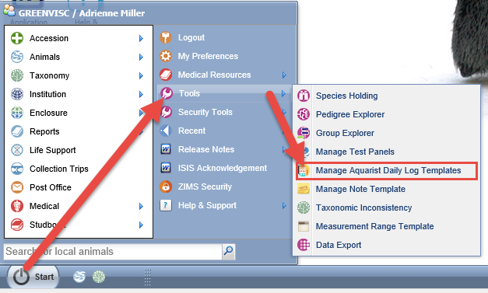
Aquarist Daily Log Template
A new Aquarist Daily Log Template can be found under the Start menu
and Tools.

Slide 35
Aquarist Daily Log
On the left you select the Enclosures, Life Supports and Components that you
want the log to apply to. On the right you select the Data Fields to include. If a
field is restricted to an entity type it is noted in red. Feed Logs and Barrier Voltage
are only appropriate for Enclosures whereas Total Volume only applies to Life
Supports or Components. The Template can be shared or editable by others.

Slide 36
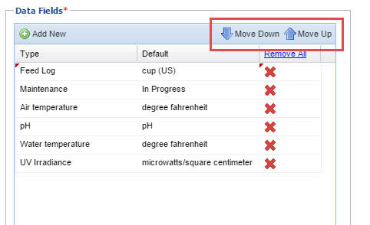
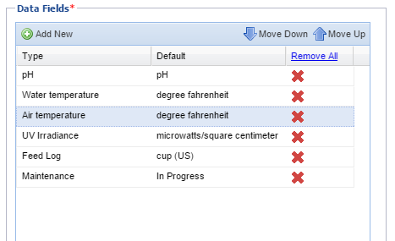
Aquarist Daily Log
You can use the Move Down and
Move Up arrows to arrange the
Data Field order. You can also
arrange the order of the Entities.

Slide 37
Using the Daily Log
Once created the Daily Log is found under the Batch Measurements tab in
the Enclosure/Life Support module. To use it you will find the template in the
drop down List and select Add New Record. This is slightly different from the
functionality for other Batch Measurement Templates where you select to Add
New Record first and then find the Template.

Slide 38
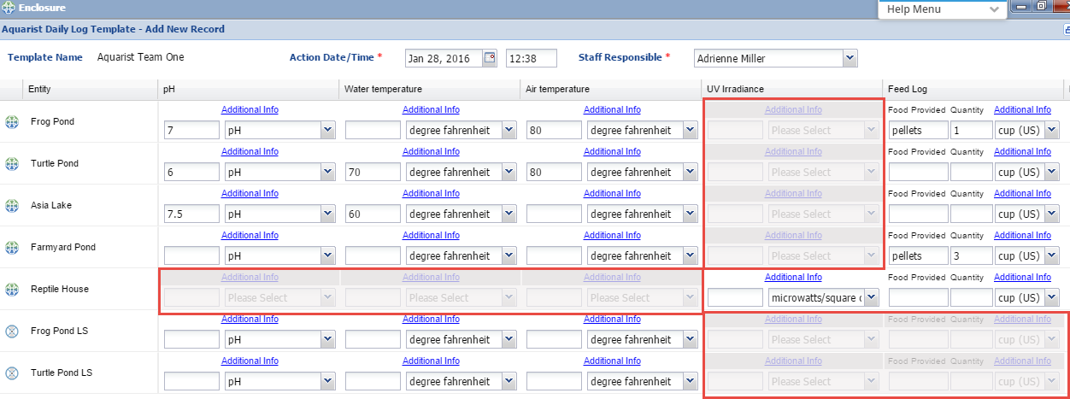
Using the Daily Log
You then fill in what measurements/actions you have taken on your entities in
the Template. Any actions that are not appropriate for the entity are greyed out
And you cannot enter data in them. The Template saves as a draft every 60 seconds
so you do not have to complete your entries all at one time. If you select Cancel (not
Save) you will be asked if you want to save the data as a draft to finish later.

Slide 39
Daily Log Drafts
The Drafts are found under the Batch Measurements>Aquarist
Daily Log Templates. Although the title is “Aquarist Daily Log”
This functionality can easily be used for as a Daily Log for terrestrial
actions also.

Slide 40
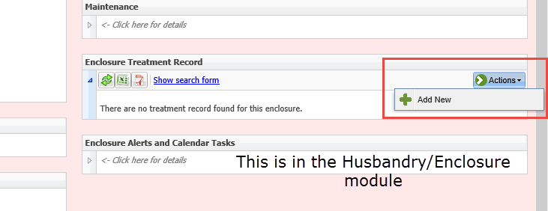
Enclosure Treatment
You can now add a treatment to
an Aquatic enclosure. First a Rx/
Treatment must be created for the
Enclosure in the Medical module
(top). Staff other than Vets can be
given the access to create an
Enclosure Treatment. To add the
Treatment you will go into the
Husbandry module (below) and
select Add New under the Actions
button.

Slide 41
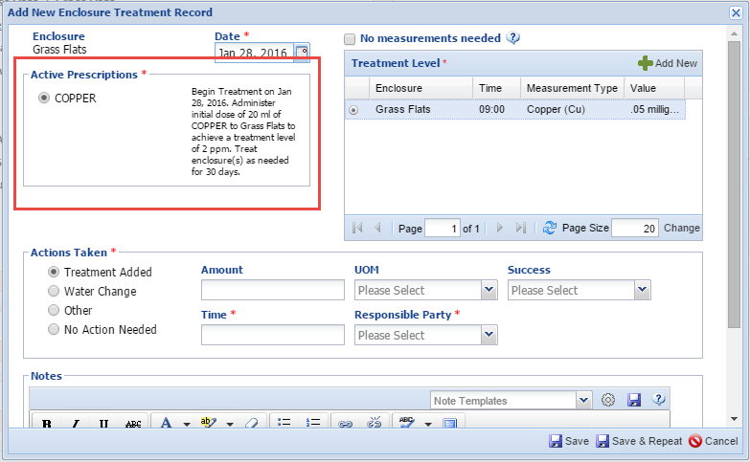
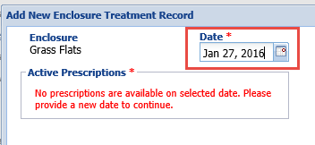
Enclosure Treatment
The Rx/Treatment will display in the upper left of the data entry screen. If the date entered is before the start of the scheduled treatment you will get a
message that there are no prescriptions at that time. You can record new measurements using the upper right hand entry field.

Slide 42
Enclosure Treatment
Your copper reading is too low (.05 mg/L) so you treat with 20 ml of copper
at 9:00 am. This treatment displays in the Enclosure Treatment grid.

Slide 43
Enclosure Treatment
You record another copper measurement
at 10:00 am. It is now to high for the desired
reading. You take an Action of a 15% water
change and check the Create Enclosure
Maintenance Record checkbox.

Slide 44
Enclosure Treatment
The Enclosure Treatment will display and the Water Change will also
display in the Maintenance grid.

Slide 45
Any Questions on Aquatic Functionality?

Slide 46
New Functionality for Studbook Keepers!
The Studbook News Feed has been moved
to the Start menu under Studbook. Two
additional features have been added –
Studbook Keeper List and Studbook
Chart. The Studbook News Feed remains
Available only to assigned Studbook
Keepers. The Studbook Keeper List and
the Studbook Chart are available to all
who have the Search/View access in the
Role(s) assigned to them

Slide 47
Studbook Keeper List
We have also added a quick way to search for studbook keepers by many various filters. Here we have found all the studbook keepers in Australia for Aves (and Taxon below). Within the Taxonomy module the studbook keeper will still be listed but this allows finding a much greater number than one at a time. Remember, this will only return results for Species360 member institutions. When the Population Management (R3) module is deployed you will be able to find studbook keepers at non-Species360 member institutions.

Slide 48
Studbook Chart
The Studbook Chart displays the number of Studbook Keeper assignments
recorded in ZIMS. Most Users can view this at the “All ZIMS” level as on
the left. Regional Associations can select to also view “My Association” level.
On the right I have signed in as AZA. Here we can see that out of the 329
studbook assignments for Aves, 160 are AZA studbooks. Clicking on the bars
will bring up a list of Studbook Keepers for the taxon.

Slide 49
Studbook (Species360) Template Role
A new Species360 Template Role has been
created titled Studbook Keeper (Species360). This
Role has access only to the Studbook
Chart and the Studbook Keeper list. To
have access to the Studbook News Feed,
all Studbook Keepers have to be assigned
this Role (at minimum). This requirement
is new. All current studbook keepers will
be assigned this Role as this is only going
forward. You can assign this Role or include
this access to other staff members, not
just Studbook Keepers. As we move forward
with the development of R3 (Population
Management), this Role will assist with
giving Studbook Keepers at non-Species360
Institutions the access they need.

Slide 50
Security Tools - Data Entry Monitoring
Transaction Monitoring is now
found under the Security Tools
and called Data Entry Monitoring.
The functionality remains the
same. Also under Security Tools
are three new Security Charts.

Slide 51
Security Charts - User Activity
The first chart lets you know how many ZIMS Users you have at your institution. This facility has 19 ZIMS Users. You can then view ZIMS logins and transactions performed to get a general idea of what percentage of Users are actually using ZIMS. Over time 17 of the 19 Users have logged in and 16 have actually performed transactions. In the past month only 10 of the Users have Logged In and only 8 have Performed Transactions. Left clicking on the Logged In or Performed Transactions will bring up a grid of names and their last transaction date.

Slide 52
Security Charts - IP Address Activity
The IP Address Activity displays locations where someone has logged into your ZIMS. The lower left lets you know if single sessions or IP restrictions apply.
If you want to update these accessibility settings the link takes you directly into the ZIMS Accessibility and Features in Institution Preferences. You can also restrict IP per User From the Edit ZIMS User Details page.

Slide 53
Security Charts - IP Address Activity
You may wonder why most of you show logins from Turkey, India and Bloomington,
Minnesota. They will display if the development/support teams have ever logged into your
facility to help with an issue. By using the +/- you can zoom in for more information.
Here we can see that I logged in from Wheeling, WV, in February of last year when I was
teaching the Institutional Records Keeping course there.

Slide 54
Security Charts - Activity Timeline
The Activity Timeline allows
you to view the number of
Sessions and the number of
Transactions for a month
over a specified date range.
A Transaction refers to a piece
of data being entered in ZIMS.
At this facility the Curator is
also the records keeper and
their busy Summer months
impacts data entry. It also
indicates the busy shipping
periods of Spring and Fall.
Viewing this chart may help
you make staffing assignments,
if possible, to capture data
in a timely manner.

Slide 55
Animal Charts
Several new charts that allow
better visualization of animal
data, both at your institution and
Globally, have been created. These
are found under the Start menu >
Animals>Charts

Slide 56
Animal Charts – Taxonomy/Animal Type by Animals
The Taxonomy/Animal Type Chart provides a visual of the number of animals
you have held, if they were Individual or Group records and if they are Current
or Historical records. Hovering over the column will provide the numbers
contained in the graph. You can also create a graph of information using
data from all of the ZIMS database.

Slide 57
Animal Charts – Taxonomy/Birth Type by Animals
The Taxonomy/Birth Type displays your institution’s Captive versus Wild Born
numbers currently and historically (left graph). As always, hovering over the
column gives you actual numbers for each. You can also look at numbers for the
entire ZIMS database (right).

Slide 58
Animal Charts – IUCN Red List, CITES and CITES EU by Animals
You can also create charts for IUCN Red
List animals as well as CITES and CITES EU
animals for your institution and for the
entire ZIMS database.

Slide 59
Animal Charts – by Species
These same charts are available by species
for both your institution and the entire
ZIMS database.

Slide 60
Institution – Data Visualizations
Under the Institution module we also added two other quick Data Visualizations – Species360 Member Maps and Data Management.

Slide 61
Species360 Member Maps
The Species360 Member Maps show Species360
members using various parameters.
You can view members by Institution,
Education or Association member
Category (upper left); by Type such as
Zoo, Aquarium, Rehab/Rescue Center
and others (upper right); and ZIMS or
ARKS use (lower left). As other maps,
zooming in and hovering over the place
markers you can view the institution.

Slide 62
Data Management – Data Currentness
The first chart for Data
Management displays the
currentness of the data.
This can help determine if
an institution is up-to-date
with data entry. You can
zoom in the map using the
+/- and hover over to get
the name of the facility.

Slide 63
Data Management – Data Sharing Map
The Data Sharing Maps are graphics indicating what institutions you are sharing records with (left) and what institutions are sharing records with you. Hovering over displays the institution name and how many records or taxonomies are being shared.
Left clicking brings up a list of the records being shared.

Slide 64
Data Management – Data Sharing Column Chart
The Data Sharing Column Chart shows how sharing
of records is gaining in popularity as more and more
Institutions (over 250) are sharing with more and more
other facilities (almost 125).

Slide 65
Data Management – Data Quality
The Data quality tab gives
you a pie chart of the quality
of your data. Hopefully
you have a lot of green (No
Issues), bit of yellow
(Warnings) and very little
Red (Errors). We have Errors
in 72 animal or group
records.

Slide 66
Data Management – Data Quality
Clicking on the Errors refreshes the pie chart to indicate what the Errors actually are. We have 71 records with Obsolete Scientific Name (Historical) and 1 record with Obsolete Scientific Name (current). Left clicking on the piece of the pie will bring up a results grid that displays the records with the Errors for correction.

Slide 67
Data Management – Data Quality
Half of my warnings have to do with
records where no parents are recorded
and these records should be
corrected. The ones where Parents are
Not in ZIMS can be treated just as a
warning unless they are incorrect.

Slide 68
Reports – Some New and Some Improved!
WILD ACQUISITION REPORT - NEW!
The Wild Acquisitions Report was designed to assist Aquariums
with their reporting requirements, but it is very useful for Zoos
also. You can run the report for specific Water Types or Collection
Methods which are often specified on these reports. The various
Sort options help you organize the report.

Slide 69
Reports – Some New and Some Improved!
ENCLOSURE ACTIVITY REPORT - NEW!
Users have been asking for an Activity Report on
Enclosures and it is here! The Event Type is
multiple select and you can run the report
using an Enclosure List to save time.

Slide 70
Reports – Some New and Some Improved!
GLOBAL PERMIT REPORT - NEW!
The Global Permit Report allows you to search for various permits that institutions have marked as a Global scope. This was developed to assist the European Region members find institutions with BALAI permits, but it is useful for many regions and will hopefully encourage more facilities to mark their permits as Global scope to assist their colleagues.

Slide 71
Reports – Some New and Some Improved!
SPECIMEN REPORT – IMPROVED!
You can now select to run multiple
Specimen Reports from an
Animal List, a great time saver
when selecting multiple records

Slide 72
Reports – Some New and Some Improved!
NOTE RETRIEVAL REPORT – IMPROVED!
You can now select to Group (Sort) the
Note Retrieval Report by Taxonomy,
Local ID, GAN, Note Date or Note Date.
This gives much more flexibility to your
results and makes it easier to find what
you are looking for.

Slide 73
Reports – Some New and Some Improved!
TRANSACTION REPORT – IMPROVED!
A Collections filter was added to the
Transaction Report, allowing you to
Select just one, or multiple,
Collections to include in the report.

Slide 74
Report Improvements – coming in February!
Weight Comparison Report
Display Multiple Animals
Enclosure Report
Include Groups
Include Enclosure History
Summary Count of Animals
Additional Sort Options
Enclosure, Taxa, Team/Department, Local ID

Slide 75
Some More Cool Things! Improved Help
Our Help documents are being updated using an application called Walk Me.
The Help Menu is available on every ZIMS screen. Walk Me will take you step-
by-step through what you need to do, actually creating the desired data entry
in the process of helping you. This menu will grow slowly to replace the Help
Pages and better connect with the Training Document library content.

Slide 76
SMCT - Species Holding Filters
Species Holding can now be filtered by Continent, Country,
Association or My Institution. This saves a lot of scrolling to find the
region you are looking for when all results were previously displayed.

Slide 77
SMCT - Additions to Basic Info
The House Name (if there is one)
has been added to the Basic
Info screen. In addition, if you are
using an Institution preferred
synonym for common or taxonomic
name, the Species360 Global taxonomy will
display in addition to your local
synonym.

Slide 78
SMCT – Group Tracking Preference
Institution Preferences under
Measurement & Census Preferences>
Census Preferences now has the
option to select default tracking for
Accessions. The default is No
Tracking when adding a new group
but you can change that here.
This is NOT available as a My
Preference, so your institution
needs consensus on this Preference.

Slide 79
Improvements to Received Dead
You can now record receiving a dead
Individual or Group (where some or all
of the members were dead) as an initial
Accession. The highlighted message lets
you know that the deaths will NOT be
counted against your institution. Once
the Received Dead box is checked you
have two options for recording the count - the number received Alive and the number Received Dead.

Slide 80
Improvements to Death in Transit
There have also been improvements
to Death in Transit, especially for
Partial group deaths. Once Death in
Transit is checked on a Disposition
you receive the yellow highlighted
note that it will not affect the count
of the disposition and the death
will not be counted against your
Institution. You also then have the
ability to record how many were
Dispositioned and how many of
those died.

Slide 81
The new medical stuff

Slide 82
Dashboard Change

Slide 83
Add/Edit - Tests & Results

Slide 84
Editing Prescription record
Old Rules:
Change the treatment item and most prescription fields were reset to blank, so that proper validation of fields would occur after new item was added
New Rules:
If new item has same active ingredient as old item (e.g., Baytril 68 mg tablet versus Baytril 136 mg tablet), then retain most of the existing prescription information

Slide 85
The New Stuff

Slide 86
Medical Apps
Single Animal Data Cleanup
Data cleanup by date range (animals with disposition records)
Batch entry of multiple data types (Rachel’s app)

Slide 87
Data Cleanup Screen > has up to 5 sections <
Active Medical Problems or Procedures
Active Prescriptions / Treatments
Future Calendar events / tasks
Health status
Body condition score

Slide 88
Data Cleanup in Batch Mode Dead Animal

Slide 89
Data Cleanup in Batch Mode Dead Animal

Slide 90
Data Cleanup in Batch Mode Shipped Animal

Slide 91
Data Cleanup in Batch Mode Health Status and Body Condition Score

Slide 92
Any Questions?
On the R2.3 Release!

