Slide 1
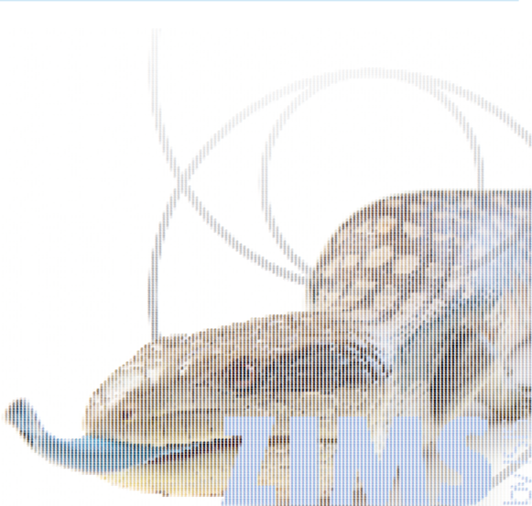
ZIMS Tips and Tricks
December 2015
ZIMS Software
Development
Process

Slide 2
ZIMS Software Process
From ‘Sort of Agile’ to AGILE!!
  What is ‘agile’?
  …a software development methodology, using:
  User Stories (Stakeholders/User Group)
  SCRUM (Developers daily meeting)
  Release early/often (Iterative value delivery)
  Value and Size (Feedback loop and ‘value’)
  Vision and Outcome guiding the process

Slide 3
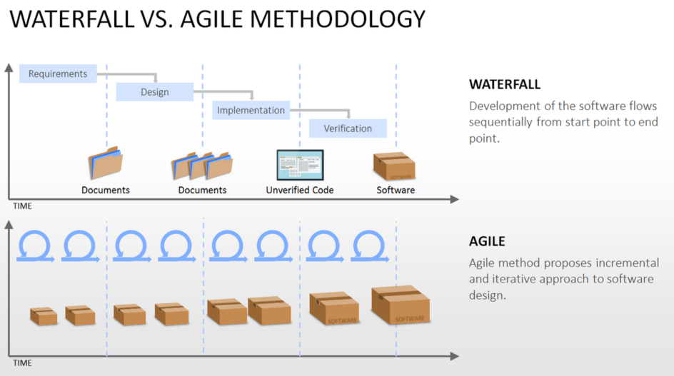
Agile vs What?

Slide 4
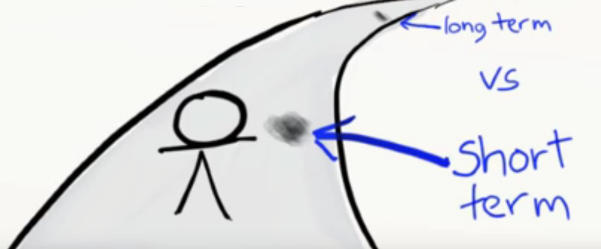

Agile: Vision and Tradeoffs
Learning when to say ‘when’.
……when.

Slide 5
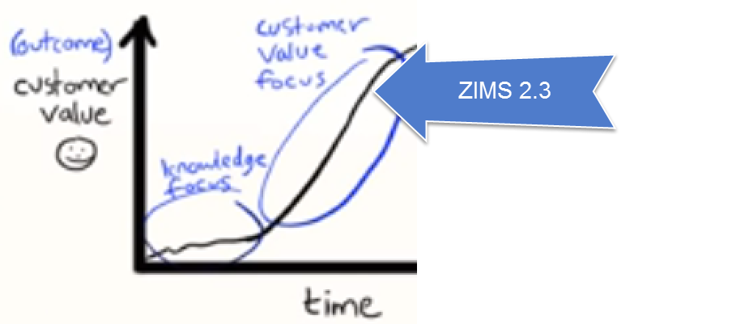
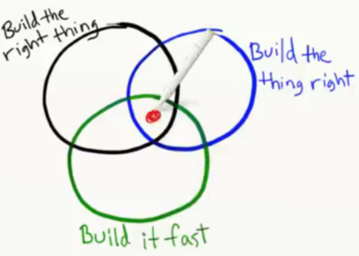

Agile: Building to Outcome
Value Driven
Outcome vs
Output

Slide 6
Agile: What Will You See?
You can expect more releases with smaller deliveries of valuable features
You can participate!
  User Funded Projects. These ‘special projects’ have brought on features like: AAM (St. Louis), Column Customization and multi-factility support (SDZG/WCS), Data Migration projects (multiple ORGs), Local Hosting (SDZG), KDR (22 Members)
  User Group! Experts Wanted…

Slide 7

What is the ZIMS User Group?

Slide 8
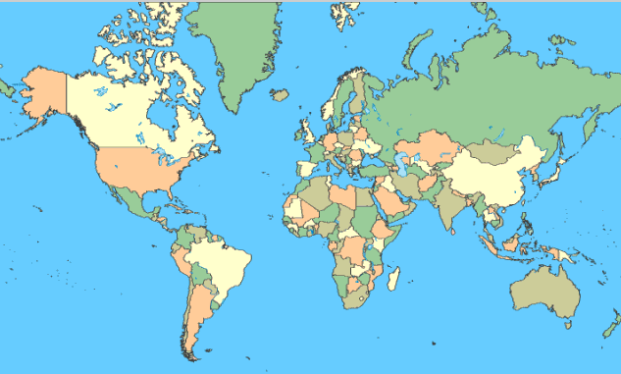
Where are Members From?
130 Institutions and 120 Individuals
14
66
23
2
3
3
3
15

Slide 9


Who is a Member?
8 Aquariums
1 Educational Facility
5 Parent Organization
3 Regional Association
112 Zoos

Slide 10
What has the User Group Done?
Two rounds of Enhancement Prioritization
  Many got into June Release
  Many will be in the January Release
Voting on Data Standard changes
Developed Enrichment Grid
  Will deploy with January Release
Release 2.2 Testing (June Release)

Slide 11
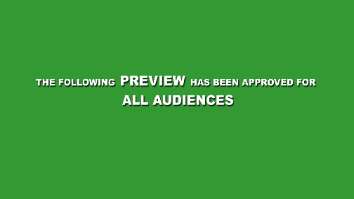
What’s Ahead?
Call went out for volunteers for testing the Release 2.3 (January update)
Testing will be January 4 - 15
Enhancement Prioritization for Release 3.0 in late Spring

Slide 12
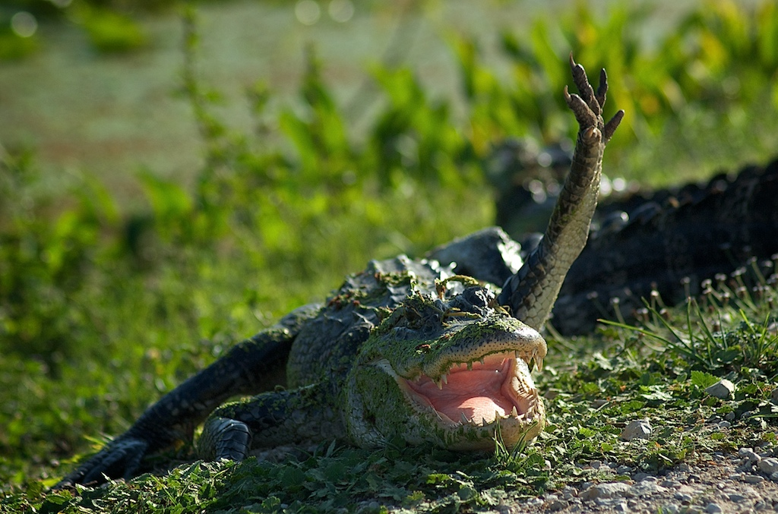
Interested in Joining?
Contact Adrienne Miller at amiller@Species360.org
One User Group member per institution

Slide 13

How Does the New Enhancement Process Work?

Slide 14
Previous Process
Issue was submitted to Support Staff
If determined not to be a Bug (broken) but an Enhancement (good idea) the “Type” was changed from Bug to Enhancement and it was submitted to Adrienne Miller for processing
If other institutions had requested the same Enhancement they were associated in an Excel file
Those Enhancements with the most institutions submitting went to the User Group for prioritization.
The Problem:
  Because the Enhancement usually started as a Bug a lot of extra baggage came along with the Enhancement and it was not always clear exactly what the User was asking for
  Support was not able to Close Bug issues if they became Enhancements, resulting in too many Open issues to effectively manage.

Slide 15
New Process
Issue will be submitted to Support Staff
If determined not to be a Bug (broken) but a possible Enhancement (good idea) the Issue is Closed by the Support staff and the submitter is notified via email.
In this notification is a link. If the User decides that they really would like to see this implemented they select the link and complete the form.
The Enhancement is then reviewed by the appropriate Species360 Staff
Once several institutions have submitted similar Enhancement Requests a Master Enhancement is created and all of the Enhancement Requests for that topic are then associated with it.
The Master Enhancements with the most Requests associated with it will go to the User Group for prioritization
The Advantage:
  The User has the ability to describe in detail exactly what they are looking for and how it would benefit them
  Support (and Users) no longer have so many Open issues. If an Enhancement is Completed (or Rejected for some reason) Support will receive automatic notification and they will contact the submitter

Slide 16
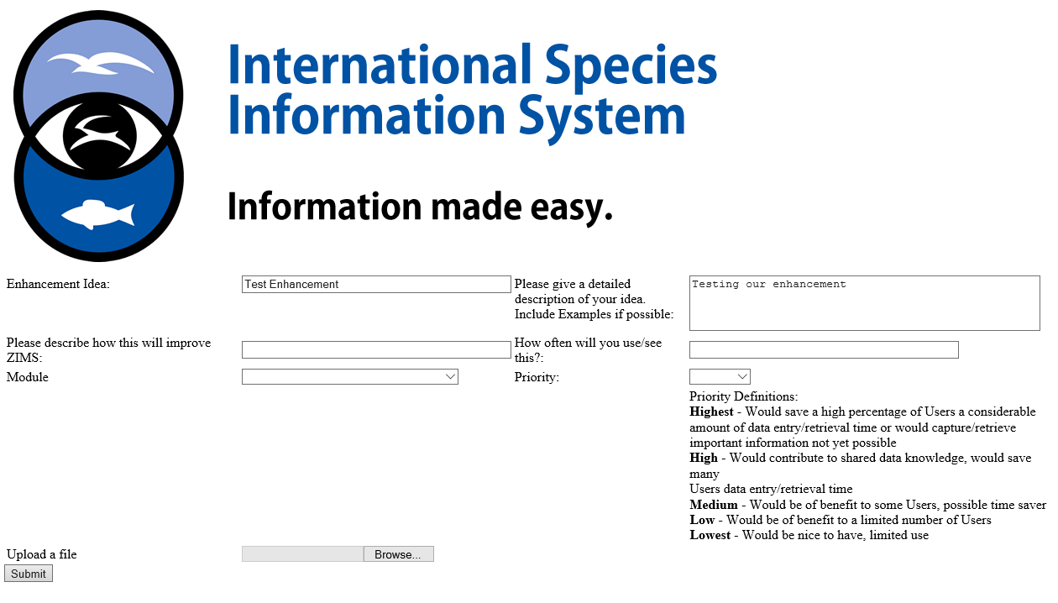
The Submission Form

Slide 17
Example Process– Data Migration
Migrating data is a large part of making ZIMS work for our members.
Where from?
~760 members came from ARKS
~120 members came from from MedARKS
Many in-house/home-grown systems, recent example:
Moorpark Teaching Zoo’s proprietary database is now in ZIMS
There will be thousands of SPARKS and PopLink datasets in Release 3

Slide 18
The Process
Identify / Understand the source of the data
  What is the storage format?
  What is the data?
Validate and Massage Data in an Intermediate Work Area
  SQL Server database to SQL Server database
  Understand the Destination
  Mapping tables
  Data Validation
  Stored Procedures / Functions
  Testing and Reporting
Load Data into Final Destination
  Moving the Data to the Final Destination
  Testing and Reporting

Slide 19
Problem Data – Examples
AnesDrug.Amount
2% | text to decimal
4+ | text to decimal
1L | text to decimal
0-2 | text to decimal
1/4 | text to decimal
2GM | text to decimal
OFF | text to decimal
<100 | text to decimal
Anesthes.Init_Efect
900\ | text to time
904+ | text to time
907- | text to time
CN_Text.rec_date
0300-11-20 | date to datetime

Slide 20
Mapping Tables - Examples
MedARKS Type | Data | Meaning | ZIMS Type | Data | Meaning
body_cond |  | NULL | BodyConditionType | NULL | NULL
body_cond | 1 | Obese / Fat | BodyConditionType | 15100158 | Obese
body_cond | 2 | Good | BodyConditionType | 15100154 | Ideal condition
body_cond | 3 | Fair / Thin | BodyConditionType | 15100152 | Moderately underconditioned
body_cond | 4 | Poor / Emaciated | BodyConditionType | 15100150 | Emaciated
MedARKS Phys Test | ZIMS Measurement Type GUID | Meaning | ZIMS_MeasurementGroup
Body temperature | 7B6E7B65-5703-4466-825D-6C3B69E6FC1A | body temperature | Physiological Measurements
Capillary refill time | 9B947537-B7B9-4452-9632-0719E6645284 | capillary refill time | Physiological Measurements
Diastolic blood pressure | 088A7BC2-F83C-4178-9C00-ADBF7DB1DEBB | diastolic indirect blood pressure | Physiological Measurements
End tidal carbon dioxide | 3B7B896C-A1FB-4E6E-993D-B737A5F557FF | end tidal carbon dioxide | Physiological Measurements
Heart rate | 5A074DB9-224B-46C7-B2A8-9BE5FEE208D2 | heart rate | Physiological Measurements
Mean blood pressure | 18BB9463-FD99-4FC8-95CB-A343B41E7B96 | mean indirect blood pressure | Physiological Measurements
Oxygen saturation | FDA33319-5428-482D-9211-AA7DBCDEA1AA | oxygen saturation | Physiological Measurements
Respiratory rate | 5495FB8C-5065-4160-9BB4-D389A14B233E | respiratory rate | Physiological Measurements
Systolic blood pressure | FCCC6BF6-EE80-425C-8FD5-AEB824A5C4BD | systolic indirect blood pressure | Physiological Measurements

Slide 21
Example Project– Community Sponsored
Daily Reporting Process
…it all started during a break at 2015 AZA’s Institutional Records Keeping
Sunset Zoo’s Curator was taking the course and asked,
“What’s possible?”
Their internal keeper daily reporting system was no longer supported
Rather than rebuild a system or hire internally to support theirs,
Sunset began a call to arms for a ZIMS version to replace:
  A system for Keepers to records data in a place where it can be reviewed before being ‘live’
  A workspace for their small and collaborative team to share data
  A place easily integrated with the animals global record
  …But they’d need help.

Slide 22
Daily Reporting Process
Their budget would cover ~1/10th of the overall ZIMS costs
The desire for better daily reporting was well known, and a call for support was issued
In total, 22 members have supported this project with finances, expertise on design and now in testing!
Project delivers two key features into ZIMS:
  Provisional data recording
    -Allows ‘keeper/aquarist/volunteers/ect’ to enter data that requires approval from administrator
  Enhanced daily activity report
    -Focus on daily husbandry and facility management events
    -Output from ZIMS
  *Delivery in ZIMS 2.3 in late January*

Slide 23
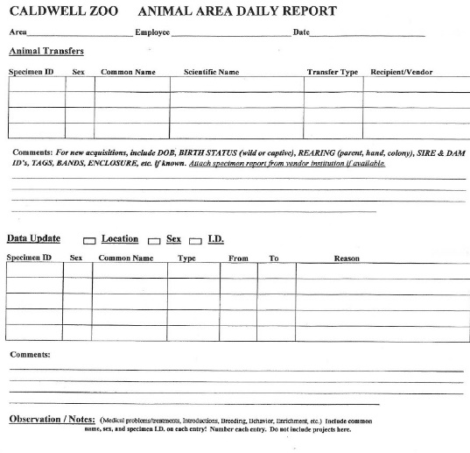
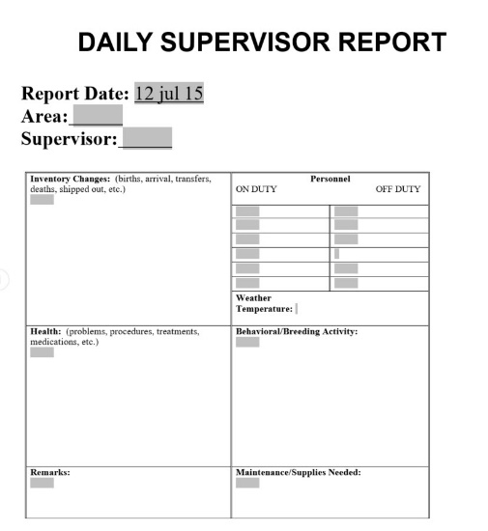
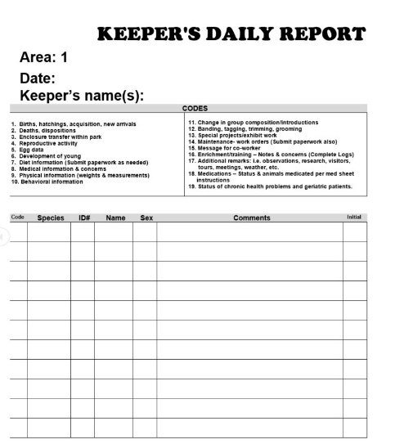
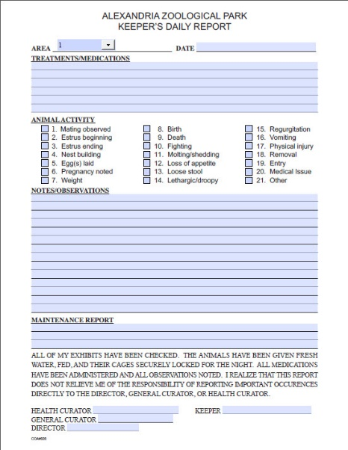
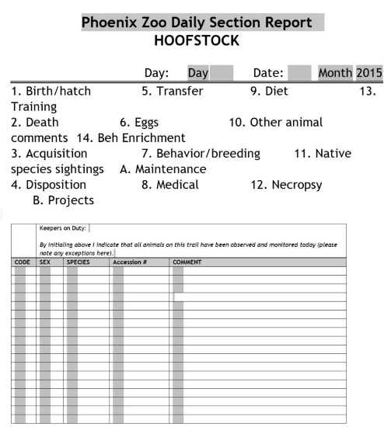
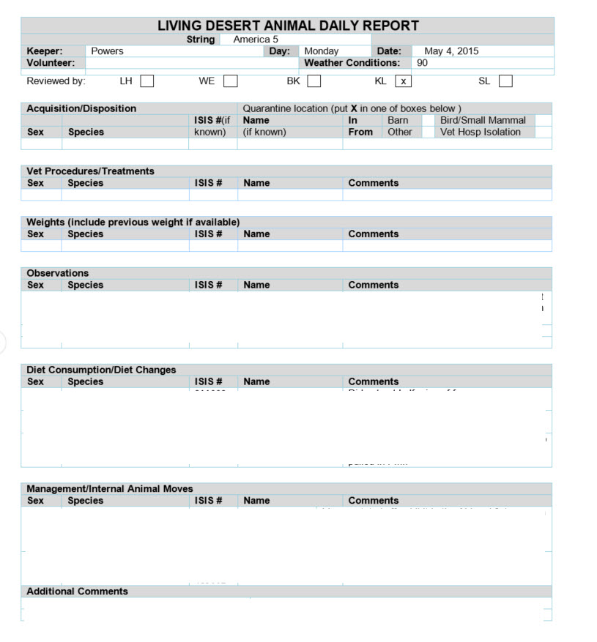
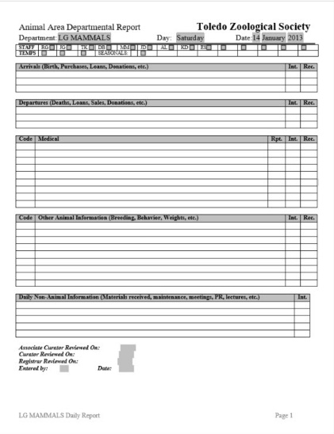
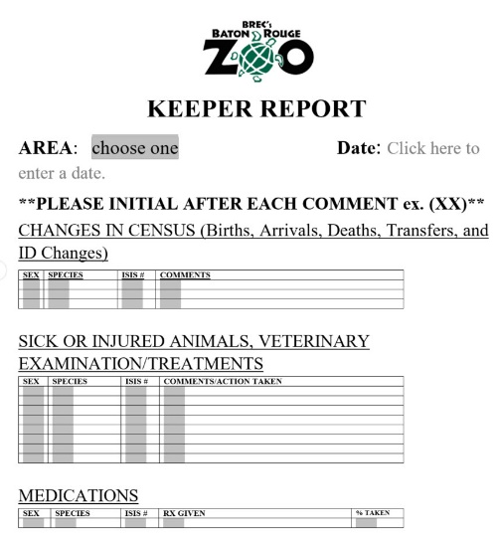
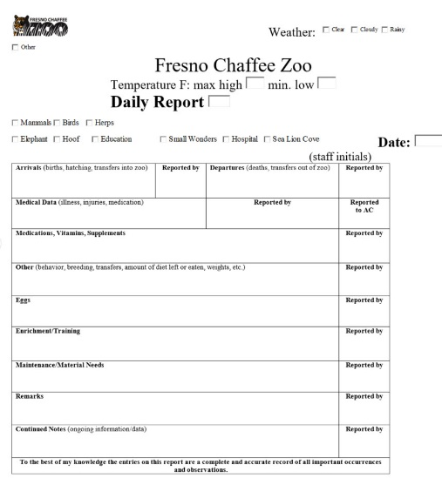
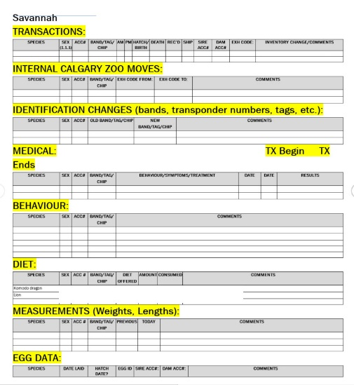
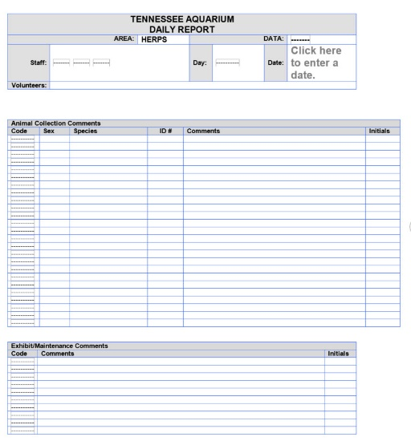
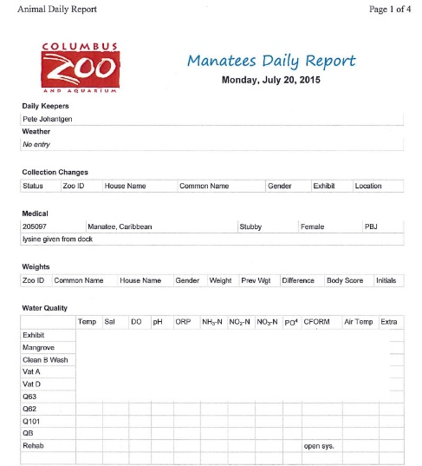
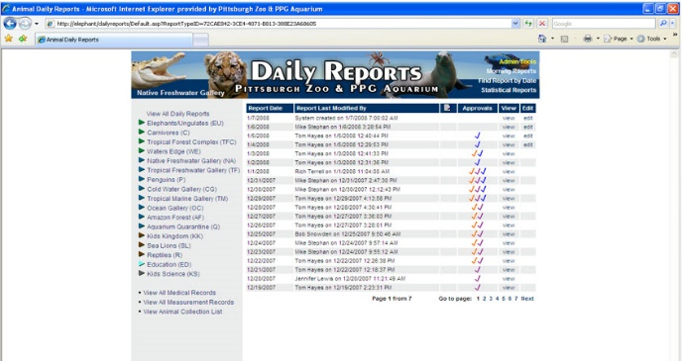
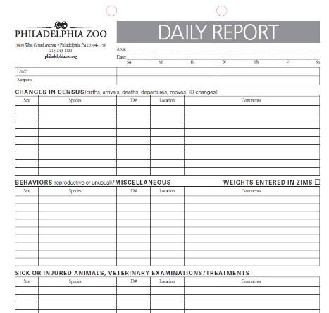
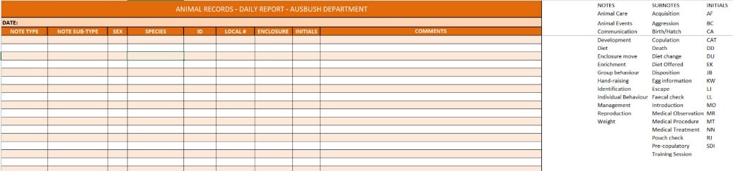
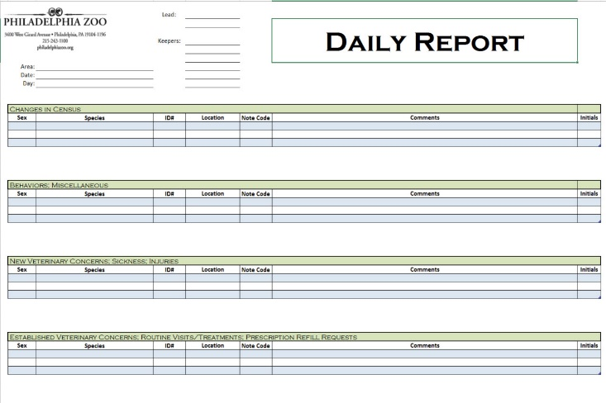
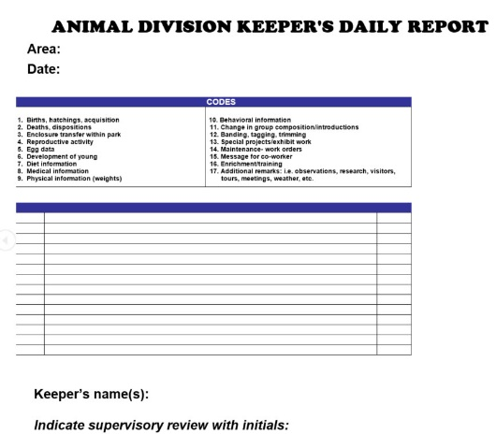
A KDR by Any Other Name
1,000 members = 1,000 examples
Notes:
When asking members on the ZRA list serve for ‘example KDR reports’ we received a different idea from each member…

Slide 24
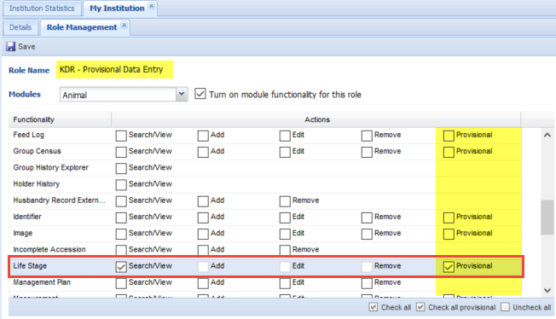
Provisional Data Entry
…setting it up
Notes:
KDR in ZIMS is 2 things 1) Provisional Data Entry…allowing the admin to grant data entry access for staff in a non-approved/local-only mode.

Slide 25
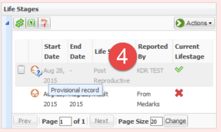
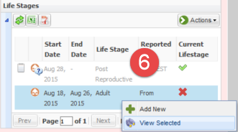

Provisional Data Entry
…adding data as provisional user
4) Provisional user can add data ‘like usual’ but record is flagged as ‘provisional record’
5) User can edit other provisional entries
6) Once approved user cannot edit
Notes:
This provisional data is visible inside of ZIMS like ‘regular data’ but not a part of the global record of the animal until the data entry has been approved. This approval process leaves an audit trail.

Slide 26
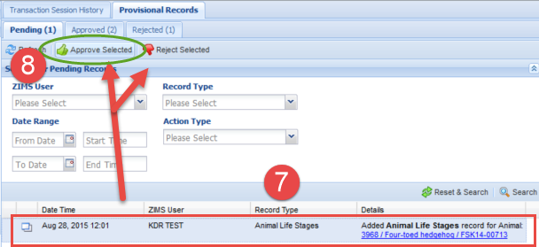
Provisional Data Entry
…managing provisional data
7) In the Data Monitor a new tab for Provisional Records tracks all entries (formerly ‘transaction monitor’)
8) Approve adds data to global database
Reject deletes the entry from ZIMS
-Approved data shows ‘created by and approved by’
-Approval/denials follow regular data monitor rules …saved for 90 days but cannot be ‘undone’.
-Approved data can always be edited in ZIMS.
Notes:
Using the existing “Transaction Monitor” in ZIMS we have ensured an easy to use and simple to maintain data workflow for the >200 data types allowed in the Provisional Data Entry model.

Slide 27
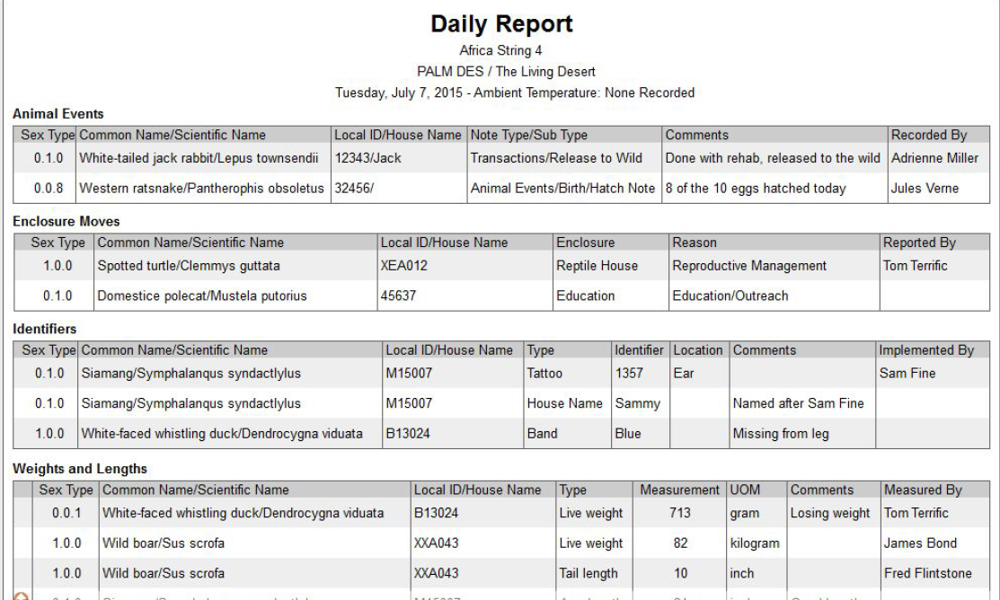
Provisional Data Entry
…Keeper Daily Report
Include provisional data added to filters on Activity, Enclosure and Note Retrieval Reports and New Report “Daily Report”
Search by Animal, Taxonomy or Animal List (string)
Search by Enclosure (include enc below) or Enclosure List
Layout is ‘keeper centric’
Notes:
And the second feature of the KDR project is an improved ‘keeper report’ that allows users to search on ‘string of animals’ and reports in a simplified fashion most appropriate to keepers workflow

Slide 28

Provisional Data Entry
…collaborative sponsorship
Abilene
Alexandria
Artis
Audubon
Baton Rouge
Calgary
Cameron Park & Botanical Gardens
Central Florida
Chattanooga
Chewhaw Park
Dickerson Park
Ellen Trout
Fresno Chaffee
Little Rock
Living Desert
Louisville
Phoenix
Sedgwick Country
Seneca Park
Sunset
Tulsa
Virginia
Notes:
Thank you to our many sponsors!

Slide 29
Questions?
Notes:
Thank you to our many sponsors!

