Slide 1
Tips & Tricks November 2015
Using ZIMS to Help Prepare Your Permit Application
and
Managing Your Permits in ZIMS
Notes:
A lot of the information that can be entered into ZIMS can be used to help you prepare your permit applications to make them less painful and hopefully speed up your next application. The examples are US based as this presentation was recently used at the Regulations and Permits Workshop in Cincinnati. However, I imagine that a lot of the questions on the applications are similar no matter what region you are in.

Slide 2
Reviewed 6 Permit Applications
Export/Re-export/Import/Interstate and Foreign Commerce/Take of Animals (3-200-37)
Eagle Exhibition (3-200-14)
Take/Import/Transport/Export of Marine Mammals (3-200-43)
Migratory Bird Special Purpose Possession – Education (3_200-10c)
Import/Acquisition/Transport of Injurious Wildlife
(3-200-42)
Captive-bred Wildlife Registration (3-200-41)
Notes:
I reviewed 6 permit applications from USFWS for questions that can be easily answered using ZIMS.
READ
>
>
>
>
As expected there was a lot if overlap in the applications, but some had similar questions worded just a bit differently, but could still be answered using the data available in the ZIMS application.

Slide 3
Quickly find your most recent permit
Do you currently have or have you ever had any Federal Fish & Wildlife permits?
If Yes, list the number of the most current permit you have held or that you are
applying to renew/reissue.
Notes:
All of the applications asked the question “Do you currently have of have you ever had any Federal Fish and Wildlife Permits? If Yes, list the number of the most current permit you have held”. You can quickly sort the permit gird to get the most recent permit at the top by using the up or down arrow in the Effective Date columns. Then you can look at the Listing Authority to get the most recently issued permit for USFWS. You can also use the search form to look for permits issued by specific Listing Authorities and then sort those results for the most current at the top.

Slide 4
Current Inventory - CBW
Provide a current inventory, including those out on loan, of the ESA-listed
species you are requesting to include in a CBW registration.
Notes:
The application for the Captive-bred Wildlife Registration asks for a current inventory, including those out on loan, of the ESA-listed species you are requesting to include in the CBW registration. To produce this you would run a Detailed Inventory Report for a one day period close to when you submit the application. All of our species for this CBW registration are mammals so we have been able to filter the report strictly to Mammalia. If you have animals in multiple Collections I suggest running for all Collections to capture them all. Make sure you check the Include Animals Out on Loan as per the directions.

Slide 5
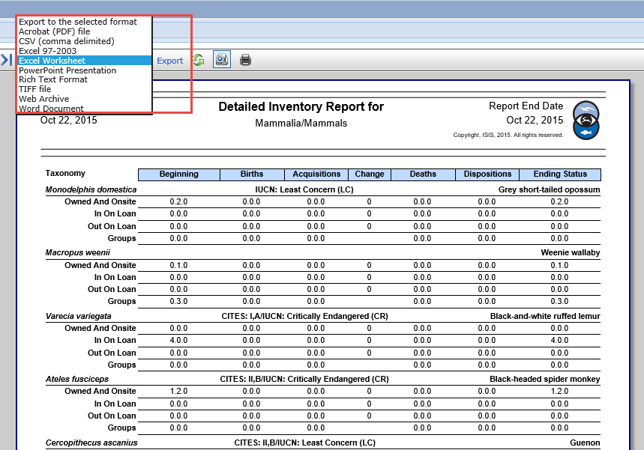
Current Inventory – CBW (cont.)
Notes:
After you run the report, select to Export it to the desired format, usually Excel, so that you can manipulate the data so only the appropriate species are included.

Slide 6
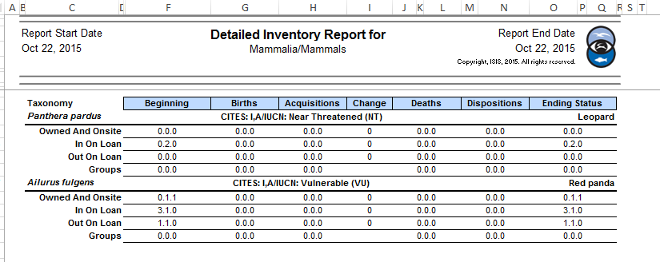
Current Inventory – CBW (cont.)
Notes:
You can then Enable Editing of the document and remove any inappropriate species from the inventory and save it. The result is a greatly shortened inventory that can be sent electronically or printed for submission with the application.

Slide 7
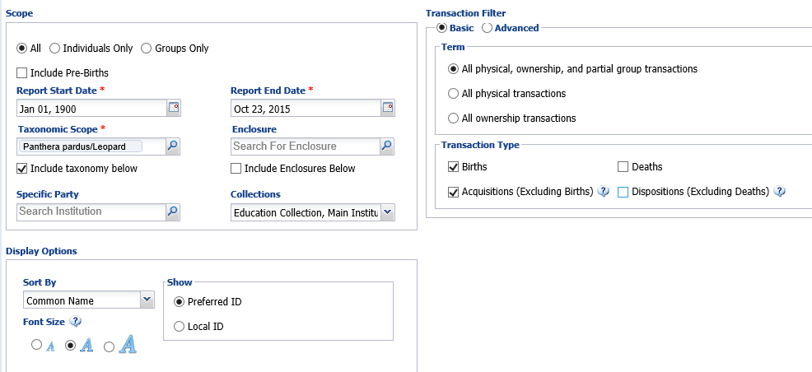
Years Species Maintained
Captive-bred Wildlife and CITES:
The number of years you or the facility has/have maintained the requested
species or similar species.
Notes:
Both the Captive-bred Wildlife and the CITES applications ask similar questions about how long you have maintained the species. One way to find this information is to run a Transaction Report for the species in question. Set the start date for the earliest possible date, such as when your institution opened, to capture all the information. Include all Collections, these are included by default, to capture all the information. You can use a Basic filter, include both Physical and Ownership transactions and select both Births and Acquisitions.

Slide 8
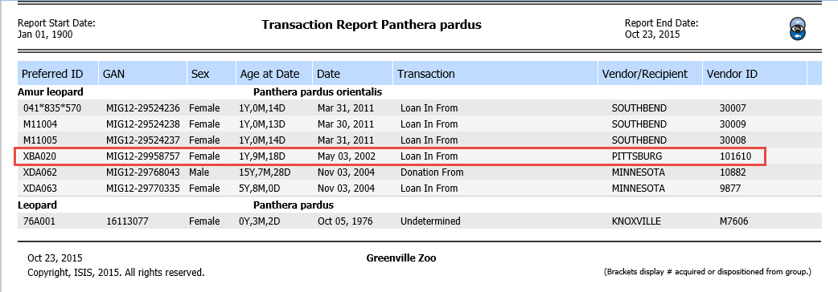
Years Species Maintained (cont.)
Notes:
Looking at the results of this report we see that the first leopard we held, an Amur leopard, was acquired in 2002. This report does not indicate if the animal is Alive or Dead or remains at your facility but it does let you know when you started maintaining the species.

Slide 9
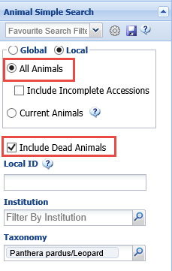
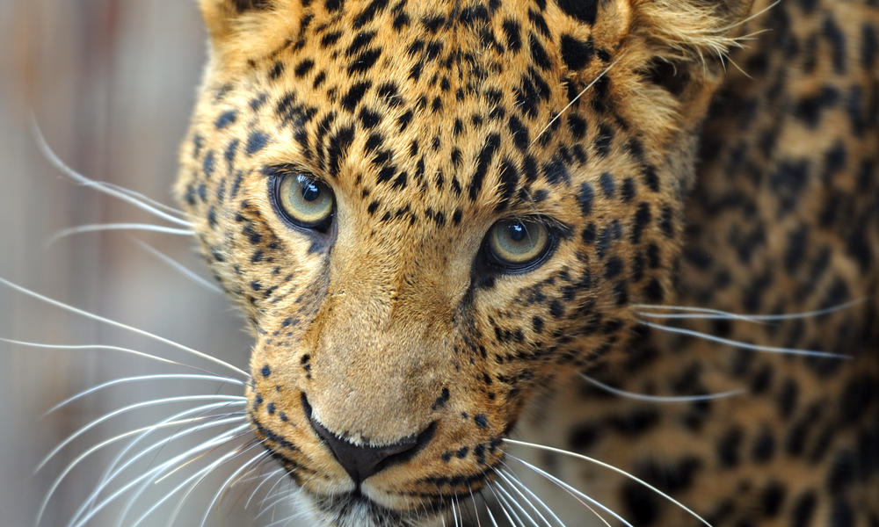
Years Species Maintained (cont.)
Notes:
If you want to know more information you can run a search for the species. Remember to select Local search, All Animals and check the Include Dead Animals checkbox. By adding and subtracting the columns that are displayed in the results grid you can see what animals are Dead or Alive, which ones have been transferred elsewhere and which ones remain at your facility

Slide 10
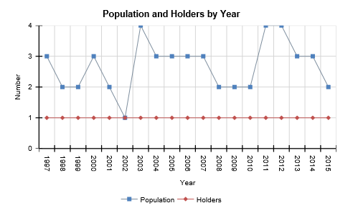
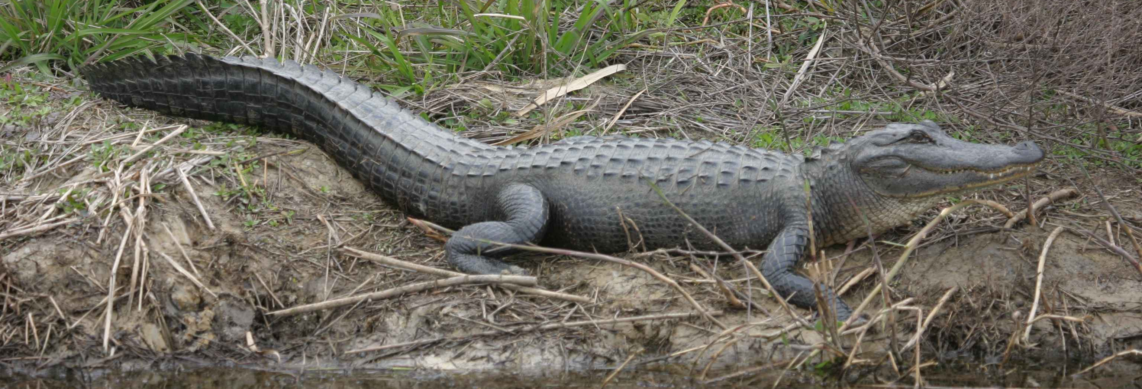
Try Population Overview

Slide 11
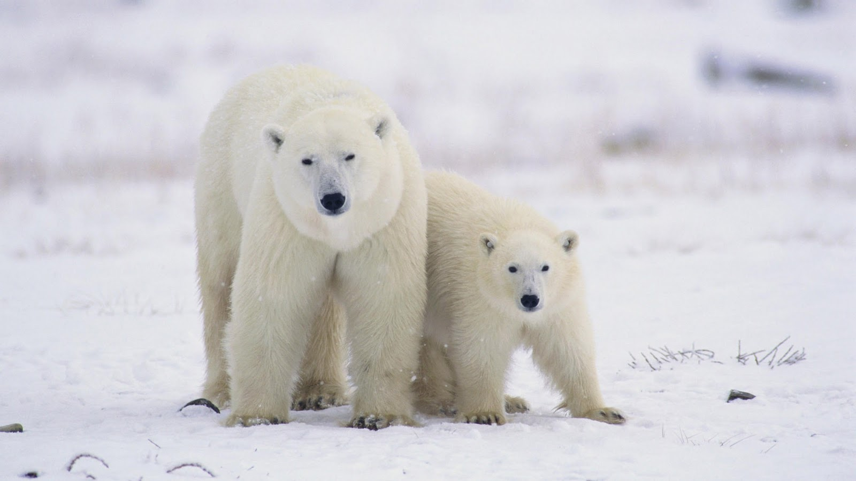
Specimen Information
Injurious Wildlife, Marine Mammals, CITES:
For each species and specimen provide Scientific Name, Common Name, Birth/Hatch
Date, Gender, Identification and Current Location. Marine Mammal also wants to
know the country of origin and the origin wild born, captive born or captive bred)
Notes:
For the Injurious Wildlife, Marine Mammals and CITES permits you must provide information on the actual animal(s) that you wish to obtain, or wish to place. Common information required is Species, Death of Birth or Hatch, Sex and Identification. The Marine Mammal and CITES also ask for the current location and the Marine Mammal wants to know the origin, captive or wild, also

Slide 12
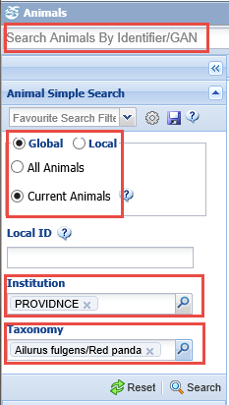
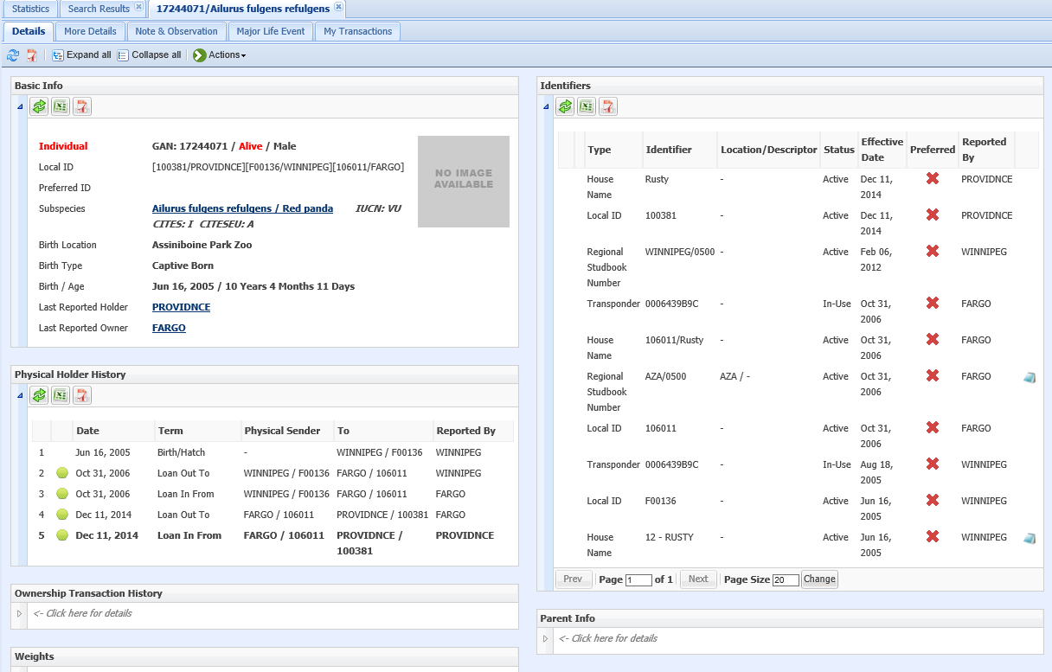
Global Specimen Report
Notes:
A ZIMS Specimen Report will provide all of this information. If you are sending an animal out you will produce a Local Specimen. For animals you are receiving you can produce a Global Specimen Report. Although Global Reports are filtered they do provide all the information that is requested in the application. If you do not yet know the GAN or Local ID of the animal you can do a general search by the sending institution and the taxonomy. Remember to select a Global search. If you do have the GAN or Local ID you can find the animal quickly by using the Search Animals by Identifier and possibly also filtering by Institution. You can tell if you are viewing a Global report because the background is blue.

Slide 13
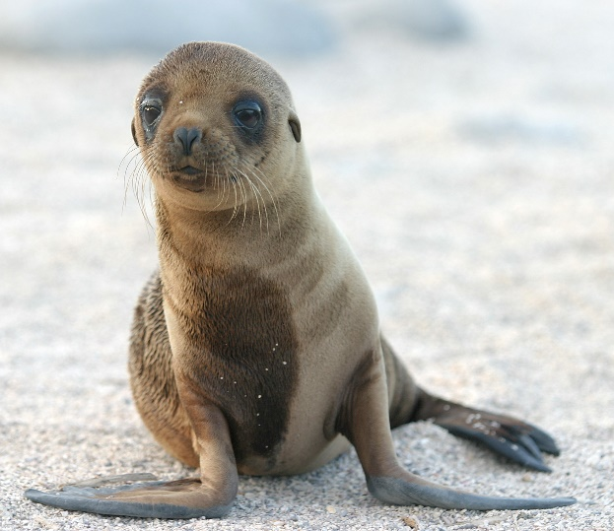
Taken From Wild Information
CITES and Marine Mammal:
Specific location of where, when and by whom the specimen was removed from
the wild.
Notes:
For animals taken from the wild, by your institution or a previous institution, the CITES and Marine Mammal applications want to know the date and location of the capture.

Slide 14
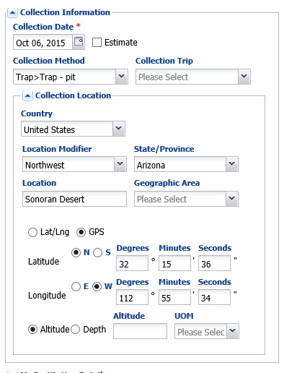
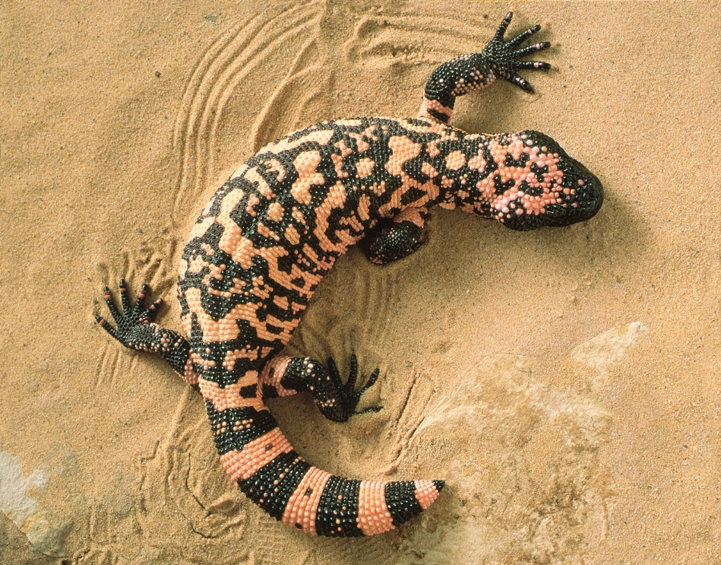
Wild Collection Information
Notes:
When you are recording an animal Collected From the Wild you have the opportunity to record details about the capture location. You can get as detailed as recording the Latitude and Longitude or the GPS coordinates, as well as the Altitude or Depth. This information can do much to assist with species identification. The information will display in the Event Location grid under More Details. To view the lat/long or GPS you will review the transaction information. If you did not record the initial accession of this animal into ZIMS, Event Location is also where you can add that information.

Slide 15
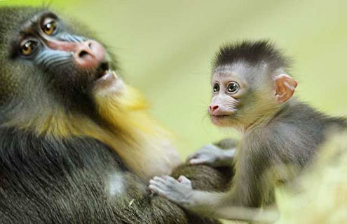
Births/Hatches in Past 5 Years
Captive-bred Wildlife and CITES:
Number of births/hatches during the past 5 years. CITES also wants to know the
number that survived beyond 30 days.
Notes:
Both the Captive-bred wildlife and CITES applications ask about the number of Births/Hatches for the species in the past 5 years. In addition, the CBW application also wants to know how many of those births/hatches survived past 30 days.

Slide 16
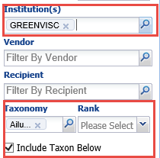
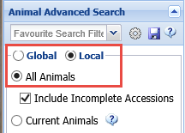
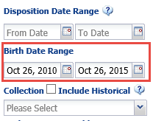
Births/Hatches (cont.)
Notes:
To gather this information run an Advanced Animal Search for the species. Remember to check the “All Animals” box and possibly even Include Incomplete accessions. Also make sure to enter your institution in the Institution field. Enter a Birth date Range for the appropriate five year period. You probably want to include all Collections so leave that field open. By adjusting the columns displayed in your search results grid – make sure that Birth Date and Status are included and move Status next to the DOB column - you can quickly see how many survived 30 days by comparing the DOB date with the date in the Status column. There were three red panda births in the time period and one unknown sex did not survive the 30 days.

Slide 17
Mortalities in Past 5 Years
Captive-bred Wildlife, Marine Mammal and CITES:
Number of mortalities of the requested species at your facility during the past 5 years.
What were the causes? What measurements have you taken to prevent future
mortalities?
Notes:
The Captive-bred Wildlife Registration, the Marine Mammal and CITES permit applications all asked about mortalities in the past 5 years, including the causes of deaths and what steps you have taken to avoid or decrease such mortalities.

Slide 18
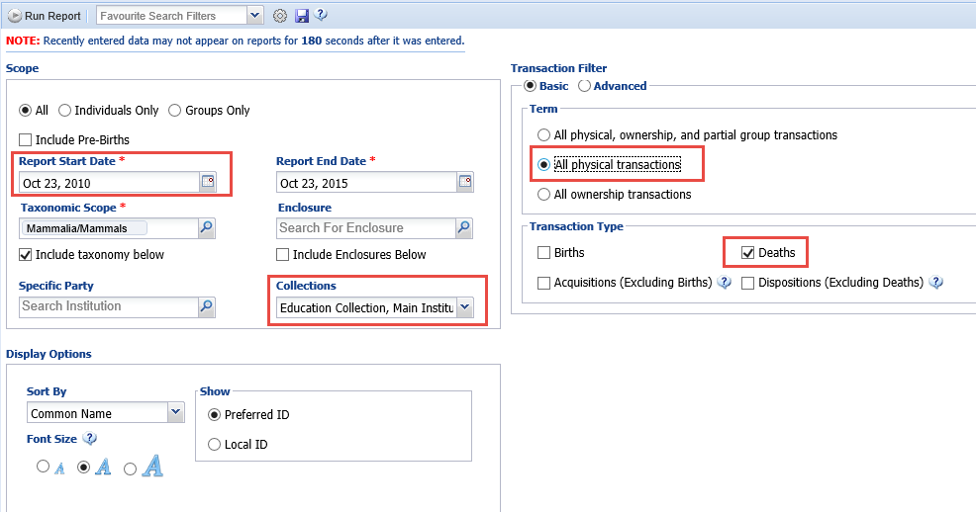
Mortalities (cont.)
Notes:
You can run a Transaction Report for Deaths to find this information. The Start Date would be 5 years prior to what you select for the End Date. If you can limit your Taxonomic scope that will produce a shorter report. You should run it for all Collections to make sure all data is captured. You can probably limit it to Physical Transactions Only. And select Death. We are currently fine-tuning this report so you can search by various Manner of Deaths.

Slide 19
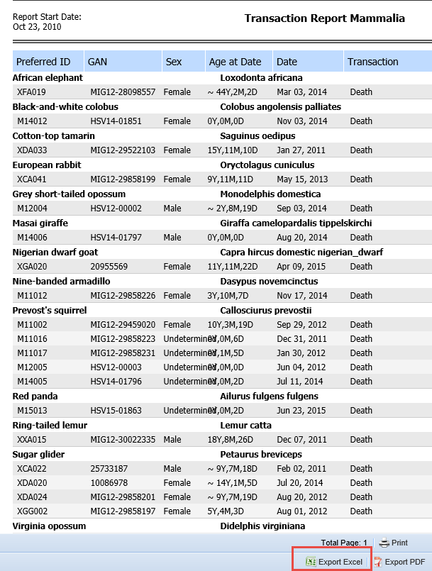
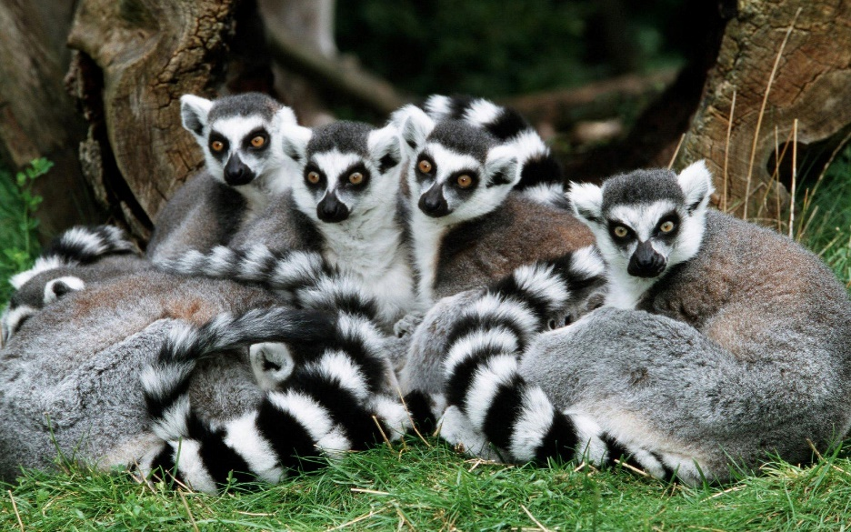
Mortalities (cont.)
Notes:
After you run the report select to Export it and then delete whatever species information is not appropriate. This will result in a shorter report to print or send electronically.

Slide 20
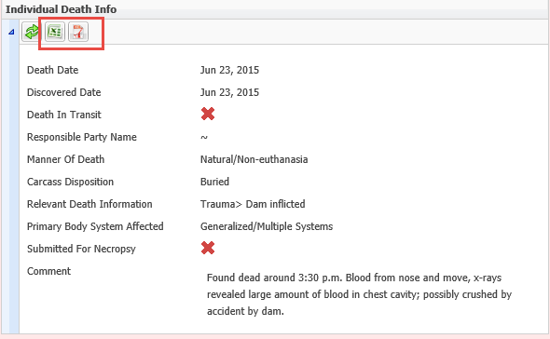
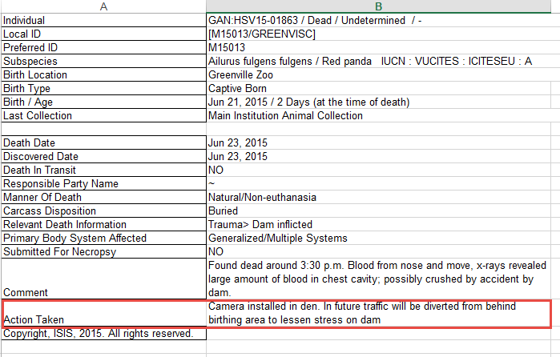
Mortalities (cont.)
Notes:
To answer the cause of death question and the steps you are taking to avoid future losses, you can export the Individual Death Info from within each record. You can then select to edit the Excel file or the pdf (if you have edit capability for pdf). Here we have added the Actions we have taken to avoid a similar mortality in the future to answer the application question.

Slide 21
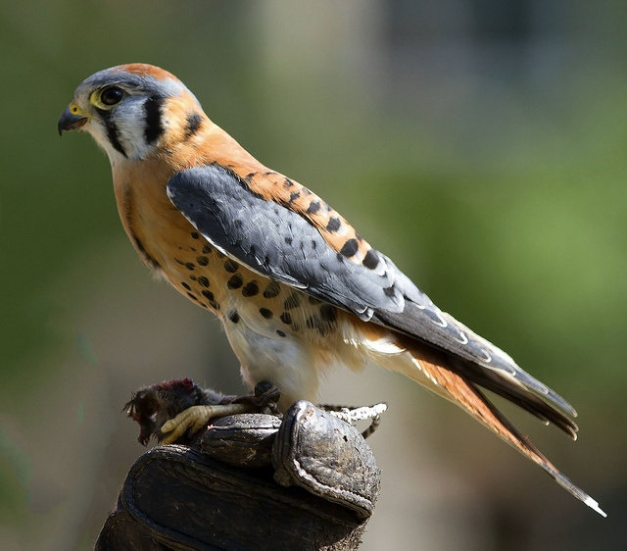
Maintain Record of Activity
Migratory Bird and Eagle Exhibition:
You must retain records relating to the activities conducted under your permit for at least 5 years after the date of expiration of your permit. Migratory Bird a minimum of 12 educational programs per year is required.
Notes:
The Migratory Bird for Education use and the Eagle Exhibition permits require that you retain records for at five years after the expiration of the permit. Of course this is easy to do with ZIMS. In addition, the Migratory Bird permit requests a minimum of 12 educational programs per year.

Slide 22
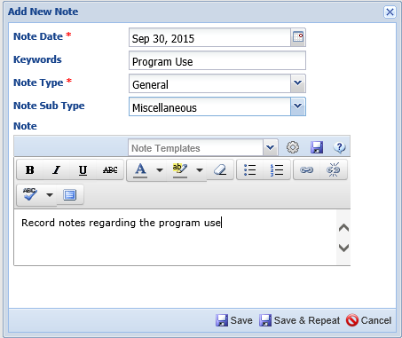
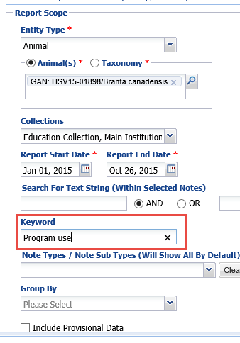
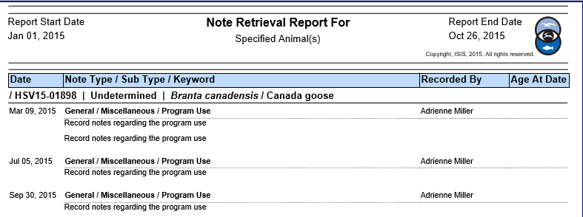
Record of Activity (cont.)
Notes:
To keep track of program use you can use the Notes module with a Keyword, here we used Program Use. You can then do a Note Retrieval Report, searching by Keyword, to easily track how often an animal has been used. You can search by Taxonomy or a single animal as we have done here. So far this year this Canada goose has been used 4 times, twice in one day. You can also use this idea to track use of your other Educational animals to avoid possible overuse – such as the double program use in a single day.

Slide 23
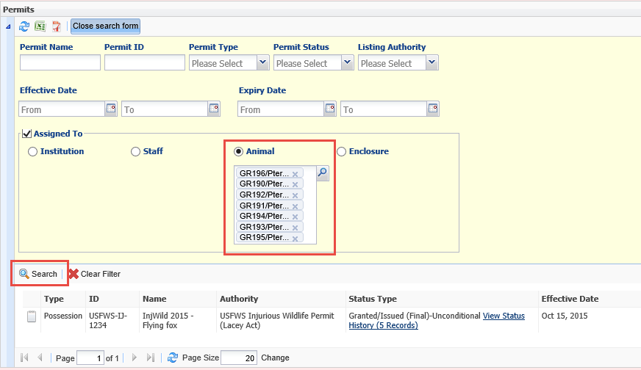
Current Authorization
Injurious Wildlife:
Are you currently authorized to maintain the requested species?
Notes:
The Injurious Wildlife application asks if you are currently authorized to hold the species. Using the search form in the permits grid and selecting Animal you can search by taxonomy. The results grid will display any permits you have for the species represented to help you quickly answer this question.

Slide 24
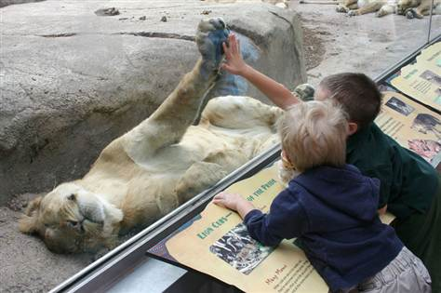
Enclosure Information
Provide a detailed description, including dimensions, construction materials, substrates, netting and protection from the elements, and photographs and detailed diagrams (no blueprints, please) clearly depicting your existing facilities where the wildlife will be maintained. Injurious Wildlife must be maintained in double escape-proof enclosures (e.g., two separate containment systems to ensure against escape) at all times.
Notes:
All of the applications asked for details about the holding and exhibit areas. Some wanted more details than

Slide 25
Enclosure Requirements
Used the USDA requirement for a tiger exhibit
Dimensions:
Fence/barrier must be 8 feet high
Total space for one or two animals must be at least 24 x 10 feet (240 square feet)
Barrier Materials:
Chain link must 9 gauge or stronger
Bars must be steel or aluminum alloy or stronger, no more than 2 inches apart
Notes:
ZIMS allows you to record a lot of information on your enclosures that will help you to answer these questions. In this example we are applying to import a tiger so we looked up the USDA requirements for tigers to make sure that our enclosures met them prior to applying for the permit. READ SLIDE

Slide 26
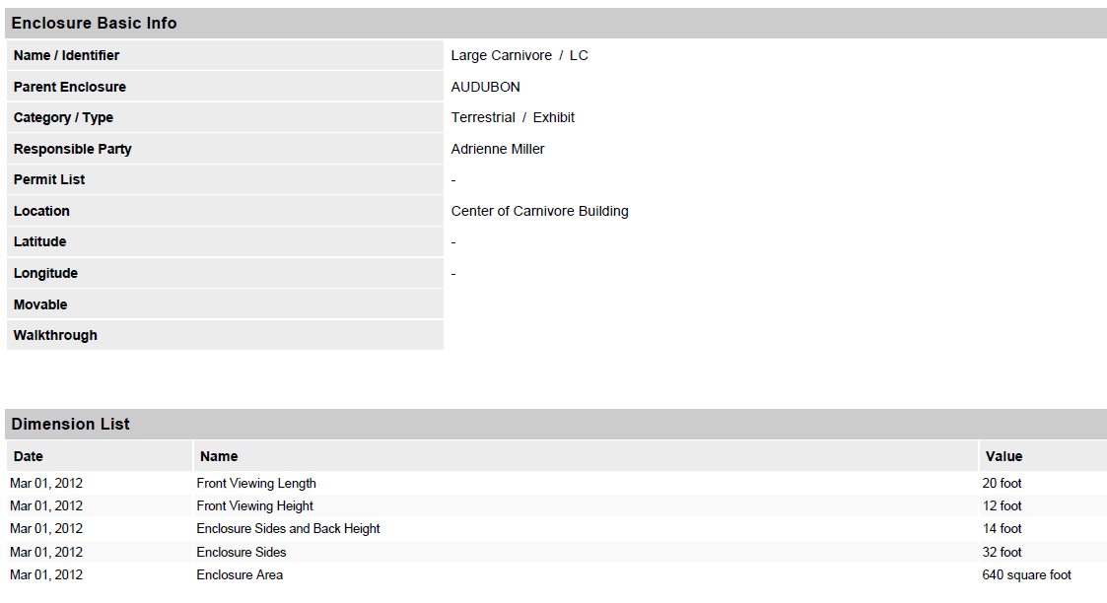
Check the Dimensions in ZIMS
Notes:
If you have recorded your enclosure information in ZIMS you can very easily see if you meet the enclosure requirements for the species. We will need to check the Large Carnivore Exhibit and the Large Carnivore Holding which are where the tiger will be held.
> We can see that the height requirements are met, the viewing is 12 feet high and the sides and back are 14 feet high. The enclosure area is 640 square feet, well beyond the minimum requirements.
> If you want to attach this information to your permit you can also export each grid, or the entire enclosure record to pdf or Excel.
> This can then be emailed or attached as a printed document to your application.

Slide 27
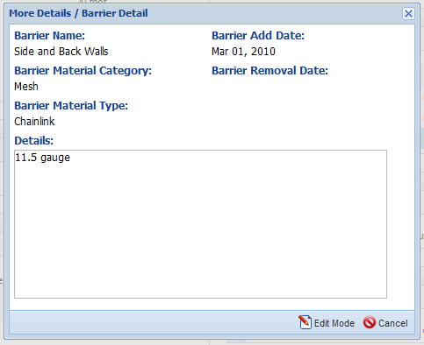
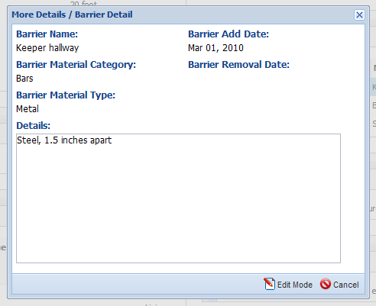
Check the Barriers in ZIMS
Notes:
In addition to dimensions you can easily find the barriers of the enclosure or holding area. Here we are looking at the barriers for the holding area. The sides are concrete which is fine. We need to check the sides which are mesh and the keeper hallway.
CLICK CLICK The keeper hallway is steel bars placed 1.5 inches apart. This meets the guidelines.
CLICK However, the sides are of 11.5 gauge chain link which does not meet the requirements. Before you submit this permit application you will need to replace the chain link on the sides with 9 gauge mesh.

Slide 28
Additional Information
Notes:
You can keep track of additional enclosure information that shows you are meeting the needs of the animals above and beyond the minimum requirements.
This enclosure has a Cave for hiding and shade and to protect from the elements, a question in some of the applications. A large dead tree makes the exhibit interesting and provides climbing opportunity for exercise. It also has two water features, a waterfall and stream into a pool.
Some of the applications required noting what the substrates were and this can also be recorded in ZIMS
Again, any of these grids, or the entire enclosure record, can simply be saved to Excel or pdf and attached to your permit application.

Slide 29
Any Questions?
On Using ZIMS to Help Prepare Your Permit Application

Slide 30
Managing Your Permits in ZIMS
Record a Permit
Track the Status of the Permit
Assign the Permit
Institution(s)
Enclosures
Staff members
Animals
Track permit expiration dates
Search for permits
Name
ID
Type
Status
Listing Authority
Effective/Expiration Dates
Assignments

Slide 31
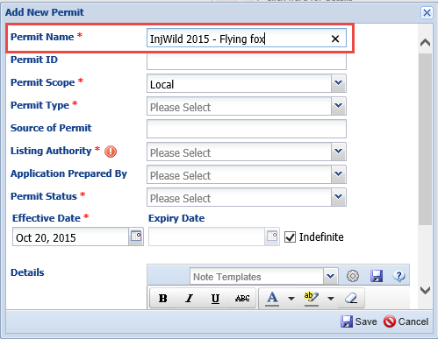
Record a Permit
Notes:
The first field when adding a permit in ZIMS is the Permit Name. This must be unique within your facility. You should come up with a convention for naming your permits so they are all similar. This makes it easier to search for the permit at a later date. Our naming convention here is the type of permit (Injurious Wildlife) followed by the year the application was submitted (2015) followed by the common name of the species. Other naming conventions are fine, the main thing is to be consistent to make searching easier and more effective. You could even start with “1” and go from there.

Slide 32
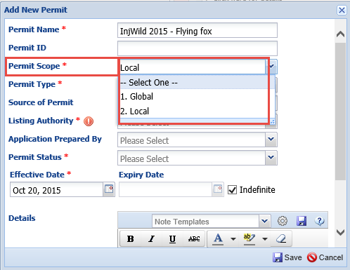
Permit Scope
Notes:
You can then select the scope of the permit. Selecting Local means that the permit information is visible only at your institution. Most permits will probably be marked as a Local scope. Marking the permit scope as Global means that others outside your facility can see it when they are viewing your institution details. This is often very helpful when other institutions need to record your permit number either on another permit or on a permit report. The annual Captive Bred Wildlife reports require the number of the other institution’s CBW permit and if you have marked it as Global scope others will be able to easily find it. This is also very useful for the European BALAI permits which make transport between two BALAI approved institutions quicker and easier.

Slide 33
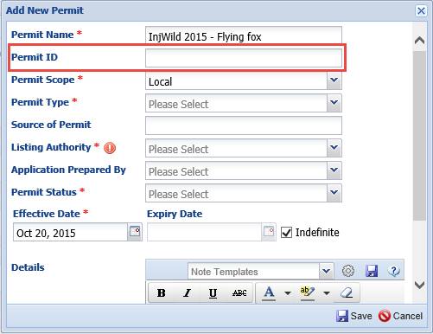
Permit ID
Notes:
The Permit ID is generally not known at the time of the permit application submission. This is a number that is issued by the listing authority regarding your permit. If you only record permits that have been granted you will know the Permit ID at the time of recording so you can enter it. If you are tracking your permit from the time of submission you will most likely have to wait to know what the Permit ID is to record it.

Slide 34
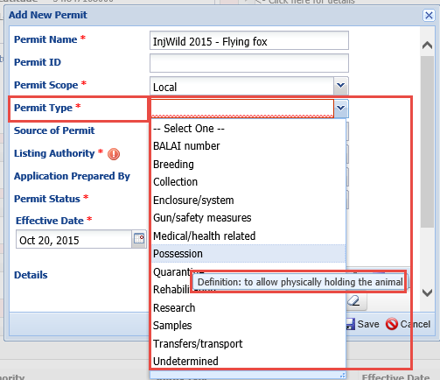
Permit Type
Notes:
The Permit Type is a single select data standard so pick the type that is closest and remember to be consistent with what you select for similar permits. Although Injurious Wildlife Permits are usually required for transferring injurious animals, this permit is for the original possession of the species at your facility, so we have chosen Possession as the Permit Type. In the future, is more of the same species are acquired you will probably select Transfers/Transport as the Permit Type If you have questions about what Permit Type is appropriate use the hover over definitions to help you decide.

Slide 35
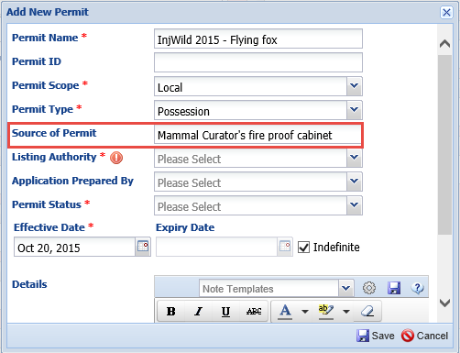
Source of Permit
Notes:
There has been discussion about what exactly the “Source” of the permit means. It was initially intended to be where the original of the permit is kept, in our case the fire proof file cabinet in the Mammal Curator’s office. Since the Listing Authority field actually covers who issues the permit, this free text field can be used however you wish and is not mandatory.

Slide 36
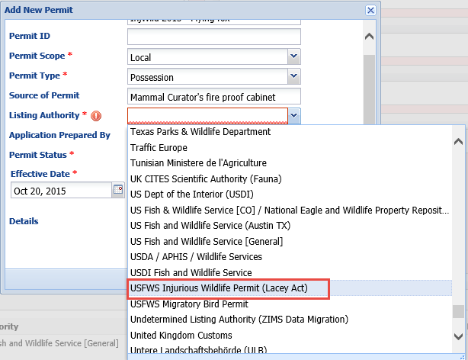
Listing Authority
Notes:
The listing Authority is a lengthy drop down list that includes international Authorities such as the various CITES authorities as well as many more localized ones such as many state authorities. If one you need is not listed please contact support@Species360.org and we can get it added to the global list. In addition, if it is a very localized agency such as a city authority you can add them as a local institution.

Slide 37
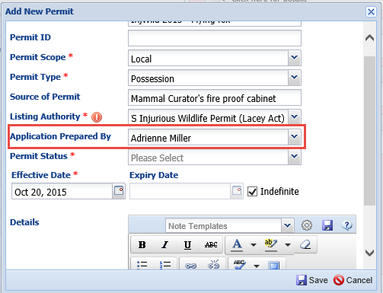
Application Prepared By
Notes:
The field for who prepared the application is not mandatory but can be valuable for future reference. Some applications do have a field for the preparers name and contact information should there be questions but many do not. This field is a single select drop down list sourced from your Staff members who are entered into ZIMS.

Slide 38
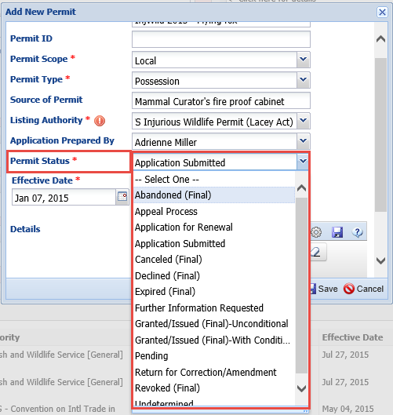
Permit Status
Notes:
The Permit Status allows you to track the permit over time. If you record the various statuses from submission to granted, your staff members can use ZIMS to check on the progress of the permit themselves. The status of this permit is that it has been submitted.

Slide 39
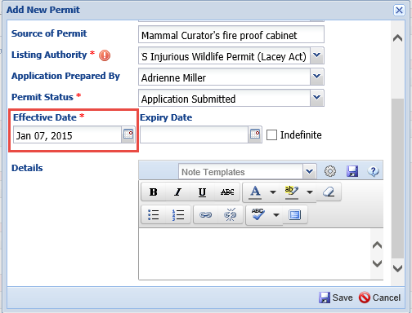
Effective/Expiry Date
Notes:
Because we are tracking this permit from the date of submission, which is 7 January 2015, we will not have an Expiry Date to record. If you are tracking only granted permits you can enter the Expiration Date or check the Indefinite box if appropriate. For our example we will need to wait to record this information.

Slide 40
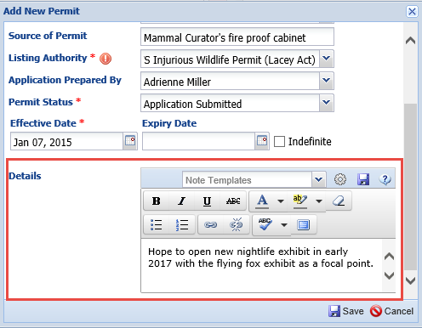
Details
Notes:
The free text Details box can be used as desired. Here we recorded why we applied for the permit, which was for a new exhibit. As the status changes you can record more notes here for further clarification as needed. You can also record notes in the Status Change Details boxes

Slide 41
Display in Permits Grid
Notes:
The permits will display in the Permits Grid under My Institution. The default display has the most recent Effective Date on the top but you can use the arrow option to reverse this order should you desire.

Slide 42
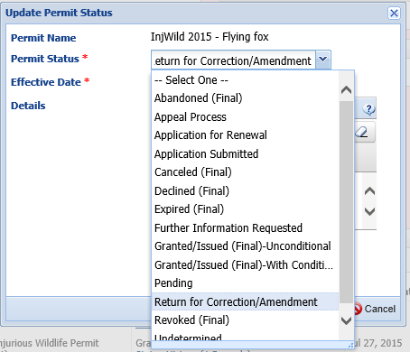
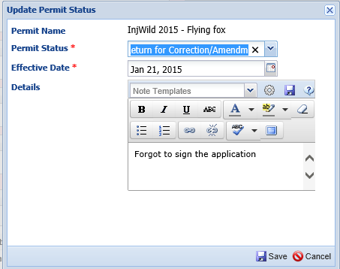
Updating Permit Status
Notes:
As the Status of the permits changes you can update it by selecting the permit and then Update Permit Status. In our situation the permit was returned for Corrections or Amendments. The date it was returned was 21 January and we recorded the reason (forgot to get a signature) in the Details box.

Slide 43
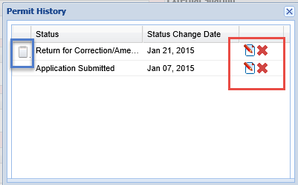
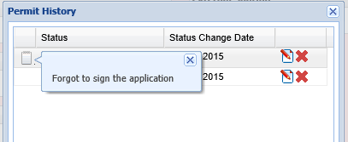
Viewing Status Changes
Notes:
The Effective Date will update in the permits grid to 21 January. In addition you will see that this permit has two different entries in the Status History. Selecting that status history will bring up a grid with the various statuses. Using the pen or X icons you can edit or delete that status directly from the grid. If you hover over the notebook icon you can view the Details recorded for the status change.

Slide 44
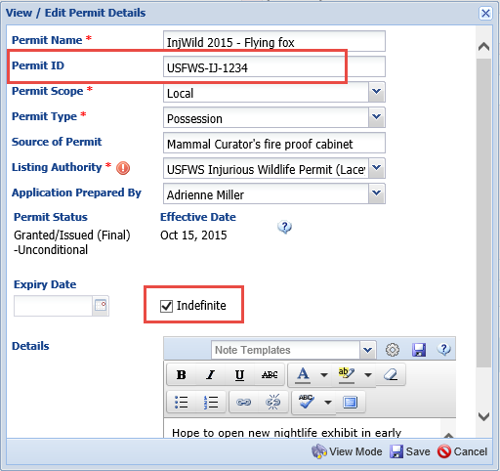
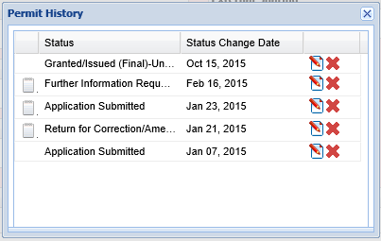
Permit is Granted
Notes:
The permit is granted on 15 October after more information was requested on 16 February. Selecting the permit and then View/Edit you can add the Permit ID and the Expiration Date. Because this type of permit has no expiration date you will check the Indefinite checkbox.

Slide 45
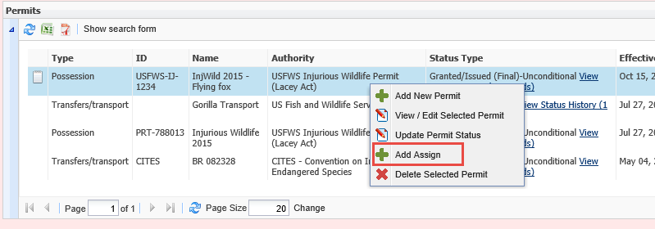
Permit Updated in Grid
Notes:
When you entered the latest status of Granted/Issued (Final)-Unconditional, the Effective Date was automatically updated in the grid and the permit is now at the top as your most recent Effective Date. The grid is also updated with the Permit ID that you entered in the last slide. You will now want to assign the permit to the appropriate entities by selecting it and choosing Add Assign.

Slide 46
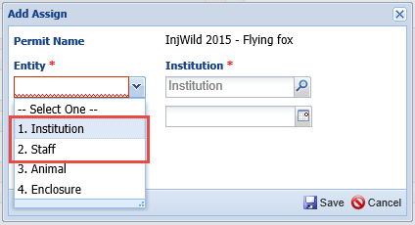
Assigning the Permit – Institution and Staff
Notes:
You can assign the permit to four different entities – Institutions, Staff, Animals and Enclosures. By default the permit is assigned to your Institution so you will not need to also assign it here. However, if you have a permit with sub-permittees covered by it you should record them here. Or, if you are operating under a permit actually held by another institution you should record that Institution here. As far as assigning to a Staff member you could assign them to your CEO, or whoever signed the permit. Generally, staff assignments are only used for permits that are issued to a particular person, such as collecting permits. We will not be assigning this Injurious wildlife permit to a staff member as that is not appropriate in this situation.

Slide 47
Assigning Permit - Enclosure
Notes:
Our bat exhibit is actually completed and ready for occupancy so we can assign the permit to that enclosure. Note that when an entity of Enclosure is selected the next field changes to an Enclosure lookup field. Because the exhibit is completed, the date of assignment will be the date that the permit was issued, 15 October 2015. In the permit grid you now see that there are 2 Assignments for the permit. Selecting the edit/view hyperlink will allow you to view these assignments. You can also Add a new assignment, Edit an assignment or Delete an assignment directly from this screen.

Slide 48
Assigning Permit - Animal
Notes:
Our bats have arrived and now you want to assign the permit to the animals. If you want to assign the permit to multiple animals you can use the lookup feature. Here we are looking for all of our current flying foxes that are owned and on grounds. You can select all the results from the results grid by checking the top left box.

Slide 49
Assigning Permit - Animal
Notes:
All of the animals will prefill into the Animal field. The animals arrived on 20 October so that is the date that the permit is assigned to them. You cannot assign a permit prior to creating a visit at your facility as this is something that is added locally. There are now 10 Assignments of the permit – your Institution, the quarantine enclosure and the exhibit and the seven bats.

Slide 50
Permit Display in the Record
Notes:
The permit will display in the record of the Enclosure or the Animal under the More Details tab. You can assign a permit directly from within the record using the Actions options. All of your permits recorded will display to select from. If you have not yet recorded the permit into ZIMS you can also create a new permit record directly from the Animal or Enclosure permit grid by selecting the Not in the List? Add New Permit hyperlink which will take you to e the Add New Permit screen.

Slide 51
Batch Assigning Permits
Notes:
You can also perform Batch Actions to assign your permits to animals. You can use an Animal List if one is created

Slide 52
Searching for Permits
Notes:
If you only have a few permits at your institution you can easily view them in the permits grid. However, if you

Slide 53
Viewing a Global Permit
Notes:
Here we are viewing a Global Captive Bred Wildlife permit recorded by the Greenville Zoo as another institution,

Slide 54
Any Questions?
On Managing your Permits in ZIMS?

