Slide 1
TAXONOMY
No, wait, it’s really cool!

Slide 2
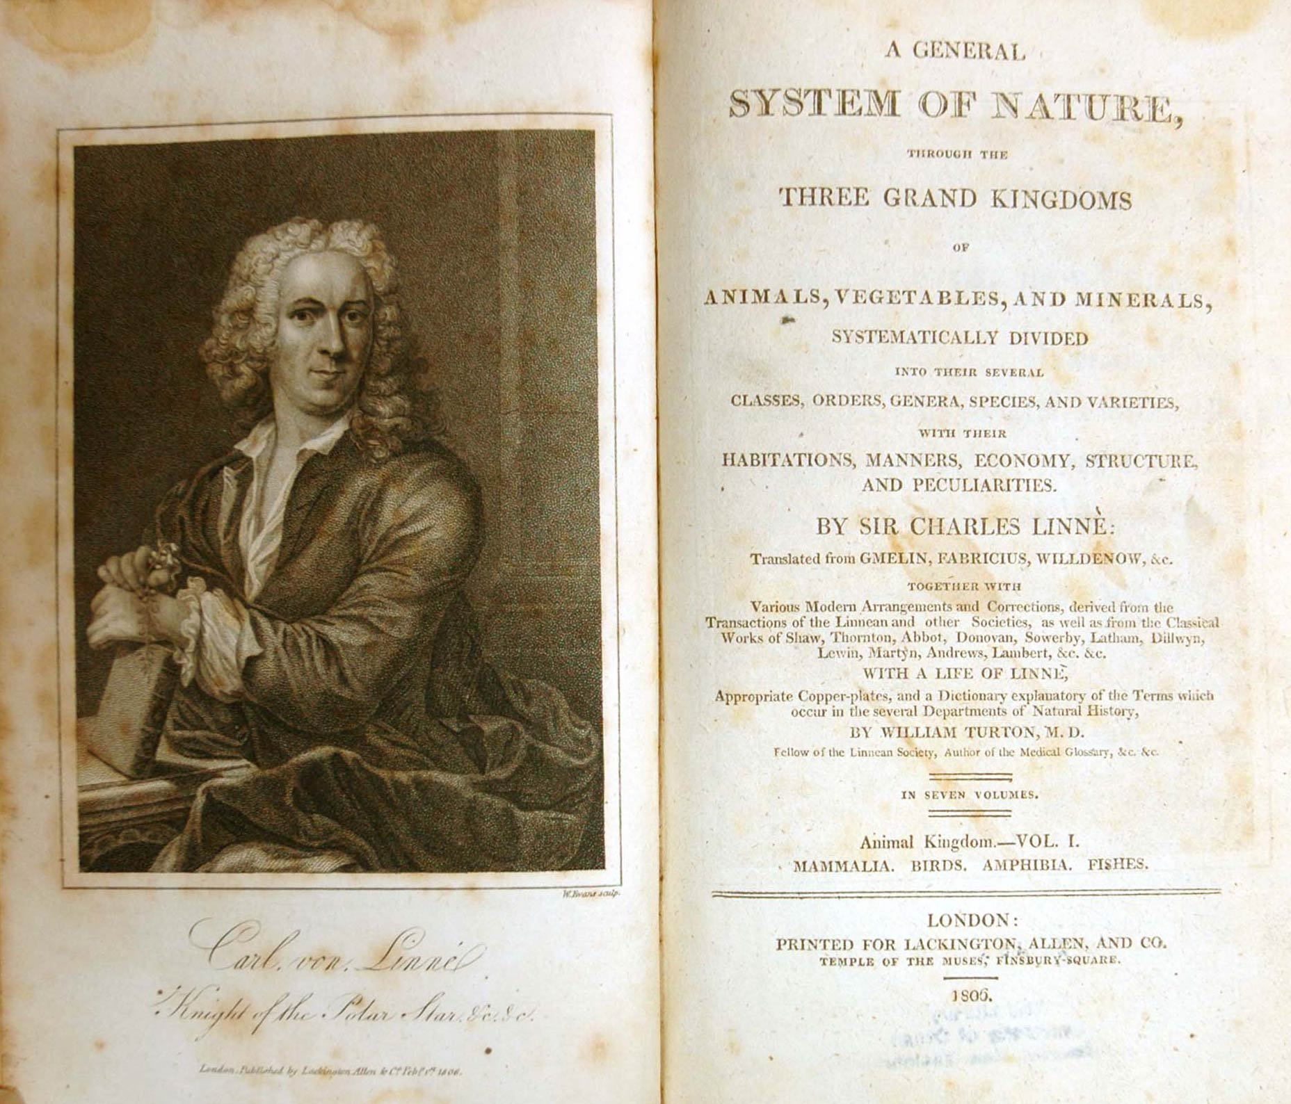
There once was a man named Linnaeus,
who wanted all nature named thus.
But changes cause such a stink
that it just makes me think
taxonomy exists to dismay us.

Slide 3
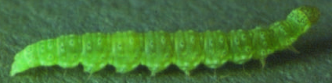
Why does taxonomy exist??
Hundred (or thousands!) of different languages
Differences even within a single language
A way to show relationships

Slide 4
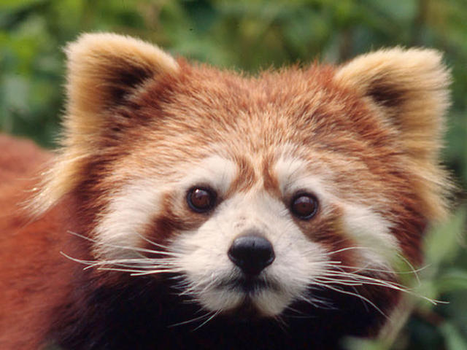
Why does taxonomy exist??
Red Panda
Hon-ho
Ailurus fulgens

Slide 5
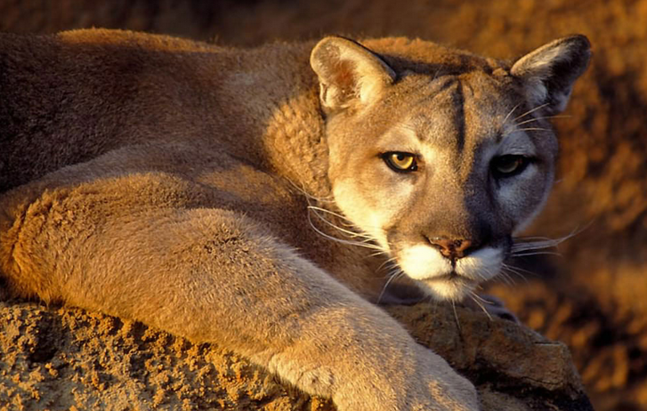
Why does taxonomy exist??
What is this animal?
Puma
Catamount
Mountain lion
Cougar
Panther
Puma concolor

Slide 6
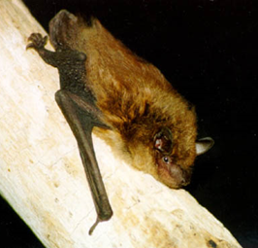
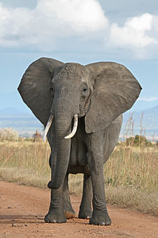
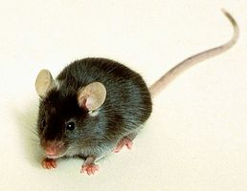
Why does taxonomy exist??
Animals Animals Animals
Things with spines Things with spines Things with spines
Mammals Mammals Mammals
Bats Rodents Elephants

Slide 7
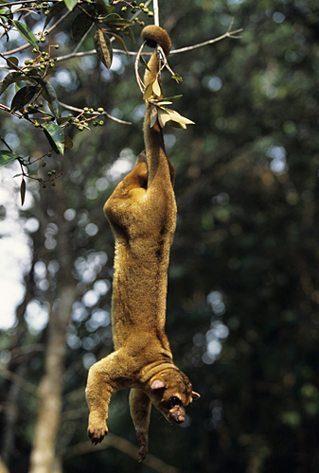
So how does it work?
Binomial nomenclature
Latinized names
Upside down “tree”

Slide 8
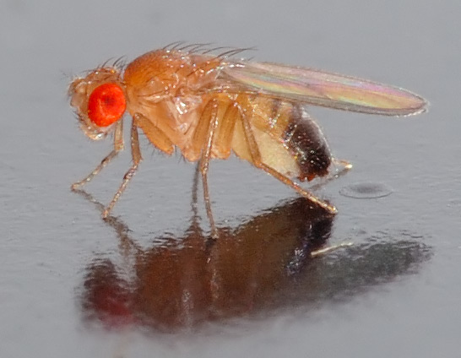
So how does it work?
Bi (two) nomial (name) nomenclature (naming system)
For example,
Homo sapiens (“wise human”)
or
Drosophila melanogaster (“black-bellied dew lover”)

Slide 9
So how does it work?
King Philip Came Over From Greece Singing
(aka “King Philip Came Over For Great S__”)
Kingdom
Phylum
Class
Order
Family
Genus
Species
Animalia
Chordata
Mammalia
Primata
Hominidae
Homo
sapiens
Animalia
Chordata
Mammalia
Primata
Hominidae
Pan
troglodytes
Animalia
Chordata
Mammalia
Carnivora
Felidae
Panthera
tigris
Animalia
Arthropoda
Insecta
HymenopteraApidae
Apis
melifera

Slide 10
So how does it work?
Super kingdom - Eukaryota
Kingdom - Animalia
Superphylum - Invertebrata
Phylum - Arthropoda
Subphyum - Uniramia
Class - Insecta
Infraclass - Neoptera
Superorder - Holometabola
Order - Hymenoptera
Suborder - Apocrita
Group - Aculeata
Superfamily - Apoidea
Family - Apidae
Genus - Apis
Species - mellifera
…but then there are the “over unders”:

Slide 11
So how does it work?
Kingdom - Viruses
Phylum - not classified
Class - not classified
Order - not classified
Family - Totiviridae
…and the “skippers”:

Slide 12

Seems simple enough… why are you so whiny about it?
Let’s look at the challenges of maintaining a single, global taxonomy list:
How I look when a taxonomy issue gets assigned to me.

Slide 13

Seems simple enough… why are you so whiny about it?
Says who??
IUCN
Catalogue of Life
CITES/CITES EU
tinyurl.com/Species360tax

Slide 14
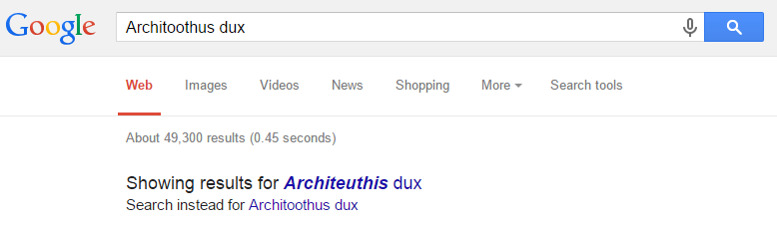
Seems simple enough… why are you so whiny about it?
People cannot spell. Or maybe they just cannot type. I love Google.

Slide 15
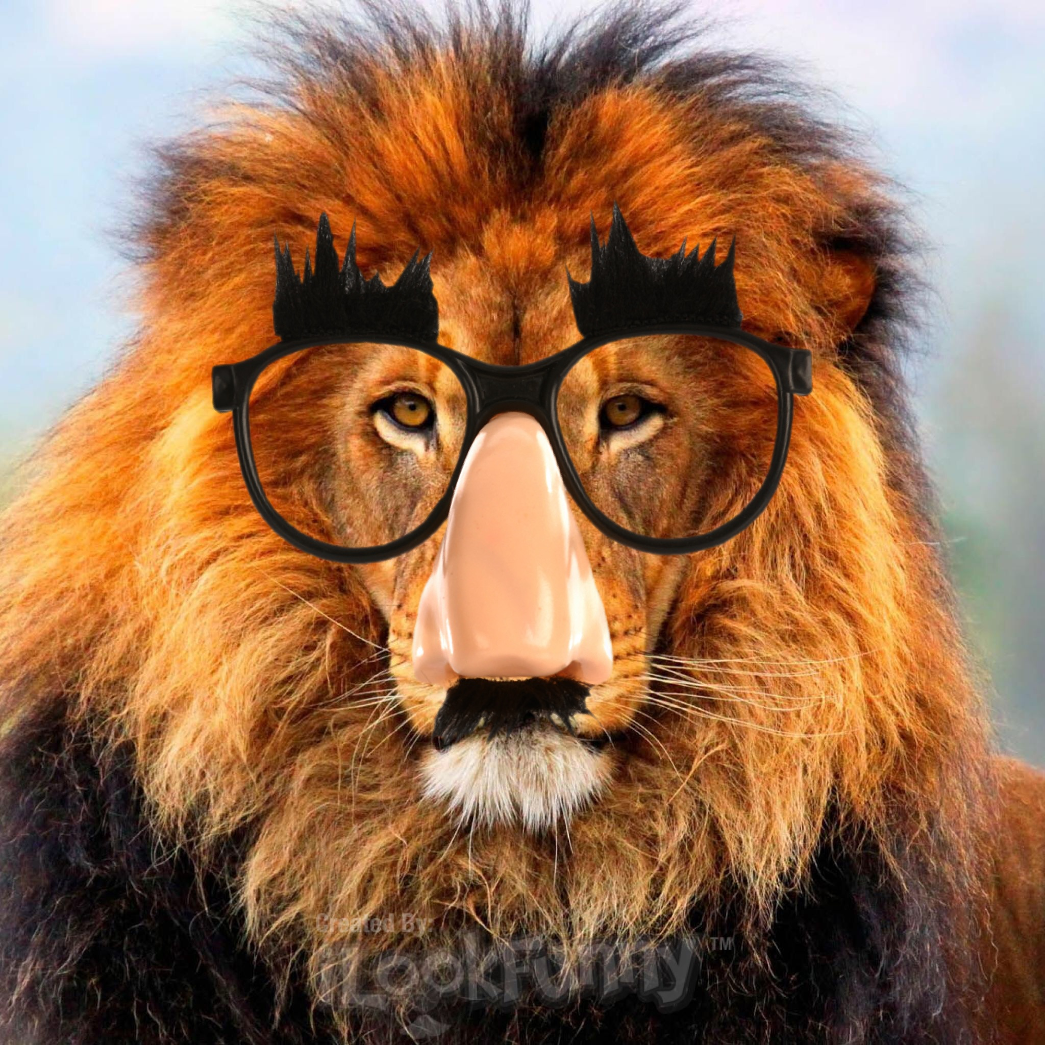
Seems simple enough… why are you so whiny about it?
Sometimes, species have secret identities.
For example, this Panthera leo has the alias Felis leo…

Slide 16

Seems simple enough… why are you so whiny about it?
…which made me wonder what other Felis species might be sneaking around?

Slide 17
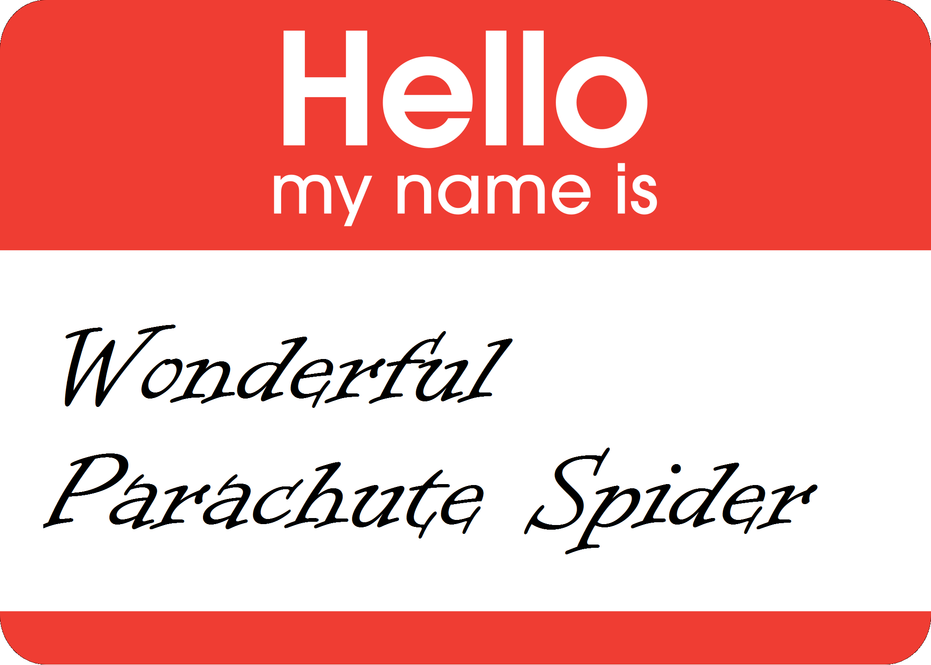
Seems simple enough… why are you so whiny about it?
And then there’s the issue of common names.

Slide 18
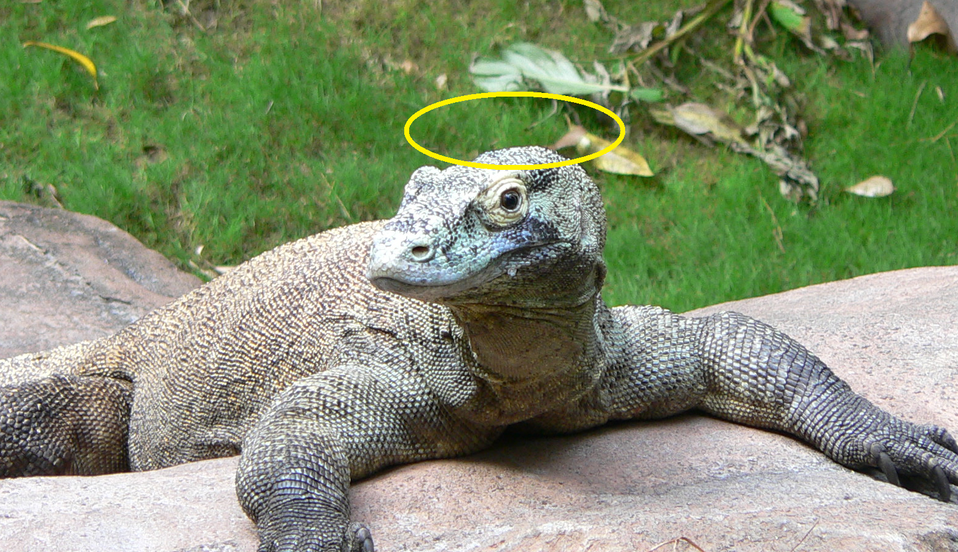
Seems simple enough… why are you so whiny about it?
Plus, we keep track of characteristics by taxon.

Slide 19
So how does ZIMS do it?

Slide 20
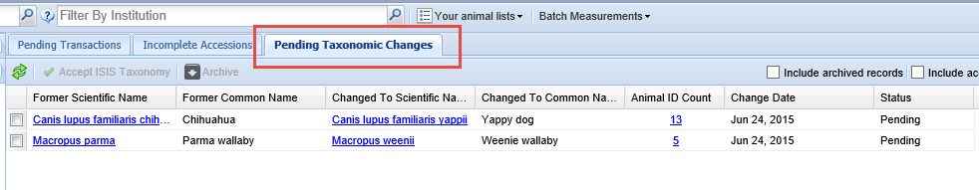
Pending Taxonomy Change Tab
There is a new tab in the Animals module titled Pending Taxonomic Changes.
This grid displays if Species360 has changed the taxonomy (Scientific Name, Common Name
or both) for a species you currently or historically had in your collection. Users
wanted the ability to accept Species360 taxonomic changes OR keep them as they are in
their records. This allows you to do that. Only if you have/had a record for the
species will it display in this grid. In the example above both the Scientific Name and the
Common Name for Chihuahuas and Parma wallaby have been changed by Species360. You
can see that 13 records for Chihuahua and 5 records for Parma wallaby may be
affected by this change.

Slide 21
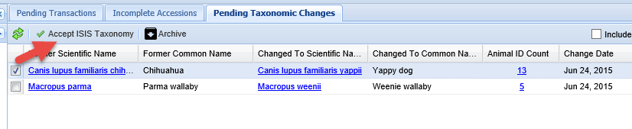
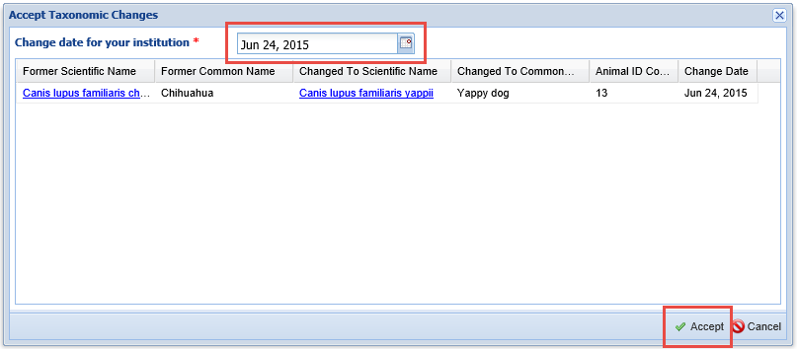
Accept Species360 Taxonomy
Checking the left side box will activate the Accept Species360 Taxonomy button. I am
going to accept the change for Chihuahuas. All 13 records for that species will
be changed. You get a second chance to review it as well as change the date.
The date is simply for your information as the species will be changed historically.

Slide 22
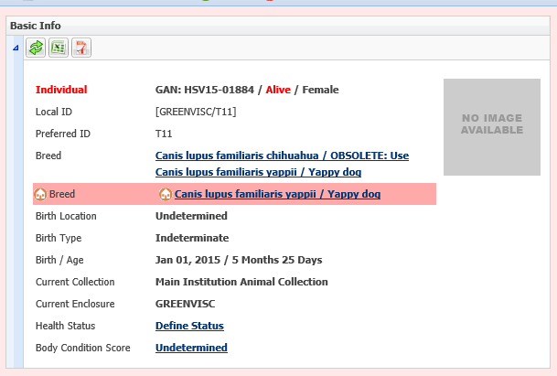
Taxonomy Conflicts
When you select to accept any new taxonomy that Species360 has changed you may see that there is a taxonomy conflict in the Basic Info. This should go away after 15 minutes when the Global taxonomy is re-calculated. For a few minutes you will see this conflict on any of your animals with that taxonomy.

Slide 23
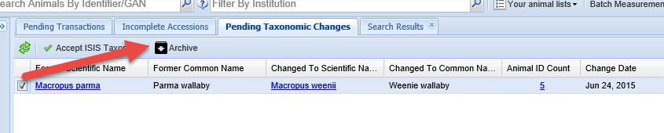
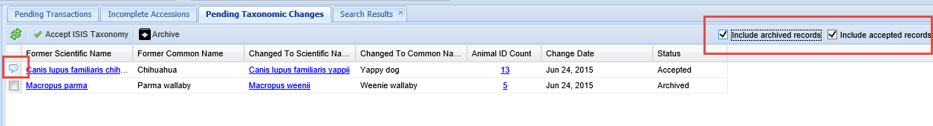
Archive Taxonomy
Should you wish to NOT accept the Species360 taxonomy you can Archive the record to
clear the grid.
Using the checkboxes to the right you can view any Archived records (you may want
to now accept the taxonomy) and any Accepted records. The note will indicate the
date the taxonomy was accepted and who accepted it.

Slide 24
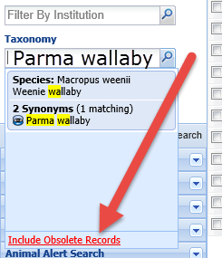
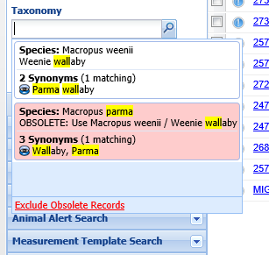
Searching By Obsolete
If you have chosen not to accept the new Species360 taxonomy, the species will be
Obsolete and this affects your searches. To find records of those species you
will need to select Include Obsolete Records. The Obsolete species will
appear in red and you can select it to find your records. The highlighted yellow
indicates matches in your type ahead search.

Slide 25
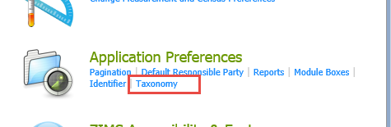
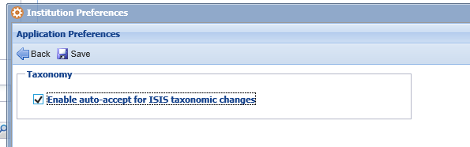
Institution Preferences
If you want to automatically
accept the Species360 taxonomy
updates you can save time
by selecting Taxonomy in
Application Preferences in
Institution Preferences and
checking the Enable Auto-
Accept for Species360 Taxonomic
Changes. This is not available
as a My Preference. If this is
checked then the Pending
Taxonomic Changes tab grid
should never be populated.

Slide 26
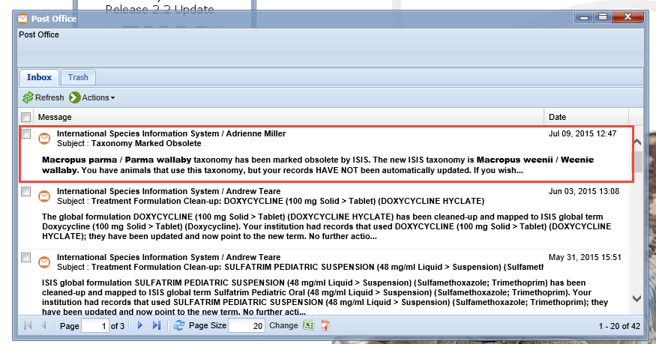
Post Office Message
Whenever a taxonomy is changed you will also receive a Post Office message. This is helpful if you have selected the Preference to automatically accept the Species360 taxonomy changes as they will not appear
in the Pending Taxonomy changes tab unless you select to Include
Accepted Records.

Slide 27
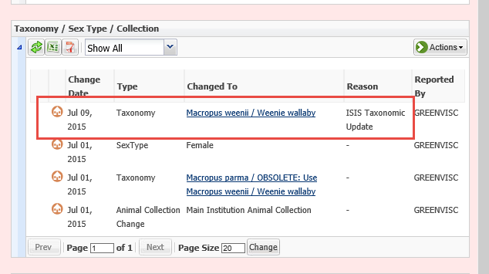
Display in Record
We went back in and accepted the taxonomic change for Parma wallaby.
It will display in your Taxonomy grid with the Change Date being the date
you entered when you accepted the change. Nothing is displayed in the
Specimen Report regarding the change.

Slide 28
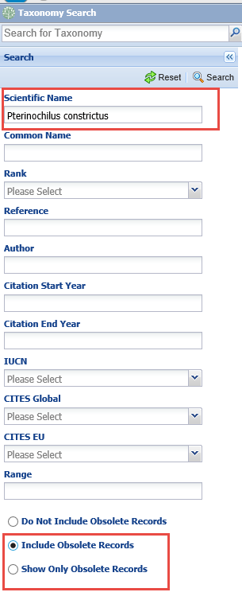
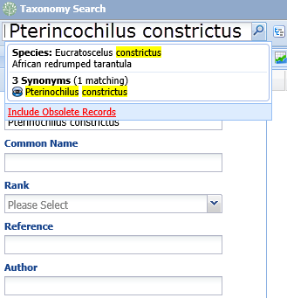
Obsolete in Taxonomy Module
Within the Taxonomy
module if you are searching
for obsolete taxonomy
remember to check the
Include Obsolete or Show
Only Obsolete Records
radio button. Otherwise
the taxonomy will not be
found.
However, if you use the
upper left hand search,
obsolete taxonomy is
found by default.

Slide 29
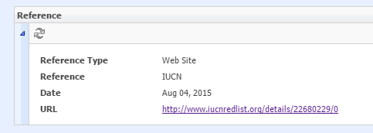
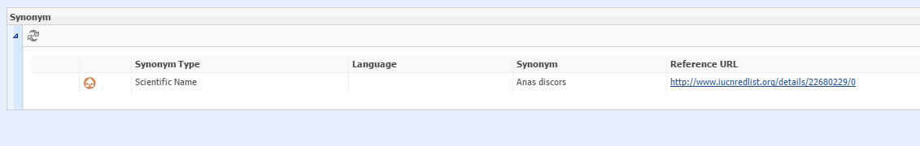
References in Taxonomy Module

Slide 30
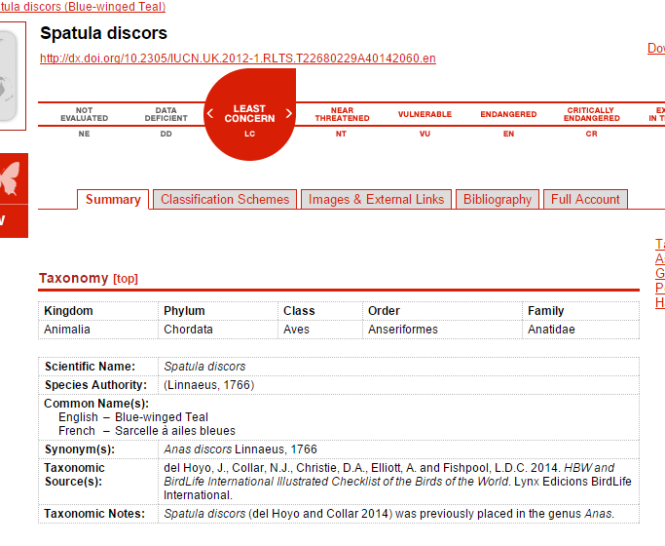
References in Taxonomy Module

Slide 31
A final verse…
Big fleas have smaller fleas
Upon their backs to bite ‘em
And smaller fleas have tiny fleas
And so it goes, ad infinitum.
- Augustus De Morgan

