Slide 1
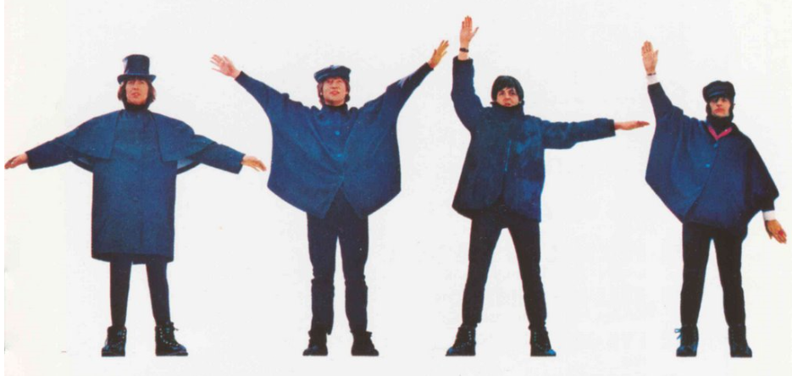
ZIMS Tips and Tricks
March 2015
HELP! (Help Us Help You!)
and ZIMS Self HELP!

Slide 2

Help Made Fast and Easy
Everyone will get help with their ZIMS questions, but some seem to get answers faster than others
This session will provide some hints to help avoid potential roadblocks and make getting ZIMS help swift and easy for you

Slide 3
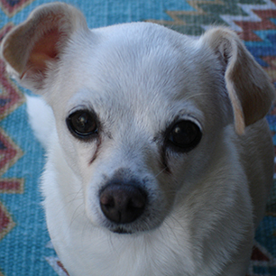
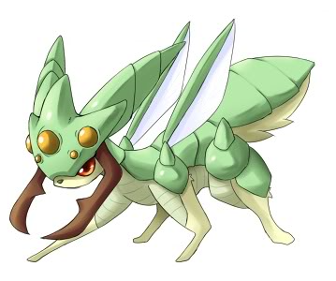
What is a Bug?
Something that is broken or does not work
You cannot perform part of your data entry or reporting tasks in ZIMS
EXAMPLE:
  A global Animal Search is displaying an incorrect institution in the Current Owner column
Bugs are fixed as soon as possible

Slide 4
Who Do I Send a Bug To?
Send an email to support@Species360.org
Do NOT send directly to your Support person’s email
  May delay a response due to high volume
Sending to Support assists with tracking and passing on to the development team
Institutions are also auto-assigned to their Support person so they will receive it
If your Support person is out others check and take issues for them

Slide 5
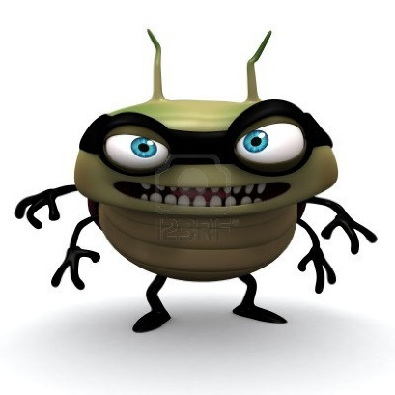
Sending to Listservs
What if I just send to one of the records listservs?
  Does help you to know if others are experiencing the same issue
  However, this will not get the Bug fixed!!
  Species360 staff are on listservs but not always monitoring them
  The quickest/only way to get assistance is to submit to your Support person
    They will create a ticket and track

Slide 6

What do I Put in the Subject Line?
Which main module is the Bug in?
  Animal Husbandry
  ZIMS for Medical
The sub-module it is found in (Animal, Enclosure, Treatments, Institution, Reports, etc.)
The title of the screen the Bug is found in
This helps Support to quickly identify related Bugs that have been previously submitted so they can be associated together

Slide 7
Examples of Subject Lines
THE BAD: Add New Enclosure is busted
THE GOOD: Husbandry, Enclosure module, Add New will not Save
THE BAD: Can’t add a Prescription
THE GOOD: Medical, Add Quick Prescription, Batch Prescription checkbox not working

Slide 8
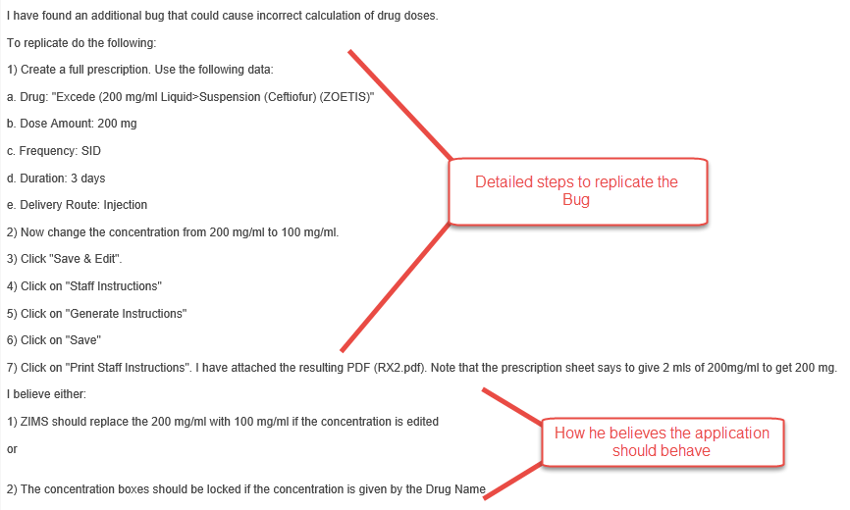
Record the Steps to Recreate the Bug

Slide 9
Be Careful with Screen Shots
Sometimes arrow/box/circle formatting is not correct when received
  MS Paint is free and may be an option
  Snag It can be trialed and purchased
Image in signature can interfere with interpreting screen shots
Often they are too small to read
If referencing a screen shot include name of the file and what to look at

Slide 10
Including an Email Chain
You can include an email chain as supportive documentation only, especially if several institutions are involved
You still need to provide exactly what the issue is in your description, including replication steps
It will slow down response time considerably if Support has to read through a dozen emails to get what the Bug is, plus they may misinterpret what you are actually asking for!

Slide 11
Some More Helpful Hints
If Animal related Bug, type out the GAN
  Allows for quick cut and paste option for support
If you have Parent/Child institution relationships reference which institution the problem is occurring in
If dates are part of your Bug write the month and year out, 03/07/99 could be anything from 7 March 1899 (yes we have ZIMS records going back that far!) to 3 July 1999
Support will let you know when Bug is fixed
Check application and let Support know your findings– they cannot Close the issue otherwise

Slide 12




Life Cycle of a Bug
Support notifies the User the Bug is fixed. User tests and reports back to Support so the
issue can be Closed
Bug is identified
by a User and
submitted to
Support
The Development
Team fixes the Bug
Support tests to replicate
and submits to the
Development Team

Slide 13
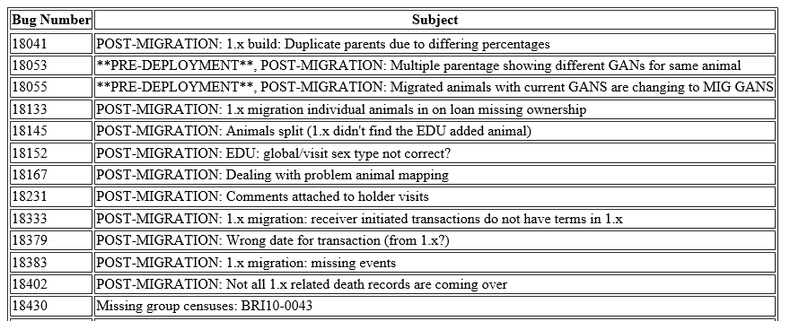
Viewing Submitted Bugs
You can view submitted Bugs with a status of High or Highest
http://www.Species360.org/bugs/
Use your ZIMS/portal login

Slide 14

What is an Enhancement?
Something that would be nice to have, a great idea
There may be a “work around” to accomplish your goal but possibly may take you longer
EXAMPLE:
  Having the cursor automatically land in the first data entry field on all screens
  It is not broken, as you can place your cursor there, it just takes longer.
Enhancements go to User Group for voting

Slide 15

How to Request an Enhancement
Sometimes what you think is a Bug may actually be an Enhancement
  Support will submit and let you know
If you just have a good idea send that to support also
Copying from listserv does not count!
  Each must email support so they can track
  The more institutions that request an enhancement the more likely it is to move forward
Identify if it is Husbandry or Medical main module
  Adrienne Miller manages Husbandry module
  Dr. Andrew Teare manages Medical module
Identify the Sub-Module affected
  Animals
  Enclosures
  Institution
Provide details
  State exactly how you would like something to work or appear
  Do NOT say “I want this to work better”
Support will let you know if it moves forward
If Completed, check it and notify Support if all is well

Slide 16

Life Cycle of an Enhancement
Remain on Enhancement
list until voted on by UG
Sent to User Group
for voting
Back into list for
possible future voting
Sent to Development
Team for
implementation
If Accepted status of Open
on the Enhancement list
Have a good idea?
Submit it to Support
Could be “Rejected” or
marked as “Duplicate”
Support adds to the Enhancement list
for Project Management Team review

Slide 17

What Happened?
Rejected
  Breaks a Business Rule (what keeps everything logical)
  May be impossible to do
  Submitter can counter with additional information
Duplicate
  Your institution has already submitted the same enhancement request
  Only one per facility
Contradictions
  Two facilities asking for enhancements that contradict each other

Slide 18
Closing Bugs & Enhancements
When Support lets you know a Bug is fixed or Enhancement added check it and let them know it is OK or not
If you are not sure if you are up-to-date with checking your Closed issues then Support can let you know what issues you need to check
Coming Attraction! Ability to monitor the status of your Issues yourself

Slide 19
How to Submit a Data Standard Addition
Include the data entry screen title
Include the field title
Term desired
Always include a definition
  Slow the process as we have to go back to you
  Makes sure we are interpreting correctly
Idea of how often it would be used
Support will notify you if implemented
Please check and let Support know that all is well – they cannot Close the issue otherwise

Slide 20

What is a Data Fix?
A Data Fix means that Species360 is needed to make the corrections
Common Examples
  Local ID edit
  Splitting/Copying records
    Info from one into another
  Pending Transaction Loops
Inventory Reports not adding correctly
  Duplicated transactions, multiple accessions

Slide 21
How to Get Help for a Data Fix
Submit to Support
Include the GAN if appropriate
For Local ID edit identify the current Local ID and the corrected one desired
Communicate with other institution if appropriate
  Can copy them in Species360 email
For splitting/copying information export a Specimen Report and highlight information you want copied
For Pending loops include the GAN and which transaction is the problem
For Inventory miscounts include the taxonomy, the report parameters, any changing/evolving numbers and the count you are expecting

Slide 22
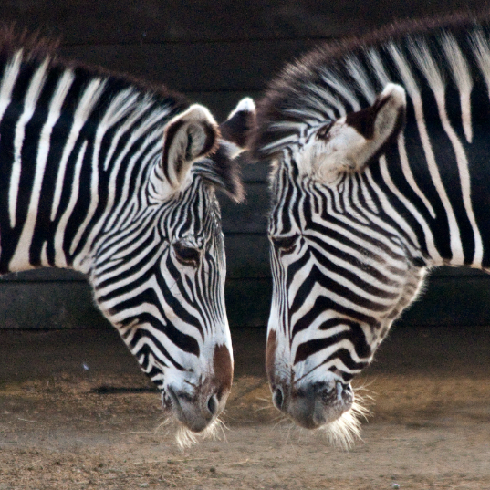
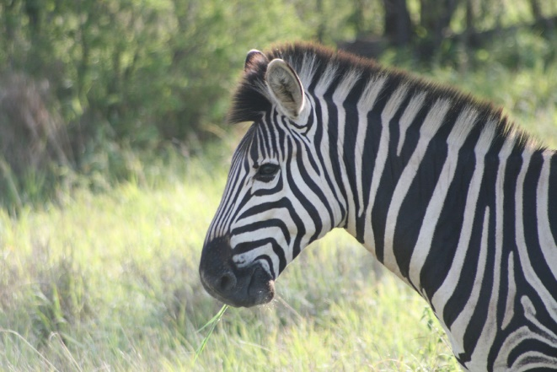
How to Request a Merge
Two animals in the database and should be only one
Confirmation required from all institutions
Two approaches
  Communicate with other institution then submit
  Communicate with other institution and Species360 simultaneously
Include BOTH GANs !!!
Usually the original GAN, or that of the first holder, is kept.
The other disappears but is redirected to the retained record.
“Disappearing” record GAN becomes an Old Accession Number identifier
No confirmation needed if the following match:
  Taxonomy
  Date of Birth
  Gender
  Birth Location
  And one of these:
    House Name
    Studbook number
    Transponder
Let Support know all is well after the merge
  Merge is correct
  All info is there

Slide 23
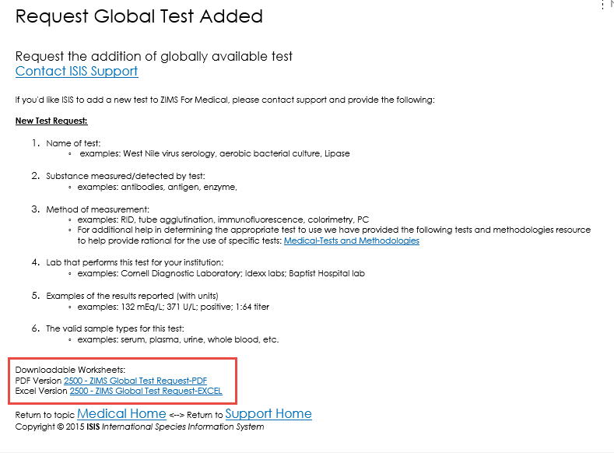
Requesting Tests
If you want to request a new test in the Medical module please do so in the desired format found at this link: http://www.Species360.org/testrequest/
To make it really easy use the hyperlinks at the bottom for downloadable worksheets

Slide 24
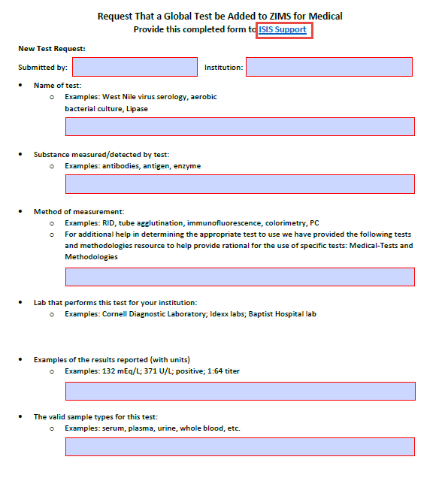
Complete & Submit to Species360

Slide 25
Working with someone Other Than Your Regular Support Rep?
If working with someone that ISN’T your regular Support person on an issue that came in while they were out, DO put ATTN: “Name of not your Support person” in the subject line
Include the issue in the subject line
Be especially specific. Do not say "been playing with that thing from last week and this is happening now“. Your Support person may not know what you are talking about as someone else helped you out

Slide 26
General Hints
Always include the GAN if Animal related
Do not send directly to your support person’s personal email
Once submitted no need to re-submit
  Reply to original issue if you have questions, do not submit a new issue
Don’t say I want it to work better, provide details on how you actually want it to work.
Subject line should be helpful
Clear your cache on a daily basis
  Minimal prior to Bug Submission
  http://Species360.org/cache
If it is a UI (User Interface) problem know what Browser and version you are using

Slide 27

Any Questions?
On how to help us help you?
(before we go into Self HELP!)

Slide 28

ZIMS Self HELP!
How to Help Yourself!

Slide 29
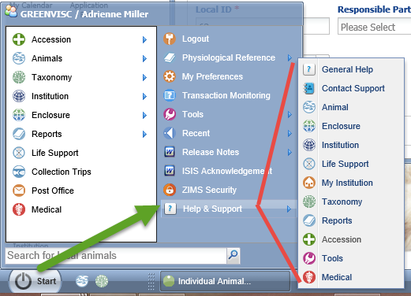
HELP! Within ZIMS – From Start
There are HELP! Documents right within the ZIMS application.
You can find them from the Start menu where a list of the topics is displayed

Slide 30
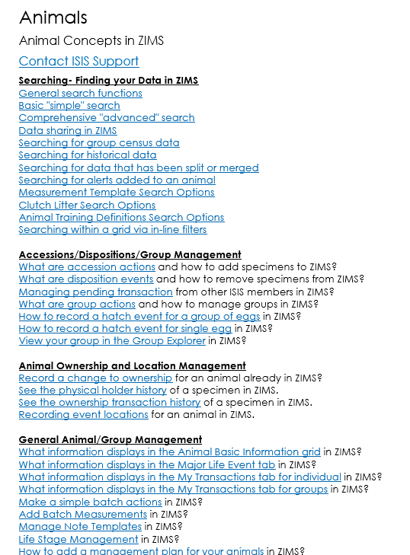
Finding the HELP! topic
When you select the
topics from the list
the various documents
are sorted under
groupings to help you
find what you are
looking for

Slide 31
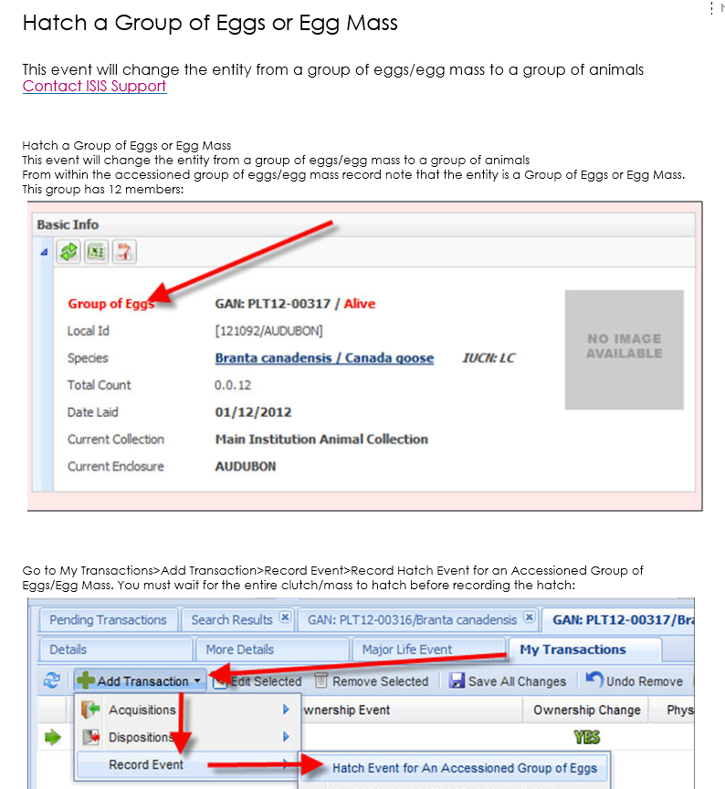
Using the HELP! documents
Here we have opened
How to Hatch a Group
of Eggs or Egg Mass.
Text and screen shots
will guide you through
your actions

Slide 32
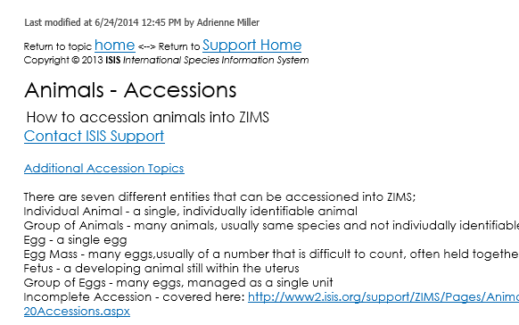
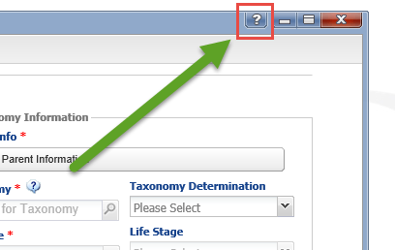
HELP! Within Topics
You can also find HELP! Documents right within many of the ZIMS screens
On the left we are in an Animal Accession screen
Selecting the “?” will take you directly into the HELP! Document for Animals – Accessioning – no need to look for it

Slide 33
HELP! On the Species360 Web Sites
The ZIMS Help Docs are available there too
The ZIMS Library contains:
  Publications submitted by your colleagues
  Sharing is Caring handouts in pdf
  Best Practices documents
  Self-training PowerPoints
    Animal Husbandry
    Medical
  Previous Tips and Tips PowerPoints
  Medical Worksheets
The ZIMS Video site
  Previous Tips and Tricks
  Recorded Training PowerPoints
  ZIMS in Spanish

Slide 34
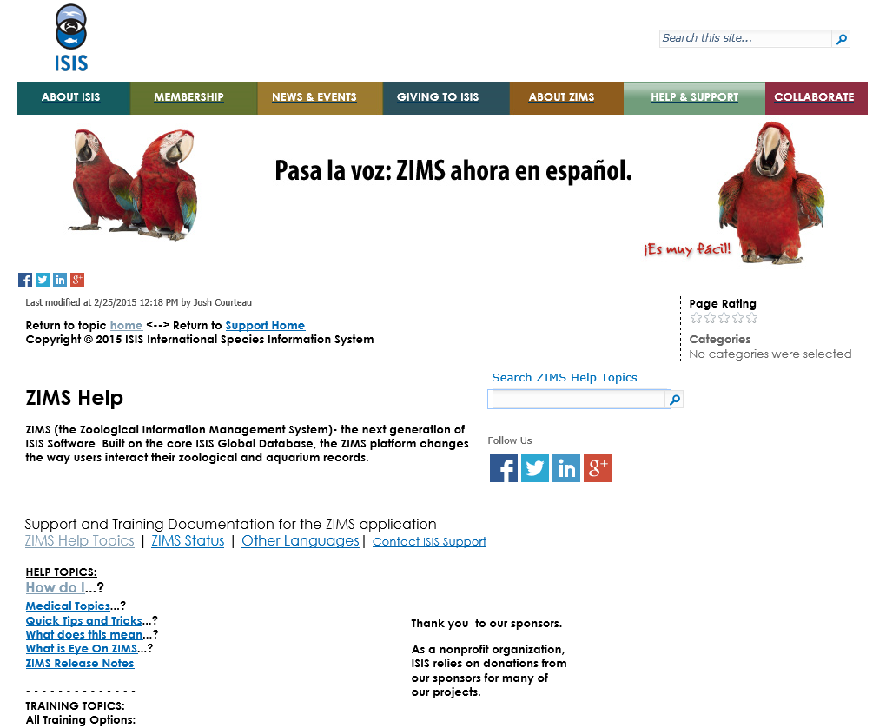
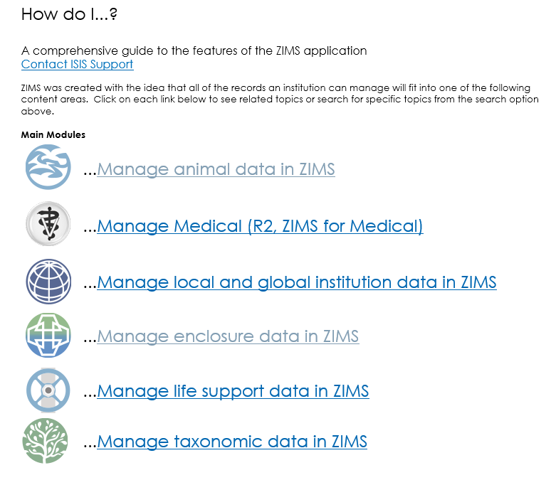
Training.Species360.org/help/

Slide 35
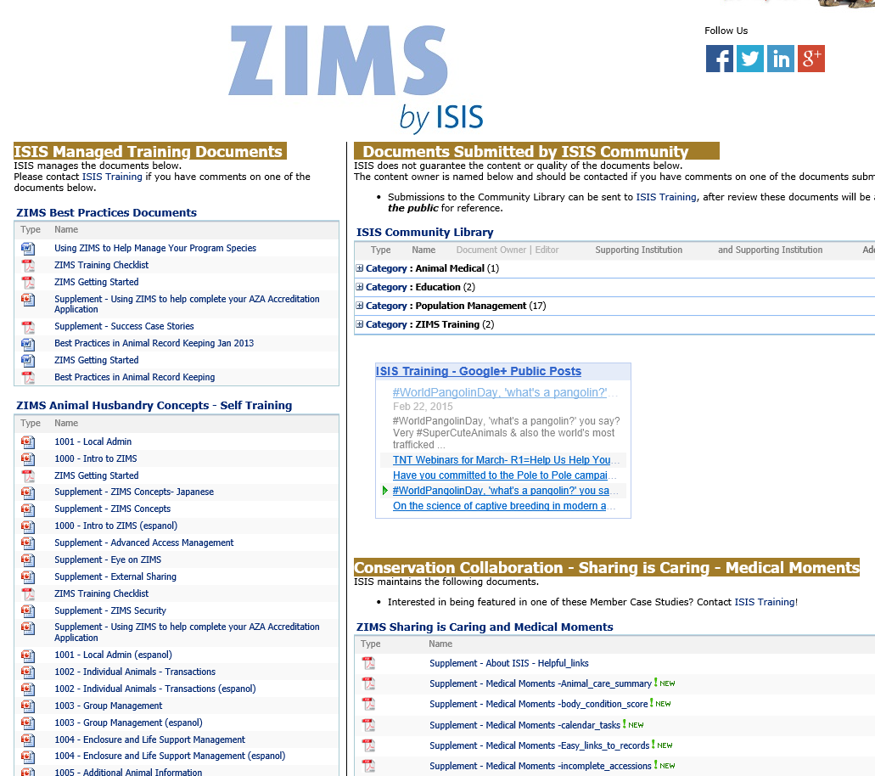
Training.Species360.org/library

Slide 36
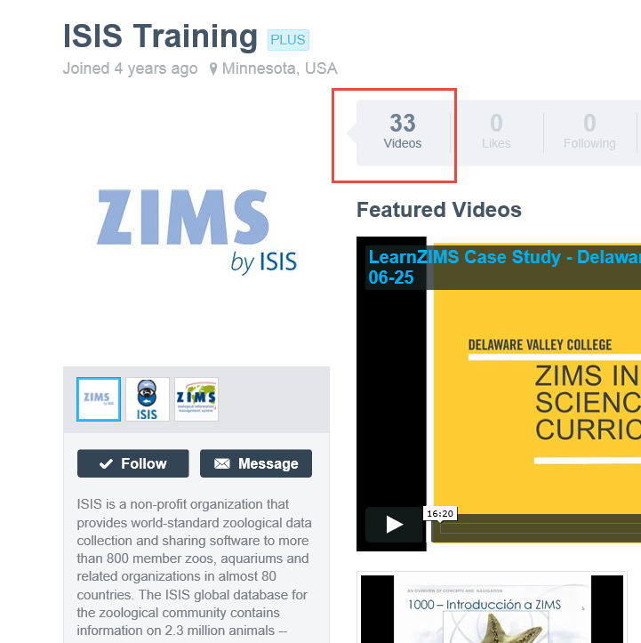
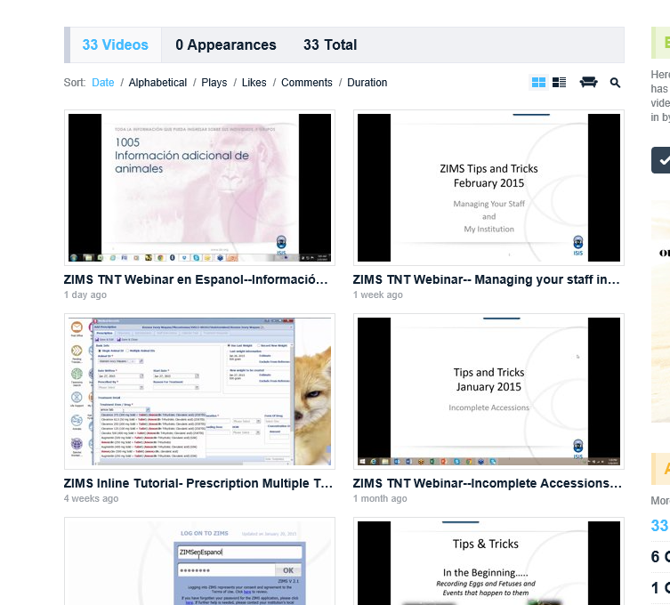
Video.Species360.org

Slide 37
Any Questions?
On How To Help Us Help You
or ZIMS Self Help

