Slide 1
Tips and Tricks January 2015
Incomplete Accessions
And
ZIMS User Group Overview

Slide 2
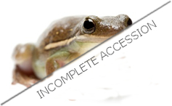
Incomplete Accessions
What They are, Where Did They Come From, and What to Do With Them!

Slide 3
Incomplete Accessions
Original intent was to allow Veterinary Staff to create a record that they could record medical data into (MedARKS non-accessioned animal) while waiting for the Registrar to actually accession the animal.
Curators may also want to use the feature should they wish to record information on an animal that has not yet been accessioned.
Incomplete Accessions can also be used to avoid Receiver Initiated transactions if the Sender has not yet recorded a disposition. This is especially helpful for groups when it is not clear if you are receiving an entire group or a group split from another group at the Sending institution.
All information recorded on an Incomplete Accession will be migrated into the permanent accession record once it is associated.
Some Incomplete Accessions are migrated from MedARKS.
Access to creating Incomplete Accessions is found under My Institution>Institution Roles>Animal module. It is not a Medical module functionality by default!

Slide 4
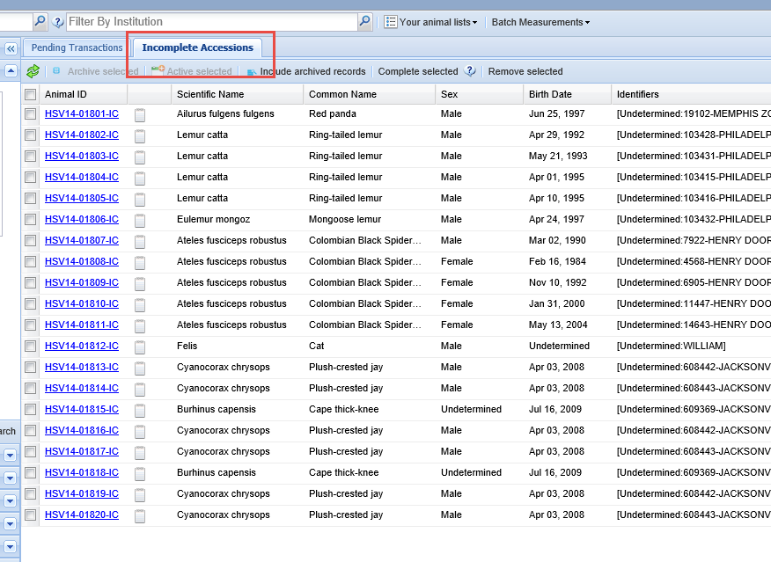
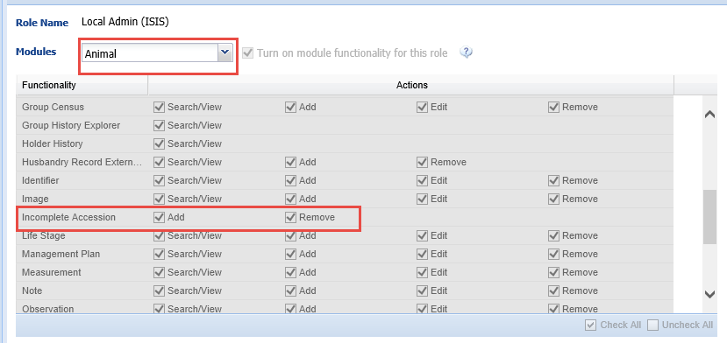
Incomplete Accessions Tab
Incomplete Accessions are located
in the tab to the right of
the Pending Transactions tab
in the Animals module.
If you do not have the role
access to Add Incomplete
Accessions you will not even
be able to View or Search for
them. We will be adding a
Search/View option.

Slide 5
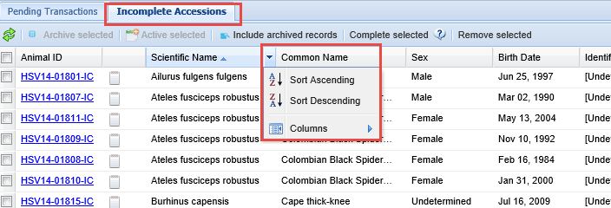
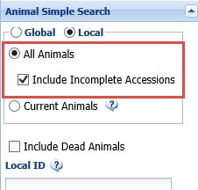
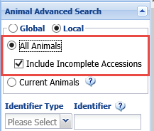
Searching for Incomplete Accessions
You can search for specific Incomplete Accessions using the column sorting in the Incomplete Accessions grid. Also, in both Animal Simple Search (left) and Animal Advanced Search (right), if Local and All Animals is selected, by default the Include Incomplete Accessions checkbox is checked. If you do not wish to include them in your search results you can simply uncheck that box and they will not be displayed.

Slide 6
Will Start at the Beginning
First will cover creating a new Incomplete Accession that will be associated with a Full Accession in a timely manner.
Second will cover migrated Incomplete Accessions that should have been associated with a Full Accession but were not.
Third will cover those migrated Incomplete Accessions that cannot be associated with a Full Accession.

Slide 7
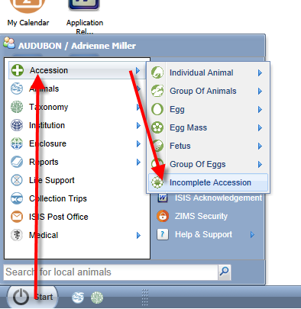
Starting an Incomplete Accession
Creating Incomplete Accessions is found under the Start menu and Accession. You will not select the entity type.

Slide 8
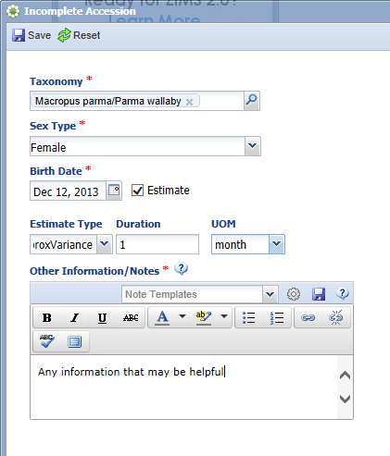
Creating an Incomplete Accession
Minimal information is required for
an Incomplete Accession. The taxonomy,
sex, birth date and appropriate notes
are the only information gathered.
All of this can be edited when the
Complete Accession is created.
An Incomplete Accession receives a
temporary GAN.

Slide 9
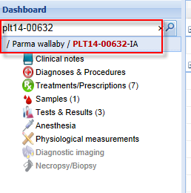
Recording Data in an IA
Most information that can be recorded in a Full Accessioned animal can be recorded in an Incomplete Accession such as weights and identifiers. To do this the User must have Inventory and Husbandry access to the animal. An IA cannot be put into an Enclosure or a Collection, Parent Information cannot be added and subsequent Transactions such as Dispositions or Deaths cannot be recorded.
In the Medical module (left) the Veterinarian can
find the Incomplete Accession record just as
they can find a Full Accession record.

Slide 10
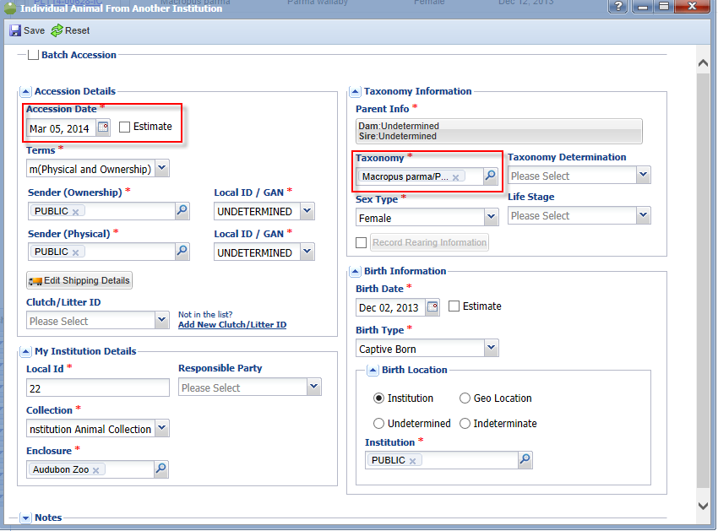
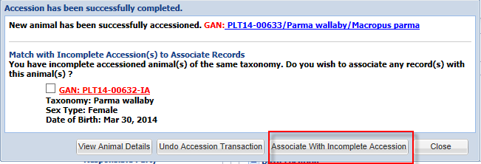
Associating an Incomplete Accession with a Complete Accession
When a Complete Accession is recorded
the ZIMS application will look into the
Incomplete Accessions created. If the
application finds any possible matches
in Incomplete Accessions you will be
asked if you wish to associate any of
these records with your accession.
Check the appropriate record and select
“Associate With Incomplete Accession”.

Slide 11
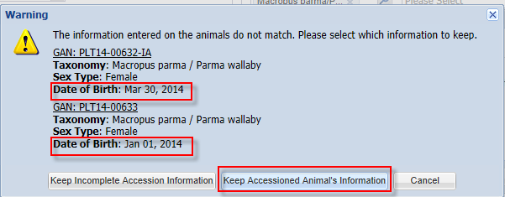
If the Information is Different
If the information for the Complete Accession does not match the information recorded for the Incomplete Accession you will be asked which information you wish to keep. In this example the birth date was different. We chose to keep the Accessioned Animal’s
information. Any data recorded in the Incomplete Accession record will be migrated into the permanent record. The animal will receive a permanent GAN. The GAN of the Incomplete Accession becomes an Old Accession Number in the Identifiers grid.

Slide 12
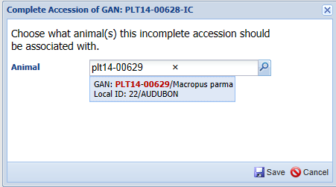
Complete Selected
If you don’t associate the Full Accession with the Incomplete Accession, the Incomplete Accession will remain in the grid. You can select it and choose to “Complete Selected”. You will be asked what animal the Incomplete Accession should be associated with. This method does require that the Complete Accession be recorded prior to Completing Selected.

Slide 13
Entity Selection
Because there is no Entity (Individual, Group, Egg, etc.) selected during the Incomplete Accession, the Entity must be selected during the Complete Accessioning process.
There may be times when several animals were received and the person doing the Incomplete Accession created only one record but the Registrar believes these animals should be separate individual records.
In reverse there may be times when several animals were received and the person doing the Incomplete Accession created multiple records but the Registrar believes these animals should be managed as a single group record.
These scenarios can be handled!

Slide 14
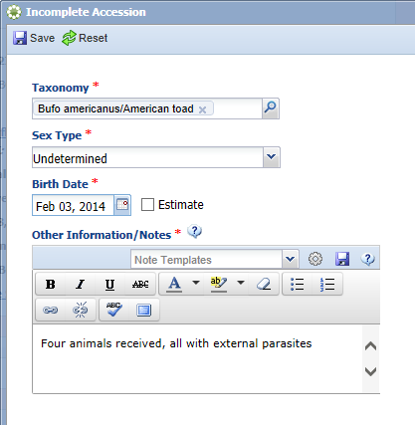
One IA into Multiple Individual Records
For the first scenario four toads were received over the weekend that required some
medical care. The Veterinarian created a single Incomplete Accession. He used the
Other Information box to note that there were four animals received.

Slide 15
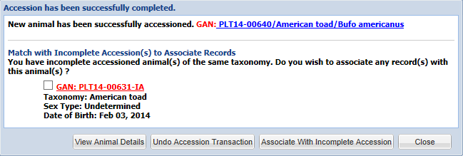
Creating the Complete Accession
When the Registrar records the first individual accession the application finds the
Incomplete Accession record. The Registrar should NOT choose to Associate With
Incomplete Accession as the medical records would be associated only with this one
record. They should instead select View Animal Details or Close. They should then
complete the remaining three accessions. If they recorded a Batch Accession for the four
toads the application will NOT look into Incomplete Accessions.

Slide 16
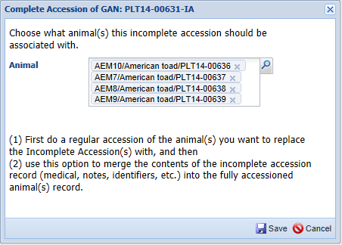
Associating the Single IA Record
To associate the single Incomplete
Accession with the four individual
Full Accessions you would
go to the Incomplete Accessions tab, check the record and select Complete Selected.
You would then enter the four
individual Full Accessions.

Slide 17
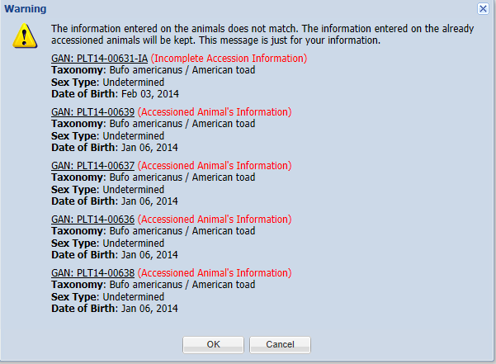
Information that Does Not Match
If the information does not match you will be given notification of such. In this
situation where the single IA is associated with multiple complete accessions,
you do not have the option to select to keep the information recorded on the
Incomplete Accession, it is simply for your information .

Slide 18
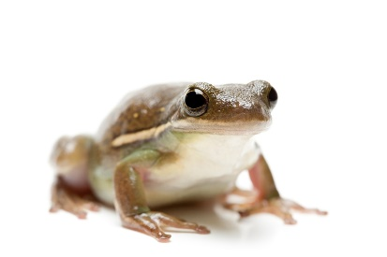
The Flow for Single Incomplete Accession into Multiple Complete Accessions
Single Incomplete Accession created
Record the first Full Accession
After Save do NOT choose to Associate with the Incomplete Accession
Record the remaining three Complete Accessions.
After Save do NOT choose to Associate with the Incomplete Accession
Go to the Incomplete Accession tab
Check the appropriate Incomplete Accession
Select the Full Accession
Associate it with the four Full Accessions

Slide 19
Multiple IAs into One Permanent Accession
For the second scenario four toads were received over the weekend that required some
medical care. The Veterinarian created four Incomplete Accessions. He used the
Other Information box to note that each record was one of four animals received.
There is currently no Batch Accession option for Incomplete Accessions.

Slide 20
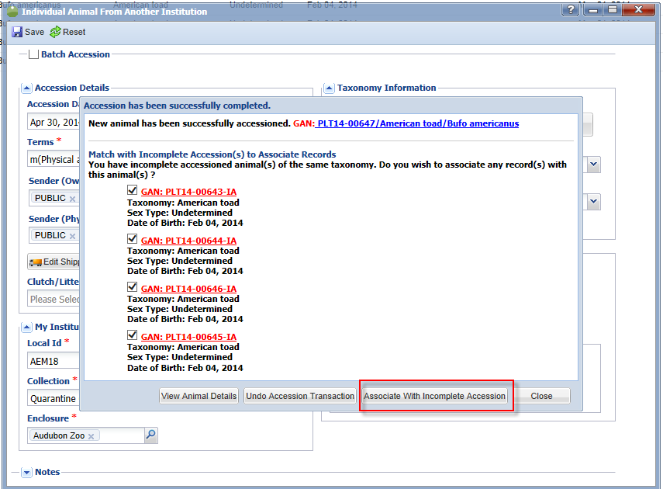
Associating the Multiple IAs
The Registrar has determined that the four toads should actually be managed as a group
record as they are not individually identifiable at this time. The Registrar records a single
Full Accession. The application finds the four possible Incomplete Accessions. All are
selected to be associated.

Slide 21
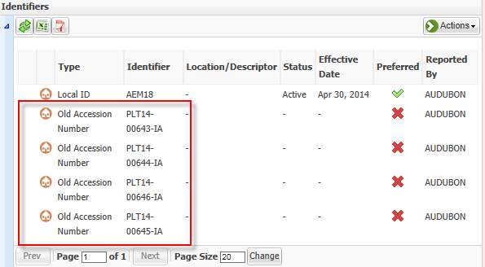
Information is Copied
When you select to associate the records you will receive a message that all information
will be copied into the single permanent accession record. All four of the Incomplete
Accession’s temporary GANs will become Old Accession Numbers.

Slide 22
The Flow for Multiple Incomplete Accessions into Single Complete Accession
Four Incomplete Accessions are created
Single Full Accession is recorded
After Save, four Incomplete Accessions are identified
Select all four Incomplete Accessions to associate with the single Full Accession

Slide 23
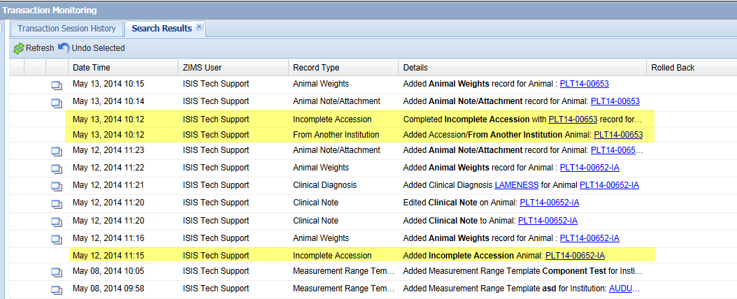
Rolling Back
Transaction Monitoring will display 3 transactions –Added Incomplete Accession,
Added Accession (the Full Accession), and Completed Incomplete Accession
(associating the two transactions). If you choose to Roll Back (Undo Selected) the
Completed Incomplete Accession if you made an error in associating the two, the
Incomplete Accession will reappear in the Incomplete Accession grid, any information entered into it will remain with it. In the Full Accession any information entered into the Incomplete Accession will be removed.

Slide 24
Any Questions on Creating and Associating New Incomplete Accessions?

Slide 25
Migrated Incomplete Accessions
Most of these came over from “non-accessioned” animals in MedARKS
Some of these may be records for animals that have been fully accessioned into your collection but were never associated
Some may be records sourced to another institution that were never meant to be associated with your institution
Some may be for animals that you recorded medical data on but never intended to fully accession
Some are records that were unable to be “linked” to existing animals in ZIMS

Slide 26
Identifying Migrated Incomplete Accessions
It is easy to tell what Incomplete Accessions migrated from MedARKS and which
ones were entered specifically as Incomplete Accessions. In the grid above only
the top entry (red box) was entered as an Incomplete Accession. All of the others
(yellow highlight) have migrated from MedARKS as non-accessioned animals. The
Record Created Date for the new Incomplete Accession will be the date that you
recorded it. The Record Created Date for the From MedARKS records will be the
date that you migrated MedARKS into ZIMS.

Slide 27
Incomplete Accession – GAN Suffix
Another easy way to tell if the Incomplete Accession was added by the
User or migrated is that ZIMS creates a temporary GAN ending in “IA”
(Incomplete Accession) for those entered via the User Interface (green
Box) while migrated Incomplete Accessions have GANS ending in “IC (InComplete
Accession) (red box).

Slide 28
Remove Selected
Not all Incomplete Accessions should be associated with a Full Accession. If you do not want
to associate you have the option to Remove it. Removing the record will delete all associated
records although you can Roll it back in Transaction Monitoring up to three months from the
time of Removing. You will receive a message if it has any associated records and you should
closely review the record first to make sure that you indeed do want to Remove it.

Slide 29
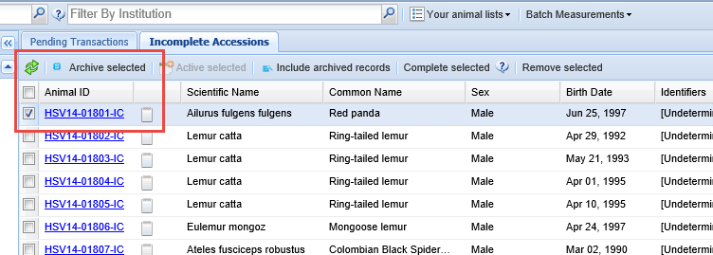
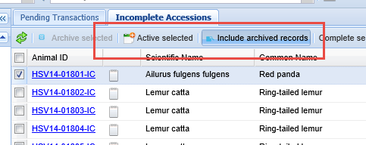
New Attraction!
The ability to Archive Incomplete
Accessions was just added to ZIMS.
This will allow you to get them off of
your main page until you can determine
how to deal with them. You can
select to “Include Archived” to once
again display these records. They can
also be made Active again so they
can be addressed properly.

Slide 30
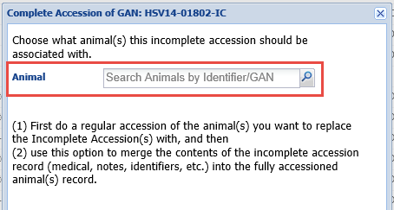
Scenario 1 - Associating with a Full Accession
For any Incomplete Accessions that should have been associated with a Full Accession but never was, you will need to use the Complete Selected option from the Incomplete Accessions grid. You will then be able to select the Full Accession with which you wish to associate the Incomplete Accession, just as you can for newly created Incomplete Accessions. If you find an animal record that should have medical data but does not, that
information has probably come over as an Incomplete Accession.

Slide 31
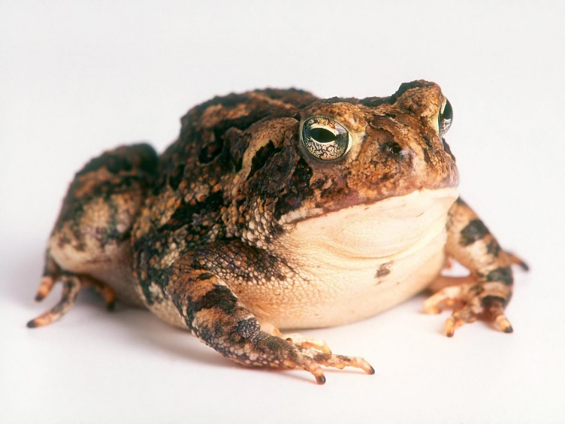
Scenario 2 – Never at your Facility
Some “non-accessioned animals” were
created when you imported medical records from another institution into MedARKS from a MedARKS data export file sent to you. For example, you received one toad. It had a group prescription record that was linked not only to it but to three other toads that stayed at the Sender’s institution. If the imported record was only linked to your animal it would appear that it received four times the dose than was actually administered and it would be misleading when you look at the record.

Slide 32
Scenario 2 continued…..
To compensate, MedARKS created
three non-accessioned records that were
sourced to the Sending institution
so the prescription record remains
attached to four animals and does not
mislead the new institution. These
non-accessioned animals came over
to ZIMS as Incomplete Accessions.
You should not create Full Accessions
and associate them with the three toads
that remained at the Sending facility.

Slide 33
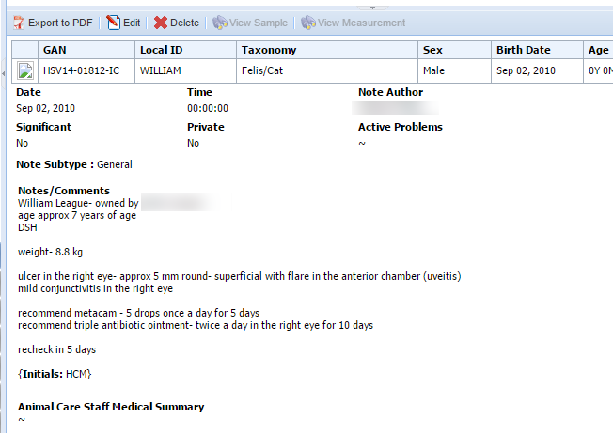
Scenario 3 – At Your Facility But Not Accessioned
Another example of when you may not want to associate an Incomplete Accession with a Full Accession is if the animal was there but you never intend to actually accession the animal. One example may be native animals found on grounds that are treated by the Vet staff. The example shown here is a staff pet that was examined. When you open the medical records you can see a diagnosis and a treatment prescribed.
Remember that not all medical modules are functional at this time.

Slide 34
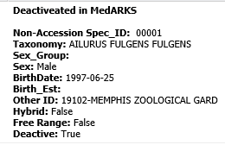
Scenario 4 – Deactivated in MedARKS
In MedARKS you could mark a non-accessioned record as “deactivated”. This was not
an actual disposition of the animal in the record but simply marking the record itself
as no longer active or as a record sourced from the Sending institution. All non-accessioned records, including those marked as deactivated migrated into ZIMS as Incomplete Accessions. It is easy to tell if a MedARKS record was marked as deactivated by hovering over the Note icon. These deactivated records may or may not be ones that you want to associate with a Full Accession.

Slide 35
Scenario 5 – Unable to Link Records
These Incomplete Accessions were created when we could not reliably identify the proper animal in ZIMS to attach the migrated data to
Too many matching animals in ZIMS for the specified animal in MedARKS
No matching animals in ZIMS for the specified animal
Duplicated Local IDs resulted in too many matching animals in ZIMS
Support can provide you with a list for your institution

Slide 36
How Do You Decide if it Should be Associated?
To decide if an Incomplete Accession needs to be associated with a Full Accession you need to determine four things:
Was it a record sourced from the Sending institution?
Would not accession, suggest to Remove or Archive
Was it an animal that you choose to never accession?
Would not accession unless you changed your mind, suggest to Archive
Was the record marked as deactivated in MedARKS?
Possibly accession, review record first, most probable Remove or Archive
Unable to link during migration
Try to find appropriate record and associate it

Slide 37
Sourced From Sender
Here we have selected an Incomplete Accession of a ring-tailed lemur from our grid. The first thing you would check is if you entered any information into this record such as Measurements, Notes or Medical information. In this record we have not. There is an identifier in the grid that is associated with the Philadelphia Zoo that was reported by you (the Greenville Zoo). However, When you hover over the Note icon you see that information is “MedARKS non-accessioned other ID data. This information was created by the MedARKS migration process.” Therefore you did not enter the information, it was created during migration and is probably sourced from the Sender.

Slide 38
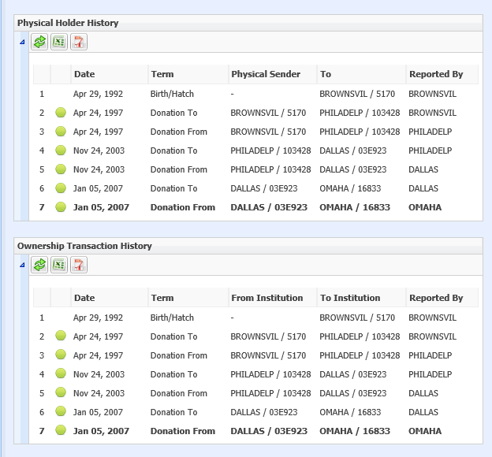
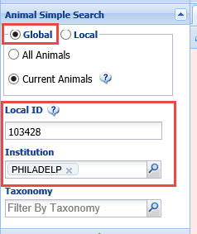
Sourced From Sender continued
To double check run a Global Search for the animal using the identifier in the grid as the Local ID and the mnemonic associated with it as the Institution. Check the Physical Holder and Ownership Transaction History to see if it was ever recorded as being sent to the Greenville Zoo. It has not. Your assumption can be that this Incomplete Accession was sourced from the Sender and you can choose to Remove or Archive it.

Slide 39
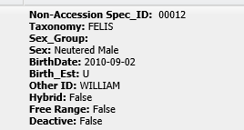
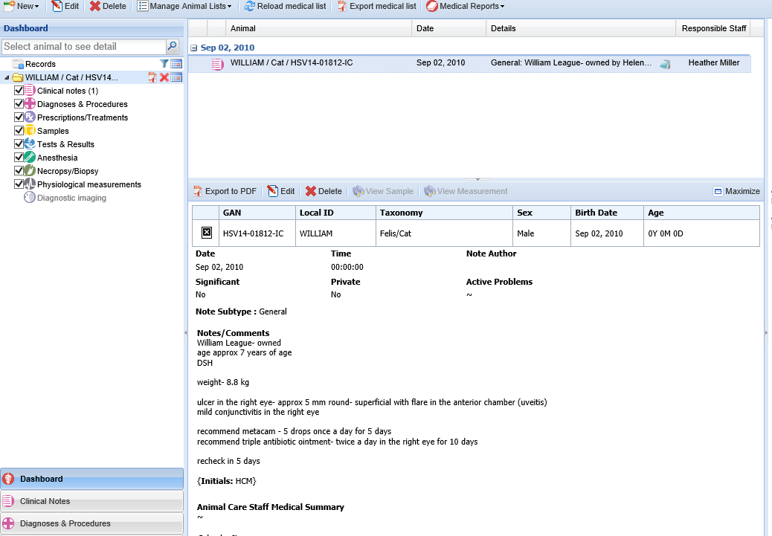
Chose to Not Accession
As the staff pet example showed earlier,
sometimes your institution created non-
accessioned animal records that you
never intended to fully accession
at a later date. For these records it is
recommended that you use the Archive
functionality and not to Remove the
record. This will retain any medical data
recorded in that record.

Slide 40
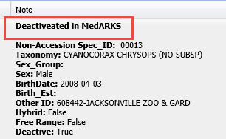
Deactivated in MedARKS
Often non-accessioned animals that
were sourced from the Sending
institution have already been marked
as deactivated. However, non-accessioned
records your institution created may also
be marked as deactivated. You will need
to make a decision whether to Remove these
or mark them as Archived.

Slide 41
Unable to be Linked
For the situations when migrated data could not be linked, those Incomplete
Accessions would have an Undetermined Identifier of Local ID using the MedARKS
Local ID and a comment that it was created by the MedARKS migration process.
This Undetermined Type of Local ID is not associated with another institution as in
the Incomplete Accession sourced from another institution. Remember you can
contact your Support person for a list of these at your institution.

Slide 42
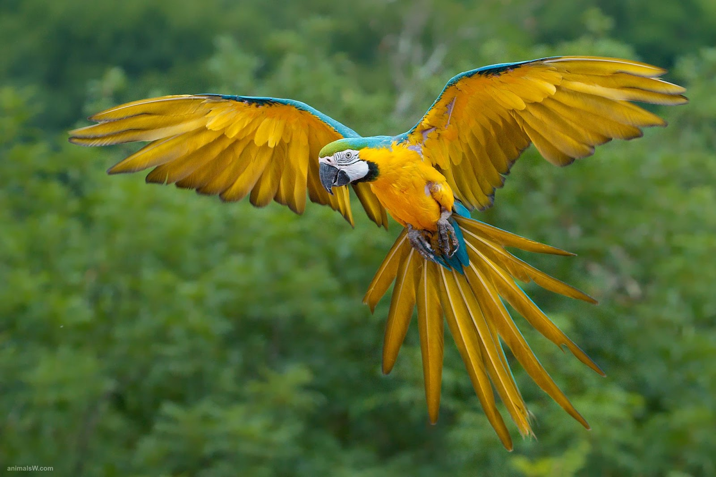
Any Questions on Migrated Incomplete Accessions?

Slide 43
ZIMS User Group
Each ZIMS using institutions has the option to have one person represent them in the ZIMS User Group
This person is totally up to the institution, Species360 does not decide and will notify an institution if more than one person has registered so they can make the decision.
This person should be knowledgeable in the ZIMS Husbandry and Inventory module. A Medical User Group will come later.
The User Group will do three things:
Help to prioritize the over 1,500 enhancement suggested by our Users
Help with regression testing of new updates
Help guide changes/additions to the ZIMS data standards
The cut off for registering is 15 January 2015. Another call for volunteers will be in about 6 months
The enhancements, testing and data standard will be staggered so the group members are dealing with only one topic at a time.
Hope to get the group active with enhancement prioritization as soon as possible in 2015
If your institution did not receive the User Group announcement or you have any questions please contact me at amiller@Species360.org.

Slide 44
Any Questions on the ZIMS User Group (aka The Guardians of the ZIMS Galaxy)?

Slide 45
Thank You!

