Slide 1
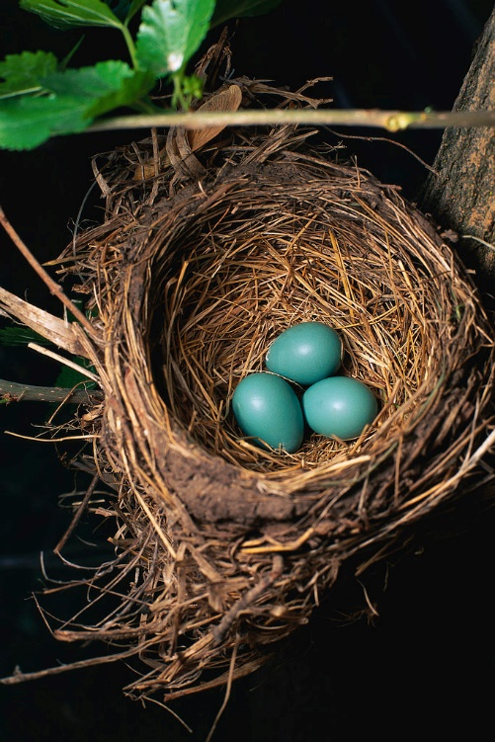
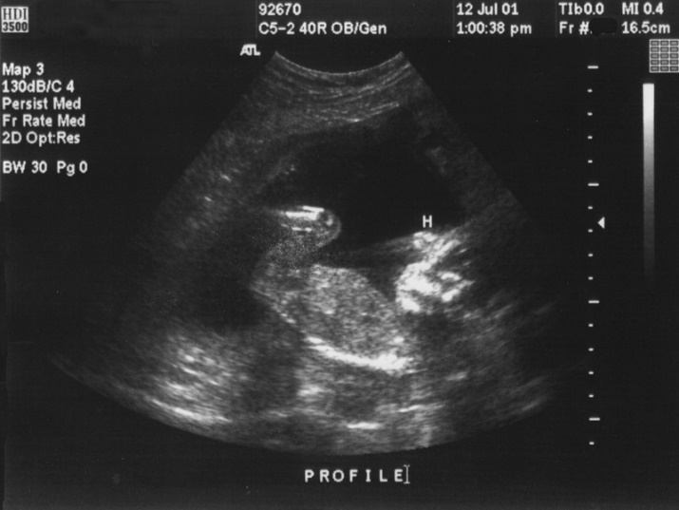
Tips & Tricks In the Beginning…..
Recording Eggs and Fetuses and Events that happen to them
December 2014

Slide 2
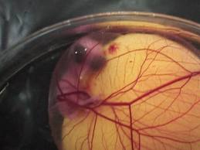
Fetus and Egg Accessions
You can start a record before birth or hatch
by recording the following entities:
Fetus
Single Egg
Group of Eggs
Egg Mass
During the accessioning of these entities you
can record an expected birth or hatch date.
Add an Alert on record (or dam’s record)
You can record successes (births or hatches) or
failures (deaths) as well as dispositions other
than death.

Slide 3
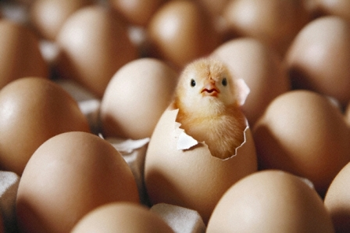
Why Does it Matter?
Fertility of Parents
A fertile egg or presence of a fetus means that both parents are fertile
Tracks unsuccessful pregnancies beyond using Notes
Track Development
Record egg weight loss on developing eggs
Record information on pipping
Record information on developing fetus
ultrasound
IMPORTANT!
When recording measurements on eggs and fetuses check the “exclude from norms” box
Identify Possible Problems
Why does this female abort at the same developmental stage?
Why does this bird’s eggs never successfully hatch?

Slide 4
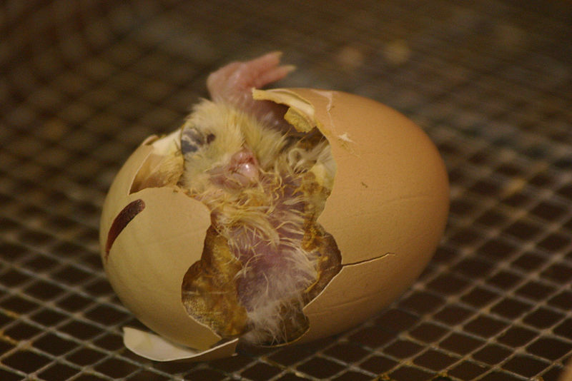
What to Accession
Births
All successful Births
Fetus Identified
At time fetus confirmed
Stillbirths
Abortions
Natural
Caused
Hatches
All successful Hatches
Egg, Group of Eggs and Egg Mass
At Lay
Late Term Dead In Shell
All Dead In Shell

Slide 5
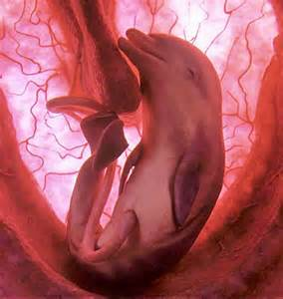
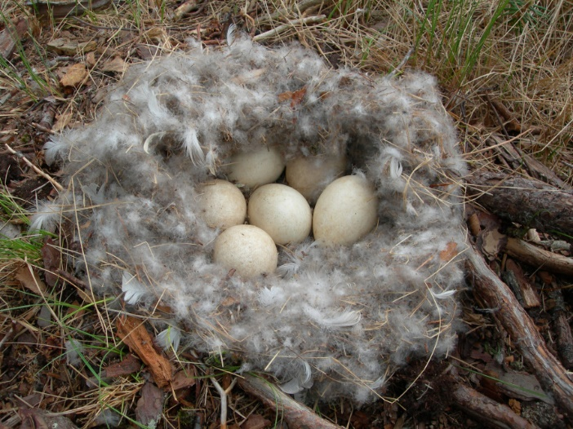
Accession Modes
Fetus
Fetus Identified
Egg and Group of Eggs
From Another Institution
Collected From Wild
Rescued
Appeared
From Lay
Egg Mass
From Another Institution
Collected From Wild
From Lay

Slide 6
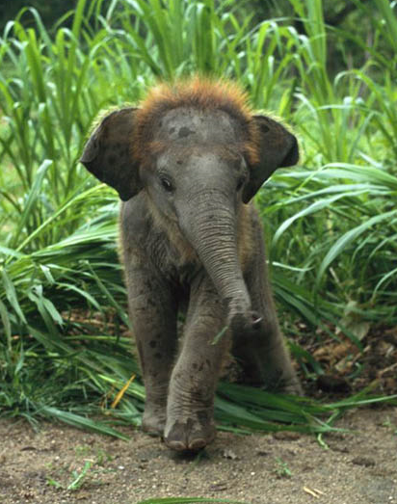
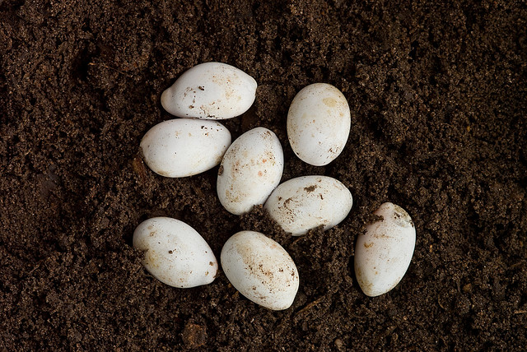
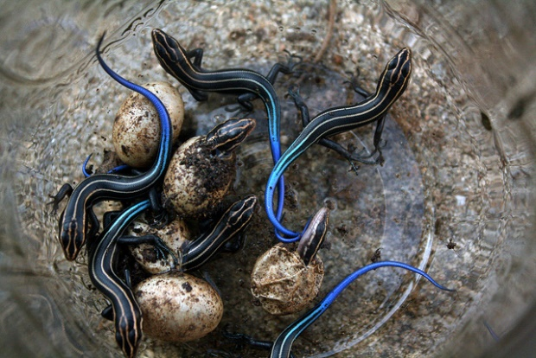
Entity Change
A Birth or Hatch are the ONLY times that an entity will change in ZIMS.
A single egg will become an Individual, a Group of Eggs or Egg Mass will become a Group of Animals, and a Fetus will become an Individual. The
GAN assigned during the accessioning remains the same even though the
entity has changed.

Slide 7
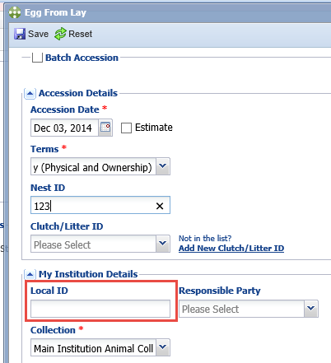
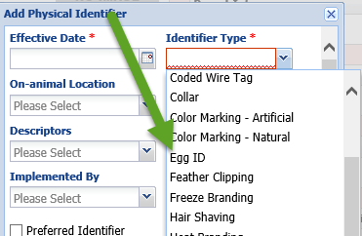
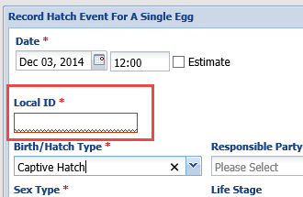
Fetus and Egg Local IDs
Local IDs are not required at the time of
accessioning a Fetus or Egg. Here we are
accessioning an egg From Lay, note that
the Local ID field is not mandatory.
For eggs you can use the Identifier field to
record an Egg ID for identification. Note
this is a Physical Identifier as in most cases
the number will be written on the egg.
When you record a birth of a Fetus or
hatch of an Egg that does not have a
Local ID recorded for it yet, it is a
mandatory field on that screen.

Slide 8
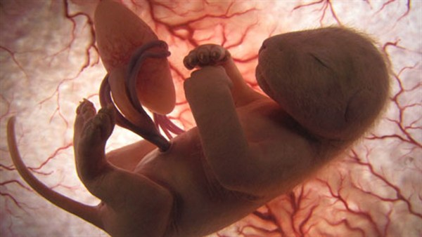
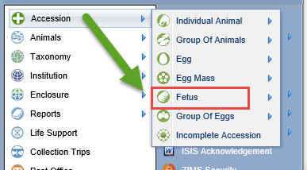
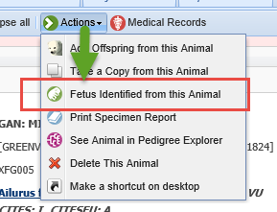
Fetus
A Fetus is the stage between being an embryo and birth or death. A Fetus can be found using an ultrasound or a pregnancy test. You can record a Fetus from the Start menu or from the dam’s record. This is not an option from the sire’s record. If multiple Fetuses are identified you can do a Batch entry from either approach.

Slide 9
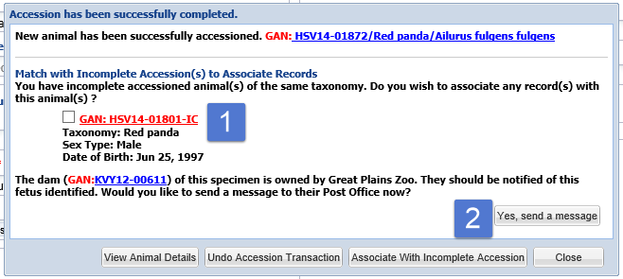
Checking the Database
Just as for a Birth or Hatch accession, the application will check the database upon
saving a Fetus or Egg record. Here ZIMS has found a possible Incomplete Accession
that you may want to associate it with. It has also identified that the dam is
not owned by your institution and asks if you would like to send a Post Office message
to notify them of the Fetus (or Egg laid) (2). It will also provide this information and
the option for a message if the Sire is in on loan.

Slide 10
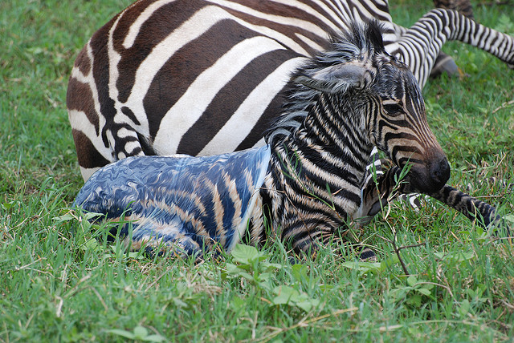
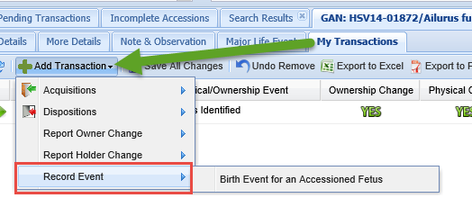
Record Birth of a Fetus
Recording a birth of a Fetus is
considered an Event and you will
select Record Event under Add
Transaction. If you have not
recorded a Local ID for the Fetus
it will be required on this screen.
If you already have it will prefill
and is not editable. The entity
will change from Fetus to
Individual in the Basic Details.
Right now there is no option for
an automatic message to the
owner of the parents (should
they be in on loan) for a Birth
Event of a fetus.

Slide 11
Event Location
In the Event Locations grid under More Details tab the Birth Location will
display. You will also have Conception Location displaying. This information
was sourced from the Fetus Identified data entry screen where you could enter
a Conception Date and Location other than your facility if appropriate.

Slide 12
Transactions with the Dam
While the dam is carrying a live Fetus you will get a notification of such should
you record a transaction for her. A death of the dam will prompt you to record
either a birth or a death of the Fetus. Any other disposition type will prompt
you to record the same transaction for the Fetus as well. There is an enhancement
to provide a link to the fetus(es) with this message but currently you can find it
using Advanced Animal search and checking Animal Type of Fetus.

Slide 13
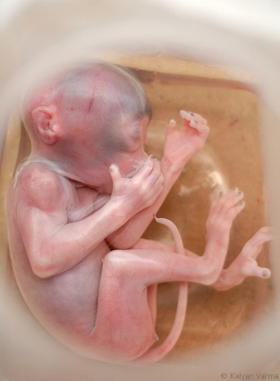
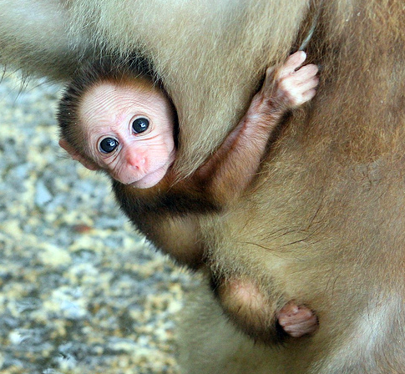
Fetus Disposition
If the Fetus is not successfully born at your
facility you will need to record a death or
disposition for it. The options are Death,
Missing, Release to Wild, To Another Institution
and Undetermined/Indeterminate. As shown
in the last slide you will receive a message if
any of those transactions happens to the dam,
reminding you to take action on the Fetus also.
The Fetus could die on its own should it be
aborted, stillborn or reabsorbed. The screens for
Death or disposition of a Fetus are the same as those for individual animals.
If it is sent to another institution and successfully is born there, the entity will change from Fetus to Individual in your records. The entity will remain a Fetus and will not be changed to an Individual should it not be born.

Slide 14
Any Fetus Questions?

Slide 15
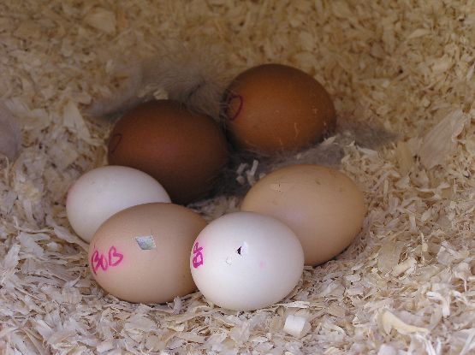
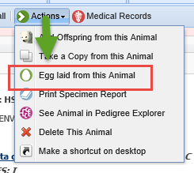
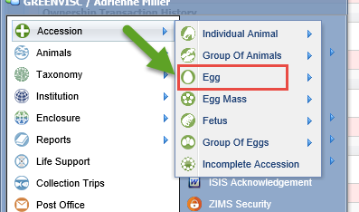
Single Egg
An egg is a single egg that can be identified.
This can be by coloration or recording a number
on the egg. It could also be identified by its
location within an incubator but be careful
with this one. You can record a single egg
from the Start menu or from the Actions tab
in the dam’s record. This is not an option in
the sire’s record.

Slide 16
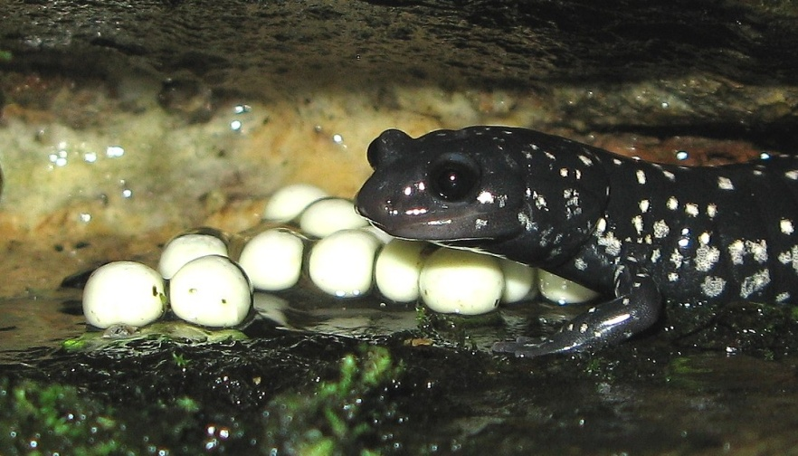
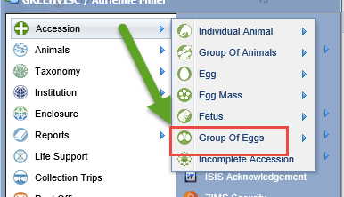
Group of Eggs
A Group of Eggs is multiple eggs that you cannot identify individually or you have chosen not to treat as individuals. You must accession a Group of Eggs from the Start menu, this is not an option from within the dam’s record. If eggs within the group become individually identifiable they can be split from the group using a Partial Disposition either singly or using the Batch checkbox.

Slide 17
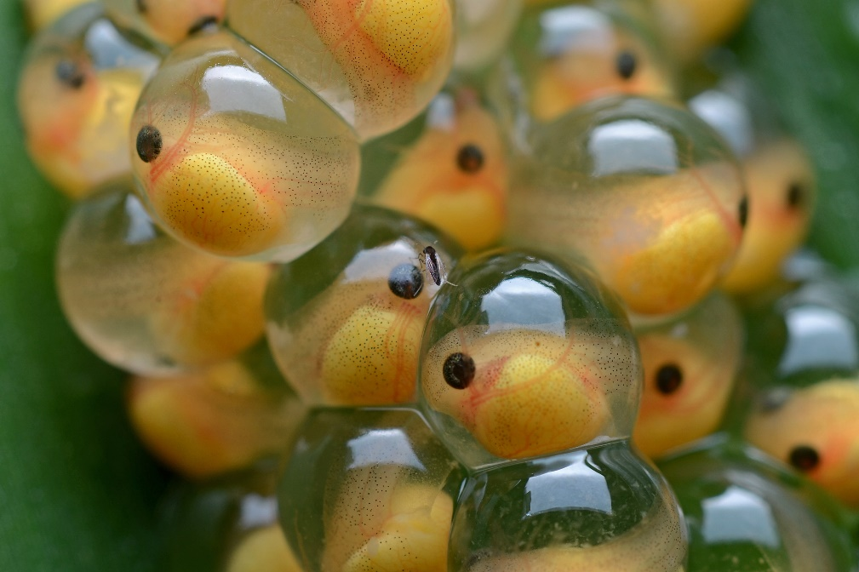
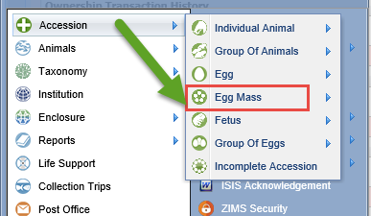
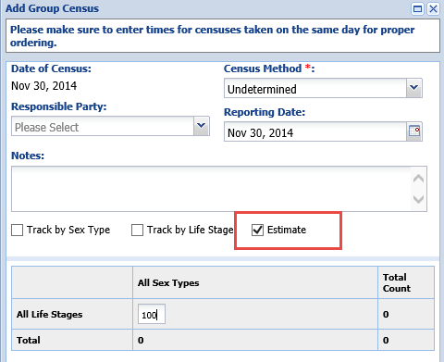
Egg Mass
An Egg Mass is a large number of eggs that
are usually held together forming a single
entity. You can also use the term Egg Mass
for egg fields, such as a tub of soil where an
invertebrate has oviposited a number of eggs.
Egg Masses are typical for invertebrates, fish
and amphibian species. It is usually difficult to
get an accurate count so the “Estimate” box is
checked in most cases when recording the
census. An Egg Mass can only be recorded from
the Start menu. Egg Masses can be split into
smaller groups or individuals.

Slide 18
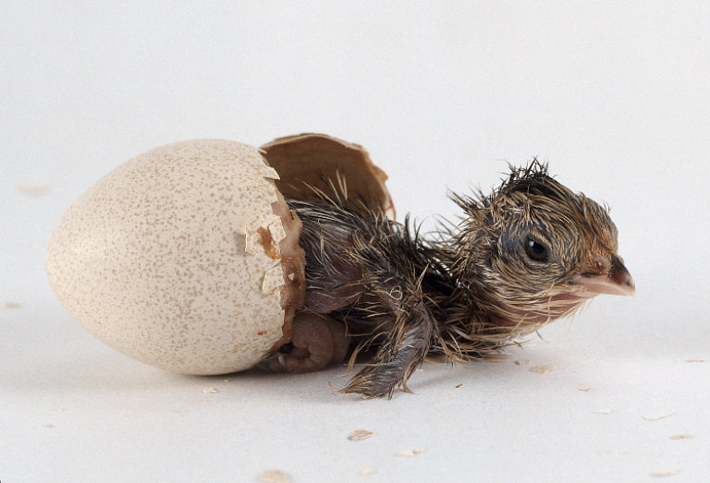
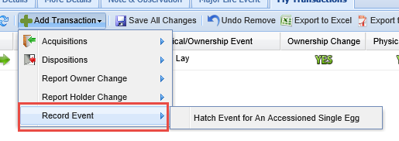
Record Hatch (single egg)
Just as for recording the birth of a Fetus, recording the Hatch of a single
Egg is considered an Event under Add Transaction. Once saved the entity
will change from Egg to Individual in the Basic Details.

Slide 19
Event Location
The Event Location grid under More Details will display the Egg Laid
Location that is sourced from the Egg accession. It also displays the
Hatch Location as sourced from the Hatch event you recorded.

Slide 20
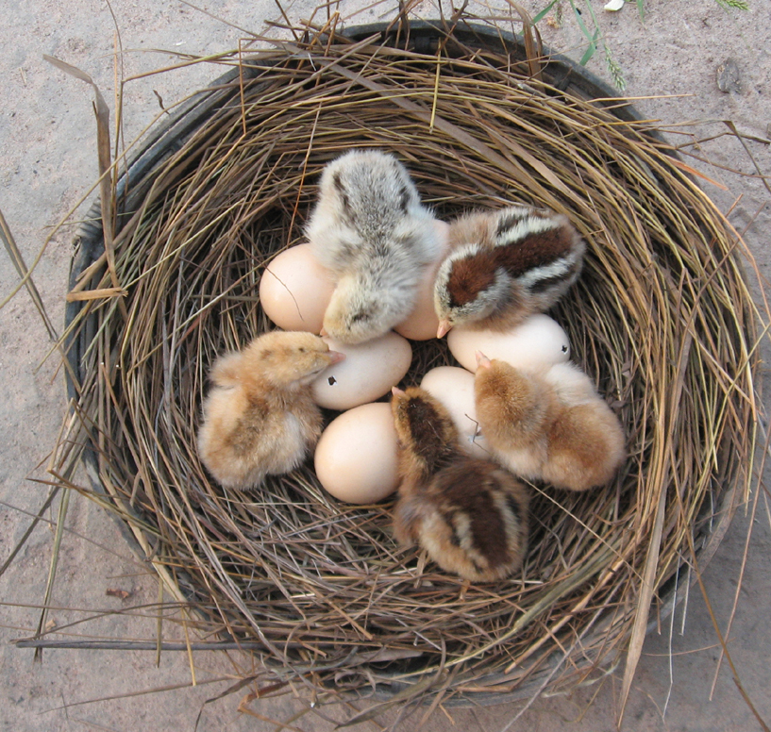
Hatch of Group of Eggs or Egg Mass
Recording the hatch of a Group
of Eggs or an Egg Mass is not
always as straight forward as the
hatch of a single Egg. If all eggs
hatch on the same day it is easy
to record. If they do not all hatch
on the same day it can be more
challenging as you cannot have
a group of mixed entities such as
this nest of five chicks and six eggs. You have two options for recording hatches over a period of time.

Slide 21
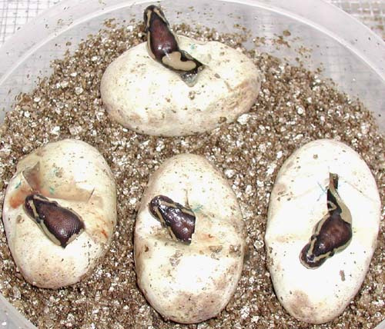
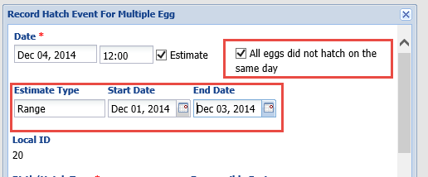
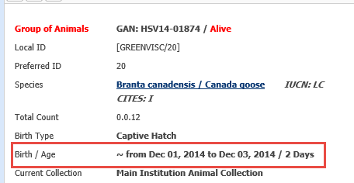
Option One – Wait for All to Hatch
The first option is to wait for all eggs to hatch.
If any are known dead or infertile record that
information first (covered later) as it cannot be
entered after a recorded Hatch. Record a Hatch
Event for Group of Eggs. Check the “All Eggs did
not hatch on the same day” checkbox. This will
bring up a date range where you can enter the
Start and End dates. Then record the number
hatched. The entity will change from Group of
Eggs to Group of Animals. The date range will
display for the Hatch date.

Slide 22
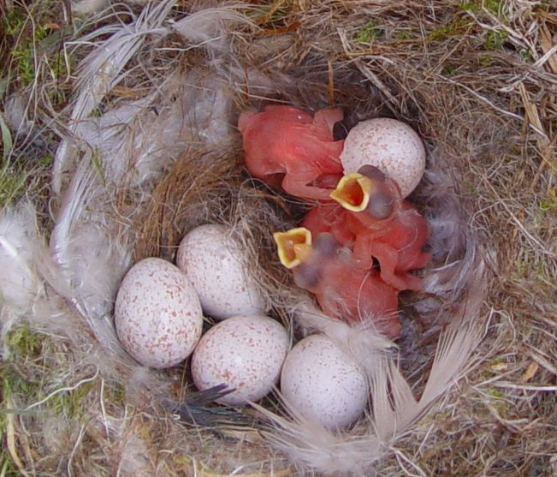
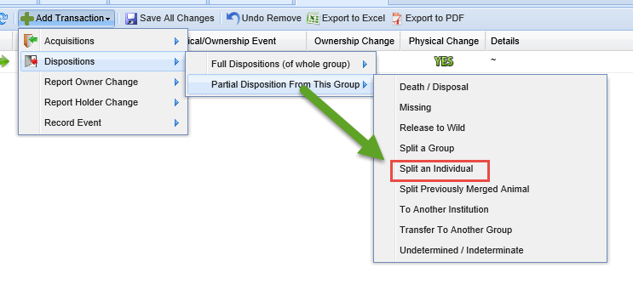
Option Two – Split Out Eggs
Option Two involves splitting out individual
Eggs as they pip or hatch and then recording
a Hatch of the single Egg. You will perform a
Partial Disposition>Split an Individual. If several
hatched on the same day you can do a Batch
action. Then you will record an Event of Hatch
for that Egg. Once all the eggs that successfully
hatched have been split out you can record a
death or disposition, as appropriate, for any
remaining Eggs in the clutch.

Slide 23
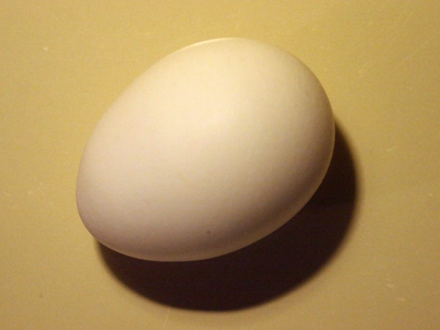
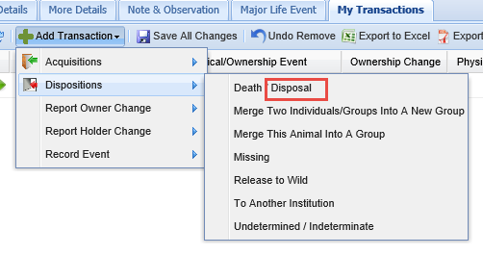
Single Egg Dispositions
The Disposition options for a single Egg are
the same as those for an Individual in addition
to Death/Disposal. Disposal allows you to gather
detailed information regarding the outcome
of the egg if it did not successfully hatch.

Slide 24
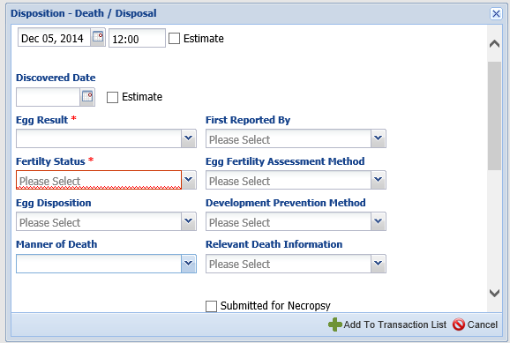
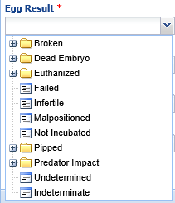
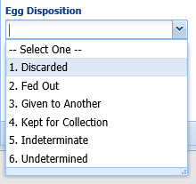
Death/Disposal
The only mandatory fields are the Egg Result (what happened to the egg if it
did not hatch) and the Fertility Status. The Egg Disposition is what you did with
the egg after the Egg Result was determined.

Slide 25
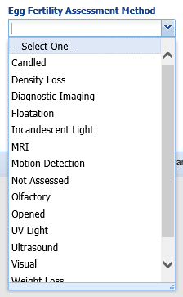
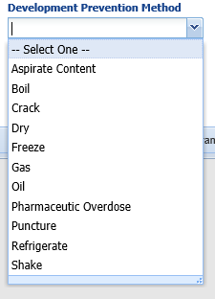
Death/Disposal
You can also record the method used to determine the fertility. If the egg was
euthanized the Development Prevention Method can be recorded. If an Egg
Death/Disposal is recorded the entity will remain an Egg.

Slide 26
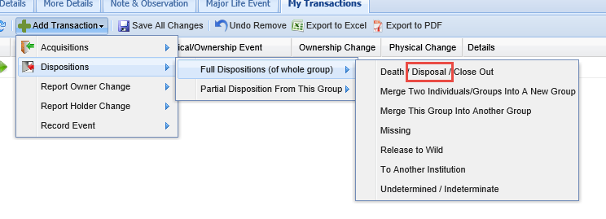
Group of Eggs/Egg Mass Disposition
The options for dispositions of a Group
of Eggs or an Egg Mass are the same as
those for Group of Animals with the
addition of Disposal as discussed on the
last slide. If the ultimate result of the
clutch is a Hatch of the remaining Eggs,
the entity will change to Group of Animals.
If the final Full Disposition is a Death/
Disposal the entity will remain a Group of
Eggs or an Egg Mass.

Slide 27
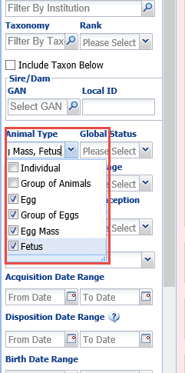
Scope of Eggs and Fetuses
Eggs and Fetuses will display
Globally so you can view the records
at other facilities. You can use the
Animal Type field in the Advanced
Animal Search to filter the search or
search by the GAN or Local ID if
one was assigned.
Even if you do not chose to filter,
the Animal Type column in the
results grid will let you see that
the entity is a pre-birth or pre-hatch
entity type.

Slide 28
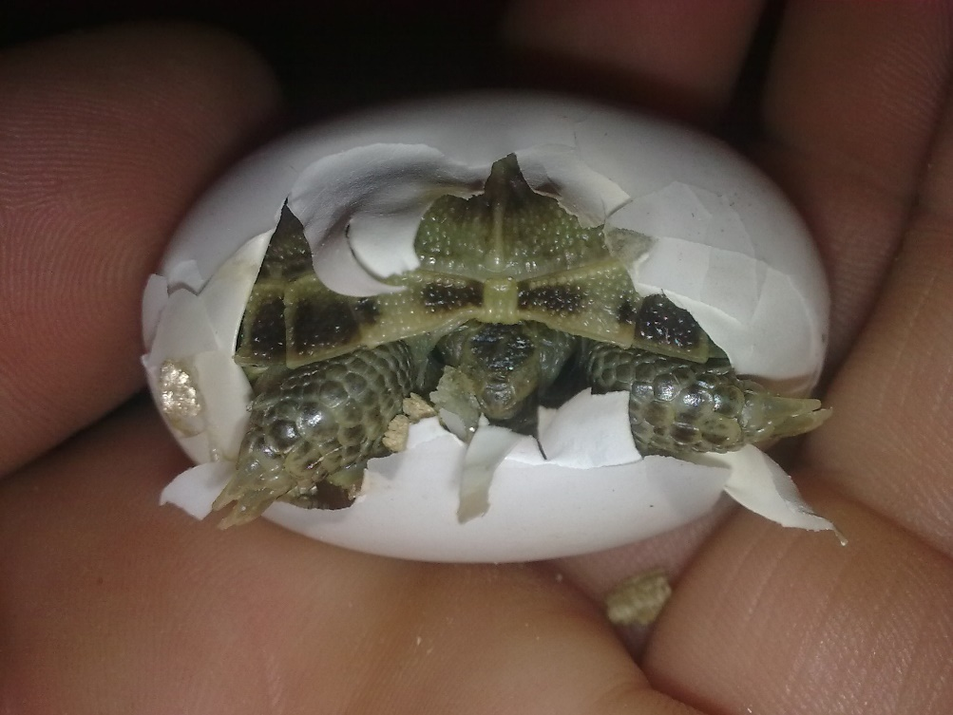
Do Not Display in These Reports/Tools
Egg and Fetus records do not display in
the following Reports and Tools:
Age Pyramid
Inventory
Detail
Summary
Peak Holding
Species Holdings
If a Fetus is born or any Eggs recorded
as hatched, that information will appear
in the Birth column in Inventory Reports.
Eggs do display on the Activity Report.
We are working on getting Fetuses to display
in that report also.

Slide 29
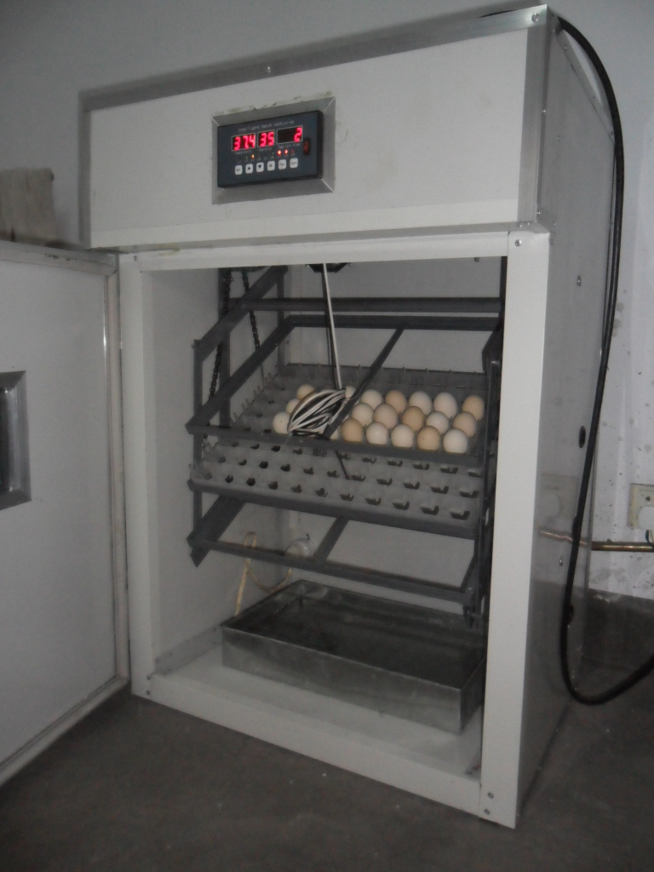
Display in Reports/Tools by Default
Eggs and Fetuses will display
by default in the following Reports
and Tools:
Enclosure
Loan
Note Retrieval
Specimen
Pedigree Explorer
Studbook News Feed
Eggs From Lay/Fetus Identified
Display as Moves
Working on correcting
Eggs from another source
Display properly as Moves

Slide 30
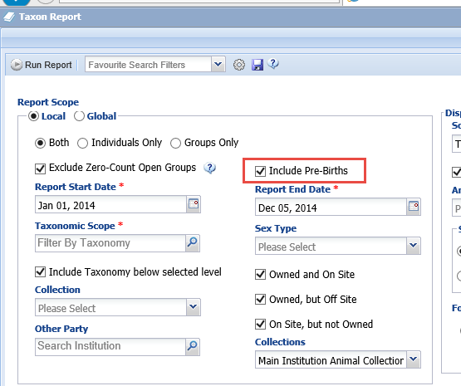
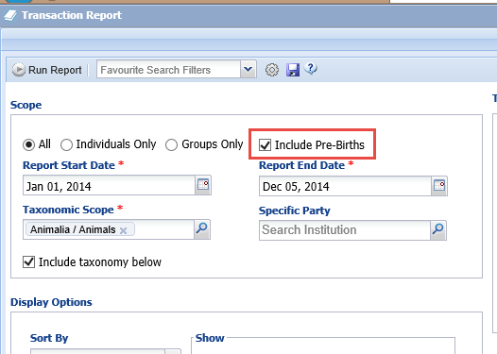
Display in Reports by Option
Both the Taxon Report and the Transaction Report have checkboxes if you
wish to include pre-birth or pre-hatch entities. By default they do not display on
these two reports. They will display on a Global Taxon Report also.

Slide 31
Any questions?
On Fetuses and Eggs and Events Related to Them

