Slide 1

Tips & Tricks
There’s More to Enclosures
Than Meets the Aye-aye
November 2014

Slide 2
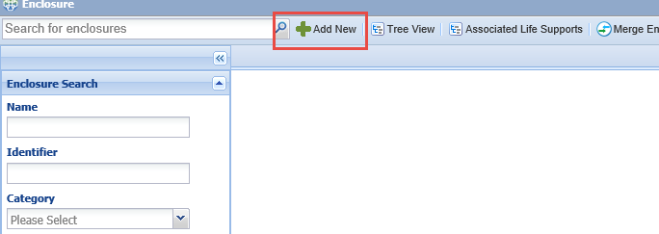
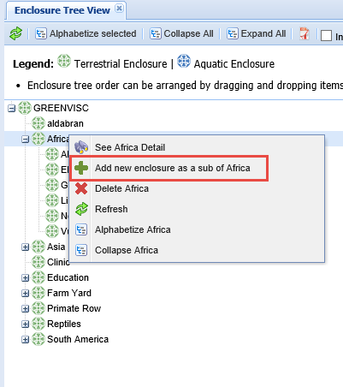
Adding an Enclosure
There are two ways to add a new
enclosure. You can select the Add
New button at the top of the
Enclosure module. Or, you can right
click on the enclosure you want to
be the Parent enclosure and select
to Add New Enclosure as a Sub.

Slide 3
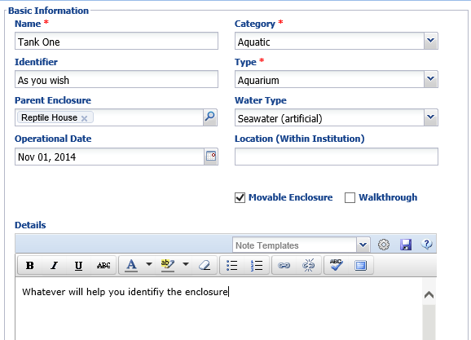
Adding an Enclosure
The Name must be unique. The
Identifier can be a shortened
version of the Name. Some Users
have used this box to record an
old Name if it has been changed.
If you are adding from the Tree the
Parent Enclosure will prefill. If
adding from Add New you will
need to enter this. If left blank it
will default to your institution.
The Category (Aquatic or Terrestrial)
will drive the Types. If Aquatic is
selected then Water Type box
appears. If you record an Operational
Date you will receive a message should
you try to put an animal into it prior to
this date. Use Location and Details
to record information that will help
you identify the enclosure. Check the
Movable Enclosure or Walkthrough
checkboxes as appropriate.

Slide 4
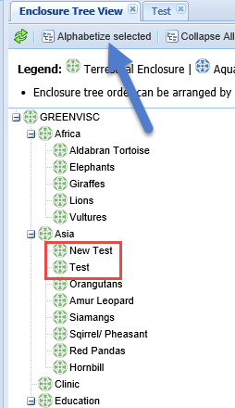
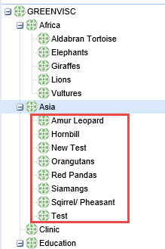
Managing the Tree –
Alphabetize
When you create new enclosures
they are added at the top of the
list under the Parent enclosure.
On the left we have added two
New enclosures – Test and New
Test.
If you highlight the Parent
Enclosure and select to
“Alphabetize Selected” the
Child enclosures will be listed
alphabetically as on the right.

Slide 5
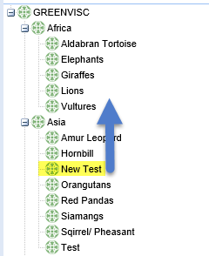
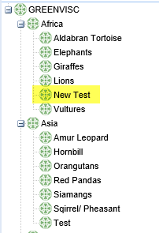
Managing the Tree –
Drag and Drop
You can also change the order of the Enclosure Tree by using the Drag and Drop function. Simply left click on the enclosure you want to move and drag it to the correct spot in the Tree. When we added New Test enclosure we incorrectly put it under Asia as the Parent enclosure but the correct Parent was Africa.
We dragged New Test into Africa and placed it alphabetically. This is not the same as actually physically moving a moveable enclosure. That function is covered under the Move History grid. It is simply cleaning up your Tree.

Slide 6

Any questions on adding enclosures and managing the tree?

Slide 7
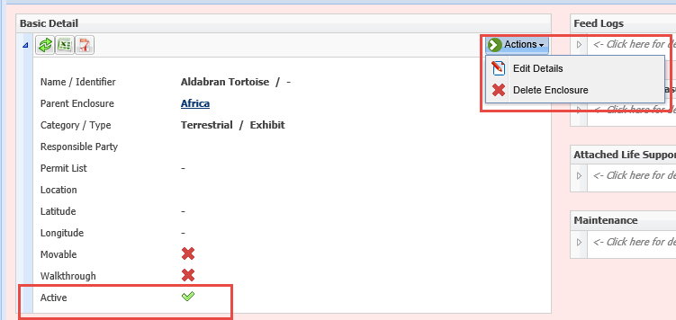
Inactive Enclosures
An Active enclosure is one that is either in use or available for occupants to be
placed in it. There are times when an enclosure becomes Inactive. It could be
Inactive permanently such as being demolished and replaced with something else.
Or, it could be under renovation for an extended period of time. An Active
enclosure displays a green checkbox in Details. To mark it Inactive select the Edit
Details option in the Actions menu.

Slide 8
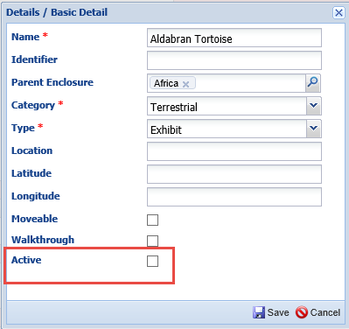
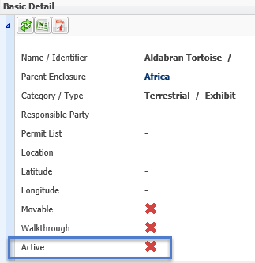
Inactive Enclosures
To mark Inactive uncheck the Active checkbox.
The Basic Details screen will now display a red “x”. You cannot place animals
into an Inactive enclosure as they will not be recognized in the data entry box.

Slide 9
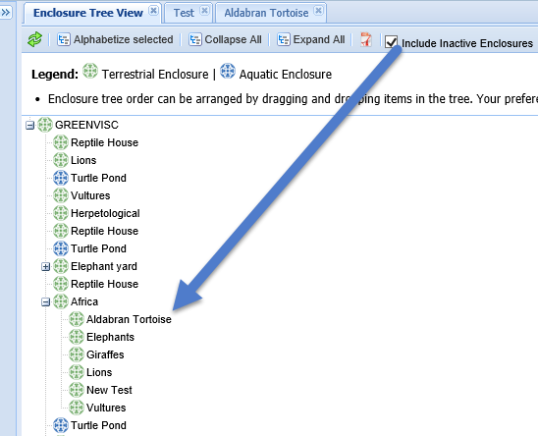
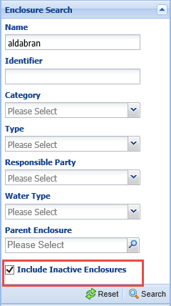
Finding Inactive Enclosures
Inactive enclosures will not display in the Tree unless
the “Include Inactive Enclosures” box is checked. We
have an Enhancement for some indication in the Tree
that the enclosure is Inactive.
Inactive enclosures cannot be found in searches unless
the “Include Inactive Enclosures” box is checked.

Slide 10

Any questions on Inactive enclosures?

Slide 11
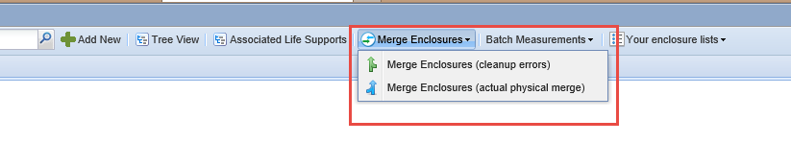
Enclosure Merges
Merge Enclosure (cleanup errors)
  Duplicate Entries (from ARKS migration)
  Incorrect Entries (different names for the same enclosure)
    Quarantine
    Quar
    QRNT
Merge Enclosures (actual physical merge)
  Two enclosures are made into a single one

Slide 12
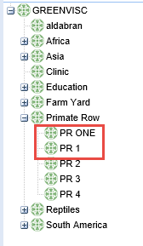
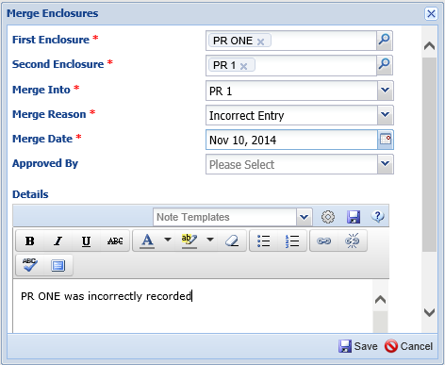
Clean Up Error Merge
In this example PR ONE and PR 1 are one and the same enclosure. We will
need to merge them for Clean Up Error. You will enter the two enclosures.
Merge Into will be the enclosure name that you keep. Adding Details is
always a help if you question later what you did.

Slide 13
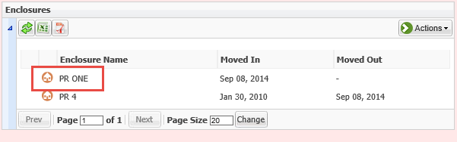
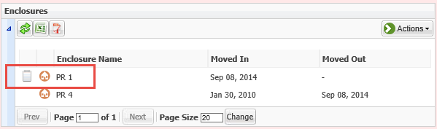

In the Animal Record
When the merge is Saved all references to PR ONE will automatically be replaced
with PR 1, keeping the date of the initial move into the enclosure.
An automatic note will be placed in that enclosure record detailing the events of
the merge.

Slide 14
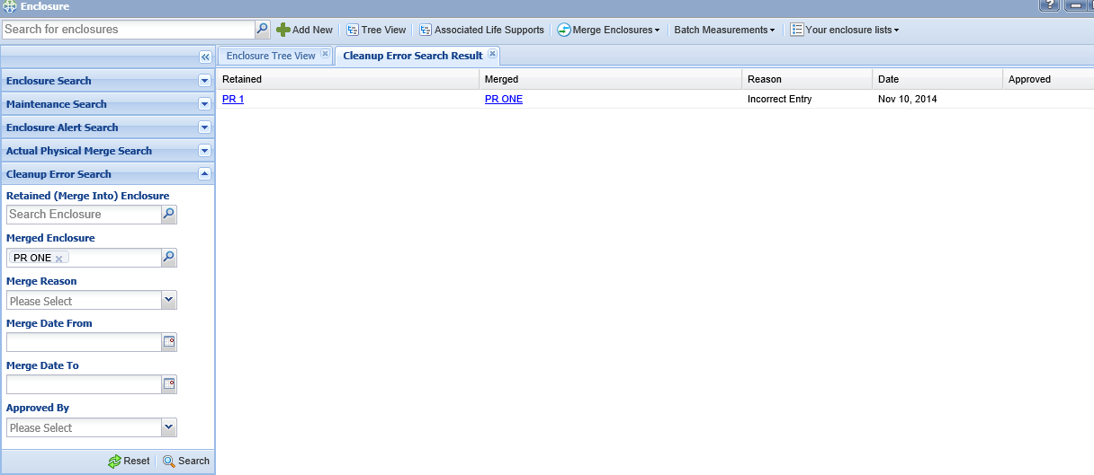
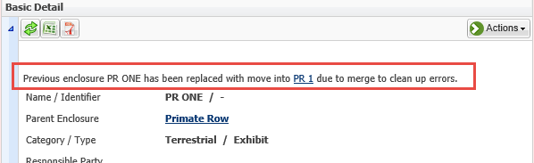
Clean Up Error Merge Search
You can search for Enclosures that have been merged for
clean up purposes by either the retained enclosure or the
merged enclosure. You can also search by merge reason
and a date range.
Using the hyperlink to the merged enclosure (PR ONE) you
see details about the merge.

Slide 15
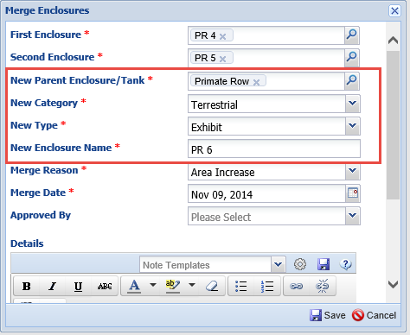
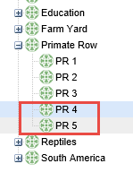
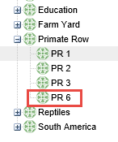
Physical Merge
Here we are performing a physical merge of PR 4 and PR 5, making them one.
When you perform a Physical Enclosure Merge you are creating a new enclosure,
you do not retain one of the original ones. Therefore you must enter the new Parent
enclosure, category, type and a new enclosure name.
The original enclosures are removed from the Tree and replaced with the new one.

Slide 16
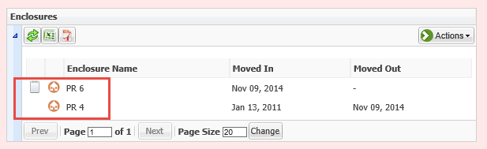
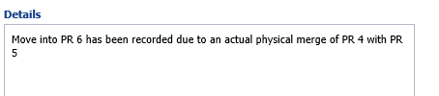
In the Animal Record
In the animal record a move into the new enclosure is created for the date of
the merge. An automatic note is included in that move record to explain the
physical merge of the enclosures.

Slide 17
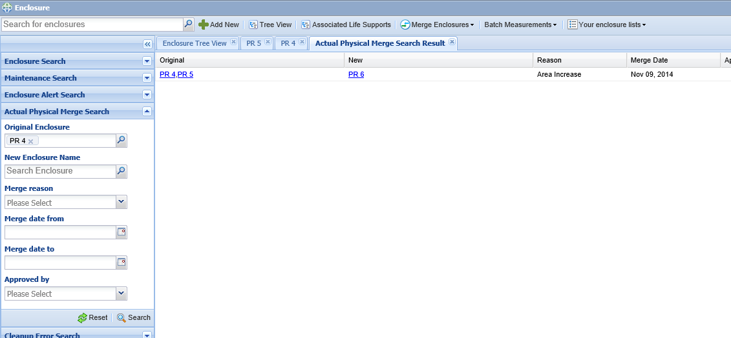
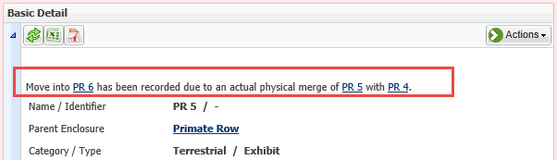
Physical Merge Search
You can search for physically merged enclosures by either one of the original
enclosures or by the new enclosure. You can also search by reason or merge
date range.
Opening the record of either of the merged enclosures will display a note
regarding the physical merge.

Slide 18
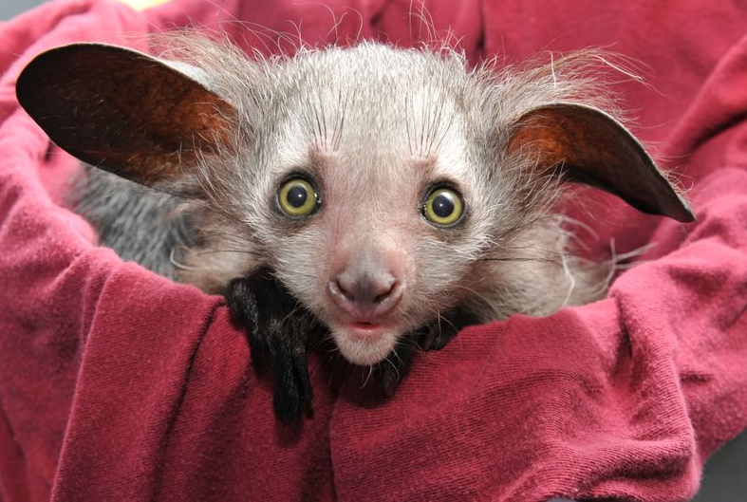
Any questions on merges?

Slide 19
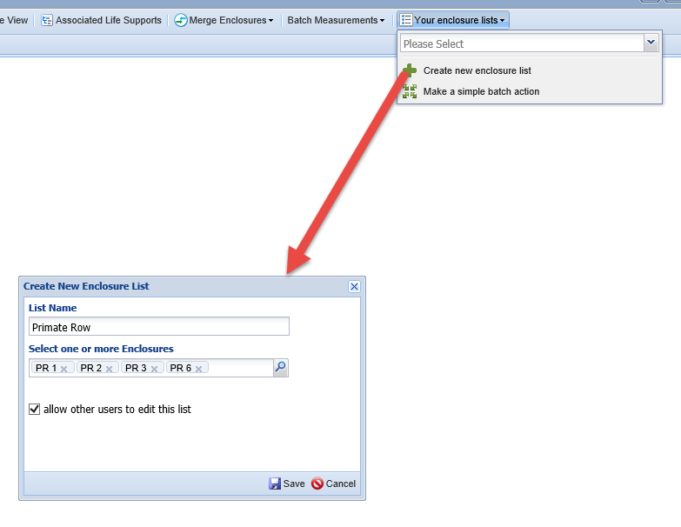
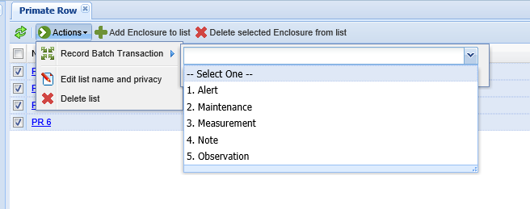
Enclosure Lists
Using the Your Enclosure Lists you
can create lists of enclosures for
easy batch entries. The List Name
must be unique. By default others
cannot edit the list so you must
check that if you want others to
be able to edit. Others can view and
use the lists that you create.
As for animals, you can also make
simple batch entries without first
creating a list.
There are 5 Batch Actions that can
be performed on enclosures

Slide 20
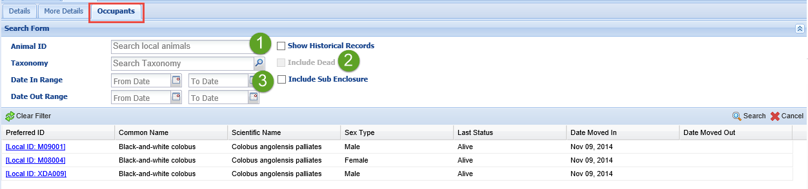
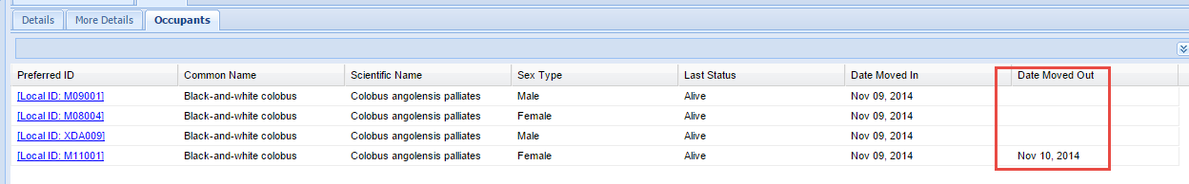
Occupants Tab and Search
The Occupants Tab will display the current inhabitants of the enclosure so there will
be no Date Moved Out information displayed. Using the search box you can find
former inhabitants. The “Show Historical Records” box (1) must be checked to activate the “Include Dead” box (2). If you want to include those occupants in sub enclosures remember to check that box (3).
When doing an historical search the Date Moved Out column will populate as
appropriate.

Slide 21
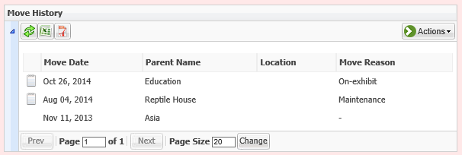
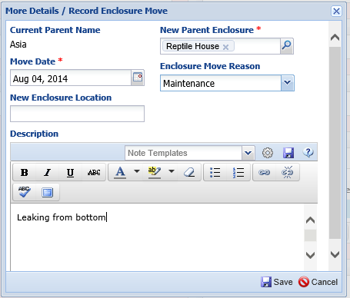
Move History
Many enclosures can be physically moved
from one area to another such as tanks or
cages. To track this movement use the
Move History grid under the More Details tab. To record an enclosure move you are simply changing the Parent enclosure. In this example an aquarium developed
a leak and was moved for repairs. Later it
was moved into the Education building to
house fish on display.

Slide 22
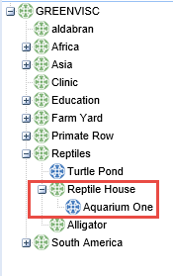
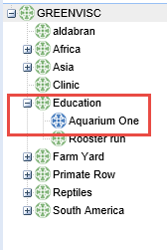
Move in Tree
As the moves are recorded, the location of the Enclosure Tree will change
as the Parent enclosure changes. Here Aquarium One is in the Reptile
House (for the repairs) and then in the Education building. If the moved
enclosure had occupants they, of course, will be moved with it.

Slide 23
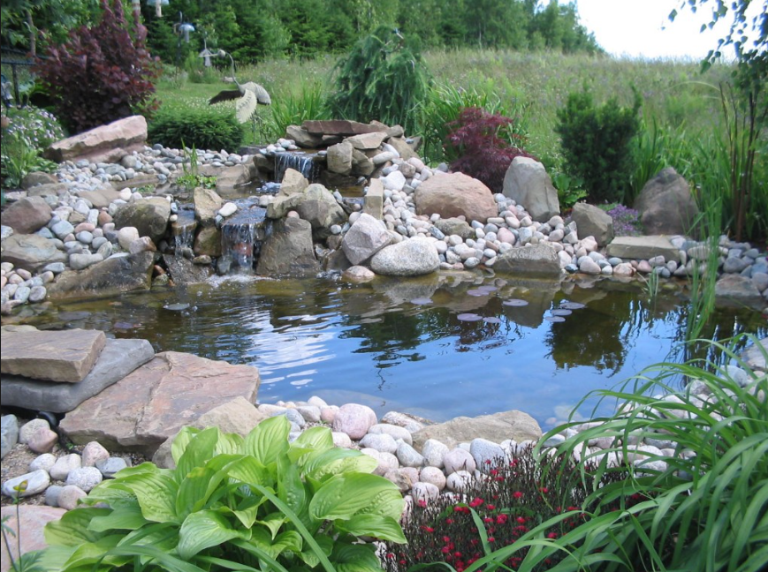
Aquatic Enclosure or Water Body?
You have a large crane exhibit with a pond at your facility. How you record
the pond will depend on how much information you want to maintain on it.

Slide 24
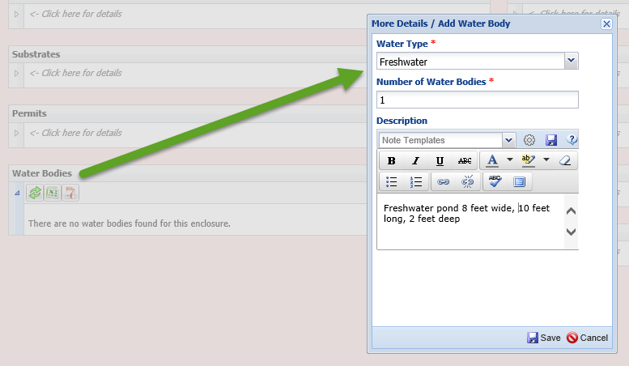
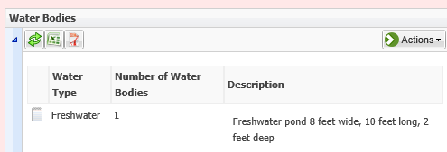
Terrestrial Enclosure Water Body
If you simply want to note that there is a pond in the exhibit you would record a Water Body in the Terrestrial (mainly land) enclosure. The only information maintained on this Water Body is the Water Type, the Number and a Description. Animals cannot be put into and no water quality measurements can be taken on a Water Body.
This information will display in the Water Bodies grid in the More Details tab.

Slide 25
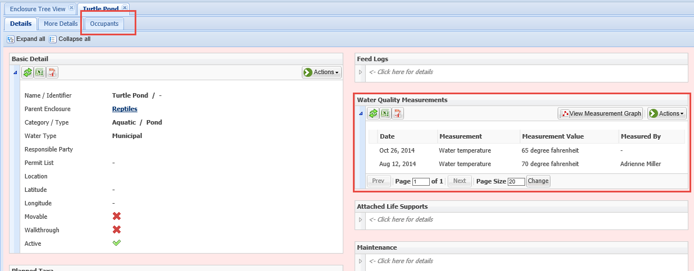
Aquatic Enclosure
If you do want to maintain information on the pond beyond simply the water type, number and size you should record it as an Aquatic enclosure. An Aquatic enclosure can have animals put into it and Water Quality measurements can be taken on it.

Slide 26
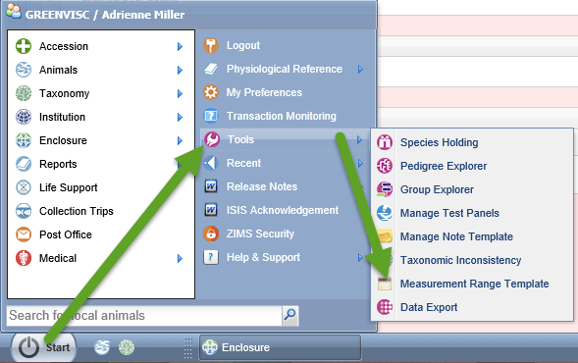
Measurement Range Template
You can take Environmental Measurements on your Terrestrial enclosures
and Water Quality Measurements on your Aquatic enclosures. Usually you
want these measurements to be in a specific range for the welfare of the
occupants. To receive an indication that a measurement is outside this desired
range you can set up Measurement Range Templates under Tools.

Slide 27
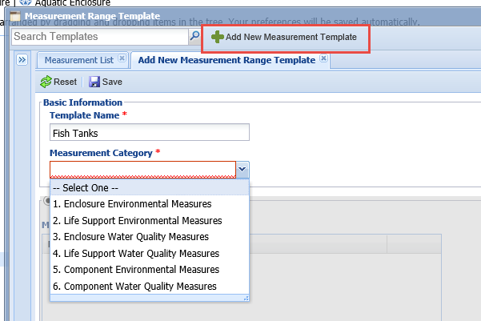
Measurement Range Template
To create a Measurement Range Template select the Add New Measurement
Template. The Template Name must be unique. What you select in the Measurement Category is very important as it will drive the Enclosures, Life Supports or Components that you can select from. For example, if you select Enclosure Environment Measures ONLY Terrestrial enclosures will be available to select.

Slide 28
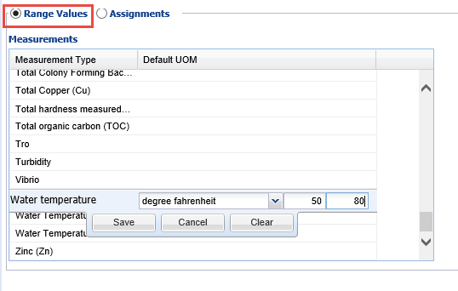
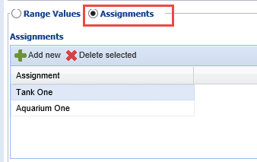
Make Assignments
You then will record the Minimum and Maximum readings for the specific
measurements. After the Range Values are recorded you must then assign
these ranges to your desired Enclosures. More than one Measurement Range
Template cannot be assigned to an Enclosure.

Slide 29
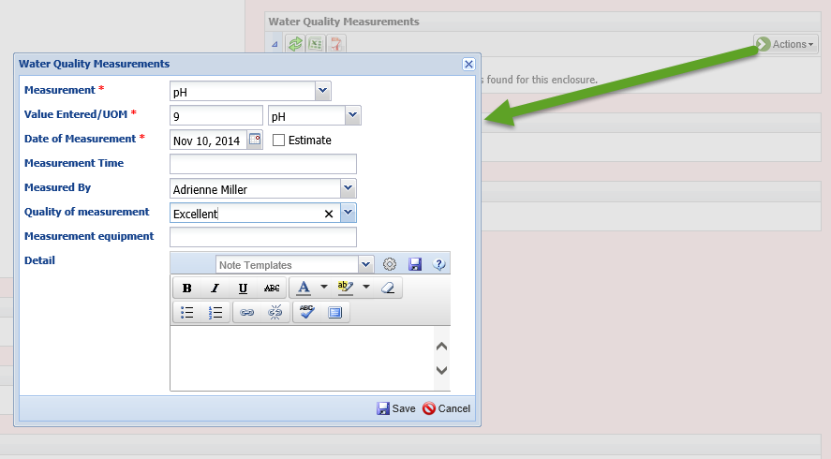
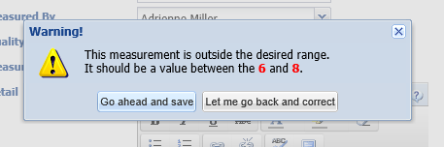
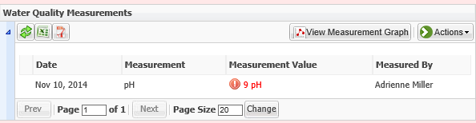
Recording Single Measurements
To record single measurements use the Add New option under the Actions button.
If the measurement is outside the range you set in your Range Template you will
receive notification. You can correct it or accept it.
Any measurements outside of the desired range will display in red in the grid.

Slide 30
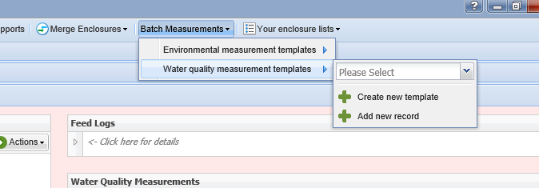
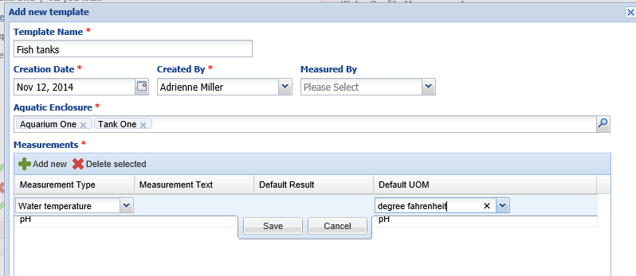
Batch Measurement Templates
You can save considerable data entry time by creating Batch Measurement Templates. First select the type of enclosure you will be measuring – Terrestrial (Environmental Measures) or Aquatic (Water Quality Measures). This is important because only those Categories of enclosures will be available to select from when assigning the Template. The Name must be unique. The Created Date is just for your information, you can use the Template for recording measurements taken before you created it. If the same Person will be taking the measurements you can record them as a default. Select the appropriate enclosures you want the Template to apply to and then select the measurements you will be taking.

Slide 31
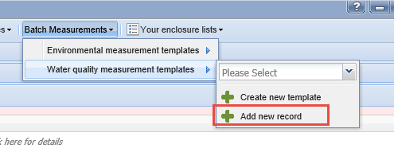
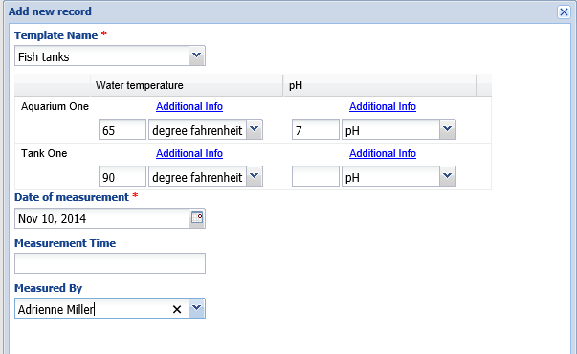


Using Templates
To use the Template select Add New
Record. Pick the appropriate Name
from the dropdown list. The
measurements and the enclosures
you selected for your Template will
populate the screen. If you had
recorded a staff member in the
Measured By field in the Template
that will default but is editable.
Because you have also recorded
the desired ranges for these
measures you will be notified if
any are outside this range.
You do not have to complete each
measurement. The application will
notify you if you have left any blank
should you want to correct.

Slide 32



Measurement Upload
You can also upload
measurements from an Excel file. You first need to download a sample blank
template. You can do this and keep it in a convenient location for future use. The
file can be uploaded only if it is in this format.

Slide 33


Uploading the File
When you want to upload the file browse
to it and select Next.
If there are any errors in the entries they
will be noted. In this example we have
Invalid Measurement Types and Measured
By.

Slide 34


Correcting the File
To correct take it line by line and from left to right using the drop down lists
to select the appropriate term. We recommend left to right because the
Measurement column filters what is available in the Unit of Measurement
column. Here we are correcting the Measured By entry and the Measurement
entry.

Slide 35


Importing the File
As you correct the entries the left side red “x” will be replaced with a green check mark, meaning all is well. There are two ways to actually import the records. You can check the left hand boxes for those entries you want to import and select “Import Selected Records”. Or you can select to “Import all Valid Records. Invalid records will never be imported.

Slide 36
Measurement Imports
Some hints
  Save a copy of the sample template
  Adjust any current Excel files to match it
  Enter the records EXACTLY as they display in ZIMS
Some cautions
  Be aware of duplication of records
  Imported measurement do NOT reference the Measurement Range Template

Slide 37


Measurement Graph
You can view a graph
of any of the
measurements you have recorded. To change the graph use the Type dropdown to select the measurement you want to see. Then select Redraw Graph.

Slide 38

Any questions on measurements?

Slide 39



Planned Taxa
You can use the Planned Taxa grid to help you organize your Collection Planning.
Our example is the Farmyard where you would like to bring in some rare breed
domestic animals over a period of time as you expand the exhibit.

Slide 40


Planned Taxa
You can record the species, the
sexes desired and the Target Year.
You can also mark it as Active by
checking the box or Inactive by
unchecking it. So even if you
change your mind you can review
what your plans had been. For
this enclosure we want to acquire
two female Dexter cows in 2015.
We had originally wanted to get
a male in 2016 but delayed that
acquisition until 2017.

Slide 41


Planned Taxa Search
You can search for your Planned Taxa by Taxonomy,
Target Year and Active or Inactive. Here we are searching
for our Plans for 2015. The results display the Enclosure,
Taxonomy, sexes and target year.

Slide 42

Enclosure Alerts
Enclosure Alerts can be used for many situation where you need a heads up on something
about the Enclosure. Your Aldabra tortoises have been digging along the back wall.
Repairs will be made next week but meanwhile you want the keepers to check and fill in
any holes they find. Your USDA inspector is coming for a recheck of a violation. An
exhibit sponsor is bringing his family to see the exhibit they sponsored so it needs to be open
earlier than normal.
The Alert Text should be short as
that is what will appear on the
Calendar. Priority is Urgent to Low.
If the Alert is only for one day
check the All Day checkbox. If it
is only for part of the day you can
enter the appropriate times. Use
the Details box to provide further
comments and explanations.

Slide 43

Alerts in Calendar
The Enclosure Alerts will display in the Calendar. The all day or
multiple day Alerts are highlighted in red. The Alerts for a time
range are displayed with red type.

Slide 44

Viewing/Editing
Double clicking on the Alert will open it up. You can see that the Sponsor visit
Alert is only from 7:00 – 7:30. You can also assign the Alert to a specific staff
member. This would allow them to view only their Alerts using the Currently
Viewing staff drop down list. If the Alert is one that can be completed you can
Mark Complete. This will remove the red “!” from in front of the Alert in the
Calendar.

Slide 45

And so much more!!!
Maintenance
Maintenance Requests
Responsible Party
  Who is in charge

Slide 46

And so much more!!!
Feed Logs
  Apply to Occupants

Slide 47

And so much more!!!
Describe the Enclosure
  Dimensions
  Barriers
  Plants
  Substrate
  Furniture
  Applications

Slide 48

And so much more!!!
Permits
  Assign to enclosure

Slide 49

And so much more!
Status
  Viewing
  Maintenance
  Treatment
  Sponsorship
  Construction
  Quarantine
  Contamination

Slide 50

Any Questions?
On Enclosures!

