Slide 1
LearnZIMS at Roskilde Technical College Denmark
Malene Friis Hansen Instructor, Supervisor, ZIMS Administrator

Slide 2
Today
A presentation of our college
Our use of LearnZIMS
Why we are teaching ZIMS
The outcome so far
Ideas for collaboration

Slide 3
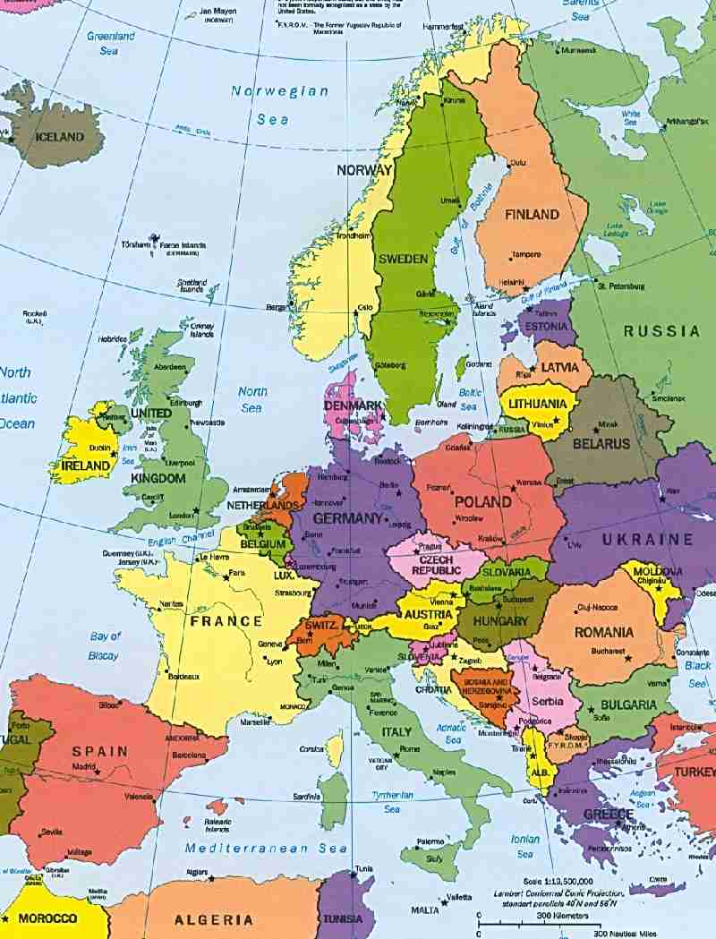
Denmark
Educates students within all fields of plant and animal care

Slide 4
The education of animal keepers
The education consists of 2 parts:
Basic Course
Main Course:
Step 1: no specialization, animal keeper assistant.
Step 2: specialising in Experimental animals, Horses or Zoo/Aquaria animals
The structure of the education
 | Basic course | Main course
 |  | Step 1 |  |  |  | Step 2
Possibly on-the-job training | School period 20 weeks | On-the-job training | School period 10 weeks | On-the-job training | School period 6 weeks | School period 6 weeks | On-the-job training | School period 10 weeks | On-the-job training
Total: 52 weeks formal education and training (College) and
138 weeks on-the-job training (Lab/Stable/Zoo)

Slide 5
Specialisations
Animal keeper
Experimental animals
Experimental animals :
Husbandry of experimental animals Laboratory techniques
Animal keeper
Experimental animals
Animal keeper
Horses
Horses:
Husbandry of horses
Horse stable technique
Zoo:
Husbandry of animals in Zoos and Aquaria
Zoo/Aquarium technique
Animal keeper
Zoos/Aquaria

Slide 6
Zoo/Aquaria Keeping students
Zoo/Aq.keeper
Profile:
25-30 years old
International experience
Committed
Hard-working
Eager to learn
Previous education in other fields

Slide 7
Subjects
Students are taught all subjects relevant to professional animal care in all fields of animal care:
Animal behaviour, welfare, nutrition, wildlife conservation, environmental education etc.

Slide 8
We aim
We aim to always keep ourselves up to date, and ensure the students are well equipped for the animal care industry
So now ZIMS!

Slide 9
ZIMS at RTS
Many animal facilities register animal data in ZIMS
It is a general aim to have keepers enter daily observations, training, enrichment and feeding data in ZIMS – not just scientific staff
We wish to prepare our keeper students for this, and professionals in the industry who has not been trained in using ZIMS

Slide 10
ZIMS at RTS
Species360 Membership
to be able to register our own animals, stay connected with zoos and aquaria nationally and internationally, increase communication.
LearnZIMS license
Teach ZIMS to Animal Keeping students
Have courses on ZIMS for staff from zoos and aquaria

Slide 11
Certificates
We provide an Species360 approved certificate for all who finishes the course

Slide 12
ZIMS for students
The students are taught everything necessary for the daily use of ZIMS
They are also taught how to add new animals, enclosures, life support and components.
They are taught how to understand the user surface, how to search for data, create graphs
Everything that can ease the daily work of the keeper and increase the welfare of the animals

Slide 13
ZIMS for professionals
We are having our first course for professional from various zoos and aquaria in November, 3rd-7th 2014.
They will be taught the same as the keepers, learning how to use it for daily registration.
However assignments will be created to suit their individual needs.

Slide 14
ZIMS for professionals
We will begin with having courses mostly aimed at animal keepers and technicians
However we do wish to also have courses for zoologist/curators/registrars and possibly vets later on
Our first course will be in Danish, yet courses in English will follow soon if there is a demand

Slide 15
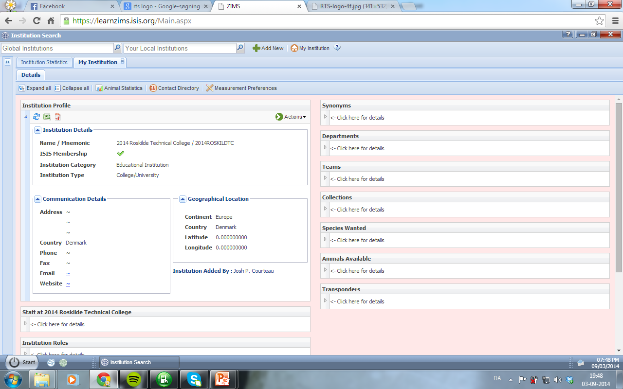
A brief overview of using LearnZIMS my institution

Slide 16
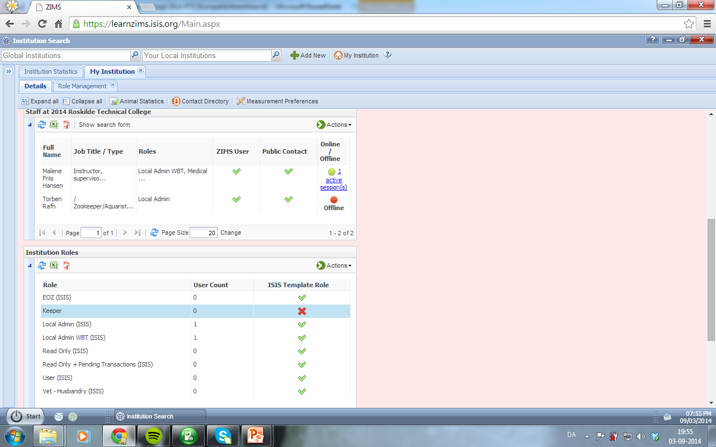
Adding students/participants
They are added as normal employees, given a password and removed when finished

Slide 17
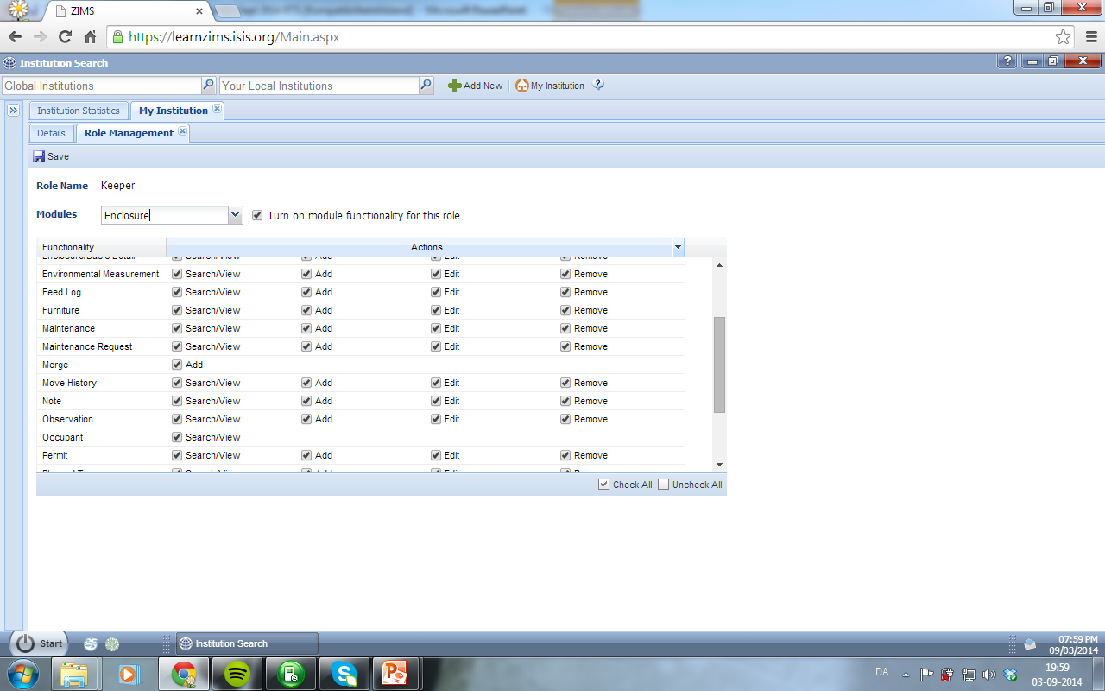
Role access
I manage it to ensure they are able to finish their assignments

Slide 18
Introduction
The students are given an introduction to ZIMS where they learn to recognize the different features and understand how it generally works
They follow my lead on their own computers

Slide 19
An assignment example
Team setup
Goal presentation – to use ZIMS as keepers for example
Create own institution
At least one species per person,
Attach enclosure and life support as well components,
Register feeding logs, training logs, weights and measurements for environmental factors and life support for the last 10 days
Create graphs of your data
Transfer the data to excel
Create a presentation for your fellow classmates explaining your institution and your choices

Slide 20
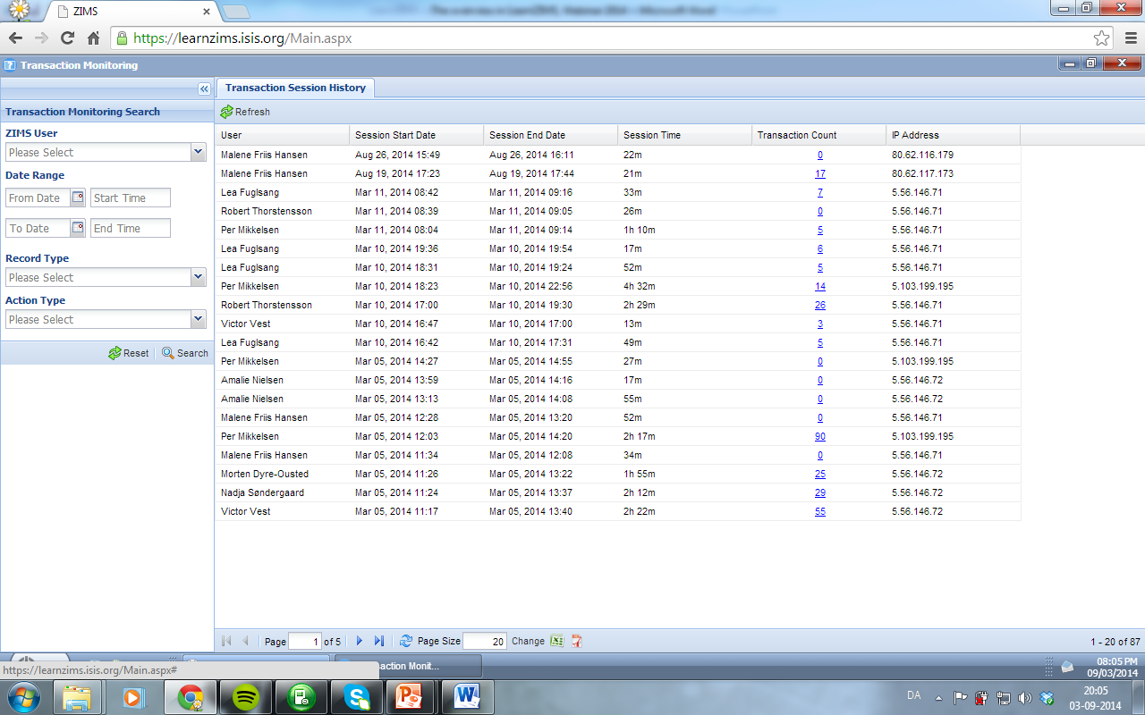
Transaction monitoring

Slide 21
The use of LearnZIMS
Students are given a lot of time and many assignments to really practice their skills
I can follow their every move in Transaction Monitoring
One problem is that I give them access to everything, this also means that they do mess with each other and erase each others animals….

Slide 22
The use of LearnZIMS
So far has been great
The students feel relaxed knowing it is ok to make a mistake
The way of teaching it with many tasks and assignments seem to enable a fast and strong knowledge of the program
Students have gone back to their apprenticeships and explained ZIMS to their managers

Slide 23
Bonus
Taxonomy
Learning about it
Finding species
Learning how to find all information when using ZIMS
Learning a holistic approach to animal keeping; measurements, observations etc.

Slide 24
Only minus
That the students cant find real data
I do not let them use ZIMS, even if its just for searching due to the privacy of the institutions. It could be great if this was possible

Slide 25
All in all
It is going very well. We have a lot of people contacting us regarding ZIMS
We hope this first course for professionals will be filled and more will come
All students graduating from us in Animal Care specialising in Zoos/Aquaria will have a ZIMS certificate
Newly graduated keepers have already been hired due to this

Slide 26
Thank you
Thank you for listening
Never hesitate to contact me:
Malene: mafh@rts.dk
+45 60142757

