Slide 1
Tips & Tricks Groups are Great!
August 2014

Slide 2
Use of a Group Record
Individuals are not identifiable
EXAMPLE – all ten frogs look alike
EXAMPLE – your mole rats, once identified by toe clips, have lost that identification due to fighting
Avoid creating fiction
Simply wish to manage as a group
Do not care about genetics or demographics
EXAMPLE – your budgie walk through exhibit

Slide 3
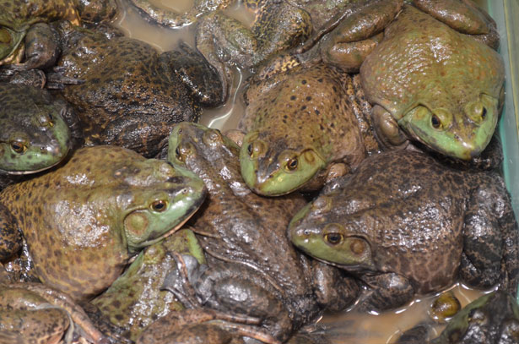
Topics Covered
Legacy Issues (created by ARKS migration)
Incomplete Accessions
Partial versus Full Transactions
Group Close Out
Hints to end confusion
Your Questions on other group topics!

Slide 4
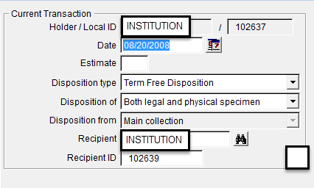
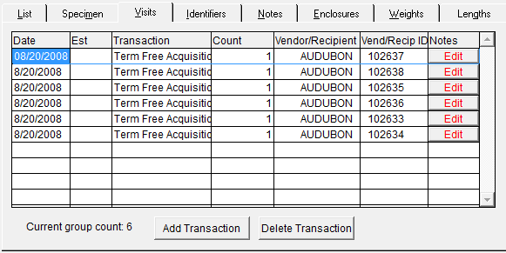
Legacy – Use of Term Free
In ARKS when Individuals
were merged into a Group,
the commonly recorded
transaction was Term Free
Disposition. Your institution
was recorded as both the Holder
and the Recipient. The Local
ID was that of the Group that the Individual was being merged
into.
In the Group record you would
record Term Free Acquisition and the Local ID of the Individual.

Slide 5
Legacy – Use of Term Free
This is what that record looks like in ZIMS. The Term Free Acquisitions are
what was recorded in the Group record as shown in the previous slide.
The Merge an Individual Into This Group are sourced from the Individual
records where you recorded a Term Free Disposition. Note that Census count
is not altered by the two displays and the count, in most cases, pulls from the
Term Free Transaction. The recommendation right now is to leave this alone.
If you remove the Term Free Acquisitions you will remove the record. If you
remove the Merge an Individual you will lose the link to the Individual record.

Slide 6
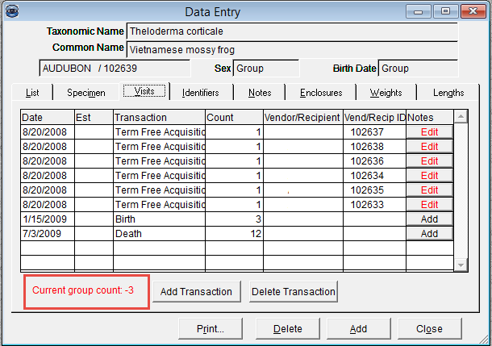
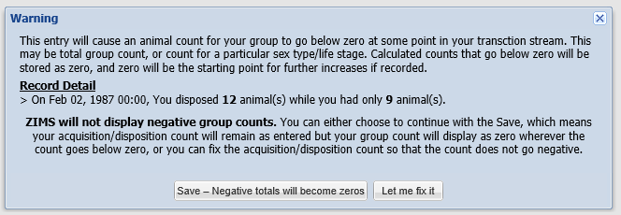
Legacy - Negative Group Counts
Another thing that ARKS allowed was
taking groups into negative numbers.
When we designed ZIMS we decided
that it is not logical to have a group
with a count less than zero. Therefore,
ZIMS does not allow this to happen.
If you record an action that will bring the
Group count below zero you receive this
message. If you select to Save, any negative
counts will become zeros. Or, you have the
option to go back and fix any transactions.

Slide 7
Legacy - Negative Group Counts
In ZIMS you are still allowed to record
a count that would actually indicate
a negative number, but the census
will not display as such. Here we have
recorded dispositioning 12 group members when we only have 9 in the group. This action must be allowed as you may be correcting counts later on. We have to take what you say as the truth but not display something that
is illogical.

Slide 8
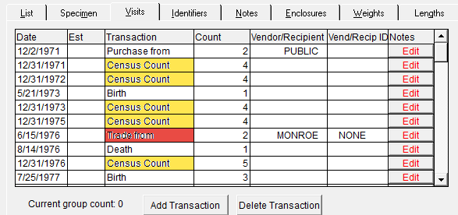
Legacy - Editing
Some of the group data that migrated from ARKS into ZIMS is editable and some is not. In this example of a migrated group record you can edit the initial acquisition and any Births or Deaths. To edit a Census Count (yellow) you must go into the census grid as this cannot be edited from My Transactions. Currently, any partial group transactions such as acquisitions or dispositions (red) from other facilities are not completely editable.

Slide 9
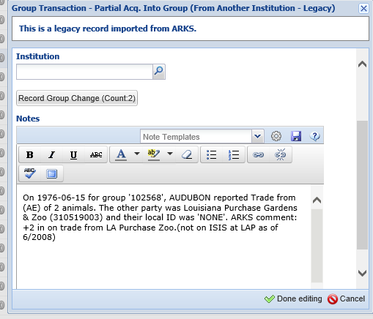
Legacy - Editing
The way these transactions
migrated from ARKS into ZIMS
shows that the institution was
recorded in the Notes section
and not the Institution field.
You can edit the date for these
Partial Transactions but the
Institution field is not editable.
We are working on a fix for this
Bug. If you cannot wait for the
fix and want to clean up these
records you will have to reenter
the transaction and delete the
one that migrated from ARKS.

Slide 10
Any questions?
On Legacy Migration of Groups

Slide 11
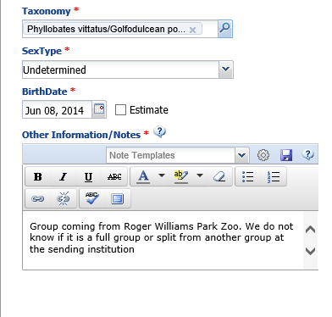
Incomplete Accessions – avoiding Receiver Initiated Transactions
Sometimes when you receive a group from another
institution you do not know if the group is being sent
in its entirety or if the sending institution is splitting part
of an existing group to send to you. If the sender has not
yet recorded the disposition, one of our ZIMS Users
suggested using an Incomplete Accession until the
disposition is recorded. Incomplete Accessions are used
to allow you to record data, such as medical information,
in a record prior to the animal or group being formally
and completely accessioned. They can also be used
while waiting for the sender to record a disposition
to avoid making a possible error in the sending institution’s ID. There is minimal data collected in an Incomplete Accession. We used the Notes section to record that we do not know if the group we received was split from another at the sending institution.

Slide 12
Incomplete Accessions – avoiding Receiver Initiated Transactions
Once the sender has recorded the
disposition you can accept the
Pending Transaction. The correct
information from the sender will
display. When you save, ZIMS will
find the Incomplete Accession to
associate it with. This approach
saves you from having to correct
information should what you record
in a Receiver Initiated Transaction be
incorrect.

Slide 13
What To Do When the Incomplete Accession Doesn’t Match the Complete Accession
There may be times when several animals were received and the person doing the Incomplete Accession created only one record (that is they assumed they would be managed as a group) but the Registrar believes these animals should be separate individual records.
In reverse there may be times when several animals were received and the person doing the Incomplete Accession created multiple records but the Registrar believes these animals should be managed as a single group record.

Slide 14
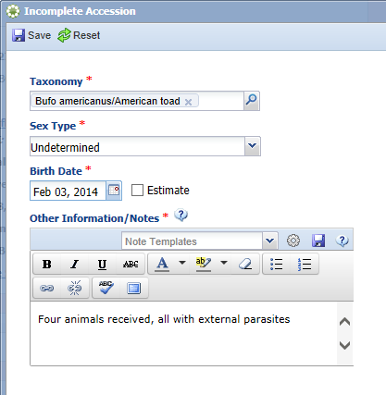
One IA into Multiple Individual Records
For the first scenario four toads were received over the weekend that required some
medical care. The Veterinarian created a single Incomplete Accession. He used the
Other Information box to note that there were four animals received.

Slide 15
Creating the Complete Accession
When the Registrar records the first individual accession the application finds the
Incomplete Accession record. The Registrar should NOT choose to Associate With
Incomplete Accession as the medical records would be associated only with this one
record. They should instead select View Animal Details or Close. They should then
complete the remaining three accessions. If they recorded a Batch Accession for the four
toads the application will NOT look into Incomplete Accessions.

Slide 16
Associating the Single IA Record
To associate the single Incomplete
Accession with the four individual
complete accessions you would
go to the Incomplete Accessions tab, check the record and select Complete Selected.
You would then enter the four
individual complete accessions.

Slide 17
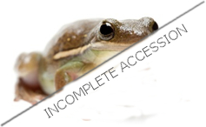
The Flow for Single Incomplete Accession into Multiple Complete Accessions
Single Incomplete Accession created
Record the first Complete Accession
After Save do NOT choose to Associate with the Incomplete Accession
Record the remaining three Complete Accessions.
After Save do NOT choose to Associate with the Incomplete Accession
Go to the Incomplete Accession tab
Check the appropriate Incomplete Accession
Select Complete Accession
Associate it with the four Complete Accessions

Slide 18
Multiple IAs into One Permanent Accession
For the second scenario four toads were received over the weekend that required some
medical care. The Veterinarian created four Incomplete Accessions. He used the
Other Information box to note that each record was one of four animals received.
There is currently no Batch Accession option for Incomplete Accessions.

Slide 19
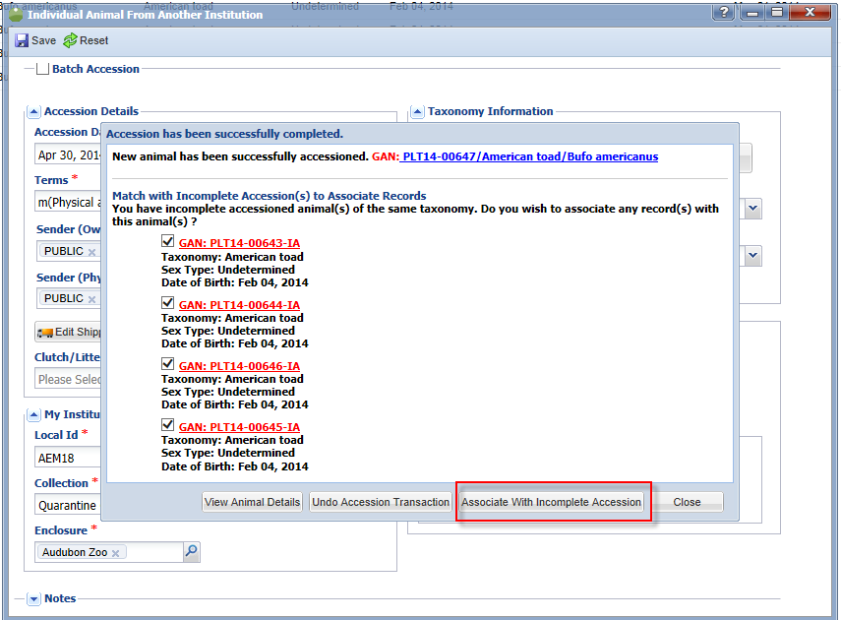
Associating the Multiple IAs
The Registrar has determined that the four toads should actually be managed as a group
record as they are not individually identifiable at this time. The Registrar records a single
complete accession. The application finds the four possible IAs. All are selected to be
associated.

Slide 20
The Flow for Multiple Incomplete Accessions into Single Complete Accession
Four Incomplete Accessions are created
Single Complete Accession is recorded
After Save, four Incomplete Accessions are identified
Select all four Incomplete Accessions to associate with the single Complete Accession

Slide 21
Any questions?
On Groups and Incomplete Accessions

Slide 22
Full Versus Partial Transactions
Full Transaction
What occurred happened to the ENTIRE group
Initial Transaction
Entire group Death or Disposition
Partial Transaction
What occurred happened only to SOME members of the group
Group is Split (into smaller group or individual)
Some members are added to the group
Some members are transferred into an existing group at your institution
Some members are Dispositioned

Slide 23
What Gets a new GAN/Local ID?
Some Partial Transactions create a new GAN and a new Local ID is required
New GAN/Local ID created
Split to form a new Group or Individual that remains at your institution
Split disposition To Another Institution
New GAN Local ID NOT created
Splitting a previously merged Individual from a Group
GAN/Local ID associated with the Individual already
Partial Transfer to Another Group (at your institution)
Partial Death, Missing or Release to Wild

Slide 24
Any questions?
On Full verses Partial Transactions

Slide 25
Group Close Out
A Full Disposition or Death will automatically finalize the group count as zero and that group will not appear in current searches, reports or inventories
The Status will be Alive (for Disposition) or Dead (for Death)
You do not have to Close Out a group with a Full Disposition or Death because ZIMS automatically removes it from your Current inventor
A Partial Death of all the group members will not automatically Close Out the Group
That is a second step
Will continue to appear on current searches and inventories if not Closed Out
All zero count groups migrated from ARKS are considered Open until you Close Out
Close Out was not an option in ARKS. ZIMS could not decide for you if wanted all zero count groups closed out, so this is your option to do
A Group does not have to have a count of zero to Close Out
Once you Close Out a group you cannot perform any transactions on it following the Close Out date
To do so you will need to delete the Close Out

Slide 26
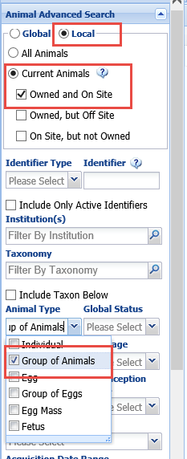
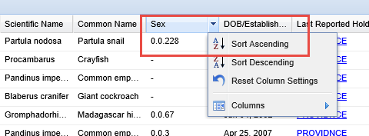
To Close Out Zero Count Migrated Groups
You can easily Close Out all of your groups that migrated
with a count of zero using the Batch functionality.
Use Advanced Animal Search and look for Local Current
Animals Owned and On Site (will cover Loans in another
slide) and Animal Type = Groups. In the results grid
select the Sex column and Sort Ascending.

Slide 27
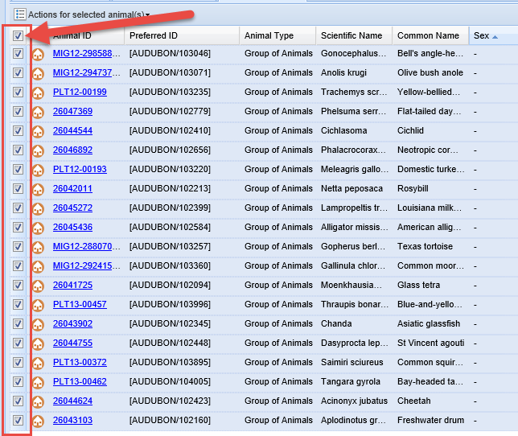
To Close Out Zero Count Migrated Groups
This will arrange the grid with the zero count groups first. Select all records that
you want to Close Out.
Remember that selecting the upper left box will ONLY select those records on the page displayed. You
will need to move through all the pages if you want to Close Out records displayed on them.

Slide 28
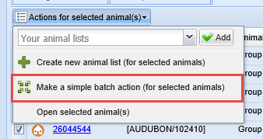
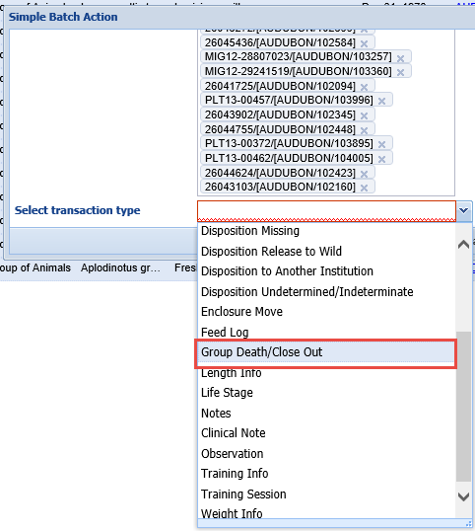
To Close Out Zero Count Migrated Groups
Select to Make a Simple Batch Action for Group
Death/Close Out. Then select the Close Out
radio button. All that is required is the date
that you would like to close the group out.

Slide 29
Group Close Out – Loan Animals
As the Holder, you can Close Out a Group that you hold but do not own.
This is generally OK because as the Holder you are allowed to perform many actions on a record for an individual/group that you do not own but physically hold.
Recommend contacting the Owner as they receive no notification (no Pending or Post Office message) that their group was Closed Out.
Also, as the Owner, you can Close Out a Group that is held by another institution.
At this time this is ONLY recommended if you contact the Holder and they agree the group should be Closed Out
We do not recommend doing this because then the Holder can perform no transactions or census counts on the group AND they have no way to delete the Close Out so that they can continue to perform actions on the group
The Owner would need to delete the Close Out
We are looking into this

Slide 30
Any questions?
On Group Close Out

Slide 31
Hints to End Group Confusion
Remember to accession as received
No apples to oranges
If you receive as a group accession as a group
Can split out individuals after
If you receive as individuals accession as individuals
Can merge into a group after
Communicate!
Senders and Receivers should talk to each other
Saves correcting time later, or waiting for Species360 to correct if you cannot
Update Transaction Documents
Consider updating Transaction Confirmation forms so it is clear if you are receiving/sending the entire group or part of a group

Slide 32
Any questions?
On Groups

