Slide 1
Tips & Tricks – Release 2!
Increased Functionality for Inventory and Husbandry Module
Addition of Medical Module
May 2014

Slide 2
The Main Attraction
The Main Attraction of this release was the addition of the medical module –
the long anticipated ZIMS Release 2! In addition to medical some other new
functionality was added that will be covered here.

Slide 3
The First to Go!!!!!!!!!
Auckland Zoo
Blank Park Zoo
Brookfield Zoo
Dallas Zoo
David Traylor Zoo of Emporia
Dreamworld Pty Ltd
DSI Givskud Zoo
Los Angeles Zoo
Melbourne Zoo
Minnesota Zoo
Museum de Besancon
Omaha’s Henry Doorly Zoo
Parc Paysager Et Animalier Du Reynou
Roger Williams Park Zoo
Rosamond Gifford Zoo at Burnet Park
Sacramento Zoo
Santa Ana Zoo
Steinhart Aquarium
The Living Desert
Toledo Zoo
Topeka Zoo
Wellington Zoo Trust
Werribee Open Range Zoo
Zoo de Granby
Zoo Parc de Beaval

Slide 4
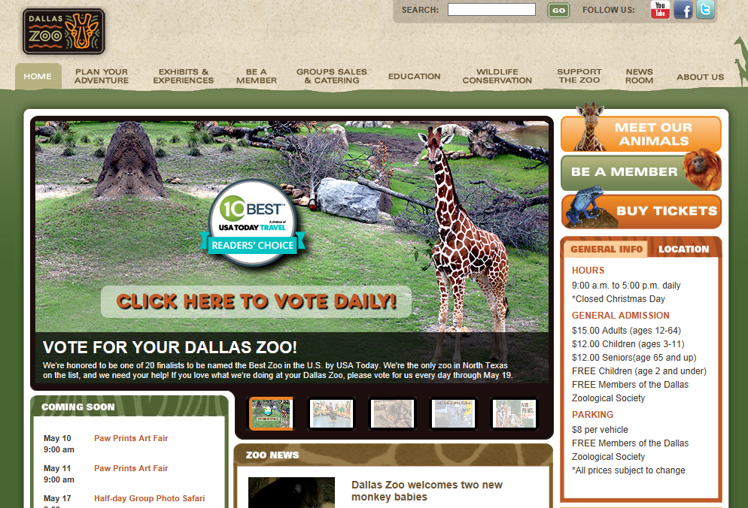
The Very First to Go!!!
Janice Raines, Dallas Zoo, made the very first medical entry!

Slide 5
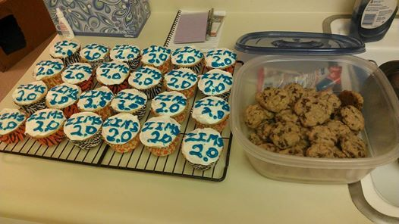
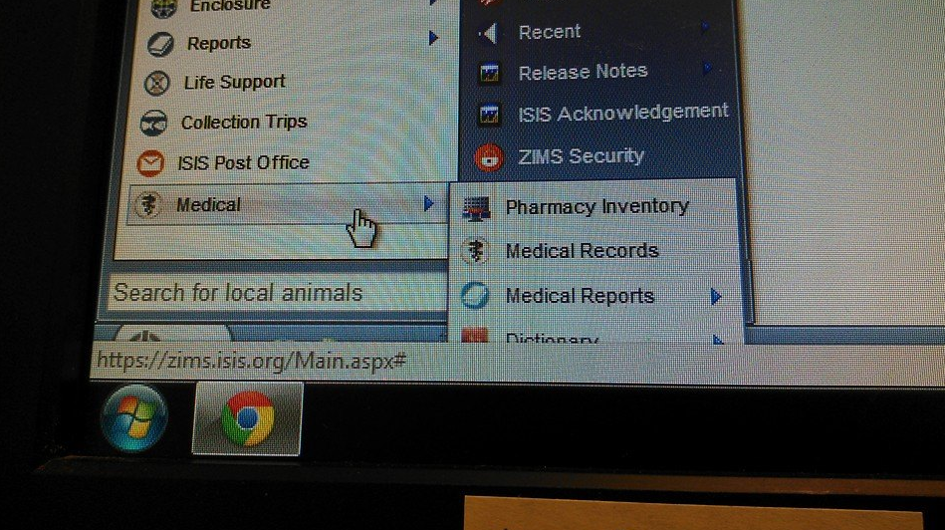
A Lot of Excitement!
Brigid Kilbane, The Living Desert, made ZIMS 2.0 cupcakes for
her team and posted her access to the Medical functionality
on Facebook!

Slide 6
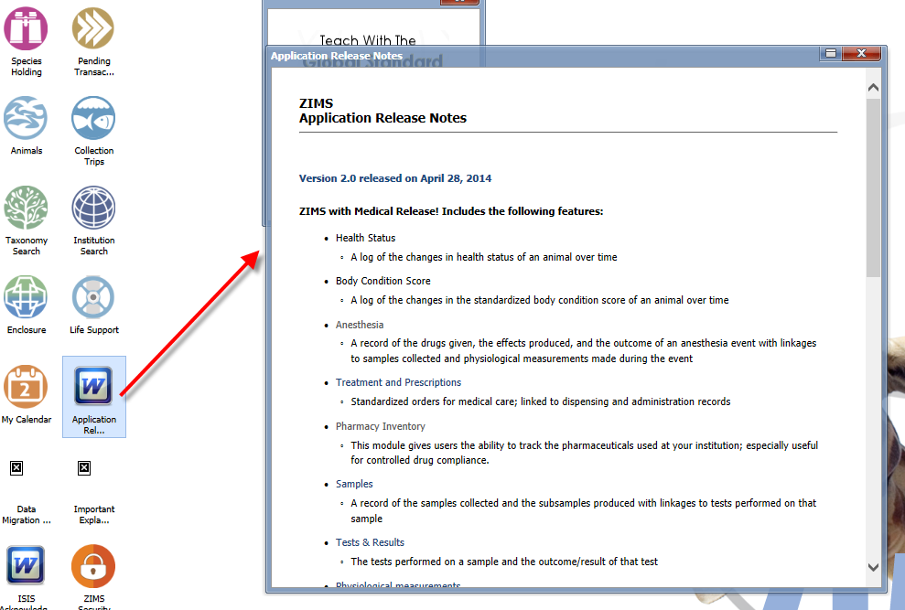
Read the Release Notes

Slide 7
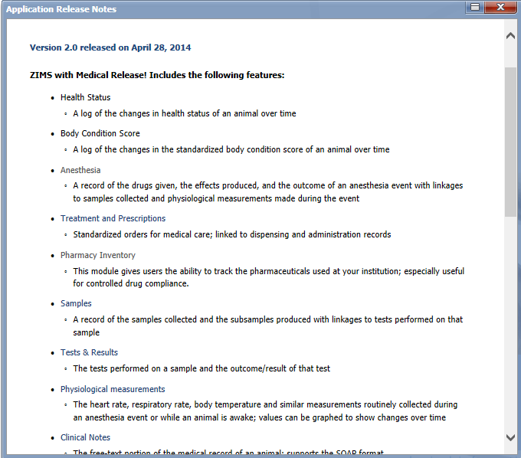
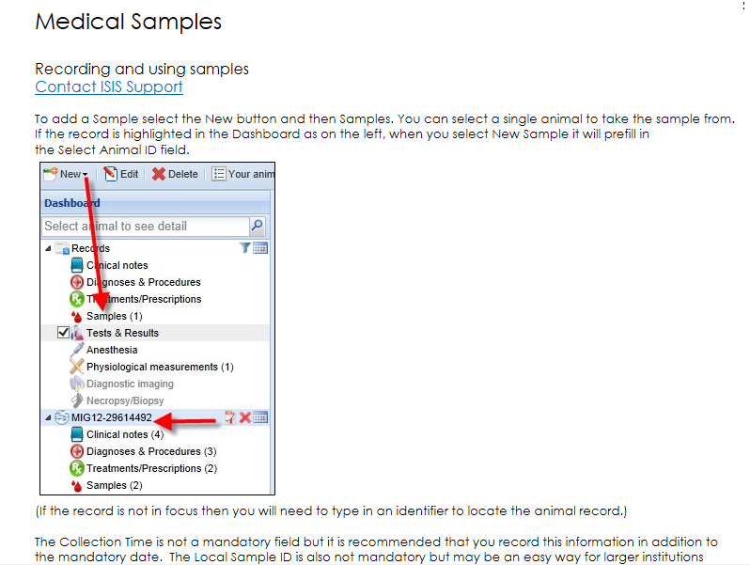
Help Documents – From Release Notes
Many of the topics in the
Release Notes are hyperlinks
to the Help Documents created
to assist you in getting started.

Slide 8
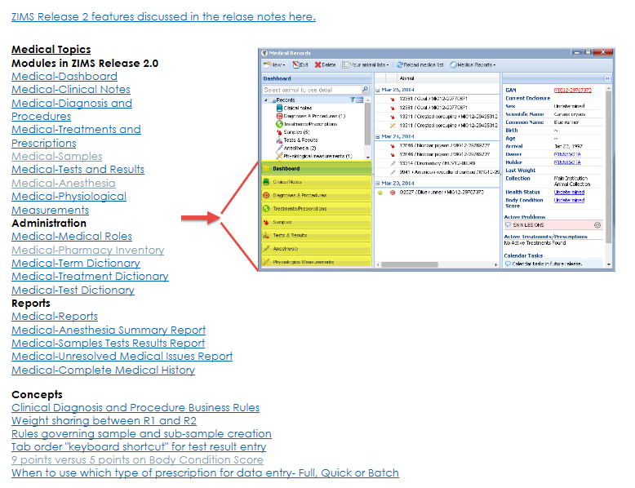
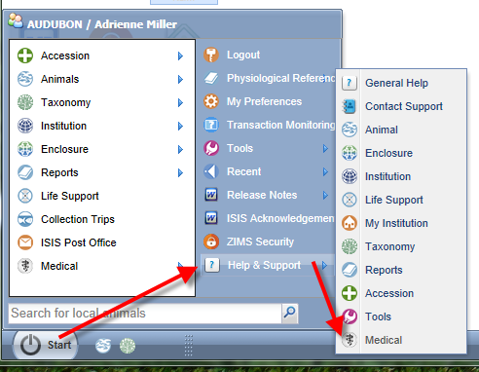
Help Documents from Start Menu
Medical Topics have also been added to the Help Documents available in the Start Menus

Slide 9
Assigning Medical Roles
Global Admin first assigns a Medical Admin Role to your Local Administrator (or what staff member you want to manage the medical roles)
The Medical Roles are managed under My Institution just like the other Roles
Medical Admin will then assign medical roles to other staff members as appropriate
There are two Species360 template Medical Roles
Medical Admin (can assign medical roles to other staff)
Veterinarian (cannot assign medical roles to other staff)
Custom Roles can be created

Slide 10
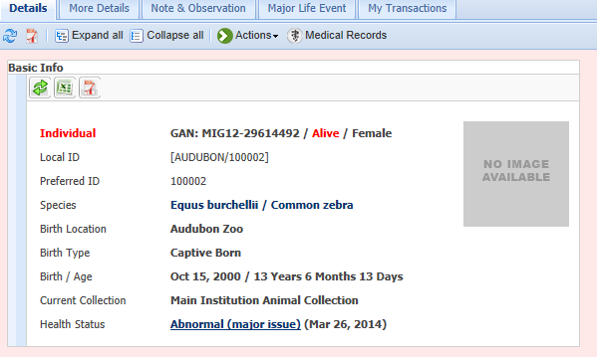
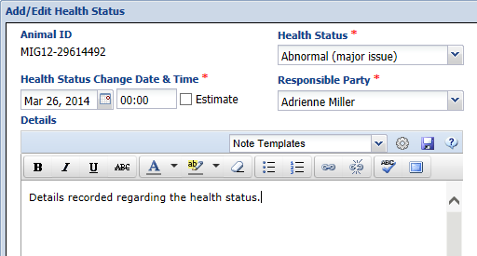
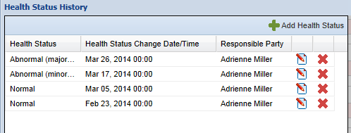
Health Status
The Health Status has been
added to the Basic Info box
in the Inventory and Husbandry
animal record. Selecting
the hyperlink will display the
Heath Status history and you
can open it to view details

Slide 11
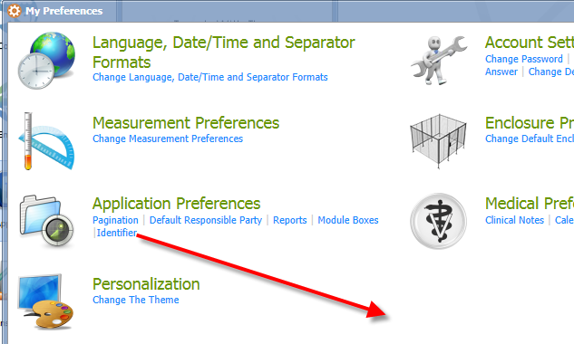
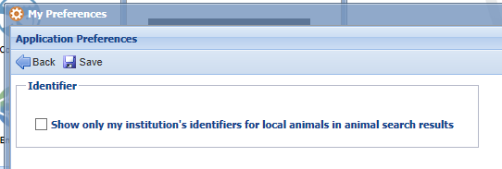
Preferences - Show Only Your Local IDs
The ability to display only your institution’s identifiers has
been added to both Institution and My Preferences

Slide 12
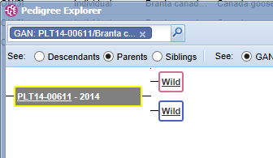
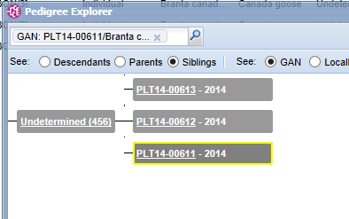
Pedigree Explorer Using Clutch/Litter ID
Pedigree Explorer is now finding siblings by using Clutch/Litter IDs. The
animal above has Wild Parents but there were two other members in
the same clutch.

Slide 13
TAG Export
The TAG Export is found under the Reports menu
It was developed as a new service intended to help TAGs and other strategic collection planning efforts
The Excel file provides details of Species360 member’s current inventory for the selected taxonomic scope in an easy to sort and filter spreadsheet
One tab displays the “conservation focus”
The % of the taxonomic scope that is At Risk according to IUCN
The % of taxa and animals in Species360 member collections of those at-risk species
We welcome suggestions for improvements

Slide 14
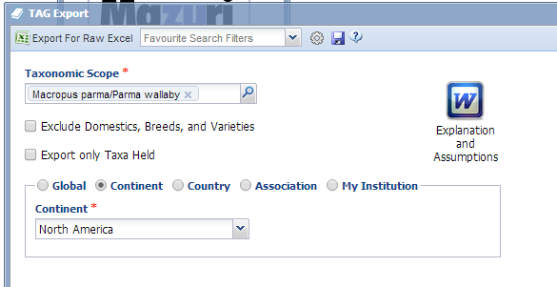
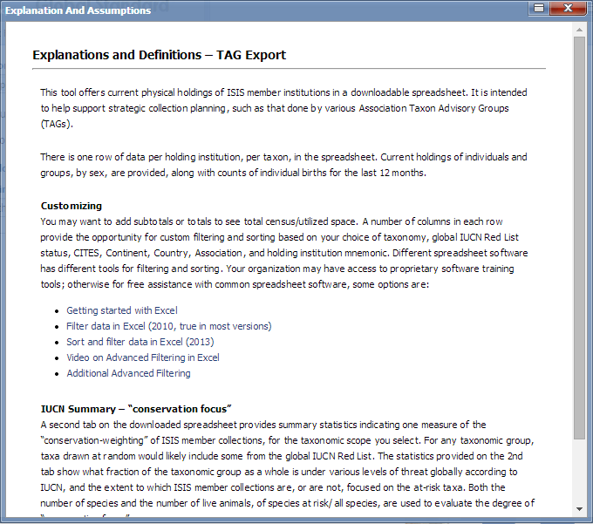
TAG Export
You can select to exclude Domestics, Breeds and Varieties. Checking the Export only Taxa Held box will eliminate taxonomy not held at any zoo or aquarium such as extinct animals for example. It can be run at various levels
from your institution only up to global level.
Before running the report make sure you read the Explanations and Assumptions to help you interpret the results.

Slide 15
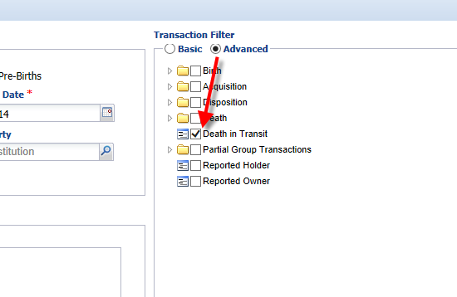
Death in Transit now in Transaction Report
The ability to find Death in Transit has
been added to the Transaction Report
under the Advanced Transaction
Filter option.
Selecting this will find both animals
that you recorded as dying in transit
after you dispositioned them and
animals that you received dead.

Slide 16
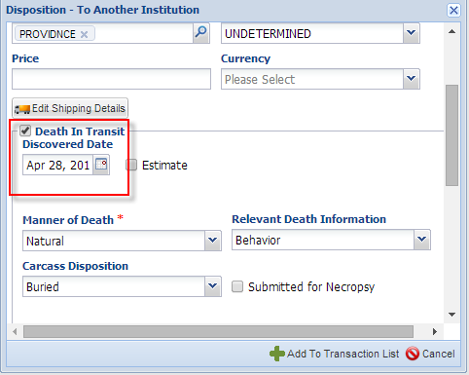
Recording a DIT - Disposition
When recording a Death in Transit for a disposition check the Death In Transit checkbox . This will activate the Discovered Date field and the standard death information fields. This is hypothetical data.
If you know the animal died in transit when you are recording the Disposition it will not create a Pending Transaction for the Receiving Institution. If you do not know the animal died when you recorded the disposition you can edit the disposition and check the box. If a Pending has already been created for the receiving institution, checking this box will remove it from their grid. The disposition will display as the intended disposition term plus Death in Transit.

Slide 17
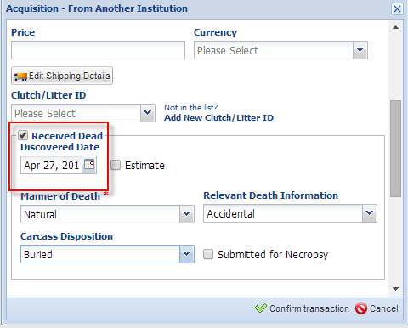
Recording a DIT - Acquisition
To record an animal that was received
dead check the Received Dead box in
the confirmation screen. This will
activate the required fields. The
transaction will display as the intended
acquisition plus Received Dead in My
Transactions. Neither DIT or Received
Dead will count against your institutions
death record.
At this time Received Dead is only
available as an option when confirming
receipt of an animal from an Species360 member.
It is not yet available for acquisitions from
non-Species360 members.

Slide 18
Report Display
If DIT is selected in a Transaction Report it will display as above.
The Taxon Report will display as below.

Slide 19
Incomplete Accessions
Original intent was to allow Veterinary Staff to create a record that they could record medical data into (MedARKS non-accessioned animal)
Curators may also want to use the feature should they wish to record information on an animal that has not yet been accessioned
All information recorded on an Incomplete Accession will be migrated into the permanent accession record
Access to creating Incomplete Accessions is found under My Institution>Institution Roles>Animal module. It is not a Medical module functionality.

Slide 20
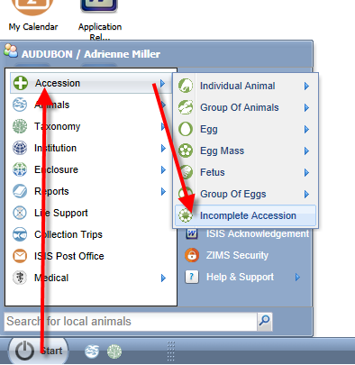
Starting an Incomplete Accession
Incomplete Accessions are found under the Start menu and Accession.
You will not select the entity type.

Slide 21
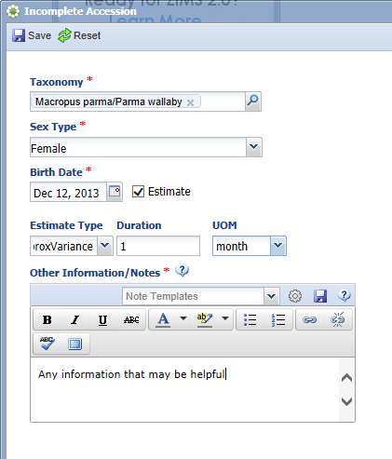
Creating an Incomplete Accession
Minimal information is required for
an Incomplete Accession. The taxonomy,
sex, birth date and appropriate notes
are the only information gathered.
All of this can be edited when the
permanent accession is created.
An Incomplete Accession receives a
temporary GAN. Note that this GAN
ends with “IA”.

Slide 22
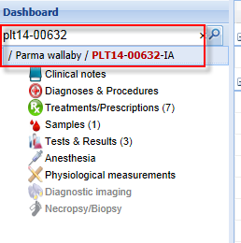
Recording Data in an IA
In the Inventory and Husbandry module (above) Incomplete Accessions are found to the right of the Pending Transactions tab.
Most information that can be recorded in an accessioned animal can be recorded in an Incomplete Accession such as weights and identifiers. To do this the User must have Inventory and Husbandry access to the animal. An IA cannot be put into an Enclosure or a Collection, Parent Information cannot be added and subsequent Transactions such as Dispositions or Deaths cannot be recorded.
In the Medical module (left) the Veterinarian can
find the Incomplete Accession record just as
they can find a permanently accessioned record.

Slide 23
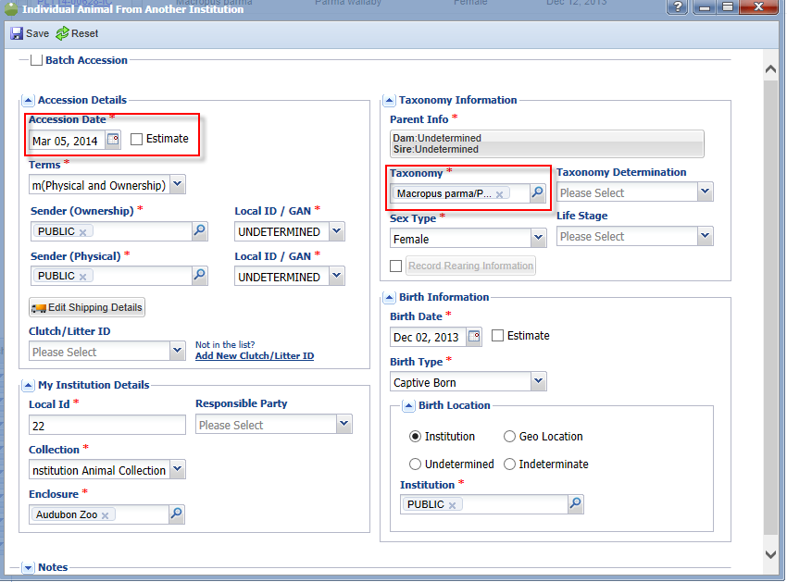
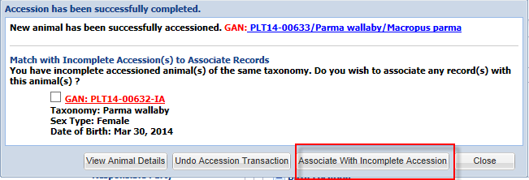
Associating an Incomplete Accession with a Complete Accession
When a permanent accession is created
if the application finds any possible
matches in Incomplete Accessions you
will be asked if you wish to associate
any of these records with your accession.
Check the appropriate record and select
“Associate With Incomplete Accession”.

Slide 24
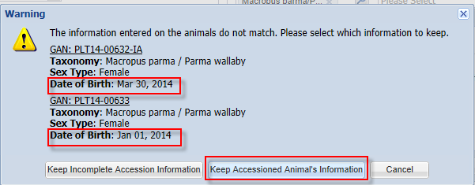
If the Information is Different
If the information for the complete accession does not match the information recorded for the Incomplete Accession you will be asked which information you wish to keep. In this example the birth date was different. We chose to keep the accessioned animal’s
information. Any data recorded in the Incomplete Accession record will be migrated into the permanent record. The GAN of the Incomplete Accession becomes an Old Accession Number in the Identifiers grid.

Slide 25
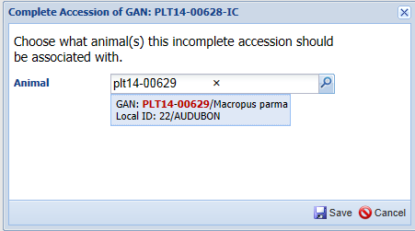
Complete Selected
If you don’t associate the complete accession with the Incomplete Accession, the Incomplete Accession will remain in the grid. You can select it and choose to “Complete Selected”. You will be asked what animal the Incomplete Accession should be associated with. This method does require that the complete accession be recorded prior to Completing Selected. This is also the method you would use to associate the records should you Confirm a Pending Transaction for an animal that has had an Incomplete Accession created for it.

Slide 26
Entity Selection
Because there is no Entity (Individual, Group, Egg, etc.) selected during the Incomplete Accession, the Entity must be selected during the permanent accessioning process.
There may be times when several animals were received and the person doing the Incomplete Accession created only one record but the Registrar believes these animals should be separate individual records.
In reverse there may be times when several animals were received and the person doing the Incomplete Accession created multiple records but the Registrar believes these animals should be managed as a single group record.
These scenarios can be handled!

Slide 27
One IA into Multiple Individual Records
For the first scenario four toads were received over the weekend that required some
medical care. The Veterinarian created a single Incomplete Accession. He used the
Other Information box to note that there were four animals received.

Slide 28
Creating the Complete Accession
When the Registrar records the first individual accession the application finds the
Incomplete Accession record. The Registrar should NOT choose to Associate With
Incomplete Accession as the medical records would be associated only with this one
record. They should instead select View Animal Details or Close. They should then
complete the remaining three accessions. If they recorded a Batch Accession for the four
toads the application will NOT look into Incomplete Accessions.

Slide 29
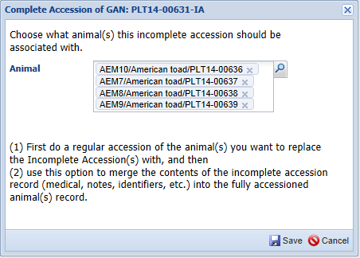
Associating the Single IA Record
To associate the single Incomplete
Accession with the four individual
complete accessions you would
go to the Incomplete Accessions tab, check the record and select Complete Selected.
You would then enter the four
individual complete accessions.

Slide 30
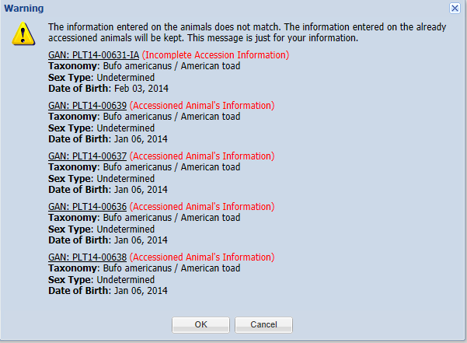
Information that Does Not Match
If the information does not match you will be given notification of such. In this
situation where the single IA is associated with multiple complete accessions,
you do not have the option to select to keep the information recorded on the
Incomplete Accession, it is simply for your information .

Slide 31
Multiple IAs into One Permanent Accession
For the second scenario four toads were received over the weekend that required some
medical care. The Veterinarian created four Incomplete Accessions. He used the
Other Information box to note that each record was one of four animals received.
There is currently no Batch Accession option for Incomplete Accessions.

Slide 32
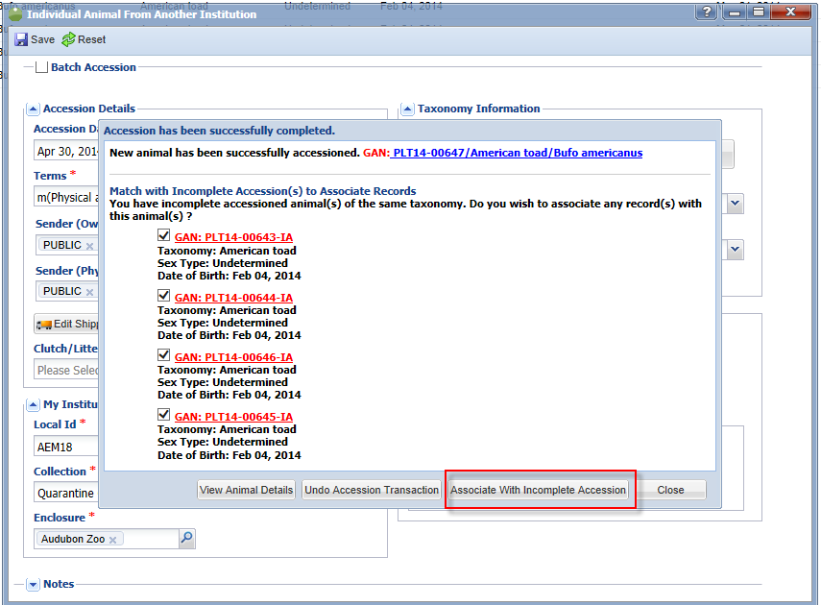
Associating the Multiple IAs
The Registrar has determined that the four toads should actually be managed as a group
record as they are not individually identifiable at this time. The Registrar records a single
complete accession. The application finds the four possible IAs. All are selected to be
associated.

Slide 33
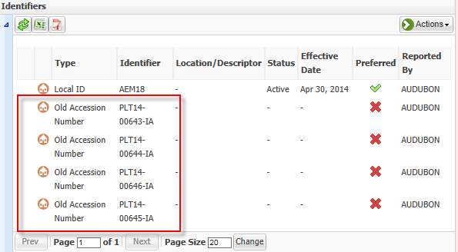
Information is Copied
When you select to associate the records you will receive a message that all information
will be copied into the single permanent accession record. All four of the IAs GANs will
become Old Accession Numbers

Slide 34
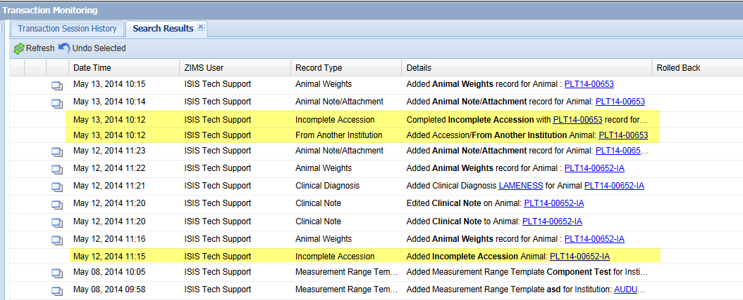
Rolling Back
Transaction Monitoring will display 3 transactions –Added Incomplete Accession,
Added Accession (the complete accession), and Completed Incomplete Accession
(associating the two transactions). If you choose to Roll Back (Undo Selected) the
Completed Incomplete Accession if you made an error in associating the two, the
Incomplete Accession will reappear in the Incomplete Accession grid, any information entered into it will remain with it. In the complete accession any information entered into the Incomplete Accession will be removed.

Slide 35
Any Questions?
On the R2 Roll Out!

