Slide 1
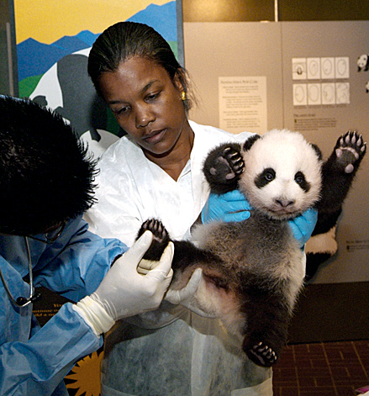
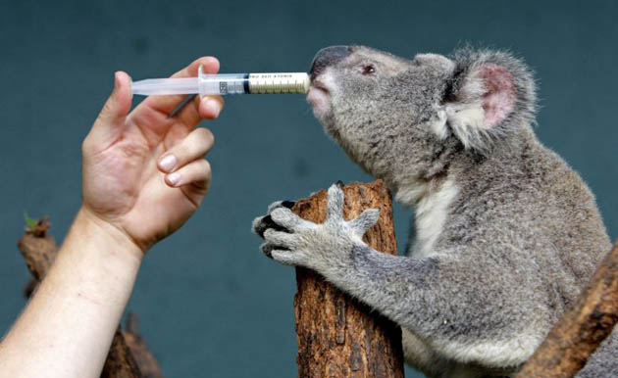
ZIMS With Medical Release 2.0 R2
An overview of the Medical Module in ZIMS and how it impacts the Animal Husbandry (R1) Module

Slide 2
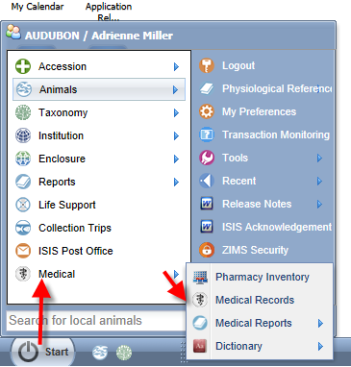
Navigation
The Medical Module is found
under the Start Menu. This will
only display if access has been
provided to you in your ZIMS Role.
There are four modules:
-Pharmacy Inventory
-Medical Records
-Medical Reports
-Dictionary

Slide 3
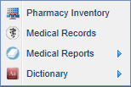
The Four Modules
Pharmacy Inventory
Your supply of drugs
Often track controlled substances
Tracks usage/availability
Medical Records
All the medical records on all the animals in your collection
Medical Reports
Anesthesia Summary
Samples/Tests/Results
Unresolved Medical Issues
Complete Medical History
Dictionary
Term
Treatment
Test

Slide 4
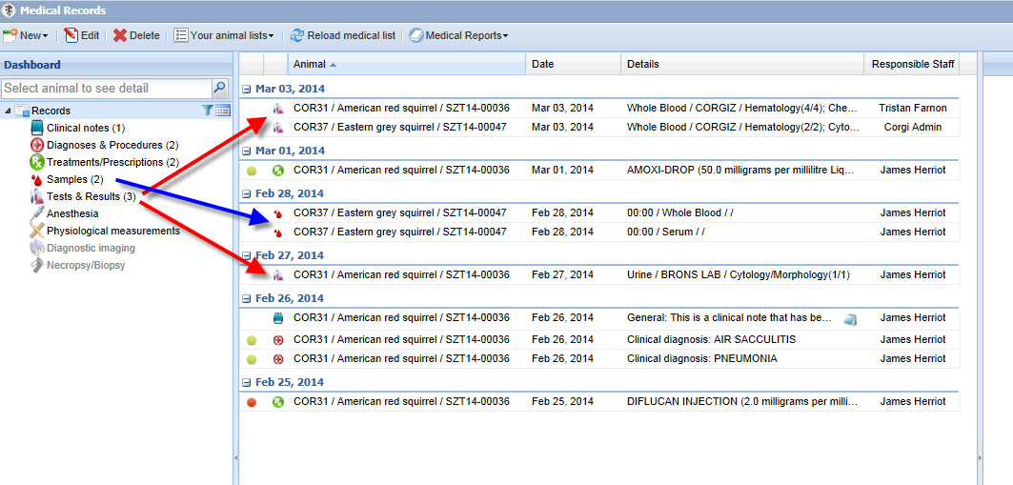
Medical Records – the Dashboard
When you first open the Medical Records module the most recent entries
will display in the middle. The left hand side indicates how many of each
type of record are included. Note how the icons allow you to easily spot
different record types. You can easily find the 3 Tests & Results records (red)
and the 2 Samples records (blue). The date range default is for the past
7 days.

Slide 5
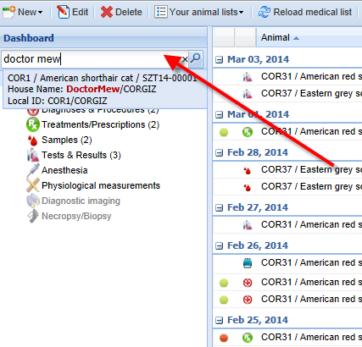
Opening an Animal Record
To open a record for a
specific animal or group
type in the GAN, Local ID,
or other identifier such as
transponder into the search
field

Slide 6
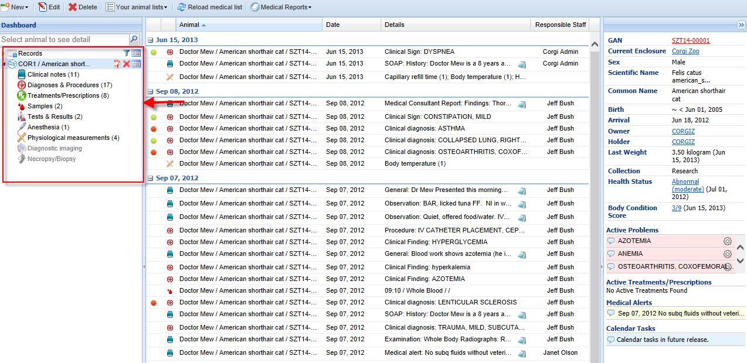
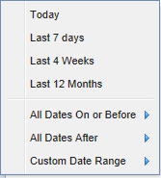
Record Selection
The left side controls the selection of the records
you want to view. There are 7 active topics you
can select from in this first release.
The date range default when an animal record is
selected is the life of the animal. Using the
calendar icon you can adjust this to your
desired date range.

Slide 7
List of Selected Records
We have selected Treatments & Prescriptions
from the left panel. Only this topic is now displayed
with the most recent date at the top.

Slide 8
Record Preview Pane
When a record is selected from the list,
the lower center panel becomes a
preview pane for the information recorded.
To view the entire entry select the
Maximize button.

Slide 9
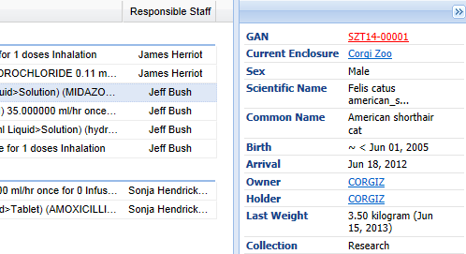
Right Side Panel - Top
The top of the right side panel displays information
that is sourced from the R1 (Animal Husbandry)
module of ZIMS.
The GAN is a hyperlink to the animal record.
The Enclosure is a hyperlink to the Enclosure record.
The Owner and Holder are hyperlinks to the Institution
record.
The Last Weight may be sourced from the R1 module
or it may have been entered directly into the Medical
(R2) module. The Unit of Measure will always be
the UOM selected in your Preferences, regardless of
what UOM was entered for the weight, and converted
if required.

Slide 10
Right Side Panel – Health Status and BCS
The rest of the information on the right side
panel is data that is sourced only from the R2 module.
The Health Status is the current health status,
as of the date displayed, and is a hyperlink to
the full health status history and the screen
where you can add a new Status or edit this one.
The Body Condition Score is as of the date displayed.
It is a hyperlink to the full Body Condition score and
the screen where you can add a new BCS or edit
this one.

Slide 11
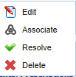
Right Side Panel – Active Problems
The Active Problems are unresolved
medical issues for this animal.
Click on the left side bubble to see more details
Click on the wheel icon to Edit the record,
associate it with other records, resolve the
problem, or delete the problem.

Slide 12
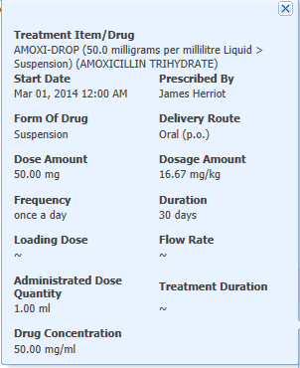
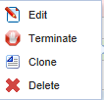
Right Side Panel – Active Treatments/ Prescriptions
Active Treatments and Prescriptions are
those that are currently active or on-going
for the animal.
Clicking on the left hand bubble will
bring up the details.
Clicking on the wheel icon will allow
you to Edit, Terminate, Clone or Delete
the information. Cloning will copy the
information but will allow editing if required.

Slide 13
Right Side Panel – Medical Alerts
Medical Alerts are a special subtype of
clinical note that contain critical
information regarding the animal.
These Alerts are different than the
Animal Alerts in the R1 side as they
usually indicate on-going Alerts for
the care of the animal.
Selecting the left side bubble is an active
link to the full text of the Alert.
Calendar Tasks are scheduled for a future
release and will include upcoming calendar
events such as medical procedures, sample
collection or treatment.

Slide 14
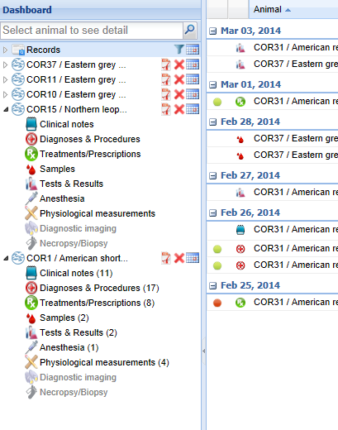
Multiple Open Records
You can keep multiple records open at
the same time for ease of comparison.
Your open records will display as a list
on the left side of the dashboard. You can
expand and collapse by using the arrows.
Using the right side icons you can print
the medical history of the animal,
remove the animal from your list of open
records, or filter the records by date.

Slide 15
R1 View in a R2 World!
When you deploy R2 and your staff begins using it, some information on the R1 side may be impacted
Some information entered into the medical module will also display in the husbandry module
You will not be able to edit this information from the R1 module

Slide 16
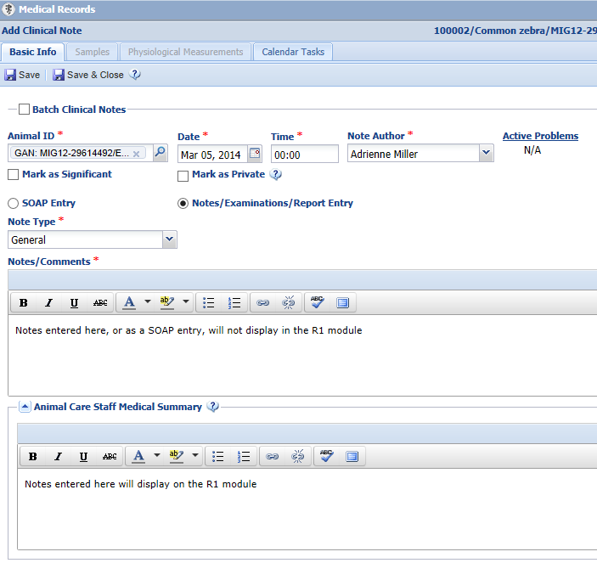
Animal Care Staff Medical Summary
In Clinical Notes there is the option to record
a simple note as selected here, or to select
the SOAP Entry (Subjective, Objective,
Assessment and Plan) button and record a
more detailed comment. The information
recorded either as a SOAP entry or as a
Note/Examination/Report Entry will display
only in the R2 module.
Any information recorded in the Animal
Care Staff Medical Summary will display
in the R1 module Notes/Observation grid,
as well as within the R2 module.

Slide 17
R1 View of Medical Summary
Below is the R1 view of the Animal Care Staff Medical Summary information
from the previous slide. You can tell this note was entered on the R2 module
as the title is Clinical Medical Summary Note. You cannot edit or delete this note.
Those actions can only be done from the R2 module because it was entered there.

Slide 18
Accessing Medical From R1
If you have access to the R2 module you can access the medical records for an
animal from within its R1 record as shown below.

Slide 19
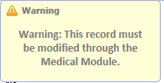
Animal Weights
When recording an anesthesia or treatment event, the Veterinarian has the option to use the last weight recorded which is usually sourced from the R1 module weight grid. However, they have the option to record a new weight for the animal.
If a new weight is recorded, this information is copied into the weight grid in the R1 animal record. If this is an estimated weight recorded during a Treatment it is NOT copied into the R1 module. This weight cannot be edited from the R1 module and can only be edited from within the R2 record. At this time there is no indication in the weight grid that the weight was sourced from an R2 entry.

Slide 20
R2 Display in Transaction Monitoring and Activity Report
Transaction Monitoring
All medical entries
Weights are not separated out as they are recorded during Anesthesia or Treatment
Activity Report
Weights recorded (including estimated weights)
Animal Care Staff Medical Summary note
Other medical entries are not displayed

Slide 21
Incomplete Accessions
Allows your Veterinary staff to start entering medical data without actually accessioning an animal
Similar to the “non-accessioned” animal functionality in MedARKS
When it is time to actually accession the animal the Incomplete Accession information will be tied to the actual accessioned record

Slide 22
Starting an Incomplete Accession
An Incomplete Accession is intended
to allow the Veterinarian to create a
temporary record so that medical
information can be recorded. This is
similar to a non-accessioned record in
MedARKS. An Incomplete Accession is
generally used when the person who does
accessions is not available to create the
permanent record.
Incomplete Accessions are found under
the Start menu and Accession. You
will not select the entity type.

Slide 23
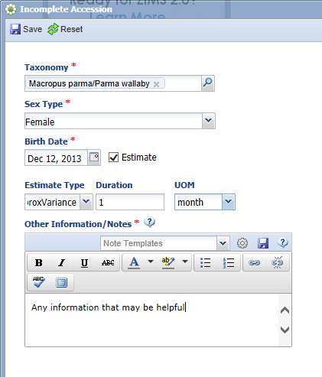
Creating an Incomplete Accession
Minimal information is required for
an Incomplete Accession. The taxonomy,
sex, birth date and appropriate notes
are the only information gathered.
All of this can be edited when the
permanent accession is created.
An Incomplete Accession receives a
temporary GAN. Note that this GAN
ends with “IC”.

Slide 24
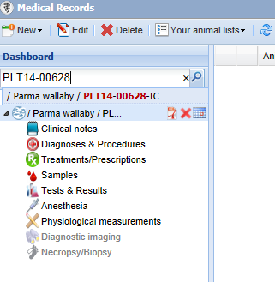
Recording Data in an IC
In the R1 module (above) Incomplete Accessions
are found to the right of the Pending
Transactions tab.
Most information that can be recorded in an accessioned animal can be recorded in an Incomplete Accession such as weights and
identifiers. An IC cannot be put into an Enclosure or a Collection, Parent Information cannot be added and subsequent Transactions such as Dispositions or Deaths cannot be
recorded.
In the R2 module (left) the Veterinarian can
find the Incomplete Accession record just as
they can find a permanently accessioned record.

Slide 25
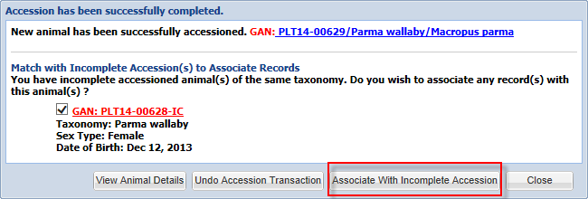
Associating an Incomplete Accession with an Actual Accession
When a permanent accession is created,
if the application finds any possible
matches in Incomplete Accessions you
will be asked if you wish to associate
any of these records with your accession.
Check the appropriate record and select
“Associate With Incomplete Accession”.

Slide 26
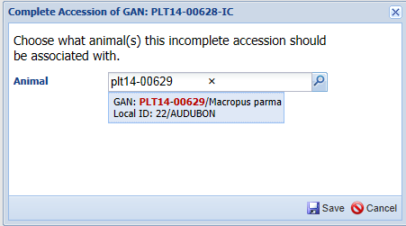
Another Way
If you don’t associate the permanent
accession with the Incomplete Accession,
the Incomplete Accession will remain in
the grid. You can select it and choose
to “Complete Selected”. You will be
asked what animal the Incomplete
Accession should be associated with.

Slide 27
If the Information is Different
If the information for the permanent accession does not match the information recorded for the Incomplete Accession you will be asked which information you wish to keep. In this example the birth date was different. We chose to keep the accessioned animal’s
information. Any data recorded in the Incomplete Accession record will be migrated into the permanent record. The GAN of the Incomplete Accession becomes an Old Accession Number in the Identifiers grid.

Slide 28
R2 is on its way to you!

