Slide 1
Loan Transactions
Making them simple
Notes:
Loan transactions can be very confusing to Users if they do not understand what some of the terms mean and how to record some of those complicated transaction flows that can arise with animals in or out on loan.

Slide 2
Loan or Lease?
Functionality is the same
Lease = $$$ changed hands
  Temporary exhibits
  May need permits!
Loan = no $$$ involved
For this session will use the term Loan, but could be Lease if appropriate

Slide 3
New Functionality for R1.7
Some Loan Transactions have been updated
Change in Owner/Holder Only
  All changes in Owner or Holder are no longer considered Acquisitions or Dispositions
  Report Owner Change
    Holder Records
    Animal In On Loan
  Report Holder Change
    Owner Records
    Animal Out on Loan

Slide 4
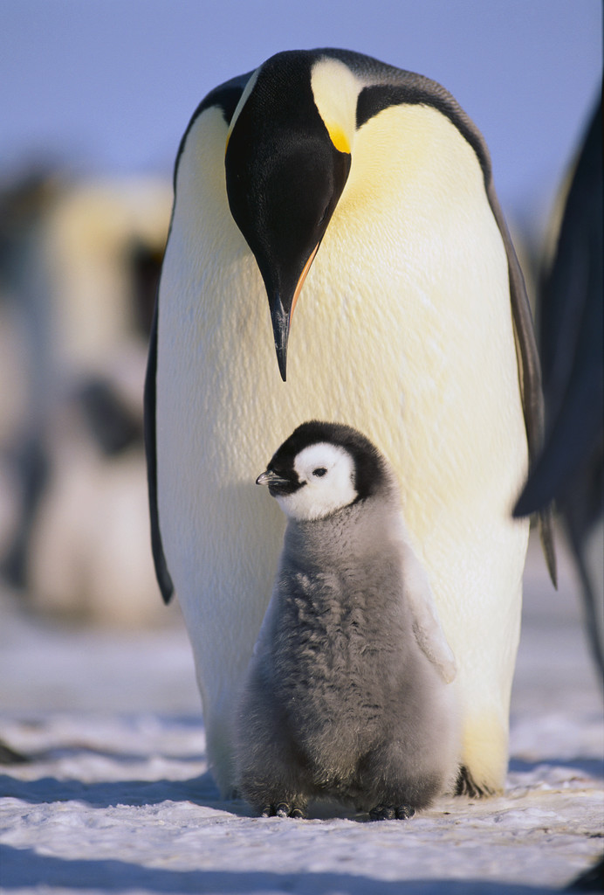
Designating Ownership for Birth/Hatch In on Loan
Follow the terms of the Loan Agreement
Work with the Owning Institution
Notes:
When trying to provide a Best Practice recommendation for designating the ownership of an animal in on loan once the survivorship is met I contacted several experiences Registrars and found that there are actually three different ways to do this and all have ositives and negatives. There are two very important things to remember regardless of how you record it.
>>Follow the terms of the loan agreement and
>work with the owning institution to record in a manner they are in agreement with.

Slide 5
Option #1
Record the possible Owner as the Owner during the accessioning process
The Owner will receive a Pending Transaction for ownership
  If they confirm and the survival period is reached all is well
  If they confirm and the survival period is NOT reached they will need to delete their part of the record by deleting the animal
  If they do NOT confirm and the survival period is not reached, the Pending will be removed with the following action…..
For the Holder if the survival period is not reached edit the record to give you Ownership and then record the death
Record Notes about what you did
This option was easier in ARKS than in ZIMS with the global record

Slide 6
Option #2
Record your institution as the Owner during the accessioning process
If survivorship not reached no changes need to be made
If survivorship reached edit the accession so the appropriate institution is the Owner from the beginning
Owner will receive a Pending for ownership to confirm
Record Notes about what you did

Slide 7
Option #3
Record your institution as the Owner during the accessioning process
If survivorship not reached no changes need to be made
If survivorship reached use a disposition of To Another Institution - Designated to Parent Institution to record the correct Owner
  Use the date that Ownership was determined
    Positive is that you know you managed the animal as yours for a period of time (medical)
  Use the birth/hatch date with time adjusted
    Positive is that you can see ownership changed in My Transactions and Ownership History grid
    And some Users believe this was the proper owner all along
New owner will receive a Pending for ownership to confirm
Record Notes about what you did

Slide 8
The Loan Terms - Dispositions
Loan Out To (Initial Transaction)
Report Holder Change - For Animal Out on Loan
  Formerly Loan Out To (Change in Reported Holder)
Loan Return to Owner (Physical Only)
Loan Transfer To (Physical Only)

Slide 9
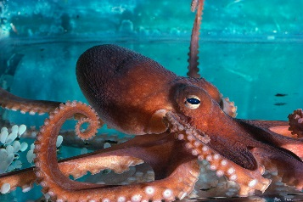
Loan Out To (Initial Transaction – Physical Only)
  DEFINITION: Dispositioning an entity physically but retaining legal title, the animal is physically sent from your facility to another facility.
  The Holder/Owner records this transaction
  The new Holder receives a Pending
EXAMPLE: An octopus was born at your facility (Physical & Ownership). It is loaned to Institution A
  Institution A now has the animal physically
  Your Institution retains legal ownership of it
Your Facility
Owner/Holder
Institution A
New Holder

Slide 10
Report Holder Change – For Animal Out on Loan (formerly Loan Out To (Change in Reported Holder))
DEFINITION: An animal that was out on loan from your institution is transferred to a another facility. The animal will now be out on loan from you to the new facility.
The Owner records this transaction
The new Holder receives a Pending
  If the old Holder has not yet recorded a Loan Transfer (next slide) they will get a Pending ONLY after the new Holder confirms
EXAMPLE: The octopus from the last scenario is transferred from Institution A to Institution B
  Institution B now has the animal physically
  Your institution retains legal ownership of it
Institution B
New Holder
Institution A
Old Holder
Owner

Slide 11
Loan Transfer To (Physical Only)
DEFINITION: Physically transferring an entity that was in on loan to you to a third party, the first party retains legal ownership.
The Holder records this transaction
The Owner receives a PO message that the animal has been transferred
The new Holder receives a Pending
  The Owner receives a Pending once the new Holder confirms
EXAMPLE: In the octopus scenario Institution A records a transfer to Institution B
  Institution B now has the animal physically
  Your institution retains legal title to it
Institution B
New Holder
Owner
Institution A
Old Holder

Slide 12
Why do 2 Institutions Record?
We take what YOU say for the Local record
If, as the Owner, you do not believe the animal was moved, your records need to reflect that
If the Owner says the animal was moved but it really wasn’t, then the Holder’s records must reflect that
Species Holding may reflect 2 animals because of this

Slide 13
Loan Return to Owner (Physical Only)
DEFINITION: Physically returning an entity that was In On Loan to your facility from another institution to you its legal owner.
The current/last Holder records this transaction
The Owner receives a Pending
EXAMPLE: Institution B (now the holder of the octopus) returns it to you
  Your institution now has both the animal physical and legal ownership of it
Institution B
Last Holder
Owner

Slide 14
The Loan Terms - Acquisition
Loan In From (Physical Only)
Loan Transfer From (Physical Only)
Loan Return to Us (Physical Only)
Report Owner Change – For Animal In On Loan
Notes:
Recording Acquisition Loan terms are usually considered Receiver Initiated transactions, that is the Receiver is recording the transaction before the Sender is recording it. Of course when receiving an animal from a non-Species360 member you must record a Receiver Initiated Transaction.

Slide 15
Loan In From (Physical Only)
DEFINITION: Physically receiving an animal entity without also acquiring the legal title from the Owner
The new Holder records this transaction
The previous Holder/current Owner receives a Pending
EXAMPLE: Your institution receives an octopus physically only from another institution
  Your institution has the animal physically
  The sending institution retains the legal title to it
Owner/Holder
Your Institution
New Holder

Slide 16
Loan Transfer From (Physical Only)
DEFINITION: Receiving an animal entity from an institution other than the Owning institution
The new Holder records this transaction
The previous Holder receives a Pending
The Owner also receives a Pending
EXAMPLE: Your institution receives the octopus from an Institution who had it In On Loan
  Your institution now has the animal physically
  The Owner retains legal title to it
Your Institution
New Holder
Owner
Previous Holder

Slide 17
Loan Return to Us (Physical Only)
DEFINITION: An animal entity that had been Out On Loan to another institution is returned to you.
The Owner records this transaction
The last Holder receives a Pending
EXAMPLE: The last holder returns the octopus to you
  Your institution now has both the animal physical and legal ownership of it
Last Holder
Owner

Slide 18
Report Owner Change – For Animal In On Loan
DEFINITION: The Owning Institution for an animal you have In On Loan has changed
The Holder records this transaction
The previous Owner receives a Pending
The new Owner also receives a Pending
EXAMPLE: Your institution is holding an octopus In On Loan from Institution A. Institution B is now the Owner of the octopus
  Your institution retains the animal physically
  The Owner is now Institution B
Your Institution
Holder
Institution A
Previous Owner
Institution B
New Owner

Slide 19
A Recommendation
Clean up your Species360 Post Office!!
Previously duplication of notification
  Pending and
  Post Office notification
Now if Pending created, no PO message received
PO messages for third party Loan transactions
  No Pendings received
Important to get these notifications

Slide 20
Scenarios From Your Records!
Notes:
We have taken some of the real life scenarios that you have run into and requested help for support to figure out. Sometimes there may be more than one way to complete the action as we will see in our first example for births/hatches of animals In On Loan. Want this to be a very interactive session, so tell us how you do things at your facility. And if I don’t cover one of your scenarios please bring it up at the end so we can discuss it.

Slide 21
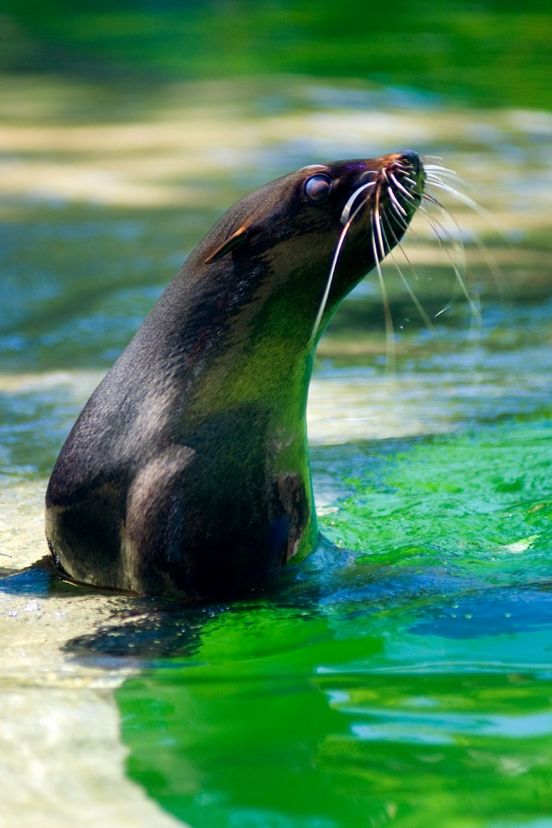
Scenario #1: Government Owned Animal goes Missing
(identical to non-Species360 In On Loan animal)
Sea lion is Rescued
Institution A = Holder
USFWS = Owner
Institution A sends to
Institution B
USFWS = Owner
Escapes at Institution B
Retrieved by Institution B
Sent back to Institution A

Slide 22
The Steps
Sea Lion is Rescued Institution A accessions as:
  Rescued (Physical Only)
  Owner = USFWS/Indeterminate Local ID
A Sends to B Institution A dispositions as:
  To Another- Loan Transfer To (Physical Only)
  Institution B receives a Pending – They Confirm
Goes Missing at B Institution B records a Missing
  Physical Only as B has no Ownership
  Institution A gets no notification as it does not own or have the animal physically any more
Retrieved at B Institution B records a Retrieval of Missing
  P & O terms are not asked for as disposition was P Only
  Owner remains USFWS and must be filled in
Returned to Institution A Institution B records a disposition as
  To Another – Loan Transfer To
    Not a Loan Return to Owner as Institution A did not own it
  Institution A receives a Pending – They Confirm
Animal is back at Institution A!

Slide 23
Scenario #2: Species360 Member Animal goes Missing and then sent to Another
Institution A loans out to Institution B
Escapes at Institution B
Retrieved by Institution B
Sent to Institution C by Institution B
Institution A gives Ownership to Institution C

Slide 24
The First Steps
A Loans to B Institution A dispositions as:
  To Another- Loan Out To (Initial Transaction – Physical Only)
  Institution B receives a Pending – They Confirm
Goes Missing at B Institution B records a Missing
  Physical Only as B has no Ownership
  Institution A gets no notification at this time
    Institution B should communicate with Institution A
    Institution A may want to retain Ownership for a period of time
    Requested that a PO message be sent to Institution A
Retrieved at B Institution B records a Retrieval of Missing
  P & O terms are not asked for as disposition was P Only
  Owner remains Institution A and must be filled in
    Institution B should communicate with Institution A
    If Institution A has not recorded a Missing (Ownership Only) they do nothing
    If Institution A has recorded a Missing (Ownership Only) they record a Retrieve of Missing (Ownership Only)

Slide 25
The B to C steps
B sends to C – B (holder) records first
  Institution B (holder) records a disposition as:
    To Another – Loan Transfer To (Physical Only)
    Institution C (new holder) receives a Pending for Physical Arrival
    Institution A (owner) receives a PO message that they should record a Change in Holder
  Institution C (new holder) confirms
    Institution A receives a Pending
      Institution A records a Report Holder Change For Animal Out on Loan
B sends to C – A (owner) records first
  Institution A (owner) records a disposition first as:
    Report Holder Change – For Animal Out on Loan
    Institution B (previous holder) receives no notification
    Institution C (new holder) receives a Pending
  Institution C (new holder) confirms the Pending
    Notice that Institution B has not yet recorded sending
    Institution B now receives a Pending
      They confirm
A gives Ownership to C
  Institution A records a disposition (Ownership Only)
  Institution C receives a Pending – They Confirm
Animal is owned and held at Institution C!

Slide 26
A Loan Transaction We are Still
Improving
Institution A loans out to Institution B
Institution A then gives Ownership to Institution C
  Sale
  Donation
  Whatever
Depending on who enters first there remain issues
Contact Support for help

Slide 27
Any Questions?

