Slide 1
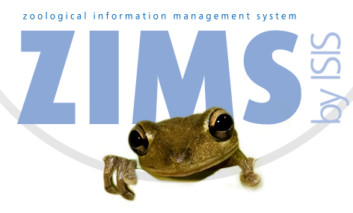
Introduction to ZIMS
An Overview of Concepts and Navigation
Notes:
Welcome to this Introduction to ZIMS. This class is targeted for those Users getting ready to deploy ZIMS. In most cases you will be migrating your data from ARKS into ZIMS. In fewer cases you may be going directly into ZIMS without any migrated data having previously used non-Species360 software to help manage your animals.

Slide 2
ZIMS Updates!
This PowerPoint is up-to-date as of: November 12th 2018
ZIMS is developed in an “agile” method
This means that it is updated every two weeks, sometimes with additional releases in between!
Use the link below to see if there have been any updates to this topic since the date above:
http://training.species360.org/updates/

Slide 3
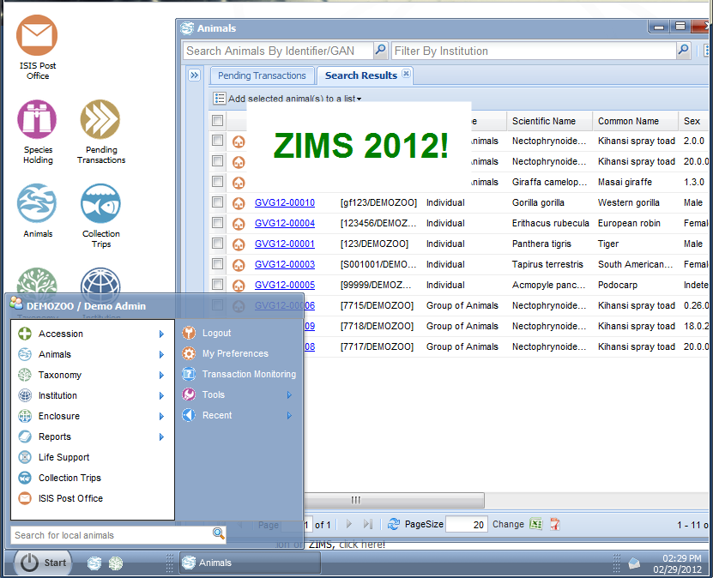
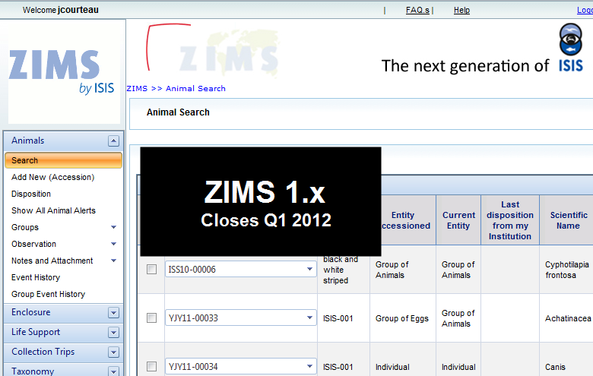
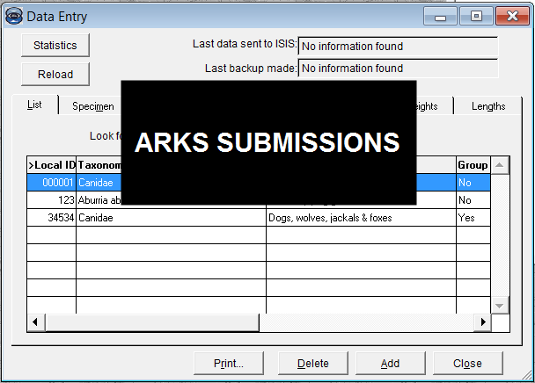
And your data is there!
Notes:
Speaking of migration, you may have heard that Users of the initial release of ZIMS were missing animals in the migration process. This is because that application had very strict Business Rules that allowed only perfect data to migrate. The current application has relaxed those Business Rules so that all records get migrated. If it is not perfect then a conflict is shown. So all your ARKS data will be there. And for those that migrated from the initial ZIMS application to the current ZIMS, all their data is there.

Slide 4
Concept 1 – Internet based
Access anywhere
Automatic updates
Instant view
Notes:
ZIMS was created using 6 basic concepts. The first concept is that it is internet based. ARKS was local and had to be installed on computers or a network. You could only work in it if the computer you were using had ARKS installed. ZIMS can be accessed from any computer that has internet access. Updates are automatic. In ARKS Users were charged with performing their own updates, so everyone was not always using the same version. ZIMS updates are automatic. Species360 will provide an overview of what bugs and enhancements are in the update. Users do not have to do anything and all are using the same build. ARKS data had to be submitted in order for it to be seen globally. In ZIMS there is no submission, the global database is updated immediately. In ZIMS as soon as information is saved, other institutions can view it instantly.

Slide 5
Concept 2 – Single Accession and Single Record
Single Accession into ZIMS – one global record
Global Accession Number (GAN)
Assigned by the application
Local Accession Number
Assigned by you
Mandatory (MedARKS and SPARKS support)
Notes:
The second concept is that an animal or group is accessioned into ZIMS only once. As it moves from institution to institution Visits are created in the global record, there are no additional accessions that need to be linked.
>When the initial accession is saved, the application assigns a Global Accession Number. This is like a social security number and will never change no matter how many times the animal may be transferred between institutions.
>With each Visit a Local Accession Number is still required to help support MedARKS and SPARKS. This Local ID is assigned by each institution.

Slide 6
Concept 3 – Business Rules
Ensure logical processes
Cannot hatch a dispositioned
egg
Developed by Programmers
and Subject Matter Experts
Our Perfect World is not Perfect
Notes:
As mentioned earlier, ZIMS operates following Business Rules to make sure the User doesn’t do anything that is illogical. For example if you have dispositioned an egg such as discarding it, then you cannot record a hatch.
>These Rules were developed by the programmers to ensure the application functioned technically logically and by Subject Matter Experts to ensure the animal data was logical
>We found that our perfect world anticipated with the initial release of ZIMS is not perfect after all

Slide 7
Concept 4 – Data Standards
What is a Data Standard?
Pre-filled lists you can select from
Avoids confusion of free text fields
Developed by Subject Matter Experts
support@Species360.org
Screen Title
Field name
Term and Definition
Frequency of Use
Notes:
Another concept was to avoid the confusion of free text fields as much as possible. Using free text means I can enter the same information differently than others are entering it. This makes searching difficult as it is all different. Data Standards are pre-filled lists which Users select from, meaning that I am using the same terms that you are. These lists were developed by Subject Matter Experts.

Slide 8
Concept 5 – Institution Management
Goes beyond animal collection
Permits
Transponders
Collection Trips
Enclosures
Dimensions, barriers, substrates
Maintenance
Water quality and environmental measurements
Staff
Teams and Departments
ZIMS Roles
Notes:
ZIMS goes beyond just helping you manage your animal collection. There is additional animal-related functionality such as managing your Permits and Transponder Inventory and creating Collection Trips.
>It also helps you manage your enclosures with the ability to record dimensions, barriers and substrates, keep track of maintenance and record environmental and water quality measurements.
>In additional it helps manage your staff and create teams and departments as well as ZIMS Roles.

Slide 9
Concept 6 – Role Based Access
Roles Assigned by Local Administrator
Species360 Template Roles – not editable
Custom roles - editable
Role Trimming
Your Role determines what screen access you have
Search/View, Edit, Add, Remove
Notes:
These ZIMS Roles are the final concept driving ZIMS. These Roles are assigned by your Local Administrator. They can select Species360 Template Roles, which are not editable, or create Custom Roles which are editable.
>These Roles will determine what screen access is available to the Users assigned them. For example, if the Role you are assigned does not have access to add a new enclosure, you will not even see that action.
>Access is provided in four levels – the ability to Search and View, the ability to Edit, to Add or to Remove.

Slide 10
The 6 Concepts of ZIMS
Internet Based
Single Record
Logical
Standardized
Entire Institution
Role Based Access
Notes:
Those are the six concepts driving ZIMS. Read Slide.

Slide 11
My Information is Different – What Shows?
Notes:
As mentioned, ZIMS now allows all of your data in, regardless of how perfect it is. So you may have information that is different from another institution. How this information is displayed depends on if you are looking at a Local view, that is an animal you either physically held or had ownership of, or a Global view of an animal that has never been under your management.

Slide 12
Taxonomy
Local View
Most updated Taxonomy at your Institution
Preferred Synonym
Global View
First Reporting Institution
Subsequent holders selecting DNA/RNA Genetic Analysis
Notes:
For Taxonomy the Local view displays the most recent taxonomy that you have recorded. In addition, if you have created a synonym and marked it as preferred that will be displayed. So if Species360 calls it a puma, but you call it a cougar, you can create a synonym of cougar and that would show locally.
>In the Global view the taxonomy is shown as per the first reporting institution. If a subsequent holder changes the taxonomy the Global view will only change if the initial recording institution changes it. However, if a subsequent holder selects DNR/RNA Genetic Analysis as the Method for Taxon Determination, then the Global view will default to that taxonomy

Slide 13
Sex
Local View
What you recorded
Global View
Per current/last holder
Notes:
For Sex, the Local view will show whatever you have recorded.
>The Global view will display what the current or last holder entered. This is because as the animal gets older, it is usually easier to determine the sex and the first record may be incorrect.

Slide 14
Birth Date
Local View
What you recorded
Global View
First reporting institution
Notes:
The Birth Date for Local view will be whatever you have recorded.
>However, Globally the first reporting institution wins out and that is what will be displayed. Whoever was closest to the Birth probably has the most accurate information.

Slide 15
Other Conflicts?
All Information Shown
Conflicts in Red
Notes:
Any conflicts will show in red in the record, allowing you to try to get consensus with the other facilities. As mentioned, everything is accepted, regardless of conflicts.

Slide 16
Why Yes, you CAN edit that!
If you entered it, you can Edit/Remove it
If entered by another facility, you cannot
Oops! moments – Undo options
Notes:
Because the animal or group record is one single global record, there are Rules as to what you can edit and what you cannot. In general, if it is data that your institution entered, it can be edited or removed by your institution. If the information was entered by another facility, you cannot edit or remove it. ZIMS also has built in many fast fixes for those Oops! moments that you may have during data entry. For almost all the screens, once you have saved the entry, you have 30 seconds to say Oops! that was wrong and Undo the entry. An example would be if you entered a record into the wrong animal or added an incorrect identifier.

Slide 17
To help you:
For information about training:
training.Species360.org
To play in ZIMS
http://training.Species360.org (WBT Option)
To submit Bugs or Future Enhancements
support@Species360.org
Questions on training
memberservices@Species360.org
Notes:
The following are some addresses and links to help you out. Read slide.

Slide 18
Into the Application!
Navigation
Multi-tasking
Multiple Windows
Multiple Tabs
Searching options
Enclosure Functionality
Creating Roles
Notes:
That’s a brief overview of the concepts driving ZIMS. We’ll get right into the application and look at some navigation. ZIMS allows multi-tasking through multiple windows and tabs. We’ll look at search options, some enclosure functionality and end with creating Roles.

