Slide 1
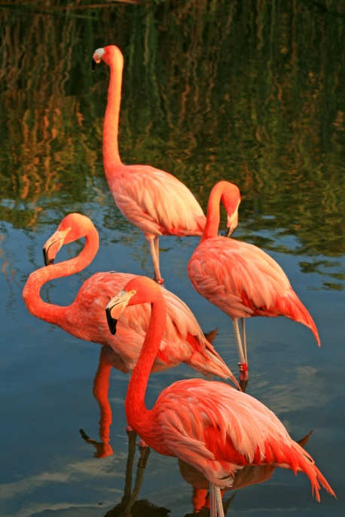
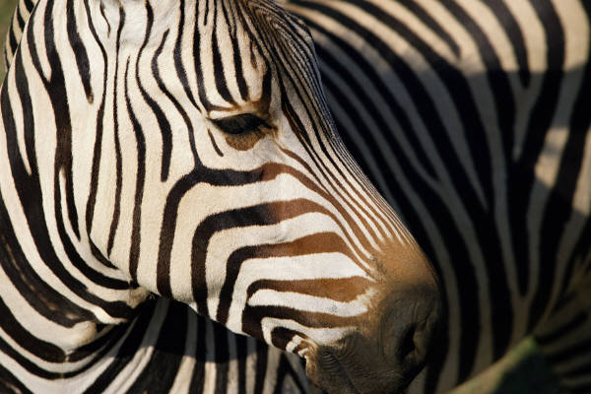
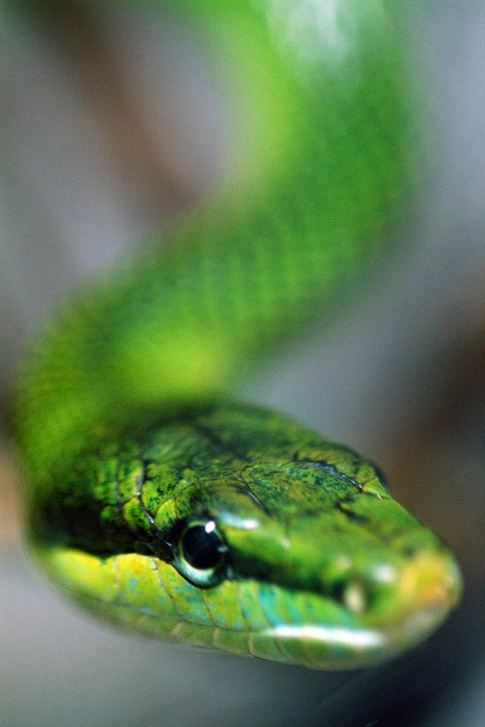
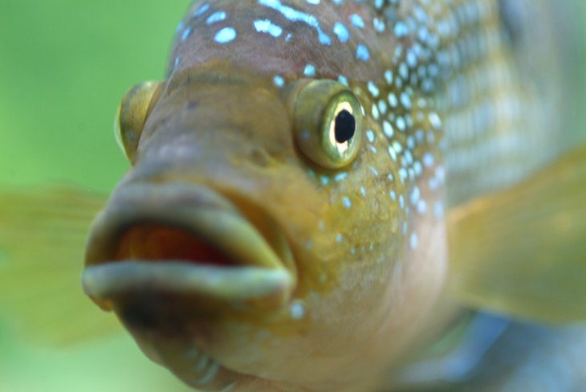
Species Holdings
Where is Everybody?
Notes:
Species Holdings allows Users to search by taxonomy and find what institutions holds the species. In addition, each individual is a hyperlink into its record as a global view. This allows you to find out more information about a particular individual or group.

Slide 2
ZIMS Updates!
This PowerPoint is up-to-date as of: November 12th 2018
ZIMS is developed in an “agile” method
This means that it is updated every two weeks, sometimes with additional releases in between!
Use the link below to see if there have been any updates to this topic since the date above:
http://training.species360.org/updates/

Slide 3
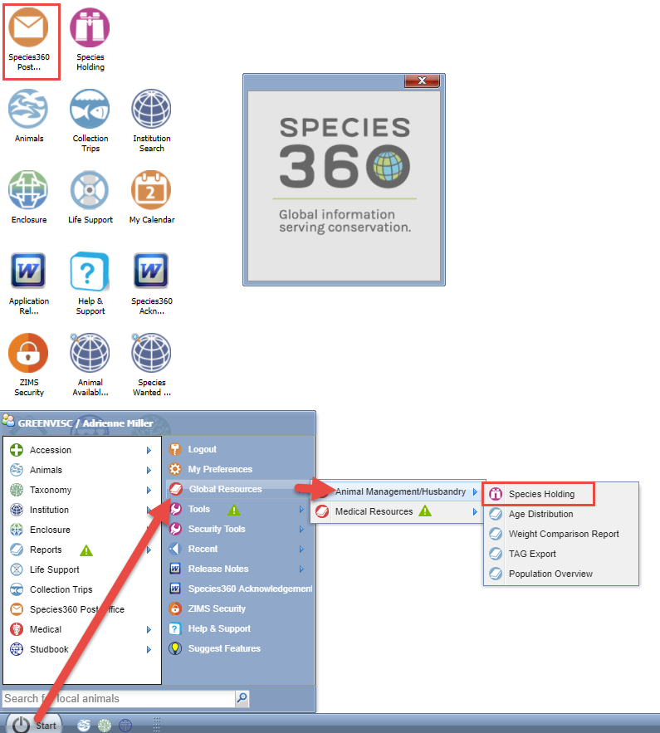
Navigation
Can be found as a
desktop icon
or
under the Start Menu

Slide 4
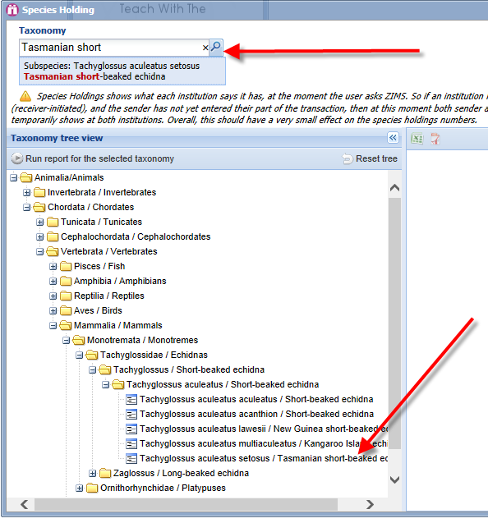
Selecting Taxonomy
Notes:
You can select your taxonomy by typing either common name or scientific name into the text box. You can also select the species by expanding the tree using the “+” box until you reach the species you want.

Slide 5
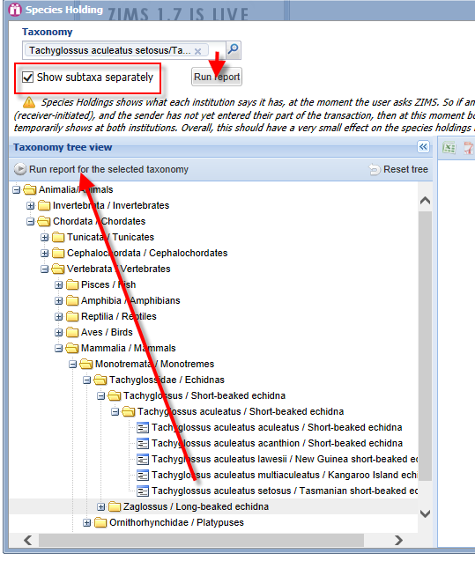
Running the Report
Notes:
If you type the taxonomy into the field you will select the Run Report Option underneath it. Checking the “Show subtaxa separately (checked by default) will bring up a report with the subtaxa shown separately. If it is not checked then the results will be lumped together under the higher taxonomic name.
If you use the tree to select the taxonomy then you will run the report by selecting Run Report for the Selected Taxonomy above the tree.

Slide 6
Understanding the Count
Species Holdings shows what each institution says it has, at the moment the User asks ZIMS. So if an institution has reported acquiring an animal from another Species360 member and the sender has not yet entered their part of the transaction, then at this moment both sender and receiver say they have an animal, so it temporarily shows at both institutions. In the reverse, if an institution has reported sending an animal but the receiver has not yet confirmed acquiring it, the animal will not be displayed at either facility. Overall, these animals in transit have a very small effect on the species holdings numbers.

Slide 7
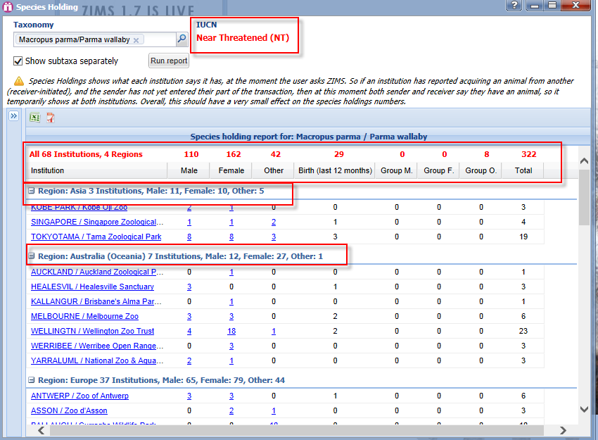
The Display
Notes:
Once you run the report the banner displays the IUCN status of the species. Parma wallabies are Near Threatened. The top line in the results grid displays the number of institutions holding the species and the number of regions involved. 68 institutions in 4 regions hold parmas. It then displays the total count by sex, the number of births in the last 12 months, and the number held as groups. The regions are then broken down by institution and count. The institution is a hyperlink to their institution page. The animal numbers are also hyperlinks to the animal records.

Slide 8
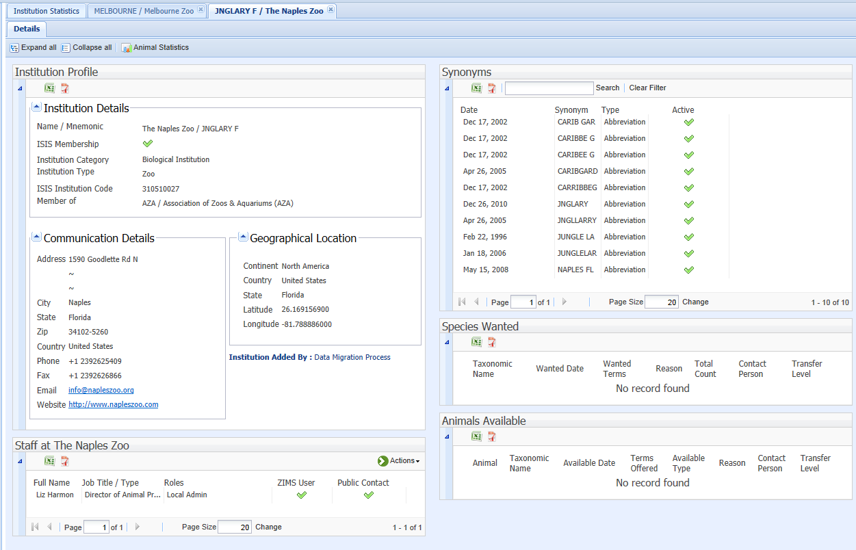
Institution
Notes:
Here we have selected the hyperlink to the Naples Zoo. We can get their address, phone and fax number, emails and website right from their ZIMS record if they have recorded it. We encourage institutions to complete their communication details for others to find. In addition, if they have marked staff members as visible outside their facility, ie public contact, we can also see a list of them. There have been many synonyms for this institution over time. Searching by any of these synonyms will point you back to this record. They have not recorded any Animals Available or Species Wanted. We will cover the last 2 topics in a later session.

Slide 9
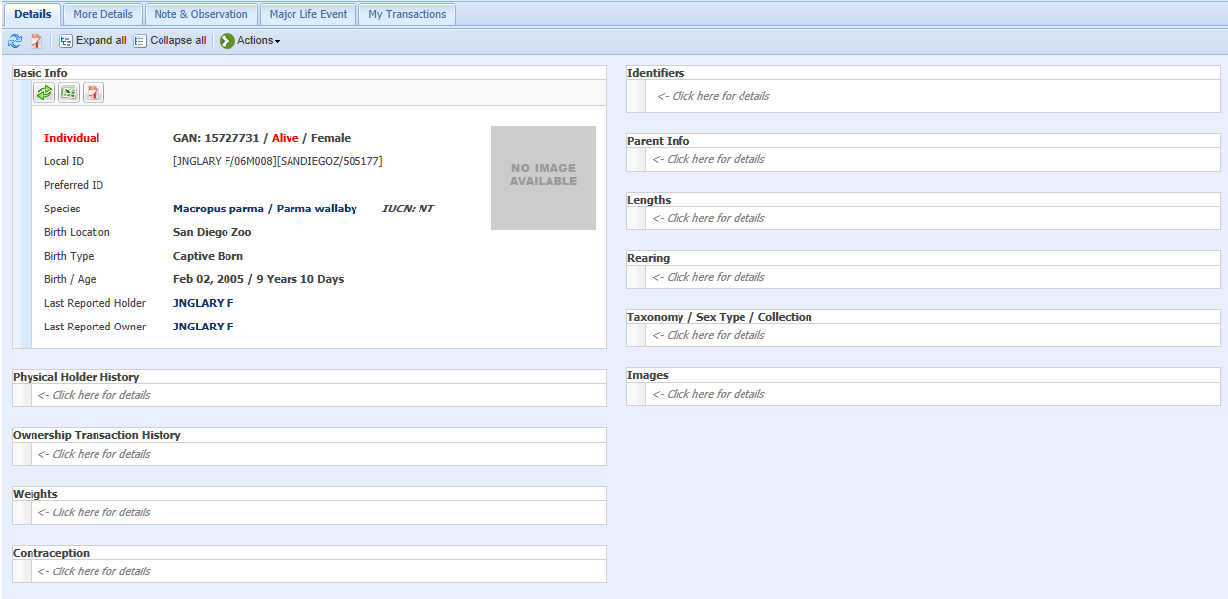
Animal Records
Notes:
Selecting the number indicated in the Species Holding grid will bring up a results grid for those animals. We have selected the 5 females held at the Naples Zoo. We selected the first animal record by clicking on the hyperlink. These records will display in the global view as we are looking at records from a facility that is not ours. A blue background in the record lets you know that it is a global view. In a global view not all details are displayed. The enclosure the animal is occupying, who is responsible for it and what collection it is in do not display. In addition, a limited number of notes are displayed.

Slide 10
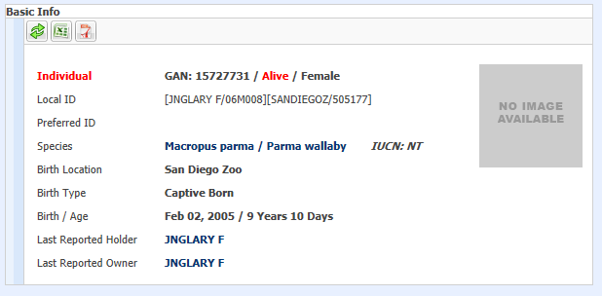
Basic Info
Notes:
The Basic Info grid provides some minimum basic information regarding the animal. It displays the entity and this is an Individual animal. The other entities are Group of Animals, or a number of animals managed as one record. Animals in a group record are not usually individually identifiable. The others are Egg, Group of Eggs, Egg Mass and Fetus. The GAN is a unique number assigned by the ZIMS application and is never repeated. The status of this animal is Alive. Other statuses are Dead, Lost to Follow Up and Closed Out. Lost to Follow Up is used when an animal is transferred to a non-Species360 member institution and we have lost the ability to gather data on it. Closed Out is used for group records when they are no longer active. And the sex is displayed. The various Local IDs are shown. Local IDs are assigned by each facility that owns or holds the animal so it changes. If they had selected an identifier that was preferred that would display here. Other information is species which is a hyperlink to the taxonomy record and IUCN status. Where it was born and the birth type (captive or wild) as well as the birth date and age at the time of viewing this record are displayed. Both the Last Reported Holder and the Last Reported Owner are hyperlinks to the institution record.

Slide 11
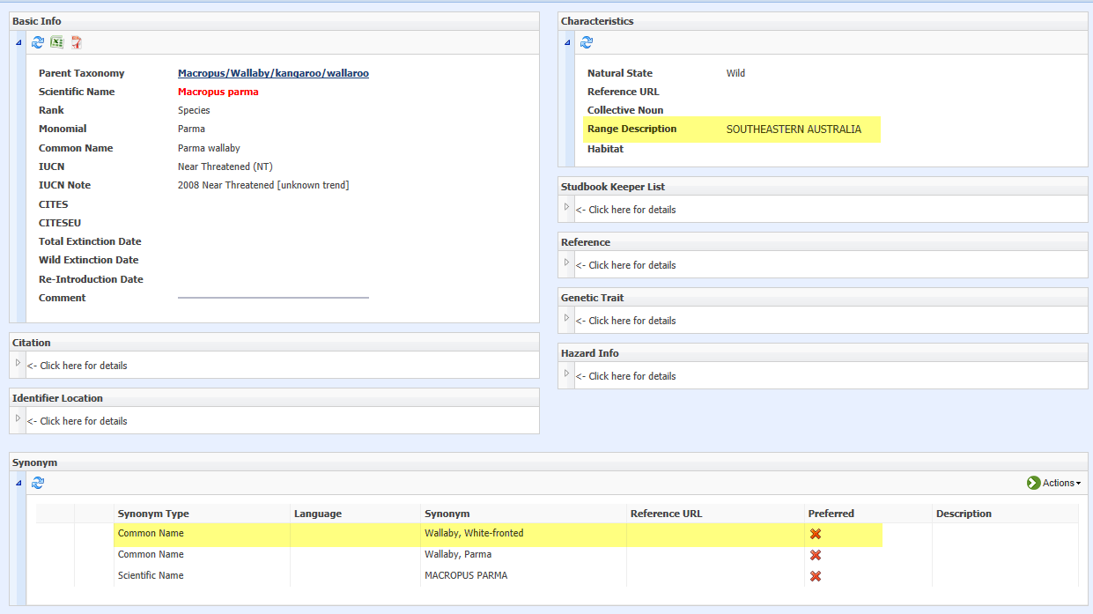
Taxonomic Information
Notes:
I selected the taxonomy hyperlink to go into the taxonomic record. Interesting information here is the range of the species. Parma wallabies are found in Southeastern Australia. And also any synonyms over the years. Previously the species had been called White-fronted wallaby. Users can actually go in and create preferred common and scientific names that will display only in their local records if they prefer names other than the Species360 recorded ones.

Slide 12
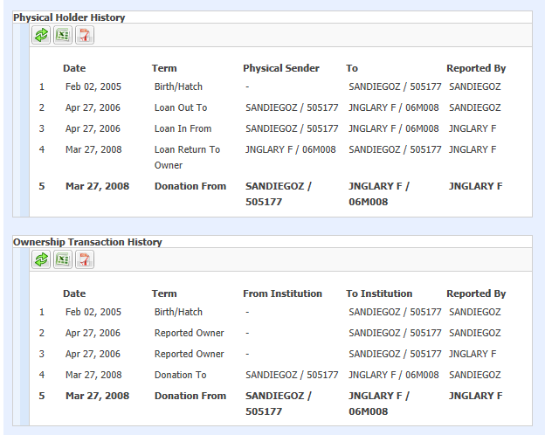
Physical Holder/Ownership Transaction History
Notes:
The next two grids display the physical location of the animal and track who had legal ownership of it. Often, these grids are identical as they are here. However they can be totally different as the animal may never have physically been at the institution that owned it. ZIMS displays what is recorded by every institution involved. In the top grid San Diego recorded a birth with themselves as the owner. San Diego then recorded a Loan Out to Naples Zoo (mnemonic JNGLARY F) and Naples Zoo recorded a Loan In From San Diego on the same day. San Diego then Donated the animal to Naples Zoo and you can see the Ownership change in the bottom grid. Any conflicts of information will display in red.

Slide 13
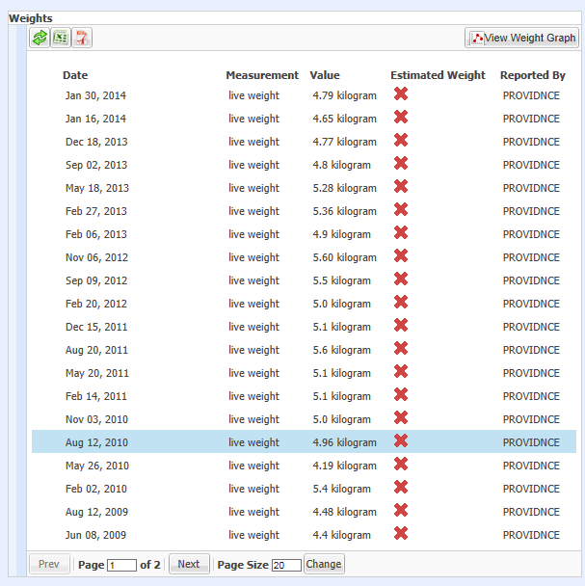
Weights
Notes:
Any recorded weights are shown. These are all actual weights as the Estimated Weight column has a red “X”. There would be a green check if the weight was estimated. Who recorded the weight is also indicated. All these weights were recorded at Roger Williams Park Zoo in Providence, RI. I went into a different wallaby record to pull one with many weights recorded.

Slide 14
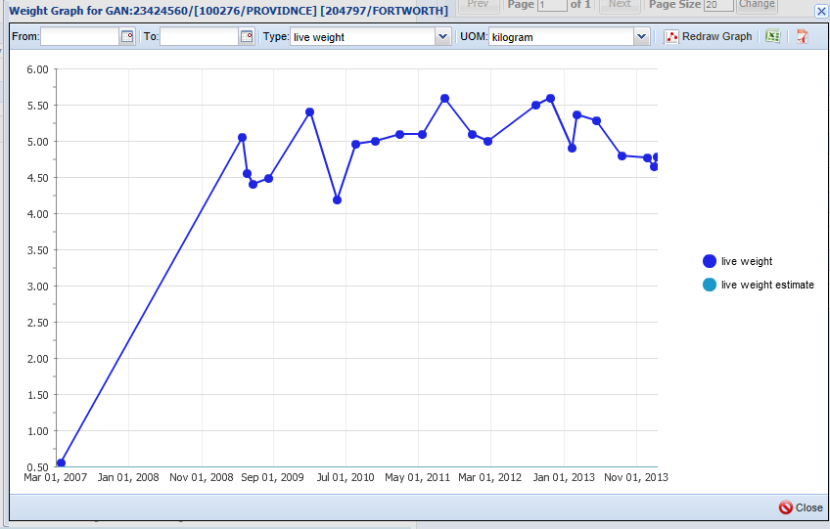
Weight Graph
Notes:
You can also graph these weights by selecting the View Weight Graph button. We recommend that Users often look at these weight graphs as they help identify possible data entry error such as recording the wrong unit of measure on the weight that may not be obvious in the weight grid but will pop out in a graph. The first weight on this animal was taken at a very young age. Lengths also display and can be graphed.

Slide 15
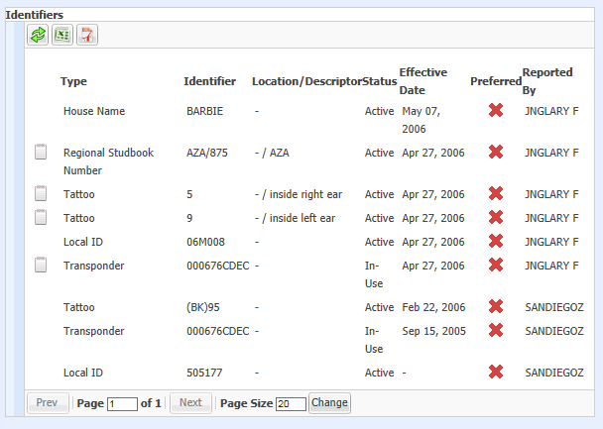
Identifiers
Notes:
The various identifiers given to the animal are displayed. The status, active or inactive, the effective date, or when the identifier was assigned or put on the animal, and what institution reported the identifier are shown.

Slide 16
Parent Info & Rearing
Notes:
Parent and Rearing Information are also shown. Sometimes there may be multiple possible parents and ZIMS can record this along with the percent possibility that it is the parent. There is only one possible Sire and one possible Dam for this animal and you can see that Naples Zoo and San Diego agrees on this record.
Rearing can also be tracked over time. This animal was only Parent Reared.

Slide 17
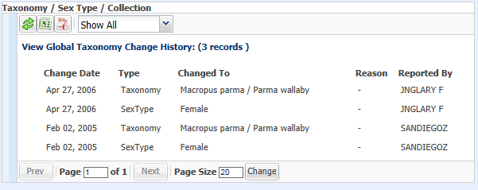
Taxonomy & Sex Type
Notes:
Both San Diego and Naples Zoo agree on the sex and taxonomy of this animal although that is not always the case. If there are conflicts they will be displayed in red. Whatever you record is what will be visible in your local record. However, if there are conflicts, we had to make a decision for what would display in a global record such as the Species Holding list. The Taxonomy is displayed as per the originator of the record. However, the sex is displayed as recorded by the last or current holder as the older animals are the easier they usually are to sex correctly.

Slide 18
Notes & Observations
Notes:
Only specific notes display in this global record. Most notes are only shown at the local level. In this record notes relating to identifiers, sexing and weights are shown.
The My Transaction tab displays no information unless this record is local to your facility as that shows transactions involving your facility only.

Slide 19
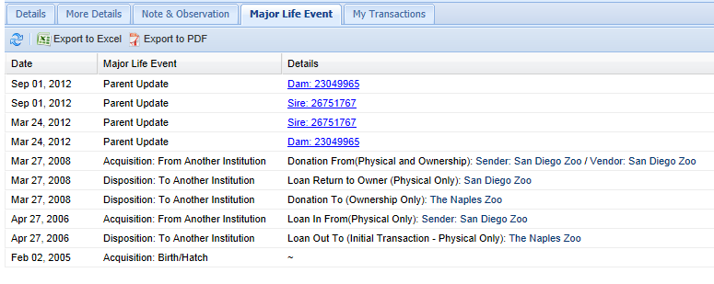
Major Life Event
Notes:
The Major Life Event tab gathers major events in the record into one place. Here the birth and the transactions involving the animal are shown, as well as when Parents are updated.

Slide 20
On Species Holdings
Any Questions?

