Slide 1

Eye On ZIMS
Your first view Into the
World of ZIMS!
Notes:
Welcome to the Introduction to ZIMS. We’ll talk about the six concepts that drive ZIMS. We’ll find out why some information looks different in the Local view than in the Global view. And then we’ll look at some basic navigation from within the application.

Slide 2
ZIMS Updates!
This PowerPoint is up-to-date as of:
November 12th 2018
ZIMS is developed in an “agile” method
This means that it is updated every two weeks, sometimes with additional releases in between!
Use the link below to see if there have been any updates to this topic since the date above:
http://training.species360.org/updates/

Slide 3
What is Eye on ZIMS?
It is your first Role before you deploy
It helps you get comfortable with ZIMS navigation
It lets you look at your (Local) and other’s (Global) animal data and how it displays in ZIMS
It allows you to run some reports
  Your animals (Local)
  Other institution’s animals (Global)

Slide 4
What Can I Do with EOZ?
View Institution Information
  Basic Details
  Staff
View My Animals
  Basic Details
  Holder and Ownership History
  Identifiers
  Parents and Rearing
Run Reports
  Local and Global Taxon
  Global Specimen
  Pedigree
View Taxonomy Information
View Species Holding
View Animals Available and Species Wanted
  Regionally and globally

Slide 5
How Do I Get Access to EOZ?
Contact Species360
  support@Species360.org
Tell Species360 that you would like an EOZ Role
  If you are already registered on the Species360 portal you can request that your User Name and Password be the same as for the portal.
  If you are not registered on the Species360 portal
  support will provide you with new ones.
Additional EOZ Users can be requested
Important!
  Your User Name cannot be changed. When
  you deploy it will be the same
  You can change your Password

Slide 6
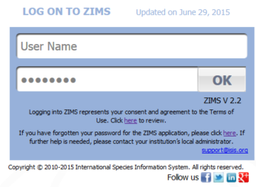
Now What?
When Species360 sends you your User Name and Password you can go into ZIMS!
Go to zims.Species360.org using the browser of your choice
Enter your User Name and Password (Passwords are case sensitive) and select OK

Slide 7
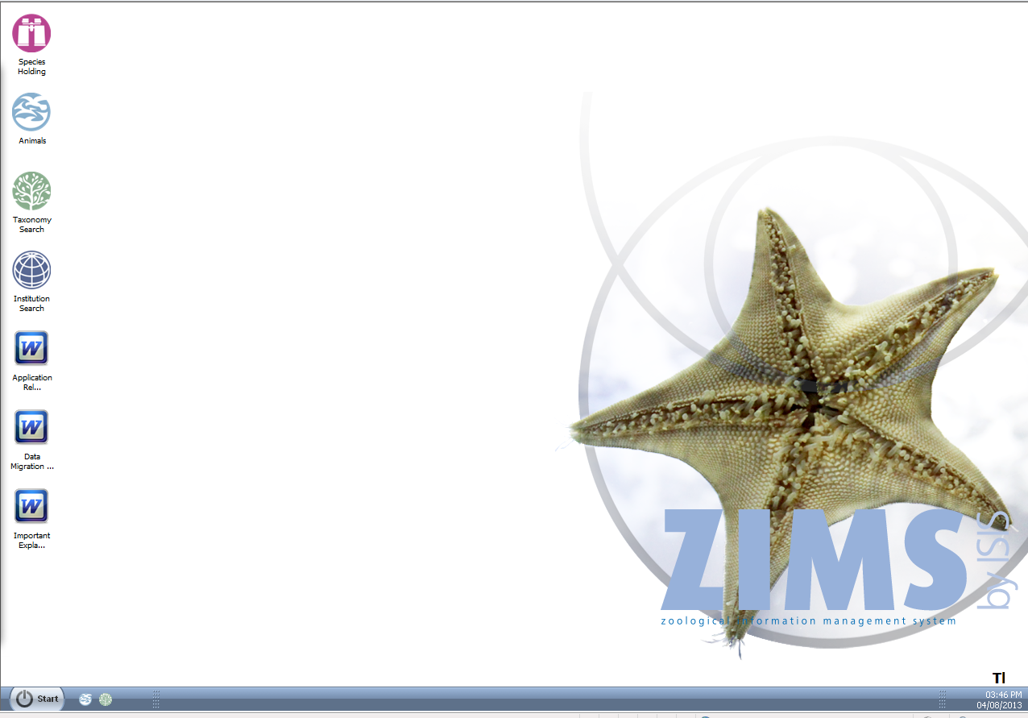
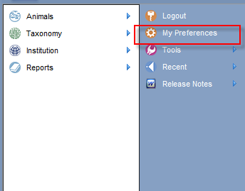
This is the desktop. You may want to change your Password. From the Start menu select My Preferences

Slide 8
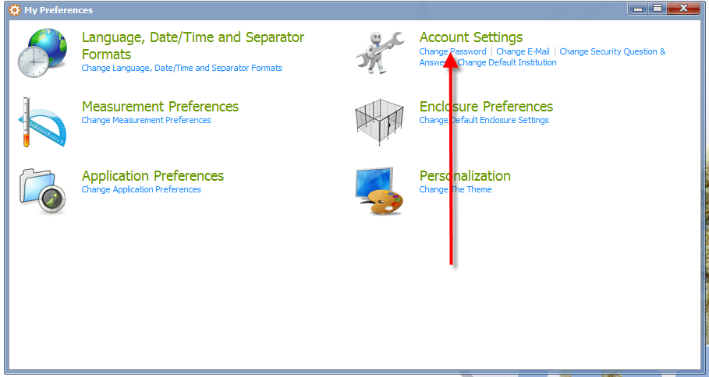
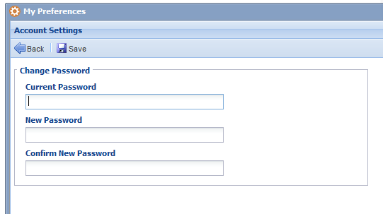
Under Account Settings select Change Password. Complete the screen and Save.

Slide 9
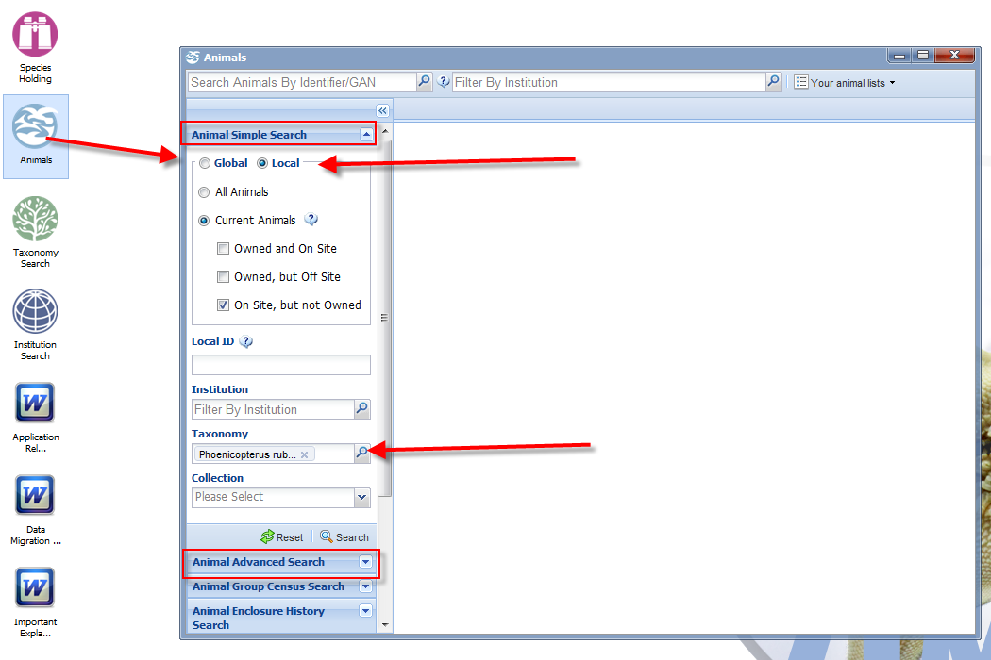
To find animals open the Animals icon. If you need more filters than shown in Simple Search open Advanced Search. For animals you have held or owned select the Local radio button.
For all other animals select the Global radio button. Here we are searching for:
Local Animals that are
On Site but Not Owned and are of the taxonomy
American Flamingo.

Slide 10
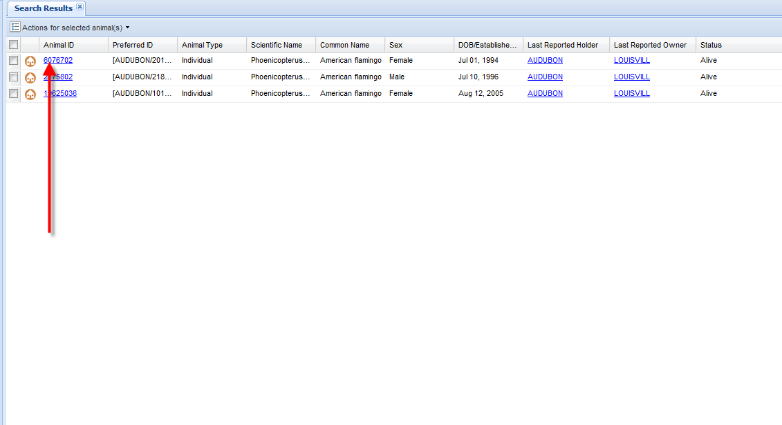
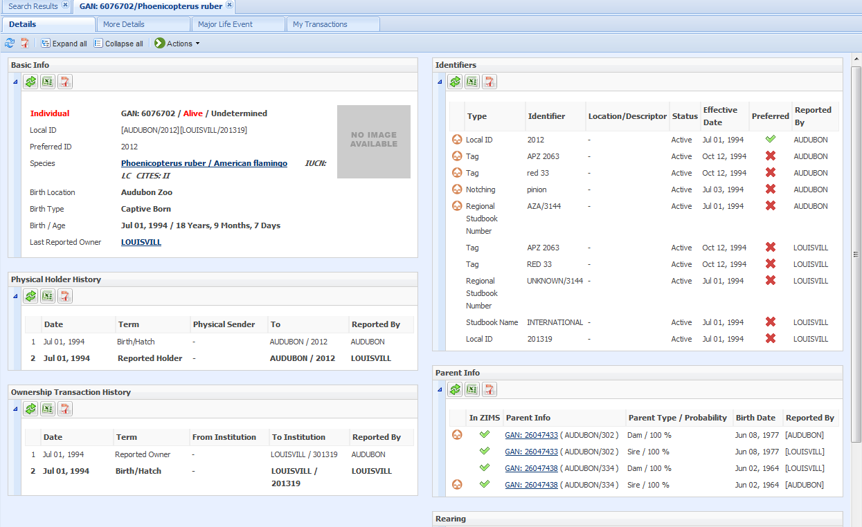
When you select the Search button a results grid will appear with animals that match your filter criteria. Selecting the hyperlink will open the animal’s record.

Slide 11
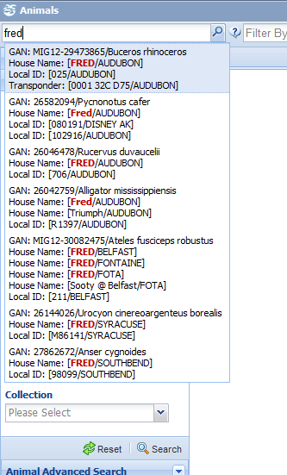
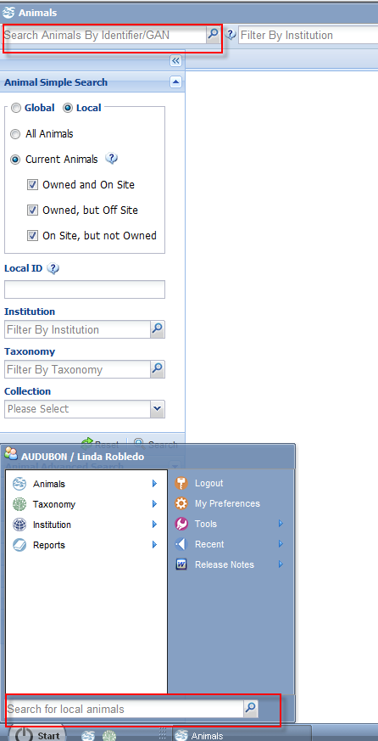
If you know the GAN or another Identifier you can search for Global animals using the Search Animals by Identifier/GAN field.
The top matches will appear and you can select from them.
Or you can search for Local animals using the Search for Local Animals Field.

Slide 12
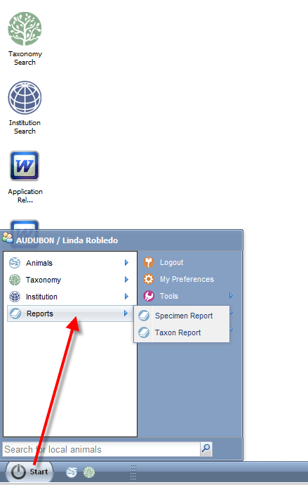
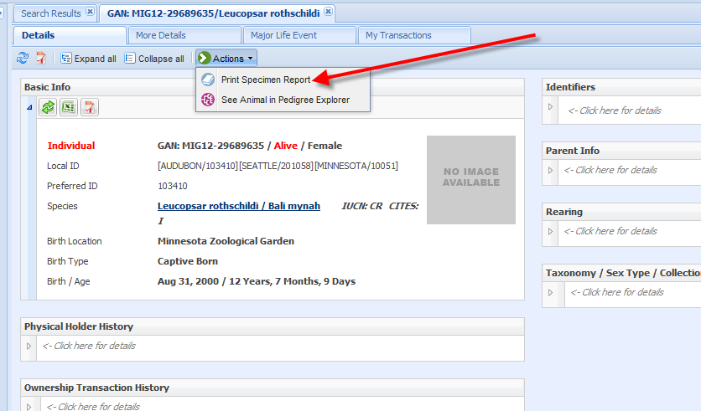
There are 2 Reports that you can run. These are found under the Start menu.
You can also run a Specimen Report from within the animal’s record using the Actions button.

Slide 13
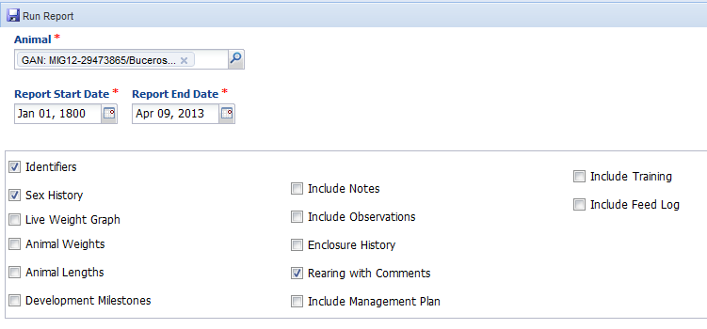
When running a Specimen Report from the Start menu you will need to enter the animal into the Animal field (use an identifier or GAN).
If running the report from within the animal record this is not required. Remember to select all the information you want to see in the report, but the EOZ Role gives you access only to core animal data.

Slide 14
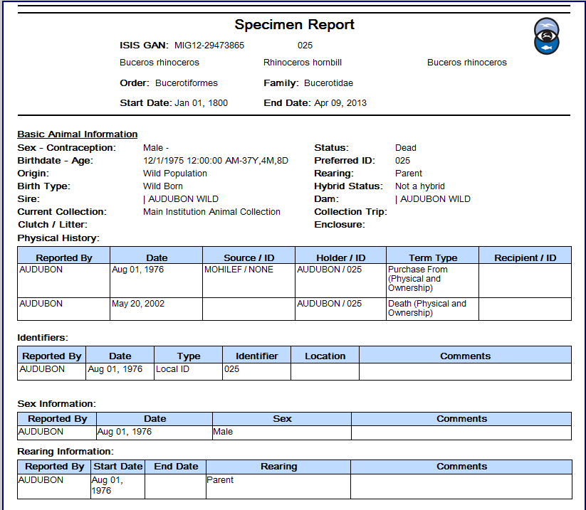
Specimen Report Output

Slide 15
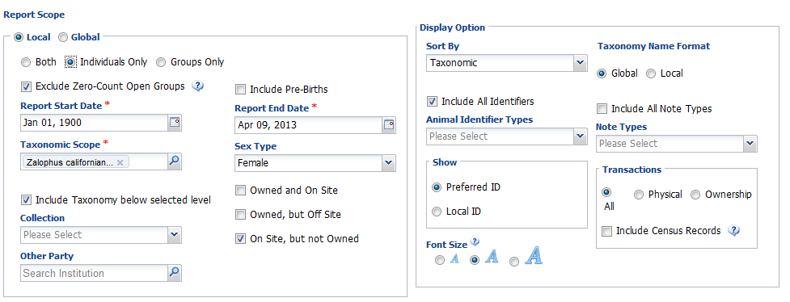
Taxon Reports show information on multiple animals of the same species. Remember to select all the filters you want.
Here we are looking for all female California sea lions that we had in on loan. (Local)

Slide 16
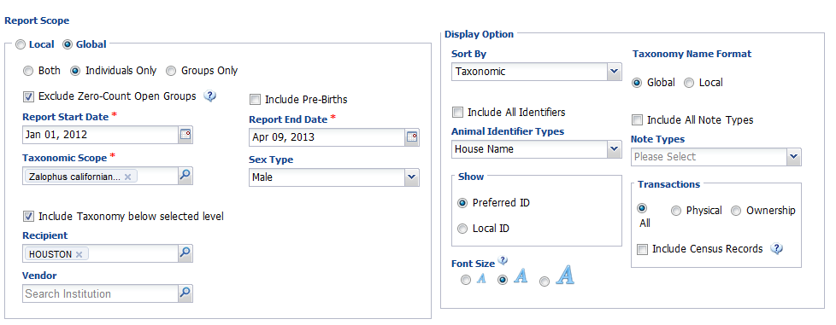
Here we are looking for all male sea lions that were held at Houston Zoo since 1 January 2012
We only want to see House Names as identifiers (GAN and Local ID display by default).

Slide 17
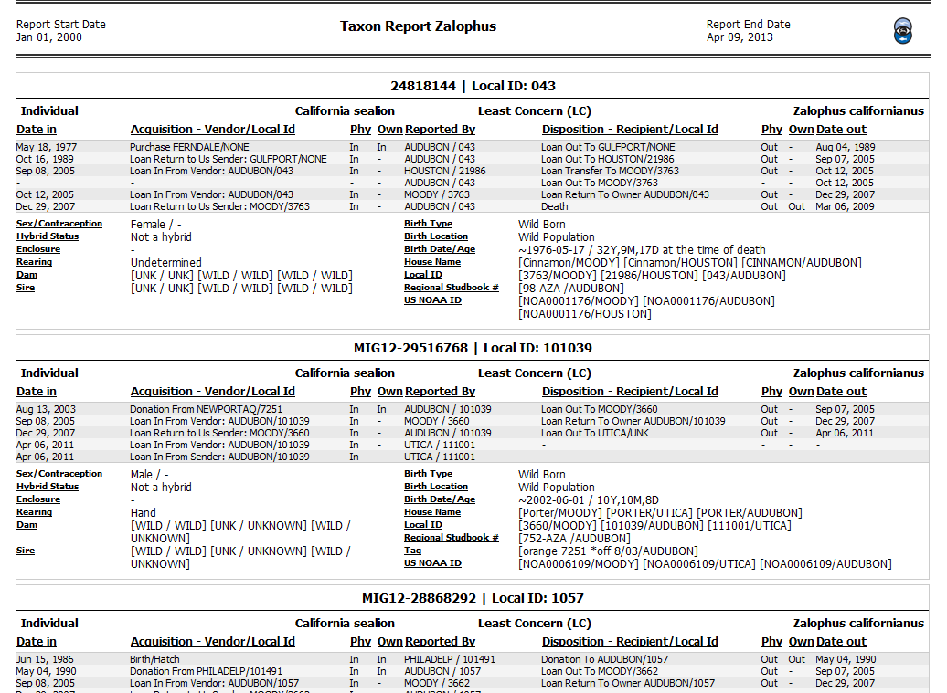
Taxon Report Output

Slide 18
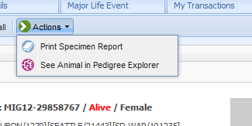
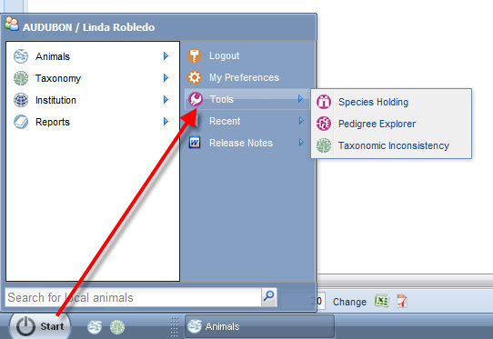
To view the Pedigree of an animal go to Start >Tools>Pedigree Explorer.
You can also view a Pedigree from within an animal’s record using the Actions button.

Slide 19
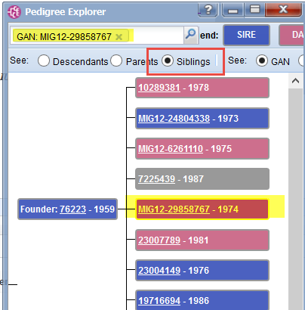
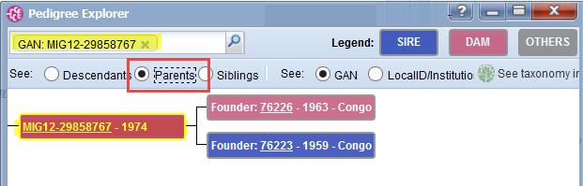
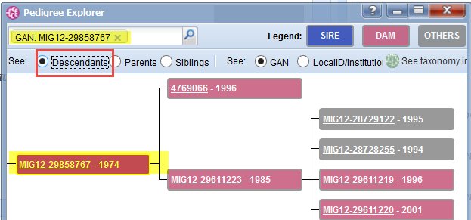
Pedigree Explorer Displays
Parents, Descendants and Siblings.

Slide 20
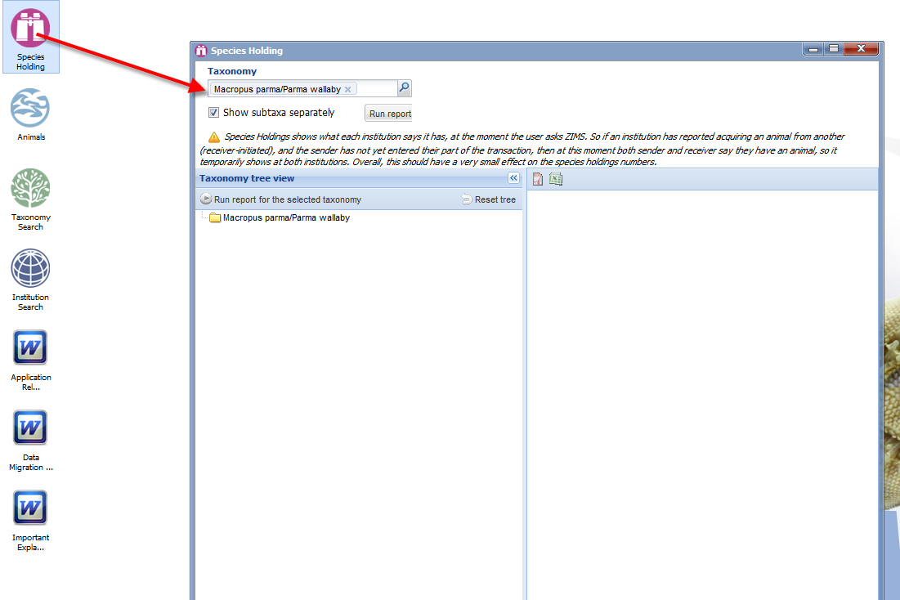
Species Holdings allows you to view where species are currently held.
Here we are looking for parma wallabies.

Slide 21
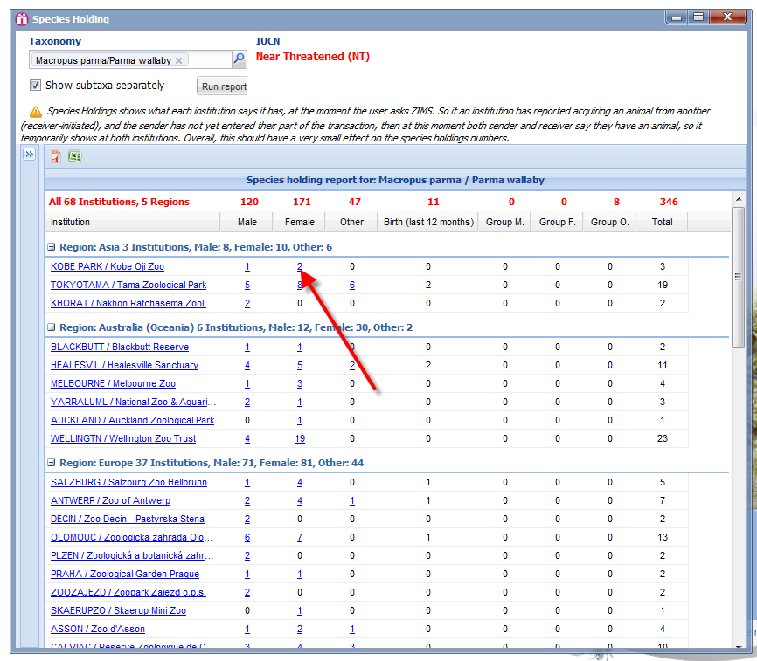
Species Holding Output
Holdings display by regions, with totals in red at the top. The numbers are hyperlinks to the records.

Slide 22
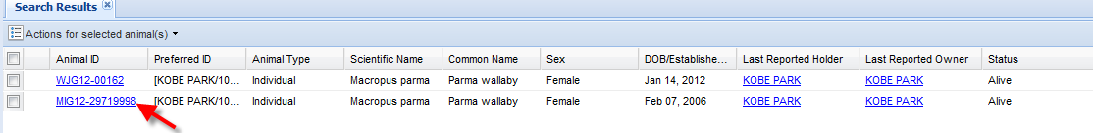
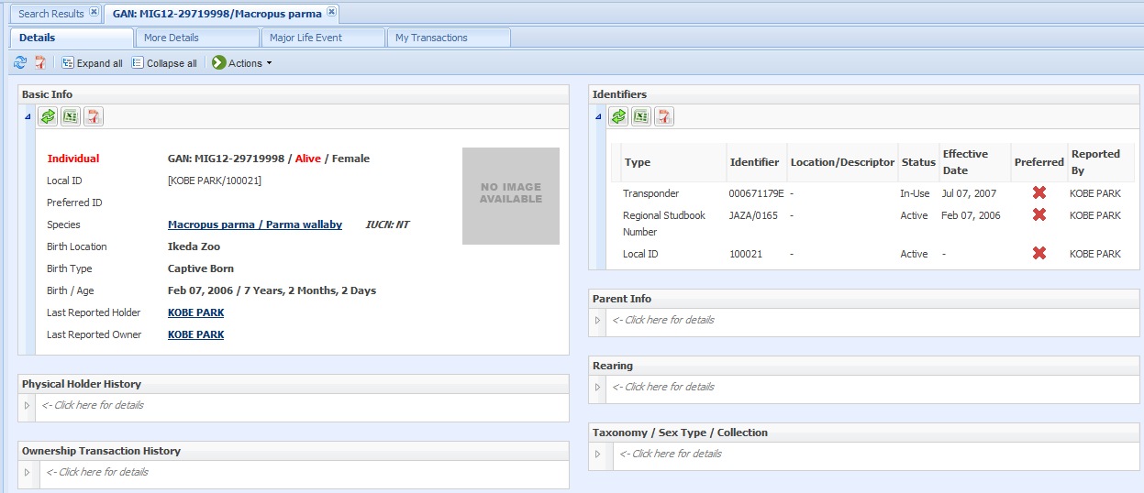
When we clicked on the 2 females at Kobe Park we got a results grid.
When we click on one of the GANS we are taken directly into the record.

Slide 23
Animals Available &
Species Wanted
For more details on this feature please download these two documents describing the purpose and use of these regional planning tools.
  Animals Available
  Species Wanted

Slide 24
If you have any questions please contact support@Species360.org

