Slide 1
Advanced Access
Management (AAM)
AAM allows you to restrict the access of Users to specific animals, taxonomies, enclosures and life supports.
AAM is giving the right people the right data at the right time, nothing more.

Slide 2
ZIMS Updates!
This PowerPoint is up-to-date as of:
October 8 2019
ZIMS is developed in an “agile” method
This means that it is updated every two weeks, sometimes with additional releases in between!
Use the link below to see if there have been any updates to this topic since the date above:
http://training.species360.org/updates/

Slide 3
How do you get the right data?
Your ZIMS Role
filtered by
Advanced Access
Management (AAM)
equals
The Right Data!
How do you get the right data?
Basically AAM takes what access
you are given by the Role you
are assigned. Then it filters
what access you are given in
Advanced Access
Management. The result is the
right access – only the data that
you need. AAM access is assigned
by Departments.

Slide 4
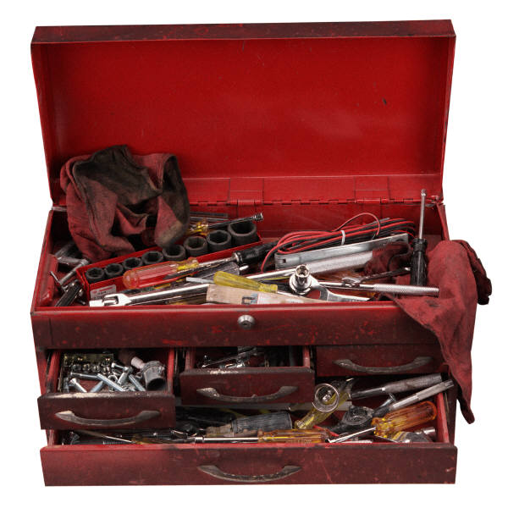
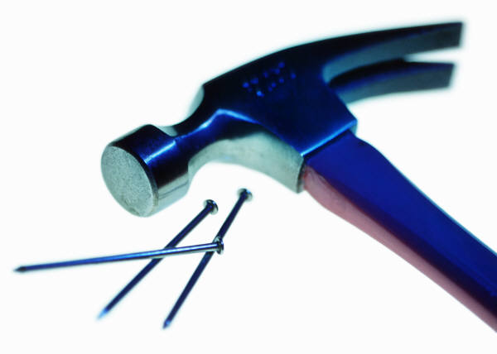
Think of it as a Toolbox
A simple way to think of it is as a toolbox. You need to hang a picture.
You could rummage through this entire toolbox for your hammer and nails.
Or, if all you were given were the tools that you needed, the hammer and nails,
your job would be much easier and quicker.

Slide 5
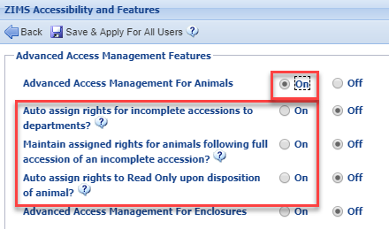
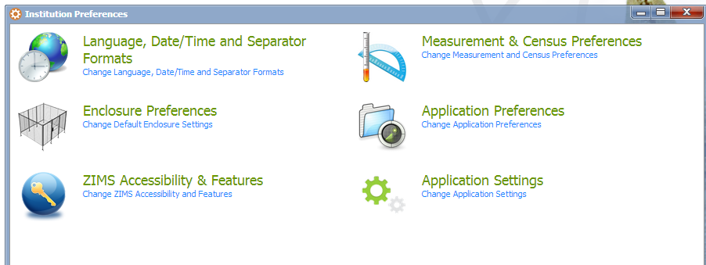
Activate using Institution Preferences
Activating AAM is a two-step process. First, the Species360 Global Admin
must turn it on for your facility. Then your Local Admin must activate it in
Institution Preferences > ZIMS Accessibility and Features. AAM can be turned
on for Animals, Enclosures and Life Support. The access to the topics in the red box are activated once access to Animals has been turned on. More an the next slide…………..

Slide 6
Additional Animal Topics
Auto assign rights for Incomplete Accessions to departments
  The ability to access Incomplete Accessions (IA)
  Automatically assigned to the Department of the IA creator
  If Incomplete Accessions-Department Rights Assignment is selected in your Role, you can also assign other Departments access to the IA
Maintain assigned rights for animals following full accession of an IA
  The Users that had rights to an IA will maintain these rights once the IA is made a full accession
Auto assign rights to Read Only upon disposition of animal
  Automatically set User rights to Read Only when the animal is dispositioned from the institution

Slide 7
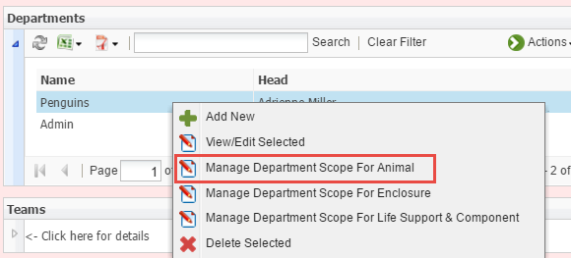
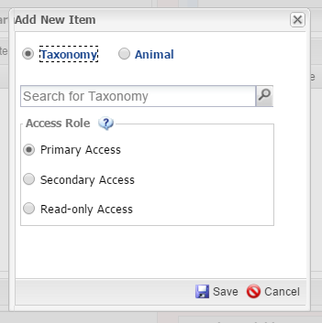
Assigning AAM Access
AAM is assigned from the
Department grid. Highlight
the Department and select
Manage Department Scope
for Animal, Enclosure or Life
Support. Selecting Enclosures
does not give access to the
occupants of the Enclosures,
it allows you to record
Enclosure information. Here
we have selected Scope for
Animals. You can select by
entire Taxonomies or by
individual Animals.

Slide 8
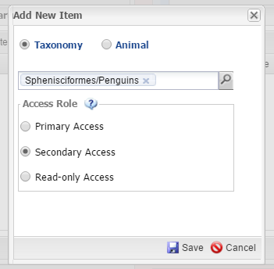
Assigning AAM Access
We are assigning AAM access to the Penguin Department so we have selected to assign by Taxonomy (Penguins) and not by individual animals. If no access is assigned, members of this department see only the Global Read Only. Primary Access gives complete access as per the ZIMS Role assignment. Secondary Access provides access to Notes, Observations and Alerts as per
the ZIMS Role assignment. Read Only Access provides the Local
Read Only access.

Slide 9
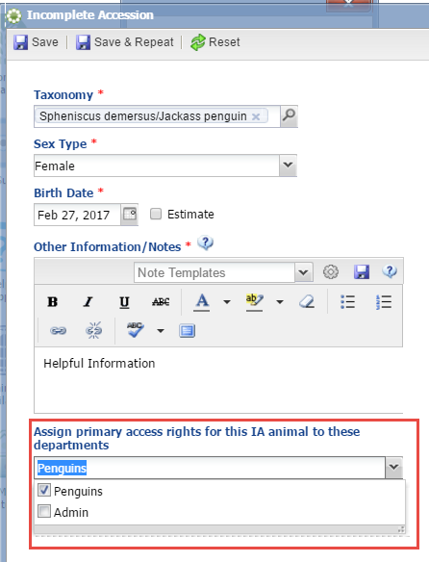
Incomplete Accessions
If your Role has been given the rights to assign IAs to other Departments (IAs are assigned to the Department of the creator of the IA), a field will display in the Incomplete Accession
screen where you can allow another Department to view the Incomplete Accession. If you have also activated the “Maintain Assigned rights for
Animals Following Full Accession of an Incomplete Accession”, the Department will continue to be able to view the record after it is fully accessioned.

Slide 10
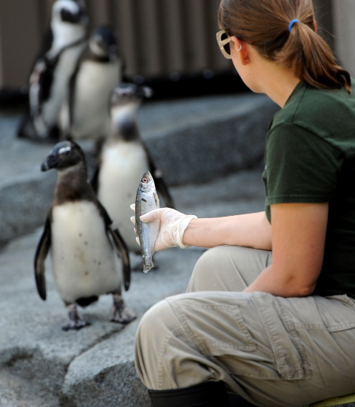
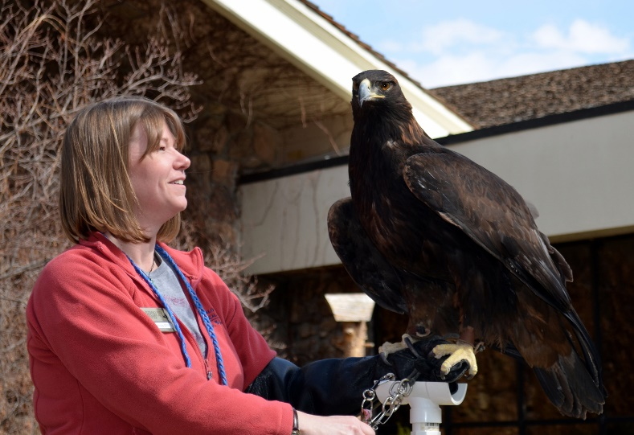
A Tale of Two Users: Different Responsibilities = Different Access
To explain how AAM works we will look
at two Users. Kendra Keeper is a penguin
keeper. She needs access to record data
only for the penguin records in ZIMS.
And she needs access to record data only
on the penguin enclosure in ZIMS.
Carrie Curator is the Bird Curator. She will
need access to all of the bird records in
ZIMS. In addition she will need access to
record data for all of the bird enclosures.

Slide 11
ZIMS Role & AAM Assignment
Kendra Keeper
  ZIMS Role
    Animals
      Add/Edit Notes & Observations, Alerts, Identifiers, Measurements
    Enclosures
      Add/Edit Barriers, Dimensions, Substrates and Measurements
  AAM Access
    Animals
      Sphenisciformes (Primary)
    Enclosures
      Penguin Exhibit (Primary)
Carrie Curator
  ZIMS Role
    Animals, Enclosures and Life Support - All Access
    Institution – some Access
    Reports – All Access
  AAM Access
    Animals
      Aves (Primary)
    Enclosures
      Bird Land (Parent for all Bird Enclosures) (Primary)
    Life Support
      AAM not turned on

Slide 12
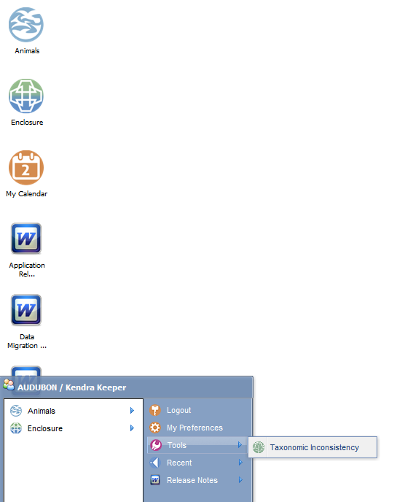
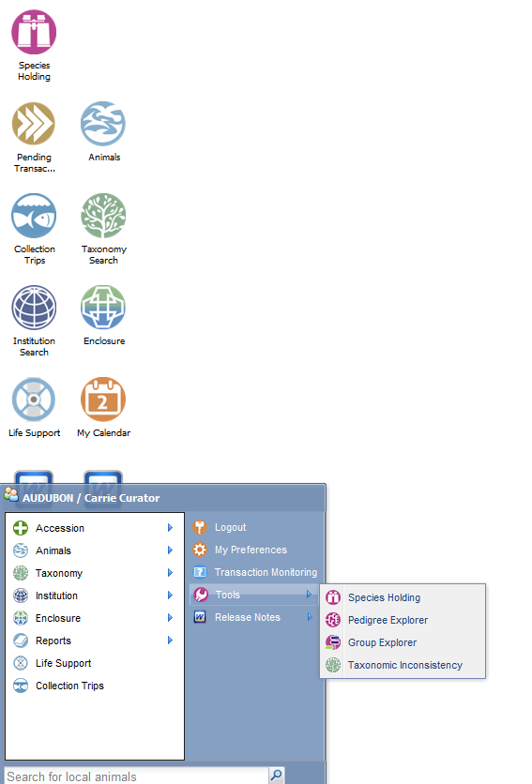
Desktop View
Kendra
Carrie
Due to their differing Role assignments their desktops will look different, and what is
available in their Start menus will vary. Kendra has access only to some of the Animal
and Enclosure topics, so that is all that appears for her. Carrie has much wider access
as you can see by the increased number of icons on her desktop and the additional
topics available under the Start menu.

Slide 13
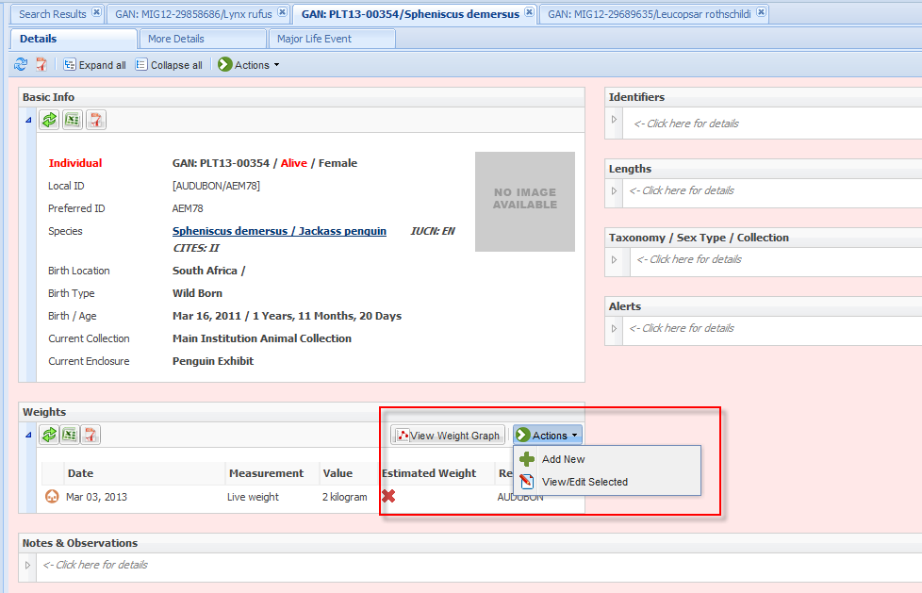
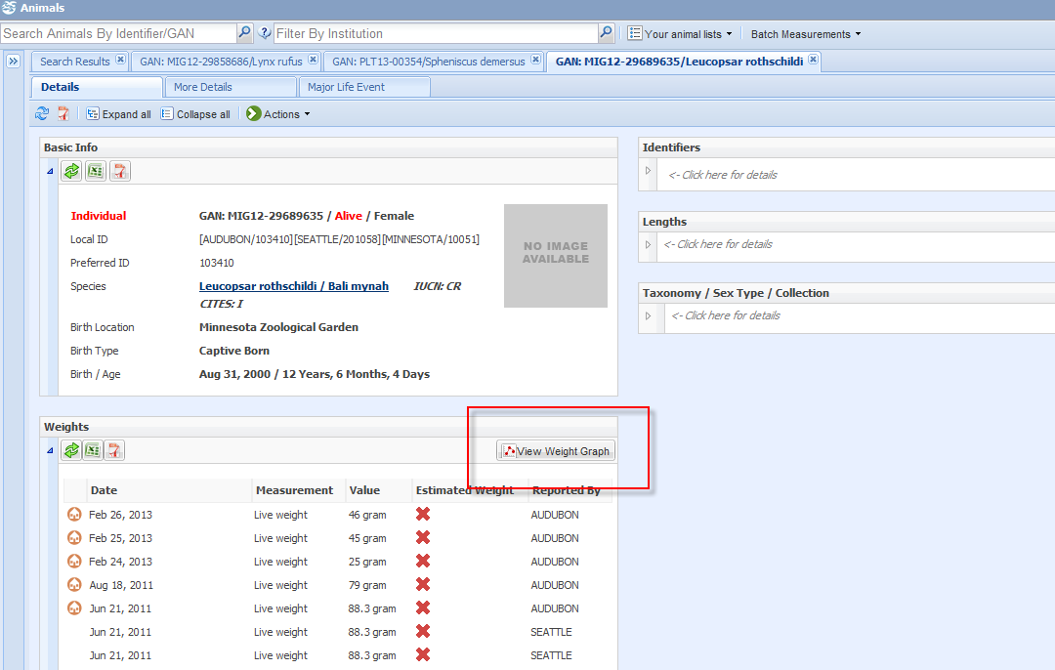
Kendra’s View (Animals)
Because Kendra has been given Primary access to the penguin records via AAM,
the background of the penguin record will be pink, indicating Local view. She has
also been given the ability to Add/Edit measurements, so these actions are available
to her. In addition, all of the topic grids can be viewed even if she does not have the
access to edit them. However, when she opens this Bali mynah record on the right
the background is blue, indicating a Global record. She was not given access to this
species in AAM so she can see only the Global view. Not all topics are available in a
Global view and you can see that the Alerts grid is not displayed here.

Slide 14
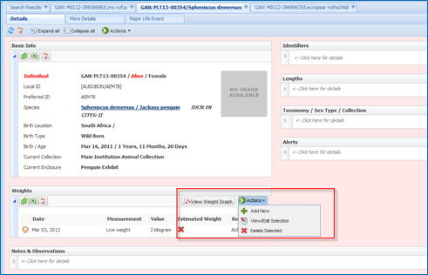
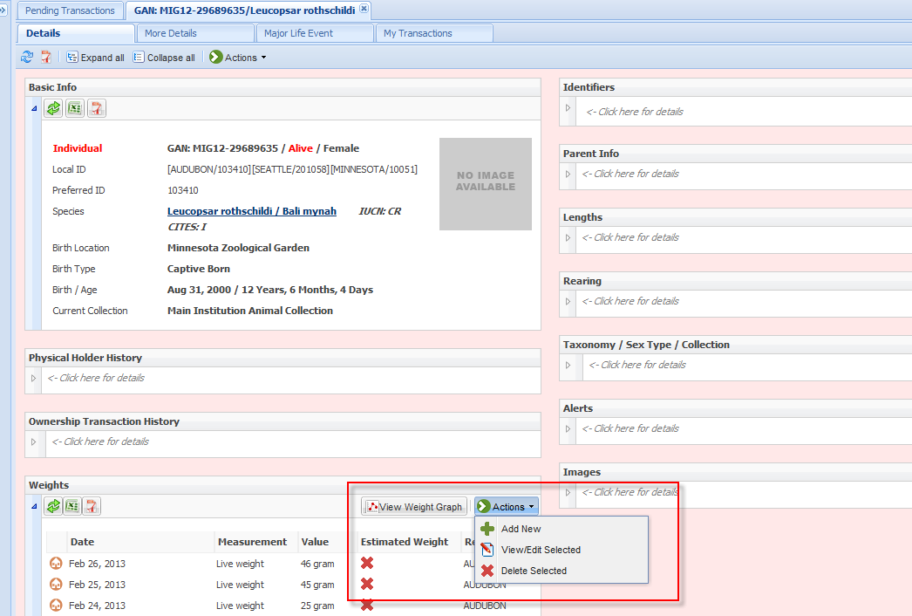
Carrie’s View (Animals)
Carrie’s view and access are different. She has access to the local penguin record as
Kendra did. But when she opens up the Bali mynah record she sees it as a Local view
because her AAM access includes all bird species.

Slide 15
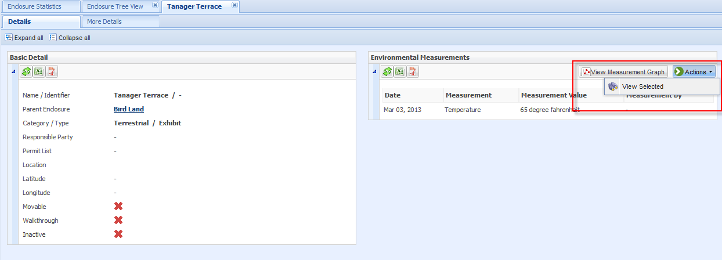
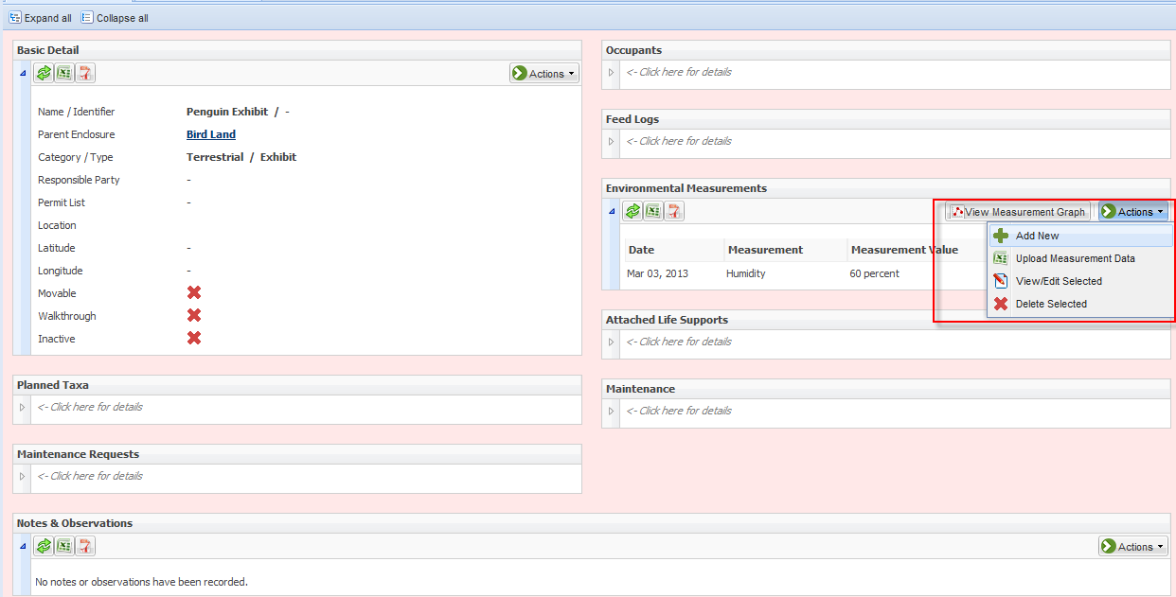
Kendra’s View (Enclosures)
For enclosures, Kendra has been given
rights only to the penguin exhibit via
AAM. If she opens the Tanager Terrace
exhibit she sees limited topics and no
ability to perform actions. But when
she opens the penguin exhibit she
sees a local view and can perform
actions as given to her by her ZIMS
Role assignment.

Slide 16
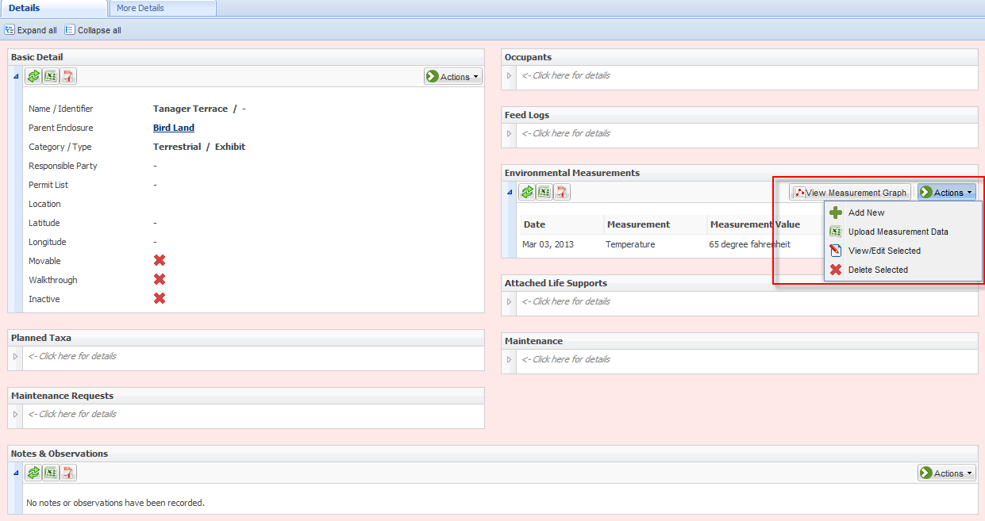
Carrie’s View (Enclosures)
Carrie has been given access to Bird Land
(the Parent enclosure for all the bird
enclosures) via her AAM assignment.
This means that she will have local access
to Bird Land and any sub, or Child,
enclosures underneath it. When she
opens up Tanager Terrace it is a Local
view and she can perform actions as
assigned per her Role. And she can do the
same with the Penguin Exhibit as that is
a child enclosure of Bird Land.

Slide 17

Advanced Access
Management
Giving the Right People
The Right Data
At the Right Time,
Nothing More

