Slide 1


ZIMS for Studbooks
User Defined Fields, Labels and Managed Groups

Slide 2
User Defined Fields vs. Labels

Slide 3
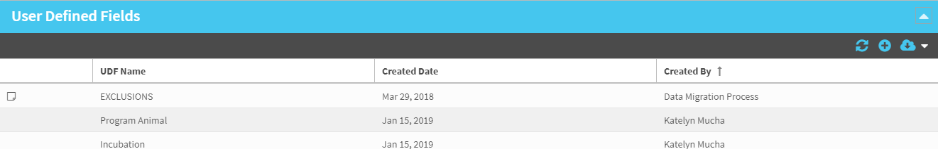
User Defined Fields (UDFs)
UDFs allow users to define as specific subset of animals for analysis.
UDFs are a legacy tool (from PopLink and SPARKS) any UDFs from those studbooks that migrated will be in ZIMS.

Slide 4
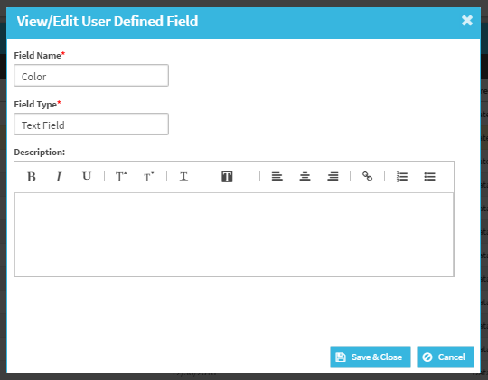
User Defined Fields – Text Field
Text Field: When user selects to add a UDF as a text field, they do not need to define terms.
  When entering a text field UDF for an animal, the user can enter any free text.
  This can cause bad data entry and is recommend only using free text UDFs when absolutely necessary (example: tracking numbers that cannot be defined)
Text Field Example:
  UDF Name = Color
  Field Type = Text Field
  No Terms or Description needed
  User will be able to enter any text in the “Color” UDF in the animal’s records
    Example: Orange, Green, Geren, Blue, Education…
    System will not check for definition

Slide 5
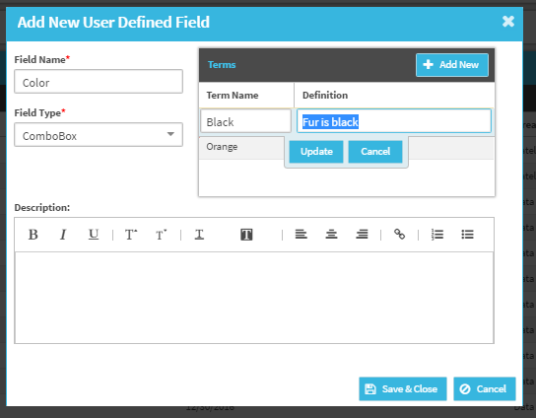
User Defined Fields – Combo Box
Text Field: When user selects to add a UDF as a text field, they do not need to define terms.
  When entering a text field UDF for an animal, the user can enter any free text.
  This can cause bad data entry and is recommend only using free text UDFs when absolutely necessary (example: tracking numbers that cannot be defined)
Text Field Example:
  UDF Name = Color
  Field Type = Text Field
  No Terms or Description needed
  User will be able to enter any text in the “Color” UDF in the animal’s records
    Example: Orange, Green, Geren, Blue, Education…
    System will not check for definition

Slide 6
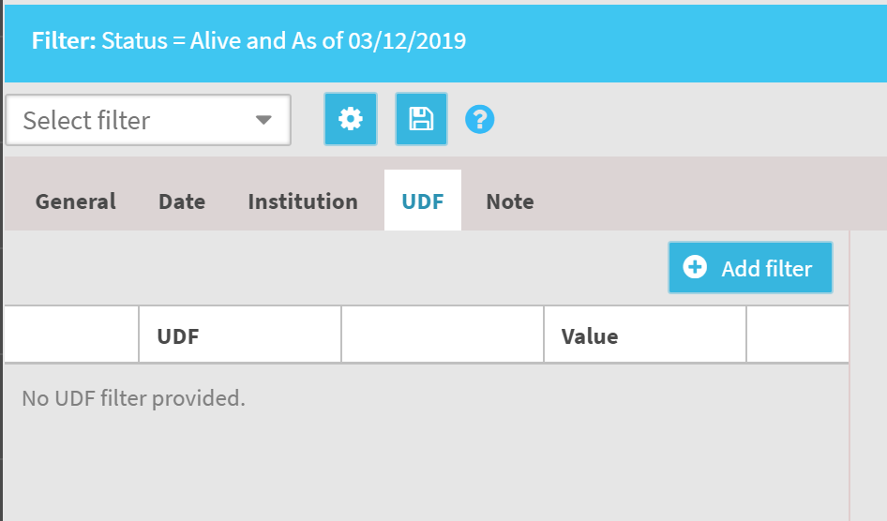
User Filters
User can apply UDF filtering to the list by selecting the Add UDF Filters button
User can select one or multiple UDF types to filter the animal list
‘and” “or” options allow user to specify and add multiple UDF filters at the same time.

Slide 7
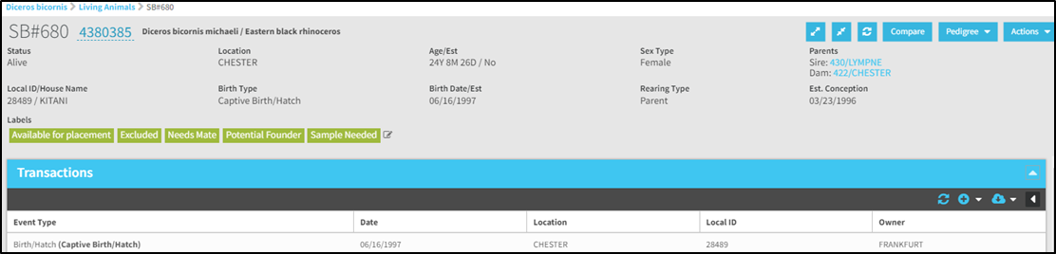
Animal Labels
Labels are tags or keywords that users can assign to animals to indicate that they possess certain characteristics or criteria.
  More flexible and informal than User Defined Fields (UDFs).
  Easier way to quickly tag an animal with a specific value.
  Way to track unique information about a single animal or multiple animals

Slide 8
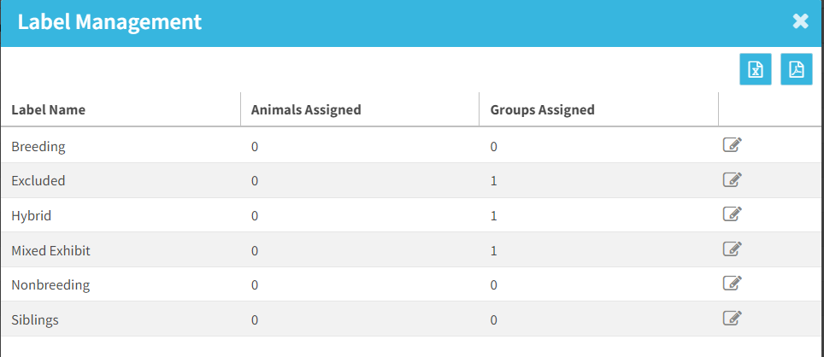
Label Creation and Management
View the Label Management screen (in the Tools menu) to:
  View list of all labels in the studbook
  View which animals/groups are assigned each label
  Edit and delete labels
  Export list of labels

Slide 9
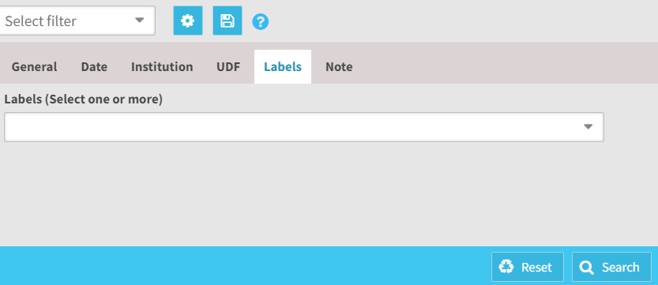
Label Filters
User can apply label filter by selecting from the label dropdown or typing text
The search is an and/or
  Example: if you enter “breeding” and “available” the results will bring back animals with either one of those labels.

Slide 10
Label Examples
Exclusions
Reason for exclusion from breeding population • Pedigree investigation needed
Animals in need of placement
Animals in need of mate
Animals available for placement
Release candidate
Animals with behavioral considerations
Animals pending transfer
Track mates (Mate of SB ID)
Genetically valuable
Potential founders
Studbooks with multiple users entering data could label animals to communicate to the other editors.
Animals that need genetic testing or have had genetic testing completed
Sample collection needed
Animals used in education programs
AI candidates / animals born through AI, etc.
Outside of managed program
Surplus
Ownership
Color morphs
Medical considerations
Aggressive animals
Indicate which animals are the alphas within group
Hybrid, generic, unknown taxonomy

Slide 11
Label vs. UDFs
Both UDFs and labels allow the user flexibility when defining a subset of the population. They can both be used to track similar data (subspecies, hybrids, management plans, etc.).
  Users can add as many labels or UDFs to an animal as needed for management.
Labels are easier to track data that may change multiple times over an animal’s lifetime
UDFs have more labor intensive management but they allow user to have multiple terms for one value.

Slide 12
 | UDFs | Labels
Type + multiple terms | X
Description option to define value | X
Advanced filters (and/or) | X
Individual column in animal lists | X
Export to PMx filter | X
 | UDFs | Labels
Can be assigned to managed groups |  | X
Batch add/remove from individuals |  | X
Delete from studbook |  | X
Quickly add from animal detail |  | X
Visible on basic animal detail |  | X
Basic filters |  | X
Grouped column in animal lists |  | X

Slide 13
Managed Groups

Slide 14
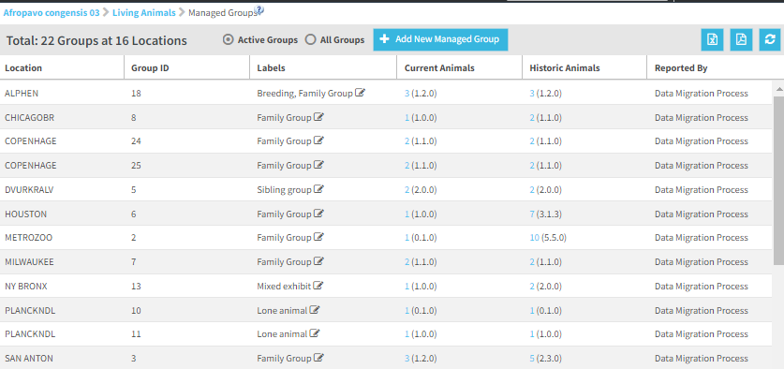
Managed Groups
This feature allows users to track groups of individual animals that are currently managed at the same location.
In legacy functionality this functionality was named “social groups” but has been renamed “managed groups in ZIMS for Studbooks.

Slide 15
Managed Groups
Track currently active and historic groups of animals
Locations can have unlimited groups
  Can have groups at institutions or geolocations
Quickly view animals currently or historically in the group
  Allows users to track which animals have interacted over time
Label groups to assist with quick identification

Slide 16
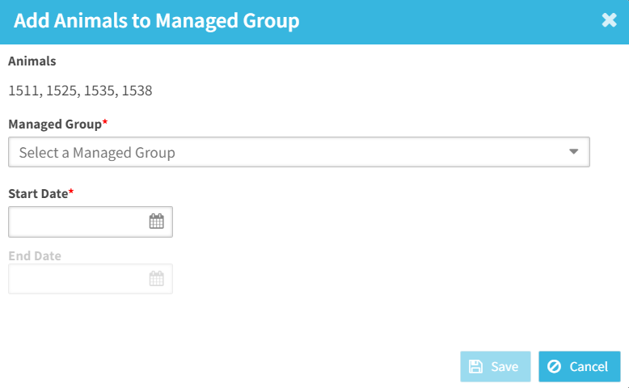
Managed Groups – Batch Add
Quickly add animals to managed group from the animal list
Helpful for getting started using managed groups or if multiple animals are moving to a new group
Reminder: Animals must have been at the same location at one point to be added to a group together
If one animal is dead, an end date will be required

Slide 17
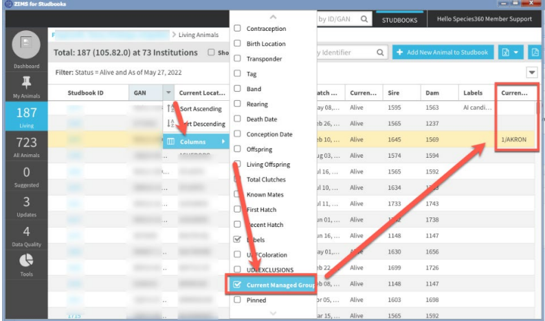
Managed Groups – Animal Lists
Add Current Managed Group to animal lists
Drag and drop this column
Exports if selected

Slide 18
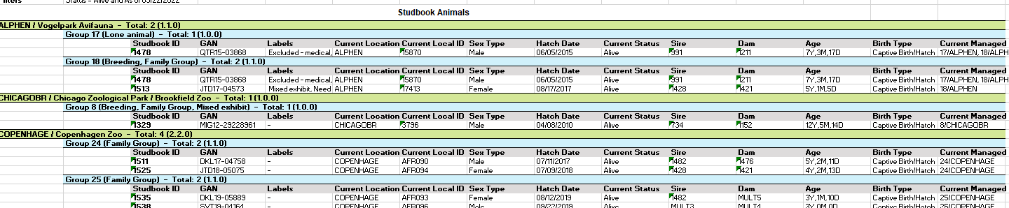
Managed Groups - Export
Export list of Managed Groups (active or all)
Export animal list grouped by institution and managed groups

Slide 19
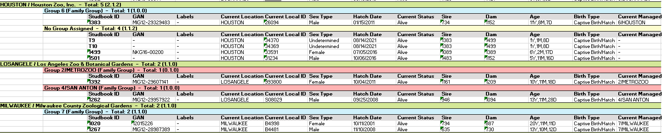
Managed Groups - Export
No groups
Animals in groups not at current location

Slide 20
Potential Managed Group Uses
Tracking social groupings: Track groupings of animals in a social capacity. This is the way the tool that is Typically used for primates at this time.
Tracking enclosures/tanks: Users can track animals within specific enclosures, as animals move enclosures they are assigned a new group.
Track animals in “rooms”: many amphibian/invert/aquatic species are maintained in multiple tanks/enclosures within a single room and there could be multiple rooms at a single institution. In some cases, the animals within each room cannot interact. Users could use this tool to track the individual rooms as groups.
  Assigning groups to animals within specific rooms could be helpful for knowing which animals have access to each other if they cannot move rooms or if they should move rooms for genetic reasons.

Slide 21
Potential Managed Group Uses
Tracking breeding pairs/groups: Users tracking animals that are together for breeding
  This could be pairs or groups of animals
  Using the tool in this way could assist studbook keepers in knowing which animals are currently in a breeding situation and which animals are not.
  Animals could be in more than one breeding group
Tracking disease exposure – Users could use this tool to track animals that have been together or had exposure to one another over time in order to track infections or diseases within the population.
  Would be helpful in knowing which animals cannot be in groups with other animals.

Slide 22
Potential Managed Group Uses
In situ animals
  Animals that have been released at the same time or within the same location
Confiscation tracking
Program/education animals vs. exhibit animals: Within institutions, it may be important to know which animals are grouped within the education department and which are exhibit animals.

Slide 23
Labels/ UDFs vs. Managed Groups
Both UDFs and labels allow the user flexibility when defining a subset of the population. They can both be used to track similar data (subspecies, hybrids, management plans, etc.)
Managed Groups allow users to track groups of animals that have physically been at the same location (social groupings, tanks, breeding groups).
  Labels can be added to managed groups for additional tracking (breeding group, sibling group, etc.)

Slide 24
 | UDFs | Labels | Managed Groups
Assign more than one value | Yes | Yes | Yes
Description option to define value | Yes | No | Only by adding label
Advanced filters | Yes | No | No
Basic filters | Yes | Yes | No (can sort by active and all groups)
Export to PMx filter | Yes | No | No
Visible on Basic Animal Detail | No | Yes | No
Column in animal lists | Individually displayed | Grouped into one column | Grouped into one column
Batch add/remove | No | Yes | Yes (only batch add)

