Slide 1
Studbook List

Slide 2
ZIMS Updates!
This PowerPoint is up-to-date as of: 17 January 2019
ZIMS is developed using an “agile” method
This means that new ZIMS updates are delivered every two weeks.
Use the link below to check if there have been any updates to this topic since the date above:
http://training.species360.org/updates/

Slide 3
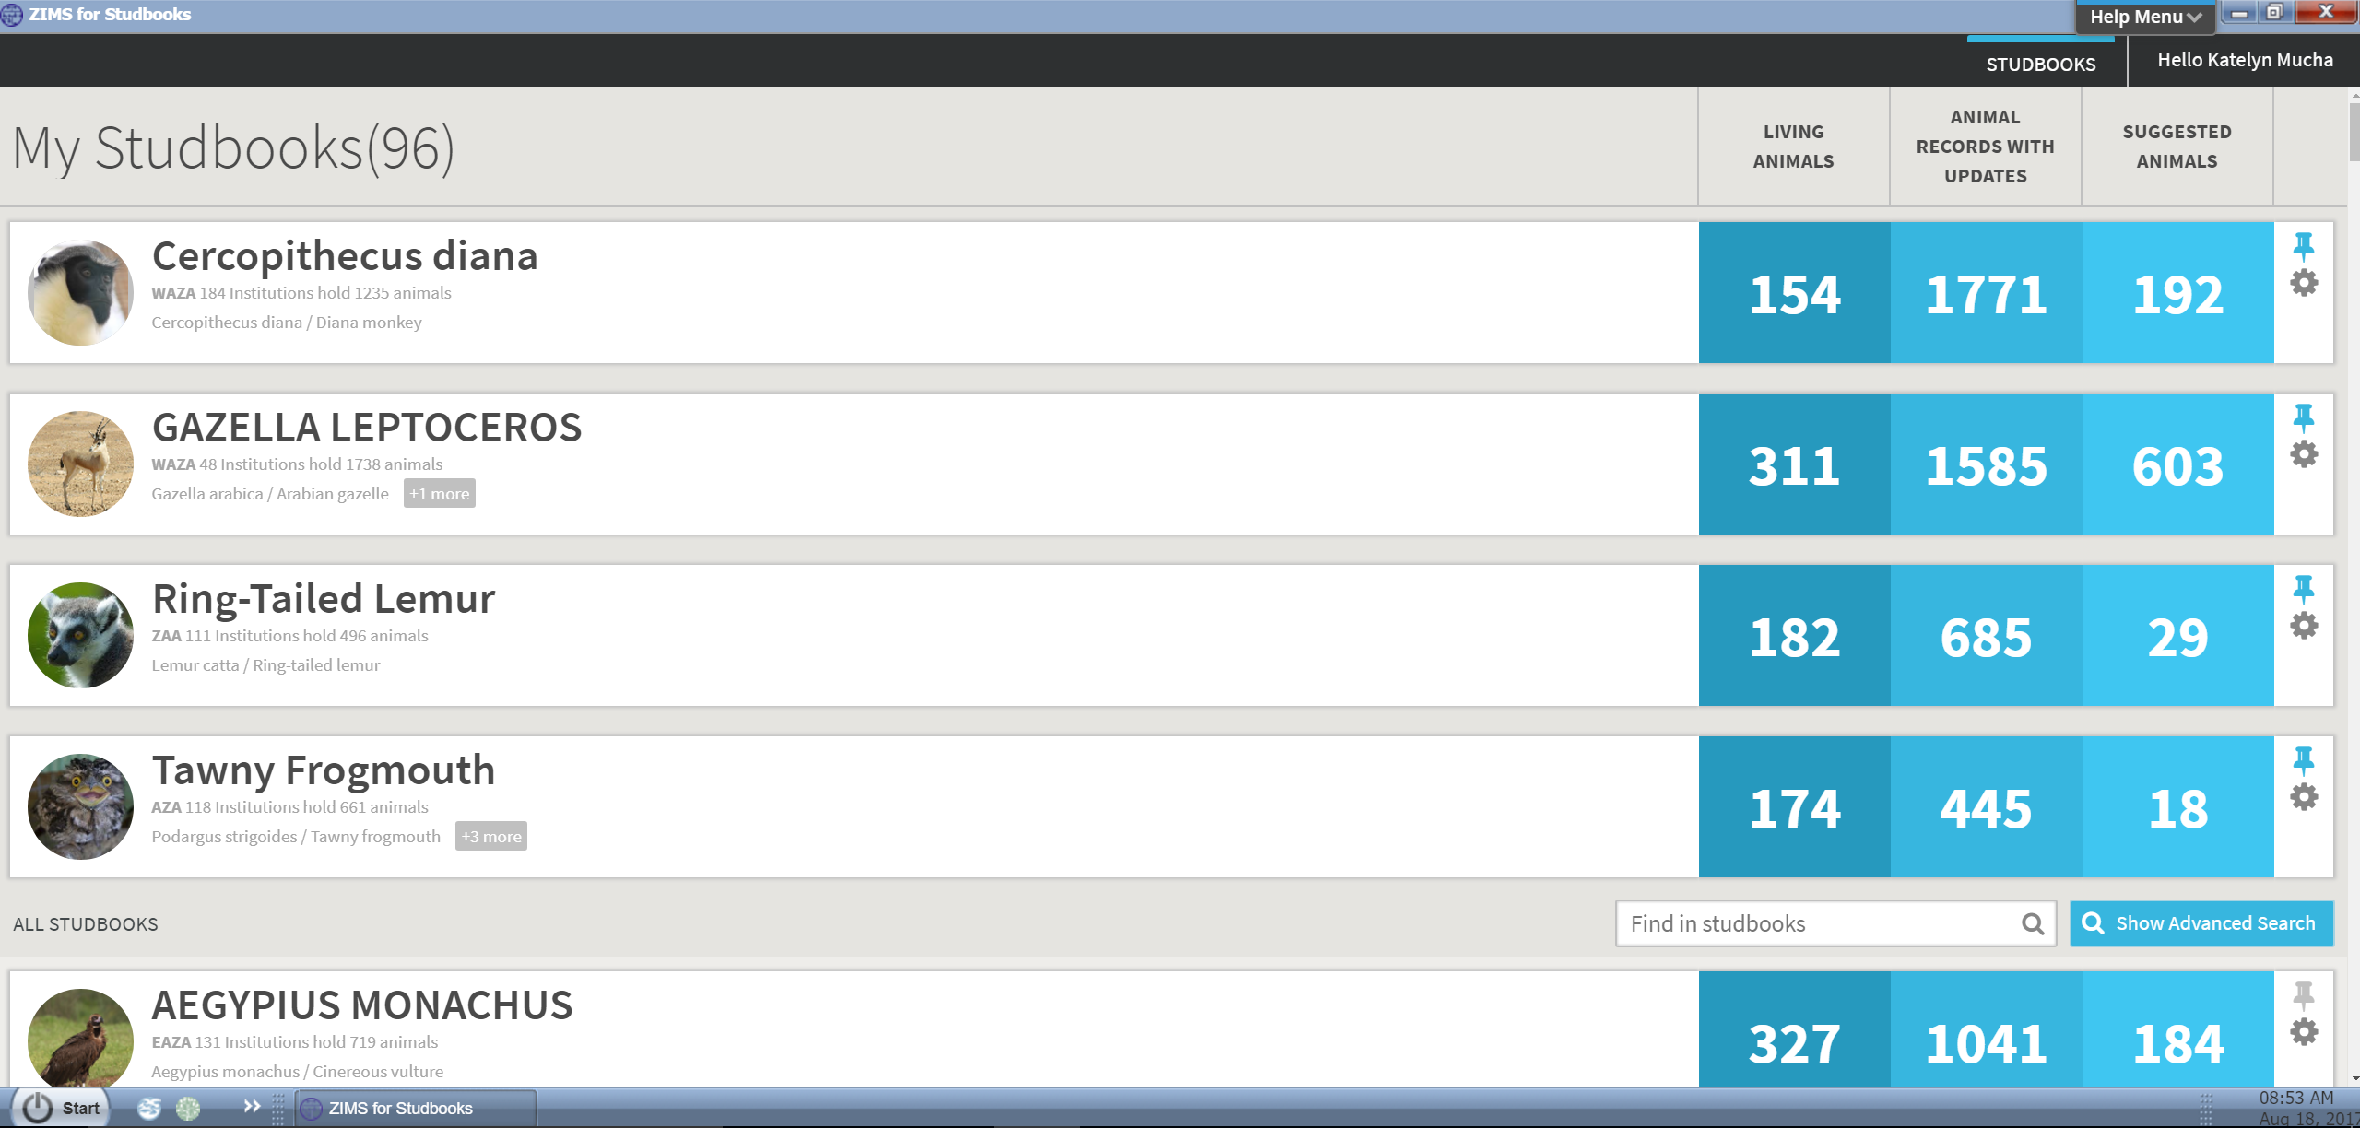
Studbook List
Studbook List: List of all the Studbooks a user has been given access to by the regional association.
Users will only see studbooks in this list that they are currently assigned access to
Listed in alphabetical order by studbook name
Click on studbook name to access the Studbook Dashboard

Slide 4
Studbook List – Quick Links
Living Animals: Number indicates the number of living animals in each studbook.
Animal Records with Updates: Indicates the number of pending updates (updates from institutions) that are in the studbook.
Suggested Animals: Indicates the number of Suggested Animals (animals recorded in ZIMS institutions but not in the studbook).
Each of these numbers is a button that takes the user directly to the corresponding list

Slide 5
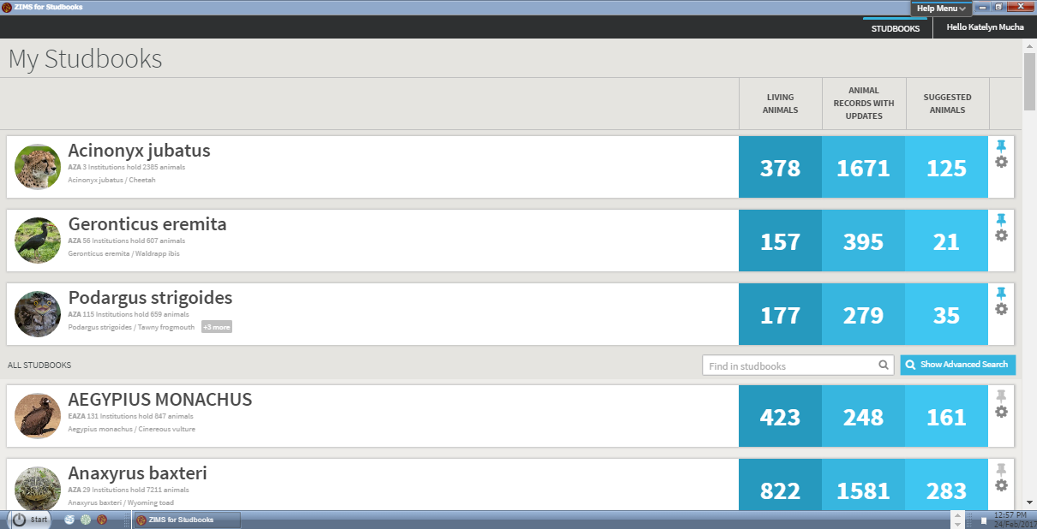
Studbook List
Add Image: User can add or delete a studbook image by selecting the gear icon.
Pin studbook: User can “pin” or favorite the studbooks that they access the most often by selecting the pin icon. This will move the studbook to the top of the studbook list.
Unpin a studbook by clicking on the pin icon.

Slide 6
Contact Support@species360.org with any questions
www.Species360.org

