Slide 1

Studbook Animal Details

Slide 2
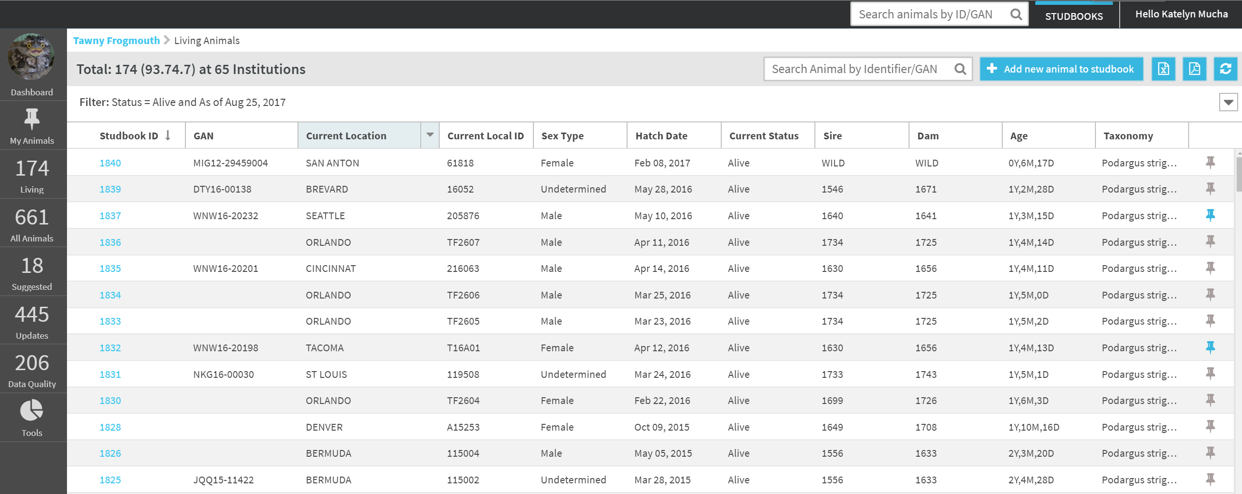
Navigate to Animal Detail Screen
To navigate to an animal’s Detail Screen select the studbook ID hyperlink or enter the ID in the Studbook Quick Search

Slide 3
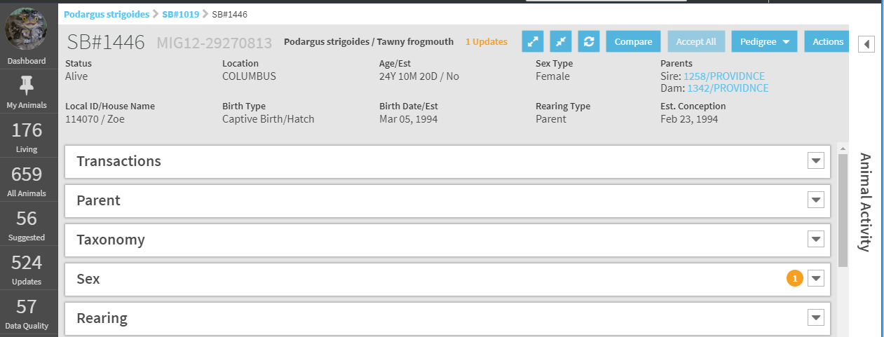
Animal Detail Screen
The Animal Detail Screen contains all of the information entered about an individual anima. From this screen, the user can add, edit, and delete information about the animal.

Slide 4
Animal Detail – Expand/Collapse
Expand or Collapse Buttons at the top of the scree open or close the below event boxes.
User can also select to have the event boxes be open or closed by default under preferences – see next slide.

Slide 5
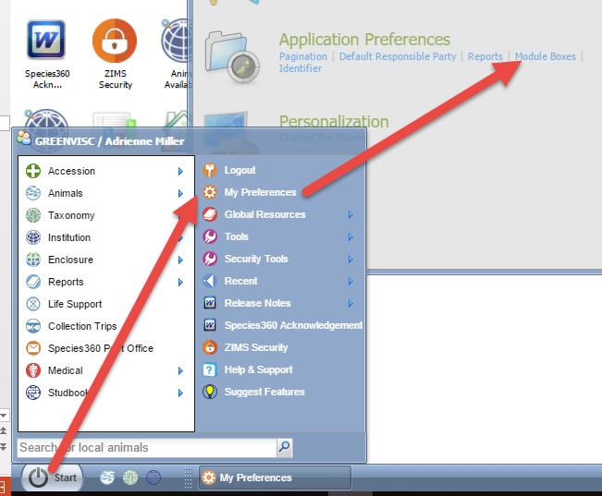
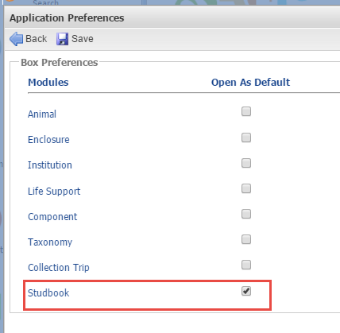
Grid Box Preferences
To set the event boxes as expanded by default follow the following steps:
In the main ZIMS screen, select My Preferences →Application
Preferences → check the box for studbooks→ save
Opening all event module boxes in Studbooks will expand all boxes automatically and user will not have to individually open the boxes.

Slide 6
Animal Detail – Compare Animal
Selecting the Compare button navigates to the Compare Animal tool.
The animal detail will now be displayed in the compare tool for comparison to another animal.

Slide 7
Animal Detail – Accept All
Accept All button allows user to automatically accept all pending updates for an animal.
If the button is not active, the user must review and manually accept the pending updates.

Slide 8
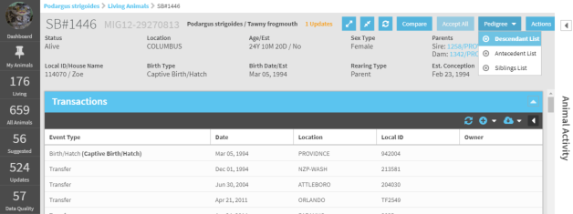
Animal Detail – Pedigree Tools
The pedigree tools in the Animal Detail allow the user to quickly run the pedigree report tools for the animal in view.
The user can quickly view the current animal’s descendant list, antecedent list, or sibling list.

Slide 9
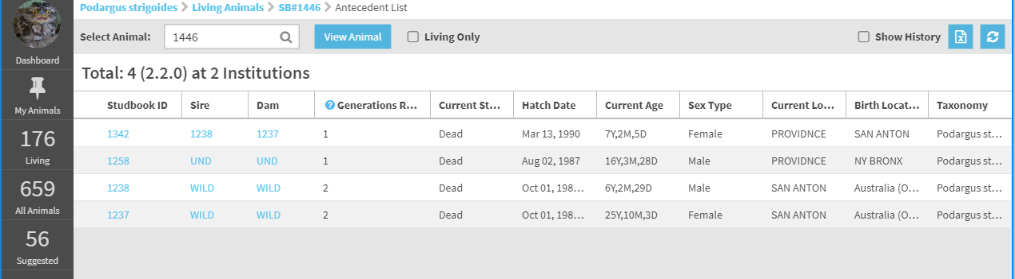
Animal Detail – Navigation
After navigating to another screen from the Animal Detail screen, users can use the breadcrumbs to quickly navigate back to the Animal Detail screen.
In this example, the user ran an antecedent report from the Animal Detail screen of 1446. To navigate back to the Animal Detail screen for 1446 the user can select the hyperlink in the breadcrumb.

Slide 10
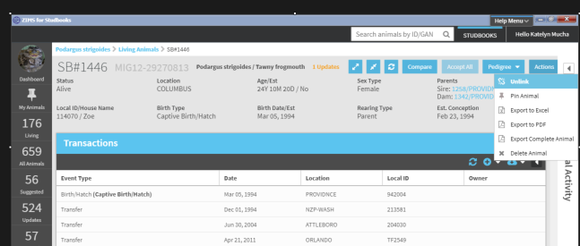
Animal Detail - Actions
Actions button contains the following options:
Unlink, Pin Animal, Export to Excel, Export to PDF, Export Complete Animal Detail, Delete Animal

Slide 11
Animal Detail - Actions
Unlink: If the animal is linked to a Husbandry animal this option will remove the link between the Husbandry and studbook animal.
Unlinking a Husbandry animal will remove the institution records that are visible in the Animal Detail.
Any pending updates that have been accepted into the studbook records will remain in the studbook after unlinking.
The unlinked Husbandry animal will display on the Suggested Animal List (if the taxonomy in Husbandry still matches the studbook taxonomy)

Slide 12
Animal Detail - Actions
Pin Animal: Selecting this option pins animal to the My Animal list (in left hand navigation).
If the animal is already pinned in the list, the an option to unpin the animal will display in the Actions drop down.

Slide 13
Animal Detail – Export
Export to Excel: Exports the Animal Basic Information to Excel.
Export to PDF: Exports the Animal Basic Information to PDF.
Export Complete Animal Detail: Exports the Animal Basic Information and all of the event grids to PDF.

Slide 14
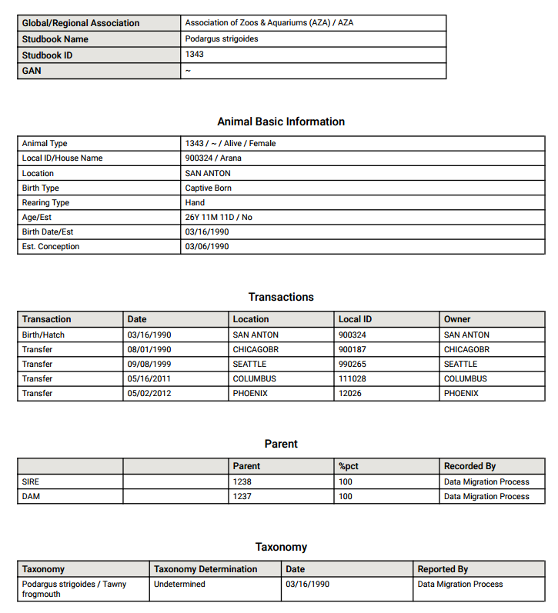
Complete Animal Export Example

Slide 15
Animal Detail – Delete Animal
Delete Animal: Remove animal from the studbook.
Business rules for deleting a studbook animal:
Animals with offspring cannot be deleted. If user wants to delete an animal with offspring, the animal must be removed from the parent grid of current offspring.
If the studbook animal is linked to a Husbandry animal, the studbook animal will be deleted but the Husbandry animal will populate on the Suggested List.
Studbook IDs that are deleted cannot be reused in the studbook.
User can delete permanent or draft animals.

Slide 16
Animal Basic Information
Animal Basic Information: Snapshot of the animal’s current information. Displays key information about the animal. This information is pulled from the event boxes in the Animal Detail.
As the animal’s records are updated the information in the basic information screen will update to reflect the changes.

Slide 17
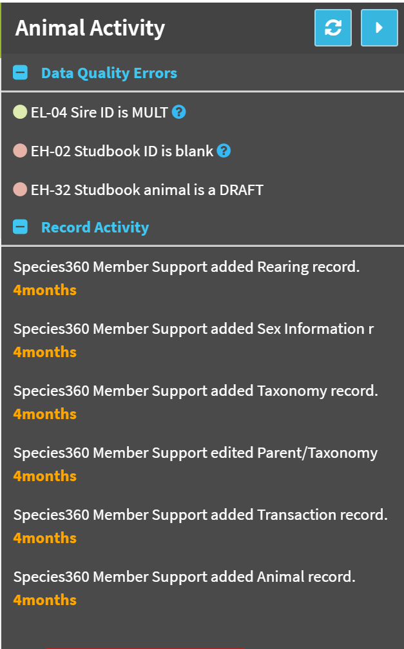
Animal Detail Activity Stream
Tracks event changes per animal though time and displays them to the user on the right hand side of the Animal Detail screen.
In addition to record changes, this tool also shows the current data quality errors for the individual making it easier for the user to fix these errors while the animal is in context.

Slide 18
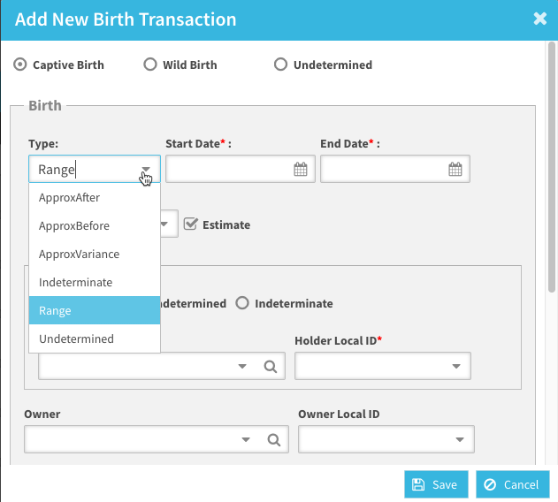
Estimating Dates
Estimating dates – critically important to using studbook data in population modeling, when an absolute date is not know, understanding the types of unknown is key:
Help on Date Estimates in ZIMS for Studbooks is here.

Slide 19
Animal Detail Record Boxes
All animals have the following record boxes. Information in these boxes are edited to track information on the animal:
Transactions – Required field
Parent – Required field
Taxonomy – Required field
Sex – Required field
Rearing – Required field
Contraception – Optional field
UDF – Optional field
Animal Notes – Optional field

Slide 20
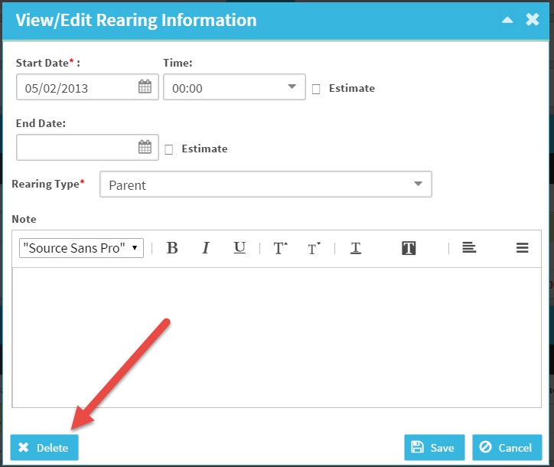
Delete Studbook Data
To delete a record, double click on the record and select the Delete button.
The following record types must have at least one event recorded. If there is only one event in the box, then the event cannot be deleted and must be edited.

Slide 21
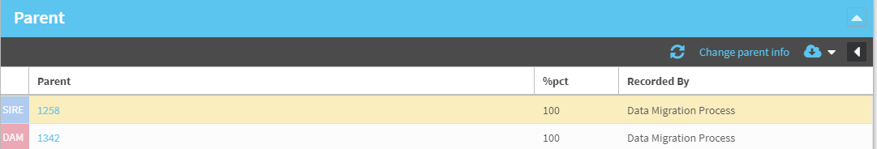
Edit Studbook Data
To edit the grids double left click on the line that you want to edit (expect for parents). This will open the view/edit screen where the user can edit the record.
To edit parent information select the Change Parent Info button. This will open the parent grid for editing.

Slide 22
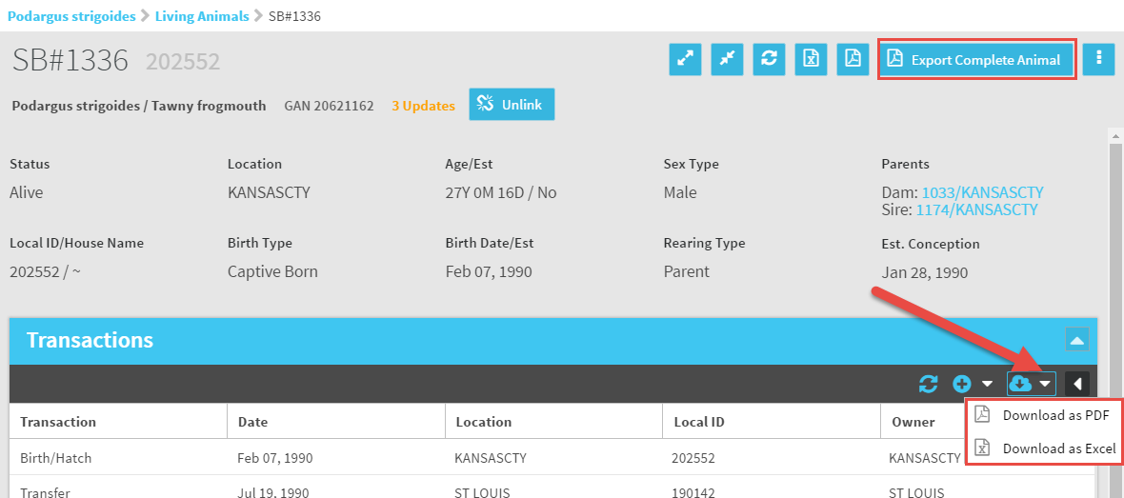
Export Animal Grids
You can download single grids by using the arrow to the right
of the cloud icon. You can export the complete record by
selecting the Export Complete Animal button at the top.

Slide 23
Transactions Box – Birth Transaction
All transaction events MUST start with birth transaction.
During migration all animals without a birth transaction will have one created using the following information:
  Birth date recorded in the Master record in legacy studbook will be used as the birth date for the transaction record.
  If animal without birth record is wild caught, the location in the newly created transaction record is the wild capture location
  If there is no wild capture transaction the location in the newly created transaction record is undetermined.
All new animals must have birth transaction created before the user can add any other transaction type – this will prevent animals from not having a birth event.
Once the birth transaction has been created, user can edit the birth record but cannot add another birth transaction.
Once a birth transaction is created, user can add other transaction types to the event grid.
Birth type is tracked within the birth transaction

Slide 24
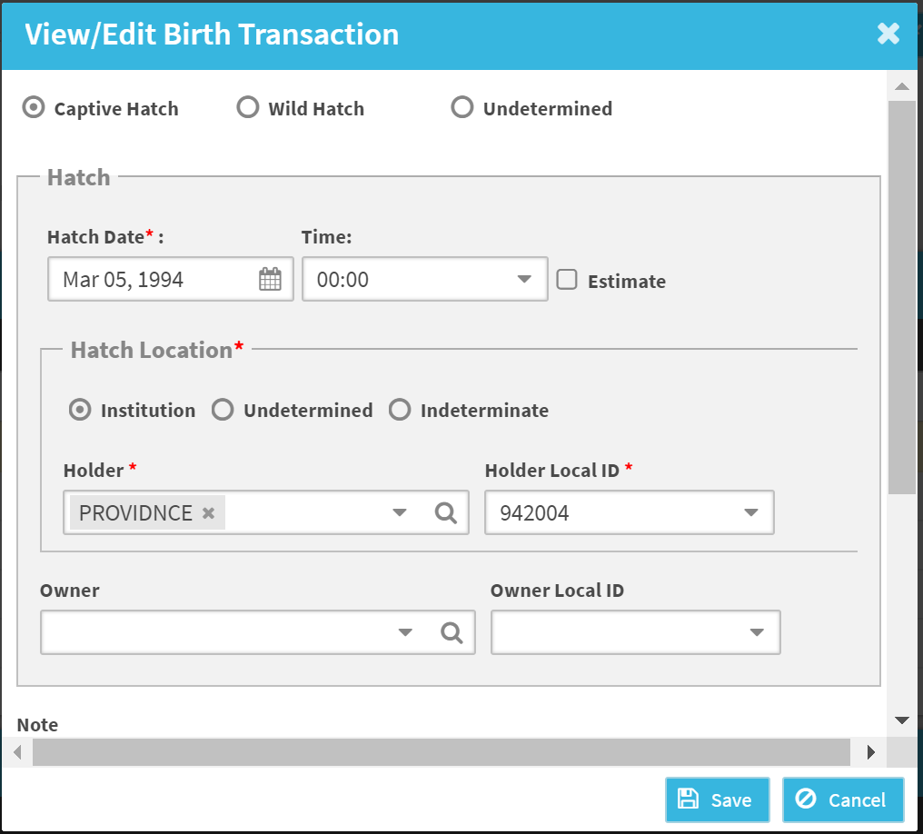
Birth Transaction and Birth Type
Birth type is tracked within the birth transaction. To edit the birth type or the birth transaction information double click the birth record.
Only one birth transaction per animal is allowed.

Slide 25
Other Transaction Types:
Transfer
Death: Only one death transaction is allowed per animal.
Go Lost to Follow-up (LTF): This is now a transaction event, not just a flag like in SPARKS.
  Animals in SPARKS that were flagged as LTF will have an event created in ZIMS.
Return from LTF: This is now a transaction event, not just a flag like in SPARKS.
    Animals in SPARKS that were flagged as return from LTF will have an event created in ZIMS.
Release
Recapture: Can now add transaction as recapture instead of wild caught.
  Any wild captures after the initial entry one in the studbook will be changed to recapture in ZIMS.

Slide 26
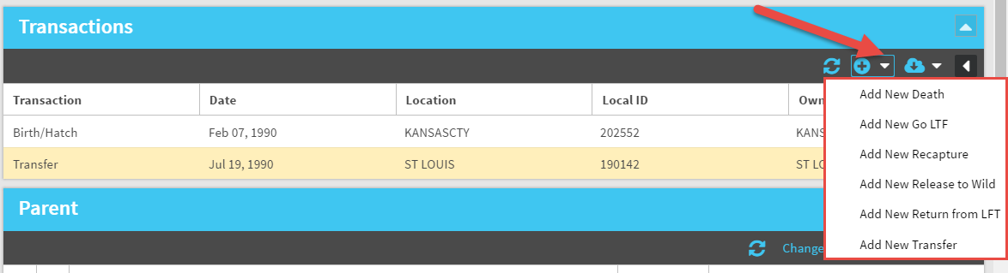
Add a Transaction
To add a new Transaction use the drop down arrow by
the “+”. Possible options will appear to select from.

Slide 27
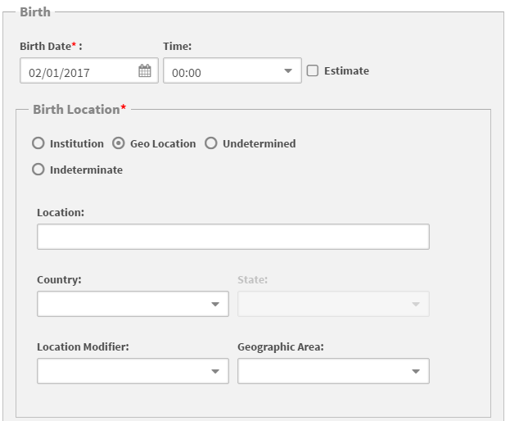
Transactions Rules
For data quality purposes, there are some new fields in ZIMS
Several data types now have a time field. This is optional and defaults to 00:00. This helps to keep data in logical order when multiple things happen on the same day.
Geolocation is separated from Institutions, and mnemonics are no longer usable for location types that are not given mnemonics in the global or local lists. This helps to prevent incorrect location mapping.

Slide 28
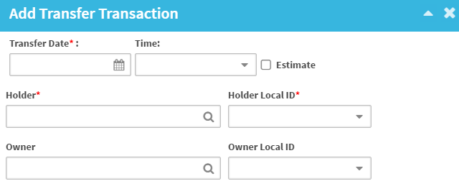
LTF Transaction Types
Transfer, Go LTF and Return LTF Transactions have the same fields and requirements.
Must enter a LTF before a return from LTF and vise versa.

Slide 29
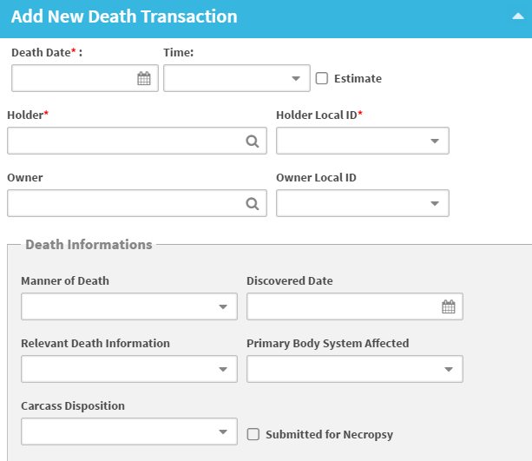
Death Transaction
Death Transactions now have access to the same optional Death Information field as Husbandry and Medical modules.
During migration, death codes will be translated into the death information grid
At this time, animals with death transactions are showing their last local ID as the death code – enhancement to change this during migration process to local ID prior to death event.
New business rule: user can only add one death event

Slide 30
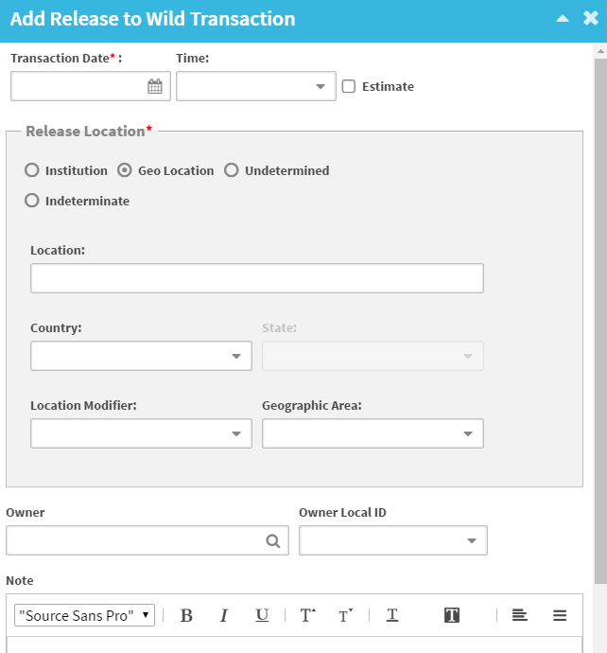
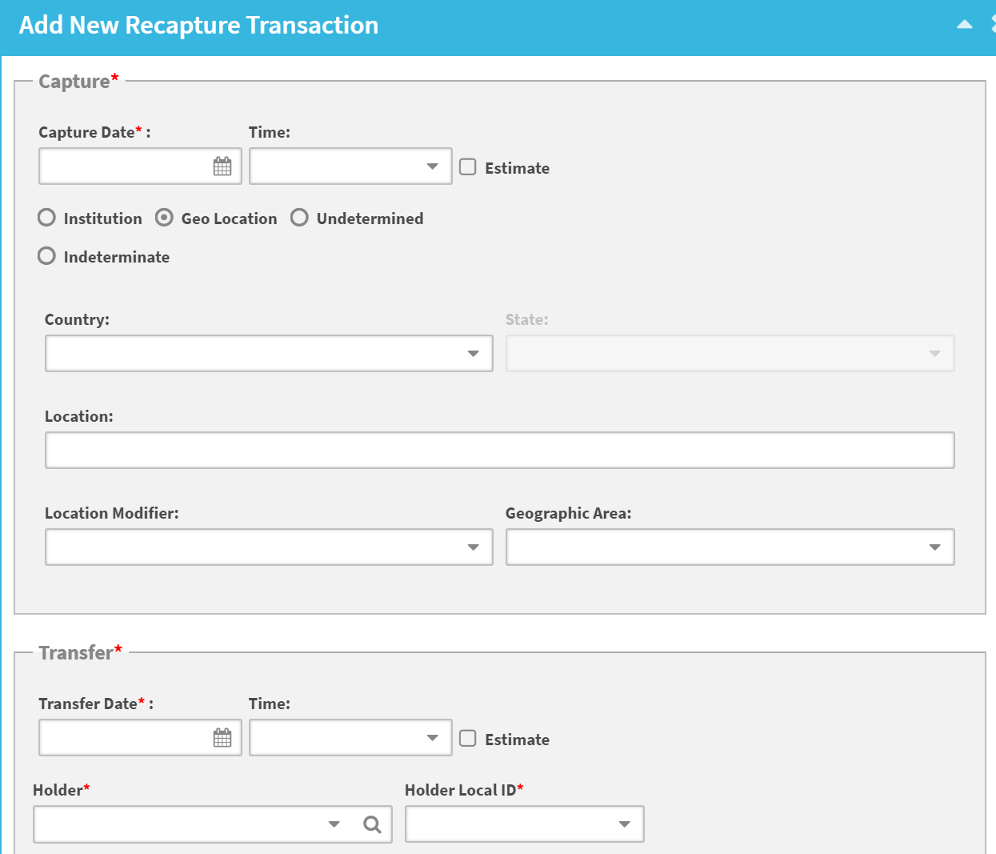
Release/Recapture Transaction Types
User can use geolocation or institution for locations

Slide 31
Animal Detail Record Boxes
Transactions – Required
Parent – Required
Taxonomy – Required
Sex – Required
Rearing – Required
Contraception – Optional
Identifiers – Optional
UDF – Optional
Animal Notes – Optional

Slide 32
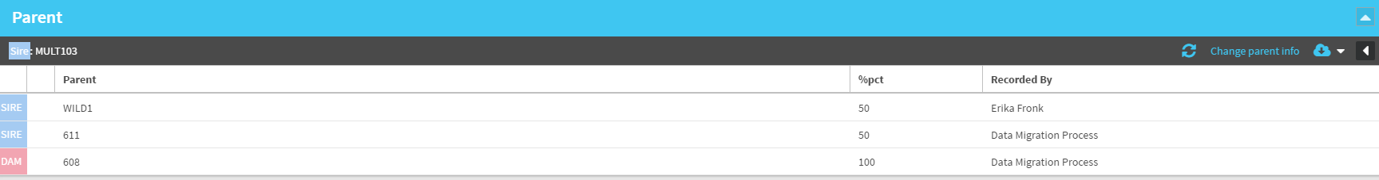
View Parent Box
MULT number is listed in the header
Sire/Dam is listed on the far left
Cannot double click to edit parents, must select “Change Parent Info”

Slide 33
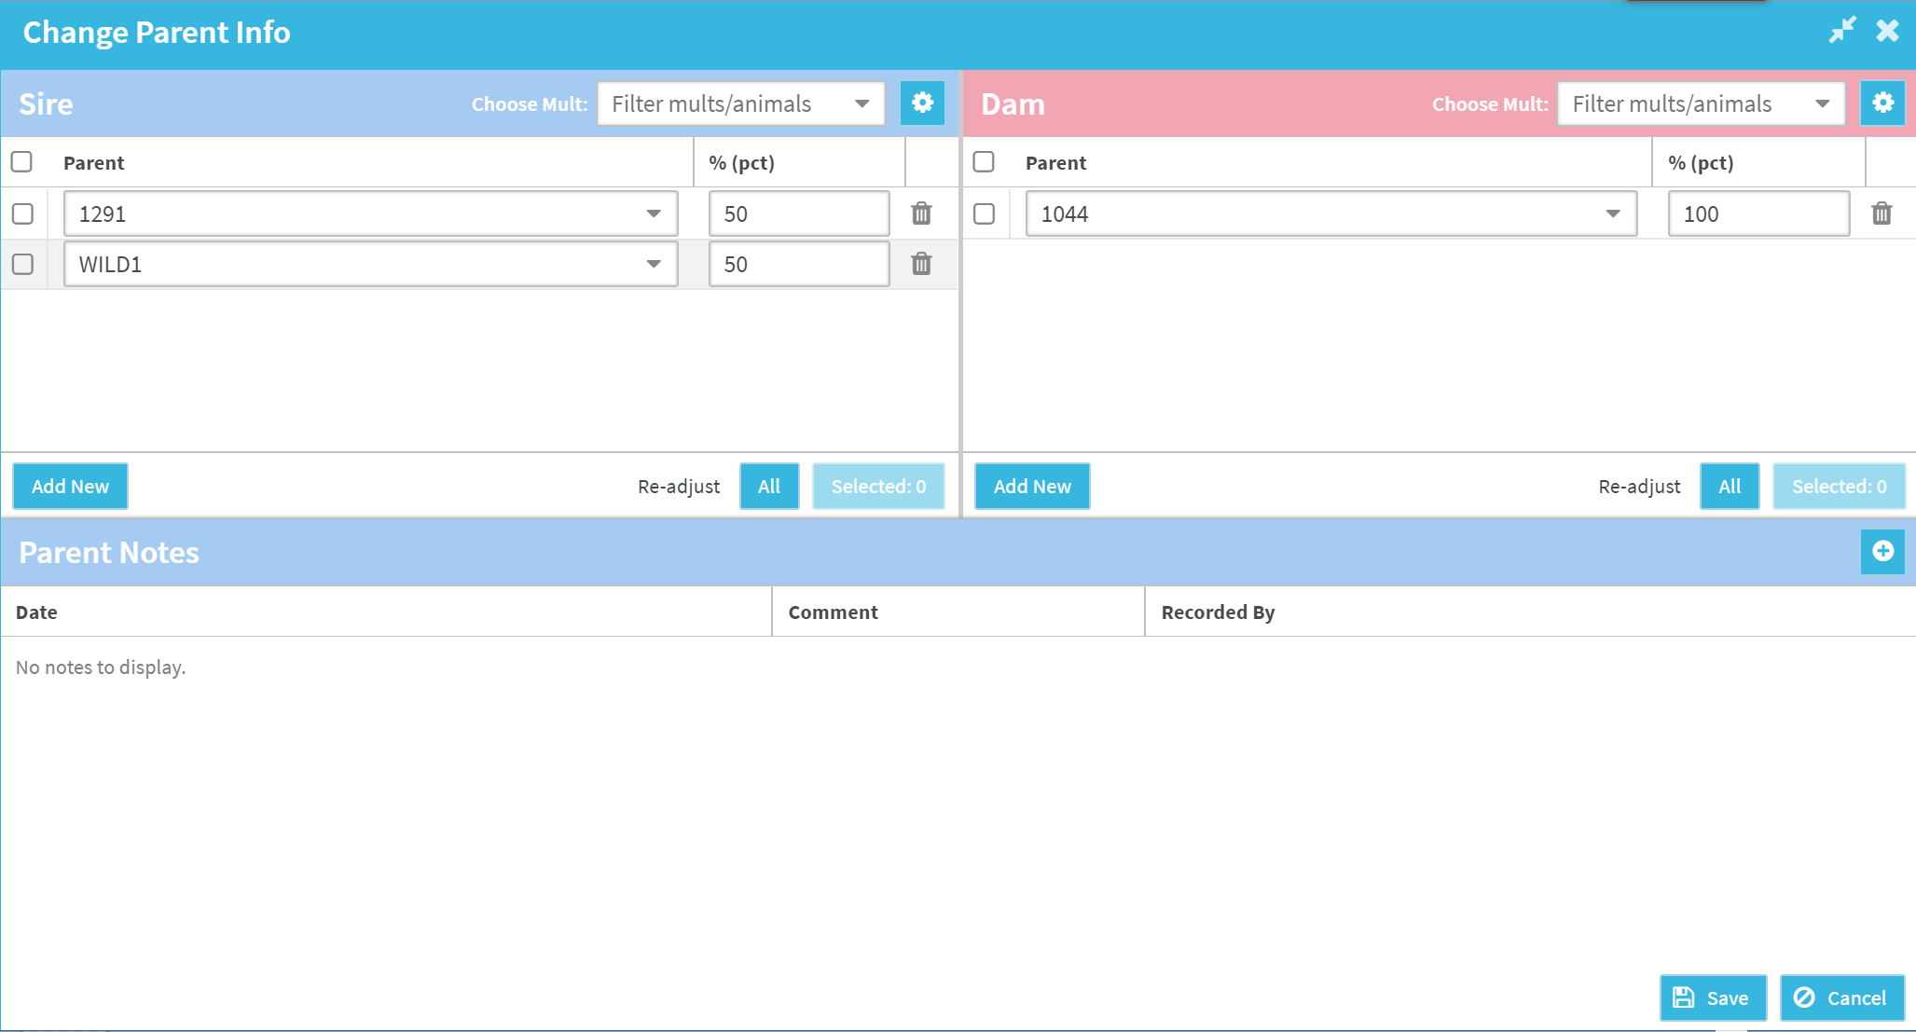
Edit Parent Box
Edit box split into Sire and Dam
Dropdown allows user to quickly select parents
Delete parent by selecting the trash icon.
Can select parents to auto-adjust percentage to equal 100%, or select “All” to split percentage evenly.
Option to add note to parent record – linked to Animal Notes

Slide 34
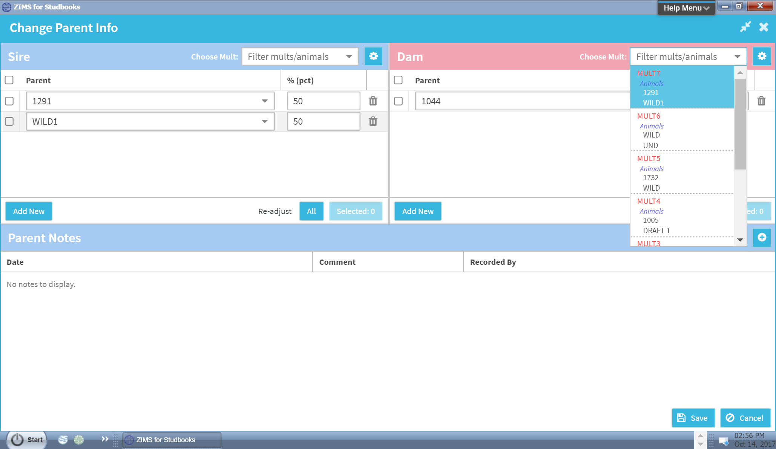
Adding Parents
“Add New” produces blank parent record.
Already existing MULTs are available by selecting “Choose MULT” dropdown.

Slide 35
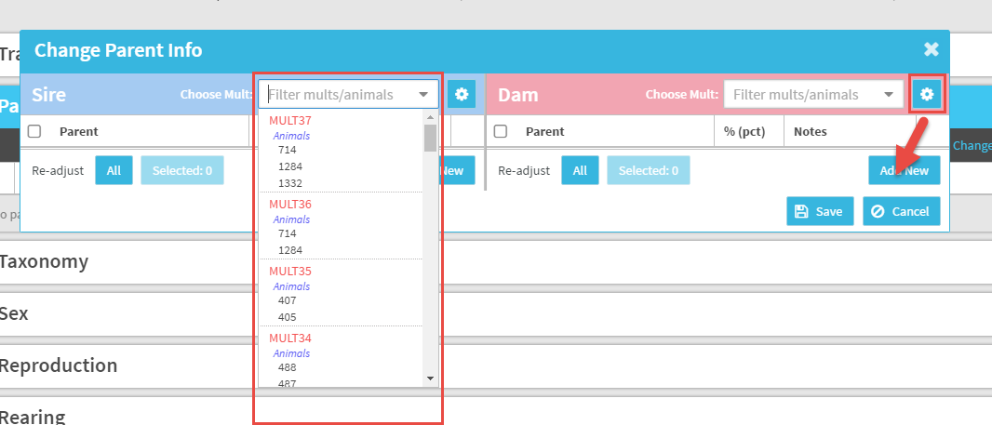
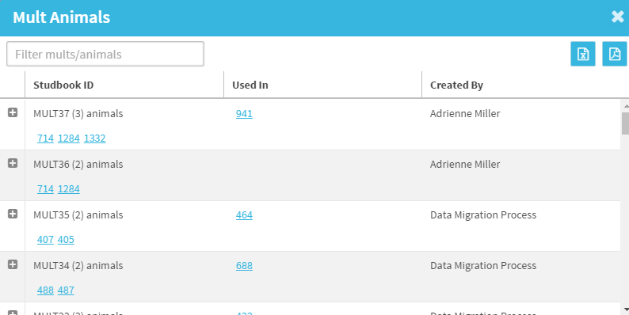
MULT# Options
When recording Parents you can find your possible MULT options from
either the dropdown arrow or the gear icon. The gear icon lets you
know what records these MULTs have been used in.

Slide 36
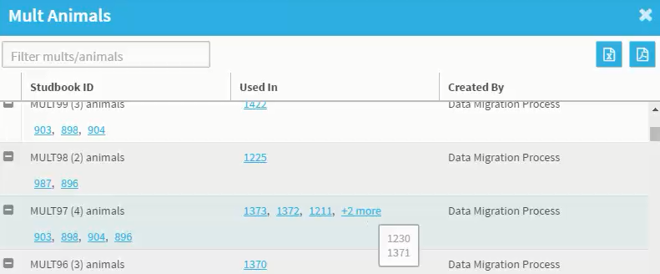
MULT List
Clicking the gear next to the Choose MULT dropdown opens the MULT List
Search by MULT and Studbook #
Exportable to Excel and PDF
The MULT List will display a list of your MULT groupings.
It also shows what records these MULTs have been used in. All studbook
IDs are hyperlinks into the records.
If there are not MULTs in the studbook, this tool will not display in the Tool Bar.

Slide 37
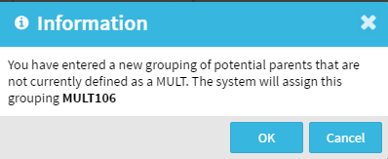
Creating MULTs
If user creates a new unique grouping of sires/dams, the system will create a new MULT grouping
System will automatically number the new MULT# (user cannot select the MULT#)
If ZIMS recognizes that you have previously entered the same combination of parents and the MULT # already exists it will not create a new one.
MULT# will be created and available in the MULT dropdown list
MULT# groupings cannot be deleted at this time.

Slide 38
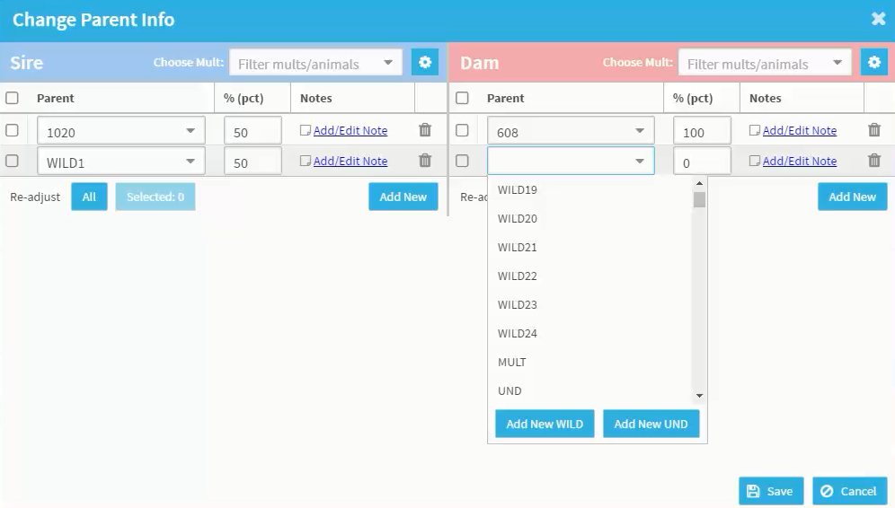
Adding Wild/Undetermined Parents
All Studbook, Wild and Undetermined #’s are available by dropdown – added during migration
User still has ability to assign MULT, UND and WILD parents.
Note: Once created, you cannot delete WILD#, UND# or MULT#
Clicking “Add New Wild/UND” produces the next sequential number available in the studbook.

Slide 39
Animal Detail Record Boxes
Transactions – Required
Parent – Required
Taxonomy – Required
Sex – Required
Rearing – Required
Contraception – Optional
Identifiers – Optional
UDF – Optional
Animal Notes – Optional

Slide 40
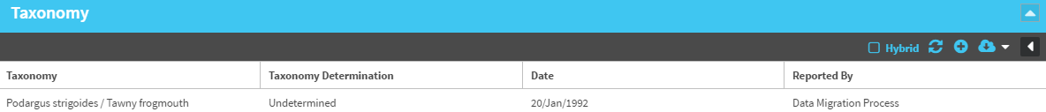
View Taxonomy Box
Hybrid checkbox: legacy functionality from SPARKS, any animal with this checked in SPARKS will migrate in as hybrid in ZIMS.
Taxonomy: All animals will migrate into studbook at the highest level taxonomy provided during migration process.
Taxonomy Determination: is not required and is a data standard field shared with husbandry.
All animals will migrate in as undetermined
Taxonomy date set as animal’s birthdate

Slide 41
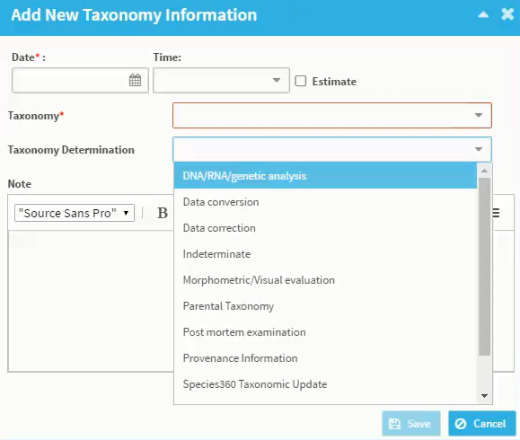
Edit/Add Taxonomy Box
Required fields = date and taxonomy
Only taxonomy defined by the studbook will display in the taxonomy dropdown.
Dropdown options for taxonomy determination
Notes are tied to Animal Notes box

Slide 42
Animal Detail Record Boxes
Transactions – Required
Parent – Required
Taxonomy – Required
Sex – Required
Rearing – Required
Contraception – Optional
Identifiers – Optional
UDF – Optional
Animal Notes – Optional

Slide 43
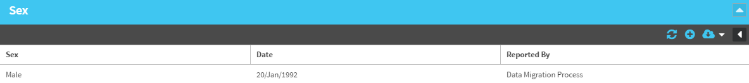
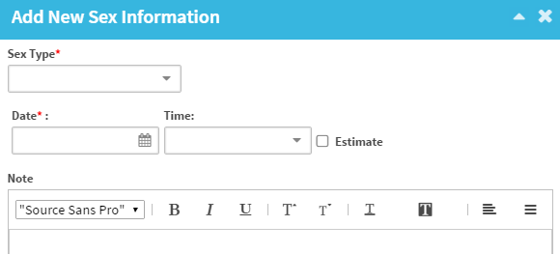
View/Edit/Add Sex Box
Sex Type and Date are the only required fields
Sex type is driven by taxonomy managed
  Male/Female
  Undetermined/Indeterminate
  Male/Female Pseudohermaphrodite
  Bilateral/Mosaic Gynandromorph
  True Hermaphrodite
  Asexual

Slide 44
Animal Detail Record Boxes
Transactions – Required
Parent – Required
Taxonomy – Required
Sex – Required
Rearing – Required
Contraception – Optional
Identifiers – Optional
UDF – Optional
Animal Notes – Optional

Slide 45
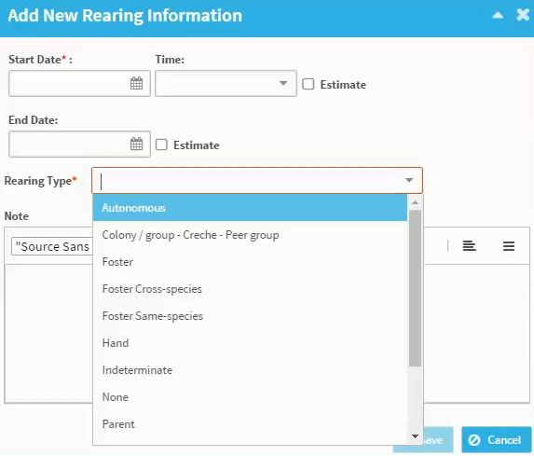
Edit/Add Rearing Box
Rearing Type and Start Date required
End time is optional; all animals migrated in without end date
Rearing Types uses husbandry data standards and allows for more detailed/searchable records.

Slide 46
Animal Detail Record Boxes
Transactions – Required
Parent – Required
Taxonomy – Required
Sex – Required
Rearing – Required
Contraception – Optional
Identifiers – Optional
UDF – Optional
Animal Notes – Optional

Slide 47
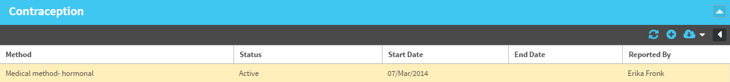
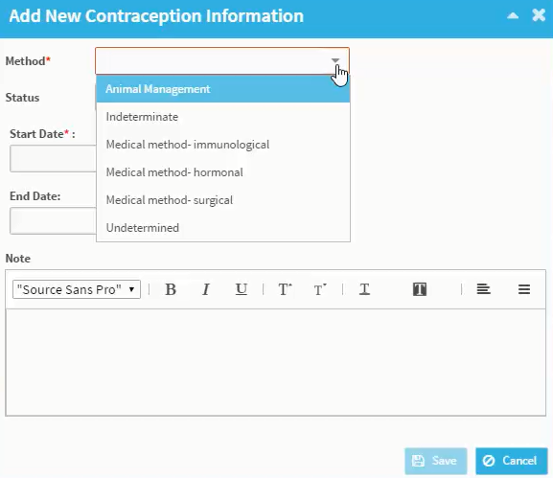
View/Edit Contraception Box
Method: method of contraception – Husbandry data standards. Mandatory when entering record.
Status options: Active, Inactive, undetermined and indeterminate. Mandatory.
Start Date: Date contraception started. Mandatory.
End Date: Date contraception ended.

Slide 48
Migrating Contraception
During migration, reproductive status for animals is mapped to the contraception record in ZIMS. Below documents how reproductive status in SPARKS is populated in ZIMS after migration.
If SPARKS Sex value is: | ZIMS Value:
Neutered Male (2) | Method: Medical method – surgical Status: Active
Neutered Female (3) | Method: Medical method – surgical Status: Active
Contracepted Male (6) | Method: Medical method – hormonal Status: Active
Contracepted Female (7) | Method: Medical method – hormonal Status: Active
All other values | No value recorded in the Contraception box

Slide 49
Animal Detail Record Boxes
Transactions – Required
Parent – Required
Taxonomy – Required
Sex – Required
Rearing – Required
Contraception – Optional
Identifiers – Optional
UDF – Optional
Animal Notes – Optional

Slide 50
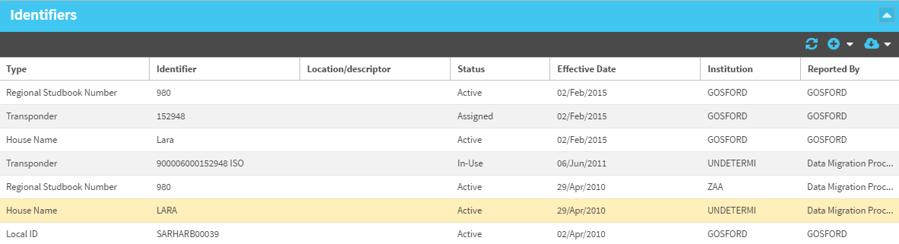
View Identifier Box
All animal linked to Husbandry animals will automatically display all identifiers entered by institution.
  User will not have to enter these identifiers!
Following Husbandry business rules, there are three types of Identifiers:
Physical Identifier: Band, Tattoo, Marking, etc.
Logical Identifier: Local ID, Cohort #, House Name, etc.
Transponder

Slide 51
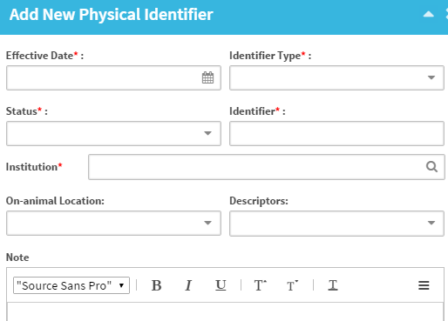
Edit/Add Physical Identifiers
Mandatory Fields:
Effective Date: Date identifier became in use.
Identifier type: Band, notch, etc.
Status: Active, inactive, removed, damaged, etc.
Identifier: Text field for user to enter identifier.
Institution: Institution associated with identifier.
Optional Fields:
On-Animal Location: anatomical site (ear, interscapular, etc.).
Description: Anatomical Direction (dorsal, distal, left, etc.).
Notes: Connected to Animal Notes.

Slide 52
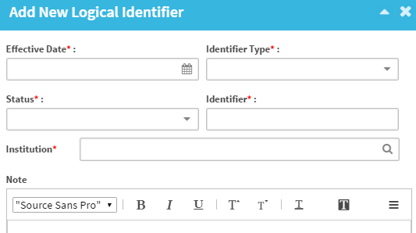
Edit/Add Logical Identifiers
Mandatory Fields:
Effective Date: Date identifier became in use.
Identifier type: House name, temp ID, etc.
Status: Active, inactive, removed, damaged, etc.
Identifier: Text field for user to enter identifier.
Institution: Institution associated with identifier.
Optional Fields:
Notes: Connected to Animal Notes.

Slide 53
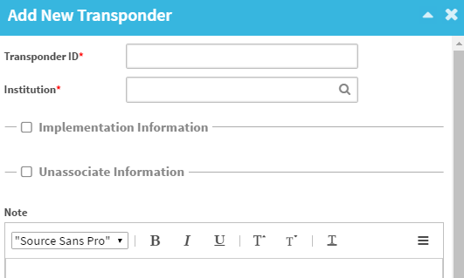
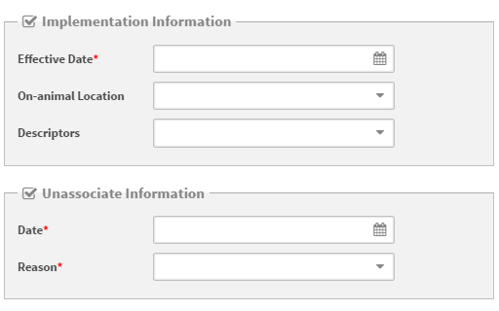
Adding Transponders
Transponder ID and Institution mandatory
You must add either Implementation Information OR Unassociate Information before saving Transponder (or both)
Reason options include:
Damage
Death
Lost
Management
Not Located

Slide 54
Animal Detail Record Boxes
Transactions – Required
Parent – Required
Taxonomy – Required
Sex – Required
Rearing – Required
Contraception – Optional
Identifiers – Optional
UDF – Optional
Animal Notes – Optional

Slide 55
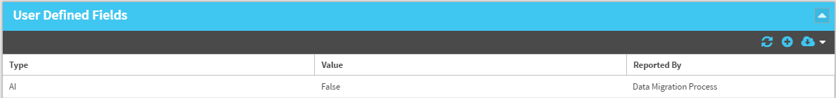
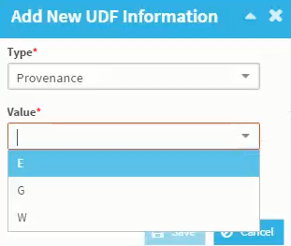
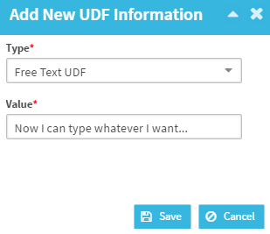
View/Edit/Add UDF Box
UDFs created in the Studbook Overview drive options available in the UDF Type dropdown
Will need to create and define the UDF in Overview before you can add it to an animal
Combo box will have dropdown options for the value
Text will have freeform text for the value
HIGHLY recommend using combo boxes to define taxonomy

Slide 56
Animal Detail Record Boxes
Transactions – Required
Parent – Required
Taxonomy – Required
Sex – Required
Rearing – Required
Contraception – Optional
Identifiers – Optional
UDF – Optional
Animal Notes – Optional

Slide 57
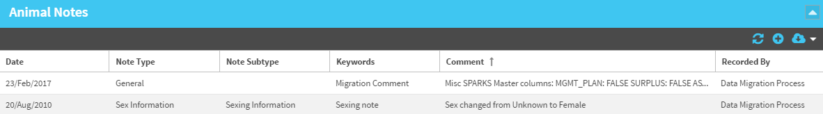
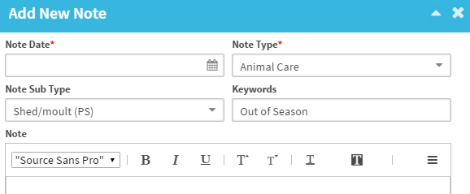
View/Edit/Add Animal Note Box
All notes created when adding an animal record will be populated here and tied to the not in the animal box. Any edits made in record box will update in the note box.
Note Date: Mandatory.
Note Type: data standard dropdown, and drives the note-subtypes available.
Keywords: free text field to create your own labels.

Slide 58

Contact Support@species360.org with any questions
www.Species360.org

